Slide 1

CAPSTONE PROJECT EVALUATION • REVIEW 1: LITERATURE SURVEY & DESIGN
System Design & Relational Modeling
Literature Review, Research Gaps, ER Diagrams, Relational Schema & System Architecture
──────────────────────────────────────────────────────
Team 06 | Project Members:
• 2520090137 — Jayavarapu Sri Charan
• 2520080060 — J. Sohan
• 2520080036 — Adithya Vishnubatala
Course: 25CS1302E — Database Management Systems (DBS) | KL University (KLH Campus)

Slide 2

REVIEW 1: DESIGN & ARCHITECTURE • REVIEW 1
Literature Survey & State-of-the-Art Analysis
Capodici et al. (2023)
Systematic Review of 68 AI Studies
Evaluated ML in CKD diagnosis. Identified major gaps: lack of real-world clinical workflow integration and insufficient external data validation.
Khalid et al. (2024)
CKD Progression Prediction Models
Demonstrated high predictive utility of gradient boosted trees but noted that models suffer when deployed without strict data preprocessing pipelines.
Pan & Tong (2024)
Meta-Analysis on Clinical Discrimination
Confirmed high diagnostic discrimination of ensemble models across diverse test cohorts, emphasizing the necessity of model interpretability.
Gogoi et al. (2024)
Trends & Challenges in Nephrology AI
Pointed out critical barriers: small datasets, black-box decision models, and isolated software systems lacking unified hospital database management.
25CS1302E — Database Management Systems (DBS) | KL University (KLH Campus) | Review 1 — Slide 2 of 8

Slide 3
REVIEW 1: DESIGN & ARCHITECTURE • REVIEW 1
Identified Research Gaps & Proposed Resolution
Gap 1: Data Silos
Identified Issue: Clinical records, lab test values, and predictions are stored in disconnected spreadsheets or isolated files.
Our System's Approach: Resolution: Centralized 3NF Relational DBMS uniting patients, tests, predictions, and consultations.
Gap 2: Black Box Barrier
Identified Issue: Clinicians distrust AI predictions when decision rationales are not transparent or physiologically explained.
Our System's Approach: Resolution: Integrated Tree SHAP game-theoretic explainability providing exact feature contributions.
Gap 3: Workflow Disconnect
Identified Issue: Algorithms operate in standalone scripts rather than within active hospital scheduling and lab workflows.
Our System's Approach: Resolution: End-to-end full stack platform with role-based routing from lab input to doctor consultation.
25CS1302E — Database Management Systems (DBS) | KL University (KLH Campus) | Review 1 — Slide 3 of 8

Slide 4
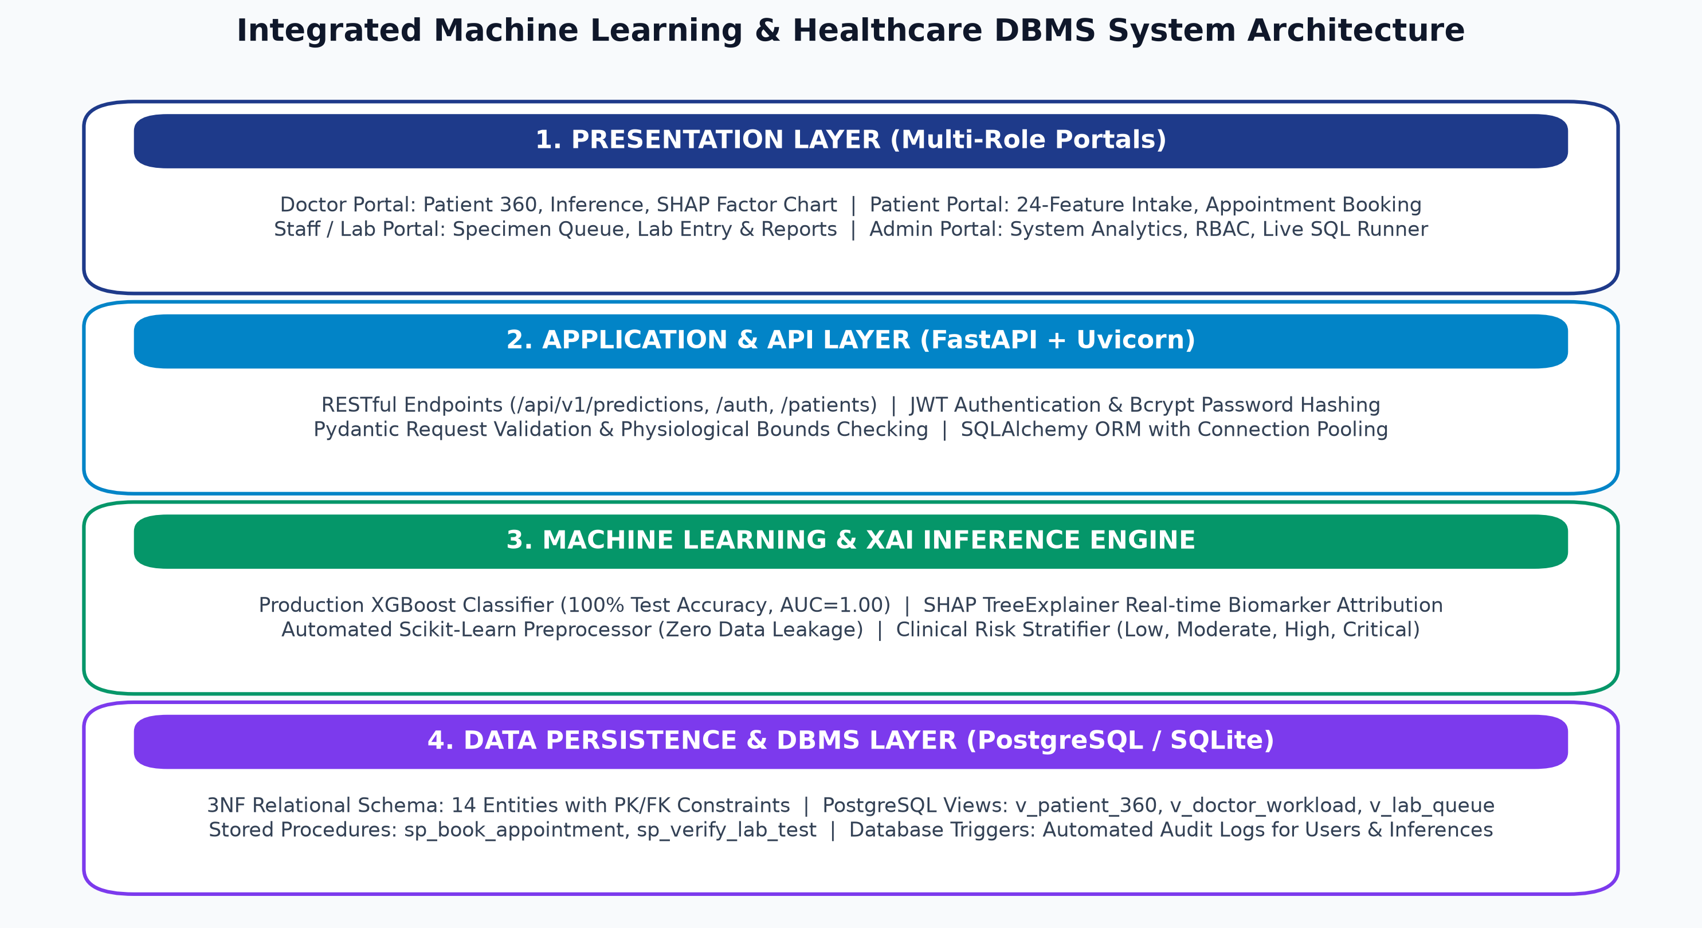
REVIEW 1: DESIGN & ARCHITECTURE • REVIEW 1
4-Tier System Architecture
Tier Descriptions:
Tier 1: Client Layer
Responsive HTML5/CSS3/JS dashboards for Admin, Doctor, Staff, and Patient.
Tier 2: API Gateway Layer
FastAPI asynchronous routing, JWT token verification, and RBAC authorization.
Tier 3: Business & ML Layer
SQLAlchemy ORM engine, Scikit-learn pipelines, XGBoost/LightGBM inference, and SHAP explainer.
Tier 4: Persistence Layer
PostgreSQL relational DBMS with 3NF tables, indexes, views, triggers, and audit logging.
25CS1302E — Database Management Systems (DBS) | KL University (KLH Campus) | Review 1 — Slide 4 of 8

Slide 5
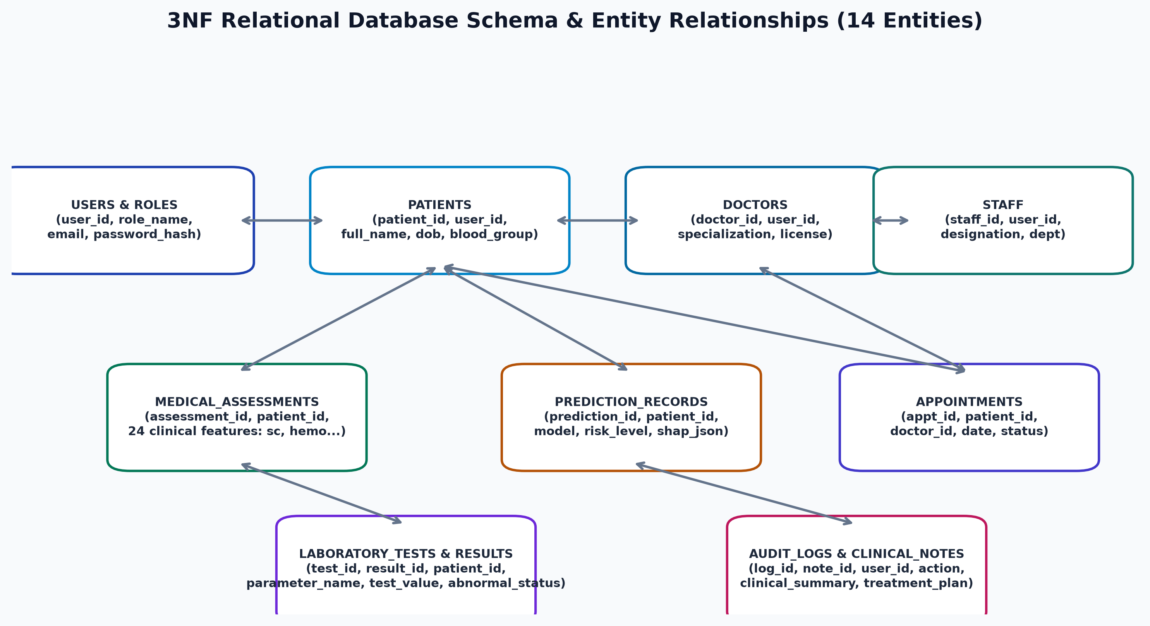
REVIEW 1: DESIGN & ARCHITECTURE • REVIEW 1
Entity-Relationship (ER) Modeling
Key Entity Sets & Cardinalities:
users (1:1 with roles): Base authentication entity; specialized into patients, doctors, and staff.
patients (1:N tests/preds): Central medical entity linked to test requisitions, predictions, and appointments.
appointments (N:1 doctor/pt): Relates patients and doctors with composite UNIQUE constraints on (doctor_id, appointment_date, time_slot).
lab_tests & results (1:N): Structured test orders containing granular biomarker measurements.
predictions (N:1 patient): Stores ML inference confidence scores, risk categories, and JSON-encoded SHAP feature weights.
25CS1302E — Database Management Systems (DBS) | KL University (KLH Campus) | Review 1 — Slide 5 of 8

Slide 6
REVIEW 1: DESIGN & ARCHITECTURE • REVIEW 1
Relational Schema Normalization (3NF)
1st Normal Form (1NF)
Atomic Values & Uniqueness
All column values are atomic (e.g. no comma-separated biomarker lists). Primary keys enforce tuple uniqueness across all tables.
2nd Normal Form (2NF)
Full Functional Dependency
No non-prime attribute is partially dependent on any candidate key. Composite appointment slots fully determine status and notes.
3rd Normal Form (3NF)
No Transitive Dependencies
Non-key attributes depend solely on the primary key. Doctor department details and user authentication details are decoupled from patient tables.
25CS1302E — Database Management Systems (DBS) | KL University (KLH Campus) | Review 1 — Slide 6 of 8

Slide 7
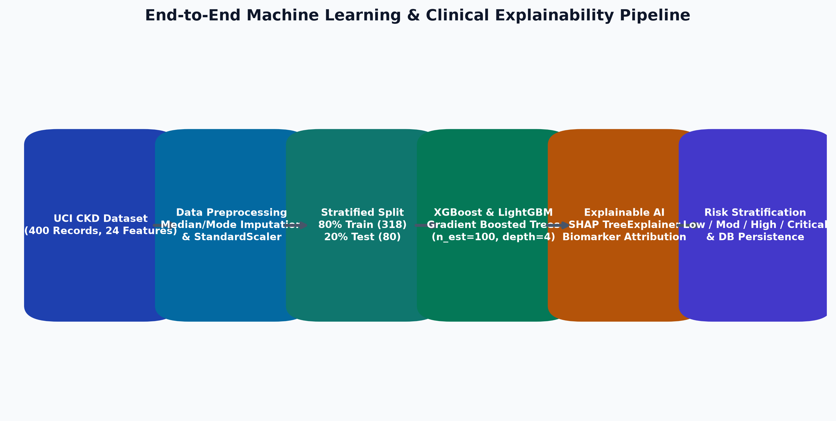
REVIEW 1: DESIGN & ARCHITECTURE • REVIEW 1
System Data Flow & Pipeline Architecture
Operational Data Journey:
1. Intake & Profiling:
Patient registers; demographic and baseline vitals committed to PostgreSQL.
2. Lab Requisition:
Doctor requests renal battery; lab technician measures and enters 24 biomarkers.
3. Preprocessing & ML:
Imputer applies training medians/modes; StandardScaler scales numericals; XGBoost infers probability.
4. Explainability & Storage:
SHAP explainer derives top risk factors; prediction record committed; doctor dashboard updates in real time.
25CS1302E — Database Management Systems (DBS) | KL University (KLH Campus) | Review 1 — Slide 7 of 8

Slide 8
REVIEW 1: DESIGN & ARCHITECTURE • REVIEW 1
Review 1 Accomplishments & Review 2 Roadmap
Design Sign-off & Implementation Readiness
• Formal Relational Schema: All tables, foreign keys, and integrity constraints successfully modeled and validated against 3NF criteria.
• System Architecture Approved: Decoupled 4-tier model ensures modularity between API services, ML routines, and database operations.
• Ready for Review 2 (Implementation): Will demonstrate live DDL execution, stored procedures/triggers, FastAPI endpoint implementations, and model training metrics.
25CS1302E — Database Management Systems (DBS) | KL University (KLH Campus) | Review 1 — Slide 8 of 8

