Slide 1

CAPSTONE PROJECT EVALUATION • REVIEW 3: TESTING & INTEGRATION
System Testing, Security & Integration
Automated Pytest Suite, RBAC Security, Database Integrity Verification & UI Workflows
──────────────────────────────────────────────────────
Team 06 | Project Members:
• 2520090137 — Jayavarapu Sri Charan
• 2520080060 — J. Sohan
• 2520080036 — Adithya Vishnubatala
Course: 25CS1302E — Database Management Systems (DBS) | KL University (KLH Campus)

Slide 2

REVIEW 3: TESTING & INTEGRATION • REVIEW 3
Automated Test Suite (Pytest)
test_auth.py
User Authentication & Registration
Validates successful login, password mismatch rejection, JWT issuance, and new patient registration flows.
test_appointments.py
Atomic Scheduling & Collision Prevention
Validates successful appointment creation and proves immediate rejection of double-booking attempts.
test_predictions.py
Inference & Feature Attribution
Submits clinical biomarker payloads, verifies prediction category generation, and ensures valid SHAP importance outputs.
test_database.py
Database Integrity & SQL Injection Defense
Validates demonstration SQL queries and proves parameterized queries reject malicious SQL injection payloads.
25CS1302E — Database Management Systems (DBS) | KL University (KLH Campus) | Review 3 — Slide 2 of 8

Slide 3
REVIEW 3: TESTING & INTEGRATION • REVIEW 3
Concurrency Control: Double-Booking Prevention
The Double-Booking Vulnerability in Healthcare
Race Condition Threat: Two patients simultaneously attempting to book Dr. Nephrologist at 10:00 AM on Monday.
Flawed Approach: Application-level checks (e.g. SELECT followed by INSERT) fail under high concurrency due to time-of-check to time-of-use (TOCTOU) race conditions.
Catastrophic Impact: Overbooked clinic hours, patient dissatisfaction, and doctor scheduling chaos.
Our Relational & Procedural Solution
Composite UNIQUE Constraint: UNIQUE (doctor_id, appointment_date, time_slot) enforced directly by the database B-tree index.
ACID Transaction Isolation: Stored procedure sp_book_appointment executes within an atomic transaction with immediate rollback on conflict.
HTTP 409 Conflict: Second concurrent request receives structured HTTP 409 Conflict with a clear message that the slot is already taken.
Pytest Verified: test_appointment_booking_and_double_booking_prevention programmatically confirms rejection.
25CS1302E — Database Management Systems (DBS) | KL University (KLH Campus) | Review 3 — Slide 3 of 8

Slide 4
REVIEW 3: TESTING & INTEGRATION • REVIEW 3
Role-Based Access Control & Security Auditing
Admin Portal
System health stats, user account management, global prediction analytics, and live SQL query demonstration runner.
Doctor Portal
Consultation queue, Patient 360 view, one-click ML prediction execution with SHAP charts, clinical notes editor.
Lab Staff Portal
Pending test requisition queue, 24 biomarker parameter entry form, test verification gating, and patient alert creation.
Patient Portal
Personal health profile, 24-feature self-assessment form, doctor appointment booking, and verified report downloads.
25CS1302E — Database Management Systems (DBS) | KL University (KLH Campus) | Review 3 — Slide 4 of 8

Slide 5
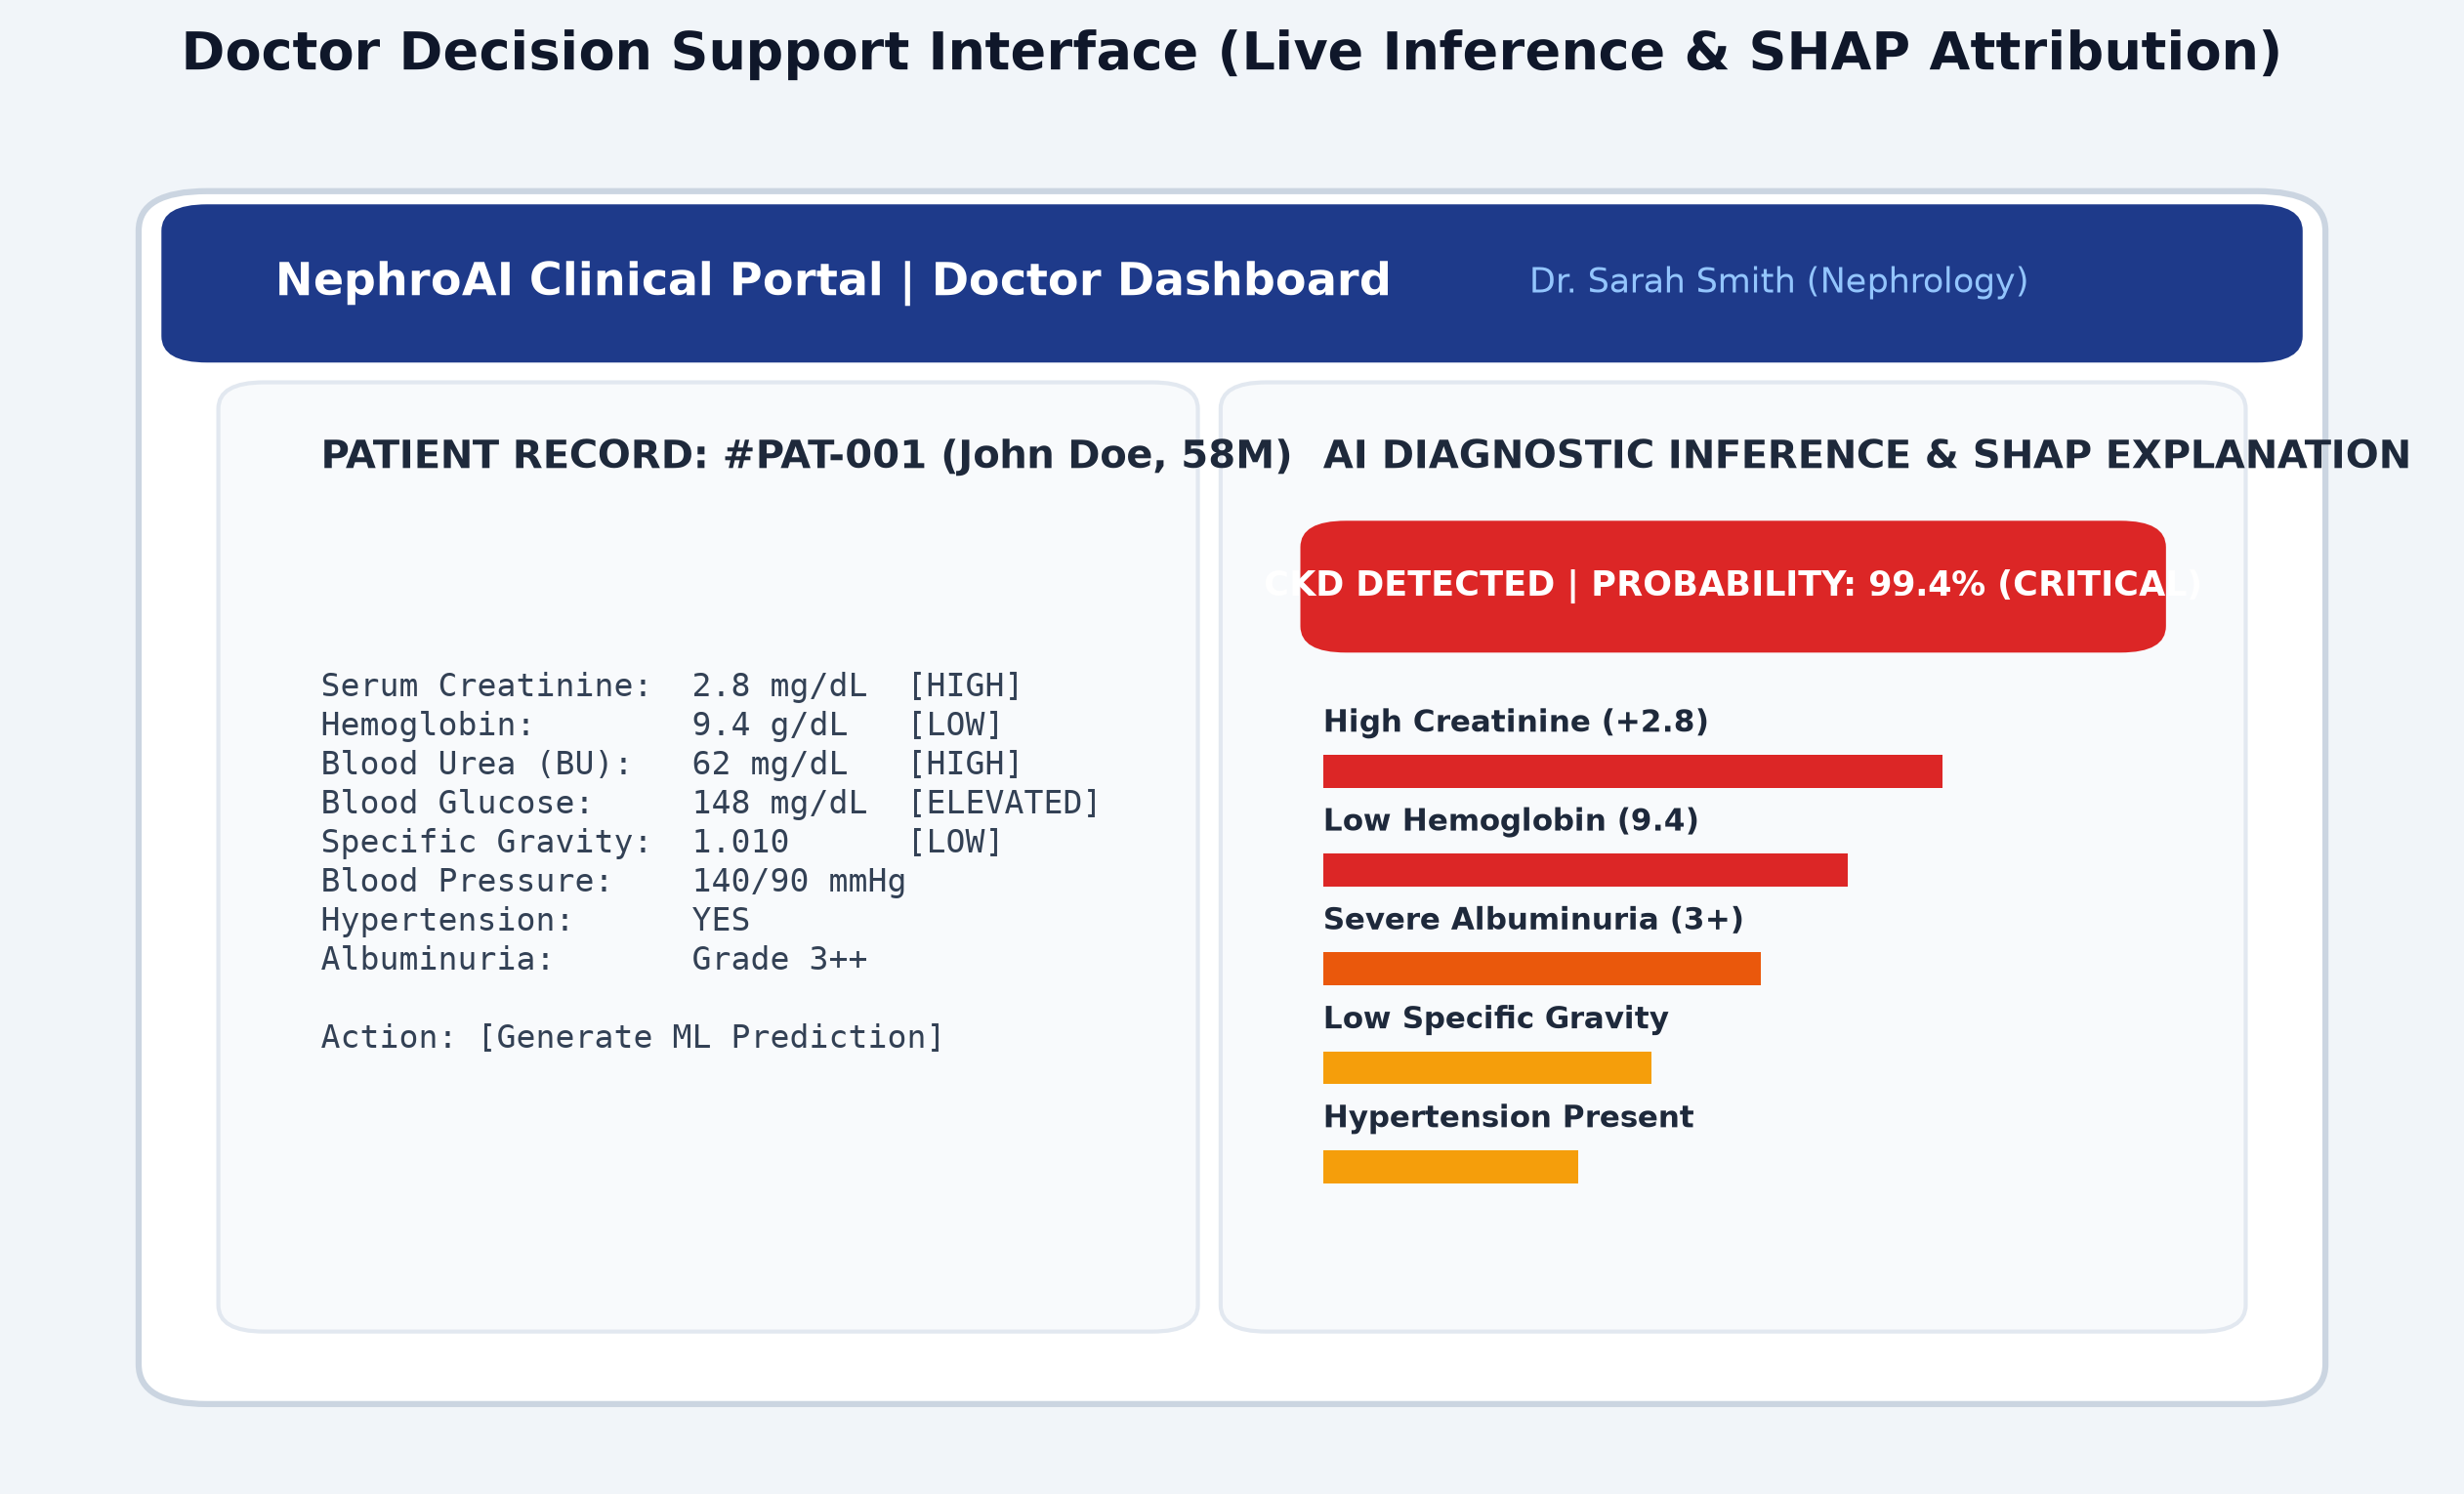
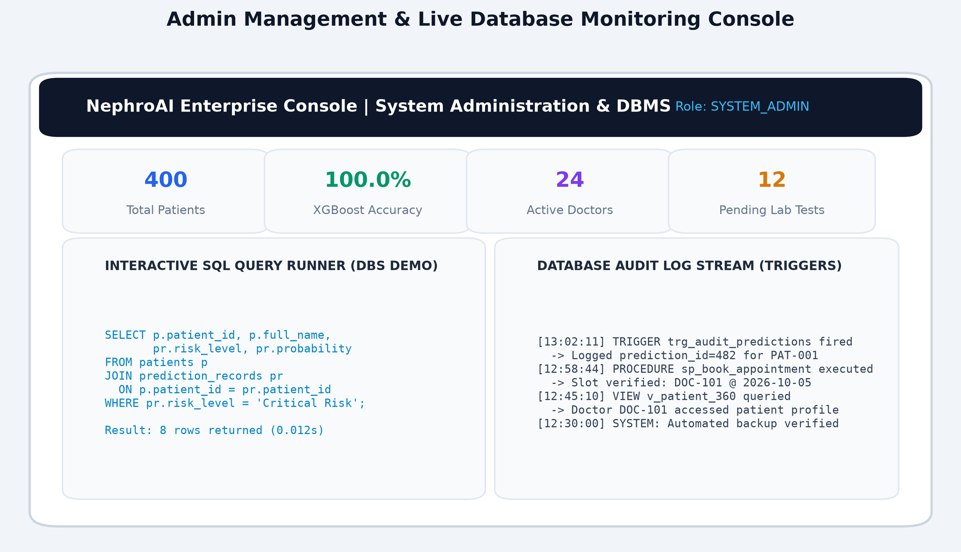
REVIEW 3: TESTING & INTEGRATION • REVIEW 3
Integrated User Portals: Doctor & Admin
25CS1302E — Database Management Systems (DBS) | KL University (KLH Campus) | Review 3 — Slide 5 of 8

Slide 6
REVIEW 3: TESTING & INTEGRATION • REVIEW 3
DBMS Views & Live Query Demonstration
v_patient_360
Composite 360-degree patient view uniting demographic details, latest lab test results, and latest CKD predictions.
v_doctor_workload
Aggregates total appointments, completed reviews, and pending consultations per physician.
v_lab_queue
Real-time list of pending biomarker requisitions highlighting abnormal values.
v_prediction_analytics
Statistical breakdown of CKD vs Not-CKD predictions, average confidence, and risk strata.
25CS1302E — Database Management Systems (DBS) | KL University (KLH Campus) | Review 3 — Slide 6 of 8

Slide 7
REVIEW 3: TESTING & INTEGRATION • REVIEW 3
Security Controls: SQL Injection & JWT Expiry
Parameterized Queries & SQL Injection Immunity
Zero String Concatenation: All queries use SQLAlchemy parameterized placeholders (:user_id, :email), completely immunizing the system against SQL injection attacks.
Validation Defense: Input payloads validated via Pydantic schemas before reaching the database driver layer.
Audit Trail: Automated triggers capture every prediction execution and clinical update.
Cryptographic & Authentication Hygiene
Bcrypt Password Hashing: Passwords salt-hashed using bcrypt; plain text passwords never stored in memory or disk.
JWT Tokens with Expiration: Cryptographically signed JWT bearer tokens with strict expiration timeouts.
RBAC Middleware: Endpoints protected with role verification dependencies ensuring patients cannot access admin/doctor routes.
25CS1302E — Database Management Systems (DBS) | KL University (KLH Campus) | Review 3 — Slide 7 of 8

Slide 8
REVIEW 3: TESTING & INTEGRATION • REVIEW 3
Review 3 Outcomes & Final Demonstration Plan
Integration Verification Accomplished
• Comprehensive Testing Completed: Pytest suites verify authentication, appointment locking, lab results, and ML prediction pipelines.
• Security Standards Met: Role-based access gating verified across all endpoints, parameterized queries prevent SQL injection.
• Ready for Review 4 (Final Evaluation): Will demonstrate live end-to-end clinical workflow, empirical comparisons, future work, and conclude the capstone evaluation.
25CS1302E — Database Management Systems (DBS) | KL University (KLH Campus) | Review 3 — Slide 8 of 8

