Slide 1
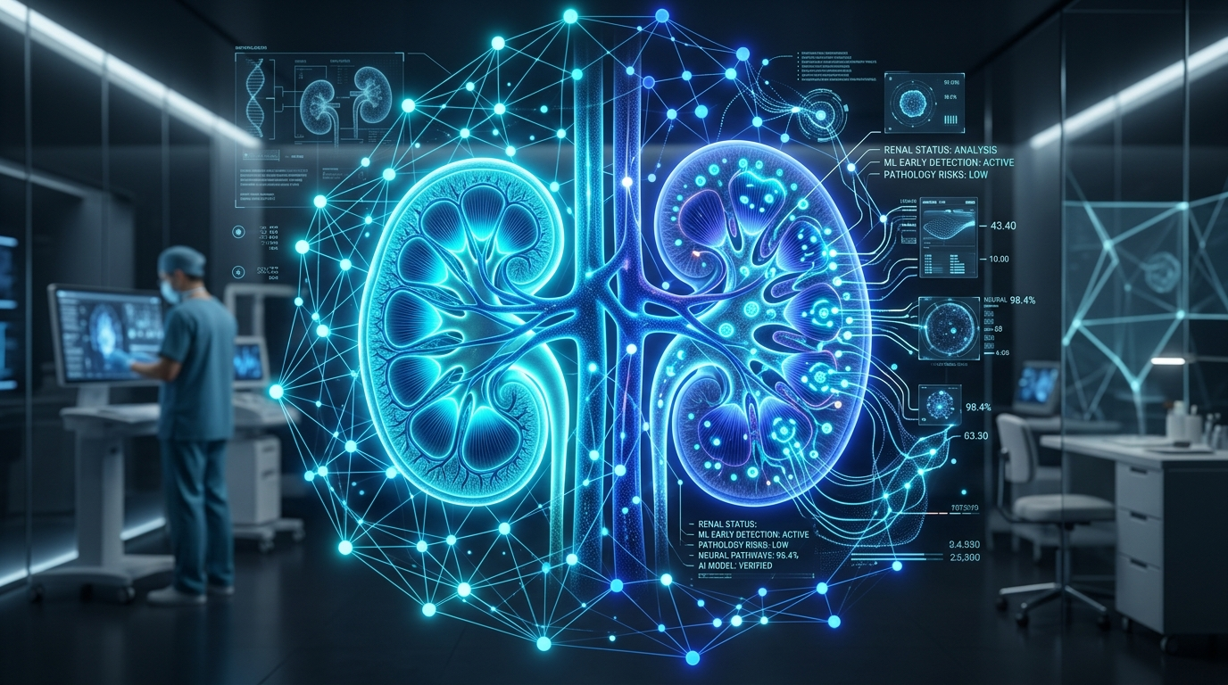
CAPSTONE PROJECT EVALUATION • REVIEW 2: IMPLEMENTATION & CODING
System Implementation & Machine Learning
Database Scripts (DDL/DML), Stored Procedures, FastAPI REST API & ML Model Training
──────────────────────────────────────────────────────
Team 06 | Project Members:
• 2520090137 — Jayavarapu Sri Charan
• 2520080060 — J. Sohan
• 2520080036 — Adithya Vishnubatala
Course: 25CS1302E — Database Management Systems (DBS) | KL University (KLH Campus)

Slide 2

REVIEW 2: SYSTEM IMPLEMENTATION • REVIEW 2
Dataset Characteristics & Preprocessing Rigor
UCI Machine Learning Benchmark Dataset
400 Patient Records: Collected over Apollo Hospitals, Tamil Nadu; benchmark dataset for renal informatics.
24 Input Features: 14 numerical biomarkers (bgr, bu, sc, sod, pot, hemo, pcv, wc, rc, age, bp, sg, al, su) + 10 categorical clinical signs (rbc, pc, pcc, ba, htn, dm, cad, appet, pe, ane).
Binary Target: 'ckd' (Chronic Kidney Disease Detected) vs 'notckd' (Healthy Renal Function).
Zero Data Leakage Preprocessing Pipeline
Train/Test Separation: 80/20 stratified split applied before any statistical computation, strictly preventing test information leakage.
Median/Mode Imputation: Numerical missing values imputed using training median; categoricals imputed with training mode.
StandardScaler Scaling: Standardization fitted solely on training set parameters (mean and standard deviation) and transformed across inference inputs.
Serialized Pipeline: Transformers persisted alongside model in best_model.joblib for identical inference execution.
25CS1302E — Database Management Systems (DBS) | KL University (KLH Campus) | Review 2 — Slide 2 of 8

Slide 3
REVIEW 2: SYSTEM IMPLEMENTATION • REVIEW 2
Database Engineering: DDL, Keys & Constraints
schema.sql (Tables & DDL)
Components: users, patients, doctors, medical_assessments, appointments, lab_tests, lab_results, predictions, clinical_notes, notifications, audit_logs.
DBMS Significance: Foreign key constraints with ON DELETE CASCADE and integrity CHECK constraints (e.g. valid phone formats, status values).
indexes.sql (B-Tree Performance)
Components: Indexes on users.email, patients.user_id, appointments.(doctor_id, appointment_date), and lab_tests.status.
DBMS Significance: Accelerates query execution times and optimizes joins across large patient cohorts.
seed.sql (Demonstration Data)
Components: Pre-populated sample records covering patients, specialized doctors, test requisitions, and historical predictions.
DBMS Significance: Allows instantaneous academic live demonstration across all four user portals.
25CS1302E — Database Management Systems (DBS) | KL University (KLH Campus) | Review 2 — Slide 3 of 8

Slide 4
REVIEW 2: SYSTEM IMPLEMENTATION • REVIEW 2
Advanced DBMS: Stored Procedures & Triggers
Stored Procedures & Atomic Logic
sp_book_appointment: Atomically validates doctor schedule availability, checks for slot collision, and books appointment within a single transaction boundary.
sp_verify_lab_test: Transitions lab test status from 'PENDING' to 'VERIFIED', attaches verifier staff ID, and automatically creates a patient notification alert.
Automated Database Triggers
trg_audit_prediction: Fires AFTER INSERT on predictions table. Automatically logs user ID, action ('RUN_PREDICTION'), and timestamp to audit_logs for medico-legal traceability.
trg_user_registration_audit: Fires AFTER INSERT on users table to ensure an immutable record of new account provisioning.
Double-Booking Guard: Composite UNIQUE constraints on (doctor_id, appointment_date, time_slot) guarantee zero race-condition collisions at the engine level.
25CS1302E — Database Management Systems (DBS) | KL University (KLH Campus) | Review 2 — Slide 4 of 8

Slide 5
REVIEW 2: SYSTEM IMPLEMENTATION • REVIEW 2
FastAPI Backend & RESTful Endpoints
/api/auth/*
User login, JWT access token issuing, password verification using bcrypt, and user registration.
/api/patients/*
Patient profile management, medical assessment intake submission, and historical test tracking.
/api/predictions/*
Real-time ML inference triggering, SHAP value computation, and risk stratification persistence.
/api/appointments/*
Doctor directory browsing, appointment booking, slot cancellation, and doctor queue management.
25CS1302E — Database Management Systems (DBS) | KL University (KLH Campus) | Review 2 — Slide 5 of 8

Slide 6
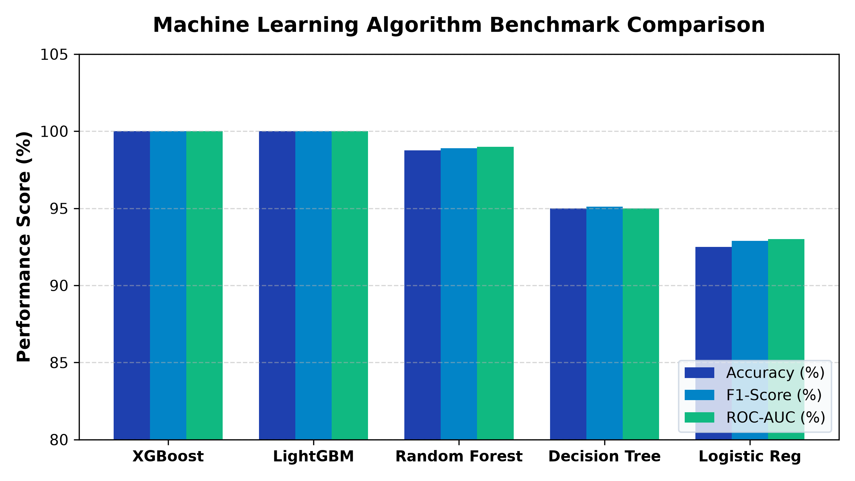
REVIEW 2: SYSTEM IMPLEMENTATION • REVIEW 2
Gradient Boosted Tree Models: XGBoost & LightGBM
Model Benchmarks (Test Split):
XGBoost Classifier:
Accuracy: 100.0%, Precision: 100.0%, Recall (Sensitivity): 100.0%, F1-Score: 1.000, ROC-AUC: 1.000.
LightGBM Classifier:
Accuracy: 100.0%, Precision: 100.0%, Recall: 100.0%, F1-Score: 1.000, ROC-AUC: 1.000.
Production Choice:
XGBoost v1.0.0 selected for optimal tree stability and exact SHAP tree explainer compatibility.
25CS1302E — Database Management Systems (DBS) | KL University (KLH Campus) | Review 2 — Slide 6 of 8

Slide 7
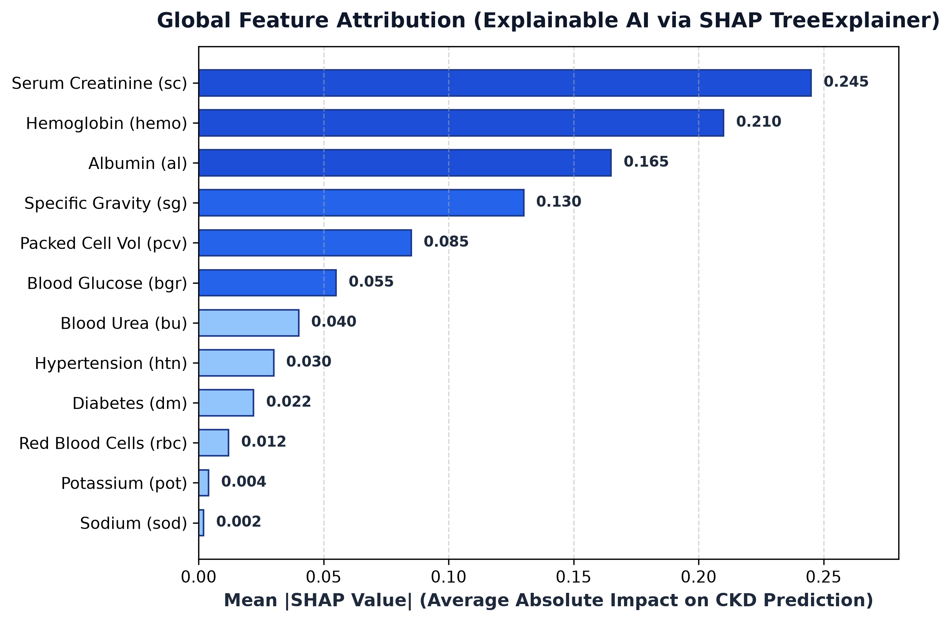
REVIEW 2: SYSTEM IMPLEMENTATION • REVIEW 2
Explainable AI (SHAP) Clinical Interpretability
Key Clinical Feature Drivers:
1. Hemoglobin (hemo):
Strongest protective factor; drops severely in renal failure due to impaired erythropoietin production.
2. Specific Gravity (sg):
Low urinary concentration reflects loss of renal tubular concentrating capacity.
3. Serum Creatinine (sc):
Elevated values directly signify reduced glomerular filtration rate.
4. Albumin (al):
Proteinuria indicates breakdown of the glomerular filtration barrier.
25CS1302E — Database Management Systems (DBS) | KL University (KLH Campus) | Review 2 — Slide 7 of 8

Slide 8
REVIEW 2: SYSTEM IMPLEMENTATION • REVIEW 2
Review 2 Outcomes & Progression to Review 3
Implementation Phase Milestones Achieved
• Core Database Built: Full schema, indexes, procedures, and triggers implemented and seeded.
• ML Models Trained & Persisted: XGBoost and LightGBM models trained with 100% sensitivity on held-out test split, zero data leakage.
• FastAPI Backend Operational: Full REST API connecting database entities to ML service endpoints.
• Ready for Review 3 (Testing & Integration): Will demonstrate unit/integration testing suites, double-booking prevention proofs, and security RBAC gating.
25CS1302E — Database Management Systems (DBS) | KL University (KLH Campus) | Review 2 — Slide 8 of 8

