Slide 1


TechTalks- Travis CI
Be fast to integrate and deploy. Follow CICD
Team Members:
Sunil Narasimhamurthy
Ajay Chandra Pendyala
Sohan Kunkerkar
Pranav Firake

Slide 2
What is CI? a software development practice where members of a team integrate their work frequently, usually each person integrates at least daily - leading to multiple integrations per day.
TechTalks- Travis CI

Slide 3
What is Travis CI? a hosted, distributed continuous integration service used to build and test software projects hosted at GitHub.
TechTalks- Travis CI

Slide 4
Functionalities: - Monitor GitHub projects - Run Tests - Provide feedback - Build artefacts - Check code quality - Deploy to cloud services
TechTalks- Travis CI

Slide 5
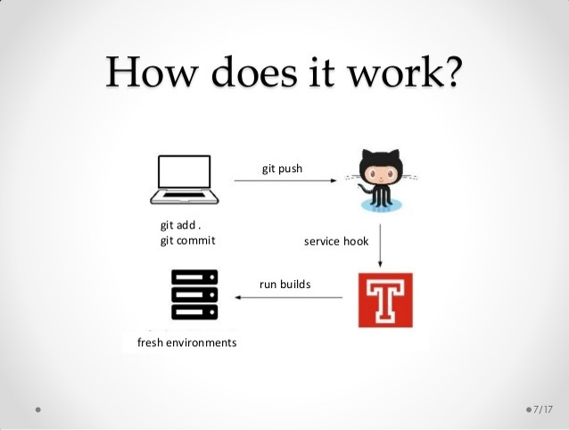
TechTalks- Travis CI

Slide 6
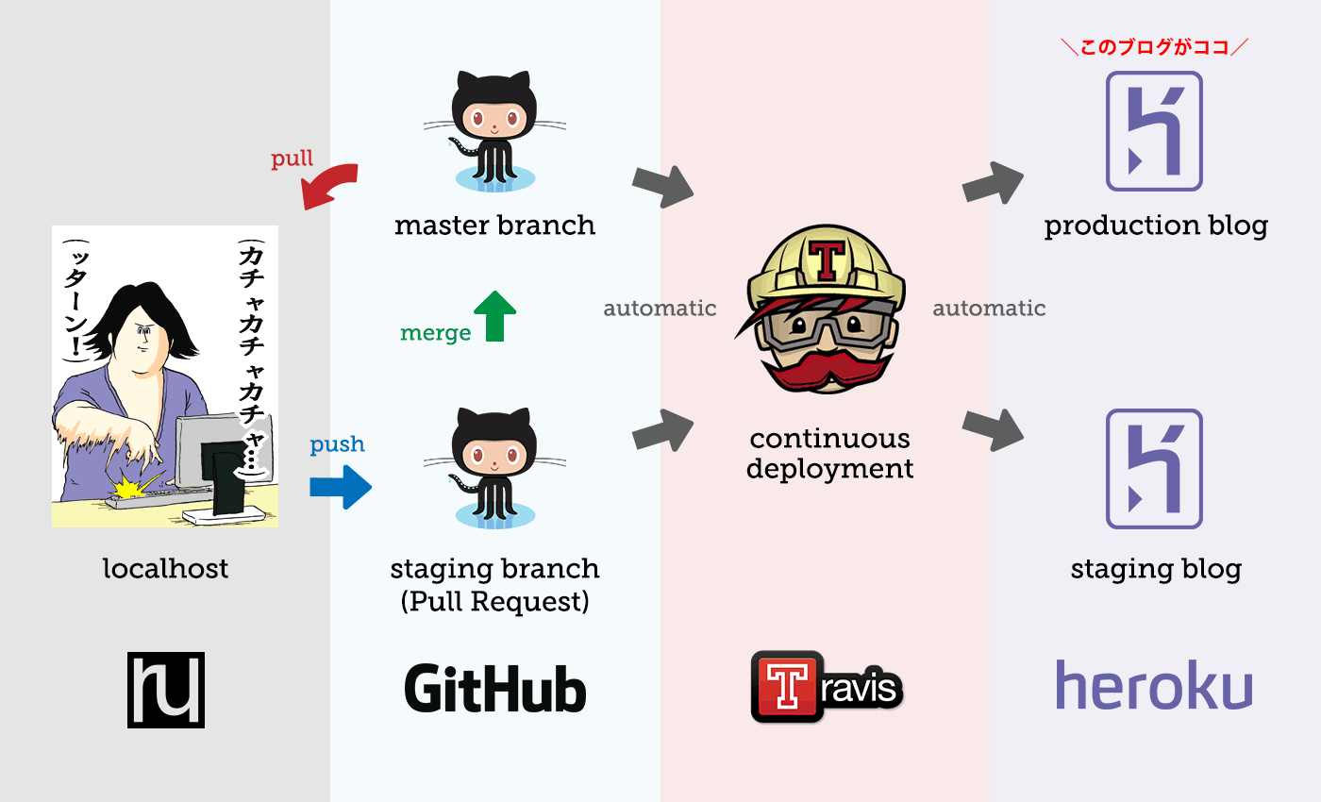
TechTalks- Travis CI

Slide 7
Features:
TechTalks- Travis CI
Open Source
Fully hosted
Distributed
Incredibly easy
built-in support to deploy to other vendors, like Heroku
No worries about back end
Save git repo maintainer's time
Easy to configure & use
High speed
Great integration with GitHub & cloud services

Slide 8

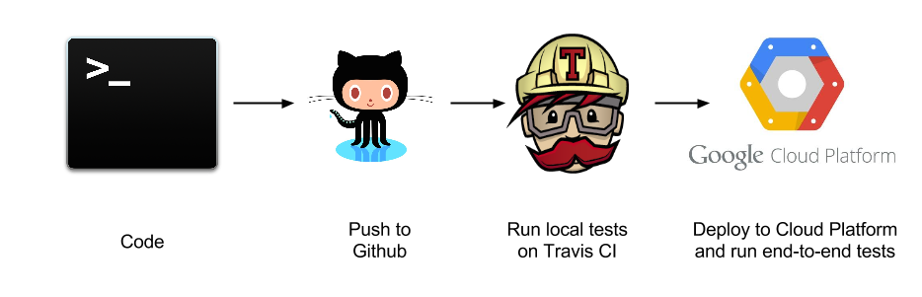



Application of Travis CI:
TechTalks- Travis CI

Slide 9


Other CI tools:
TechTalks- Travis CI

Slide 10

TechTalks- Travis CI
Travis CI | Jenkins
fully Hosted with GitHub integration | Hosted internally
Commercial | Open-Source
Service | Application
Convention | Configuration
Easy to use | Flexible

Slide 11
Our Views:
TechTalks- Travis CI
If we are coding an open source project on github and want easy to configure CI tool go for Travis CI. The another cool thing is badge we can put on a website or in our readme of GitHub to show whether the build is passing or not.
Travis CI for non-open source projects is very expensive ☹ starts at $129 per month
Jenkins would be better option if you are already familiar with it.
Preference for projects :
in-house → Jenkins
Open source and Github.com → Travis-CI

Slide 12
TechTalks- Travis CI
<demo>
<\demo>

