Slide 1

Smart Healthcare Appointment and Patient Management System
CNAD Project Review-1
 | Under the Guidance of Mr. Madhu Guda Assistant Professor, Department of Computer Science and Engineering, KLH CSE Bowrampet Campus
Team Members KOUSHIK – 2420030232 NRUSIMHA – 2420030114 SOHAN SAI - 2420090139

Slide 2
Outline of Project Work
Focus
Introduction
Literature Survey
Challenges
Research Objectives
Conclusion & Future Work
References
Publications Details

Slide 3
Problem Statement
Problem Statement
Healthcare appointment management often involves separate processes for patient registration, doctor availability, appointment booking and patient information management.
Traditional/manual workflows can result in:
Appointment scheduling conflicts
Difficulty tracking doctor availability
Repeated patient-data entry
Delays in appointment confirmation
Inefficient coordination between patients and healthcare providers
Fragmented management of patient information

Slide 4
Objectives
01 — Appointment Management
Enable patients to book, reschedule and cancel appointments efficiently.
02 — Patient Management
Maintain organized patient profiles and appointment history.
03 — Doctor Management
Manage doctor profiles, availability and schedules.
04 — Smart Scheduling
Identify suitable appointment slots while reducing scheduling conflicts.
05 — Automated Notifications
Provide appointment confirmations, reminders and updates.
06 — SOA-Based Integration
Separate healthcare functions into independent, scalable services.

Slide 5
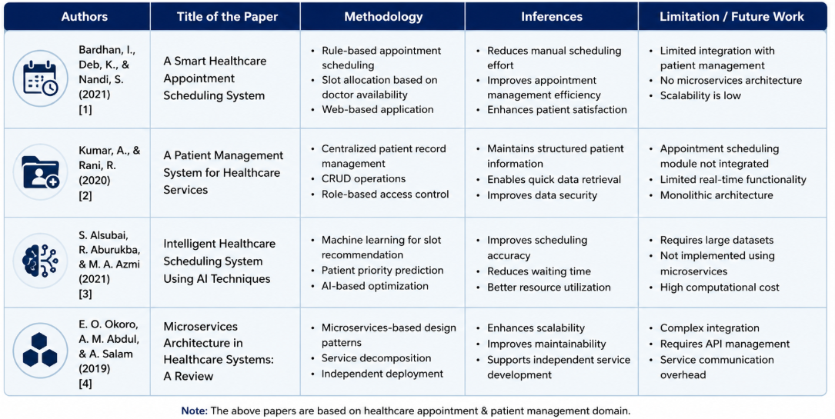
Literature Survey
Authors | Title of the Paper | Methodology | Inferences | Limitation/Future work
Paper 1 Author(s) | Healthcare Appointment Management System | Appointment scheduling / management approach | Efficient appointment handling | Limited integration / scalability

Slide 6
Problem Gap Identification
Existing Systems
Appointment Management
Patient Management
Doctor Scheduling
Notifications
⬇️
Research Gap
Existing healthcare systems may manage individual functions separately, but there is a need for an integrated platform connecting appointment management, patient management and doctor availability through a scalable service-oriented architecture.
⬇️
Proposed System
SMART HEALTHCARE APPOINTMENT AND PATIENT MANAGEMENT SYSTEM
Integrated Healthcare Workflow
Patient → Appointment → Doctor Availability → Confirmation → Notification

Slide 7
Innovation, Creativity, and Novelty
👤 Smart Patient Management
Centralized patient profiles and appointment history.
🩺 Doctor Availability Management
Manage doctor schedules and available appointment slots.
📅 Smart Appointment Scheduling
Efficiently allocate appointments based on availability.
🔔 Automated Notifications
Send appointment confirmations, reminders and updates.
⚙️ SOA-Based Microservices
Separate healthcare functions into independent services for modularity and scalability.

Slide 8
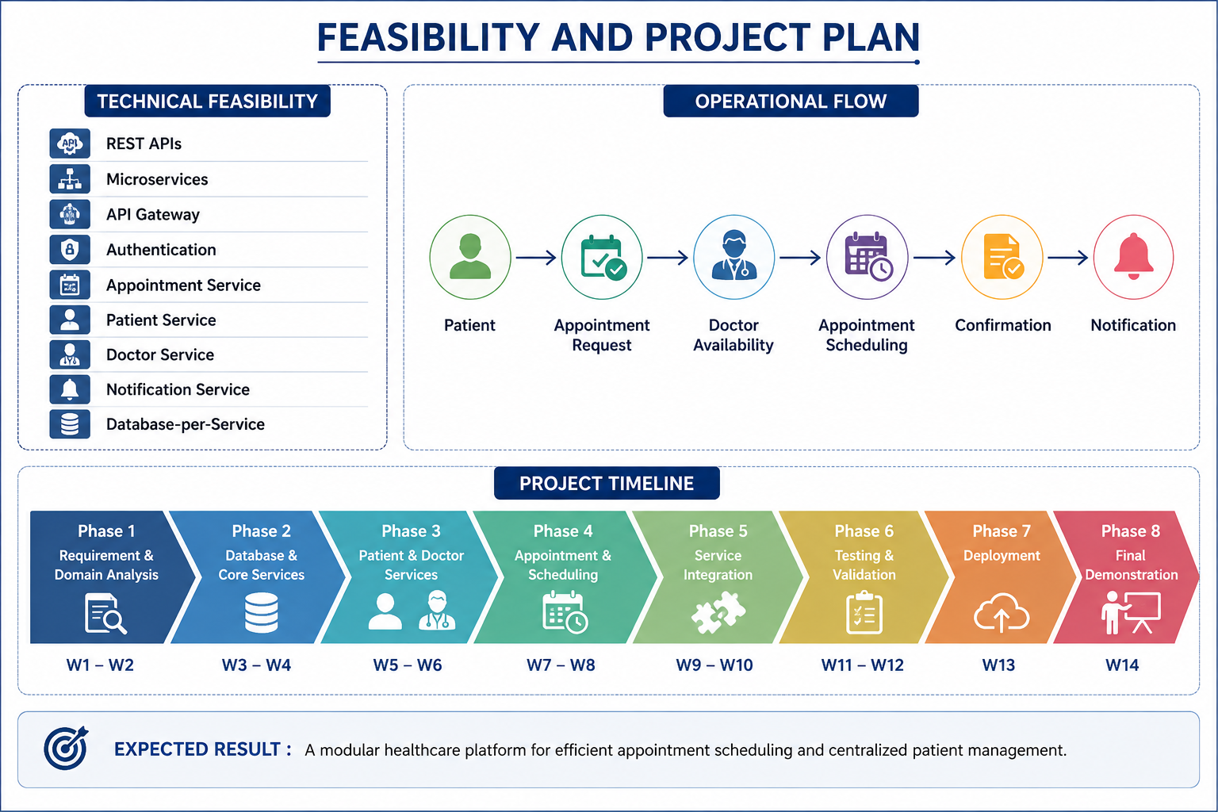
Feasibility and Project Plan
TIMELINE CHART FOR EACH PHASE OF YOUR PROJECT SHOULD BE THERE AFTER EXPLANATION

