Slide 1

Smart Healthcare Appointment and Patient Management System
CNAD Project Review-2
 | Under the Guidance of Mr. Madhu Guda Assistant Professor Department of Computer Science and Engineering, KLH CSE Bowrampet Campus
Team Members KOUSHIK – 2420030232 NRUSIMHA – 2420030114 SOHAN SAI - 2420090139

Slide 2
Problem Statement
Healthcare appointment management often involves separate processes for patient registration, doctor availability, appointment booking, and patient information management.
Traditional/manual workflows can lead to:
Appointment scheduling conflicts
Difficulty tracking doctor availability
Repeated patient-data entry
Delays in appointment confirmation
Inefficient coordination between patients and healthcare providers
Fragmented management of patient information
Problem: There is a need for an integrated, secure, and scalable healthcare platform that connects patients, doctors, appointments, medical records, billing, and notifications through a unified system.

Slide 3
Solution
Smart Healthcare Appointment and Patient Management System :
Centralized Platform – Manage patients, doctors, appointments, medical records, billing, and notifications.
Smart Appointment Management – Check doctor availability and book, reschedule, or cancel appointments.
Role-Based Access – Separate functionality for patients, doctors, and administrators.
Microservices Architecture – Independent services for authentication, patients, doctors, appointments, records, billing, and notifications.
Secure & Scalable – JWT authentication with Docker and Kubernetes for deployment and scalability.

Slide 4
Tech stack
🐍 Python + FastAPI
Backend development and REST API implementation
🧩 Microservices
Independent services for authentication, patients, doctors, appointments, medical records, billing, and notifications
🗄️ PostgreSQL
Persistent storage and database management
🔐 JWT Authentication
Secure login and authenticated access
🐳 Docker
Containerization of individual services
☸️ Kubernetes
Deployment, service management, and scalability
📧 Email Notifications
Appointment confirmations, reminders, and updates
Architecture Flow:
Fontend → REST APIs → Microservices → PostgreSQL -> Docker → Kubernetes → Deployment & Scaling

Slide 5
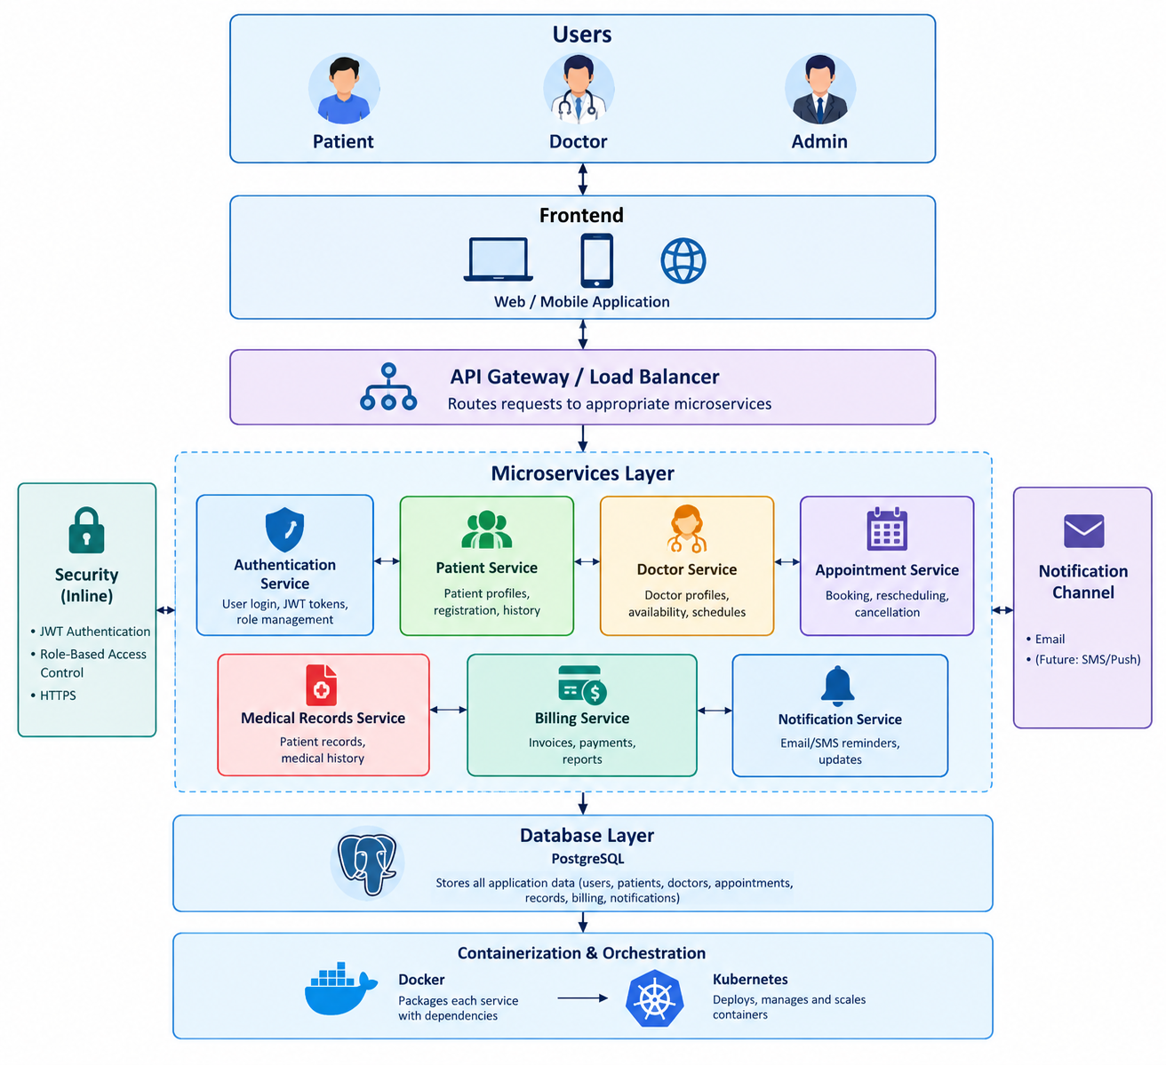
System architecture

Slide 6
Methodology
Patient :
Patient opens the application.
Creates an account by providing required details.
Login credentials are authenticated.
The system generates a secure authentication token.
Patient is redirected to the patient dashboard.
Doctor :
Doctor logs into the system.
Authentication service verifies the credentials.
Doctor accesses the doctor dashboard.
Doctor can manage availability, appointments, and patient records.
Admin :
Administrator logs into the system.
Admin authentication is verified.
Admin accesses the administration dashboard.
Admin can monitor and manage system activities.

Slide 7
Future Scope
Future Scope :
AI-powered doctor recommendations
Telemedicine integration
Mobile application
Smart notifications
Advanced analytics
Cloud scalability
Enhanced security
“Towards a smarter, secure, and connected healthcare ecosystem.”

