Slide 1

Accounting

Slide 2
Synopsis
What is Accounting?
Objectives/Significance of Accounting
Users of Accounting information
Branches of Accounting
Accounting Cycle
Accounting Terminology
Accounting Concepts/Principles
Accounting Conventions
Double entry Book keeping

Slide 3

Introduction
Every business organization wants to know whether it has made profit or not at the end of a given period.
For this purpose it must prepare an account consisting of Revenues and Expenses called as
Profit and Loss Account
It also wants to know what it owns (assets) and how much it owes (liabilities) to suppliers and others.
For this purpose it must prepare a statement that shows full list of Assets and Liabilities known as
Balance Sheet
In order to prepare these statements, the business organization has to maintain a set of accounts.

Slide 4
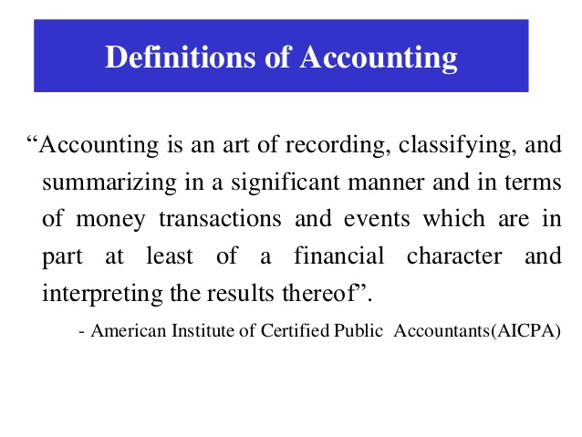

Slide 5
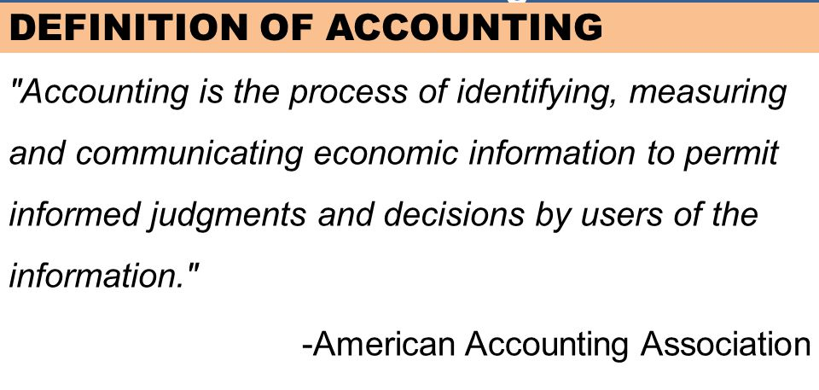

Slide 6
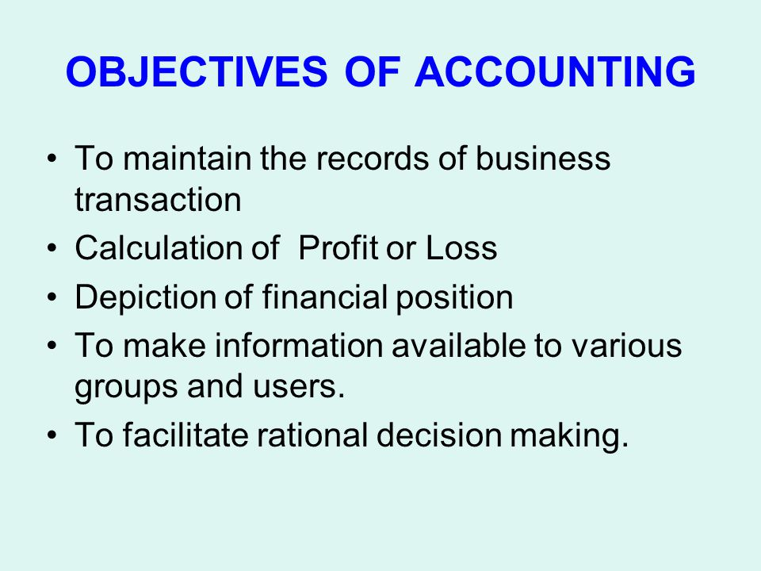

Slide 7
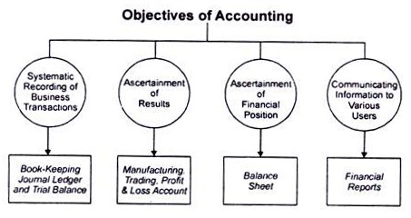

Slide 8
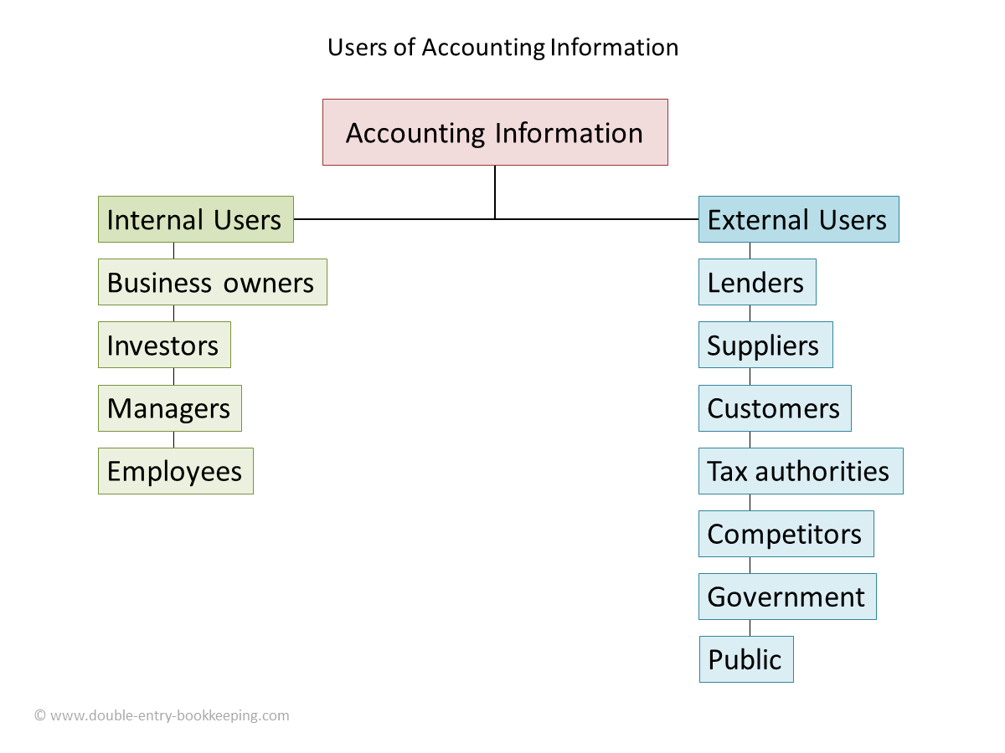

Slide 9
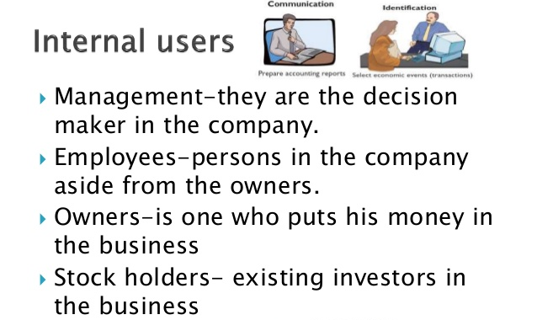

Slide 10
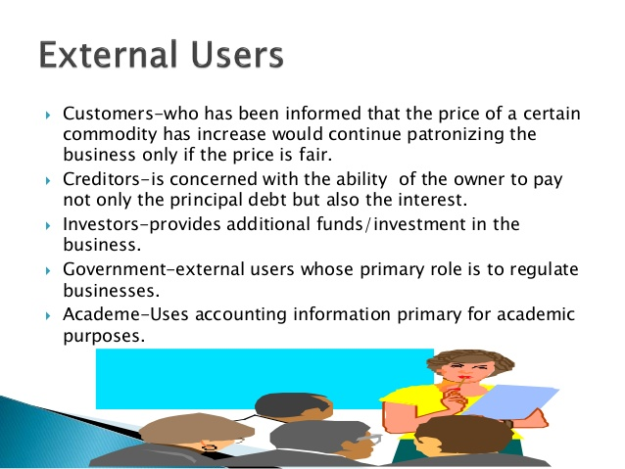

Slide 11
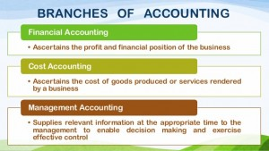

Slide 12
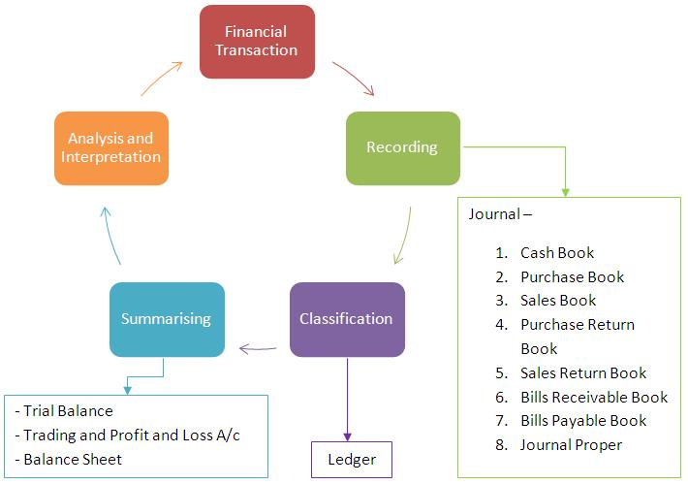
Accounting Cycle

Slide 14
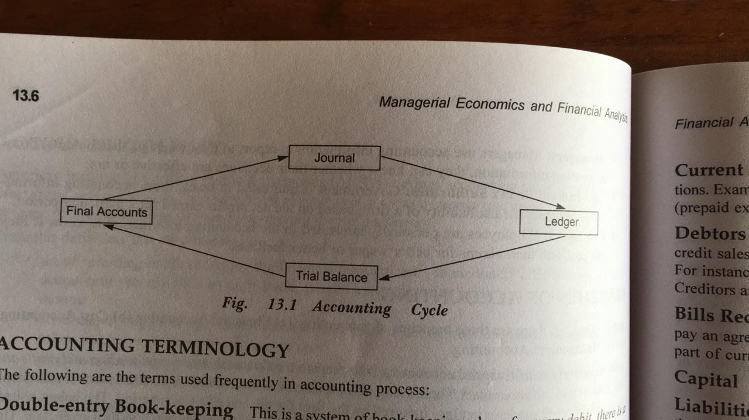
Accounting Cycle - Simplified

Slide 15
Accounting Terminology
The following are the terms used frequently in accounting process:
Double-entry Book-keeping - This is a system of book -keeping where for every debit, there is a corresponding credit.
Account - This is a financial record in T shaped format, under double entry book-keeping, dealing with financial transactions.
Debit - The left-hand side of the account.
Credit - The right-hand side of the account.
Accounting Period - Accounting period refers to the period for which accounts are maintained. Normally it is a period of one year.

Slide 16
Transaction - Transaction involves exchange of money or money's worth between two parties. Transaction may be of two types: cash transaction or credit transaction.
Cash transaction involves the payment or receipt of cash. For example, Sold goods worth Rs. 5000 to Gopal for cash. ln this transaction, the goods are sold for cash to Gopal.
Credit transaction does not involve cash. It involves a promise to pay cash at a future date. For ex Purchased goods worth Rs. 30,000 from Gopal. Here Gopal supplies goods worth Rs. 30,000 purchase goods on credit. Cash is to be paid at a future date, not immediately. So it is called a credit transaction.

Slide 17
Assets - All such items that have value are known as assets. lt refers to what a business owns, namely its plant, machinery, furniture, land and so on.
Tangible fixed assets - Tangible fixed assets can be touched and seen. Examples are plant, machinery etc. Such assets have long life, could be used in business, and resold later.
Intangible fixed assets - Such fixed assets that cannot be seen or touched are called intangible assets. They can be felt. The reputation of a firm (also called goodwill), the value of patents, traden and brand names such as Coke or Pepsi, refers to intangible fixed assets.

Slide 18
Current Assets : Current assets are expected to be realised in cash or consumed during business operations.
Examples for current assets are Cash in hand, Cash at bank, Stock, Debtors, Expenses paid in advance (prepaid expenses), Incomes yet to be received, Short-term investments, Bills receivable and so on.
Slock/lnventory : Stock or inventory refers to the goods in which the firm deals. A large business may have three types of stock : raw materials, work in progress and finished goods.

