Slide 1
LEDGER
Meaning, features, posting & balancing of ledger

Slide 2
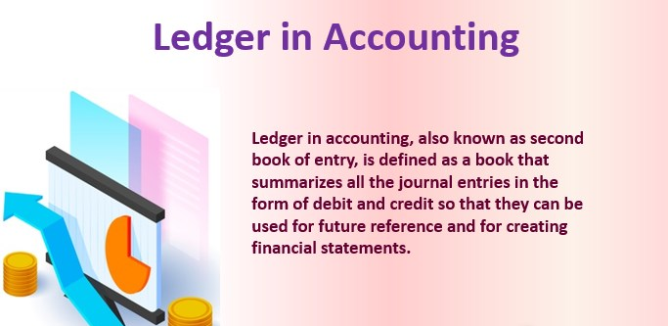

Slide 3
Features of Ledger
Ledger is the Book of second entry.
1. Ledger contains all the accounts – personal, real and nominal
2. It is a permanent record of business transactions
3. It provides a means of easy reference, and
4. It provides final balance of accounts.

Slide 4
It gives answers to the following pertinent questions:
1. How much amount is due from others to the business?
2. How much amount is owed to others?
3. What is the total sales to an individual customer and what are the total purchases from an
individual supplier?

Slide 5
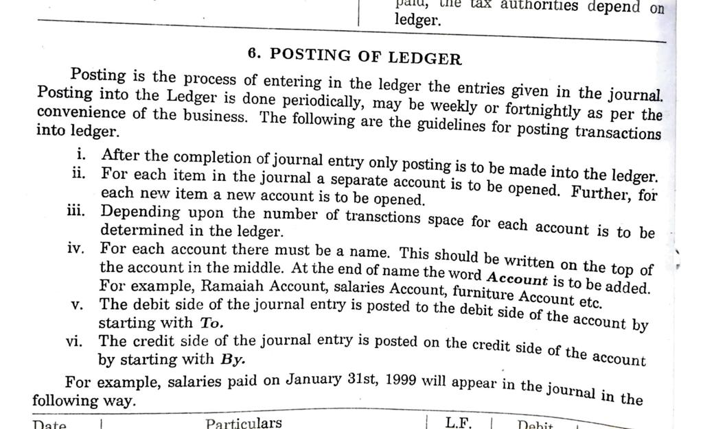

Slide 6
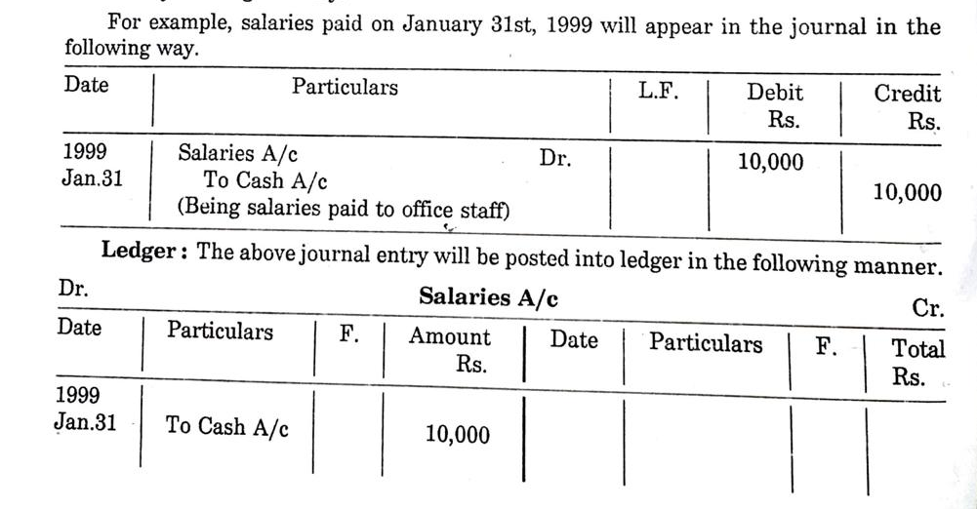

Slide 7
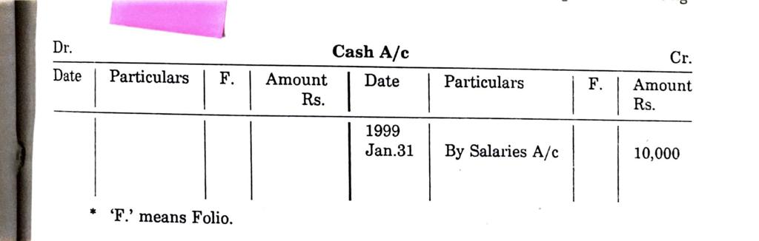

Slide 8
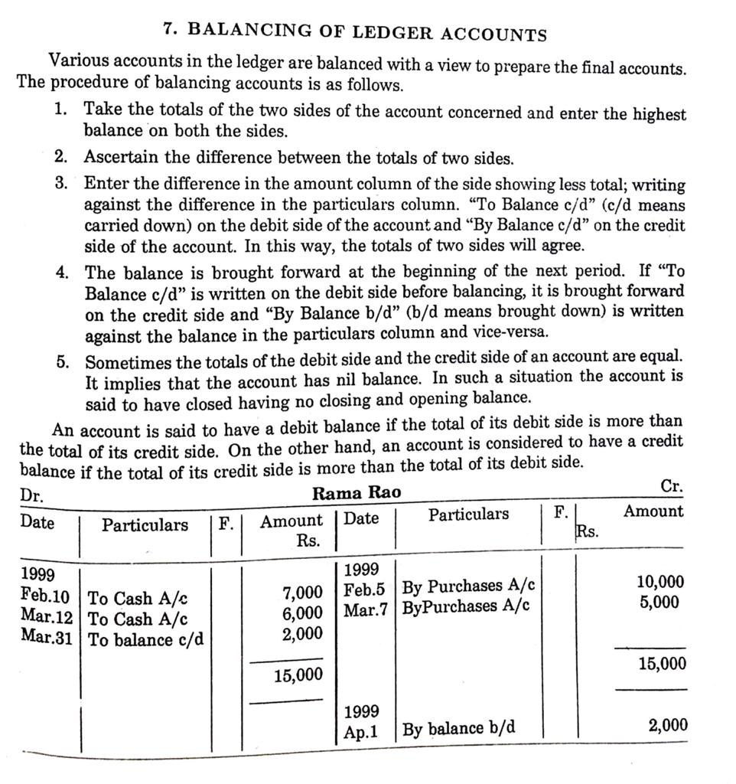

Slide 9
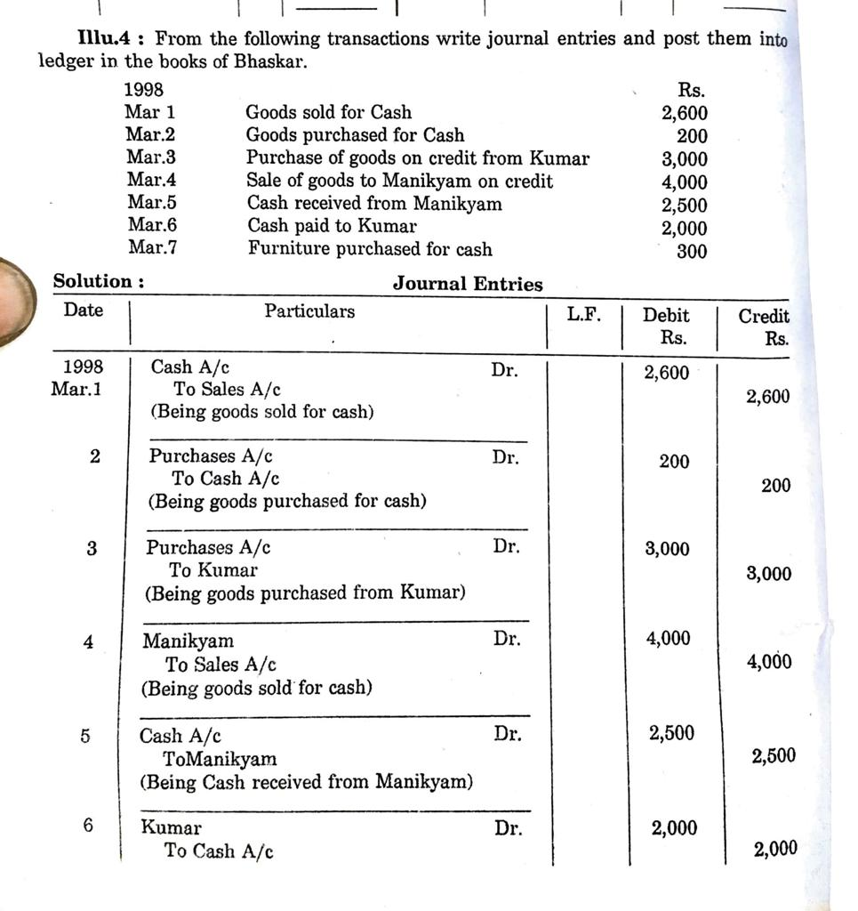

Slide 10
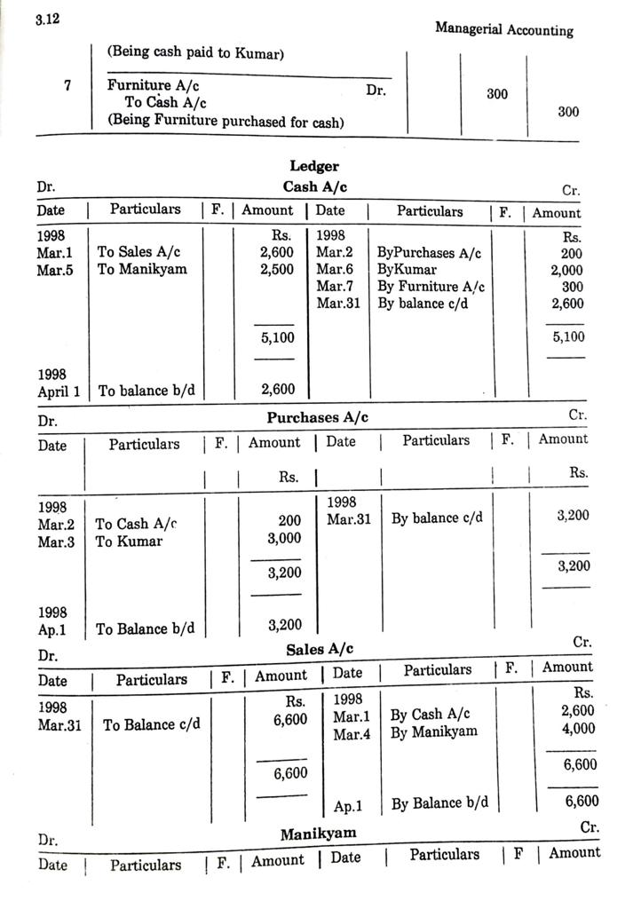

Slide 11
