Slide 1

Journal
How to Journalize Business Transactions

Slide 2
Book-Keeping
In financial accounting, there are two systems of book-keeping:
a) Single-entry book-keeping
b) Double-entry book-keeping

Slide 3
Single –entry system is an unscientific and haphazard way of maintaining accounts. Small business units in the unorganized sector maintain their books of accounts under single-entry system of book-keeping.
Double-entry book-keeping is a scientific way of recording transactions based on the fact that for every debit, there is a corresponding credit. Under double-entry system, both debit and credit aspects of the transaction are being recorded.

Slide 4
Advantages of Double-entry book-keeping
1. Information about every Account
2. Helps to know the Receivables and Payables
3. Arithmetical Accuracy
4. Helps to Locate Errors
5. Helps to Ascertain Profit/Loss
6. Helps to know the Financial Position
7. Monitoring and Auditing made easier.

Slide 5
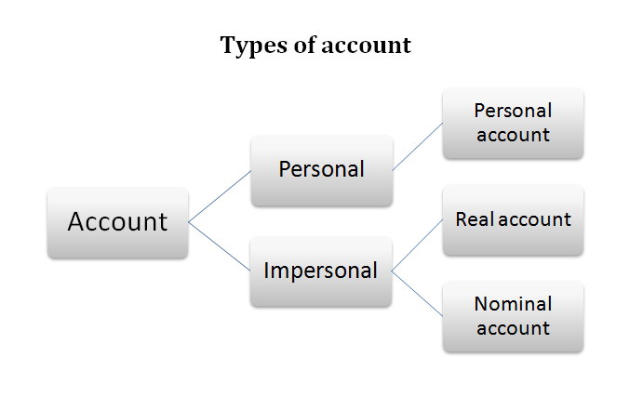

Slide 6
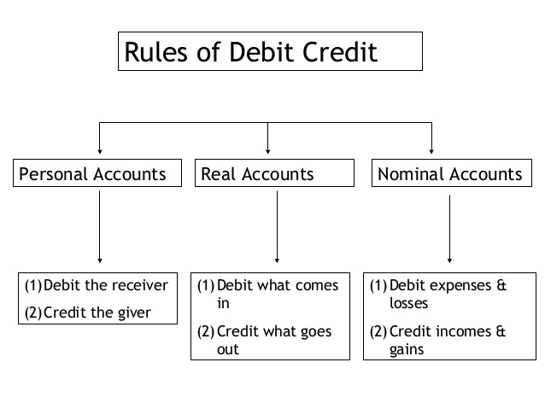

Slide 7
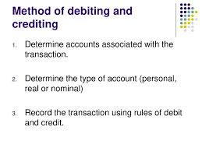

Slide 8
What is Journal?
Journal is the primary book of keeping accounts. The book wherein the transactions are recorded in a chronological order of dates after determining the debit account and credit account of transactions with explanation is called journal.
The first step of the accounting process is to maintain a journal or journalizing of transactions.

Slide 9
From the definitions and its recording procedures, The following are the features of the journal:
Book of primary entry
2. Daily record book
3. Chronological order
4. Use of dual aspects of transactions
5. Use of explanation
6. Different columns: Every page of the journal is divided into five columns: Date, account titles and explanation, ledger folio, debit money column, and credit money column.
7. Subsidiary book: Journalizing of transaction helps preparation of ledger conveniently. That is why the journal is called a subsidiary book to the ledger.

Slide 10
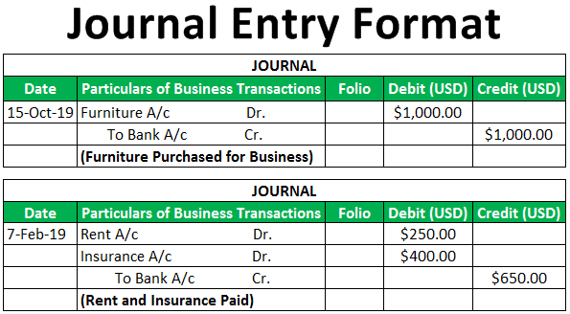

Slide 11
Journalize the following transactions
1. Furniture is purchased for Rs.1,000
2. Purchased goods for cash Rs.5,000
3. Sold good to Mahesh Babu for Rs.10,000
4. Paid salaries Rs.15,000 to employees
5. Purchased goods worth Rs.1,000 from Samantha
6. Paid Rs.7,500 as rent
7. Sold goods worth Rs.1,000 for cash to Rajnikanth
8. Entertainment expenses Rs.1,000
9. Sold goods worth Rs.5,000 to Virat Kohli
10. Goods returned to Samantha Rs.200.

Slide 12
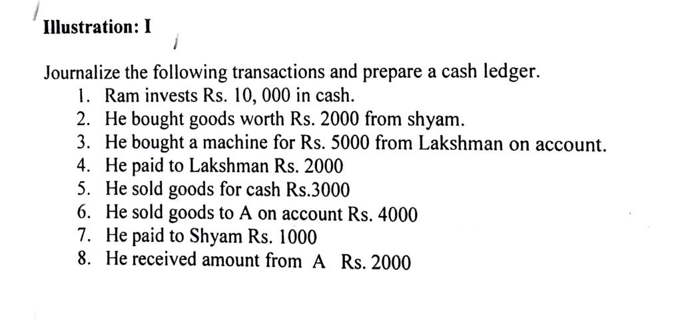

Slide 13
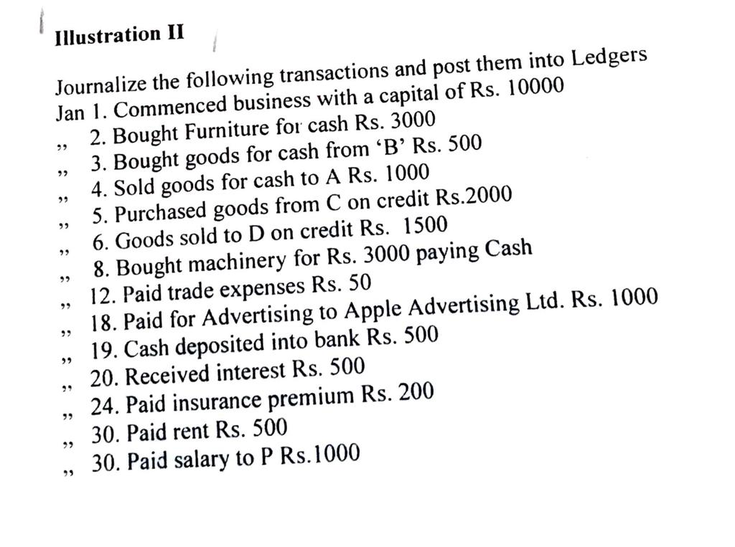

Slide 14
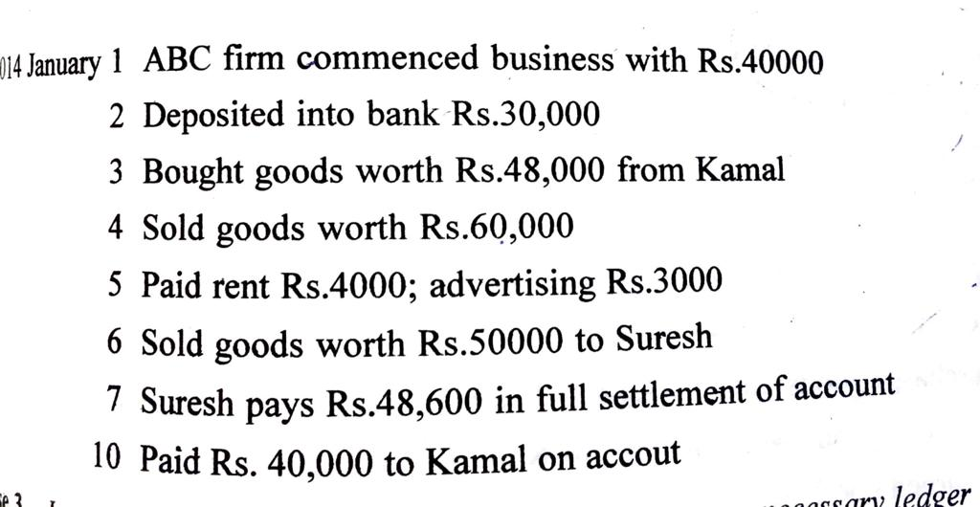

Slide 15
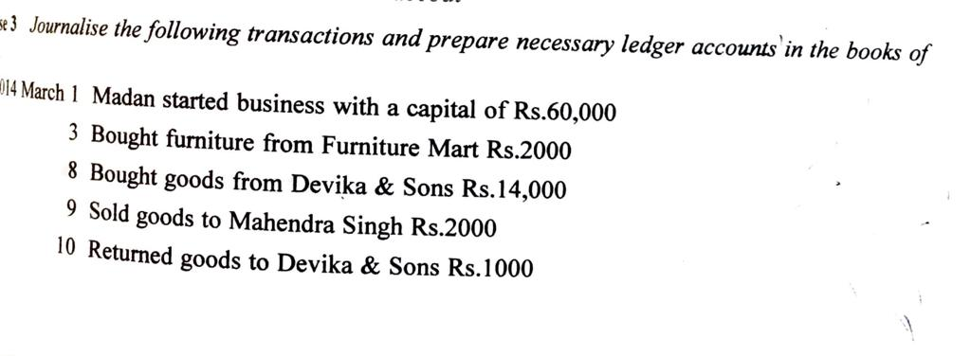

Slide 16
