Slide 1
THE BIXI CREW
BIXI Demand MLOps Platform
15-minute demand forecasting for every Montreal station — departures & arrivals — productionised on AWS
Othmane Zizi
@othmane-zizi-pro
Sarah Liu
@sarahliu-mma
Ruihe “Louis” Zhang
@Mudkipython
Rui Zhao
@ruizhaoca
Repository github.com/ruizhaoca/bixi-demand-mlops-platform
Live demo bixidemandlocal.streamlit.app EC2 3.16.250.166:8501
Notes:
Shared open (Sarah leads). We are The Bixi Crew. Our project forecasts 15-minute BIXI demand for every Montreal station, separately for departures and arrivals, and turns that into a rebalancing tool — productionised end-to-end on AWS. Four of us each own a part: I introduce the problem and the data, Louis covers the AWS structure, Othmane the modelling, Rui the rebalancing layer and the live app. Repo and two live demos are on screen.

Slide 2
INTRODUCTION & BUSINESS VALUE
The rebalancing problem — and why our design fits it
Sarah Liu
The operational pain
● BIXI runs ~1,100+ stations. Bikes pile up downtown and run out in residential areas — riders find empty docks or no free dock.
● Operators must move bikes by truck before pressure builds. That needs demand foresight at operational resolution, not daily totals.
● A course-1 prototype predicted hourly demand for the top ~400 stations — too coarse and too partial to act on.
Our design choices
▸ 15-minute resolution
4× finer than hourly — matches how fast a station empties.
▸ Departures vs arrivals, separately
one shared pipeline, run twice — the gap is the rebalancing signal.
▸ All ~1,100 stations
every station scored, not just the busy core.
▸ Leakage-safe & productionised
honest evaluation, then served live as an MLOps platform.
Notes:
Sarah (1/3). BIXI has ~1,100+ stations. Bikes pile up downtown and vanish in residential areas, so riders hit empty or full docks. Operators rebalance with trucks but need foresight at operational resolution. The course-1 prototype was hourly and only the top ~400 stations — too coarse and partial. So we made four deliberate design choices: 15-minute resolution (4× finer), departures and arrivals predicted separately (their gap is the signal), all stations, and a leakage-safe, productionised platform.

Slide 3
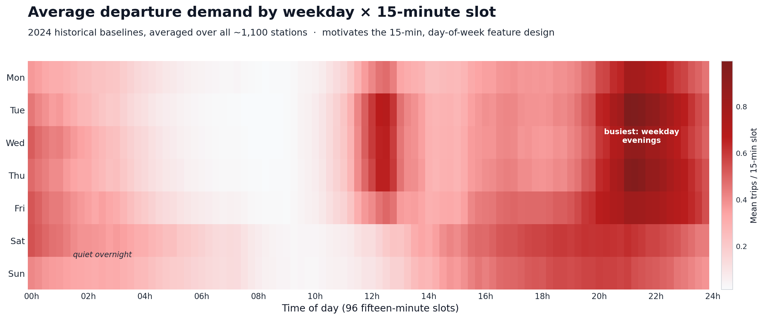
DATA ENGINEERING
Data: sources, cleaning & what the demand looks like
Sarah Liu
BIXI open data
2024 + May/Oct 2025 trips, all stations
Open-Meteo weather
15-min temp, precip, wind, humidity
Clean & reshape
trips → 15-min station demand; dep/arr split
Tidy 15-min demand table
~1,100 stations × 96 daily slots × day-of-week
Notes:
Sarah (2/3). Sources: BIXI open-data trips for 2024 plus May and October 2025, joined to Open-Meteo 15-minute weather. We clean trips into a tidy 15-minute station-demand table, split into departures and arrivals. The heatmap is average demand by weekday and 15-minute slot over all stations: quiet overnight, building through midday, and busiest on weekday evenings. That structure is exactly what our time features capture.

Slide 4
FEATURES & HONEST EVALUATION
Feature engineering — informative and leakage-safe
Sarah Liu
Engineered features
▸ Cyclical time
slot-of-day (sin/cos), day-of-week, month — no false ordering.
▸ 2024 profile baselines
historical average demand + prev-15min / prev-1h / yesterday-same-slot, built leave-one-out on training rows.
▸ Weather joins
15-minute temperature, precipitation, wind, humidity, code.
▸ Advanced station encoding
frequency + smoothed target encoding of the high-cardinality station name.
▸ Demand tiers
low / medium / high — used later for fairness parity.
Leakage-safe by construction
✓ Strict temporal split — train 2024, validate May-2025, test Oct-2025.
✓ Encoders & baselines fit on TRAIN only, then applied forward.
✓ Leave-one-out baselines so a row never sees its own label.
TRAIN
2024 (full year)
VALIDATION
May 2025
TEST
Oct 2025
Time → encoders & baselines learned on the left, only applied to the right
Notes:
Sarah (3/3). Features: cyclical slot-of-day, day-of-week and month; 2024 historical baselines (average plus recent-lag baselines) built leave-one-out; 15-minute weather; and advanced frequency + smoothed target encoding of the station name. Crucially everything is leakage-safe: a strict temporal split — train on 2024, validate on May-2025, test on Oct-2025 — with encoders and baselines fit on train only and applied forward. Over to Louis.

Slide 5
AWS & PRODUCTIONISED STRUCTURE
Architecture — GitHub to AWS, all infrastructure-as-code
Ruihe “Louis” Zhang
GitHub
main + PRs
GitHub Actions CI
pytest + build images
Docker images
train + Streamlit serving
Serving
Streamlit Community Cloud
app.py · committed artifacts, no AWS at runtime
AWS us-east-2 · provisioned by AWS CDK (infra/)
BixiNetwork
VPC, public subnets
BixiStorage
S3 bucket + SSM
BixiMlflow
MLflow on EC2 + S3
BixiBatch
ECR + AWS Batch
EC2 Streamlit container
app_ec2.py · same artifacts from S3
AWS Batch runs python -m bixi.pipeline over the full dataset
source data s3://insy684 → checkpoints, models, reports → S3 + MLflow
bixidemandlocal.streamlit.app
3.16.250.166:8501
Identical code runs locally on a station subsample and on AWS Batch over the full dataset. No credentials in git — default boto3 chain (SSO locally, IAM role in cloud).
Notes:
Louis (1/3). Everything is infrastructure-as-code. Push to GitHub triggers Actions CI: it runs pytest and builds both Docker images. AWS in us-east-2 is provisioned entirely by AWS CDK in four stacks — BixiNetwork (VPC), BixiStorage (S3 + SSM), BixiMlflow (MLflow on EC2 + S3), and BixiBatch (ECR + AWS Batch). AWS Batch runs python -m bixi.pipeline over the full dataset from s3://insy684. Serving is two Streamlit deployments — Community Cloud and an EC2 container. No credentials in git: default boto3 chain, SSO locally, IAM role in the cloud.

Slide 6
PRODUCTIONISATION
A resumable, staged pipeline — same code everywhere
Ruihe “Louis” Zhang
ingest
trips + weather → 15-min demand
features
leakage-safe feature tables
data
encode, tiers, range-filter
train
candidates + FLAML + Optuna
explain
SHAP + LIME
fairness
error parity
drift
Evidently 4-type
register
promote to production
Each stage writes a _SUCCESS marker to S3 — a run resumes from any step. Default run starts at data (cleaned data already in S3); full rebuild starts at ingest.
CI builds both Docker images and smoke-tests the pipeline image with no AWS.
Notes:
Louis (2/3). The pipeline is eight ordered stages: ingest, features, data, train, explain, fairness, drift, register. It is resumable — each stage writes a _SUCCESS marker to S3, so a run can restart from any step. The default run starts at data because cleaned data already lives in S3; a full rebuild starts at ingest. The same code runs on a local subsample and on AWS Batch, and CI smoke-tests the pipeline image with no AWS.

Slide 7
CLEAN, CONFIG-DRIVEN DESIGN
Repository structure — single-responsibility modules
Ruihe “Louis” Zhang
src/bixi/ the pipeline package
├ config.py central config + data/feature contract + stages
├ io.py S3 + local I/O (default boto3 chain)
├ ingest.py / *_cleaning raw trips + weather → 15-min demand
├ feature_engineering leakage-safe feature tables
├ data.py range filter, station encoding, tiers
├ models.py candidates, FLAML, Optuna, metrics
├ pipeline.py resumable staged runner
├ explain / fairness / drift SHAP+LIME, parity, Evidently
├ registry.py MLflow tracking + promotion
├ rebalancing.py net-flow priorities (dep+arr)
└ streamlit_*_serving local + S3 serving helpers
app.py / app_ec2.py Streamlit UIs (Cloud / EC2)
infra/ AWS CDK app (4 stacks)
docker/ Dockerfile.train, Dockerfile.streamlit_ec2
tests/ pytest (synthetic data, no network)
docs/ scripts/ notebooks/
Why it scores
▸ Single responsibility
each module owns one stage of the contract in config.py.
▸ Config-driven
env vars switch local subsample ↔ full cloud run — same code.
▸ Infra as code
every AWS resource lives in infra/ CDK — nothing clicked.
▸ Tested & CI-gated
pytest on synthetic data; PRs must stay green.
▸ Reproducible
Docker pins the runtime for training and serving.
Notes:
Louis (3/3). The repo mirrors the pipeline: single-responsibility modules in src/bixi, each owning one stage of the contract defined in config.py. It is config-driven — environment variables flip between a local subsample and the full cloud run with identical code. infra/ is the CDK app, docker/ pins the runtime, tests/ runs on synthetic data with no network. Clean, reproducible, and CI-gated. Othmane takes the modelling.

Slide 8
PREDICTIVE MODELLING
Modelling — a multi-model search, auto-selected
Othmane Zizi
Candidates
LightGBM + XGBoost
baselines
Optuna HPO
Bayesian search
every trial → MLflow
Select best
by validation RMSE
lgbm_optuna
promoted → production alias
FLAML AutoML
automated model + config search
Run once per target (departure & arrival). Both targets independently select lgbm_optuna — a consistent, automatic, reproducible winner, not a hand-picked model.
Notes:
Othmane (1/5). Rather than hand-pick a model, we run a search: LightGBM and XGBoost baselines, FLAML AutoML, and Optuna Bayesian hyperparameter tuning, with every trial logged to MLflow. The best model by validation RMSE is selected and promoted automatically. Run once per target; both departures and arrivals independently land on lgbm_optuna — a consistent, reproducible winner.

Slide 9
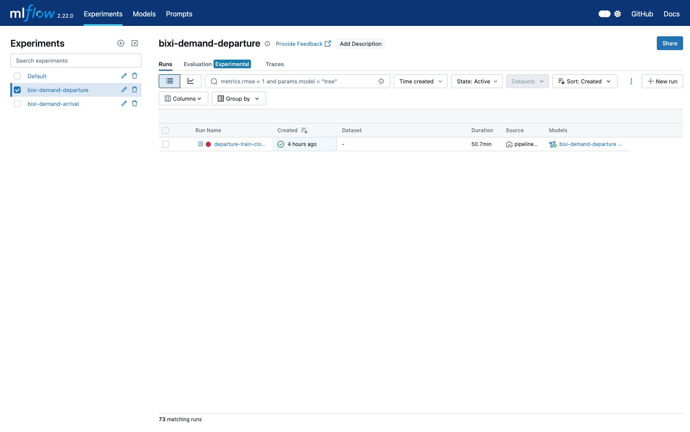
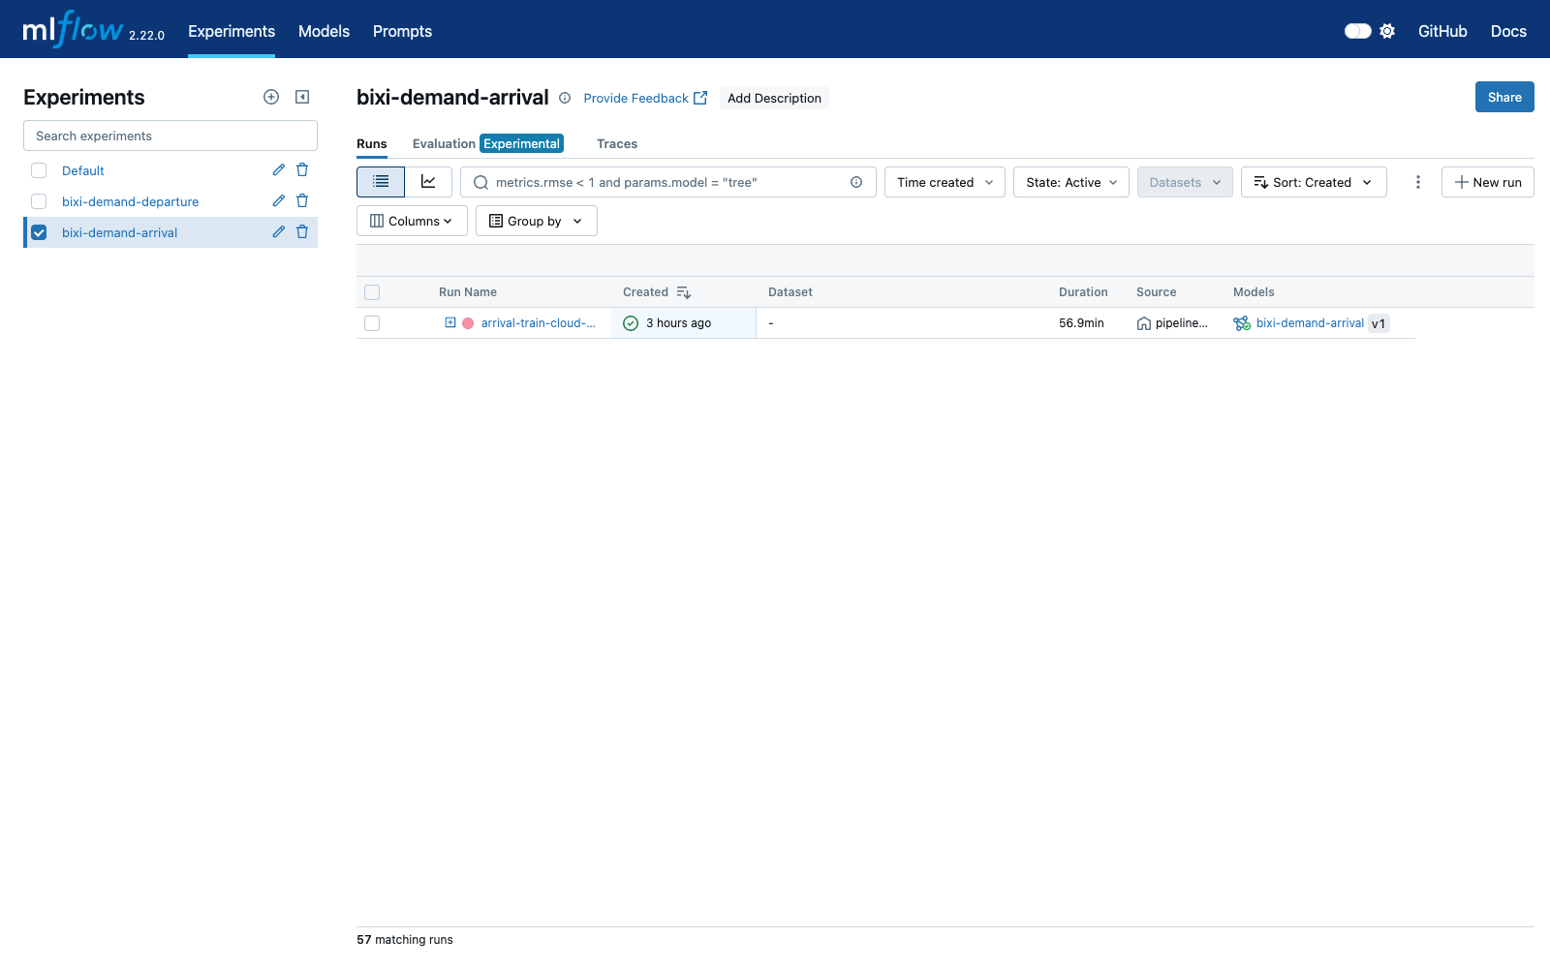
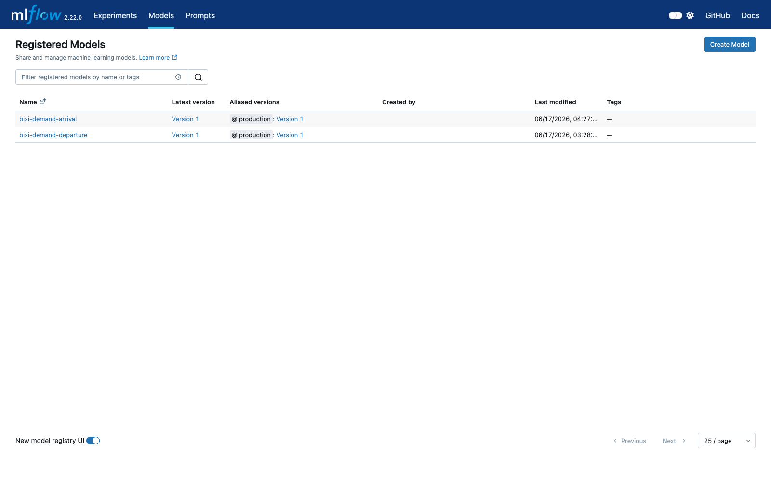
EXPERIMENT TRACKING & REGISTRY
MLflow — every run tracked, best model registered
Othmane Zizi
departure · 73 runs
arrival · 57 runs
model registry · production alias
Tracking server on EC2 with an S3 artifact store. Experiments bixi-demand-departure / -arrival capture every candidate, FLAML and Optuna run (params, metrics, model). The best run per target is registered and promoted to the production alias — the exact artifact the apps serve.
Notes:
Othmane (2/5). MLflow gives full traceability: a tracking server on EC2 with an S3 artifact store. The departure experiment has 73 runs, arrival 57 — every candidate, FLAML and Optuna trial with its params, metrics and model. The best run per target is registered and promoted to the production alias, which is exactly the artifact the apps serve.

Slide 10
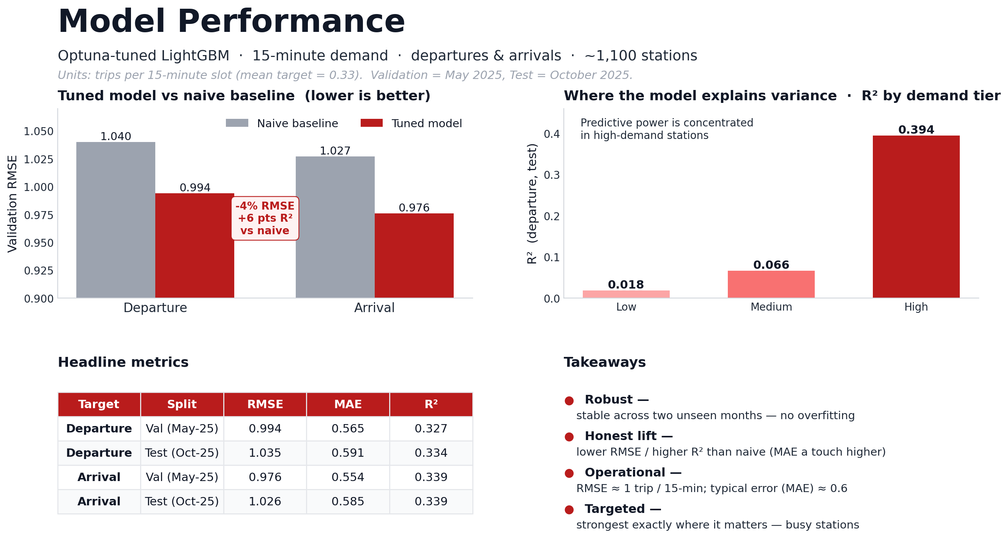
Othmane Zizi
Notes:
Othmane (3/5). Results per split. 15-minute slot demand is genuinely noisy — many zero slots — so absolute R² is modest by design, but errors are well under one trip per slot. The tuned model beats a naive baseline on RMSE and R², it is stable across two unseen months (no overfitting), and its predictive power is concentrated exactly where it matters — busy stations.

Slide 11
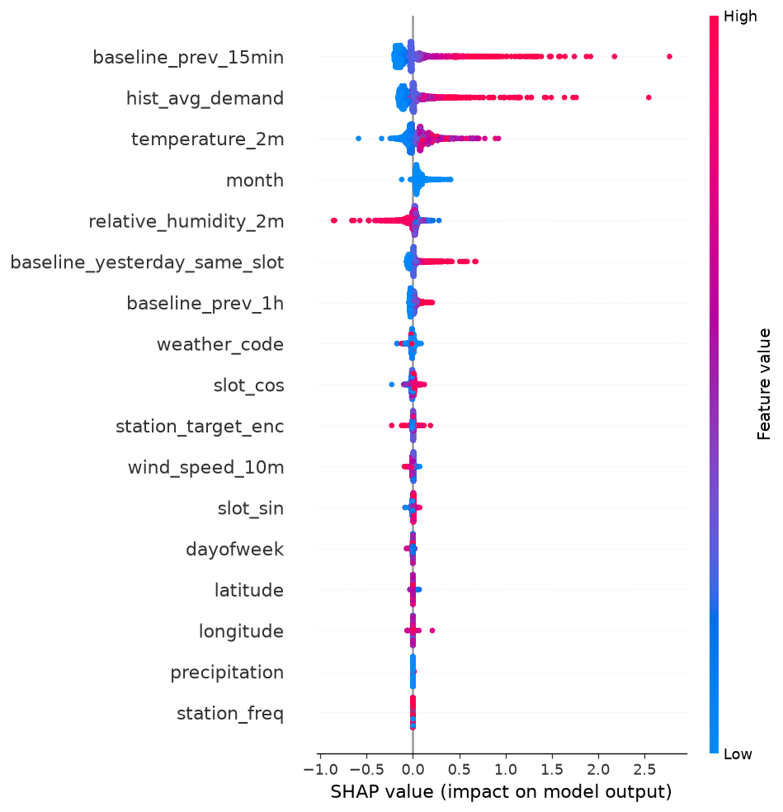
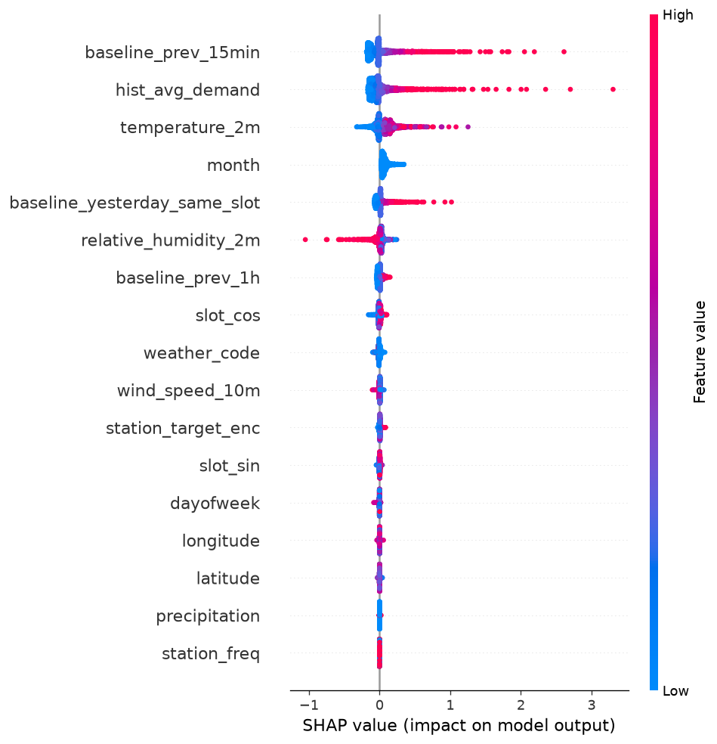
RESPONSIBLE AI
Explainability — SHAP & LIME on both models
Othmane Zizi
SHAP · departure
SHAP · arrival
Most signal comes from the 2024 historical baselines and cyclical time-of-day; weather is a secondary driver. LIME force plots explain individual predictions. Same story for departures and arrivals — the model is behaving sensibly.
Notes:
Othmane (4/5). Explainability with SHAP and LIME on both models. The SHAP beeswarms show most signal comes from the 2024 historical baselines and cyclical time-of-day, with weather as a secondary driver — the same, sensible story for departures and arrivals. LIME explains individual predictions on demand.

Slide 12
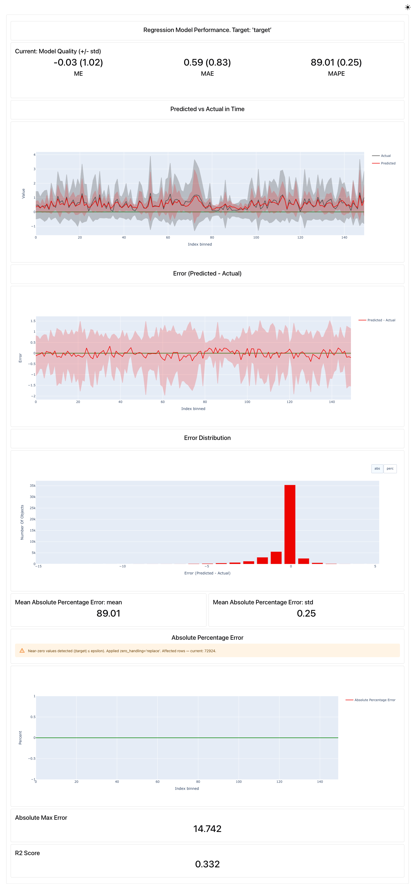
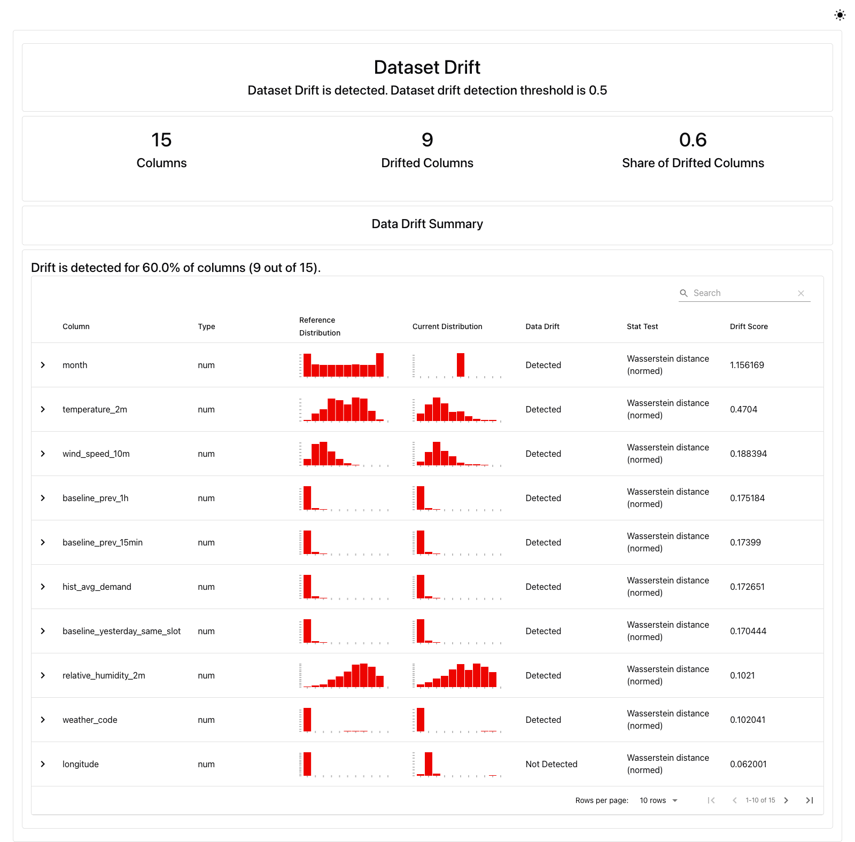
RESPONSIBLE AI & MONITORING
Fairness & four-type drift monitoring
Othmane Zizi
Fairness
● Error parity (RMSE/MAE) across demand tiers and geography.
● Accuracy concentrates in high-demand stations; low-tier R² is near zero.
● Flagged so operators don’t over-trust quiet-station forecasts.
Four drift types (Evidently)
▸ feature
▸ target
▸ prediction
▸ concept
feature drift · Oct-2025
concept drift · Oct-2025
Notes:
Othmane (5/5). Responsible AI and monitoring. Fairness: we check error parity across demand tiers and geography — accuracy concentrates in high-demand stations and low-tier R² is near zero, which we surface so operators don’t over-trust quiet-station forecasts. And we run all four Evidently drift types — feature, target, prediction and concept — shown here on October-2025 data. Over to Rui.

Slide 13
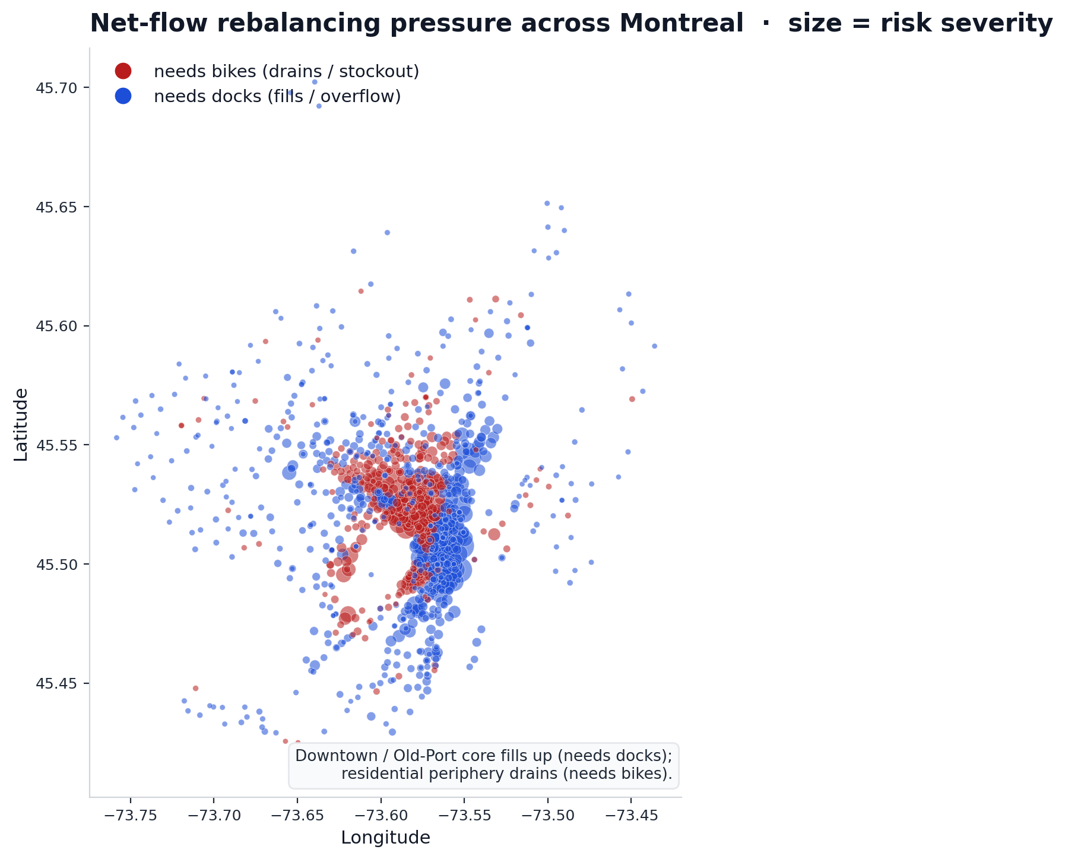
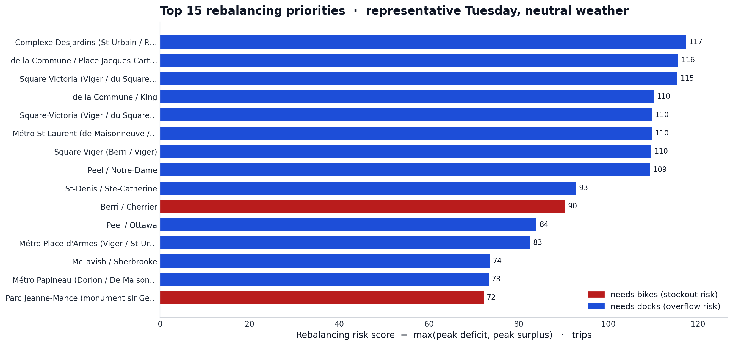
FROM PREDICTION TO OPERATIONS
Net-flow rebalancing — turning forecasts into action
Rui Zhao
net_flow = arrival − departure → cumulate across the day → read peak deficit (needs bikes) / peak surplus (needs docks) → rank by severity
Notes:
Rui (1/3). The forecasts are only useful together. Net flow is arrival minus departure per station per 15-minute slot; cumulating it across the day gives a relative occupancy trajectory. From it we read each station’s peak deficit — needs bikes, stockout risk — and peak surplus — needs docks, overflow risk — then rank by severity. The map shows the pattern: the downtown core fills up and needs docks, the residential periphery drains and needs bikes.

Slide 14
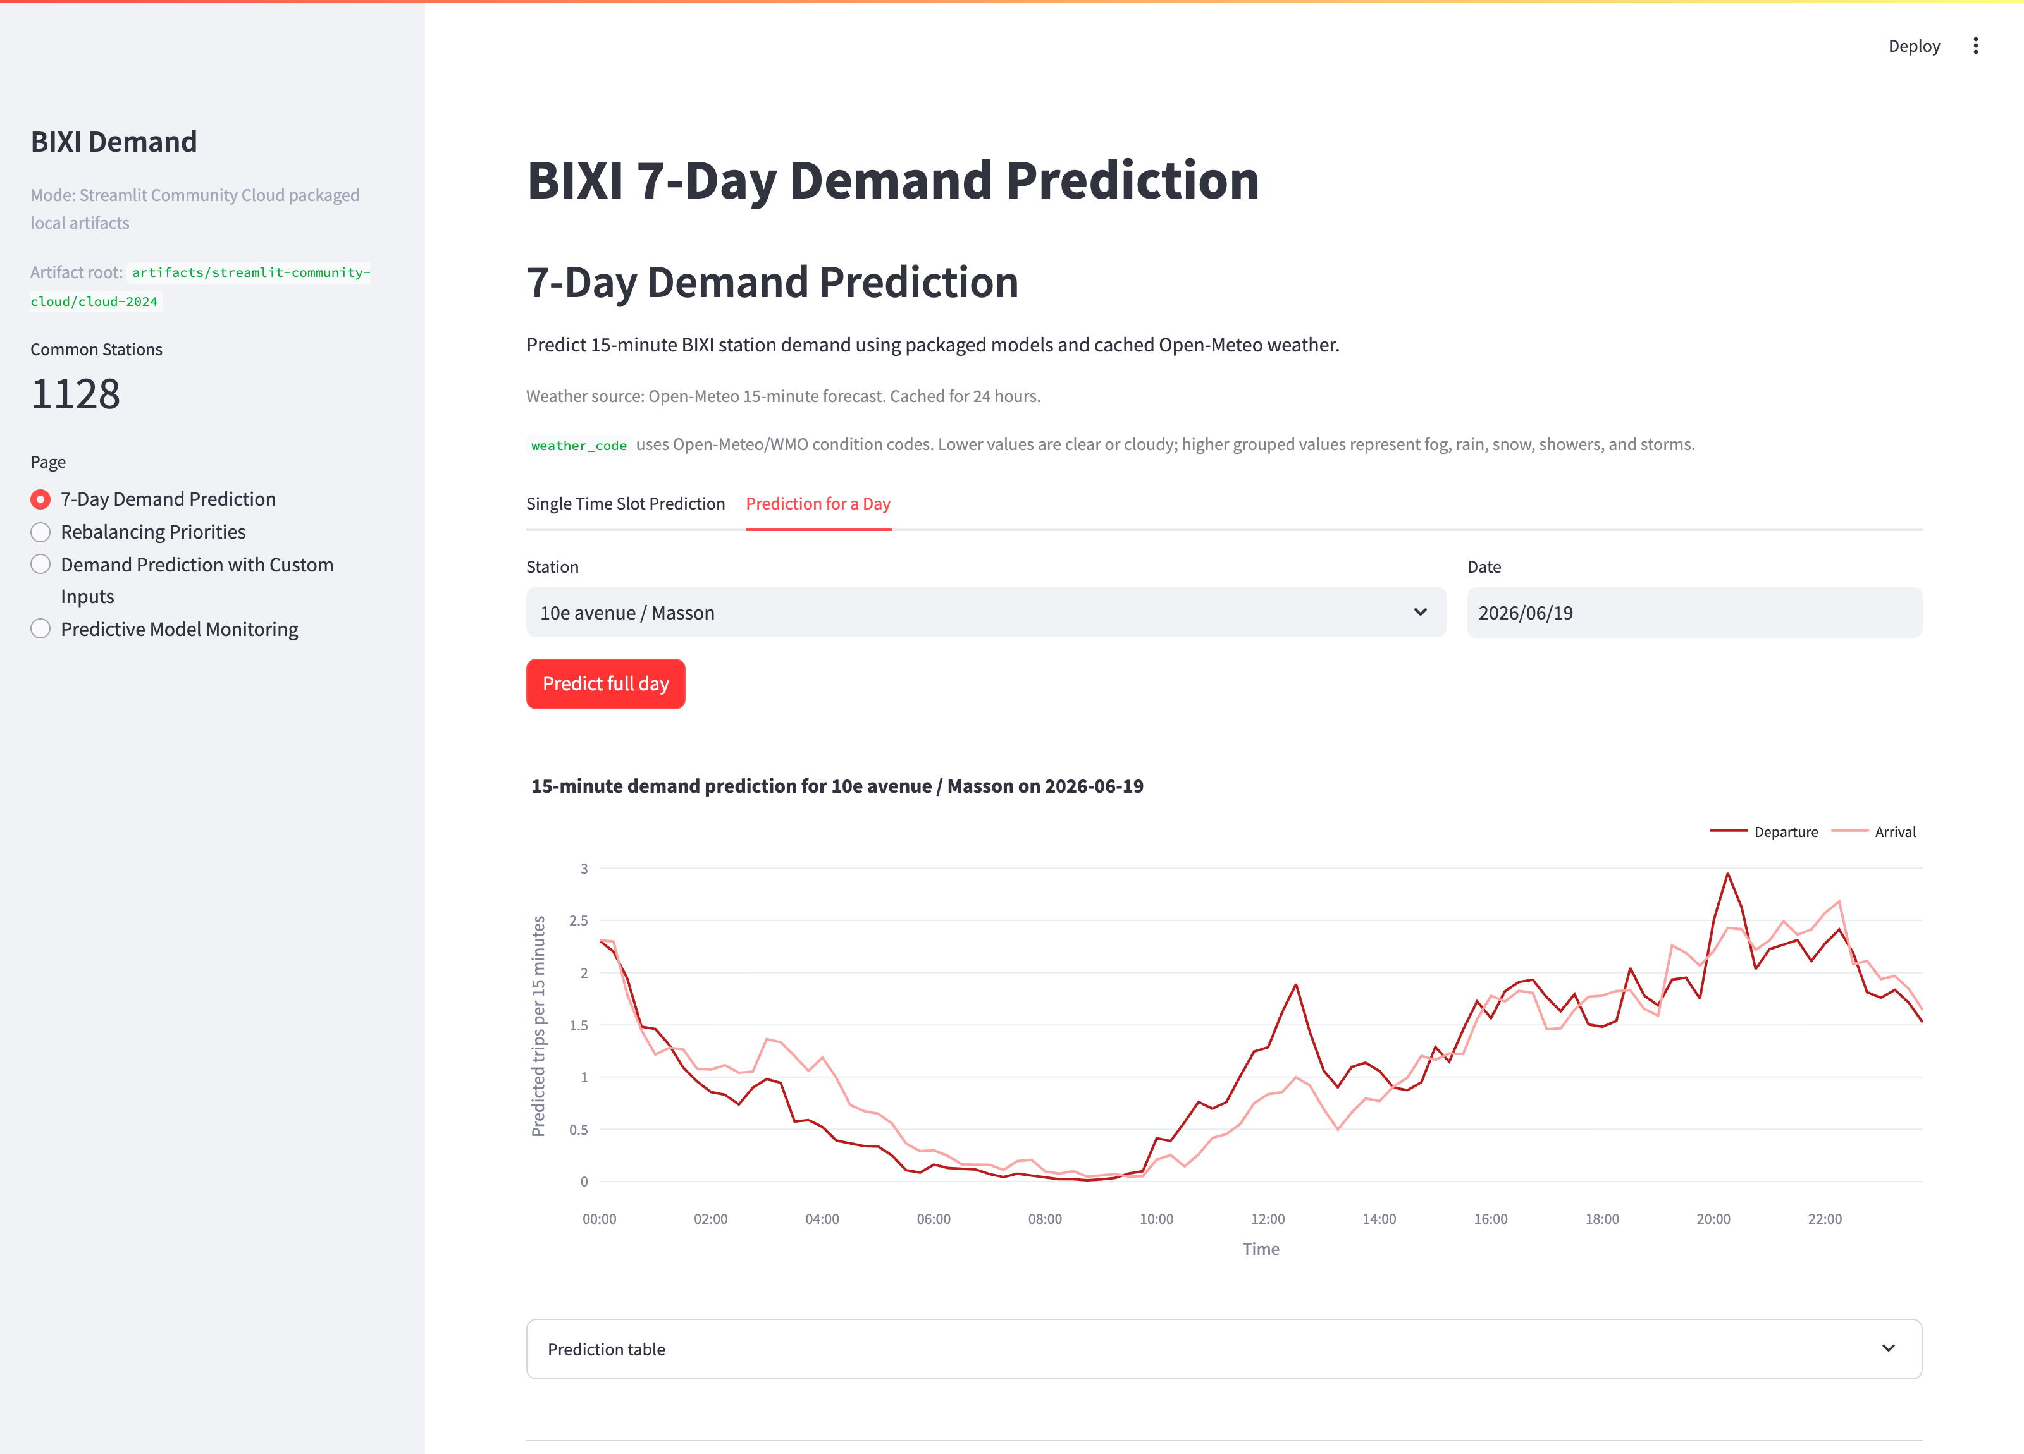
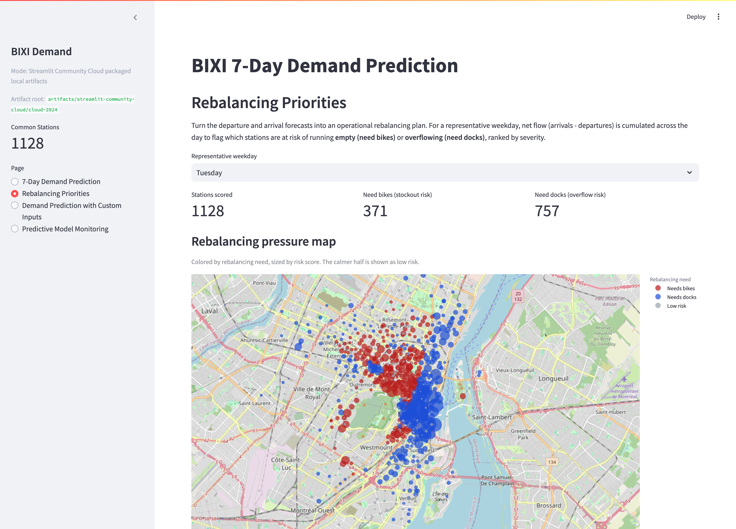
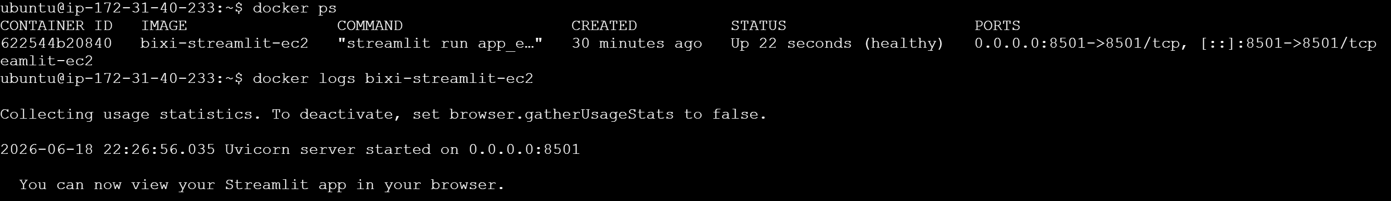
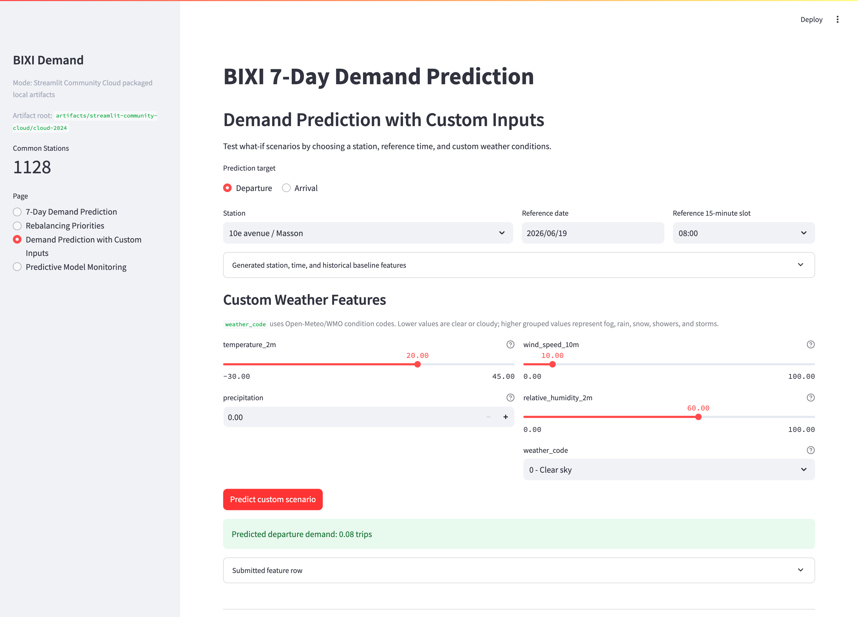
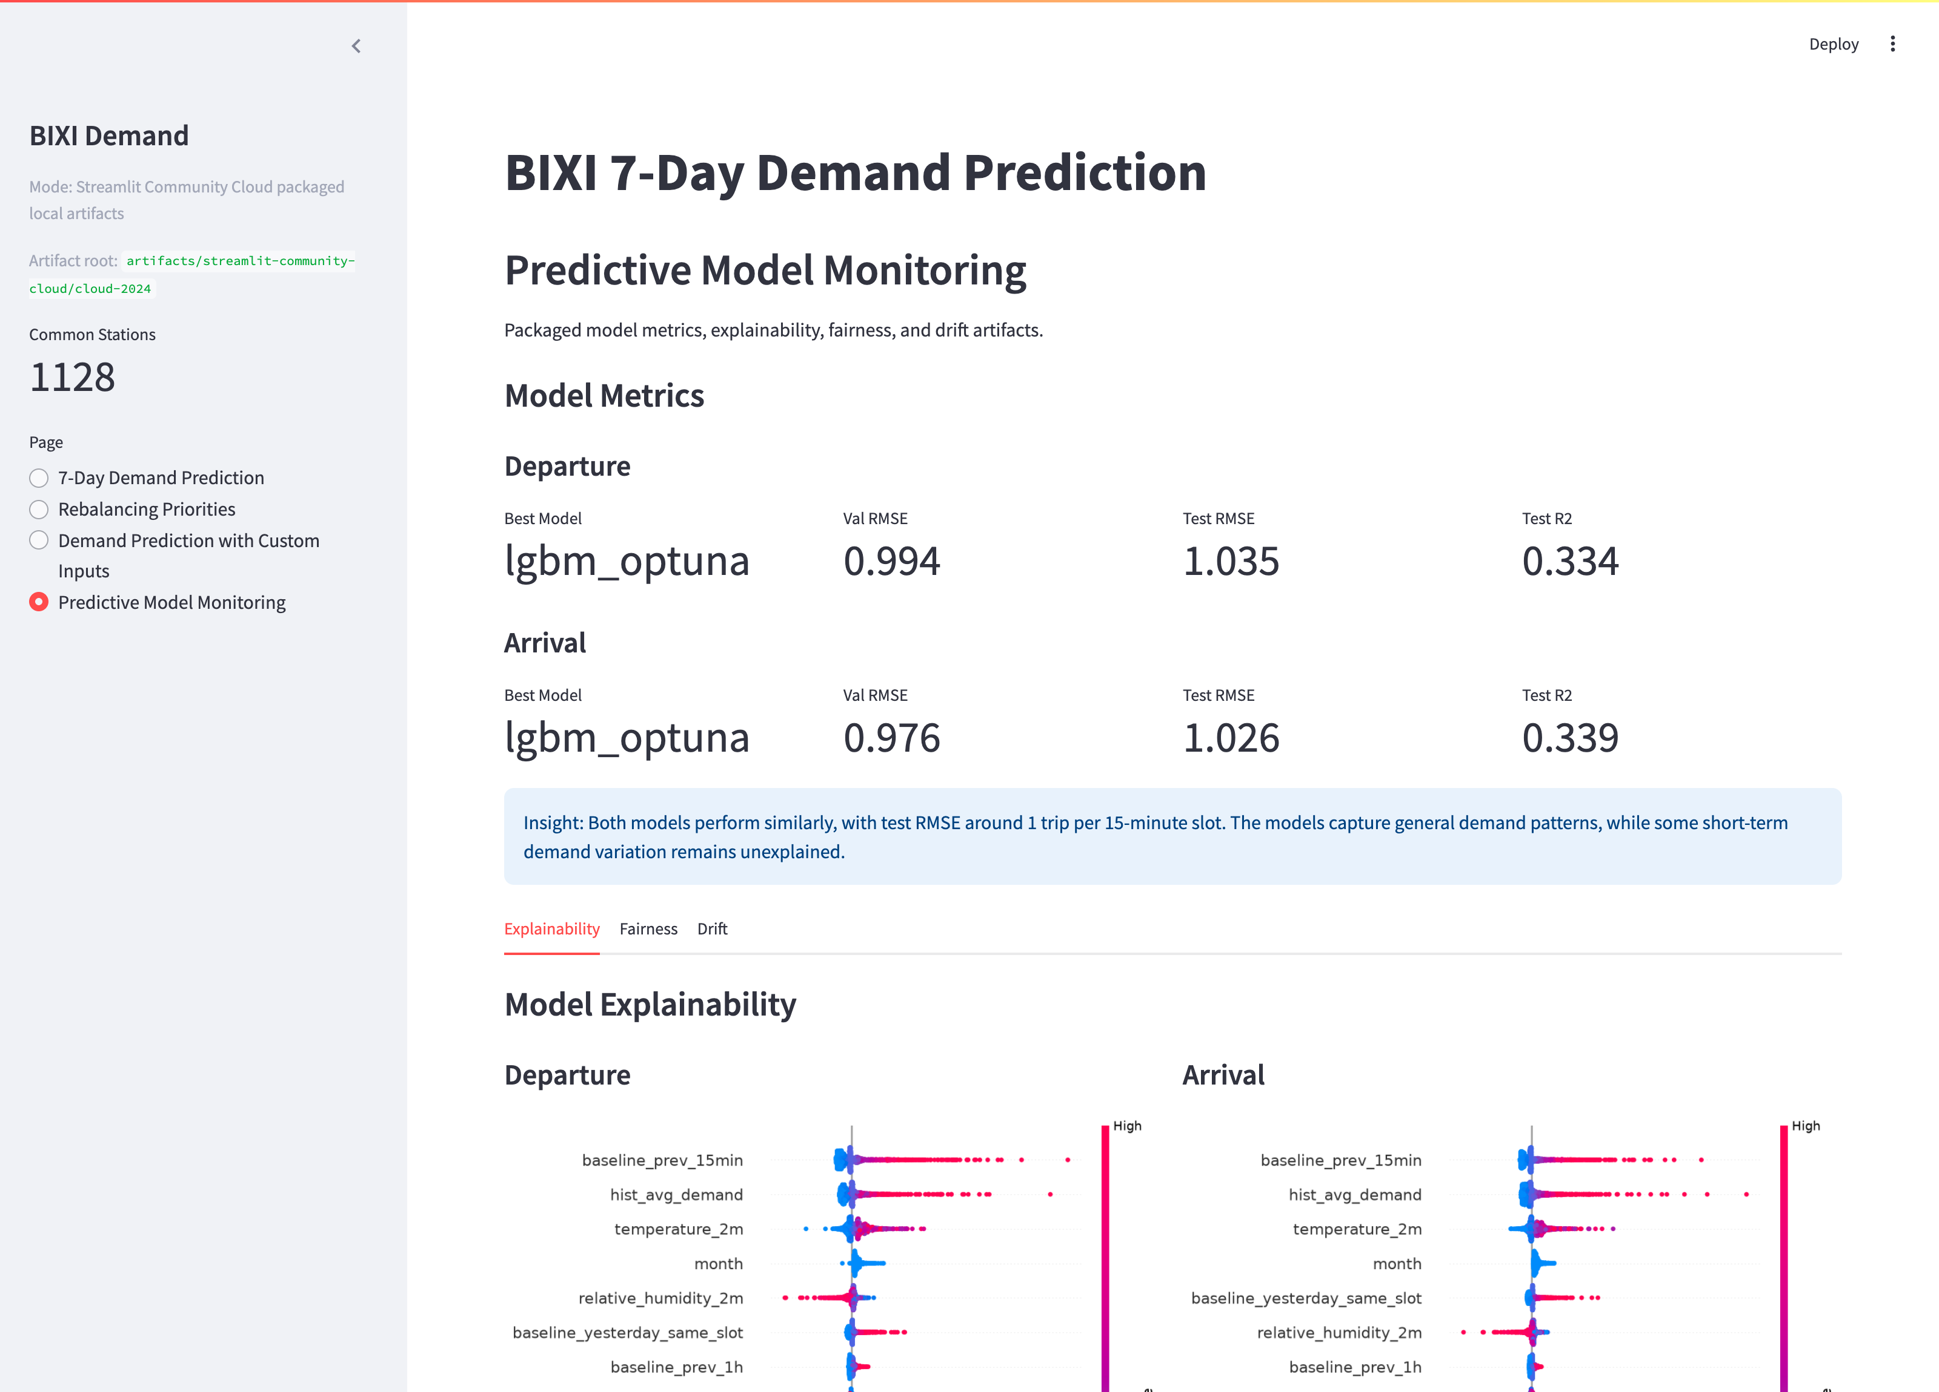
SERVING & PRODUCT
The Streamlit app — live demo
Rui Zhao
EC2 container running
7-Day Forecast
Rebalancing Priorities
Two live deployments
Community Cloud
bixidemandlocal.streamlit.app
EC2 (S3-backed)
3.16.250.166:8501
Four pages · one shared UI · no AWS needed for the Cloud app.
Custom Inputs
Model Monitoring
Notes:
Rui (2/3). This is the live Streamlit app — one shared UI, four pages: a multi-day 15-minute forecast, the rebalancing-priorities map with a ranked list and per-station trajectory, a custom what-if input page, and a model-monitoring page with the SHAP, fairness and drift artifacts. It runs on Community Cloud with committed artifacts (no AWS at runtime) and on an EC2 container backed by S3. Let’s look at it live.

Slide 15
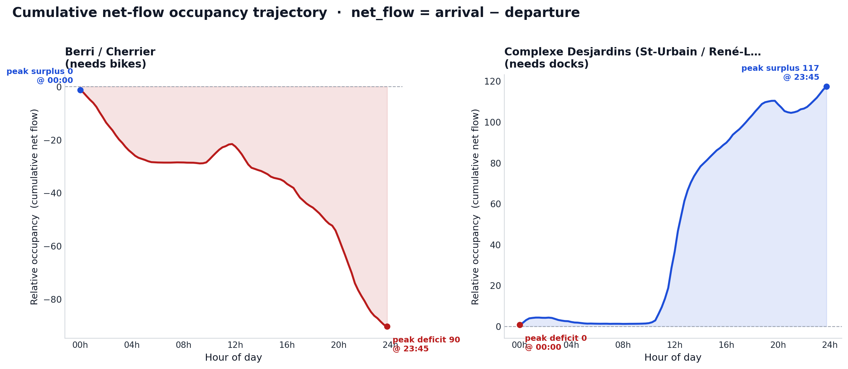
CONCLUSION
What it means — value, limits, and what’s next
Rui Zhao
Operational value
A daily, ranked priority list of which stations to service first — grounded in 15-minute departure & arrival forecasts.
Honest limitation
No dock capacity or real-time occupancy in the trip data, so the trajectory is a relative risk ranking — not exact stockout clock-times or fill levels.
MLOps maturity & roadmap
▸ Tracking + registry, explainability, fairness, 4-type drift, CI, Docker, CDK — end to end.
▸ Next: live station-status feed for absolute occupancy; scheduled drift-triggered retrains.
relative occupancy starts from a common zero reference
Notes:
Rui (3/3). The operational value: a daily ranked list of where to send a rebalancing truck first. The honest limitation — the trip data has no dock capacity or real-time occupancy, so the trajectory starts from a common zero and gives a relative ranking, not exact stockout times. On MLOps maturity we cover the full lifecycle — tracking, registry, explainability, fairness, four-type drift, CI, Docker and CDK. Next steps: a live station-status feed for absolute occupancy, and drift-triggered scheduled retrains.

Slide 16
Thank you
Questions & live demo welcome
Repository github.com/ruizhaoca/bixi-demand-mlops-platform
Live demo (Community Cloud) bixidemandlocal.streamlit.app
Live demo (EC2) 3.16.250.166:8501
The Bixi Crew · Othmane Zizi · Sarah Liu · Ruihe “Louis” Zhang · Rui Zhao
Notes:
Shared close. Thank you — happy to take questions and walk through the live app. Repo and both live demos are on screen; the team is The Bixi Crew: Othmane, Sarah, Louis and Rui.

