Slide 1
Technical Presentation on Azure Firewall and Ansible
Exploring security automation and cloud firewall solutions
Notes:
AI-generated content may be incorrect. ---

Slide 2
Azure Firewall
Notes:
Introduction to Azure Firewall, Azure Firewall Configuration & Deployment, Advanced Features & Real-World Scenarios

Slide 3

Introduction to Azure Firewall
Cloud-native Firewall
Azure Firewall provides stateful, cloud-native firewall protection for Azure Virtual Networks.
Integrated Monitoring
Fully integrated with Azure Monitor for logging and analytics to enhance security insights.
Comprehensive Traffic Control
Supports inbound and outbound filtering with centralized management via Azure Firewall Manager.
Advanced Security Features
Offers threat intelligence filtering, deep packet inspection, and logging for enterprise deployments.
Notes:
Azure Firewall is a cloud-native and intelligent network security service that provides stateful firewall capabilities for Azure environments. It is designed to protect Azure Virtual Network resources and offers features such as threat intelligence-based filtering, logging, and application and network rule collections. Azure Firewall is fully integrated with Azure Monitor for logging and analytics, making it a powerful tool for enterprise-grade security. It supports both inbound and outbound filtering and can be centrally managed using Azure Firewall Manager. Compared to other Azure security tools like Network Security Groups (NSGs) and Azure Web Application Firewall (WAF), Azure Firewall provides more comprehensive and centralized control over network traffic. NSGs are primarily used for basic traffic filtering at the subnet and NIC level, while Azure WAF is focused on protecting web applications from common threats. Azure Firewall, on the other hand, offers deep packet inspection, threat intelligence, and logging capabilities, making it suitable for complex and large-scale deployments.

Slide 4
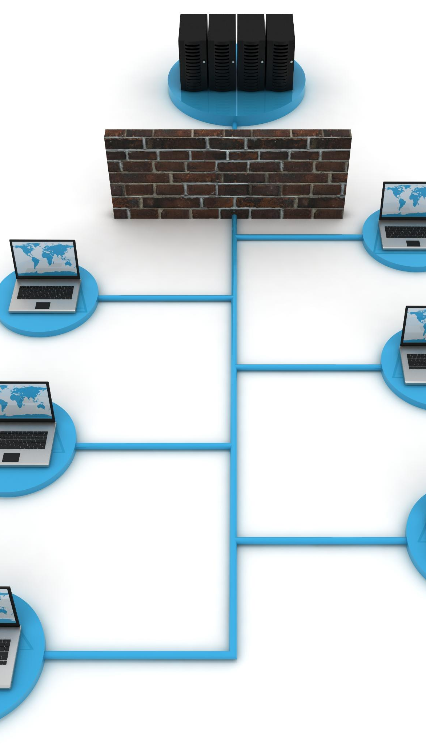
Azure Firewall Configuration & Deployment
Deployment Methods
Azure Firewall can be deployed via Azure Portal, ARM templates, or automation tools like Terraform and Ansible.
Network Architecture
Typical setup includes Virtual Network, dedicated firewall subnets, and route tables directing traffic through the firewall.
Firewall Policies
Firewall policies offer centralized management, scalability, and advanced features compared to classic rules.
Monitoring & Logging
Integration with Azure Monitor and Log Analytics enables detailed traffic logging and security auditing.
Notes:
Deploying Azure Firewall involves several steps, including setting up the necessary network architecture and configuring firewall policies. It can be deployed via the Azure Portal, using ARM templates, or through automation tools like Terraform and Ansible. The typical architecture includes a Virtual Network with dedicated subnets for the firewall and route tables to direct traffic through the firewall. Azure Firewall supports both classic rules and firewall policies, with the latter offering more advanced features and better scalability. Firewall policies allow for centralized management and can be shared across multiple firewalls. Integration with Azure Monitor and Log Analytics enables detailed logging and monitoring of traffic, which is essential for security auditing and troubleshooting. Administrators can define application and network rule collections to control traffic based on protocols, ports, and IP addresses. The deployment process also includes configuring DNAT and SNAT rules to manage inbound and outbound traffic. Overall, Azure Firewall provides a robust and flexible solution for securing Azure environments.

Slide 5

Advanced Features & Real-World Scenarios
Threat Intelligence Filtering
Blocks traffic from known malicious IPs using alert or deny modes for flexible threat management.
DNAT and SNAT Rules
Manages traffic routing effectively with destination and source network address translation rules.
Application & Network Rules
Defines granular access controls based on protocols, ports, and IP addresses with prioritized rule collections.
Real-World Use Cases
Secures multi-tier web apps and hybrid environments controlling traffic between on-premises and cloud.
Notes:
Azure Firewall offers several advanced features that enhance its security capabilities. One of the key features is threat intelligence-based filtering, which allows the firewall to block traffic from known malicious IP addresses. This feature can be configured in alert or deny mode, providing flexibility in how threats are handled. DNAT (Destination Network Address Translation) and SNAT (Source Network Address Translation) rules enable the firewall to manage traffic routing effectively, especially in scenarios involving public IP addresses. Application and network rule collections allow administrators to define granular access controls based on protocols, ports, and IP addresses. These rules can be grouped and prioritized to ensure efficient traffic management. In real-world scenarios, Azure Firewall is used to secure multi-tier web applications, where it acts as a central point of control for traffic between front-end, application, and database tiers. It is also used in hybrid environments to manage traffic between on-premises networks and Azure. By leveraging these advanced features, organizations can build secure and scalable network architectures in Azure.

Slide 6
Ansible
Notes:
Introduction to Ansible, Ansible for Azure Automation, Integrating Ansible with Azure Firewall

Slide 7

Introduction to Ansible
Open-source Automation Tool
Ansible is an open-source tool for automation, configuration, and deployment tasks.
Agentless Architecture
Ansible requires no agents installed on target machines, simplifying management.
YAML-based Playbooks
Uses easy-to-read YAML playbooks to define and automate tasks.
Core Components
Inventory, playbooks, modules, and roles organize and execute automation tasks.
Notes:
Ansible is an open-source automation tool used for configuration management, application deployment, and task automation. It is known for its simplicity and agentless architecture, which means it does not require any software to be installed on the target machines. Ansible uses YAML-based playbooks to define automation tasks, making it easy to read and write. The core components of Ansible include inventory files, playbooks, modules, and roles. Inventory files define the hosts to be managed, while playbooks contain the tasks to be executed. Modules are reusable units of code that perform specific tasks, and roles help organize playbooks into reusable components. Ansible is widely used in cloud and DevOps environments for automating infrastructure provisioning, configuration, and deployment. Its agentless nature and support for SSH make it suitable for managing a wide range of systems. Ansible also integrates well with CI/CD pipelines, allowing for automated deployments and updates. Overall, Ansible provides a powerful and flexible solution for IT automation.

Slide 8

Ansible for Azure Automation
Azure Resource Management
Ansible modules enable creating, updating, and deleting Azure resources efficiently.
Secure Authentication
Service principals and managed identities ensure secure access to Azure APIs.
Playbook Automation
Playbooks define and automate desired Azure states, deployable manually or via CI/CD.
Dynamic Inventory
Dynamic inventory queries Azure for current resources, aiding in managing large environments.
Notes:
Ansible can be used to automate the management of Azure resources through its Azure modules. These modules allow users to create, update, and delete Azure resources such as virtual machines, network security groups, and storage accounts. Authentication with Azure can be achieved using service principals or managed identities, ensuring secure access to the Azure API. Ansible playbooks can be written to define the desired state of Azure resources, and these playbooks can be executed manually or integrated into CI/CD pipelines for automated deployments. For example, a playbook can be created to deploy a virtual machine with specific configurations or to set up a network security group with predefined rules. Ansible also supports dynamic inventory, which allows it to query Azure for the current state of resources and use that information in automation tasks. This feature is particularly useful for managing large and dynamic environments. By using Ansible for Azure automation, organizations can achieve consistent and repeatable deployments, reduce manual errors, and improve operational efficiency.

Slide 9

Integrating Ansible with Azure Firewall
Automation of Firewall Rules
Ansible automates deployment and management of Azure Firewall rules efficiently.
Use of Azure Modules
Ansible uses Azure modules to create and update firewall rule collections and policies.
Dynamic Inventory and Tagging
Resource tagging helps manage firewall rules applied to specific resource groups easily.
CI/CD Pipeline Integration
Playbooks integrate with CI/CD tools for automated, version-controlled firewall deployments.
Notes:
Integrating Ansible with Azure Firewall enables the automation of firewall rule deployment and management. This integration allows administrators to define firewall rules in Ansible playbooks and apply them consistently across environments. Ansible can use Azure modules to interact with the Azure Firewall API, creating and updating rule collections, DNAT/SNAT rules, and firewall policies. Dynamic inventory and tagging can be used to manage resources based on metadata, making it easier to apply rules to specific groups of resources. Ansible playbooks can be integrated into CI/CD pipelines using tools like GitHub Actions or Azure DevOps, enabling automated and version-controlled deployments. For example, a playbook can be created to deploy a set of application rules that allow traffic to specific ports and IP addresses. This playbook can be triggered automatically when changes are made to the configuration repository. A demo of deploying firewall rules via Ansible playbook can showcase the power and flexibility of this integration. By automating firewall management with Ansible, organizations can improve security, reduce manual effort, and ensure compliance with policies.

