Slide 1

Project Presentation | Software Engineering Lab (530220)
Shopping Mall Parking Management System (SMPMS)
A web-based parking management system using PHP and MySQL
Presented by: Md Sohanur Rahman Shuvo
Class ID 95 | NU Reg. 21502005609 | Session 2021-22
Supervisor: Shekh Tanjil Sharif, Lecturer, Dept. of CSE
Institute of Science Trade and Technology (ISTT), Mirpur-13, Dhaka
Notes:
[about 20 sec]
Assalamu alaikum. I am Md Sohanur Rahman Shuvo, Class ID 95. Today I will present my project, the Shopping Mall Parking Management System, SMPMS, a web-based system built with PHP and MySQL, under the supervision of Shekh Tanjil Sharif.

Slide 2
Problem and Objectives
The problem
The objective
Free slots not known instantly
Duplicate or lost paper tickets
Hand-calculated fees, disputes
Payments not recorded uniformly
Slow, unauditable income reports
A secure, easy and low-cost web system that automates the whole parking cycle:
Role-based secure access
Fast entry and unique tickets
Automatic fee and payment
Dashboard and reports
Notes:
[about 40 sec]
In many malls, parking is still managed with paper slips and hand-calculated fees. So free slots are unknown, slips get lost or duplicated, fee errors cause disputes, and income reports are slow. My objective was a secure, easy and low-cost web system that automates the whole cycle: secure role-based access, fast entry with unique tickets, automatic fee and payment, and a dashboard with reports.

Slide 3
Key Features
1
Role-based login
2
Vehicle entry
3
Unique ticket
Admin and Operator, hashed passwords
Plate check, duplicate block, auto slot
SMP-yymmdd-XXXXXX with QR, printable
4
Automatic fee
5
Payment and receipt
6
Dashboard and reports
Started hour rounded up x hourly rate
Cash, bKash, Nagad, card recorded
Live stats, date-range revenue, activity log
Notes:
[about 40 sec]
SMPMS has six key features. Role-based login for Admin and Operator. Vehicle entry that validates the plate and blocks a second entry for the same vehicle. A unique ticket with a QR image. Automatic fee: any started hour counts as a full hour, at 50 taka per hour, so 61 minutes costs 100 taka. Payment by cash, bKash, Nagad or card is recorded with a receipt. And a dashboard with date-wise reports.

Slide 4
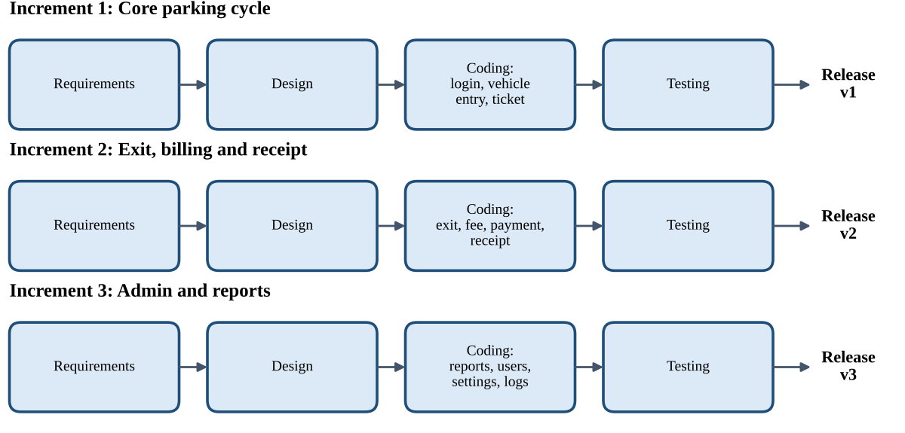
Method and Requirements
11
Functional requirements
6
Non-functional categories
Incremental model: working, tested version after each increment
Why Incremental: natural split, early working version, early defect detection, easy to extend.
Notes:
[about 35 sec]
I used the Incremental Model, in three increments: first login, entry and ticket; second exit, fee and payment; third reports, users and settings. It suits this project because the system splits naturally, a working version comes early, and defects are found early. The requirements are 11 functional requirements and 6 non-functional categories.

Slide 5
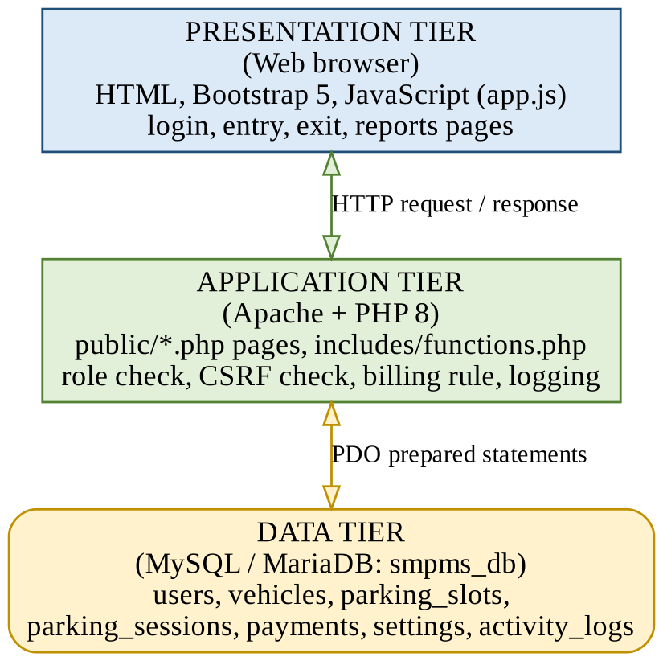
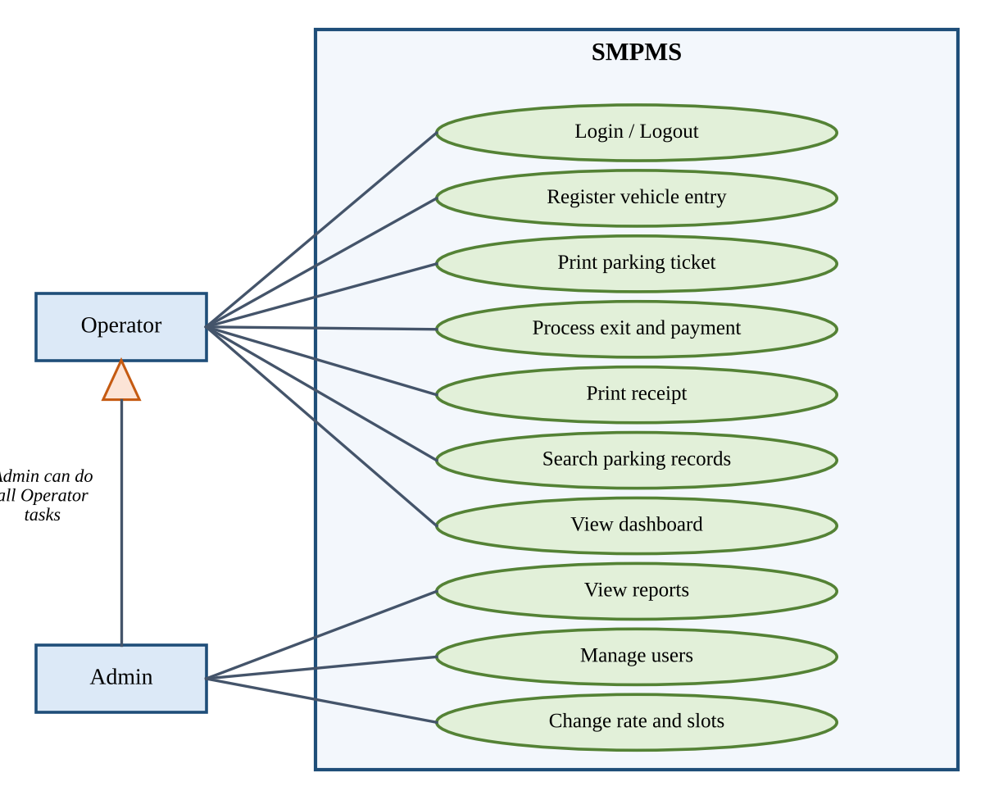
Architecture and Use Cases
Three-tier architecture
Use case: Operator and Admin
Notes:
[about 40 sec]
The system has three tiers: the browser, PHP on Apache which applies the rules, and the MySQL database accessed through prepared statements. There are two users. The Operator handles entry, tickets, exit, payment and search. The Admin can do all that, plus reports, user management, and changing the rate and slots.

Slide 6
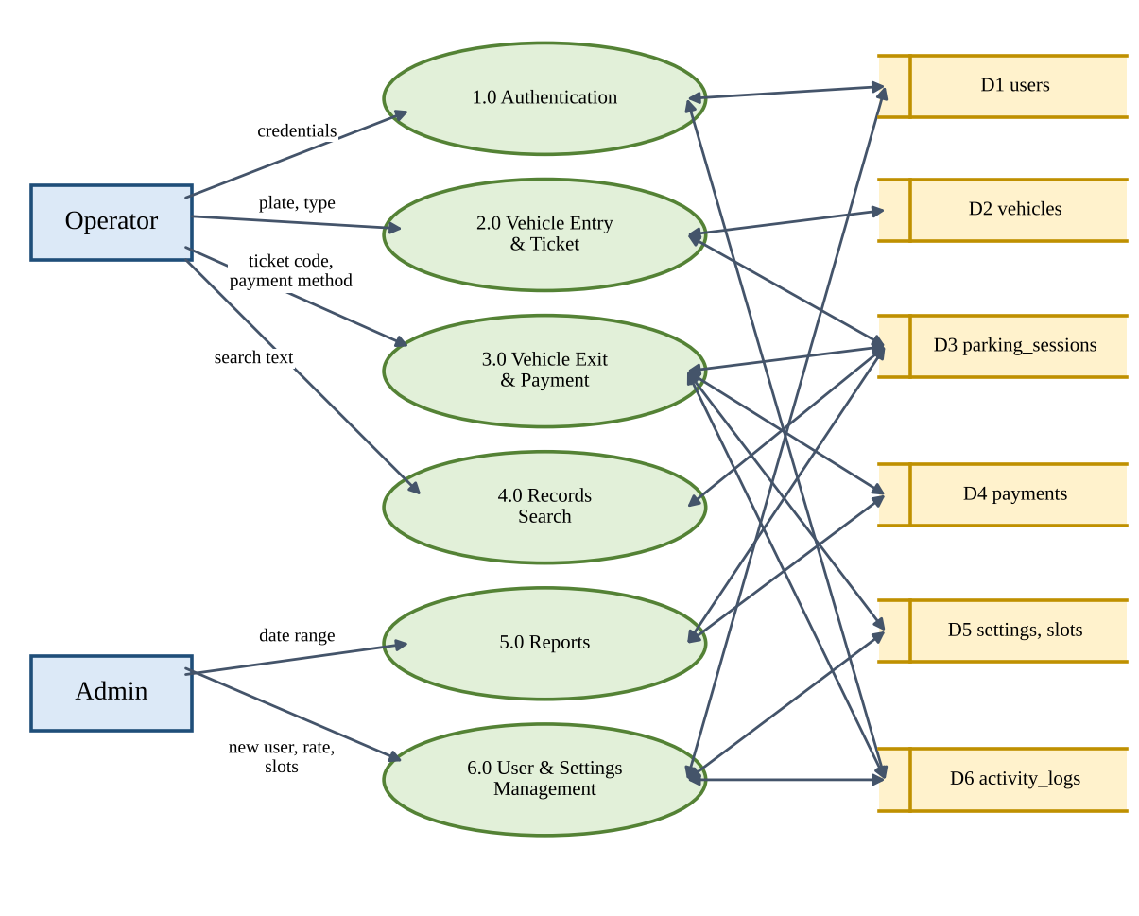
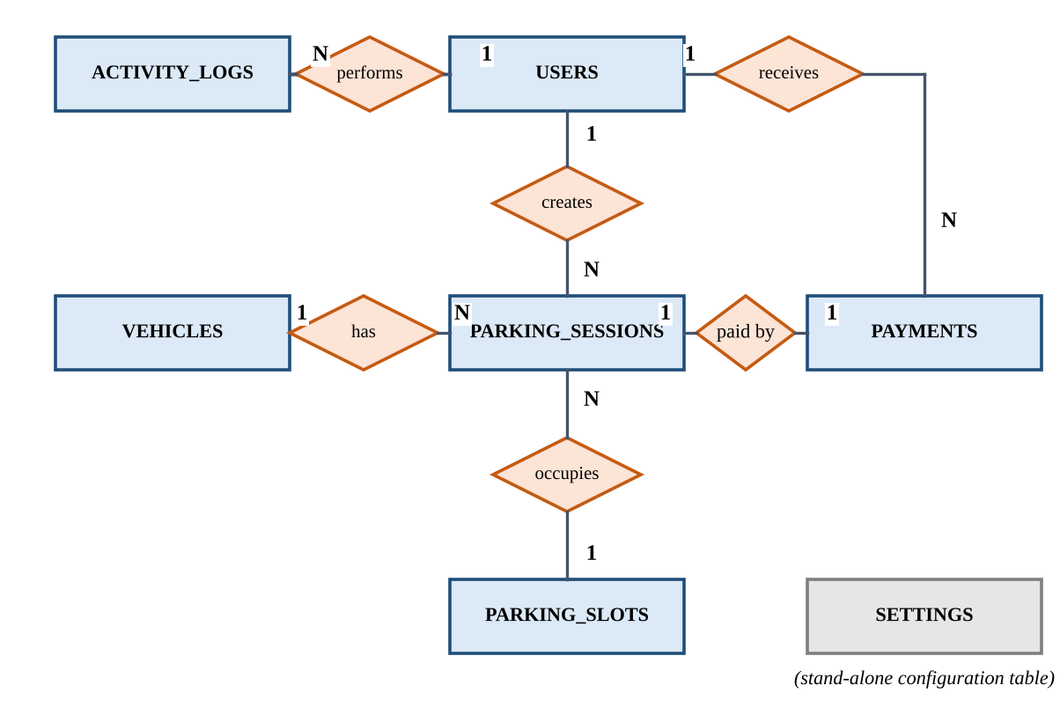
Data Flow and Database
Level-0 DFD: 6 processes
ER diagram: 7 tables
Notes:
[about 40 sec]
The Level-0 data flow diagram shows six processes, such as entry, exit and payment, and reports, and six data stores. The ER diagram shows seven tables. A user creates many sessions, a vehicle and a slot also have many sessions, and each session has one payment. The database is normalized to 3NF.

Slide 7
Security and Testing
Security measures
Hashed passwords (bcrypt)
Role check on every page
CSRF token on forms
Session ID regenerated
Prepared statements, output escaping
Activity log of actions
24 test cases designed
Notes:
[about 40 sec]
For security, passwords are hashed with bcrypt, every page checks the user's role, forms use CSRF tokens, SQL uses prepared statements, and every important action is logged. I designed 24 black-box test cases. The chart shows the fee rule: 30 and 60 minutes cost 50 taka, 61 minutes 100, and 135 minutes 150. A live run and user testing are future work.

Slide 8
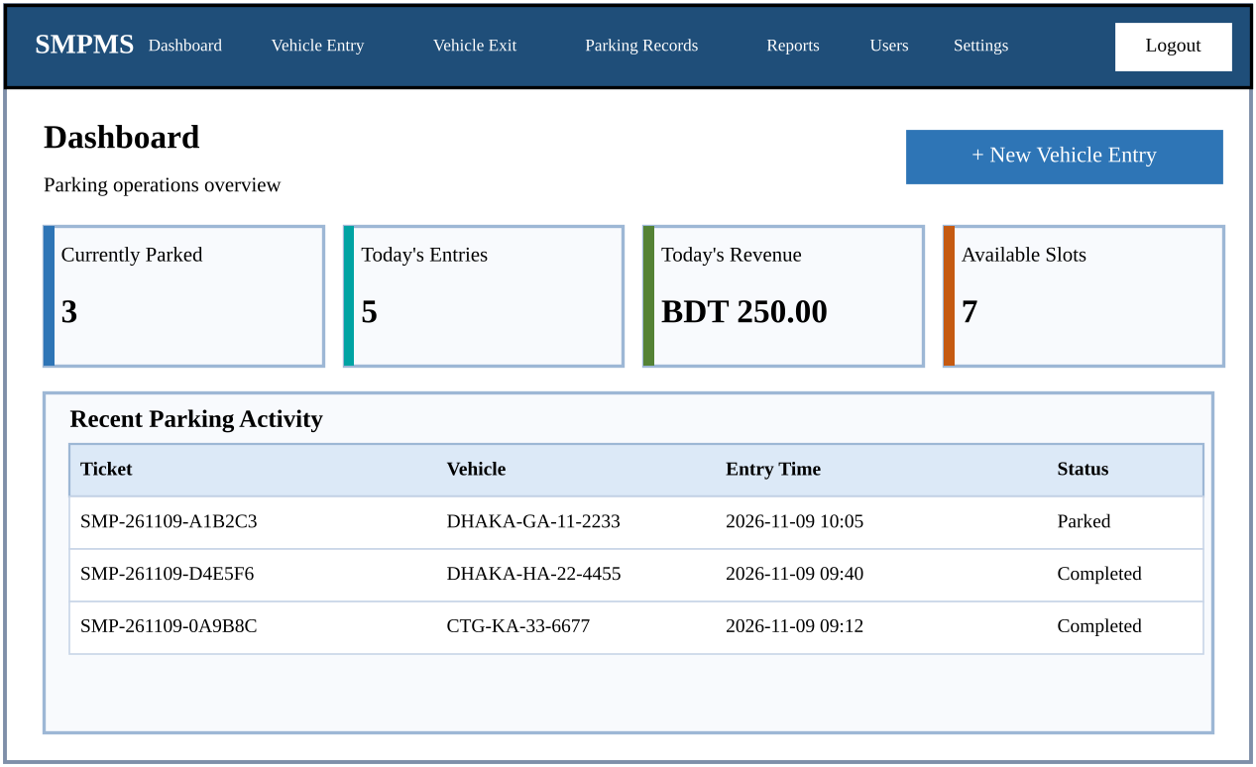
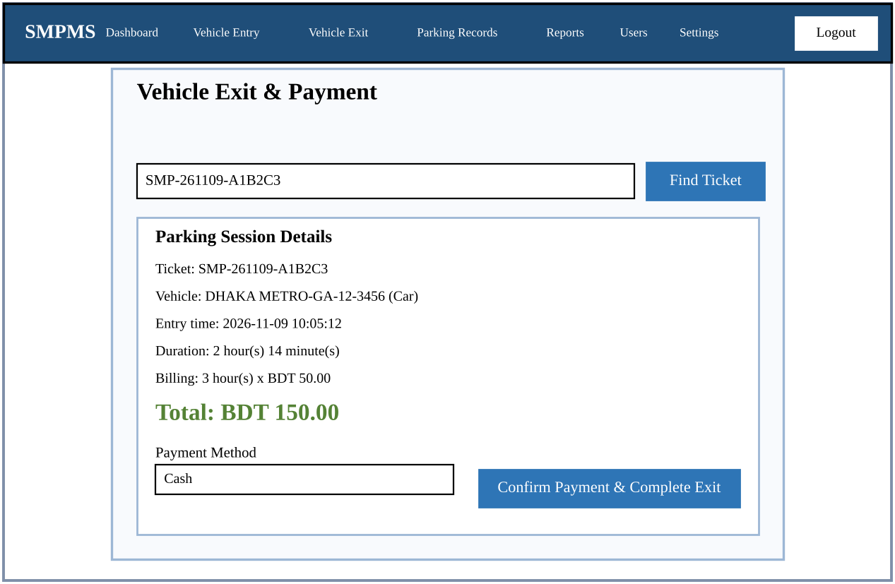
Output Screens
Dashboard
Exit, Fee and Payment
Notes:
[about 35 sec]
Here are the main screens. The dashboard shows parked vehicles, today's entries, revenue and free slots. On the exit page, the operator enters the ticket code and the system shows the duration and total fee. The operator chooses the payment method, confirms, and a receipt is generated. (These are sample screens; if the real system is running, show it live.)

Slide 9
Cost and Future Work
0.834
1.98
3.24
37,743
KLOC
person-months
months
BDT total cost
Limitations
Future work
Default admin password
Payments only recorded
No hardware integration
Payment gateways
QR scanner and number-plate recognition
Mobile app
Notes:
[about 30 sec]
Using Basic COCOMO, the code size is 0.834 KLOC, effort is about 1.98 person-months, time is about 3.2 months, and the total estimated cost is about 37,743 taka. The main limitations are the default admin password, payments that are only recorded, and no hardware integration. In future I plan to add payment gateways, a QR scanner with number-plate recognition, and a mobile app.

Slide 10
Conclusion
SMPMS automates entry, ticketing, fee calculation, payment and reporting with free tools, and applies security from the start. With a real payment gateway and hardware integration it can become a practical low-cost parking solution.
Thank you
Questions and discussion are welcome
Notes:
[about 20 sec]
In conclusion, SMPMS automates the full parking cycle, from entry and ticket to fee, payment and reports, using free tools and with security built in from the start. With a real payment gateway and hardware integration, it can become a practical, low-cost parking solution. Thank you. I am happy to answer your questions.
Quick answers if asked:
- Why Incremental? Natural parts, early working version, easy to change.
- How is the fee calculated? ceil(minutes / 60) hours times the hourly rate.
- How are duplicate entries blocked? A transaction checks for an active session of the same vehicle.

