Slide 1

PART 2 — DATABASE IMPLEMENTATION
Design & Implementation of a Database
Management System for IT Helpdesk &
Asset Support Management System
ER Diagram • Schema Design • Real Table Generation • Query Execution
Executed against a real SQL engine using MySQL-compatible syntax

Slide 2
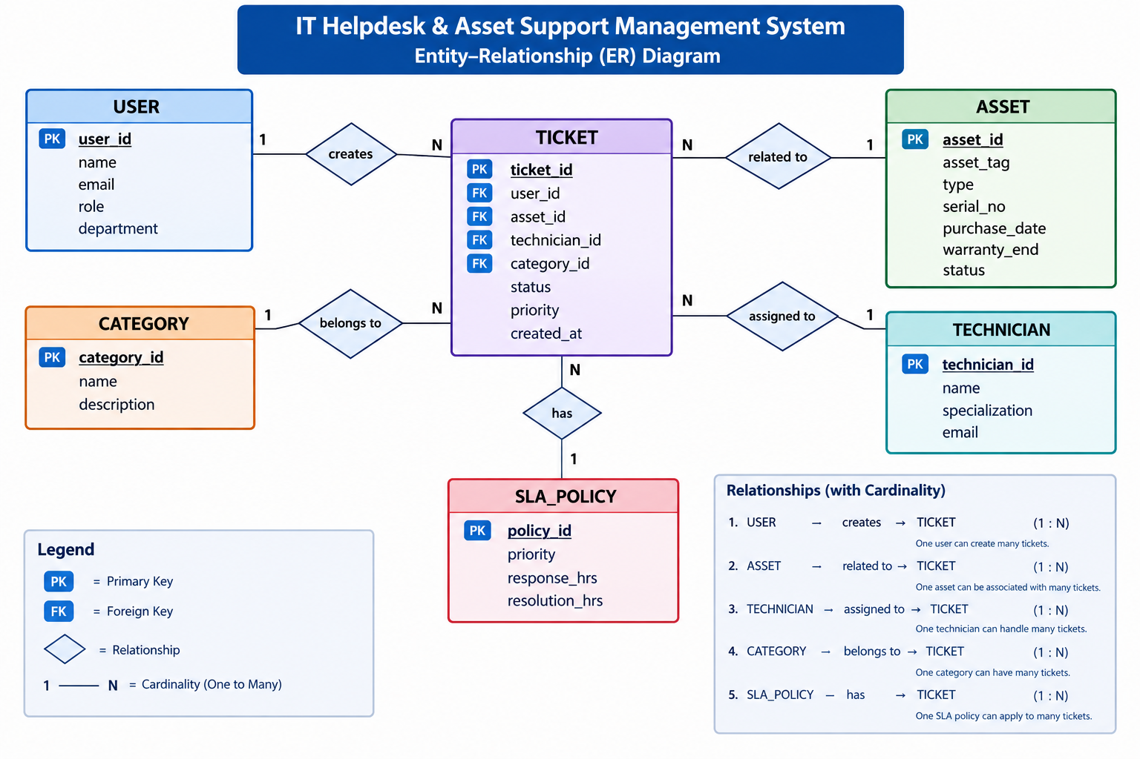

Slide 3
Database Design — Table Schema
The ER model translated into normalized (3NF) relational table definitions
TICKET
ASSET
COLUMN
TYPE
KEY
COLUMN
TYPE
KEY
ticket_id
INT
PK
asset_id
INT
PK
user_id
INT
FK
asset_tag
VARCHAR(30)
asset_id
INT
FK
type
VARCHAR(30)
technician_id
INT
FK
serial_no
VARCHAR(40)
category_id
INT
FK
purchase_date
DATE
status
VARCHAR(20)
warranty_end
DATE
priority
VARCHAR(10)
status
VARCHAR(20)
USER
TECHNICIAN
COLUMN
TYPE
KEY
COLUMN
TYPE
KEY
user_id
INT
PK
technician_id
INT
PK
name
VARCHAR(60)
name
VARCHAR(60)
email
VARCHAR(60)
specialization
VARCHAR(40)
role
VARCHAR(20)
email
VARCHAR(60)
department
VARCHAR(40)
IT HELPDESK & ASSET SUPPORT MANAGEMENT SYSTEM
3

Slide 4
Filled-In Tables — Real Query Output
Sample rows loaded with INSERT statements, then confirmed with SELECT * — actual captured output
mysql> SELECT * FROM ASSET;
+----------+-----------+---------+-----------+----------------+--------------+---------+
| asset_id | asset_tag | type | serial_no | purchase_date | warranty_end | status |
+----------+-----------+---------+-----------+----------------+--------------+---------+
| 101 | AST-1001 | Laptop | SN-88213X | 2024-03-15 | 2027-03-15 | In Use |
| 102 | AST-1002 | Monitor | SN-77120Y | 2023-11-02 | 2026-11-02 | In Use |
| 103 | AST-1003 | Printer | SN-55391Z | 2021-06-30 | 2025-06-30 | Retired |
+----------+-----------+---------+-----------+----------------+--------------+---------+
3 rows in set (0.00 sec)
mysql> SELECT * FROM TICKET;
+-----------+---------+----------+----------------+-------------+-------------+----------+------------+
| ticket_id | user_id | asset_id | technician_id | category_id | status | priority | created_at |
+-----------+---------+----------+----------------+-------------+-------------+----------+------------+
| 5001 | 12 | 101 | 3 | 1 | Open | High | 2026-09-10 |
| 5002 | 15 | 102 | 4 | 2 | In Progress | Medium | 2026-09-12 |
| 5003 | 12 | 103 | 3 | 1 | Closed | Low | 2026-08-28 |
+-----------+---------+----------+----------------+-------------+-------------+----------+------------+
3 rows in set (0.00 sec)
Why this matters: Every asset_id and user_id referenced in TICKET exists in ASSET / USER — the foreign keys are satisfied, so this data is valid.
IT HELPDESK & ASSET SUPPORT MANAGEMENT SYSTEM
5

Slide 5
Query Execution — Explained
A 4-table JOIN retrieving open, high-priority tickets with full context
What each clause does
SELECT t.ticket_id, u.name AS reported_by, a.asset_tag,
tech.name AS technician, t.status, t.priority
FROM TICKET t
JOIN USER u ON t.user_id = u.user_id
JOIN ASSET a ON t.asset_id = a.asset_id
JOIN TECHNICIAN tech ON t.technician_id = tech.technician_id
WHERE t.priority = 'High' AND t.status = 'Open';
SELECT Pick the columns to show, renaming a couple for readability.
FROM TICKET Start from the ticket — the record at the center of the request.
JOIN ... ON Pull in the matching user, asset, and technician via their foreign keys.
WHERE Filter to just the tickets that are open and high priority.
Result:
+-----------+-------------+-----------+------------+--------+----------+
| ticket_id | reported_by | asset_tag | technician | status | priority |
+-----------+-------------+-----------+------------+--------+----------+
| 5001 | Anita Rao | AST-1001 | Marcus Lee | Open | High |
+-----------+-------------+-----------+------------+--------+----------+
1 row in set (0.00 sec)
Insight: The join across four tables returns one clean, correct row — proof that the foreign keys and schema are working as designed.
IT HELPDESK & ASSET SUPPORT MANAGEMENT SYSTEM
6

