Slide 1
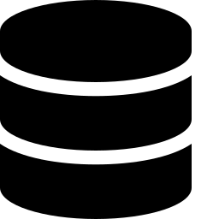
DESIGN & IMPLEMENTATION OF A
Database Management System for
IT Helpdesk & Asset Support
A relational data platform for ticketing, asset lifecycle tracking, and IT service delivery
Database Design | System Architecture | Implementation Plan

Slide 2




Introduction & Objectives
IT helpdesks handle a constant stream of tickets, incidents, and hardware/software assets. A purpose-built DBMS replaces spreadsheets and email threads with a single source of truth — linking every request to a user, a technician, and the asset involved, while enforcing data integrity through relational constraints.
Streamline Ticketing
Why it matters
Log, assign, and track support tickets from creation to closure.
Centralized data means faster ticket resolution, accurate asset audits, and reliable SLA reporting for IT management.
Track Assets
Maintain a full lifecycle record for every hardware & software asset.
Core goal
Enforce Data Integrity
Use keys, constraints, and normalization to eliminate redundancy.
One normalized schema that connects Users, Tickets, Assets, and Technicians end to end.
IT HELPDESK & ASSET SUPPORT MANAGEMENT SYSTEM
2

Slide 3
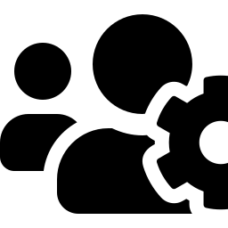


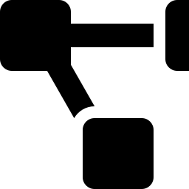
Core Functional Modules
The system requirements driving the database schema
Ticket Management
Asset Registry
User & Role Access
Create, categorize, prioritize, and route tickets to the right technician.
Track hardware/software assets, warranties, locations, and ownership.
Manage end users, technicians, and admins with role-based permissions.
SLA & Escalation
Reporting & Audit
Knowledge Base
Monitor response/resolution deadlines and auto-escalate breaches.
Generate performance, asset-utilization, and compliance reports.
Link recurring issues to solutions for faster future resolution.
IT HELPDESK & ASSET SUPPORT MANAGEMENT SYSTEM
3

Slide 4


Implementation — Architecture & Stack
A layered architecture from client interface down to the persistence layer
Presentation Layer
Tech Stack
Web & mobile helpdesk portal for end users, technicians, and admins
MySQL / PostgreSQL
Node.js / Django REST
Application / API Layer
Business logic, authentication, ticket routing, and SLA engine
React / Angular UI
Role-Based Auth (JWT)
Database Layer
REST API integration
Relational DBMS (MySQL / PostgreSQL) storing users, tickets, assets, SLAs
Cloud or on-prem hosting
Infrastructure Layer
Hosting, backups, and scaling — on-premise or cloud (AWS / Azure)
IT HELPDESK & ASSET SUPPORT MANAGEMENT SYSTEM
5

Slide 5
Real-World Example — A Ticket Walkthrough
How the database moves a single support request from report to resolution
Scenario: An employee's laptop won't boot. She opens the helpdesk portal and submits a request.
1
2
3
4
5
Ticket Logged
Asset Linked
Technician Assigned
SLA Tracked
Resolved & Logged
New row in TICKET: user_id, category = "Hardware", priority = High.
TICKET.asset_id joins to ASSET, pulling model, serial no. & warranty.
Router matches category + workload, sets TICKET.technician_id.
SLA_POLICY sets a 4-hr deadline; a breach flag fires if it's missed.
Status → Closed; fix is added to the knowledge base for reuse.
Result: One linked record set — no re-entry, no lost history, and a reportable SLA outcome.
IT HELPDESK & ASSET SUPPORT MANAGEMENT SYSTEM
6

Slide 6

Conclusion & Future Scope
A normalized, relational DBMS gives IT teams one reliable source of truth — linking users, tickets, assets, and technicians so support work is faster, auditable, and easy to report on.
Delivered
3NF schema covering users, tickets, assets, categories, SLAs, and technicians.
Impact
Faster ticket resolution and accurate, audit-ready asset records.
Next Steps
Add AI-based ticket triage, automated asset discovery, and predictive SLA alerts.
Thank you
IT HELPDESK & ASSET SUPPORT MANAGEMENT SYSTEM
7

