Slide 1
Student portal

Slide 2
Submitted by
Submitted to
Nadia Islam Rupa
ID:223002047
Kawser Miah
ID:223002063
Feroza Naznin
Lecturer department of CSE
Green University of Bangladesh

Slide 3
agenda
Objective
Learning outcome
Technologies
Key feature
Fronted overview
Backend overview
Future Enhancements

Slide 4
objective
To create a centralized platform for students to manage academic and financial information.
To enhance user experience through a responsive and interactive interface.
To implement secure backend systems for user authentication and data management.

Slide 5
Learning outcome
Mastered the integration of HTML, CSS, and JavaScript for front-end development.
Gained proficiency in PHP and database management using MySQL.

Slide 6
Technologies
Front-End:
HTML, CSS, JavaScript
Back-End:
PHP

Slide 7
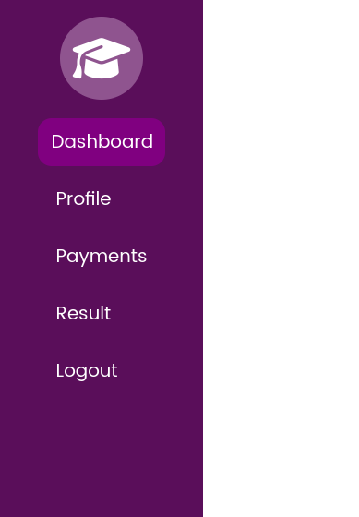
Key Features
Dashboard:
Welcome a student in the portal
Profile Management:
View their personal details.
Payments Section:
Manage tuition fees and other payments.
Results Page:
Access grades and progress reports.
Logout Feature:
Ensures session security.

Slide 8
Front-End Overview

Slide 9
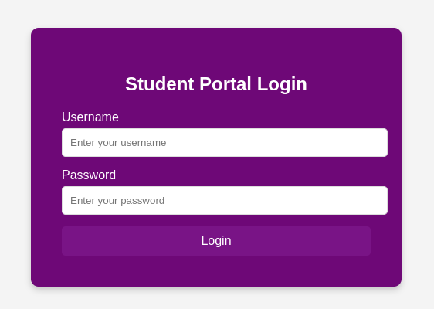
Log in

Slide 10
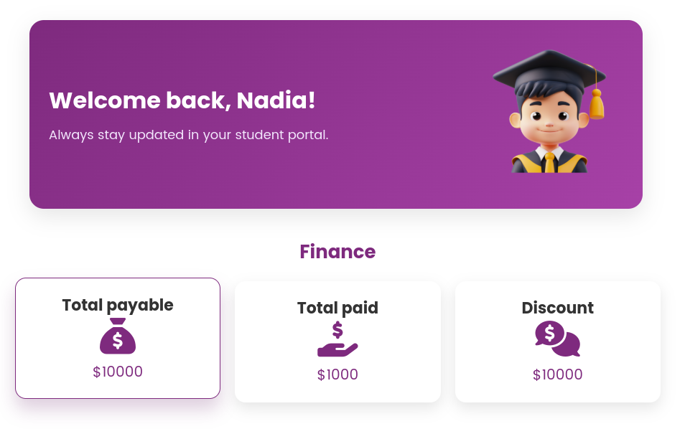
Dashboard

Slide 11
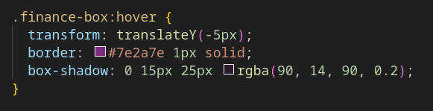
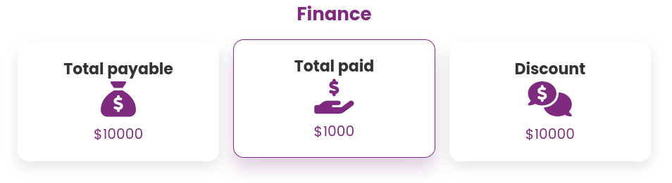

Slide 12
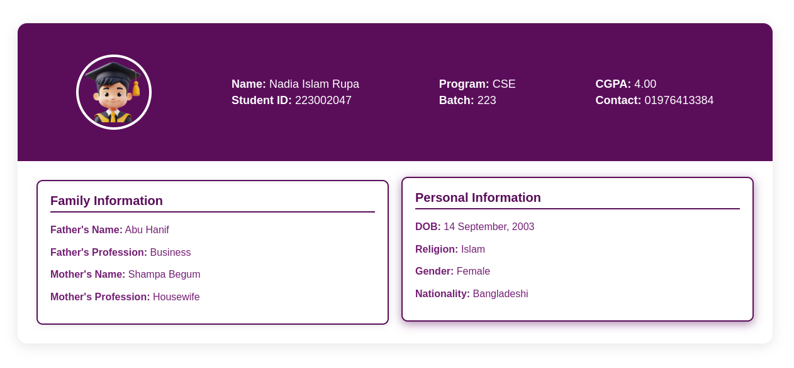
Profile

Slide 13
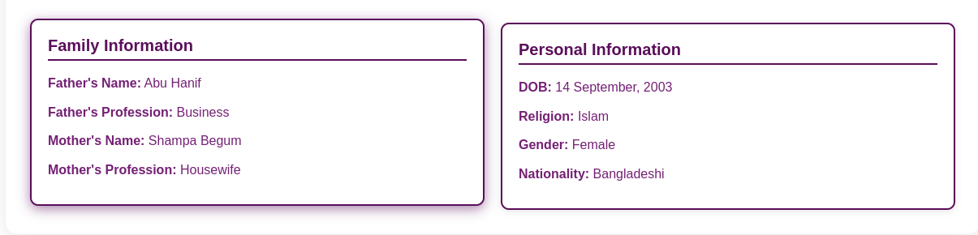
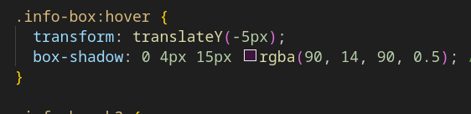

Slide 14
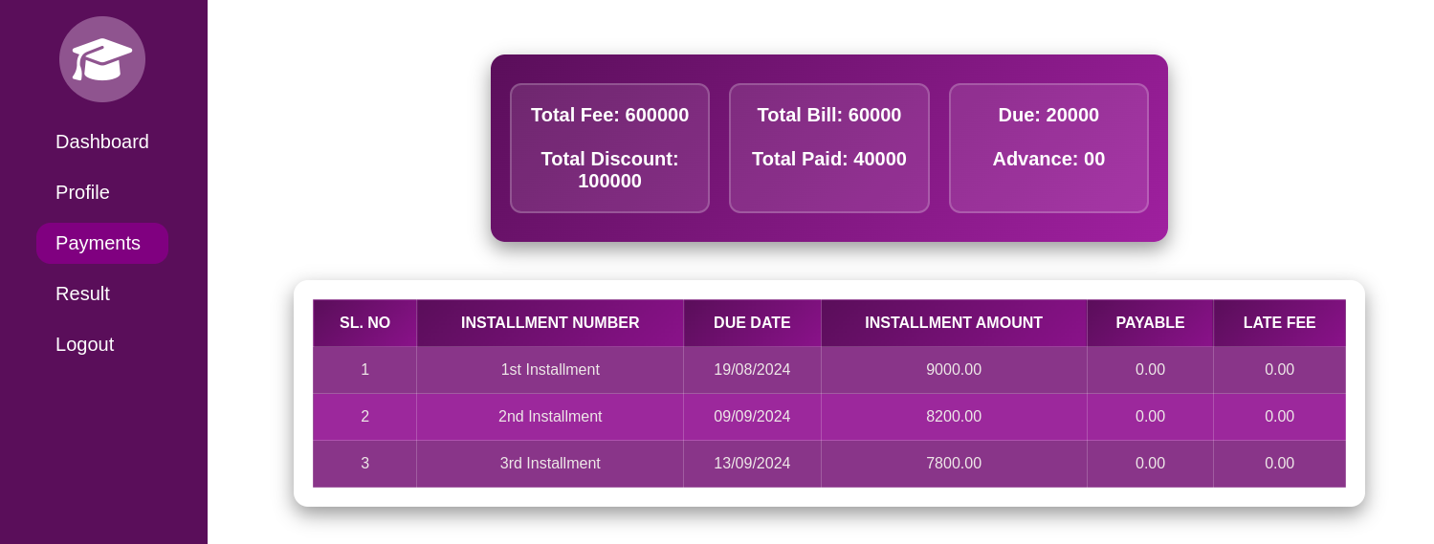
payments

Slide 15
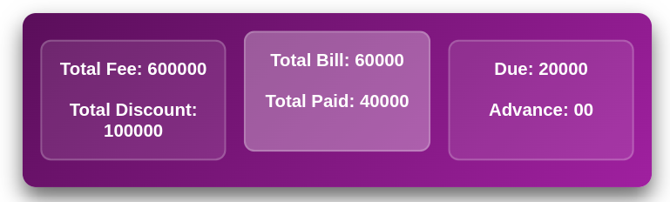
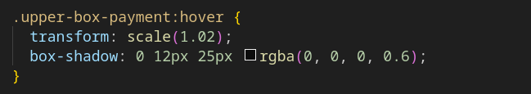
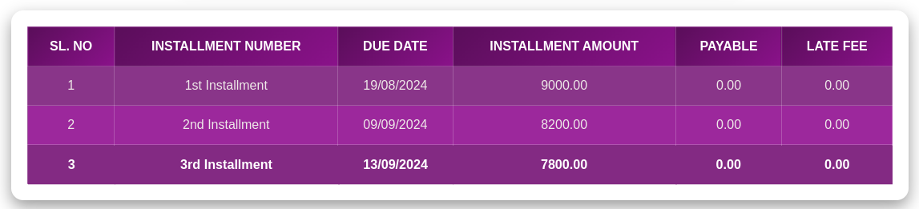
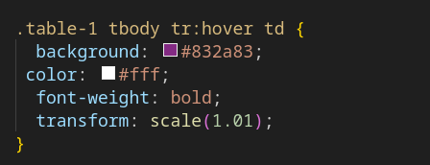

Slide 16
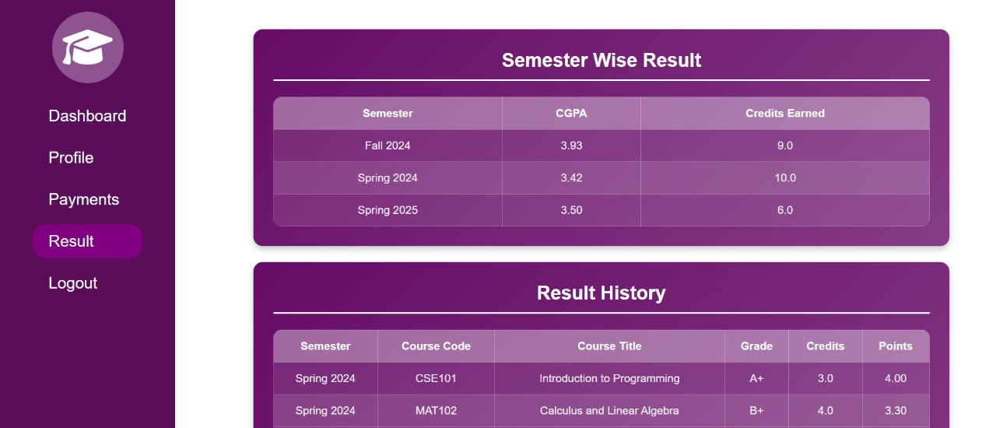
Result

Slide 17
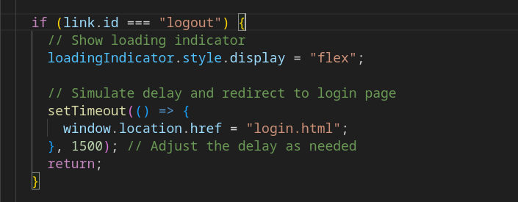
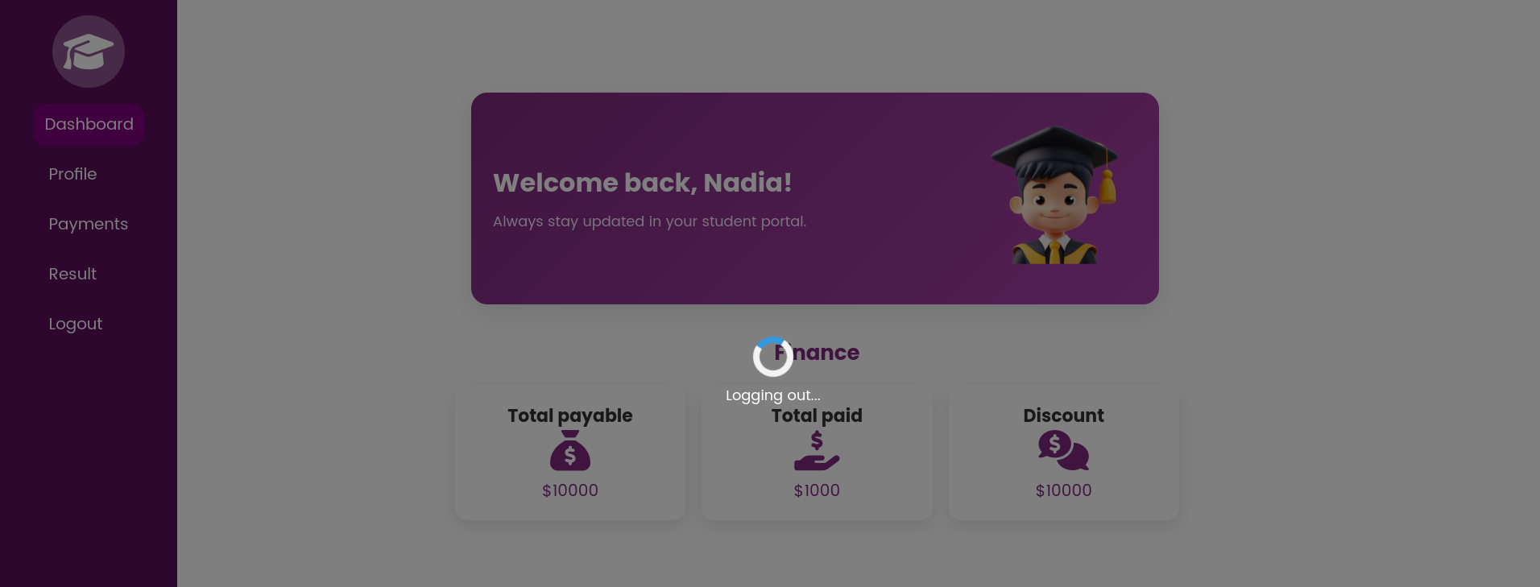
Log out

Slide 18
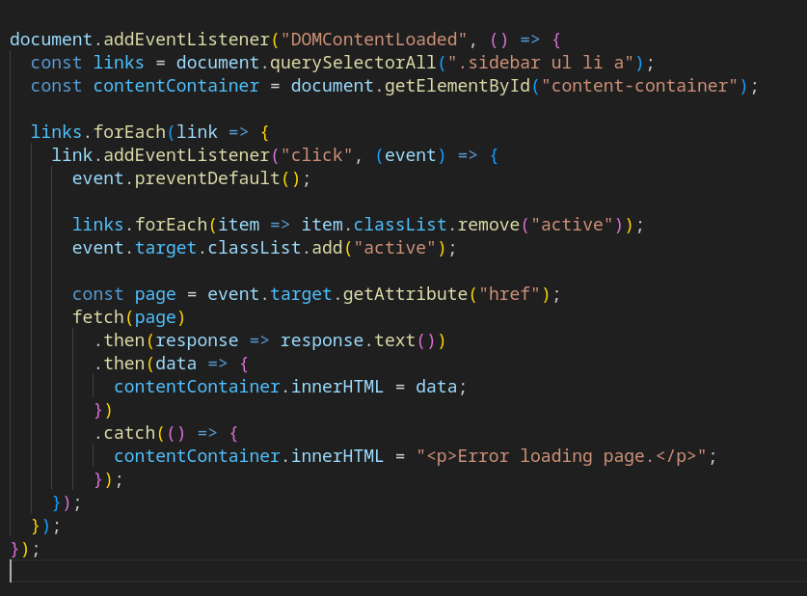
Side bar

Slide 19
Back-End Overview

Slide 20
overview
PHP:
Manages user sessions, authentication, and data communication.
Database Interaction:
CRUD operations (Create, Read) for user data.
Example Workflow:
Login form submission → PHP authenticates → Redirects to dashboard.

Slide 21
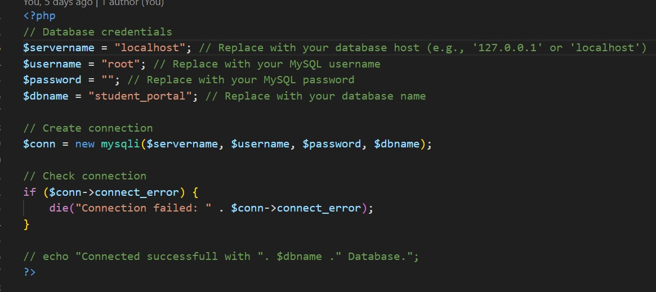
Connection

Slide 22
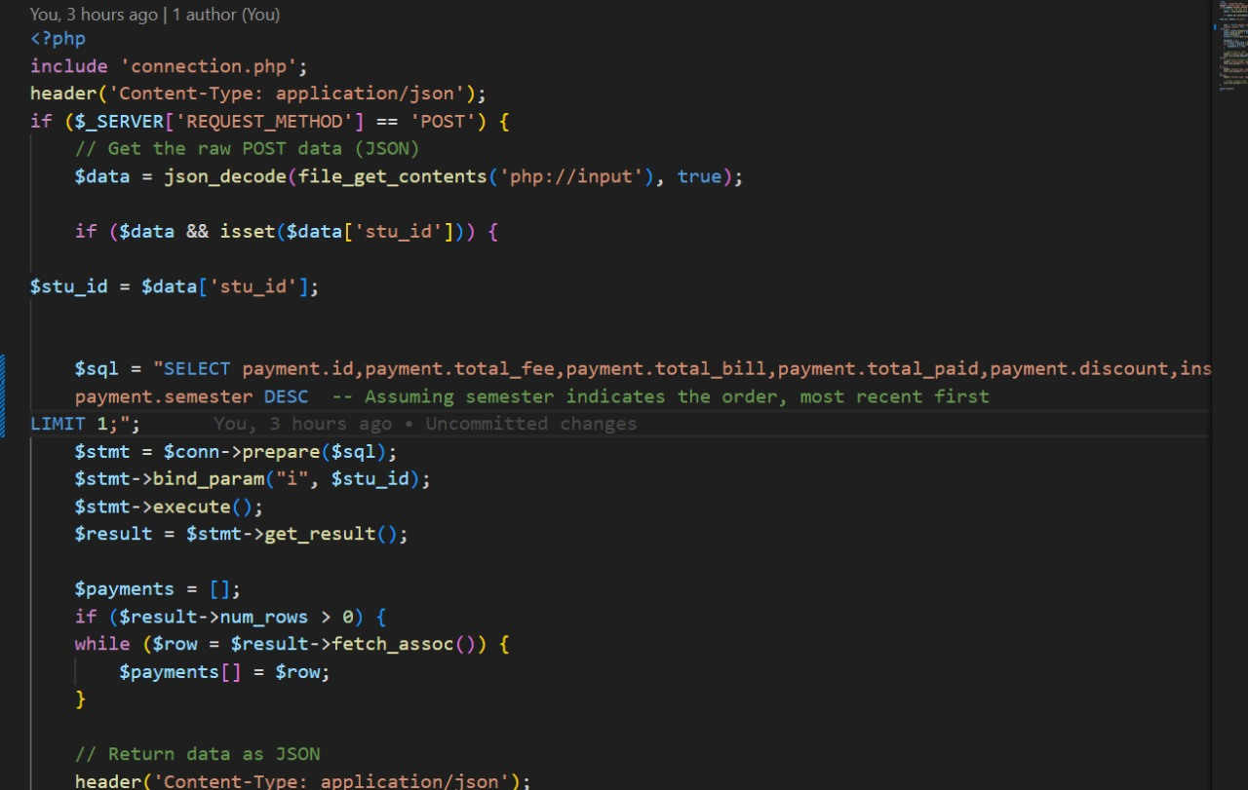
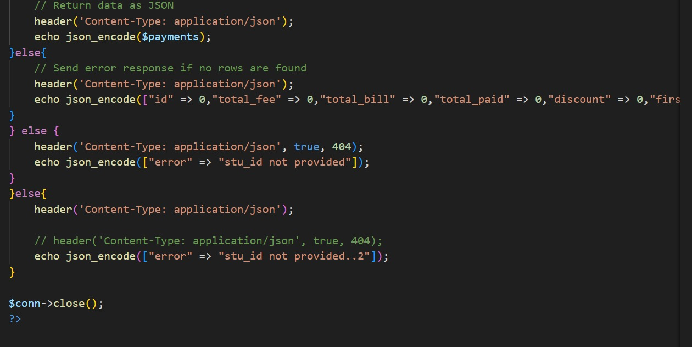
Data fetch

Slide 23
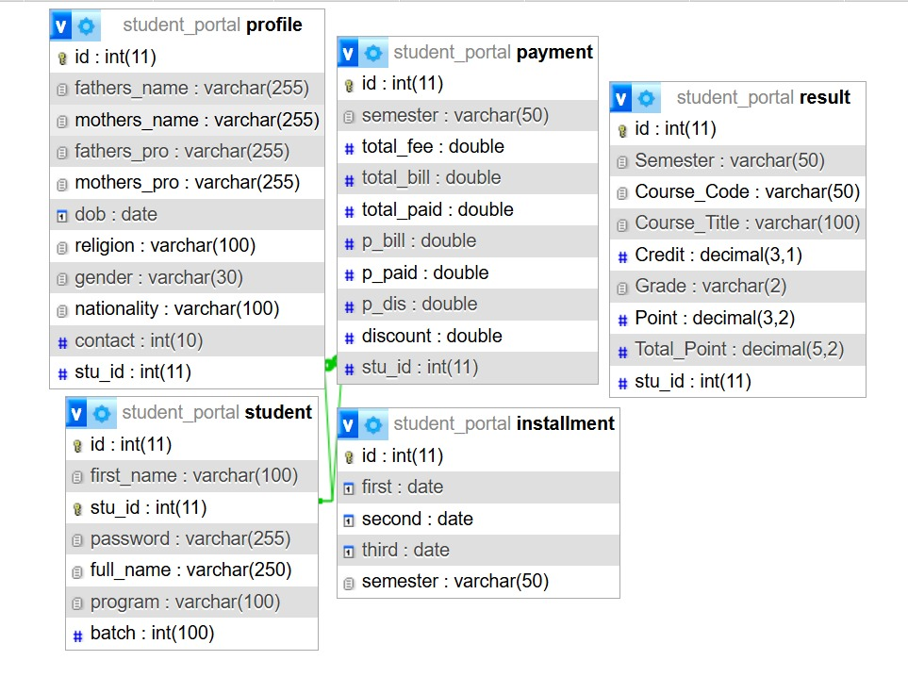
tables

Slide 24
Future Enhancements
Add Notifications:
Alerts for due payments or new results.
Mobile Application:
Build a companion mobile app.
Payment Gateway Integration:
Direct online fee payment.

Slide 25

Thank you

