Slide 1
Linear Algebra
2020 Winter Seminar
Chapter 2: Vector Spaces (2)
Sohee Lim
Keyword: Graph, Incidence Matrix, N($A^{T}$), Linear Transformation

Slide 2
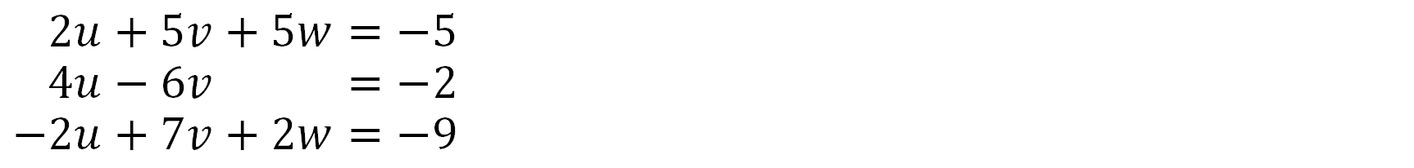
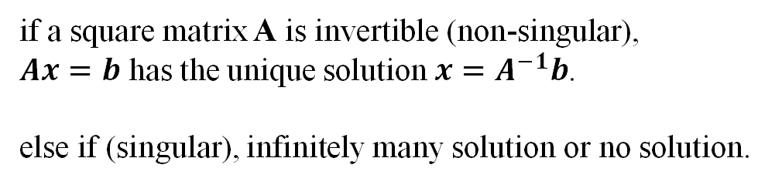


Chapter 1 Review
$$−2u+5v+5w=−5$$
$$−4u−6v+5w=−2$$
$$−2u+7v+2w=−9$$
System of linear equations
A
x
b
Gaussian Elimination
x
$$=$$
if a square matrix A is invertible (non-singular),
$Ax=b$ has the unique solution $x=A^{−1}b$.
else if (singular), infinitely many solution or no solution.
$$n×n$$
# of eqns = # of unknowns

Slide 3


Chapter 2 Overview
U: Echelon form
R: Reduced row echelon form
x
A $→$ U $→$ R
A
b
Gaussian Elimination
x
$$=$$
$$m×n$$
Rectangular Matrix
unique solution
infinitely many solution
no solution

Slide 4
Contents
Vector Spaces
2.1 Vector Spaces and Subspaces
2.2 Solving Ax = 0 and Ax = b
2.3 Linear Independence, Basis, and Dimension
2.4 The Four Fundamental Subspaces
2.5 Graphs and Networks
2.6 Linear Transformations

Slide 5
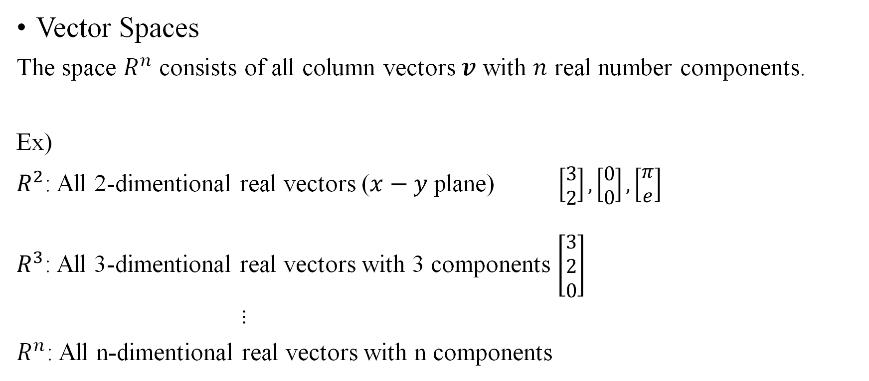
2.1 Vector Spaces and Subspaces
Vector Spaces
The space $R^{n}$ consists of all column vectors $v$ with $n$ real number components.
Ex)
$R^{2}$: All 2-dimentional real vectors ($x−y$ plane) $\left[\begin{matrix}3 \\ 2\end{matrix}\right],\left[\begin{matrix}0 \\ 0\end{matrix}\right],\left[\begin{matrix}π \\ e\end{matrix}\right]$
$R^{3}$: All 3-dimentional real vectors with 3 components $\left[\begin{matrix}3 \\ 2 \\ 0\end{matrix}\right]$
$⋮$
$R^{n}$: All n-dimentional real vectors with n components

Slide 6
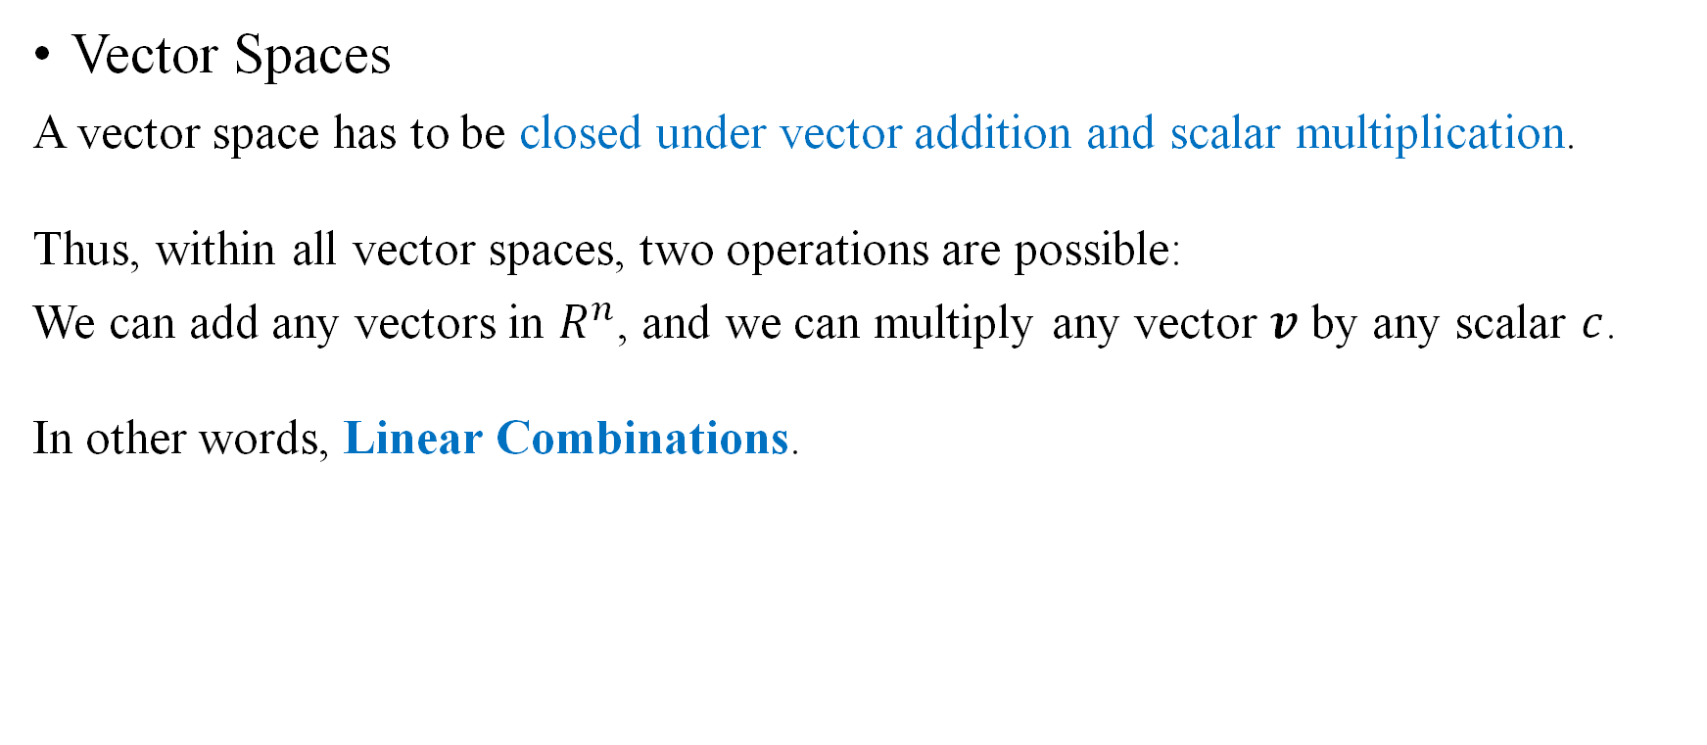
2.1 Vector Spaces and Subspaces
Vector Spaces
A vector space has to be closed under vector addition and scalar multiplication.
Thus, within all vector spaces, two operations are possible:
We can add any vectors in $R^{n}$, and we can multiply any vector $v$ by any scalar $c$.
In other words, Linear Combinations.

Slide 7
2.1 Vector Spaces and Subspaces
Vector Spaces
A set of vectors including 0 that satisfies requirements:
If v and w are vectors in the subspace and c, d is any scalar, then
(i) v + w is in the space
(ii) cv is in the space
(iii) all linear combinations cv + dw are in the space

Slide 8
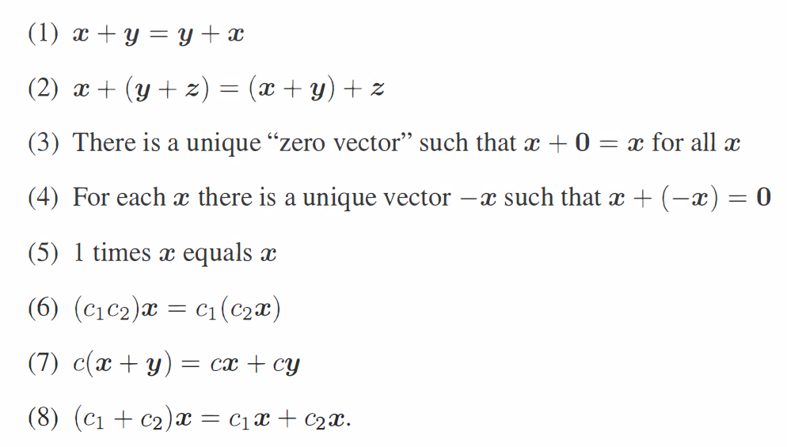
2.1 Vector Spaces and Subspaces
Vector Spaces
In the definition of a vector space, vector addition x + y and scalar multiplication cx must obey the following eight rules:

Slide 9

2.1 Vector Spaces and Subspaces
Vector Spaces
Every vector space contains the zero vector
$v_{1}=\left[\begin{matrix}3 \\ 2\end{matrix}\right], v_{2}=−v_{1}=\left[\begin{matrix}−3 \\ −2\end{matrix}\right]$
$v_{1}+v_{2}=\left[\begin{matrix}0 \\ 0\end{matrix}\right]$

Slide 10

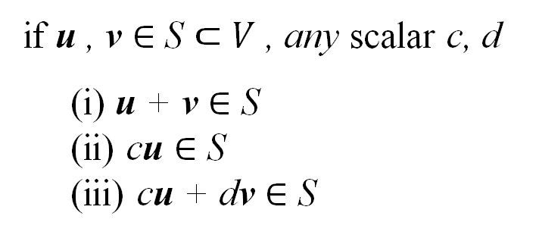
2.1 Vector Spaces and Subspaces
S$⊂$ V
Subspaces
A subset of a vector space
V
if u , v $∈$ S $⊂V$ , any scalar c, d
(i) u + v $∈$ S
(ii) cu $∈$ S
(iii) cu + dv $∈$ S
S

Slide 11
2.1 Vector Spaces and Subspaces
Subspaces
case) not a vector space
closure under vector addition
not closure under scalar multiplication

Slide 12


2.1 Vector Spaces and Subspaces
Subspaces
case) a vector space inside $R^{2}$
$$l$$

Slide 13
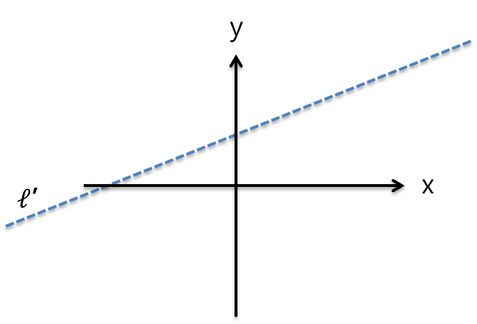
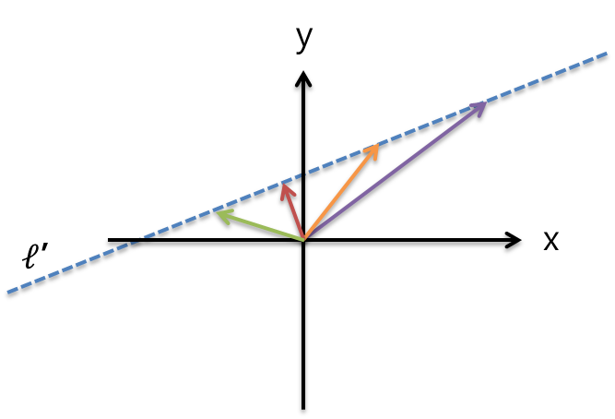
2.1 Vector Spaces and Subspaces
Subspaces
Every subspace contains the zero vector

Slide 14


2.1 Vector Spaces and Subspaces
Subspaces
Subspace of $R^{2}$
all of $R^{2}$
any line through zero vector
the zero vector alone
Subspace of $R^{3}$
all of $R^{3}$
any plane through the origin
any line through the origin
the origin (zero vector) alone
P
L
Z

Slide 15
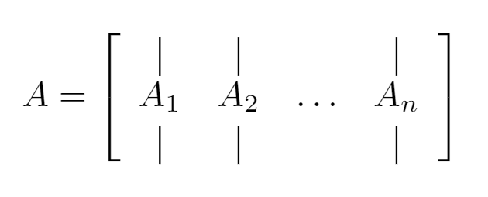
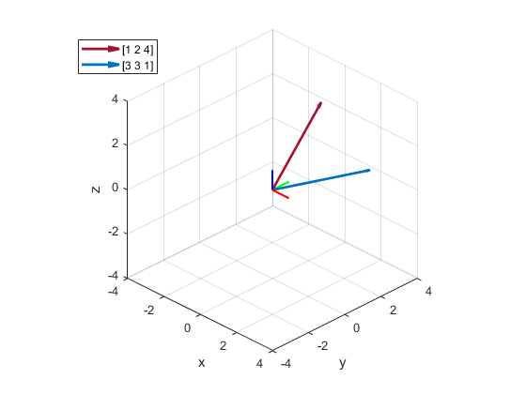
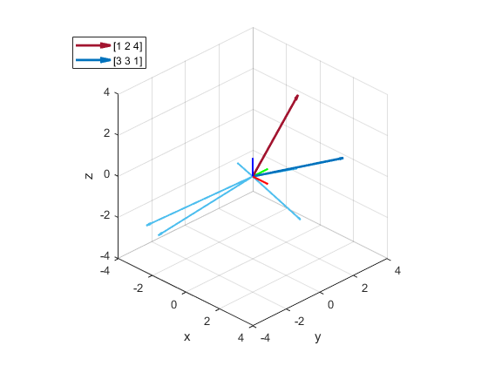
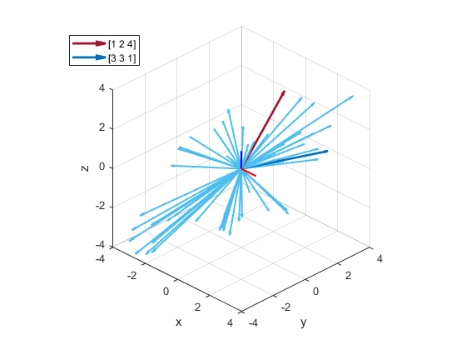
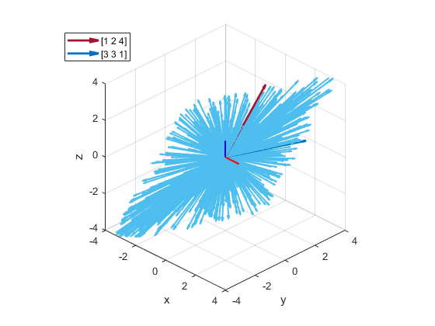

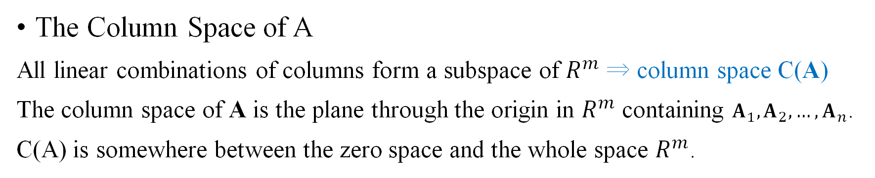
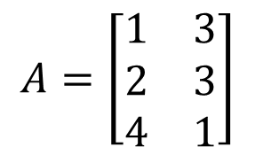

2.1 Vector Spaces and Subspaces
The Column Space of A
All linear combinations of columns form a subspace of $R^{m}$ ⇒ column space C(A)
The column space of A is the plane through the origin in $R^{m}$ containing $A_{1}, A_{2}, …, A_{n}$.
C(A) is somewhere between the zero space and the whole space $R^{m}$.
$$\left[\begin{matrix}1 \\ 2 \\ 4\end{matrix}\right]$$
$$A=\left[\begin{matrix}1 & 3 \\ 2 & 3 \\ 4 & 1\end{matrix}\right]$$
$$\left[\begin{matrix}3 \\ 3 \\ 1\end{matrix}\right]$$

Slide 16
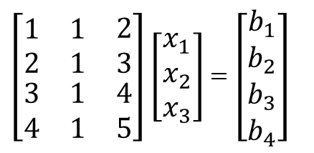
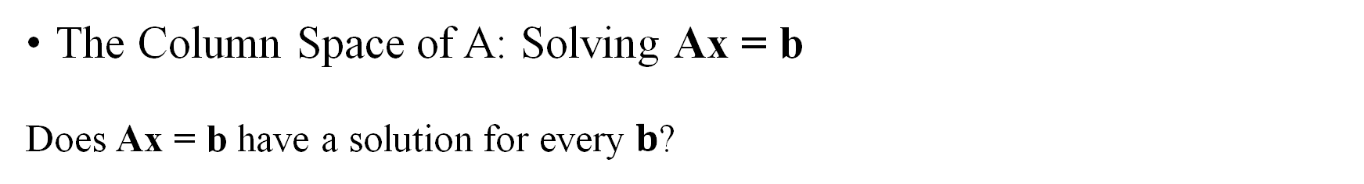
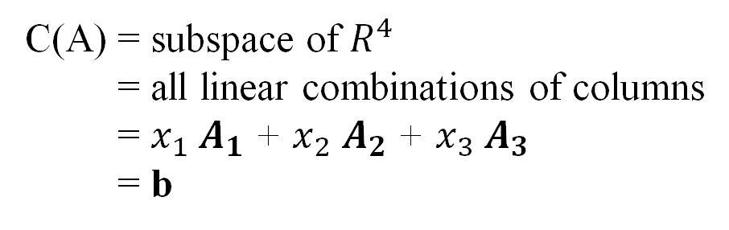


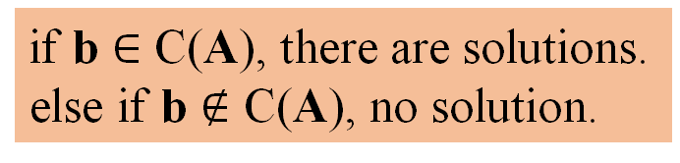

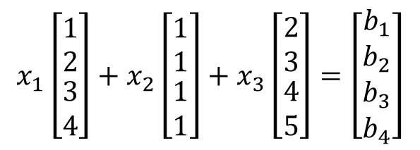
2.1 Vector Spaces and Subspaces
The Column Space of A: Solving Ax = b
Does Ax = b have a solution for every $b$?
No.
Why? Independent / Dependent
$\left[\begin{matrix}\begin{matrix}\begin{matrix}1 \\ 2\end{matrix} \\ \begin{matrix}3 \\ 4\end{matrix}\end{matrix} & \begin{matrix}\begin{matrix}1 \\ 1\end{matrix} \\ \begin{matrix}1 \\ 1\end{matrix}\end{matrix} & \begin{matrix}\begin{matrix}2 \\ 3\end{matrix} \\ \begin{matrix}4 \\ 5\end{matrix}\end{matrix}\end{matrix}\right]\left[\begin{matrix}x_{1} \\ x_{2} \\ x_{3}\end{matrix}\right]$ = $\left[\begin{matrix}\begin{matrix}b_{1} \\ b_{2}\end{matrix} \\ \begin{matrix}b_{3} \\ b_{4}\end{matrix}\end{matrix}\right]$
$$x_{1}\left[\begin{matrix}\begin{matrix}1 \\ 2\end{matrix} \\ \begin{matrix}3 \\ 4\end{matrix}\end{matrix}\right]+x_{2}\left[\begin{matrix}\begin{matrix}1 \\ 1\end{matrix} \\ \begin{matrix}1 \\ 1\end{matrix}\end{matrix}\right]+x_{3}\left[\begin{matrix}\begin{matrix}2 \\ 3\end{matrix} \\ \begin{matrix}4 \\ 5\end{matrix}\end{matrix}\right]=\left[\begin{matrix}\begin{matrix}b_{1} \\ b_{2}\end{matrix} \\ \begin{matrix}b_{3} \\ b_{4}\end{matrix}\end{matrix}\right]$$
A x = b
$$A_{1}$$
$$A_{2}$$
$$A_{3}$$
C(A) = subspace of $R^{4}$
C(A) = all linear combinations of columns
C(A) = $x_{1}$ $A_{1}$ + $x_{2}$ $A_{2}$ + $x_{3}$ $A_{3}$
C(A) = b
if b $∈$ C(A), there are solutions.
else if b $∉$ C(A), no solution.
Can solve Ax = b when b is in C(A)

Slide 17
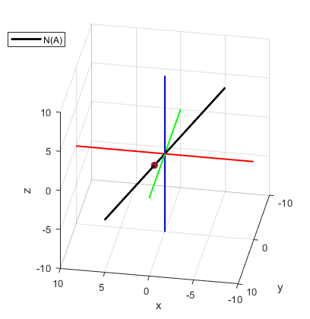

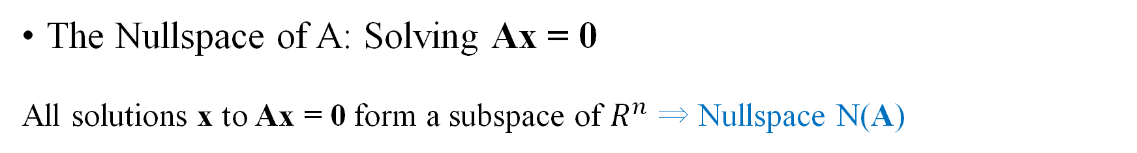
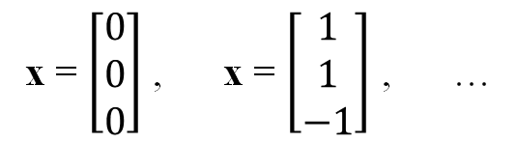
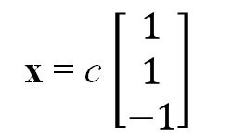
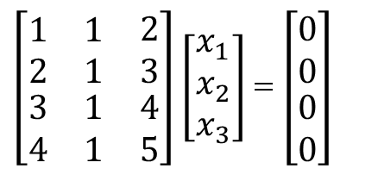
2.1 Vector Spaces and Subspaces
The Nullspace of A: Solving Ax = 0
All solutions x to Ax = 0 form a subspace of $R^{n}$ ⇒ Nullspace N(A)
$\left[\begin{matrix}\begin{matrix}\begin{matrix}1 \\ 2\end{matrix} \\ \begin{matrix}3 \\ 4\end{matrix}\end{matrix} & \begin{matrix}\begin{matrix}1 \\ 1\end{matrix} \\ \begin{matrix}1 \\ 1\end{matrix}\end{matrix} & \begin{matrix}\begin{matrix}2 \\ 3\end{matrix} \\ \begin{matrix}4 \\ 5\end{matrix}\end{matrix}\end{matrix}\right]\left[\begin{matrix}x_{1} \\ x_{2} \\ x_{3}\end{matrix}\right]$ = $\left[\begin{matrix}\begin{matrix}0 \\ 0\end{matrix} \\ \begin{matrix}0 \\ 0\end{matrix}\end{matrix}\right]$
$$\left[\begin{matrix}1 \\ 1 \\ −1\end{matrix}\right]$$
x = $\left[\begin{matrix}0 \\ 0 \\ 0\end{matrix}\right]$ , x = $\left[\begin{matrix}1 \\ 1 \\ −1\end{matrix}\right]$ , …
A x = 0
x = c $\left[\begin{matrix}1 \\ 1 \\ −1\end{matrix}\right]$

Slide 18
2.1 Vector Spaces and Subspaces
The Nullspace of A
Requirement:
(i) If Av = 0 and Aw = 0 then A(v + w) = 0
(ii) If Ax = 0 then A(cx) = 0

Slide 19
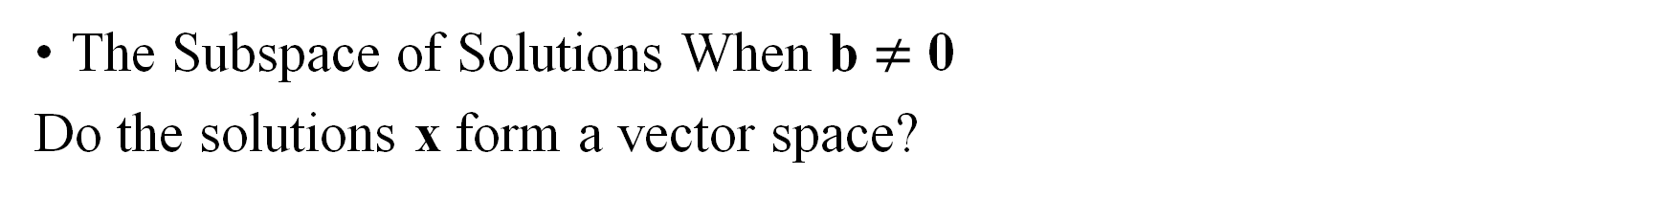
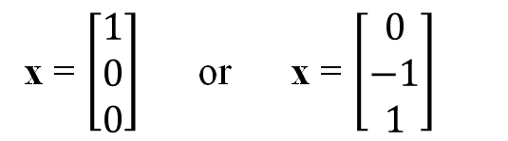
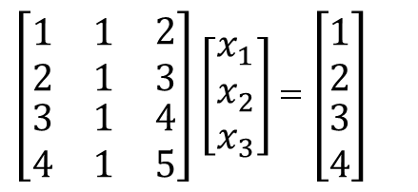
2.1 Vector Spaces and Subspaces
The Subspace of Solutions When b $≠$ 0
Do the solutions x form a vector space?
No.
$\left[\begin{matrix}\begin{matrix}\begin{matrix}1 \\ 2\end{matrix} \\ \begin{matrix}3 \\ 4\end{matrix}\end{matrix} & \begin{matrix}\begin{matrix}1 \\ 1\end{matrix} \\ \begin{matrix}1 \\ 1\end{matrix}\end{matrix} & \begin{matrix}\begin{matrix}2 \\ 3\end{matrix} \\ \begin{matrix}4 \\ 5\end{matrix}\end{matrix}\end{matrix}\right]\left[\begin{matrix}x_{1} \\ x_{2} \\ x_{3}\end{matrix}\right]$ = $\left[\begin{matrix}\begin{matrix}1 \\ 2\end{matrix} \\ \begin{matrix}3 \\ 4\end{matrix}\end{matrix}\right]$
x = $\left[\begin{matrix}1 \\ 0 \\ 0\end{matrix}\right]$ or x = $\left[\begin{matrix}0 \\ −1 \\ 1\end{matrix}\right]$
A x = b
Why? The zero vector is not a solution.
A plane/line that doesn’t go through the origin.

Slide 20

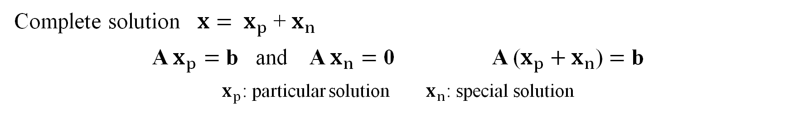

2.2 Solving Ax = 0 and Ax = b
U: Echelon form
R: Reduced row echelon form
x
A $→$ U $→$ R
A
b
Gaussian Elimination
x
$$=$$
$$m×n$$
Rectangular Matrix
unique solution
infinitely many solution
no solution
Complete solution ${x= x}_{p}$ + $x_{n}$
A $x_{p}=$ b and A $x_{n}=$ 0 A ($x_{p}+x_{n}$) $=$ b
$x_{p}$: particular solution $x_{n}$: special solution

Slide 21

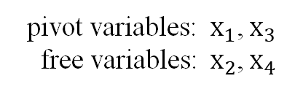
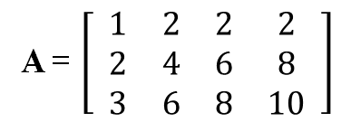

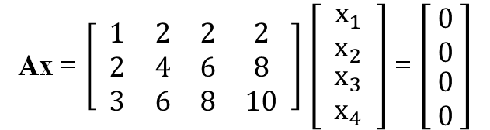


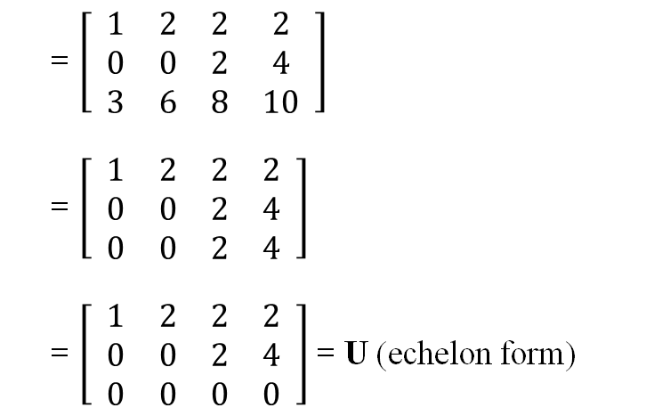
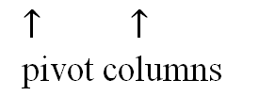
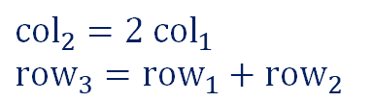
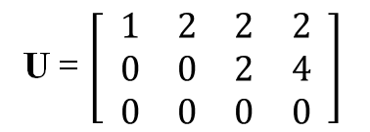
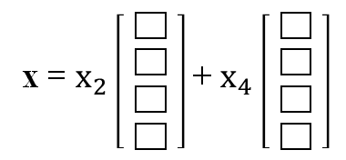
2.2 Solving Ax = 0 and Ax = b
Rank of A = # of pivots
Ax = $\left[ \begin{matrix}\begin{matrix}1 & 2 \\ 2 & 4 \\ 3 & 6\end{matrix} & \begin{matrix}2 & 2 \\ 6 & 8 \\ 8 & 10\end{matrix}\end{matrix} \right]$ $\left[ \begin{matrix}\begin{matrix}x_{1} \\ x_{2}\end{matrix} \\ \begin{matrix}x_{3} \\ x_{4}\end{matrix}\end{matrix} \right]$ = $\left[ \begin{matrix}\begin{matrix}0 \\ 0\end{matrix} \\ \begin{matrix}0 \\ 0\end{matrix}\end{matrix} \right]$
Computing The Nullspace (Ax = 0)
Dependent
A = $\left[ \begin{matrix}\begin{matrix}1 & 2 \\ 2 & 4 \\ 3 & 6\end{matrix} & \begin{matrix}2 & 2 \\ 6 & 8 \\ 8 & 10\end{matrix}\end{matrix} \right]$
$${col}_{2}=2 {col}_{1}$$
$${row}_{3}={row}_{1}+{row}_{2}$$
$${row}_{2}={row}_{2}−2{ row}_{1}$$
free columns
$↓$ $↓$
pivot variables: $x_{1}$, $x_{3}$
free variables: $x_{2}$, $x_{4}$
A = $\left[ \begin{matrix}\begin{matrix}1 & 2 \\ 0 & 0 \\ 3 & 6\end{matrix} & \begin{matrix}2 & 2 \\ 2 & 4 \\ 8 & 10\end{matrix}\end{matrix} \right]$
A = $\left[ \begin{matrix}\begin{matrix}1 & 2 \\ 0 & 0 \\ 0 & 0\end{matrix} & \begin{matrix}2 & 2 \\ 2 & 4 \\ 2 & 4\end{matrix}\end{matrix} \right]$
A = $\left[ \begin{matrix}\begin{matrix}1 & 2 \\ 0 & 0 \\ 0 & 0\end{matrix} & \begin{matrix}2 & 2 \\ 2 & 4 \\ 0 & 0\end{matrix}\end{matrix} \right]$ = U (echelon form)
U = $\left[ \begin{matrix}\begin{matrix}1 & 2 \\ 0 & 0 \\ 0 & 0\end{matrix} & \begin{matrix}2 & 2 \\ 2 & 4 \\ 0 & 0\end{matrix}\end{matrix} \right]$
$${row}_{3}={row}_{3}−3 {row}_{1}$$
x = $x_{2}$ + $x_{4}$
$↑$ $↑$
pivot columns
$${row}_{3}={row}_{3}−{row}_{2}$$

Slide 22
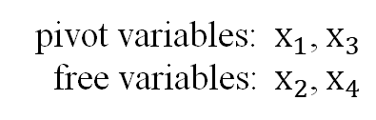

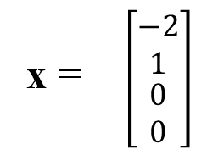
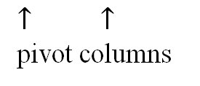

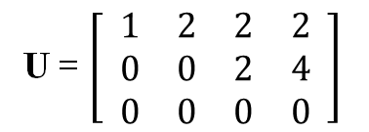
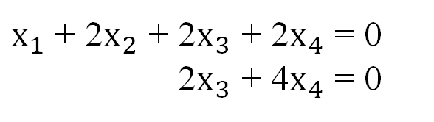
2.2 Solving Ax = 0 and Ax = b
Rank of A = # of pivots
Ax = $\left[ \begin{matrix}\begin{matrix}1 & 2 \\ 2 & 4 \\ 3 & 6\end{matrix} & \begin{matrix}2 & 2 \\ 6 & 8 \\ 8 & 10\end{matrix}\end{matrix} \right]$ $\left[ \begin{matrix}\begin{matrix}x_{1} \\ x_{2}\end{matrix} \\ \begin{matrix}x_{3} \\ x_{4}\end{matrix}\end{matrix} \right]$ = $\left[ \begin{matrix}\begin{matrix}0 \\ 0\end{matrix} \\ \begin{matrix}0 \\ 0\end{matrix}\end{matrix} \right]$
Computing The Nullspace (Ax = 0)
A = $\left[ \begin{matrix}\begin{matrix}1 & 2 \\ 2 & 4 \\ 3 & 6\end{matrix} & \begin{matrix}2 & 2 \\ 6 & 8 \\ 8 & 10\end{matrix}\end{matrix} \right]$
$x_{1}$ + 2$x_{2}$ + 2$x_{3}$ + 2$x_{4}$ = 0
$x_{1}$ + 2$x_{2}$ + 2$x_{3}$ + 4$x_{4}$ = 0
free columns
$↓$ $↓$
$↑$ $↑$
$1$ $0$
U = $\left[ \begin{matrix}\begin{matrix}1 & 2 \\ 0 & 0 \\ 0 & 0\end{matrix} & \begin{matrix}2 & 2 \\ 2 & 4 \\ 0 & 0\end{matrix}\end{matrix} \right]$
pivot variables: $x_{1}$, $x_{3}$
free variables: $x_{2}$, $x_{4}$
x = $\left[\begin{matrix}\begin{matrix}−2 \\ 1\end{matrix} \\ \begin{matrix}0 \\ 0\end{matrix}\end{matrix}\right]$
Ax = Ux
c
$↑$ $↑$
pivot columns

Slide 23


2.2 Solving Ax = 0 and Ax = b
Rank of A = # of pivots
Ax = $\left[ \begin{matrix}\begin{matrix}1 & 2 \\ 2 & 4 \\ 3 & 6\end{matrix} & \begin{matrix}2 & 2 \\ 6 & 8 \\ 8 & 10\end{matrix}\end{matrix} \right]$ $\left[ \begin{matrix}\begin{matrix}x_{1} \\ x_{2}\end{matrix} \\ \begin{matrix}x_{3} \\ x_{4}\end{matrix}\end{matrix} \right]$ = $\left[ \begin{matrix}\begin{matrix}0 \\ 0\end{matrix} \\ \begin{matrix}0 \\ 0\end{matrix}\end{matrix} \right]$
Computing The Nullspace (Ax = 0)
A = $\left[ \begin{matrix}\begin{matrix}1 & 2 \\ 2 & 4 \\ 3 & 6\end{matrix} & \begin{matrix}2 & 2 \\ 6 & 8 \\ 8 & 10\end{matrix}\end{matrix} \right]$
$x_{1}$ + 2$x_{2}$ + 2$x_{3}$ + 2$x_{4}$ = 0
$x_{1}$ + 2$x_{2}$ + 2$x_{3}$ + 4$x_{4}$ = 0
free columns
$↓$ $↓$
$↑$ $↑$
$0$ $1$
U = $\left[ \begin{matrix}\begin{matrix}1 & 2 \\ 0 & 0 \\ 0 & 0\end{matrix} & \begin{matrix}2 & 2 \\ 2 & 4 \\ 0 & 0\end{matrix}\end{matrix} \right]$
pivot variables: $x_{1}$, $x_{3}$
free variables: $x_{2}$, $x_{4}$
x = $\left[\begin{matrix}\begin{matrix}2 \\ 0\end{matrix} \\ \begin{matrix}−2 \\ 1\end{matrix}\end{matrix}\right]$
Ax = Ux
d
$↑$ $↑$
pivot columns

Slide 24


2.2 Solving Ax = 0 and Ax = b
Rank of A = # of pivots
Ax = $\left[ \begin{matrix}\begin{matrix}1 & 2 \\ 2 & 4 \\ 3 & 6\end{matrix} & \begin{matrix}2 & 2 \\ 6 & 8 \\ 8 & 10\end{matrix}\end{matrix} \right]$ $\left[ \begin{matrix}\begin{matrix}x_{1} \\ x_{2}\end{matrix} \\ \begin{matrix}x_{3} \\ x_{4}\end{matrix}\end{matrix} \right]$ = $\left[ \begin{matrix}\begin{matrix}0 \\ 0\end{matrix} \\ \begin{matrix}0 \\ 0\end{matrix}\end{matrix} \right]$
Computing The Nullspace (Ax = 0)
A = $\left[ \begin{matrix}\begin{matrix}1 & 2 \\ 2 & 4 \\ 3 & 6\end{matrix} & \begin{matrix}2 & 2 \\ 6 & 8 \\ 8 & 10\end{matrix}\end{matrix} \right]$
Nullspace of A & U
: All linear combination of special solution vectors
x = c $\left[\begin{matrix}\begin{matrix}−2 \\ 1\end{matrix} \\ \begin{matrix}0 \\ 0\end{matrix}\end{matrix}\right]$ + d $\left[\begin{matrix}\begin{matrix}2 \\ 0\end{matrix} \\ \begin{matrix}−2 \\ 1\end{matrix}\end{matrix}\right]$
free columns
$↓$ $↓$
U = $\left[ \begin{matrix}\begin{matrix}1 & 2 \\ 0 & 0 \\ 0 & 0\end{matrix} & \begin{matrix}2 & 2 \\ 2 & 4 \\ 0 & 0\end{matrix}\end{matrix} \right]$
A: m $×$ n
$r$ = rank of A = # of pivot variables
$n−r$ = # of free variables = # of special solutions
$↑$ $↑$
pivot columns

Slide 25






2.2 Solving Ax = 0 and Ax = b
Ax = $\left[ \begin{matrix}\begin{matrix}1 & 2 \\ 2 & 4 \\ 3 & 6\end{matrix} & \begin{matrix}2 & 2 \\ 6 & 8 \\ 8 & 10\end{matrix}\end{matrix} \right]$ $\left[ \begin{matrix}\begin{matrix}x_{1} \\ x_{2}\end{matrix} \\ \begin{matrix}x_{3} \\ x_{4}\end{matrix}\end{matrix} \right]$ = $\left[ \begin{matrix}\begin{matrix}0 \\ 0\end{matrix} \\ \begin{matrix}0 \\ 0\end{matrix}\end{matrix} \right]$
R = Reduced Row Echelon Form
pivots = 1 and zeros above and below pivots
A = $\left[ \begin{matrix}\begin{matrix}1 & 2 \\ 2 & 4 \\ 3 & 6\end{matrix} & \begin{matrix}2 & 2 \\ 6 & 8 \\ 8 & 10\end{matrix}\end{matrix} \right]$
free columns
$↓$ $↓$
R
U = $\left[ \begin{matrix}\begin{matrix}1 & 2 \\ 0 & 0 \\ 0 & 0\end{matrix} & \begin{matrix}2 & 2 \\ 2 & 4 \\ 0 & 0\end{matrix}\end{matrix} \right]$ → $\left[ \begin{matrix}\begin{matrix}1 & 2 \\ 0 & 0 \\ 0 & 0\end{matrix} & \begin{matrix}0 & −2 \\ 2 & 4 \\ 0 & 0\end{matrix}\end{matrix} \right]$ → $\left[ \begin{matrix}\begin{matrix}1 & 2 \\ 0 & 0 \\ 0 & 0\end{matrix} & \begin{matrix}0 & −2 \\ 1 & 2 \\ 0 & 0\end{matrix}\end{matrix} \right]$
R = $\left[ \begin{matrix}\begin{matrix}1 & 2 \\ 0 & 0 \\ 0 & 0\end{matrix} & \begin{matrix}0 & −2 \\ 1 & 2 \\ 0 & 0\end{matrix}\end{matrix} \right]$
$${row}_{1}={row}_{1}−{ row}_{2}$$
${row}_{2}={ row}_{2}$ / pivot 2
$↑$ $↑$
pivot columns

Slide 26










2.2 Solving Ax = 0 and Ax = b
Ax = $\left[ \begin{matrix}\begin{matrix}1 & 2 \\ 2 & 4 \\ 3 & 6\end{matrix} & \begin{matrix}2 & 2 \\ 6 & 8 \\ 8 & 10\end{matrix}\end{matrix} \right]$ $\left[ \begin{matrix}\begin{matrix}x_{1} \\ x_{2}\end{matrix} \\ \begin{matrix}x_{3} \\ x_{4}\end{matrix}\end{matrix} \right]$ = $\left[ \begin{matrix}\begin{matrix}0 \\ 0\end{matrix} \\ \begin{matrix}0 \\ 0\end{matrix}\end{matrix} \right]$
R = Reduced Row Echelon Form
pivots = 1 and zeros above and below pivots
free columns
$↓$ $↓$
F = $\left[ \begin{matrix}2 & −2 \\ 0 & 2\end{matrix} \right]$
$x_{1}$ + 2$x_{2}$ $x_{3}−$ 2$x_{4}$ = 0
$x_{1}$ + 2$x_{2}$ + $x_{3}$ + 2$x_{4}$ = 0
$x_{1}$ = $−$ 2$x_{2}$ +22$x_{4}$
$x_{3}$ =$−$ 2$x_{2}$ $−$ 2$x_{4}$
R = $\left[ \begin{matrix}\begin{matrix}1 & 2 \\ 0 & 0 \\ 0 & 0\end{matrix} & \begin{matrix}0 & −2 \\ 1 & 2 \\ 0 & 0\end{matrix}\end{matrix} \right]$ = $\left[ \begin{matrix}\text{I} & \text{F} \\ 0 & 0\end{matrix} \right]$
x = $x_{2}$ + $x_{4}$
-2
2
= $−$F
$↑$ $↑$
pivot columns
If some rows of A are linearly dependent,
the lower rows of R will be filled with zeros.
1
0
0
-2
$↑$ $↑$
coefficient
= I
I = $\left[ \begin{matrix}1 & 0 \\ 0 & 1\end{matrix} \right]$
pivot variables: $x_{1}$, $x_{3}$
free variables: $x_{2}$, $x_{4}$
0
1

Slide 27




2.2 Solving Ax = 0 and Ax = b
Ax = $\left[ \begin{matrix}\begin{matrix}1 & 2 \\ 2 & 4 \\ 3 & 6\end{matrix} & \begin{matrix}2 & 2 \\ 6 & 8 \\ 8 & 10\end{matrix}\end{matrix} \right]$ $\left[ \begin{matrix}\begin{matrix}x_{1} \\ x_{2}\end{matrix} \\ \begin{matrix}x_{3} \\ x_{4}\end{matrix}\end{matrix} \right]$ = $\left[ \begin{matrix}\begin{matrix}0 \\ 0\end{matrix} \\ \begin{matrix}0 \\ 0\end{matrix}\end{matrix} \right]$
x = c $\left[\begin{aligned}−2 \\ 1 \\ 0 \\ 0\end{aligned}\right]$ + d $\left[\begin{aligned}2 \\ 0 \\ −2 \\ 1\end{aligned}\right]$
Ax = Ux = Rx = 0
A = $\left[ \begin{matrix}\begin{matrix}1 & 2 \\ 2 & 4 \\ 3 & 6\end{matrix} & \begin{matrix}2 & 2 \\ 6 & 8 \\ 8 & 10\end{matrix}\end{matrix} \right]$
U = $\left[ \begin{matrix}\begin{matrix}1 & 2 \\ 0 & 0 \\ 0 & 0\end{matrix} & \begin{matrix}2 & 2 \\ 2 & 4 \\ 0 & 0\end{matrix}\end{matrix} \right]$
R = $\left[ \begin{matrix}\begin{matrix}1 & 2 \\ 0 & 0 \\ 0 & 0\end{matrix} & \begin{matrix}0 & −2 \\ 1 & 2 \\ 0 & 0\end{matrix}\end{matrix} \right]$

Slide 28

2.2 Solving Ax = 0 and Ax = b
Echelon Form U and Row Reduced Form R

Slide 29












2.2 Solving Ax = 0 and Ax = b
Ax = $\left[ \begin{matrix}\begin{matrix}1 & 2 \\ 2 & 4 \\ 3 & 6\end{matrix} & \begin{matrix}2 & 2 \\ 6 & 8 \\ 8 & 10\end{matrix}\end{matrix} \right]$ $\left[ \begin{matrix}\begin{matrix}x_{1} \\ x_{2}\end{matrix} \\ \begin{matrix}x_{3} \\ x_{4}\end{matrix}\end{matrix} \right]$ = $\left[ \begin{matrix}b_{1} \\ \begin{matrix}b_{2} \\ b_{3}\end{matrix}\end{matrix} \right]$
Solving Ax = b, Ux = c, Rx = d
Augmented Matrix
A$x_{p}=$ b and A$x_{n}=$ 0 $→$ A ($x_{p}+x_{n}$) $=$ b
$\left( A | b \right)$ → $\left( U | c \right)$ → $\left( R | d \right)$
$$\left( U | c \right)$$
$\left( \begin{matrix}\begin{matrix}1 & 2 \\ 2 & 4 \\ 3 & 6\end{matrix} & \begin{matrix}2 & 2 \\ 6 & 8 \\ 8 & 10\end{matrix}\end{matrix} | \begin{matrix}b_{1} \\ \begin{matrix}b_{2} \\ b_{3}\end{matrix}\end{matrix} \right)$ → $\left( \begin{matrix}\begin{matrix}1 & 2 \\ 0 & 0 \\ 0 & 0\end{matrix} & \begin{matrix}2 & 2 \\ 2 & 4 \\ 2 & 4\end{matrix}\end{matrix} | \begin{matrix}b_{1} \\ \begin{matrix}b_{2}−2b_{1} \\ b_{3}−3b_{1}\end{matrix}\end{matrix} \right)$ → $\left( \begin{matrix}\begin{matrix}1 & 2 \\ 0 & 0 \\ 0 & 0\end{matrix} & \begin{matrix}2 & 2 \\ 2 & 4 \\ 0 & 0\end{matrix}\end{matrix} | \begin{matrix}b_{1} \\ \begin{matrix}b_{2}−2b_{1} \\ b_{3}−b_{2}−b_{1}\end{matrix}\end{matrix} \right)$
→ $\left( \begin{matrix}\begin{matrix}1 & 2 \\ 0 & 0 \\ 0 & 0\end{matrix} & \begin{matrix}0 & −2 \\ 2 & 4 \\ 0 & 0\end{matrix}\end{matrix} | \begin{matrix}3b_{1}−b_{2} \\ \begin{matrix}b_{2}−2b_{1} \\ b_{3}−b_{2}−b_{1}\end{matrix}\end{matrix} \right)$ → $\left( \begin{matrix}\begin{matrix}1 & 2 \\ 0 & 0 \\ 0 & 0\end{matrix} & \begin{matrix}0 & −2 \\ 1 & 2 \\ 0 & 0\end{matrix}\end{matrix} | \begin{matrix}3b_{1}−b_{2} \\ \begin{matrix}\frac{1}{2}b_{2}−b_{1} \\ b_{3}−b_{2}−b_{1}\end{matrix}\end{matrix} \right)$
$${row}_{2}={row}_{2}−2 {row}_{1}$$
$${row}_{3}={row}_{3}−3 {row}_{1}$$
$${row}_{3}={row}_{2}−{row}_{2}$$
For solution to exist,
$b_{3}−b_{2}−b_{1}$= 0 and b $∈$ C(A)
$${row}_{1}={row}_{1} −{row}_{2}$$
$${row}_{2}=\frac{1}{2} {row}_{2}$$
$\left( R | d \right)$

Slide 30










2.2 Solving Ax = 0 and Ax = b
Ax = $\left[ \begin{matrix}\begin{matrix}1 & 2 \\ 2 & 4 \\ 3 & 6\end{matrix} & \begin{matrix}2 & 2 \\ 6 & 8 \\ 8 & 10\end{matrix}\end{matrix} \right]$ $\left[ \begin{matrix}\begin{matrix}x_{1} \\ x_{2}\end{matrix} \\ \begin{matrix}x_{3} \\ x_{4}\end{matrix}\end{matrix} \right]$ = $\left[ \begin{matrix}b_{1} \\ \begin{matrix}b_{2} \\ b_{3}\end{matrix}\end{matrix} \right]$
Solving Ax = b, Ux = c, Rx = d
A$x_{p}=$ b and A$x_{n}=$ 0 $→$ A ($x_{p}+x_{n}$) $=$ b
$\left( R | d \right)$
b = $\left[ \begin{matrix}1 \\ \begin{matrix}5 \\ 6\end{matrix}\end{matrix} \right]$
$\left( \begin{matrix}\begin{matrix}1 & 2 \\ 0 & 0 \\ 0 & 0\end{matrix} & \begin{matrix}0 & −2 \\ 1 & 2 \\ 0 & 0\end{matrix}\end{matrix} | \begin{matrix}3b_{1}−b_{2} \\ \begin{matrix}\frac{1}{2}b_{2}−b_{1} \\ b_{3}−b_{2}−b_{1}\end{matrix}\end{matrix} \right)$ = $\left( \begin{matrix}\begin{matrix}1 & 2 \\ 0 & 0 \\ 0 & 0\end{matrix} & \begin{matrix}2 & 2 \\ 1 & 2 \\ 0 & 0\end{matrix}\end{matrix} | \begin{matrix}−2 \\ \begin{matrix}3/2 \\ 0\end{matrix}\end{matrix} \right)$
$x_{1}$ + 2$x_{2}$2$x_{3}$ $−$ 2$x_{4}$ = $−$2
$x_{1}$ + 2$x_{2}$ 2$x_{3}$ + 2$x_{4}$ = 3 / 2
$x_{1}$ = $−$2$x_{2}$ + 2$x_{4}−$2
$x_{3}$ = $−$2$x_{4}$ + 3 / 2
x $=$ $x_{2}$ + $x_{4}$ +
-2
2
-2
= $−$F | d
1
0
0
0
-2
3/2
0
1
0
= I | 0
$$=$$
$$x_{n}$$
$$+$$
$$x_{p}$$

Slide 31




2.2 Solving Ax = 0 and Ax = b
Complete solution ${x= x}_{p}$ + $x_{n}$
A $x_{p}=$ b and A $x_{n}=$ 0 A ($x_{p}+x_{n}$) $=$ b
$x_{p}$: particular solution
$x_{n}$: special solution
${x= x}_{p}$ + $x_{n}$
$$x_{n}$$

Slide 32




2.3 Linear Independence, Basis, and Dimension
Linear Independence
$c_{1}v_{1}$+ $c_{2}v_{2}$ + $⋯$ + $c_{n}v_{n}=$ 0 → Only $c_{1}=c_{2}=⋯=c_{n}=0$
If any other combination of the vectors gives zero, they are dependent.
The columns of A are independent exactly when N(A) = {zero vector} (except all $c_{i}=0$)
dependent
independent
Notes:
If Gaussian elimination of A generates m non-zero rows, it means m independent column vectors in A

Slide 33



2.3 Linear Independence, Basis, and Dimension
Spanning
Set of vectors constructs a vector space by linear combinations
The set of vectors span the vector space
If given linearly independent vectors, ⇒ Linear comb. is unique
(1) $\left[ \begin{matrix}1 \\ \begin{matrix}0 \\ 0\end{matrix}\end{matrix} \right]$, $\left[ \begin{matrix}0 \\ \begin{matrix}1 \\ 0\end{matrix}\end{matrix} \right]$
(2) $\left[ \begin{matrix}1 \\ \begin{matrix}0 \\ 0\end{matrix}\end{matrix} \right]$, $\left[ \begin{matrix}1 \\ \begin{matrix}1 \\ 0\end{matrix}\end{matrix} \right]$
(3) $\left[ \begin{matrix}1 \\ \begin{matrix}0 \\ 0\end{matrix}\end{matrix} \right]$, $\left[ \begin{matrix}0 \\ \begin{matrix}1 \\ 0\end{matrix}\end{matrix} \right]$, $\left[ \begin{matrix}1 \\ \begin{matrix}1 \\ 0\end{matrix}\end{matrix} \right]$
y
linearly independent
linearly dependent
$$\begin{matrix} \\ (i) \\ (ii)\end{matrix}\begin{matrix}c_{1} & c_{2} & c_{3} \\ 2 & 2 & 0 \\ 0 & 0 & 2\end{matrix}$$
$$\left[ \begin{matrix}2 \\ \begin{matrix}2 \\ 0\end{matrix}\end{matrix} \right]$$
x
z

Slide 34



2.3 Linear Independence, Basis, and Dimension
Basis
minimum # of vectors to span a vector space
maximum # of linearly independent vectors
A basis for a vector space is a sequence of vectors $v_{1}$, $v_{2}$, …, $v_{α}$ with 2 properties:
The vectors are linearly independent
They span the space
Basis vector is not unique for a vector space

Slide 35
2.3 Linear Independence, Basis, and Dimension
Dimension of vector space
= # of linearly independent vectors
Rank of A (r)
= # of independent column vectors
= # of independent row vectors
= # of pivots in Gaussian Elimination

Slide 36








2.4 The Four Fundamental Subspaces
Column Space C(A): linear comb. of column vectors ${⊂R}^{m}$
Null Space N(A): {x | Ax = 0} $⊂R^{n}$
Row Space C($A^{T}$): linear comb. of row vectors ${⊂R}^{n}$
Left Null Space N($A^{T}$): {y | $A^{T}$y = 0} $⊂R^{m}$
$y^{T}A$ = $0^{T}$
$$n$$
x
A
$$n$$
$$m$$
$$m$$
$$A^{T}$$
y
$$n$$
$$m$$
N(A) & C($A^{T})$ is subspace of $R^{n}$ C(A) & N($A^{T}$) is subspace of $R^{m}$
→ N(A) $⊥$ C($A^{T})$ → C(A) $⊥$ N($A^{T}$)

Slide 37




2.4 The Four Fundamental Subspaces
z
N(A)
y
C($A^{T})$
N(A) & C($A^{T})$ is subspace of $R^{n}$
→ N(A) $⊥$ C($A^{T})$
C(A) & N($A^{T}$) is subspace of $R^{m}$
→ C(A) $⊥$ N($A^{T}$)
x
y
N($A^{T}$)
r
m - r
x
r
n - r
C(A)

Slide 38











2.4 The Four Fundamental Subspaces
Existence of Inverses
An inverse exists only when the rank is as large as possible.
Two-sides inverse : $A^{−1}A=A{ A}^{−1}=I$ r = m = n (Square case)
Left inverse : $A^{−1}A=I$ r = n (m $≥$ n)
Right inverse : $A{ A}^{−1}=I$ r = m (m $≤$ n)
n$×$n
m$×$m
$${ A}^{−1}$$
$$A$$
$$A$$
$${ A}^{−1}$$
$${ A}^{−1}$$
$$A$$
$$A$$
$${ A}^{−1}$$
Two-sides inverse
(unique solution)
Left inverse
(unique solution)
Right inverse
(infinitely many solution)

Slide 39

2.4 The Four Fundamental Subspaces
Existence of Inverses
An inverse exists only when the rank is as large as possible.
Ax = b
Left inverse : $A^{−1}Ax=A^{−1}$b x = $A^{−1}$b unique (# of eqns > # of unknowns)
Right inverse : $A{ A}^{−1}x=A^{−1}\text{b}$ x = infinitely many solution
$${ A}^{−1}$$
$$A$$
$$A$$
$${ A}^{−1}$$
$${ A}^{−1}$$
$$A$$
$$A$$
$${ A}^{−1}$$
Two-sides inverse
(unique solution)
Left inverse
(unique solution)
Right inverse
(infinitely many solution)

Slide 40


Homework
Summary
A Geometric View of Gauss – Jordan Elimination
Ax = Ux = Rx = b
4 Fundamental Subspace 변환식 관계 설명
Column Space
Null Space
Row Space
Left Null Space
C(A)${⊂R}^{m}$
N(A) $⊂R^{n}$
C($A^{T}$) ${⊂R}^{n}$
N($A^{T}$) $⊂R^{m}$

Slide 41

Relation between Linearly Independent & Linear Algebra
Notes:
선형독립과 선형대수의 관계
선형독립 혹은 1차 독립 (linearly independent) 개념은 나중에 이어서 소개할 기저(base)와 차원(dimension), 행렬의 계수(rank)와 선형연립방정식의 존재성(existence), 유일성(uniqueness), 가우스 소거법(Gauss Jordan Elimination)과의 관계 등에 줄줄이 연관이 되어있으므로 정확히 이해하는 것이 필요합니다. 선형독립에 대한 이해가 집의 주춧돌인 셈입니다. 집을 지을 때 주춧돌이 부실하면 나중에 집이 무너지는 수가 있습니다. 차원을 정의하고 선형연립방정식 푸는데 가장 밑에 받쳐주는 개념이 선형독립(linearly independent) 개념이므로 배워야 합니다.
출처: https://rfriend.tistory.com/163 [R, Python 분석과 프로그래밍의 친구 (by R Friend)]

Slide 42




2.1 Vector Spaces and Subspaces
Subspaces
A plane P through ${\left[0 0 0\right]}^{T}$is a subspace of $R^{3}$
A line L through ${\left[0 0 0\right]}^{T}$ is a subspace of $R^{3}$
In this case, only intersection vector is zero vector
The intersection S$∩$ T of two subspace S and T is a subspace.
P
L
P$∪$ L = all vectors in P or L or both
This (is / is not) a subspace.
P$∩$ L = all vectors in both P and L
This (is / is not) a subspace.
Notes:
Union
Intersection

Slide 43
2.1 Vector Spaces and Subspaces
The Nullspace of A
Requirement:
(i) If Av = 0 and Aw = 0 then A(v + w) =Av + Aw = 0
(ii) If Ax = 0 then A(cx) = cA(x) = 0
Notes:
Ax=0의 해들이 이루는 공간

Slide 44






2.2 Solving Ax = 0 and Ax = b
Rank of A = # of pivots
Ax = $\left[ \begin{matrix}\begin{matrix}1 & 2 \\ 2 & 4 \\ 3 & 6\end{matrix} & \begin{matrix}2 & 2 \\ 6 & 8 \\ 8 & 10\end{matrix}\end{matrix} \right]$ $\left[ \begin{matrix}\begin{matrix}x_{1} \\ x_{2}\end{matrix} \\ \begin{matrix}x_{3} \\ x_{4}\end{matrix}\end{matrix} \right]$ = $\left[ \begin{matrix}\begin{matrix}0 \\ 0\end{matrix} \\ \begin{matrix}0 \\ 0\end{matrix}\end{matrix} \right]$
Computing The Nullspace (Ax = 0)
Dependent
A = $\left[ \begin{matrix}\begin{matrix}1 & 2 \\ 2 & 4 \\ 3 & 6\end{matrix} & \begin{matrix}2 & 2 \\ 6 & 8 \\ 8 & 10\end{matrix}\end{matrix} \right]$
$${col}_{2}=2 {col}_{1}$$
$${row}_{3}={row}_{1}+{row}_{2}$$
free columns
$↓$ $↓$
pivot variables: $x_{1}$, $x_{3}$
free variables: $x_{2}$, $x_{4}$
$${row}_{2}={row}_{2}−2{ row}_{1}$$
A = $\left[ \begin{matrix}\begin{matrix}1 & 2 \\ 0 & 0 \\ 3 & 6\end{matrix} & \begin{matrix}2 & 2 \\ 2 & 4 \\ 8 & 10\end{matrix}\end{matrix} \right]$
A = $\left[ \begin{matrix}\begin{matrix}1 & 2 \\ 0 & 0 \\ 0 & 0\end{matrix} & \begin{matrix}2 & 2 \\ 2 & 4 \\ 2 & 4\end{matrix}\end{matrix} \right]$
A = $\left[ \begin{matrix}\begin{matrix}1 & 2 \\ 0 & 0 \\ 0 & 0\end{matrix} & \begin{matrix}2 & 2 \\ 2 & 4 \\ 0 & 0\end{matrix}\end{matrix} \right]$ = U (echelon form)
U = $\left[ \begin{matrix}\begin{matrix}1 & 2 \\ 0 & 0 \\ 0 & 0\end{matrix} & \begin{matrix}2 & 2 \\ 2 & 4 \\ 0 & 0\end{matrix}\end{matrix} \right]$
x = $x_{2}$ + $x_{4}$
$${row}_{3}={row}_{3}−3 {row}_{1}$$
$↑$ $↑$
pivot columns
x = $\left[\begin{matrix}\begin{matrix}−2 \\ 1\end{matrix} \\ \begin{matrix}0 \\ 0\end{matrix}\end{matrix}\right]$
$x_{1}$ + 2$x_{2}$ + 2$x_{3}$ + 2$x_{4}$ = 0
$x_{1}$ + 2$x_{2}$ + 2$x_{3}$ + 4$x_{4}$ = 0
$${row}_{3}={row}_{3}−{row}_{2}$$
Ax = Ux
c

Slide 45




2.2 Solving Ax = 0 and Ax = b
R = Reduced Row Echelon Form
m = 3, n = 4, r = 2
m = # of rows
n = # of cols
r = rank of A = # of pivot vars, r $≤$ m, r $≤$ n
free columns
$↓$ $↓$
F = $\left[ \begin{matrix}2 & −2 \\ 0 & 2\end{matrix} \right]$
R = $\left[ \begin{matrix}\begin{matrix}1 & 2 \\ 0 & 0 \\ 0 & 0\end{matrix} & \begin{matrix}0 & −2 \\ 1 & 2 \\ 0 & 0\end{matrix}\end{matrix} \right]$ = $\left[ \begin{matrix}\text{I} & \text{F} \\ 0 & 0\end{matrix} \right]$
r = n: Full column rank
r = m: Full row rank
r = m = n: Full row and column rank
$↑$ $↑$
pivot columns
I = $\left[ \begin{matrix}1 & 0 \\ 0 & 1\end{matrix} \right]$

Slide 46



2.4 The Four Fundamental Subspaces

Slide 47








Homework
Column Space
Null Space
Row Space
Left Null Space
C(A)${⊂R}^{m}$
N(A) $⊂R^{n}$
C($A^{T}$) ${⊂R}^{n}$
N($A^{T}$) $⊂R^{m}$
C($A^{T}$)
dim = r
C(A)
dim = r
$$R^{n}$$
$$R^{m}$$
$$∟$$
$$∟$$
N(A)
dim = n-r
N($A^{T}$)
dim = m-r

Slide 48


Homework
Column Space
Null Space
Row Space
Left Null Space
C(A)${⊂R}^{m}$
N(A) $⊂R^{n}$
C($A^{T}$) ${⊂R}^{n}$
N($A^{T}$) $⊂R^{m}$

Slide 49


2.5 Graphs and Networks
Graph
A graph is mathematical structures used to model pairwise relations between objects.
A graph consists of a set of vertices or nodes, and a set of edges that connect them.
Notes:
그래프 합성곱 신경망 (Graph Convolutional Network, GCN) https://untitledtblog.tistory.com/152

Slide 50




2.5 Graphs and Networks
Incidence Matrix
Graph = {nodes, edges}
n = 4
m = 4
start node end node
node 1
edge 4
node 4
$−$1 1
node 1 | node 2 | node 3 | node 4
 |  |  |  | edge 1
 |  |  |  | edge 2
 |  |  |  | edge 3
 |  |  |  | edge 4
 |  |  |  | edge 5
dependent
 |  | 0 | 0
0 |  |  | 0
 | 0 |  | 0
 | 0 | 0
0 | 0
edge 1
loop 2
$−$1 | 1
 | $−$1 | 1
$−$1 |  | 1
$−$1 |  |  | 1
 |  | $−$1 | 1
edge 3
loop 1
loop 1
edge 5
loop 2
node 2
edge 2
node 3

Slide 51




2.5 Graphs and Networks
column vectors
→ independent
N(A) = { zero vector }
→ dependent
N(A) = { x | Ax = 0 } : set of solutions
Null Space of A
⇒ column vectors: Independent / Dependent
potentials at nodes
↓
$−$1 | 1 | 0 | 0
0 | $−$1 | 1 | 0
$−$1 | 0 | 1 | 0
$−$1 | 0 | 0 | 1
0 | 0 | $−$1 | 1
$$x_{2}−x_{1}$$
$$x_{3}−x_{2}$$
$$x_{3}−x_{1}$$
$$x_{4}−x_{1}$$
$$x_{4}−x_{3}$$
0
0
0
0
0
$$x_{1}$$
$$x_{2}$$
$$x_{3}$$
$$x_{4}$$
$$1$$
$$1$$
$$1$$
$$1$$
Ax = = =
x = c
↑
potentials differences between nodes
dim(N(A)) = n – rank(A) = 1
rank(A) = 3

Slide 52


2.5 Graphs and Networks
Null Space of A
Ax $=$ $x_{1}$ $\left[\begin{aligned}−1 \\ 0 \\ −1 \\ −1 \\ 0\end{aligned}\right]$ + $x_{2}\left[\begin{aligned} 1 \\ −1 \\ 0 \\ 0 \\ 0\end{aligned}\right]$ + $x_{3}$ $\left[\begin{aligned} 0 \\ 1 \\ 1 \\ 0 \\ −1\end{aligned}\right]$ +$x_{4}\left[\begin{aligned} 0 \\ 0 \\ 0 \\ 1 \\ 1\end{aligned}\right]$
$x_{4}=0$, ground
dim(N(A)) = n – r = 1
r = dim(C(A)) = # of pivot = 3

Slide 53





2.5 Graphs and Networks
Null Space of $A^{T}$
N($A^{T}$): {y | $A^{T}$y = 0} ⇒ Kirchhoff’s current law
$$y_{1}$$
$$y_{2}$$
$$y_{3}$$
$$y_{4}$$
$$y_{5}$$
$−$1 | 0 | $−$1 | $−$1 | 0
1 | $−$1 | 0 | 0 | 0
0 | 1 | 1 | 0 | $−$1
$$0$$ | 0 | 0 | 1 | 1
0
0
0
0
$A^{T}$y = =
↑
current on edges
A =
dim(C(A)) = r = 3
dim(N(A)) = n – r = 1
dim(C($A^{T}$)) = r = 3
dim(N($A^{T}$)) = m – r = 2
= # pivot columns
= # free columns
5 $×$ 4

Slide 54









2.5 Graphs and Networks
$$y_{1}$$
$$y_{2}$$
$$y_{3}$$
$$y_{4}$$
$$y_{5}$$
$−$1 | 0 | $−$1 | $−$1 | 0
1 | $−$1 | 0 | 0 | 0
0 | 1 | 1 | 0 | $−$1
$$0$$ | 0 | 0 | 1 | 1
0
0
0
0
Null Space of $A^{T}$
$A^{T}$y = =
node 1
edge 4
node 4
$$y_{4}$$
edge 1
loop 2
node 1
node 2
node 3
node 4
$$−y_{1}−y_{3}−y_{4}$$
$$y_{1}−y_{2}$$
$y_{2}\text{ +} y_{3}−$ $y_{5}$
$y_{4}$ + $y_{5}$
0
0
0
0
$$y_{1}$$
edge 3
$$y_{3}$$
$$y_{5}$$
=
=
loop 1
edge 5
$$y_{2}$$
node 2
edge 2
Kirchhoff’s Current Law
All the currents at a node sum to zero
node 3

Slide 55






2.5 Graphs and Networks
Null Space of $A^{T}$
How about big loop? $y_{1}$ → $y_{2}$ → $y_{5}$ → $y_{4}$
$\left[\begin{aligned} 0 \\ 0 \\ 1 \\ −1 \\ 1\end{aligned}\right]$ = $\left[\begin{aligned} 1 \\ 1 \\ −1 \\ 0 \\ 0\end{aligned}\right]$ + $\left[\begin{aligned} 0 \\ 0 \\ 1 \\ −1 \\ 1\end{aligned}\right]$
Basis for N($A^{T}$) $\left[\begin{aligned} 1 \\ 1 \\ −1 \\ 0 \\ 0\end{aligned}\right]$ , $\left[\begin{aligned} 0 \\ 0 \\ 1 \\ −1 \\ 1\end{aligned}\right]$
loop 1: $y_{1}$,$y_{2}$, $y_{3}$
node 1: $− y_{1}−y_{3}=0$
loop 2: $y_{3}$, $y_{4}$,$y_{5}$
node 1: $− y_{3}−y_{4}=0$
dependent
⇒ not basis
loop 1
loop 2
dim(C(A)) = r = 3
dim(N(A)) = n – r = 1
dim(C($A^{T}$)) = r = 3
dim(N($A^{T}$)) = m – r = 2
= # loop
= # of pivot vars
= # of free vars = # of special solutions

Slide 56








2.5 Graphs and Networks
Column Space of $A^{T}$ = Row Space
Tree = A graph without loops
r = # pivot columns = 3
node 1
edge 4
node 4
$$y_{4}$$
$$y_{1}$$
$$y_{2}$$
$$y_{3}$$
$$y_{4}$$
$$y_{5}$$
$−$1 | 0 | $−$1 | $−$1 | 0
1 | $−$1 | 0 | 0 | 0
0 | 1 | 1 | 0 | $−$1
$$0$$ | 0 | 0 | 1 | 1
edge 1
loop 2
$$y_{1}$$
$A^{T}$y =
edge 3
$$y_{3}$$
$$y_{5}$$
loop 1
edge 5
$$y_{2}$$
↑ ↑ ↑
pivot columns
node 2
edge 2
node 3

Slide 57


2.5 Graphs and Networks
Relationship between graph and the four fundamental subspaces
e = b$−$Ax
y = Ce

Slide 58

2.5 Graphs and Networks
Euler’s Formula
(# of nodes) $−$ (# of edges) + (# of loops) = 1
n m
Null Space:
Column Space:
Row Space:
Left Null Space:
dim = n – r, contains x
dim = r = # of independent columns
dim = r = # of independent rows from any spanning tree
dim = m – r, contains y’s from the loops

Slide 59
2.6 Linear Transformations
Review
Ax = b
Row picture: system equation
x = solution
Column picture: linear combination of column vectors
x = scalar coefficients

Slide 60





2.6 Linear Transformations
Transformation T : $R^{n} → R^{m}$
mapping, function
$(m×n)$ $\left(n×1\right) (m×1)$
A x = b
$$R^{n} R^{m}$$

Slide 61

2.6 Linear Transformations
A transformation (or mapping) T is linear if:
T(u + v) = T(u) + T(v) for all u, v in the domain of T
T(cu) = cT(u) for all scalars c and all u in the domain of T
If T is a linear transformation, then
T(0) = 0
T(cu + dv) = cT (u) + dT (v)
Superposition principle T($c_{1}v_{1}+…+c_{n}v_{n}$) = $c_{1}$T ($v_{1}$) + $c_{n}$T ($v_{n}$)
T(0) = T(0u) = 0 T(u) = 0
Notes:
Transformation $R^{n}→R^{m}$
중첩의 원리

Slide 62


2.6 Linear Transformations
Matrix Transofrmation
T(x) = Ax
A(cu + dv) = cAu + dAv Linear Transformation
contracting

Slide 63




2.6 Linear Transformations
$$R^{n+1} → R^{n}$$
$$R^{n+1} → R^{n+2}$$
$$Ap\left(t\right)=\left(a_{1}x_{1}\left(t\right)+a_{2}x_{2}\left(t\right)\right)p\left(t\right)=a_{1}x_{1}\left(t\right)p\left(t\right)+a_{2}x_{2}\left(t\right)p\left(t\right)$$

Slide 64








2.6 Linear Transformations
$${c_{1}x}_{1}+{c_{2}x}_{2}$$
A
$$y$$
$${c_{1}x}_{1}$$
A
$$y_{1}$$
The Matrix of A Linear Transformation
If given Ax for every basis vetors x,
A$x_{1}=a_{1},$ A$x_{2}=a_{2}$, ..., A$x_{n}=a_{n}$
then, we can find any transform results in the vector space without A.
+
$${c_{2}x}_{2}$$
A
$$y_{2}$$
$${{=c}_{1}a}_{1}+…+{c_{n}a}_{n}$$

Slide 65

2.6 Linear Transformations
The Matrix of A Linear Transformation
Let T: $R^{n} → R^{m}$ be a linear transformation. Then there exists a unique matrix A such that
T(x) = Ax for all x in $R^{n}$
In fact, A is the $m×n$ matrix whose $jth$ column is the vector T($e_{j}$), where $e_{j}$ is the $jth$ column of the identity matrix in $R^{n}$:
A$=\left[\begin{aligned}| \\ {\text{T}\text{(}e}_{1}\text{)} \\ |\end{aligned} \begin{aligned}| \\ {\text{T}\text{(}e}_{2}) \\ |\end{aligned} \begin{aligned}| \\ ⋯ \\ |\end{aligned} \begin{aligned}| \\ {\text{T}\text{(}e}_{n}) \\ |\end{aligned}\right]$
Notes:
basis를 알고 있다면 A 행렬 구할 수 있다.
basis는 column vector를 구성한다.
Transformations represented by matrices
선형 함수는 모두 행렬로 표현할 수 있다.

Slide 66




2.6 Linear Transformations
Standard Matrix of A Linear Transformation
If we know the Ax for the standard basis vectors,
$x=I_{n}x=[e_{1}{ e}_{2} ⋯ e_{n}]$ $x=x_{1}e_{1}+x_{2}e_{2}+⋯+x_{n}e_{n}$
e =
T(x) $=$ T($x_{1}e_{1}+x_{2}e_{2}+⋯+x_{n}e_{n}$)
T(x) $=$ $x_{1}$T($e_{1}\text{)}+x_{2}\text{T}\text{(}e_{2}\text{)}+⋯x_{n}{\text{T}\text{(}e}_{n}$)
T(x) $=\left[\begin{aligned}| \\ {\text{T}\text{(}e}_{1}\text{)} \\ |\end{aligned} \begin{aligned}| \\ {\text{T}\text{(}e}_{2}) \\ |\end{aligned} \begin{aligned}| \\ ⋯ \\ |\end{aligned} \begin{aligned}| \\ {\text{T}\text{(}e}_{n}) \\ |\end{aligned}\right]\left[\begin{aligned}x_{1} \\ x_{2} \\ ⋮ \\ x_{n}\end{aligned}\right]$
T(x) $=$ Ax
A$=\left[\begin{aligned}| \\ {\text{T}\text{(}e}_{1}\text{)} \\ |\end{aligned} \begin{aligned}| \\ {\text{T}\text{(}e}_{2}) \\ |\end{aligned} \begin{aligned}| \\ ⋯ \\ |\end{aligned} \begin{aligned}| \\ {\text{T}\text{(}e}_{n}) \\ |\end{aligned}\right]$ Standard Matrix

Slide 67



2.6 Linear Transformations
The Matrix of A Linear Transformation
Ex) The columns of $I_{2}= \left[ \begin{matrix}1 & 0 \\ 0 & 1\end{matrix} \right]$ are $e_{1}=\left[ \begin{matrix}1 \\ 0\end{matrix} \right]$ and $e_{2}=\left[ \begin{matrix}0 \\ 1\end{matrix} \right]$.
Suppose T is a linear transformation from $R^{2}$ into $R^{3}$ such that
${\text{T}\text{(}e}_{1}\text{)}\text{ = }\left[\begin{matrix} 5 \\ −7 \\ 2\end{matrix}\right]$ and ${\text{T}\text{(}e}_{2}\text{) = }\left[\begin{matrix}−3 \\ 8 \\ 0\end{matrix}\right]$
with no additional information, find a matrix A.
T(x) = Ax
$$x=\left[ \begin{matrix}x_{1} \\ x_{2}\end{matrix} \right]=x_{1}\left[ \begin{matrix}1 \\ 0\end{matrix} \right]+x_{2}\left[ \begin{matrix}0 \\ 1\end{matrix} \right]=x_{1}e_{1}+x_{2}e_{2}$$
T(x) = $\text{T}{(x}_{1}e_{1})+\text{T}\left(x_{2}e_{2}\right)=x_{1}\text{T}\left(e_{1}\right)+x_{2}\text{T}\left(e_{2}\right)=$ $x_{1}\left[\begin{matrix} 5 \\ −7 \\ 2\end{matrix}\right]+x_{2}\left[\begin{matrix}−3 \\ 8 \\ 0\end{matrix}\right]=\left[ \begin{matrix} 5 \\ −7 \\ 2\end{matrix} \begin{matrix}−3 \\ 8 \\ 0\end{matrix} \right]\left[ \begin{matrix}x_{1} \\ x_{2}\end{matrix} \right]$
A

Slide 68

2.6 Linear Transformations
The Matrix of A Linear Transformation
Ex) Find the standard matrix A for the dilation transformation T(x) = 3x for x in $R^{n}$
$I_{2}= \left[ \begin{matrix}1 & 0 \\ 0 & 1\end{matrix} \right]$ ⇒ $e_{1}=\left[ \begin{matrix}1 \\ 0\end{matrix} \right]$ and $e_{2}=\left[ \begin{matrix}0 \\ 1\end{matrix} \right]$
${\text{T}\text{(}e}_{1}\text{)}\text{ = 3}e_{1}=\left[ \begin{matrix}3 \\ 0\end{matrix} \right]$ and ${\text{T}\text{(}e}_{2}\text{) =}e_{2}=\left[ \begin{matrix}0 \\ 3\end{matrix} \right]$
A$=\left[\begin{aligned}| \\ {\text{T}\text{(}e}_{1}\text{)} \\ |\end{aligned} \begin{aligned}| \\ {\text{T}\text{(}e}_{2}) \\ |\end{aligned}\right]=\left[ \begin{matrix}3 & 0 \\ 0 & 3\end{matrix} \right]$

Slide 69






2.6 Linear Transformations
The Matrix of A Linear Transformation
Ex) Let T: $R^{2} → R^{2}$ be the transformation that rotates each point in $R^{2}$ about the origin through an angle $θ$, with counterclockwise rotation for a positive angle. We could show geometrically that such a transformation is linear. Find the standard matrix A of this transformation.
$$I_{2}= \left[ \begin{matrix}1 & 0 \\ 0 & 1\end{matrix} \right]$$
$${\text{T}\text{(}e}_{1}\text{) = }\left[ \begin{matrix} cosθ \\ sinθ\end{matrix} \right]$$
$${\text{T}\text{(}e}_{1}\text{) = }\left[ \begin{matrix}−sinθ \\ cosθ\end{matrix} \right]$$
A$=\left[\begin{matrix}{\text{T}\text{(}e}_{1}\text{)} & {\text{T}\text{(}e}_{2}\text{)}\end{matrix}\right]=\left[ \begin{matrix}cosθ & −sinθ \\ sinθ & cosθ\end{matrix} \right]$
$$1$$
$$θ$$

