Slide 1
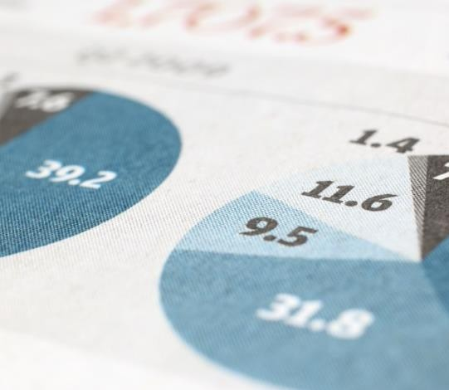
The battle of Neighborhood
Capstone project
Chennoufi Mohamed Soheib
4/28/20
Data Science

Slide 2

1. Introduction/Business Problem
Discussion of the business problem and the audience who would be interested in this project.
The average Canadian moves about eleven times in their lifetime. This brings us to the question: Do people move until they find a place to settle down where they truly feel happy, or do our wants and needs change over time, prompting us to eventually leave a town we once called home for a new area that will bring us satisfaction ? or, do we too often move to a new area without knowing exactly what we’re getting into, forcing us to turn tail and run at the first sign of discomfort?
To minimize the chances of this happening, we should always do proper research when planning our next move in life. Consider the following factors when picking a new place to live so you do not end up wasting your valuable time and money making a move you’ll end up regretting. Safety is a top concern when moving to a new area. If you don’t feel safe in your own home, you’re not going to be able to enjoy living there.
The crime statistics dataset of TORONTO found has crimes in each Neighborhood of Toronto from 2014 to 2019. The year 2019 being the latest, we will be considering the data of that year which is actually old information as of now. The crime rates in each borough may have changed over time.
This project aims to select the safest borough in Toronto based on the total crimes, explore the neighborhoods to find the 10 most common venues in each neighborhood and finally cluster the neighborhoods using k-mean clustering.
Expats who are considering relocating to Toronto will be interested to identify the safest Borough in Toronto, analyze the Neighborhoods there and explore the common venues around each one.

Slide 3

2. Data Acquisition and cleaning:
The data acquired for this project is a combination of data from three sources.
The first data source of the project uses a Toronto crime data that shows the crime per Neighborhood in Toronto this data is from the Toronto Polish Department Data http://data.torontopolice.on.ca/datasets/mci-2014-to- 2019. I made changes to remove the useless data. The dataset contains the following columns:
Neighborhood: the common name of Toronto.
Population : the population of each neighborhood
AVG : the average of crimes for each category ( between 2014 and 2019)
Total: the total average of crimes of all categories.
The second source of data is scraped from a Wikipedia page that contains the list of Toronto Neighborhoods. The columns are : Borough and Neighborhood.
Borough: The names of the 10 Boroughs of Toronto.
Neighborhood: the names of Neighborhood of each Borough.
The third source of data is the one that we used in the last assignment which contains the list of all the Neighborhoods, Boroughs and their Latitude and Longitude.

Slide 4

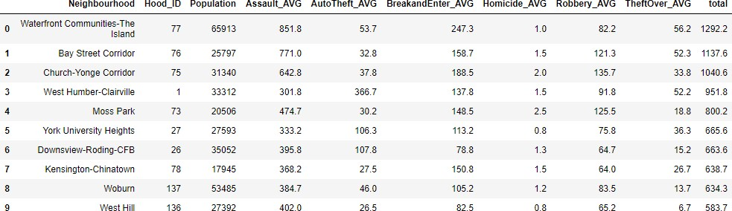
The data preparation for each of the three sources of data is done separately.
1/- From the Toronto crime data, the crimes during the years (2014- 2019) are selected.

Slide 5
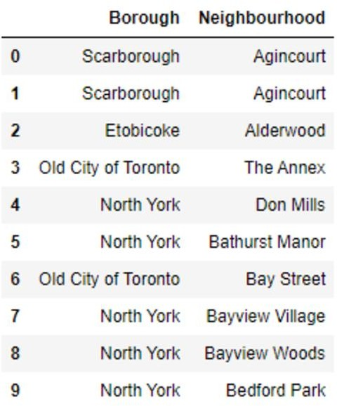
2/-The second Data contains the list of Boroughs and their Neighborhoods.
It is scraped from Wikipedia page (https://en.wikipedia.org/wiki/List_of_city- designated_neighbourhoods_in_Toronto ) using the Beautiful soup library in Python. Using this library, we can extract the data in the table as shown in the webpage.
After the web scraping, string manipulation is required to get the names of boroughs in the correct form. It is important because we will merge the two datasets using the Neighborhood names.

Slide 6
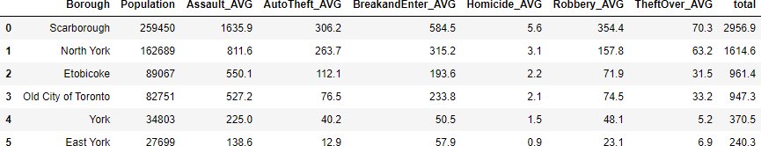
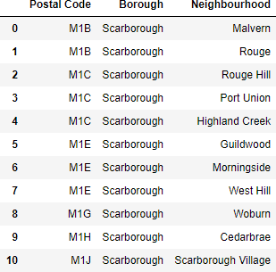
The two datasets are merged on the Neighborhood names to form a new dataset that combines the necessary information in one dataset.
The purpose is to visualize the crimes rates in each Borough with the
average crime number from 2014 to 2019.
After visualizing the crime in each borough we can find the one with the lowest crime number and hence tag that borough as the safest one.
3/-The third source of data is acquired from the list of neighborhoods that we worked with in WEEK03 assignment (Wikipedia).
This dataset is created from scratch, the pandas data frame is created with the names of neighborhood and Boroughs, latitude and longitude.

Slide 7
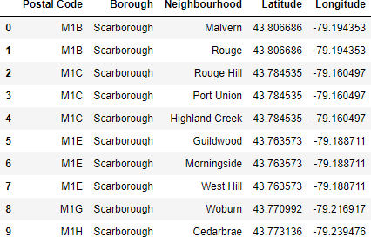
The coordinates of the neighborhoods is to be obtained using Google Maps API Geocoding to get the final dataset.
The new dataset is used to generate the venues for each neighborhood using the Foursquare API.

Slide 8

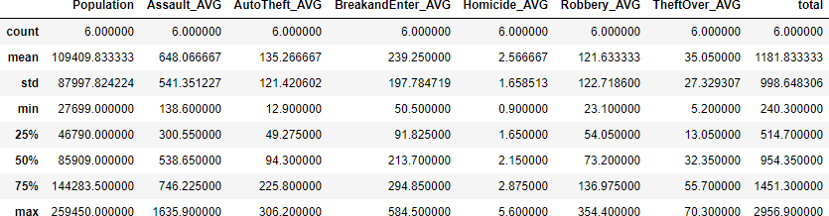
3.Methodology
The describe function in python is used to get statistics of Toronto crimes data, this returns the mean, standard deviation, minimum, maximum, 1st quartile (25%), 2nd quartile (50%), and the 3rd quartile (75%) for each of the major categories of crime.
The count for each of the major categories of crime returns the value 6, which is the number of Toronto boroughs. “Assault” is the highest reported crime during the years (from 2014 to 2019) followed by “Break and enter” and “Auto Theft”.
The lowest recorded crimes are “Homicide” and ‘Theft over’.

Slide 9
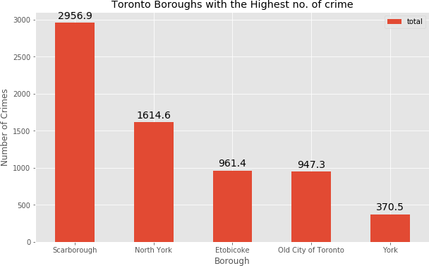
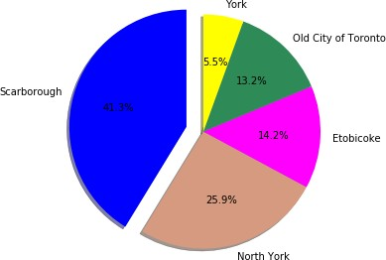
Comparing five boroughs with the highest crime rate during these years it is evident that Scarborough has the highest crimes recorded followed by North York, ETOBICOKE, Old city of Toronto and York.
We can see that Scarborough had the highest number of population followed by North York.
We can say that there is a relation between the number of crimes and the population.

Slide 10
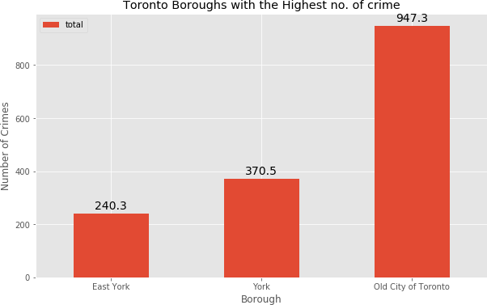

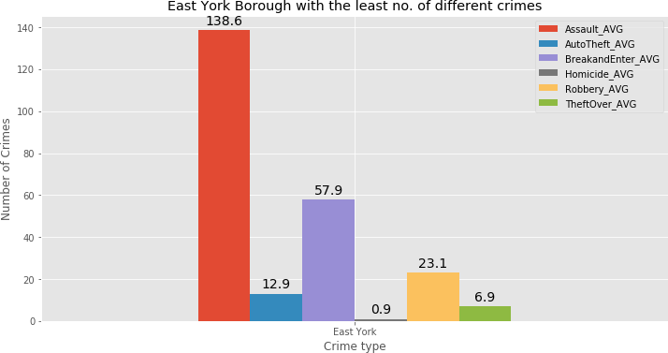
Comparing three boroughs with the lowest crime rate during the period (2014-2019), East York has the lowest recorded crimes followed by York.

Slide 11

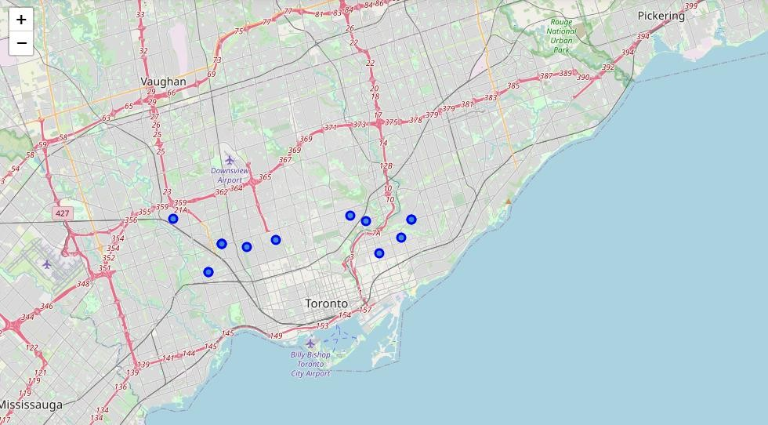
Next, we will analyze data and neighborhoods in the two safest boroughs: East York and York.
There are 13 neighborhoods in York and East York; they are visualized on a map using folium on python.
Fig 1: Neighborhoods in York and East York

Slide 12
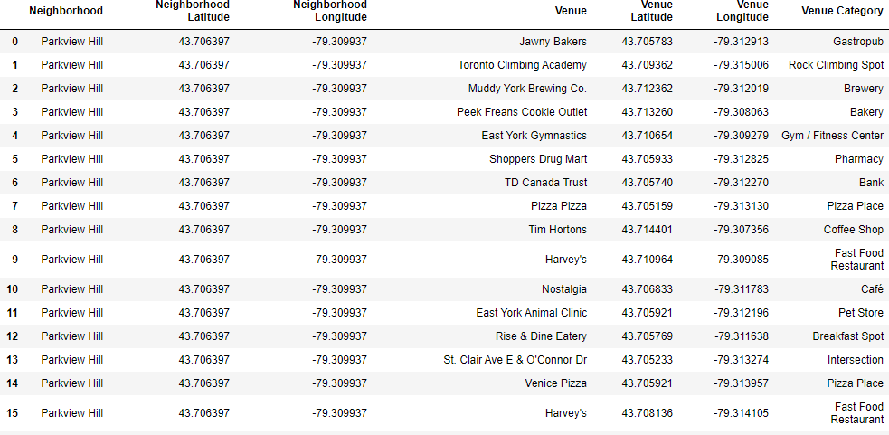
3.2 Modelling
Using the final dataset containing the neighborhoods in York and East York along with the latitude and longitude, we can find all the venues within a 500 meters radius of each neighborhood by connecting to the Foursquare API.
This returns a json file containing all the venues in each neighborhood, which is converted to a pandas dataframe. This data frame contains all the venues along with their coordinates and category.
One hot encoding is done on the venues data. (One hot encoding is a process by which categorical variables are converted into a form that could be provided to ML algorithms to do a better job in prediction).
The Venues data is then grouped by the Neighborhood and the mean of the venues are calculated, finally the 10 common venues are calculated for each of the neighborhoods.
To help people find similar neighborhoods in the safest borough we will be
clustering similar neighborhoods using K - means clustering which is a form of unsupervised machine learning algorithm that clusters data based on predefined cluster size. We will use a cluster size of 4 for this project that will cluster the 13 neighborhoods into 4 clusters.

Slide 13
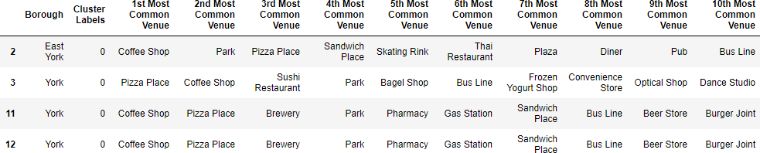
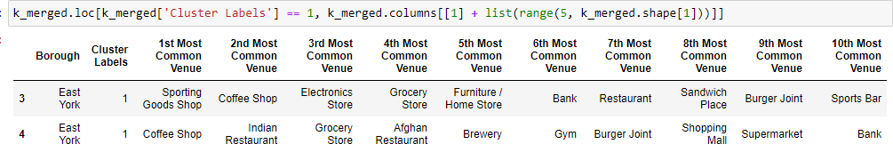
The reason to conduct a K- means clustering is to cluster neighborhoods with similar venues together so that people can shortlist the area of their interests based on the venues/amenities around each neighborhood.
4. Results
After running the K-means clustering we can access each cluster created to see which neighborhoods were assigned to each of the five clusters.
Looking into the neighborhoods in the first cluster .
Fig 2: cluster 1
The cluster one is the biggest cluster with 4 of the 13 neighborhoods in York and East York.
Upon closely examining these neighborhoods we can see that the
most common venues in these neighborhoods are Restaurants, Café. and stores.
Looking into the neighborhoods in the second, third and fourth clusters:
Fig 3: cluster 2

Slide 14
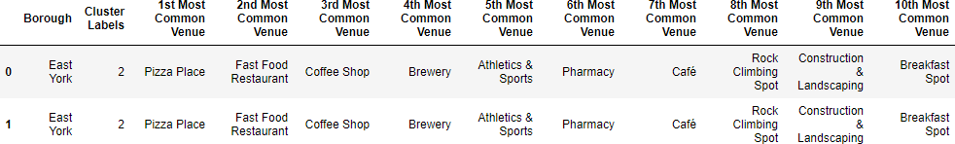
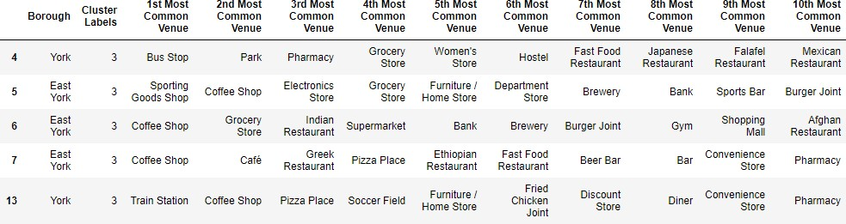
Fig 4: cluster 3
Fig 5: Cluster 4

Slide 15
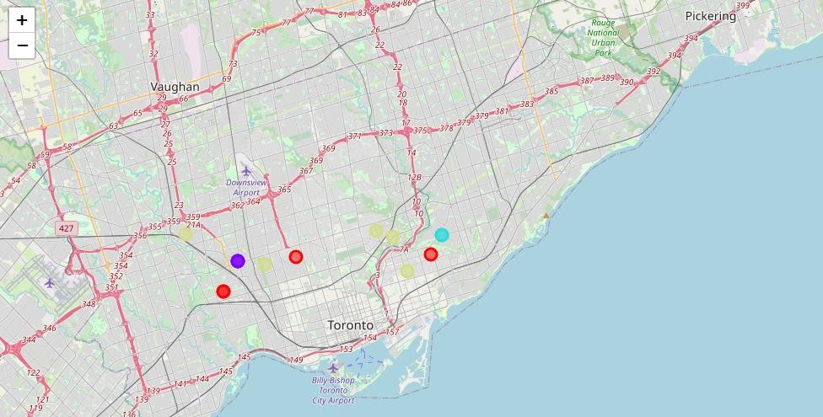
Visualizing the clustered neighborhoods on a map using the folium library:
5.Results and Discussion
The aim of this project is to help people who want to relocate to the safest borough in Toronto, expats can chose the neighborhoods to which they want to relocate based on the most common venues in it. For example if a person is looking for a neighborhood with good connectivity and public transportation we can see that Clusters 1 and 4 have Train stations and Bus Lines as the most common venues.
If a person is looking for a neighborhood with stores and restaurants in a close proximity then the neighborhoods in the first cluster is suitable.

Slide 16
For a family I feel that the neighborhoods in Cluster 2 and 3 are more suitable dues to the common venues in that cluster, these neighborhoods have common venues such as Parks, Gym centers, Bus Stops, Restaurants, Electronics Stores and Soccer fields that is ideal for a family.
6.Conclusion
This project helps a person get a better understanding of the neighborhoods with respect to the most common venues in that neighborhood.
It is always helpful to make use of technology to stay one-step ahead i.e. finding out more about places before moving into a neighborhood.
We have just taken safety as a primary concern to shortlist the borough of
Toronto. The future of this project includes taking other factors such as cost of living in the areas into consideration to shortlist the borough based on safety and a predefined budget.

