Slide 1
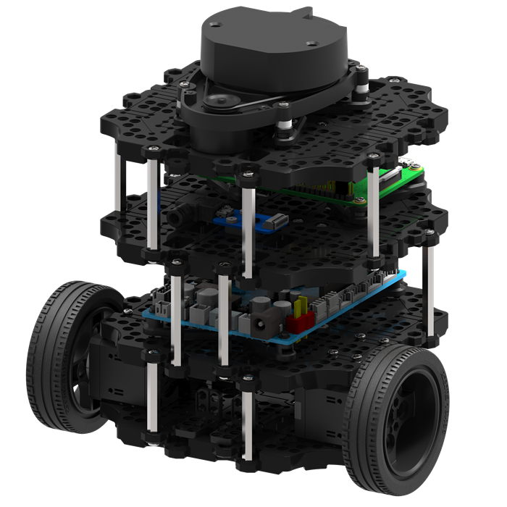
Object Detection Using 2D LiDAR
Lightweight Learning on TurtleBot3 with Raspberry Pi 4
Presented by: Mina Ghaderi , Soheil Behnam
Affiliation: Hanze university of applied sciences
Date: April 2025

Slide 2
Project Scope & Constraints
Develop a real-time, fully onboard object recognition system for indoor mobile robots using only raw 2D LiDAR data — no camera, no images, and no external compute.
Target Platform:
Robot: TurtleBot3 Burger
Compute: Raspberry Pi 4 (2GB RAM) + OpenCR 1.0
Sensor: 360° 2D LiDAR (LDS-01), IMU
Constraints:
No RGB or Depth Cameras
No Cloud or Offboard Compute
Real-Time Inference (< 50 ms)
Low Power & Lightweight Deployment
Recognition Task
Objects: Chair, Table, Cabinet, Door Frame
Environment: Cluttered indoor scenes (e.g., home, office)
Input: Raw scan (1×360)
Output: Object class and geometric location (center, radius)

Slide 3
Problem Statement
Why is this problem important?
Most indoor object recognition systems rely on vision (RGB-D cameras, images, occupancy maps).
These approaches need:
High computational power
Consistent lighting conditions
Often external computation (cloud or workstation)
But many service robots (e.g., TurtleBot3) must work autonomously with:
No camera (privacy)
Low power (e.g., Raspberry Pi)
Real-time processing constraints
Technical Goals
Operate fully onboard in Python on a Raspberry Pi 4
Avoid any image conversion (no occupancy grid, no YOLO-style projection)
Explore if a raw-scan-to-classification pipeline is viable
Support multiple objects in cluttered scenes
Our Core Challenge
Can we perform object identification using only raw 2D LiDAR data? Onboard, in real-time, and without any camera, images, or map?

Slide 4
Stakeholder Analysis
Who Benefits from Our System?
In real-world robotics, stakeholders span users, developers, and systems that rely on fast, local perception. Our LiDAR-based onboard recognition system offers value to:
Primary Stakeholders
Mobile Indoor Robots: Require accurate and fast perception in cluttered spaces (e.g., hospitals, offices).
Assistive Robots: Benefit from privacy-preserving, low-power solutions for home or care facilities.
Smart Warehouse Systems: Need onboard-only recognition to scale low-cost, autonomous agents.
Secondary Stakeholders
Embedded Robotics Developers: Need lightweight models deployable on constrained hardware.
Academic Research Groups: Explore non-vision pipelines for perception and object learning.

Slide 5
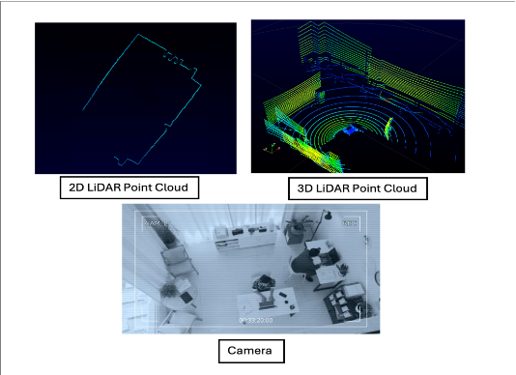
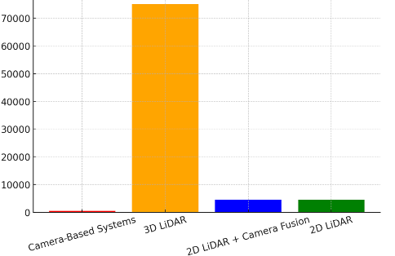
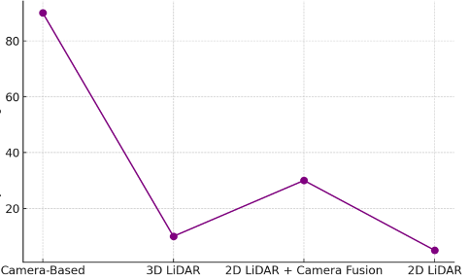
Why Our Solution Matters
Privacy & Lighting Robustness
Our approach avoids cameras and 3D sensors, offering privacy-friendly and lighting-invariant perception.
Price Efficiency Comparison of Object Identification Methods
Real-Time, Low-Power
Runs entirely onboard Raspberry Pi 4 (2GB), enabling autonomy in lightweight robots.
Cost (per Unit)
Better than Typical Alternatives
YOLO on images: High accuracy, but high compute and power draw
3D LiDAR + GPU: Accurate, but expensive and heavy
Our method: Minimal hardware, real-time inference, high potential for embedded AI
Object Identification Methods
Privacy Concern Across Identification Methods
No Cloud, No Map, No Image Needed
Fully self-contained — just raw 2D LiDAR.
Privacy Concern Level
Fills a Critical Gap
We meet real-time requirements without vision, maps, or offboard compute.
Object Identification Methods

Slide 6
Requirements: Derived from Research, Stakeholders, and Constraints
These requirements are not just wishful specifications—they are each derived from specific findings in the literature, real-world needs from target users, and practical feasibility considerations.
ID | Requirement | Why It's Critical
R1 | Object detection & classification | Enables autonomous navigation
R2 | Only 2D LiDAR, no vision | Cost-effective & privacy-safe
R3 | Real-time & low-latency | Required for moving robots
R4 | Shape-based clustering | Detect object instances
R5 | Wall/background filtering | Avoid false positives
R6 | Edge-device ready | Runs on Raspberry Pi
R7 | Semantic2D compatibility | Enables ML-based recognition
R8 | ROS-ready | Plug into real robots
R9 | Dynamic environment stable | Handle moving chairs/people
All further design and implementation decisions are based on fulfilling these nine requirements.

Slide 7
Related Work: Pros & Cons of Existing Approaches
Approach | Pros | Cons
YOLO / Vision-Based | High detection accuracy, Fast runtime when optimized | Requires camera, Lighting-sensitive, Privacy risk, Needs GPU
Occupancy Map Pipelines | Useful for navigation + mapping, LiDAR-compatible | Low classification precision, Coarse resolution, Latency issues
Analytical Segmentation | Fast and interpretable, No ML training needed, Low compute cost | No learning, Poor generalization, Handles only simple geometry
End-to-End 1D CNN Models | Learns directly from raw data, No handcrafted features needed | Requires large labeled dataset, Black-box behavior, Heavy training load
Sequential Models (GRU/CNN) | Good at temporal tracking, Improves consistency over time | Needs multiple scans, Higher latency, May exceed Pi limits if unoptimized
Most current approaches either require vision, heavy computation, or lack generalization. Lightweight, real-time object recognition on embedded robots using only 2D LiDAR remains an open challenge

Slide 8
What Is X and What Is Y? Defining Our Model Architecture
What Is X? (Input)
X = Raw 2D LiDAR Scan (Single or Multiple Frames)
Single-frame: 1 × 360 array of distances (in meters)
Multi-frame: N × 360 sequence of scans for temporal models
Each value = distance to nearest object at that angle (1° resolution)
No RGB, no depth, no grid — pure sensor data
Designed for real-time, lightweight onboard use
X is raw, compact, and ideal for efficient processing on constrained robots — as a single scan or a short temporal buffer.
What Is Y? (Output)
Y = Structured Per-Sector Object Predictions (Custom YOLO-Inspired Format)
Output shape: 30 × 9
Each of the 30 sectors (12°) predicts:
objectness: probability that an object exists in the sector
angle_offset: fine angle adjustment within the sector
radius: estimated object size (boundary radius)
diameter: distance from the robot to the object center
chair: score for chair
table: score for table
cabinet: score for cabinet
door: score for door
nothing: score for “no object” (for empty space)
Each sector encodes geometry and class likelihood — using raw per-class scores instead of softmax, for better control and onboard speed.”

Slide 9
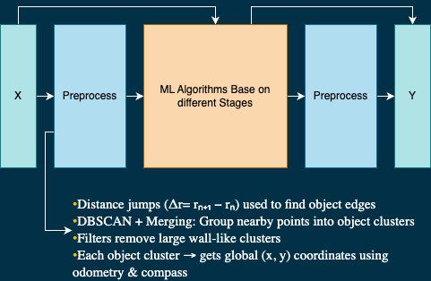
What Is X and What Is Y? Defining Our Model Architecture

Slide 10
What Is X and What Is Y? Defining Our Model Architecture
What Is X? (Input)
X = Raw 2D LiDAR Scan (Single or Multiple Frames)
Single-frame: 1 × 360 array of distances (in meters)
Multi-frame: N × 360 sequence of scans for temporal models
⁠Distance jumps (Δr = rₙ₊₁ − rₙ) used to find object edges
DBSCAN + Merging: Group nearby points into object clusters
⁠Filters remove large wall-like clusters
Each object cluster → gets global (x, y) coordinates using odometry & compass
What Is Y? (Output)
Y = Each object cluster is classified using a trained ML model
Output shape: 0-3
Each cluster is extracted from raw 2D LiDAR using DBSCAN + shape filtering.
Features like size, shape, and local density are calculated for each cluster.
A trained lightweight SVM or MLP classifier is used for labeling.
⁠Each object gets a semantic label
Labels are added in real-time to the object’s global position for mapping.

Slide 11
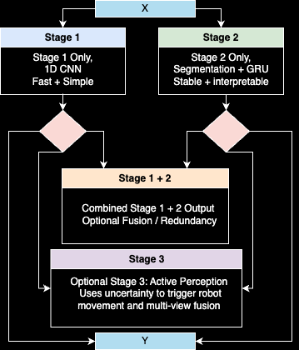
Modular Recognition Pipeline: Flexible, Adaptable, Real-Time
Our object recognition system is designed to adapt to the needs of each use case. Stage 1 and Stage 2 can run independently or together. Stage 3 is optional and enhances performance through active perception.
Stage | Use Case | Input | Key Benefit
Stage 1 | Minimal setup | Single/Multiple scan | Fast YOLO-style detection
Stage 2 | Precise + interpretable | Sequence buffer | Geometric tracking + class prediction
1 + 2 Combo | Redundancy or fusion | Both paths | Boosts accuracy, fallback logic
Stage 3 (optional) | Mobile robots | Multiview scans | Improves confidence, handles occlusions
The pipeline is modular: use Stage 1 or 2 alone, combine them, or extend with Stage 3 when active movement and uncertainty handling are required — all onboard, real-time, and without cameras.

Slide 12
Exploration of Proof-of-Concept Designs Based on Requirements
Concept | Description | Pipeline Mapping | Requirements Met | Pros | Cons
A | DBSCAN + Merge | Rule-based baseline | R1, R3–R6 | Fast, interpretable, no ML needed | Not adaptive, lacks semantics, poor generalization
B | End-to-End 1D CNN | Stage 1 | R1, R2, R3, R6–R8 | Lightweight, simple, fast | No clustering (R4), weak filtering (R5), no temporal modeling (R9)
C | Deep CNN (S3-Net style) | Discarded | R1, R7 | High model capacity | Too heavy for Raspberry Pi, impractical
D | Segmentation + Features + GRU | Stage 2 | R1–R9 | Interpretable, stable, handles motion | Requires segmentation logic, higher complexity
E | Active Perception + View Fusion | Stage 3 (Optional) | R1–R9 | Improves low-confidence cases, handles occlusion | Needs robot mobility and control logic
F | Modular Hybrid System | Full pipeline (1 + 2 + optional 3) | R1–R9 | Flexible deployment, best coverage | Most complex to integrate and tune
Each concept explores a different tradeoff between speed, accuracy, interpretability, and deployability. Our modular pipeline builds from these foundations to support multiple operating modes depending on task needs and hardware limits.

Slide 13
Training Strategy: Simulated Dataset, Learning Objectives, and Temporal Design
Simulated Dataset – Webots Environment
3×3m indoor simulation space with randomized object placement
Target objects: chair, table, cabinet, door frame
LiDAR: LDS-01 simulation, 360° scans (1×360 vectors)
Each simulation run generates thousands of labeled scans
Includes variation in:
Object type, distance, rotation
Scene clutter
Empty scenes for “nothing” class
All training data is synthetic, ensuring full label control and coverage across object classes and positions.
Learning Objectives Per Stage
Stage 1 (1D CNN):
Supervised learning with per-sector objectness + class scores
Grid loss combines: object presence, angle offset, distance, and per-class score (MSE or BCE)
Stage 2 (GRU/1D CNN over features):
Clustered objects tracked over time (5–10 frame buffer)
Handcrafted features extracted per cluster (size, symmetry, etc.)
Temporal classification using GRU or sequence CNN
Stage 3 (Optional):
Monte Carlo dropout for uncertainty estimation
If low confidence → trigger motion to collect second scan
Fuse class probabilities and positions from multiple angles
Models are trained stage-by-stage using structured targets and simulated variation — no camera or map needed.

Slide 14
Evaluation Plan: Metrics, Methodology, and Simulation Setup
Metrics:
Evaluation Setup:
Simulation: Webots 3×3m arena
Test splits: unseen instances + new scene configs
Hardware: Raspberry Pi 4, real-time constraints
Test cases:
Stage 1 vs Stage 2
With and without Stage 3
Static vs dynamic scenes
Metric | What it shows
Accuracy | Correctly predicted object labels
Inference Time | Speed per scan / per frame
Confidence Stability | Temporal consistency of predictions
False Positives | Misclassified or spurious detections
This structured evaluation will allow us to benchmark each stage of the pipeline independently, and in combination — in terms of speed, accuracy, robustness, and reliability for onboard deployment.

Slide 15
Visual Results: Scanning, Segmentation, and Prediction
Visual Type | Description
▶ Raw LiDAR Scanning Mode 1 ▶ Raw LiDAR Scanning Mode 1 | Video showing raw 360° scan from Webots simulation. The robot rotates while collecting frames for Stage 1 training.
▶ Analytical Segmentation Output Video local ▶ Analytical Segmentation Output Video_Global | Segment boundaries highlighted using geometric discontinuities. Clusters are color-coded and passed to the feature extractor.
📈 Segmentation/Training Plot 1 📈 Segmentation/Training Plot_object_detected | Plot of segmented LiDAR points, training loss curve, or example feature vectors (e.g., size, symmetry).

Slide 16
Conclusion
Proposed a modular, three-stage pipeline for onboard object recognition using only raw 2D LiDAR.
Each stage supports a different tradeoff:
Stage 1: Fast, YOLO-inspired 1D CNN for dense sector-wise detection.
Stage 2: Segment-based, interpretable classification using handcrafted features and GRU.
Stage 3: Optional active perception for uncertainty-aware refinement via robot motion.
The system is designed to run fully onboard on Raspberry Pi 4, without external sensors or cloud support.
A comprehensive simulation-based training and evaluation pipeline has been set up in Webots.

