Slide 1



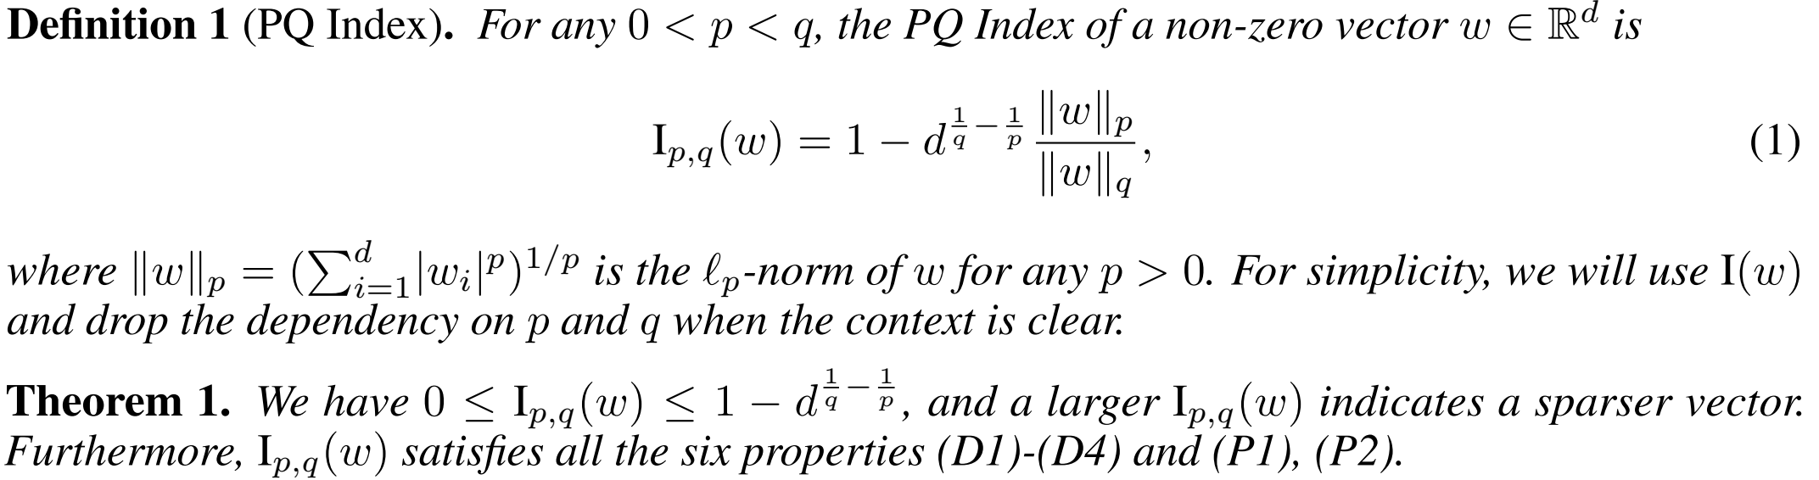
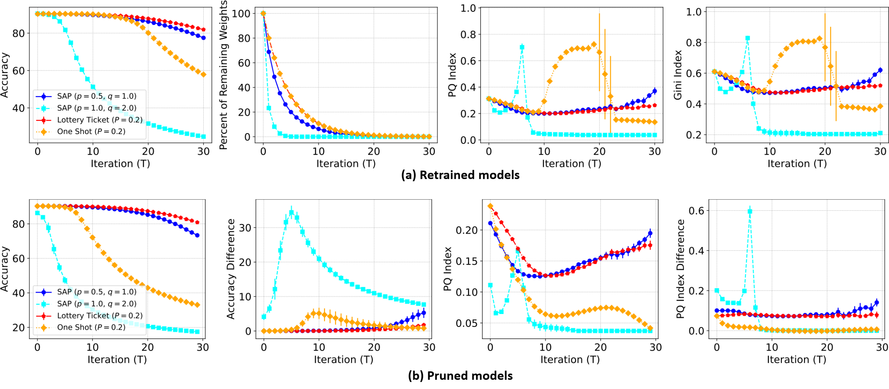
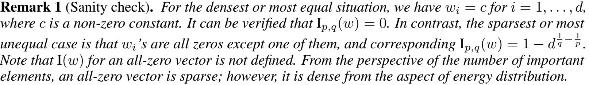
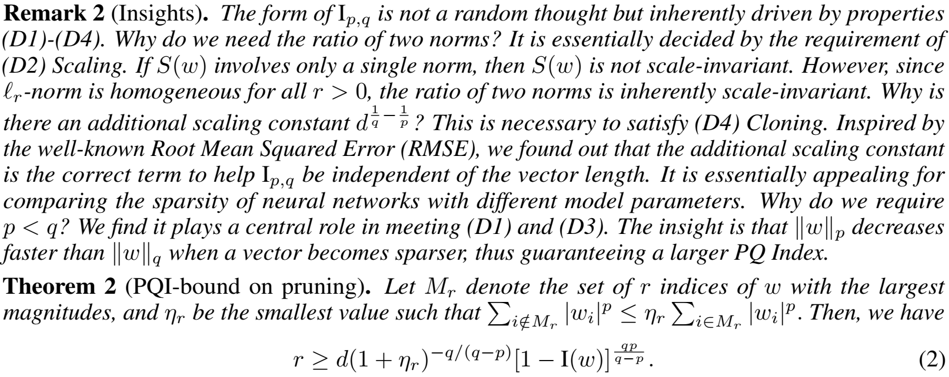
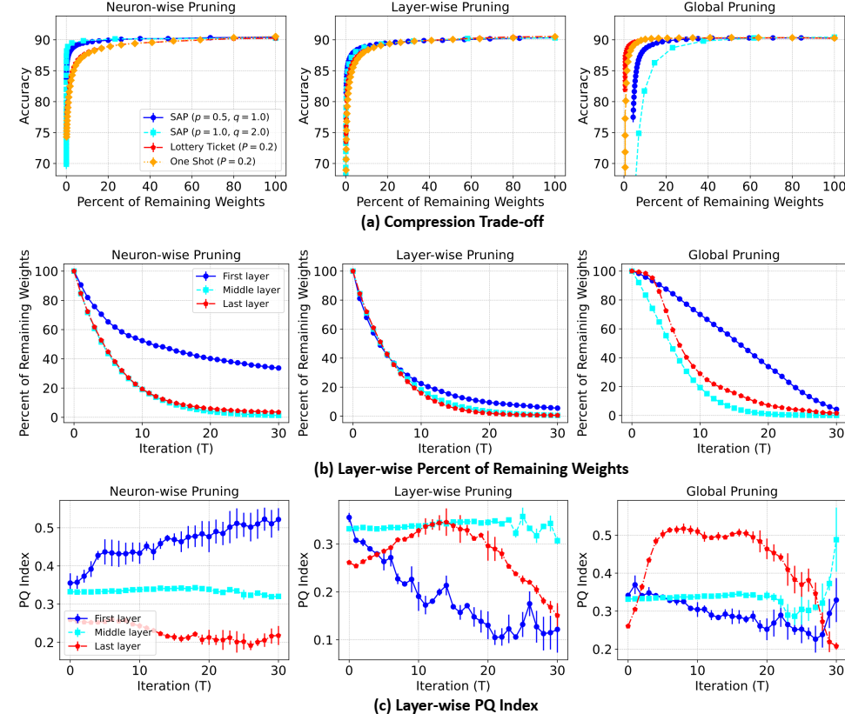
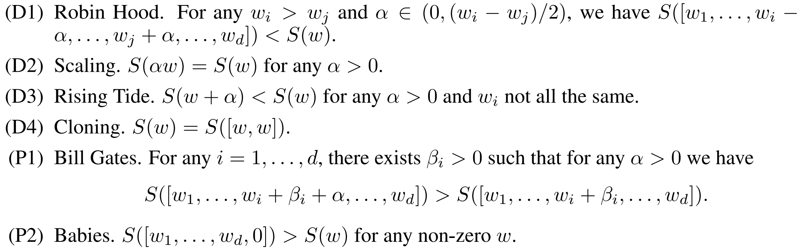
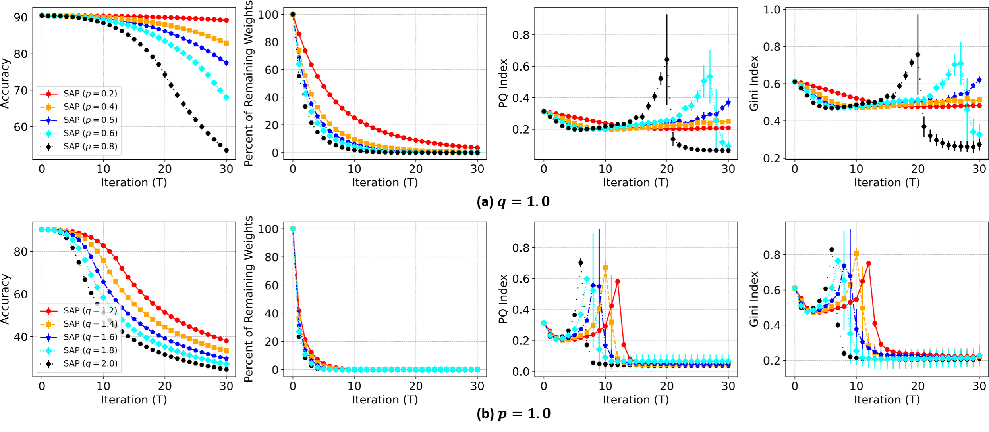
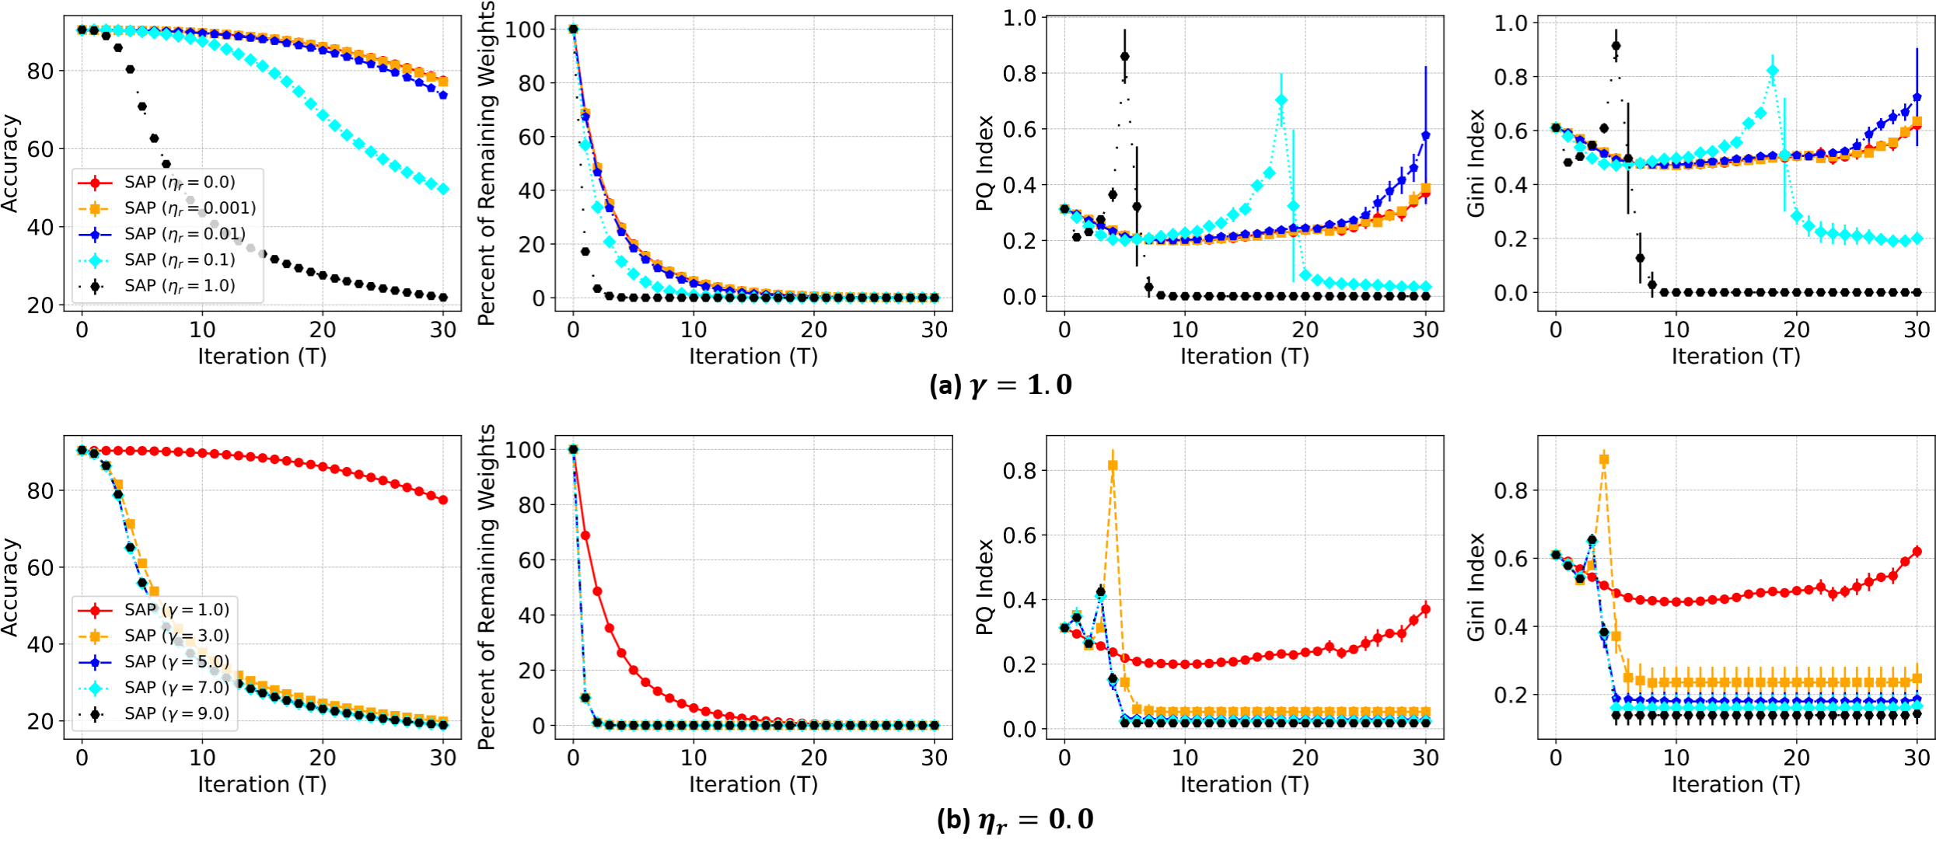

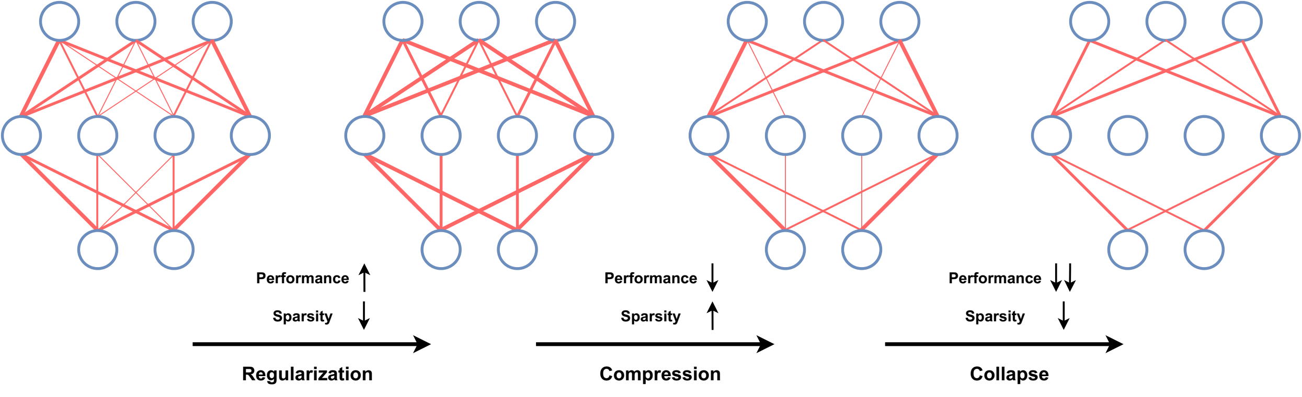
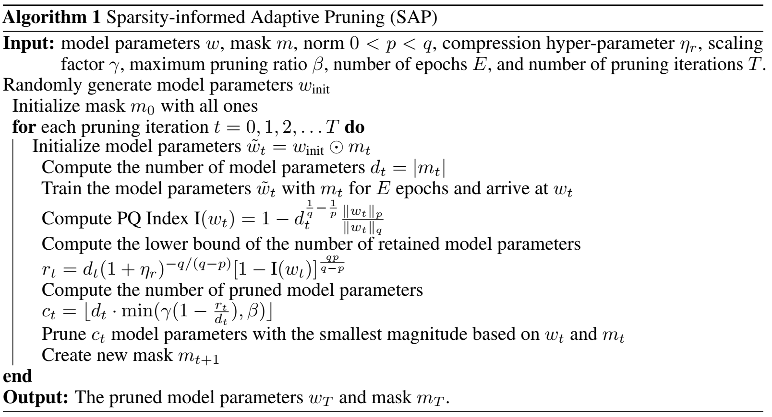

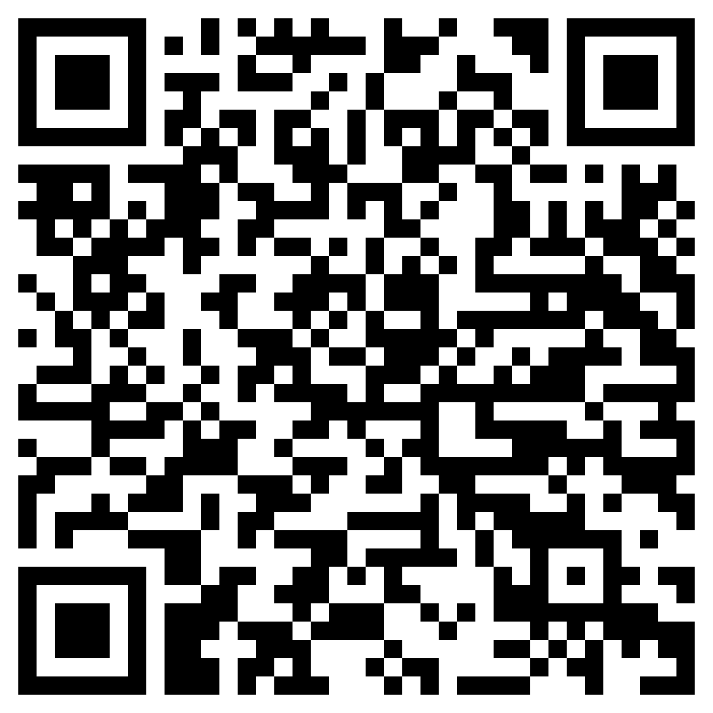


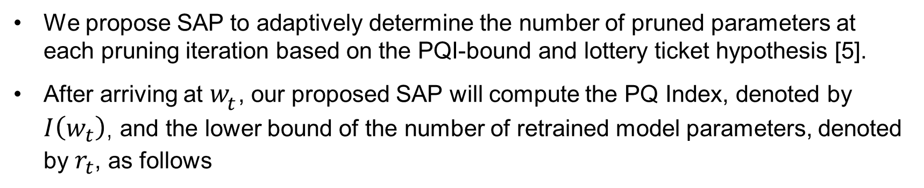
Pruning Deep Neural Networks from a Sparsity Perspective
Enmao Diao¹* Ganghua Wang²* Jiawei Zhang²
Yuhong Yang² Jie Ding² Vahid Tarokh¹
¹Duke University ²University of Minnesota-Twin Cities *Equal Contribution
Overview
Pruning with PQ Index
Experiments
We connect the compressibility and performance of a neural network to its sparsity. In a highly over-parameterized network, one popular assumption is that the relatively small weights are considered redundant or non-influential and may be pruned without impacting the performance.
We propose a new notion of sparsity for vectors named PQ Index (PQI), with a larger value indicating higher sparsity. We prove that PQI meets all six properties proposed by [1,2,3,4], which is the first measure of sparsity related to vector norms that satisfies all the properties shared by the Gini Index [1].
We develop a new perspective on the compressibility of neural networks. We measure the sparsity of pruned models by PQI and postulate a hypothesis on the relationship between sparsity and compressibility of neural networks.
Motivated by our proposed PQI and hypothesis, we further develop a Sparsity-informed Adaptive Pruning (SAP) algorithm that uses PQI to choose the pruning ratio adaptively.
We conduct extensive experiments to measure the sparsity of pruned models and corroborate our hypothesis. SAP can compress more efficiently and robustly compared with iterative pruning algorithms such as the lottery ticket-based pruning methods.
PQ Index (PQI)
Retrained and Pruned models
All the six properties (D1)-(D4) and (P1), (P2) are hold for our proposed PQ Index (PQI).
Obtained from the models after (a) retraining and (b) directly from those after pruning.
The dynamics of the sparsity corroborate our hypothesis.
Figure 2. Results of (a) retrained and (b) pruned models at each pruning iteration for ‘Global
Pruning’ with CIFAR10 and CNN.
Pruning scopes
Motivation
SAP with ‘Global Pruning’ performs worse than ‘One Shot’ and ‘Lottery Ticket’ when the percent of remaining weights is small.
SAP with ‘Neuron-wise Pruning’ and ‘Layer-wise Pruning’ perform better than ‘One Shot’ and ‘Lottery Ticket.’
SAP Aligns with the intuition that the initial layers of CNN are more important to maintain the performance [6].
Existing approaches lack a quantifiable measure to estimate the compressibility of a sub-network . For a non-negative vector 𝑤 = [𝑤_1,…,𝑤_𝑑 ] , we have six properties that an ideal sparsity measure 𝑆(𝑤) should have
Sparsity-informed Adaptive Pruning (SAP)
We propose SAP to adaptively determine the number of pruned parameters at each pruning iteration based on the PQI-bound and lottery ticket hypothesis [5].
After arriving at $w_{t}$, our proposed SAP will compute the PQ Index, denoted by $I\left(w_{t}\right)$, and the lower bound of the number of retrained model parameters, denoted by $r_{t}$, as follows
Figure 3. Results of various pruning scopes regarding (a) compression trade-off, (b) layer-wise percent of remaining weights, and (c) layer-wise PQ Index for CIFAR10 and CNN.
Ablation studies
Hypothesis
Regularization: Performance moderately improves, and Sparsity decrease.
Compression: Performance moderately degrades, and Sparsity increases.
Collapse: Performance significantly degrades, and Sparsity decreases.
The dynamics of the sparsity measure of SAP with various ablation studies also corroborate our hypothesis.
Then, we compute the number of pruned model parameters as follows
Figure 4. Ablation studies of $p$ and $q$ for global pruning with CIFAR10 and CNN.
Figure 5. Ablation studies of $η_{r}$ and $γ$for global pruning with CIFAR10 and CNN.
References
[1] Gini, Corrado. Variabilità e mutabilità: contributo allo studio delle distribuzioni e delle relazioni statistiche.[Fasc. I.]. Tipogr. di P. Cuppini, 1912.
[2] Dalton, Hugh. "The measurement of the inequality of incomes." The Economic Journal 30.119 (1920): 348-361.
[3] Rickard, Scott, and Maurice Fallon. "The Gini index of speech." Proceedings of the 38th Conference on Information Science and Systems (CISS’04). 2004.
[4] Hurley, Niall, and Scott Rickard. "Comparing measures of sparsity." IEEE Transactions on Information Theory 55.10 (2009): 4723-4741.
[5] Frankle, Jonathan, and Michael Carbin. "The lottery ticket hypothesis: Finding sparse, trainable neural networks." arXiv preprint arXiv:1803.03635 (2018).
[6] Gale, Trevor, Erich Elsen, and Sara Hooker. "The state of sparsity in deep neural networks." arXiv preprint arXiv:1902.09574 (2019).
Figure 1. An illustration of our hypothesis on the relationship between sparsity and compressibility of neural networks. The width of connections denotes the magnitude of model parameters.
Paper
Code

