Slide 1




Pruning Deep Neural Networks from a Sparsity Perspective
Presenter: Enmao Diao
Paper
Code
Enmao Diao¹* Ganghua Wang²* Jiawei Zhang²
Yuhong Yang² Jie Ding² Vahid Tarokh¹
¹Duke University ²University of Minnesota
*Equal Contribution
Notes:
Hello everyone my name is Enmao Diao today I will present our work
Pruning Deep Neural Networks from a Sparsity Perspective
This work is published by Enmao Diao, Ganghua Wang, Jiawei Zhang, Yuhong Yang, Jie Ding, and Vahid Tarokh .
You can access our paper and source codes by scanning these QR codes.

Slide 2
Overview
Motivation
Sparsity measure
Hypothesis
Pruning with PQ Index
PQ Index (PQI)
Sparsity-informed Adaptive Pruning (SAP)
Experiments
Retrained and Pruned models
Pruning scopes
Ablation studies
Conclusion
Notes:
First, I will talk about our motivation including the ideal properties of sparsity measure and our proposed hypothesis.
Then I will introduce our proposed PQ Index for measuring sparsity and Sparsity-informed Adaptive Pruning for compressing deep neural networks
Next, I will demonstrate our experimental results
Finally, I will draw our conclusion and discuss future works.

Slide 3
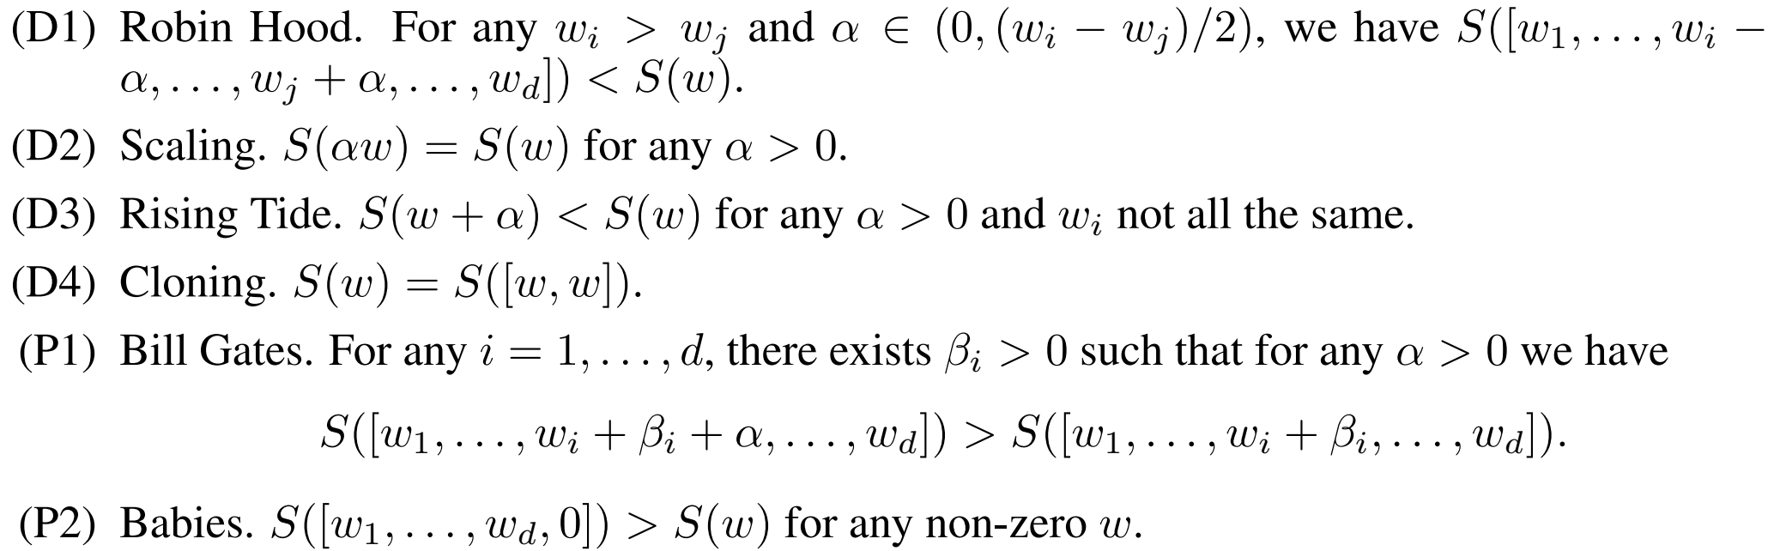

Motivation
Sparsity measure
Existing approaches lack a quantifiable measure to estimate the compressibility of a sub-network
For a non-negative vector $w=\left[w_{1},…,w_{d}\right]$, we have six properties that an ideal sparsity measure $S\left(w\right)$should have [1,2,3,4]
Notes:
Existing approaches on model compression lack a quantifiable measure to estimate the compressibility of a sub-network during each pruning iteration and thus may under prune or over-prune the model.
In this work, we connect the compressibility and performance of a neural network to its sparsity.
Let us consider the sparsity of a non-negative vector and a sparsity measure. We summarize six properties that an ideal sparsity measure should have as follows.
###
In a highly over-parameterized network, one popular assumption is that the relatively small weights are considered redundant or non-influential and may be pruned without impacting the performance.

Slide 4
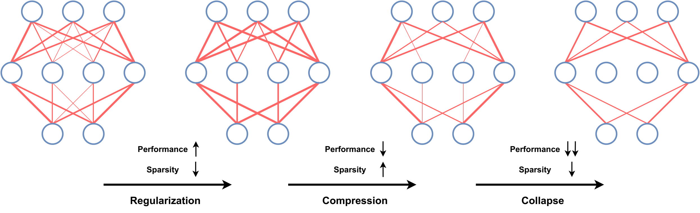
Motivation
Hypothesis
Regularization: Performance moderately improves, and Sparsity decrease
Compression: Performance moderately degrades, and Sparsity increases
Collapse: Performance significantly degrades, and Sparsity decreases
Figure 1. An illustration of our hypothesis on the relationship between sparsity and compressibility of neural networks. The width of connections denotes the magnitude of model parameters.
Notes:
Our study is motivated by following hypothesis. In the beginning stage of model compression, the sparsity of model parameters will decrease, and the performance may be improved due to regularization. When the model is further compressed, part of the model parameters will become smaller when the model converges. Thus, the sparsity will increase, and the performance will moderately decrease. Finally, when the model collapse starts to occur, the sparsity will decrease, and performance will significantly degrade.
###
Our extensive experiments on pruning algorithms corroborate the hypothesis.
Consequently, PQI can infer whether a model is inherently compressible. Motivated by this discovery, we also propose the Sparsity-informed Adaptive Pruning (SAP) algorithm, which can compress more efficiently and robustly compared with iterative pruning algorithms such as the lottery ticket-based pruning methods. Overall, our work presents a new understanding of the inherent structures of deep neural networks for model compression. Our main contributions are summarized below.

Slide 5
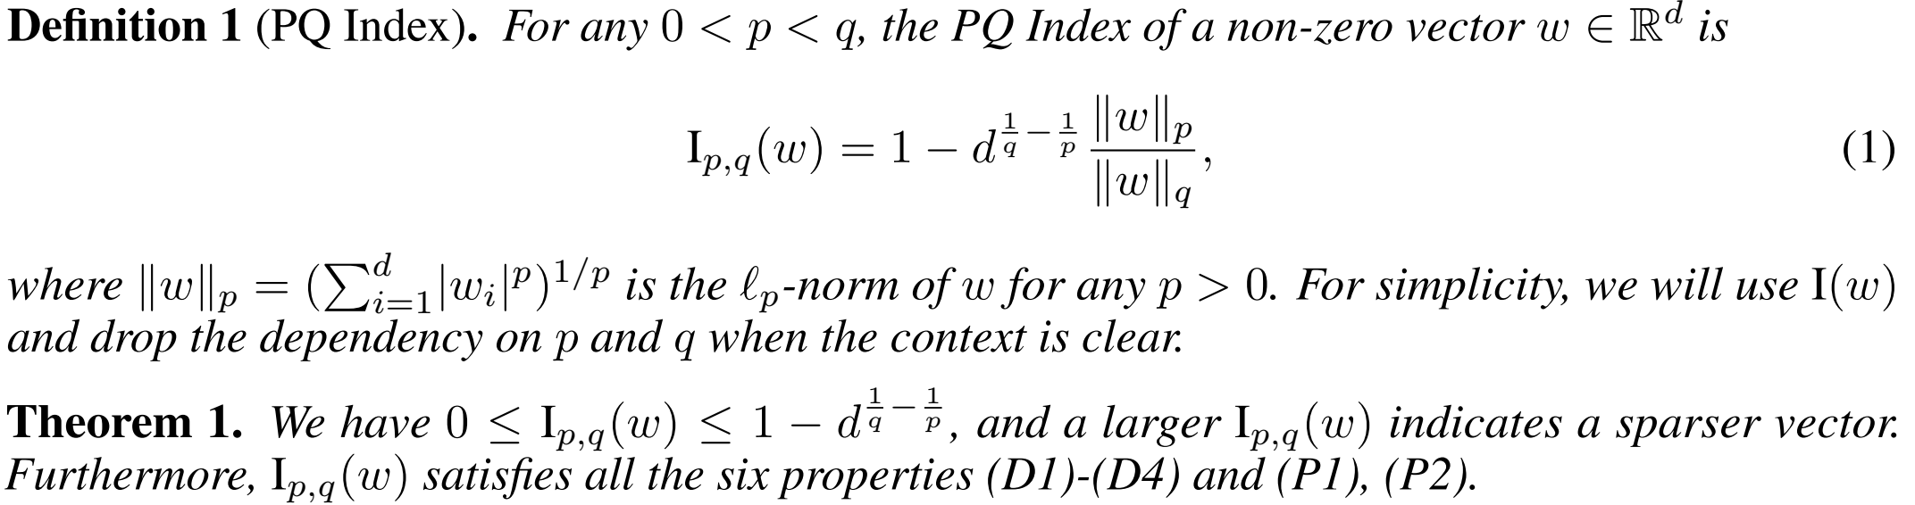
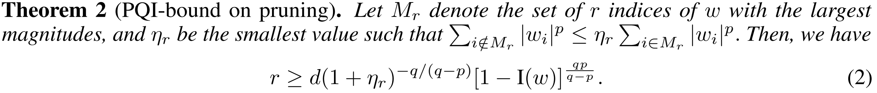
Pruning with PQ Index
PQ Index (PQI)
All the six properties (D1)-(D4) and (P1), (P2) are hold for our proposed PQ Index (PQI)
Notes:
We proposed PQ Index (PQI) which satisfies all the six properties a sparsity measure should have as proved in Theorem 1.
As model pruning algorithm assumes that parameters with small magnitudes are removable. We immediately have a lower bound for the retaining ratio of the pruning algorithm from Theorem 2.

Slide 6
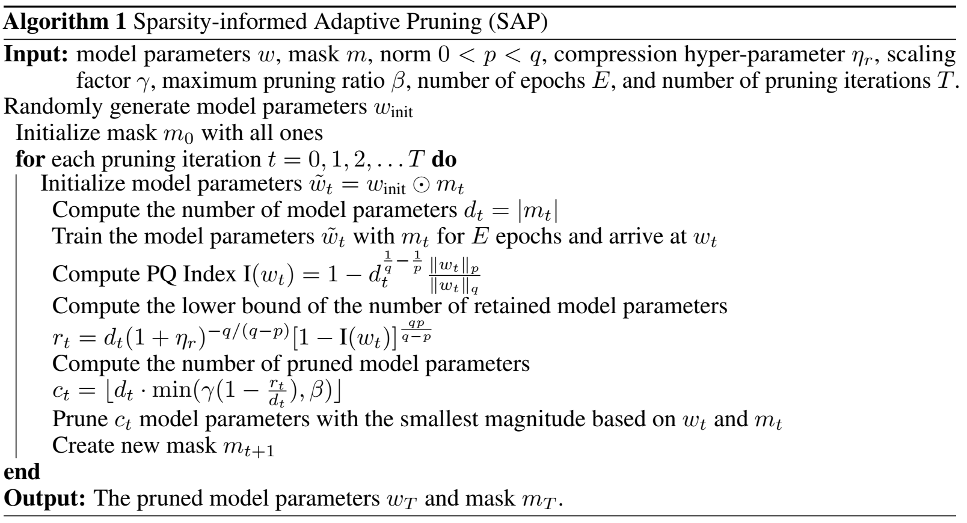
Pruning with PQ Index
Sparsity-informed Adaptive Pruning (SAP)
We propose SAP to adaptively determine the number of pruned parameters at each pruning iteration based on the PQI-bound and lottery ticket hypothesis [5]
Notes:
We introduce the Sparsity-informed Adaptive Pruning (SAP) algorithm as illustrated in Algorithm 1. SAP can adaptively determine the number of pruned parameters at each pruning iteration based on the PQI-bound and lottery ticket hypothesis.

Slide 7
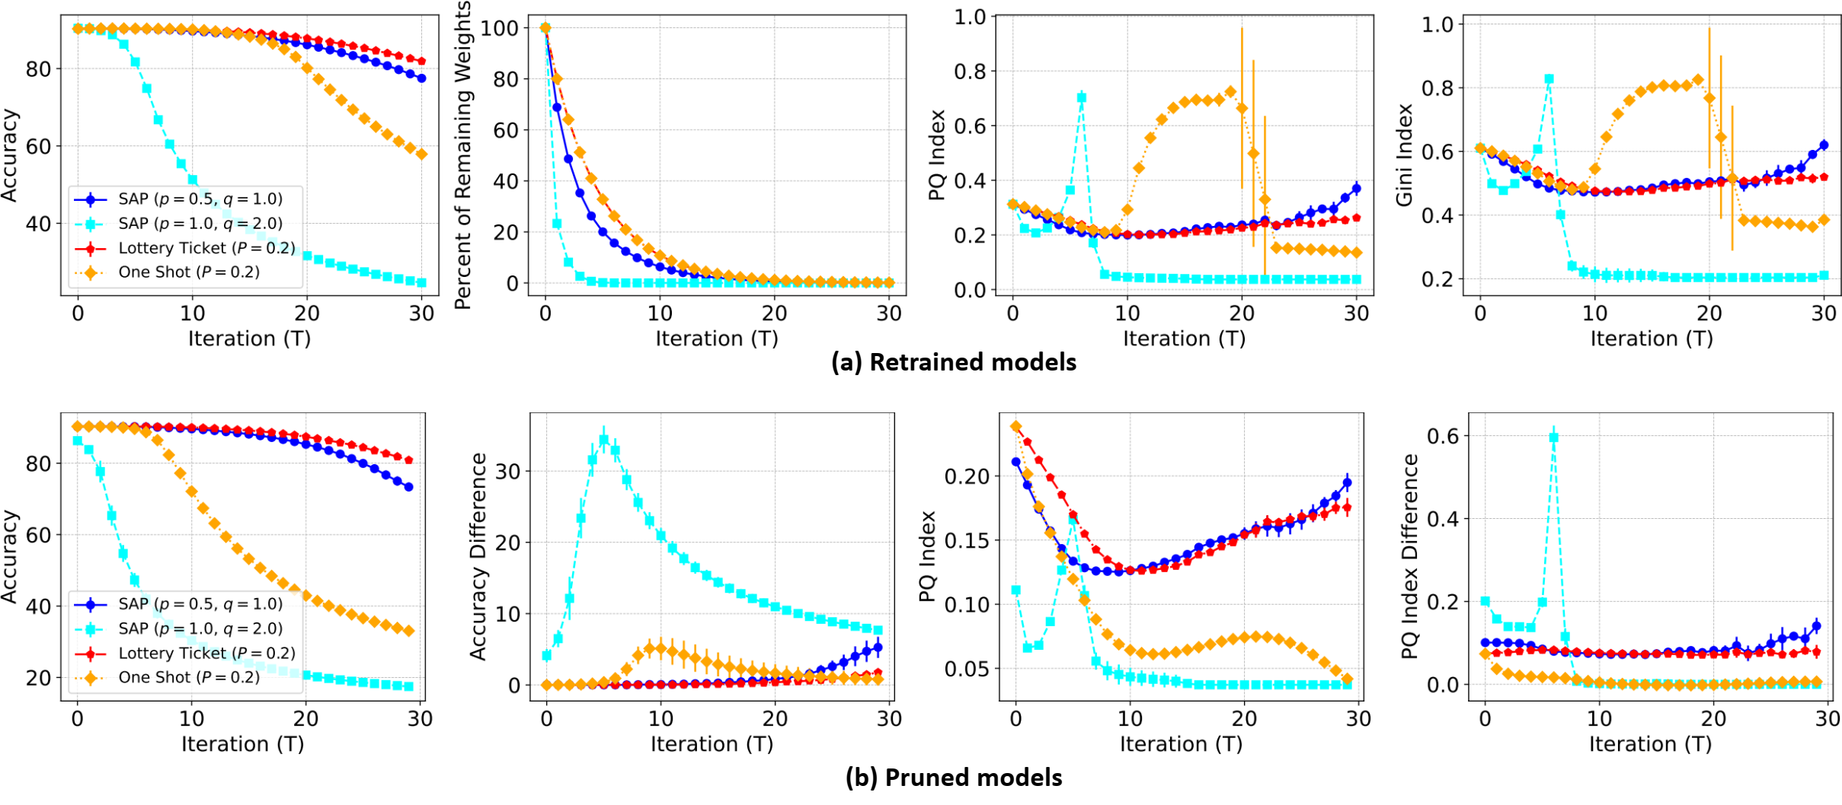
Experiments
Retrained and Pruned models
Obtained from the models after (a) retraining and (b) directly from those after pruning
The dynamics of the sparsity corroborate our hypothesis
Figure 2. Results of (a) retrained and (b) pruned models at each pruning iteration for ‘Global
Pruning’ with CIFAR10 and CNN.
Notes:
We compare the proposed SAP with two baselines, including `One Shot' and `Lottery Ticket'~\citep{frankle2018lottery} pruning algorithms. We compare the proposed PQ Index ($p=0.5$, $q=1.0$) with the well-known Gini Index~\citep{gini1912variabilita} to validate its effectiveness in evaluating sparsity. Furthermore, we perform pruning on various pruning scopes, including `Neuron-wise Pruning,' `Layer-wise Pruning,' and `Global Pruning.' The results show that the dynamics of the sparsity corroborate our hypothesis and an ideal pruning procedure should avoid a rapid increase in sparsity.
###
In particular, `Global Pruning' gather all model parameters as a vector for pruning, while `Neuron-wise Pruning' and `Layer-wise Pruning' prune each neuron and layer of model parameters separately.

Slide 8
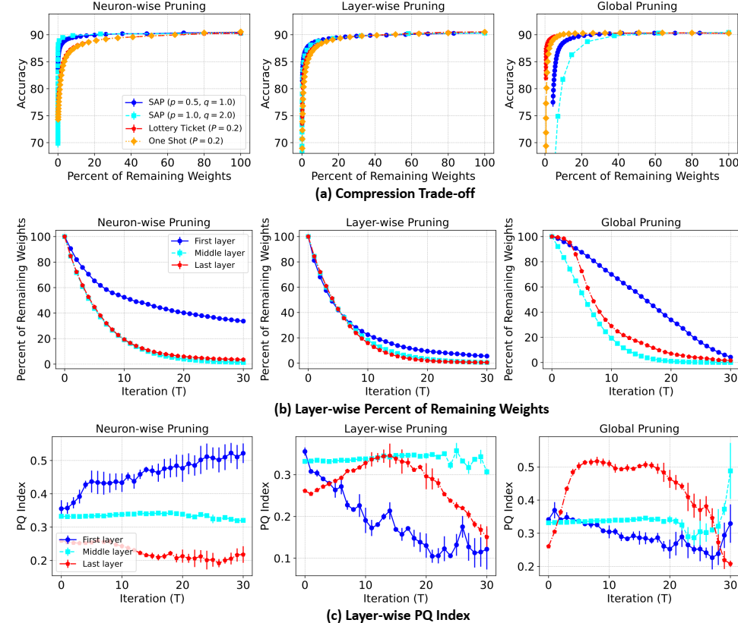
Experiments
Pruning scopes
SAP with ‘Global Pruning’ performs worse than ‘One Shot’ and ‘Lottery Ticket’ when the percent of remaining weights is small
SAP with ‘Neuron-wise Pruning’ and ‘Layer-wise Pruning’ perform better than ‘One Shot’ and ‘Lottery Ticket’
SAP Aligns with the intuition that the initial layers of CNN are more important to maintain the performance [6]
Figure 3. Results of various pruning scopes regarding (a) compression trade-off, (b) layer-wise percent of remaining weights, and (c) layer-wise PQ Index for CIFAR10 and CNN.
Notes:
We demonstrate various pruning scopes regarding compression trade-off, layer-wise percent of remaining weights, and layer-wise PQ Index. SAP with `Neuron-wise Pruning' and `Layer-wise Pruning' perform better than `One Shot' and `Lottery Ticket.’ SAP can adaptively adjust the pruning ratio of each neuron and layer, but `One Shot' and `Lottery Ticket' may over-prune specific neurons and layers because they adopt a fixed pruning ratio. Interestingly, the parameters of the first layer are pruned more aggressively by `Neuron-wise Pruning' than `Global Pruning' in the early pruning iterations. However, they are not pruned by `Neuron-wise Pruning' in the late pruning iterations, while `Global Pruning' still prunes them aggressively. It aligns with the intuition that the initial layers of deep neural networks are more important to maintain the performance

Slide 9
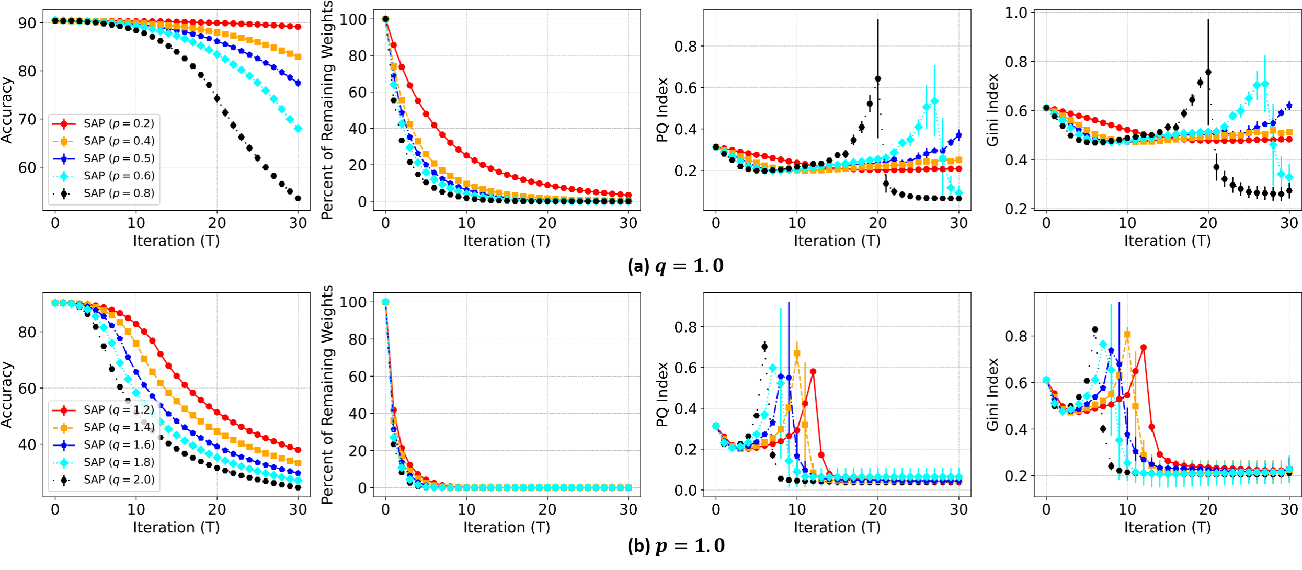
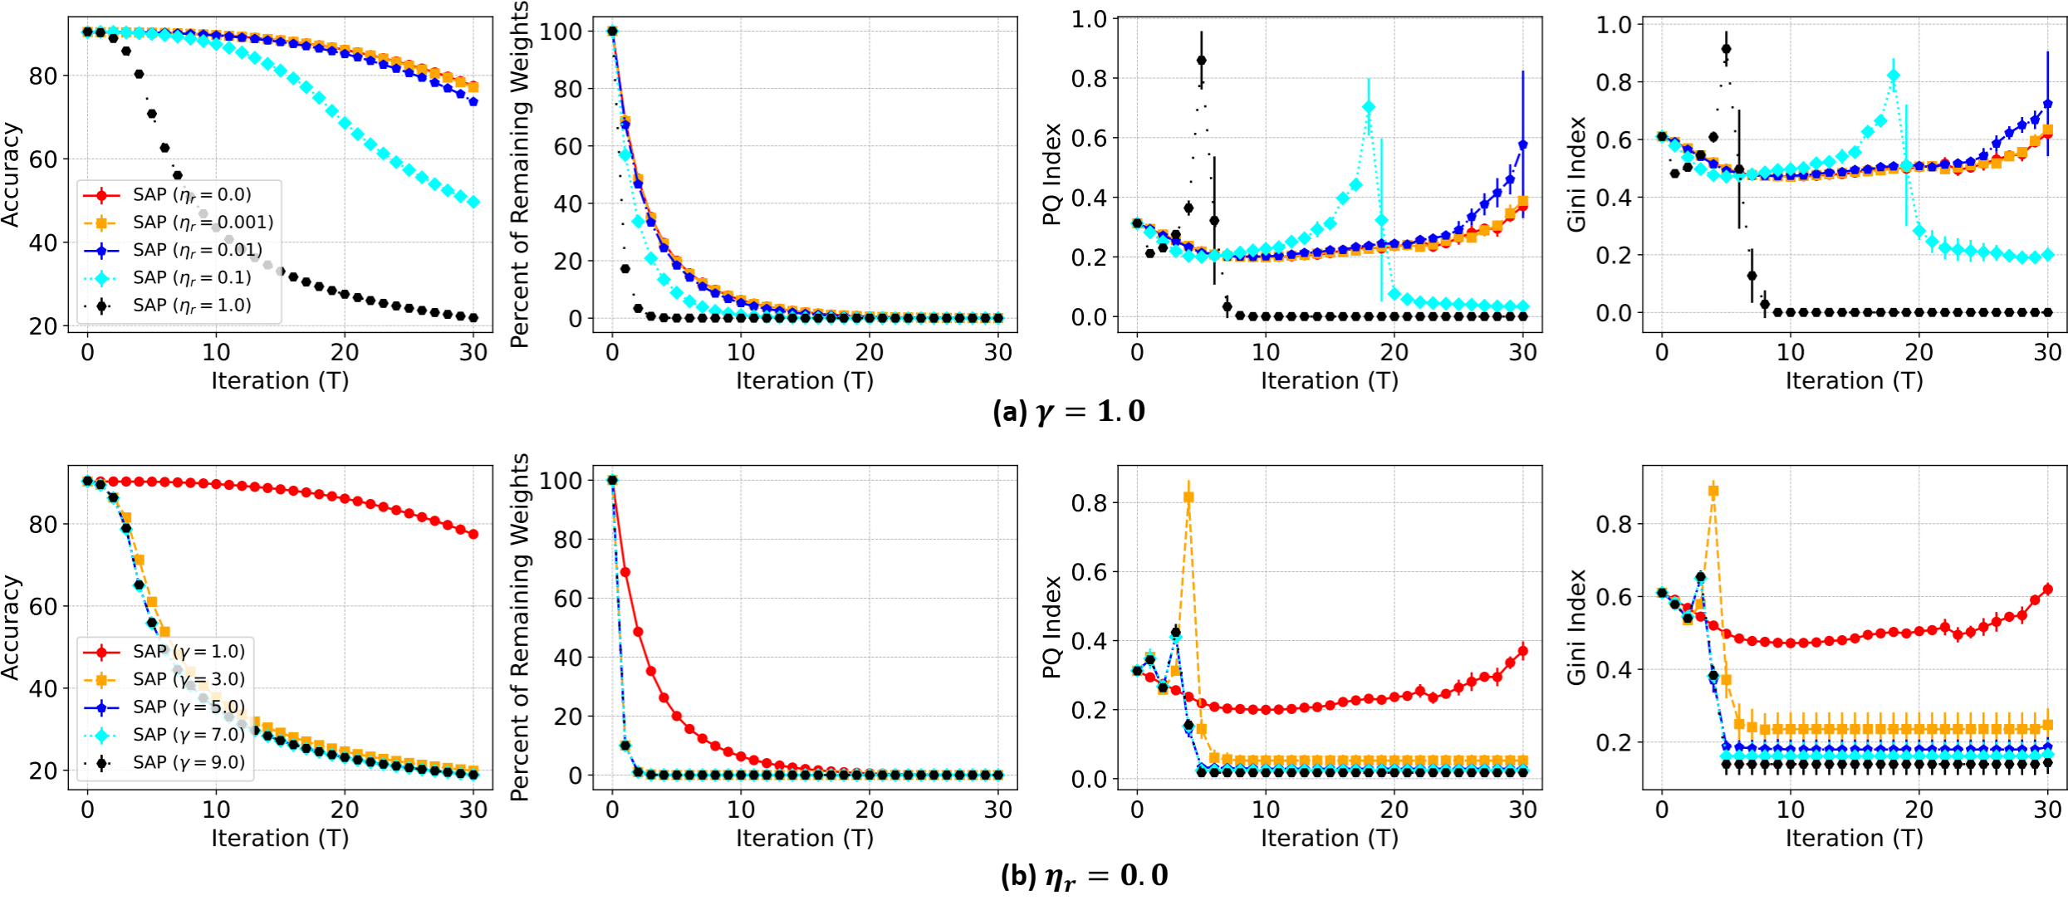

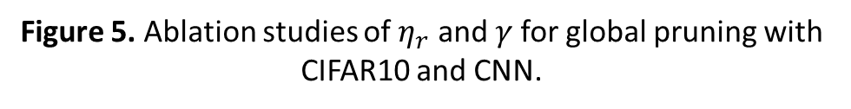
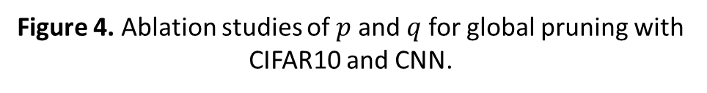
Experiments
Ablation studies
SAP prunes more aggressively when $q=1.0$ and $p$ is close to $q$, $p=1.0$and $q$ is distant from $p$, $η_{r}> 0$and $γ=1.0$and when $η_{r}=0.0$and $γ>1.0$
The dynamics of the sparsity measure of SAP with various ablation studies also corroborate our hypothesis
Figure 4. Ablation studies of $p$ and $q$ for global pruning with CIFAR10 and CNN.
Figure 5. Ablation studies of $η_{r}$ and $γ$for global pruning with CIFAR10 and CNN.
Notes:
We demonstrate ablation studies of various hyper parameters used in our algorithm. The dynamics of the sparsity measure of SAP with various ablation studies also corroborate our hypothesis

Slide 10
Conclusion
We proposed a new notion of sparsity for vectors named PQ Index (PQI), which follows the principles a sparsity measure should obey
We develop a new perspective on the compressibility of neural networks by measuring the sparsity of pruned models
We postulate a hypothesis on the relationship between the sparsity and compressibility of neural networks
We further develop a Sparsity-informed Adaptive Pruning (SAP) algorithm that uses PQI to choose the pruning ratio adaptively
Our experimental results demonstrate that SAP can compress more efficiently and robustly than state-of-the-art algorithms
Notes:
In this work,
We proposed a new notion of sparsity for vectors named PQ Index (PQI), which follows the principles a sparsity measure should obey
We develop a new perspective on the compressibility of neural networks by measuring the sparsity of pruned models
We postulate a hypothesis on the relationship between the sparsity and compressibility of neural networks
We further develop a Sparsity-informed Adaptive Pruning (SAP) algorithm that uses PQI to choose the pruning ratio adaptively
Our experimental results demonstrate that SAP can compress more efficiently and robustly than state-of-the-art algorithms
Some interesting future directions including using PQ Index for regularization and measuring the sparsity of a graph

Slide 11
Thank you!

Slide 12
References
[1] Gini, Corrado. Variabilità e mutabilità: contributo allo studio delle distribuzioni e delle relazioni statistiche.[Fasc. I.]. Tipogr. di P. Cuppini, 1912.
[2] Dalton, Hugh. "The measurement of the inequality of incomes." The Economic Journal 30.119 (1920): 348-361.
[3] Rickard, Scott, and Maurice Fallon. "The Gini index of speech." Proceedings of the 38th Conference on Information Science and Systems (CISS’04). 2004.
[4] Hurley, Niall, and Scott Rickard. "Comparing measures of sparsity." IEEE Transactions on Information Theory 55.10 (2009): 4723-4741.
[5] Frankle, Jonathan, and Michael Carbin. "The lottery ticket hypothesis: Finding sparse, trainable neural networks." arXiv preprint arXiv:1803.03635 (2018).
[6] Gale, Trevor, Erich Elsen, and Sara Hooker. "The state of sparsity in deep neural networks." arXiv preprint arXiv:1902.09574 (2019).

