Slide 1
Network-attached Encryption Accelerators
ECE532 - Final Presentation (Group 7)
Chunyee Chu
Serdar Ozturk
Soheil Shahrouz​

Slide 2
Agenda
Overview
Initial Proposed System
Mid-Project System
Problems Faced
Changes Made
Final System
Custom/Pre-built Blocks
Design Process
What we Learned

Slide 3
Overview
Encrypt data network on FPGA at line rate
Motivation
Software implementation has high latency (OS overhead and DDR latency)
Non-deterministic latency
Power inefficient
A network attached hardware accelerator
Custom IP-cores handle network traffic
No OS overhead
No external memory
Low energy consumption and deterministic latency

Slide 4
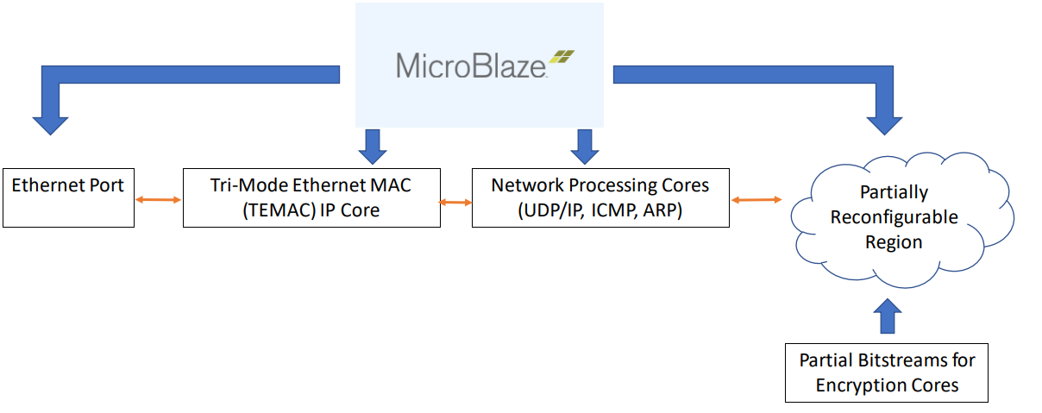
Initial System

Slide 5


Mid-Project System
Packet
Ethernet Port
TEMAC
Parser
Distributer
ARP
Type
ICMP
Aggregator
UDP Depacketizer
DES
UDP Packetizer
AXI-MM
AXI-Stream
HLS Core

Slide 6
Problems Faced
Lots of required research beforehand
Partial reconfiguration
Hard to debug code with partial reconfiguration
Hard to integrate with the rest of the project without it being completed
There are concerns of program correctness when using an AXI interface with partial reconfiguration
A member of our team left during the term.

Slide 7
Changes Made
Partial reconfiguration was removed
After a seperate mid-project demonstration, partial reconfiguration was removed
SD card introduction
To replace Partial Reconfiguration, we introduced SD-card implementation to the project.

Slide 8
Final System
Ethernet Port
TEMAC
Parser
Distributer
ARP
ICMP
Aggregator
UDP Depacketizer
DES
UDP Packetizer
MUX
DEMUX
AXI-MM
MUX
DEMUX
AXI-Stream
SD Card
AES
SD Card
HLS Core
Notes:
Integration of all blocks successfully done
AES and DES encryption meeting line rate of 12.5MB/s

Slide 9
Custom Blocks Pre-Built Blocks
AES encryption core (HLS)
DES encryption/decryption core (HLS)
Network Cores (ICMP, ARP, UDP)
AXI DMA
PmodSD IP
Tri-Mode MAC

Slide 10
Design Process
Network
Split the work into three parts, each member is responsible for a part:
Worked in parallel, with regular assistance in-between members.
Simulations were used to verify correctness before full implementation.
Encryption cores
Partial Reconfig/ SD card

Slide 11
What we learned
Planning is one of the most important steps of the design process. Plan for failure!
Working with HLS
Start from simple C or C++ codes
Optimization techniques in hardware, e.g. writing nested loops, merging loops, partitioning arrays, “unrolling” …
The benefits of using HLS ⇒ Rapid development!
Techniques of debugging
The importance of communication
Knowledges about networks, encryption algorithms and partial reconfiguration

Slide 12
Demo

