Slide 1


Centripetal Text: An Efficient Text Instance Representation for Scene Text Detection.
Prepared By:
Group No-28
20266006 Md Maksudur Rahaman Sohag
20266032 Sheikh Shariful Islam Shimul
20266033 Md. Zubaer Alam
20366015 Sohel Rana

Slide 2



1. Introduction
Increasing interest in Computer vision community.
Rapid development of Object detection and Segmentation.
Strategies to solve problem arising from challenges:
Treat Text Instances
Decompose text Instances.

Slide 3
2. Related Works
Component-free Methods
Component-based Methods

Slide 4
3. Methodology
3.1 Representation
An efficient scene text detector must have a well-defined representation for text instances. The traditional description methods inherited from generic object detection fail to encode the geometric properties of irregular texts.

Slide 5
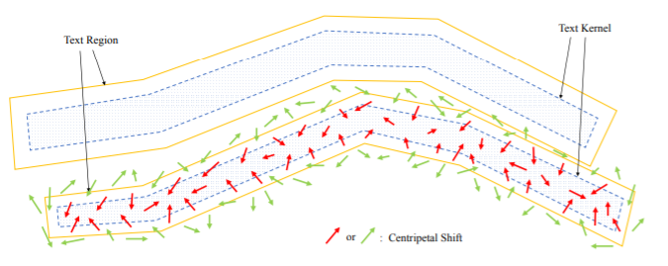
3.1 Representation

Slide 6
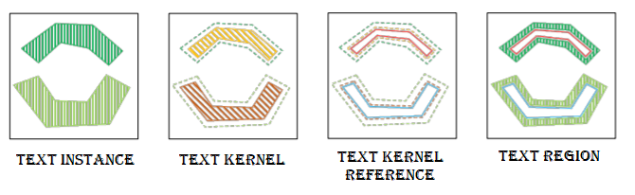
Label Generation

Slide 7
3.2 Scene text detection with CentripetalText
Network Architecture
In order to detect texts with arbitrary shapes fast and accurately, It is used the efficient model design in PAN (Pixel Aggregation Network) and equip it with our CT and Relaxed L1 loss.
Steps:
ResNet18 is used as the default backbone for fair comparison.
Two cascaded FPEMs (Feature Pyramid Enhancement Module) are utilized to continuously enhance the feature pyramid in both top-down and bottom-up manners.
Afterwards, the generated feature pyramids of different depths are fused by FFM (Feature Fusion Module) into a single basic feature.
Finally, It is predicted the probability map and the centripetal shift map.

Slide 8
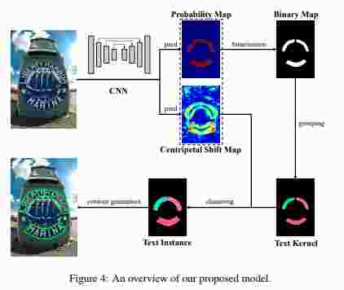
3.2 Scene text detection with CentripetalText
Inference
Binarize the probability map with a constant threshold
Find the connected components
Assign each pixel to the corresponding cluster and finally build the text contour for each group of text pixels.
Optimization
Loss function can be formulated as:
L = Lsegmentation + (lamda) * Lregression
CentripetalText Proposal Network (CPN)
Transforming the polygonal outputs to the minimum area rectangles and instance masks.
Following Text detection and recognition modules of Mask TextSpotter v3 and replace SPN with our CPN for the comparison of proposal quality and recognition accuracy

Slide 9

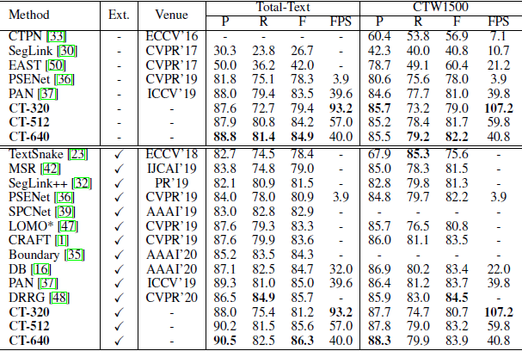

4. Experiments
4.1 Datasets:
SynthText
Total-Text
CTW1500
MSRA-TD500
4.2 Implementation Details:
ResNet pre-trained on ImageNet is used as the backbone of this method.
All models are optimized by the Adam optimizer
Train this model under two training strategies:
(1) Learning from scratch
(2) Fine-tuning models pre-trained on the SynthText dataset.
4.3 Ablation Study:
Table 1: Quantitative results of our text detection models
with different backbones and necks.
Table 2: Comparison between PAN [37] and our models with different regression losses. “Rep.” denotes representation
Table 3: Quantitative detection results on Total-Text and CTW1500. “P”, “R” and “F” represent the precision, recall, and F-measure, respectively.

Slide 10
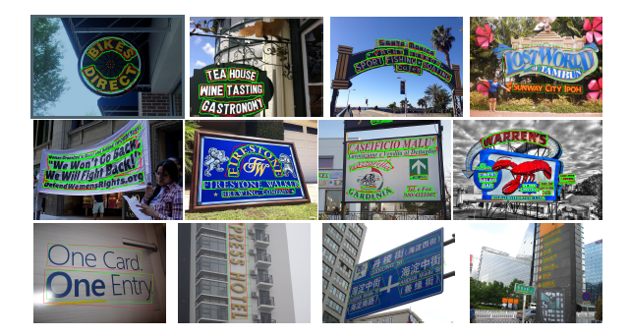
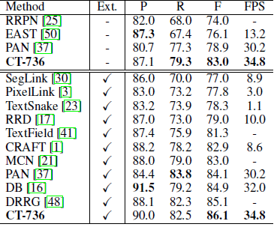
4.4 Comparisons with state-of-the-art methods
Curved text detection , We first evaluate our CT on the Total-Text and CTW1500 datasets to examine its capability for curved text detection. During testing, we set the short side of images to different scales (320, 512, 640) and keep their aspect ratios. We compare our methods with other state-of-the-art detectors in Tab. 3.
Table 4: Quantitative detection results on MSRATD500. “P”, “R” and “F” represent the precision, recall, and F-measure, respectively. “Ext.” denotes external training data.
Figure 5: Qualitative results of the proposed method. Images in row 1-3 are sampled from Total-Text, CTW1500, and MSRA-TD500, respectively. Ground-truth annotations are in red and our detection results are in green.
Multi-oriented text detection, We also evaluate CT on the MSRA-TD500 dataset to test the robustness in modeling multi-oriented texts. As shown in Tab. 4, CT achieves the F-measure value of 83.0% at 34.8 FPS without external training data.

Slide 11
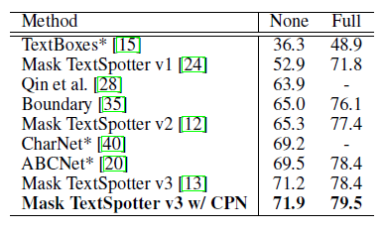
Table 5: Quantitative end-to-end recognition results on Total-Text. The evaluation protocol is the same as the one in Mask TextSpotter v3 [13]. “None” means recognition without any lexicon. “Full” lexicon contains all words in the test set. * indicates the multi-scale testing is performed.
End-to-end text recognition, We simply replace SPN in Mask TextSpotter v3 with our proposed CPN to develop a more powerful end-toend text recognizer. We evaluate CPN-based text spotter on Total-Text to test the proposal generation quality for the text spotting task. As shown in Tab. 5, equipped with CPN, Mask TextSpotter v3 achieves the F-measure values of 71.9% and 79.5% when the lexicon is not used and used respectivel
5. Conclusion
To keep the simplicity and robustness of text instance representation, we proposed CentripetalText (CT) which decomposes text instances into the combination of text kernels and centripetal shifts. Text kernels identify the skeletons of text instances while centripetal shifts guide the external text pixels to the internal text kernels. Moreover, to reduce the burden of model training, a relaxation operation was integrated into the dense regression for centripetal shifts, allowing the correct prediction in a range. Equipped with the proposed CT, our detector achieved superior or comparable performance compared to other state-of-the-art methods while keeping the real-time inference speed.

Slide 12
Thank You

