Slide 1
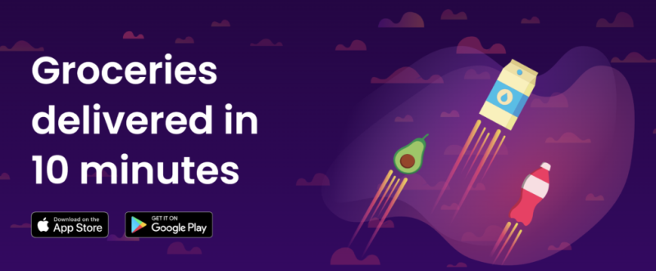
18CSE301J Information Visualisation
Sit Dolor Amet
Done By :- - Shaik Sohel Pasha (RA2111003010669)
- Aalap Sangvikar (RA2111003010690)
UNVEILING ZEPTO (An In-Depth Analysis and Exploration)

Slide 2
Zepto Delivery Insights: A Closer Look at Efficiency and Excellence
In today's fast-paced world, the need for quick and reliable delivery services has never been greater. Zepto Delivery is at the forefront of this paradigm shift, offering a comprehensive analysis of its groundbreaking business model.
Our in-depth exploration of Zepto Delivery will take you on a journey through its inception, growth, and its impact on the delivery industry. We delve into the innovative strategies that have propelled Zepto into the limelight, redefining customer expectations and reimagining last-mile delivery.
Discover how Zepto utilizes cutting-edge technology, from AI-driven logistics optimization to user-friendly mobile apps, to connect consumers with an array of services ranging from food delivery to grocery shopping, and even prescription drug delivery. We'll dissect the key components of Zepto's ecosystem, shedding light on its seamless order processing, real-time tracking, and contactless delivery practices.
Moreover, our analysis will provide insights into Zepto's business sustainability, market penetration, and its role in shaping the future of on-demand delivery. We'll also address the challenges Zepto faces in a competitive landscape and its strategies for overcoming them.

Slide 3
Dataset description
The "Zepto Delivery Analysis" dataset, sourced from Kaggle, provides a comprehensive set of attributes related to various products available on the Zepto delivery platform. This dataset is designed to support an in-depth analysis of Zepto's product offerings, pricing strategies, and inventory management. With a total of five columns, it offers valuable insights into the dynamics of Zepto's online marketplace.
Columns:
Product Name: This column contains the names or descriptions of the products available on the Zepto platform. It helps identify and categorize the different items offered for delivery.
MRP (Maximum Retail Price): MRP represents the highest price at which a product can be sold to consumers. It serves as a reference point for pricing and helps customers understand the potential value of a product.
Discount Percentage: This column indicates the percentage of discount applied to each product. Discounts can attract customers and influence their purchase decisions.
Available Quantity: It provides information about the quantity of each product currently in stock and available for purchase. This data can be crucial for inventory management and predicting product availability.
Discount Selling Price: This column represents the selling price of a product after applying discounts. It showcases the actual price customers will pay for the item.

Slide 4
Fruits and vegetables
The dataset provides valuable insights into the pricing dynamics of fruits and vegetables available on the Zepto delivery platform. It specifically focuses on two key aspects: the Maximum Retail Price (MRP) and the Discounted Price for these fresh produce items. Analyzing this data allows us to understand how Zepto manages pricing strategies for essential perishable goods, ensuring affordability and quality for its customers.
Price Variations: Analyze MRP and discounted prices to understand how Zepto manages pricing fluctuations for fruits and vegetables.
Customer Affordability: Assess how Zepto's pricing policies contribute to making fresh fruits and vegetables more affordable and accessible to a wide range of customers.

Slide 5
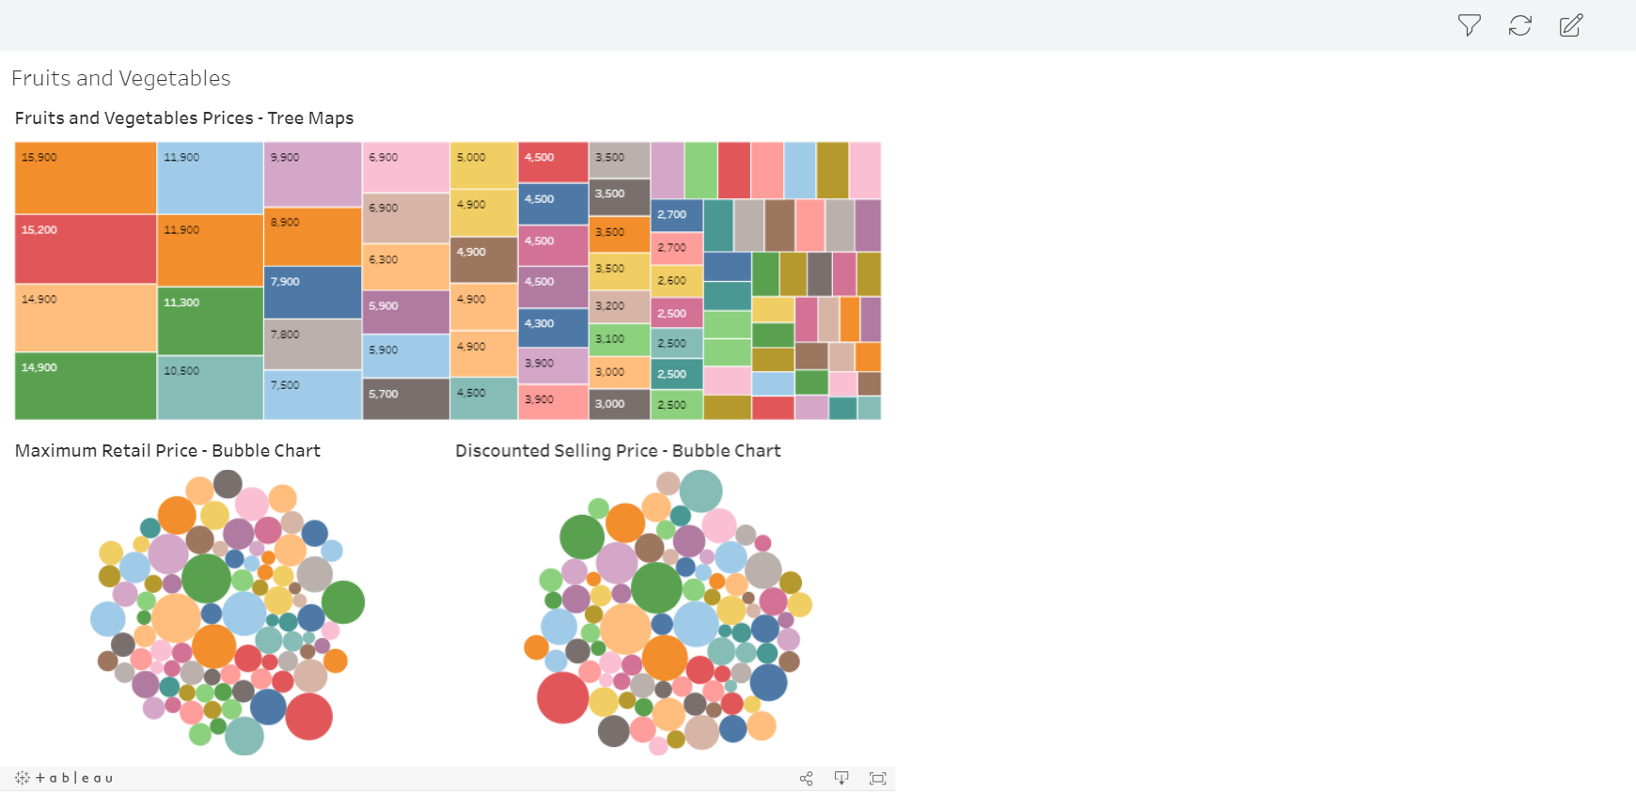
Tableau representation

Slide 6
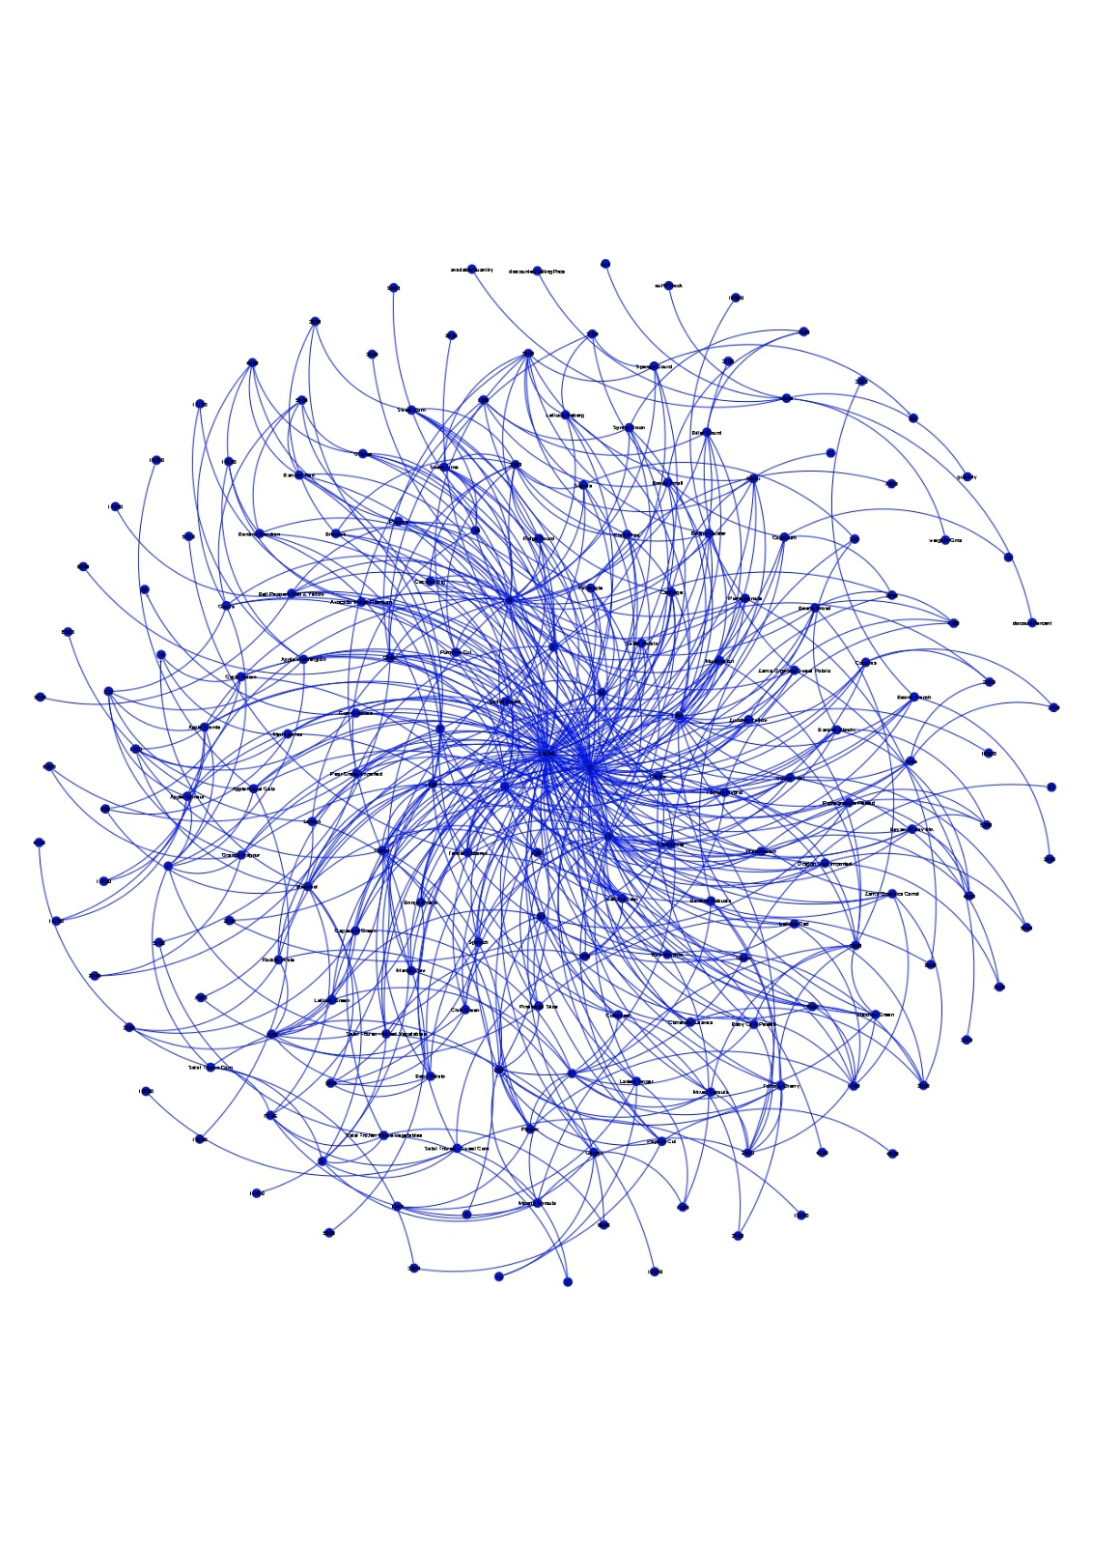
Gephi representation

Slide 7
Dairy, bread and batter
This analysis focuses on the pricing dynamics of Dairy, Bread, and Batter products on Zepto. It examines Maximum Retail Prices (MRP) as the reference point for customers and the Discounted Prices offered to attract and influence consumer choices. Understanding these prices in these essential categories helps customers make informed decisions and allows Zepto to optimize its pricing strategies for growth and competitiveness.
Maximum Retail Price (MRP):MRP for Dairy, bread and batter sets the highest price at which these snack items can be legally sold on Zepto. It serves as a reference point for customers, helping them gauge the value and cost-effectiveness of their biscuit purchases.
Discounted Selling Price: The Discounted Selling Price represents the actual cost that customers pay for biscuits after applying any discounts, promotions, or offers on Zepto. It reflects the immediate savings that customers can enjoy when buying biscuits through the platform.

Slide 8
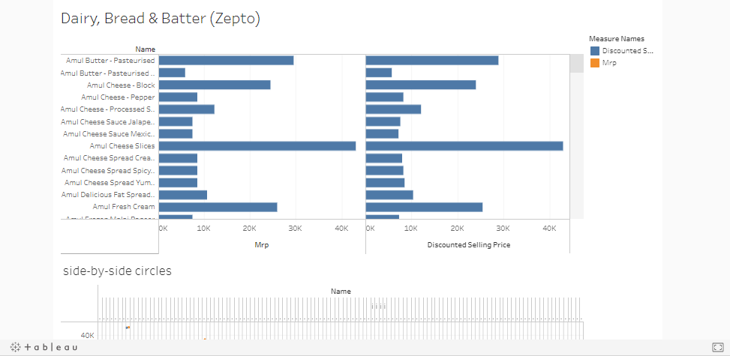
TABLEAU REPRESENTATION

Slide 9

GEPHI REPRESENTATION

Slide 10
BISCUITS
The Maximum Retail Price (MRP) and Discounted Selling Price for biscuits on Zepto are essential factors for customers and the platform's pricing strategy:
Maximum Retail Price (MRP):MRP for biscuits sets the highest price at which these snack items can be legally sold on Zepto. It serves as a reference point for customers, helping them gauge the value and cost-effectiveness of their biscuit purchases.
Discounted Selling Price:The Discounted Selling Price represents the actual cost that customers pay for biscuits after applying any discounts, promotions, or offers on Zepto. It reflects the immediate savings that customers can enjoy when buying biscuits through the platform.
Analyzing both MRP and Discounted Selling Price for biscuits provides transparency to customers and helps Zepto optimize its pricing strategies, ensuring competitive prices and attractive offers for this popular snack category.

Slide 11
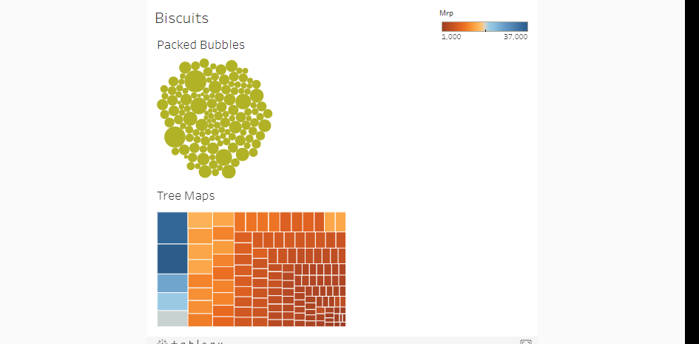
TABLEAU REPRESENTATION

Slide 12
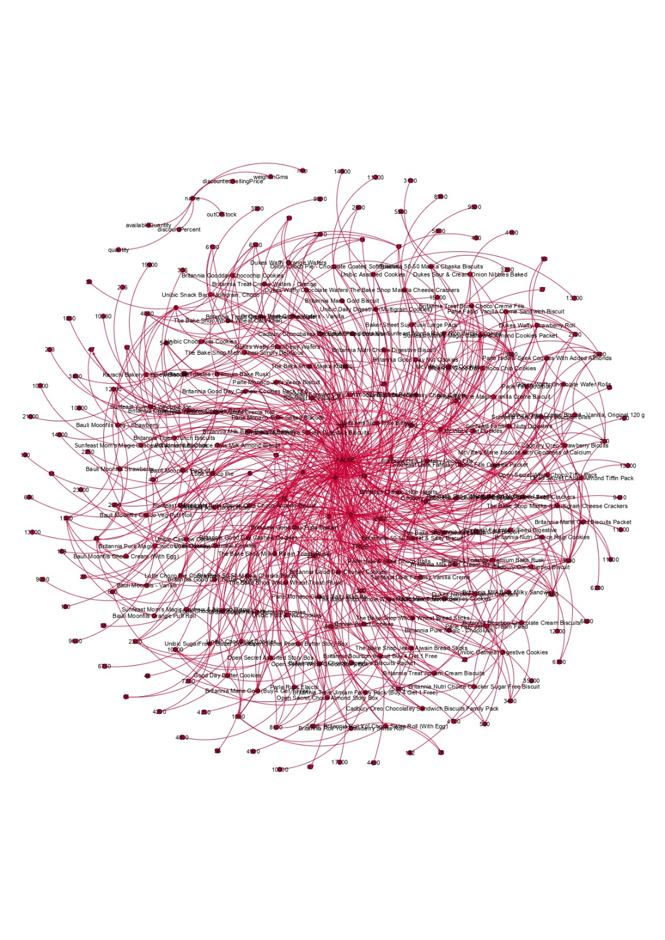
GEPHI REPRESENTATION

Slide 13
MEAT, FISH AND EGGS
The Maximum Retail Price (MRP) and Discounted Selling Price for meat, fish, and eggs on Zepto are crucial for understanding pricing dynamics and value for customers:
Maximum Retail Price (MRP):MRP for meat, fish, and eggs sets the highest price at which these products can be legally sold on Zepto. It acts as a reference point, allowing customers to assess the value and cost of these essential food items.
Discounted Selling Price:The Discounted Selling Price represents the actual price customers pay for meat, fish, and eggs after applying discounts, promotions, or special offers on Zepto. It reflects the immediate savings that customers can benefit from when purchasing these products through the platform.
Analyzing both MRP and Discounted Selling Price for meat, fish, and eggs provides transparency to customers and helps Zepto optimize its pricing strategies, ensuring competitive prices and attractive deals in these critical food categories.

Slide 14
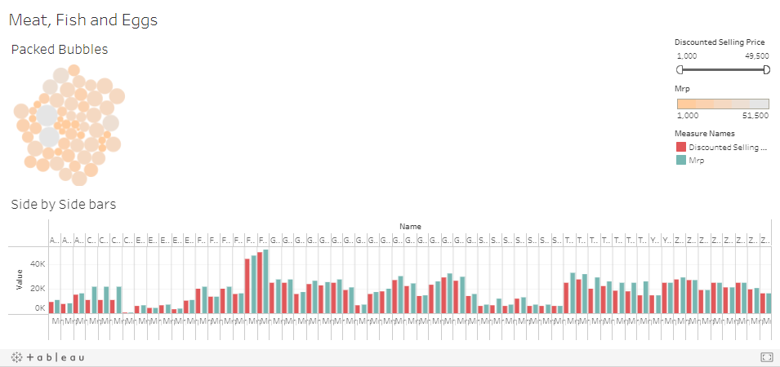
TABLEAU REPRESENTATION

Slide 15
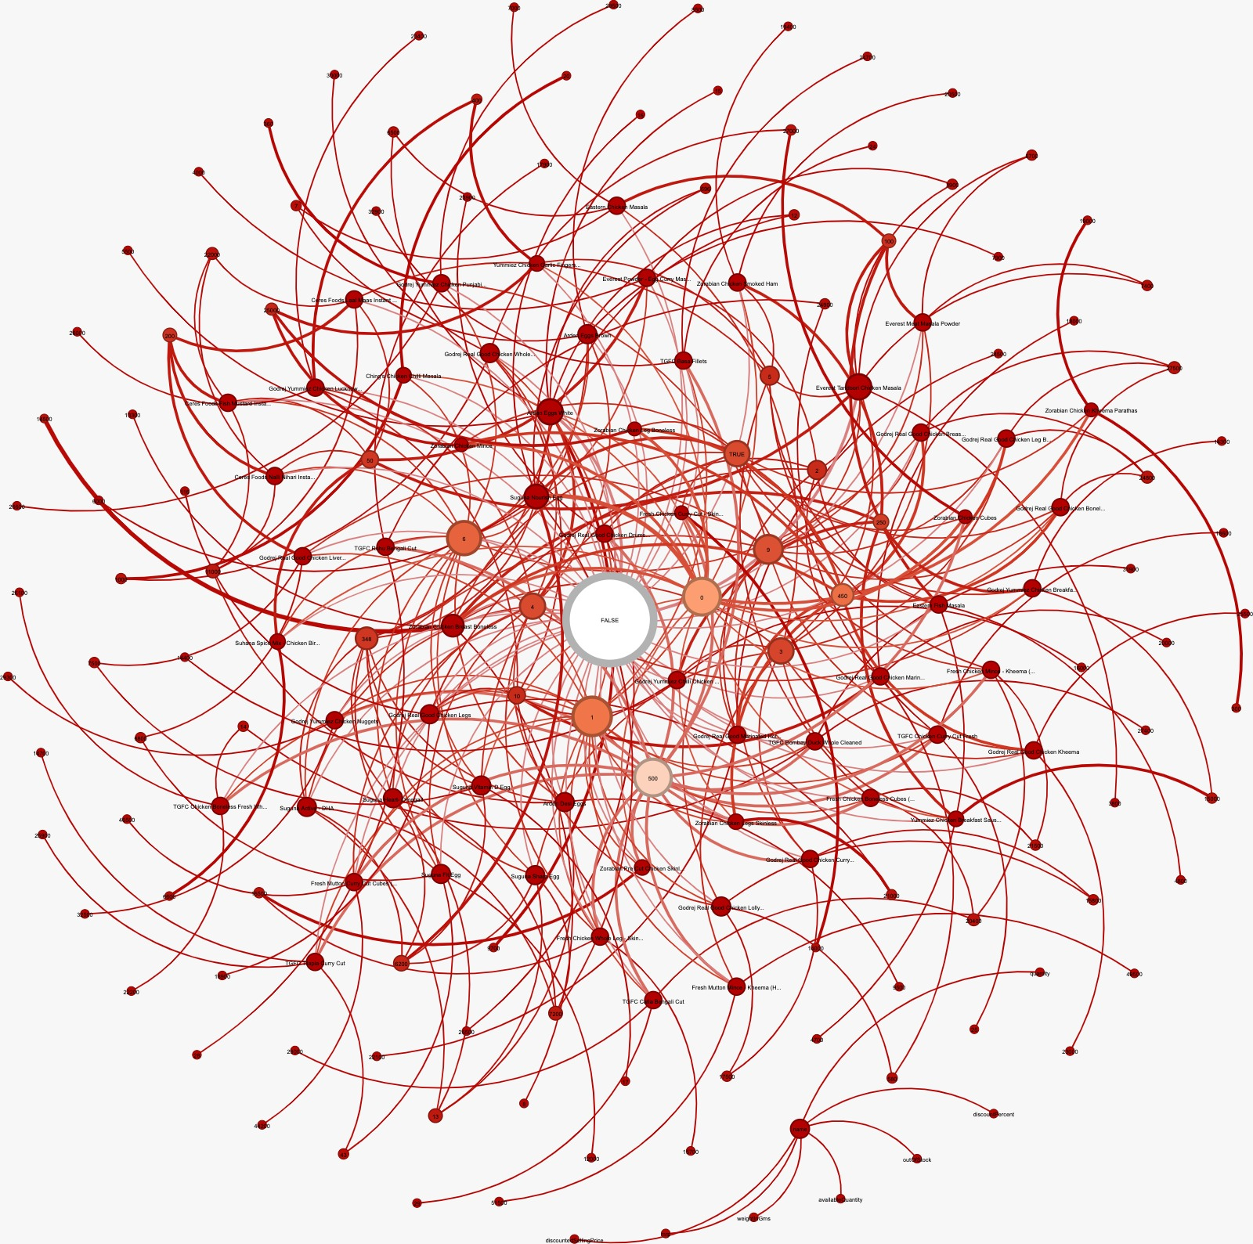
GEPHI REPRESENTATION

Slide 16
HEALTH AND HYGIENE PRODUCTS
The Maximum Retail Price (MRP) and Discounted Selling Price for health and hygiene products on Zepto are significant aspects for consumers and the platform's pricing strategy:
Maximum Retail Price (MRP):MRP for health and hygiene products establishes the highest price at which these items can legally be sold on Zepto. It serves as a reference point, enabling customers to assess the value and cost-effectiveness of their purchases in this essential category.
Discounted Selling Price:The Discounted Selling Price represents the actual price customers pay for health and hygiene products after applying discounts, promotions, or special offers on Zepto. It reflects the immediate savings that customers can enjoy when buying these items through the platform.
The analysis of both MRP and Discounted Selling Price for health and hygiene products enhances transparency for customers and enables Zepto to refine its pricing strategies, ensuring competitive prices and attractive deals in this critical product category.

Slide 17
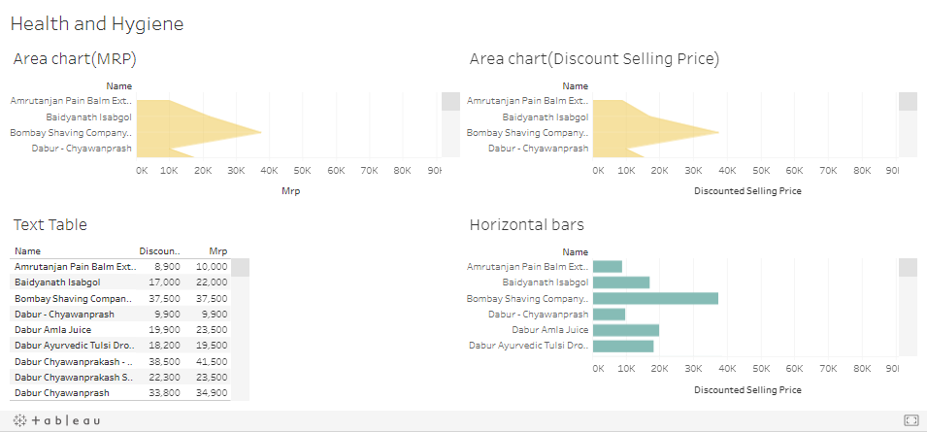
TABLEAU REPRESENTATION

Slide 18
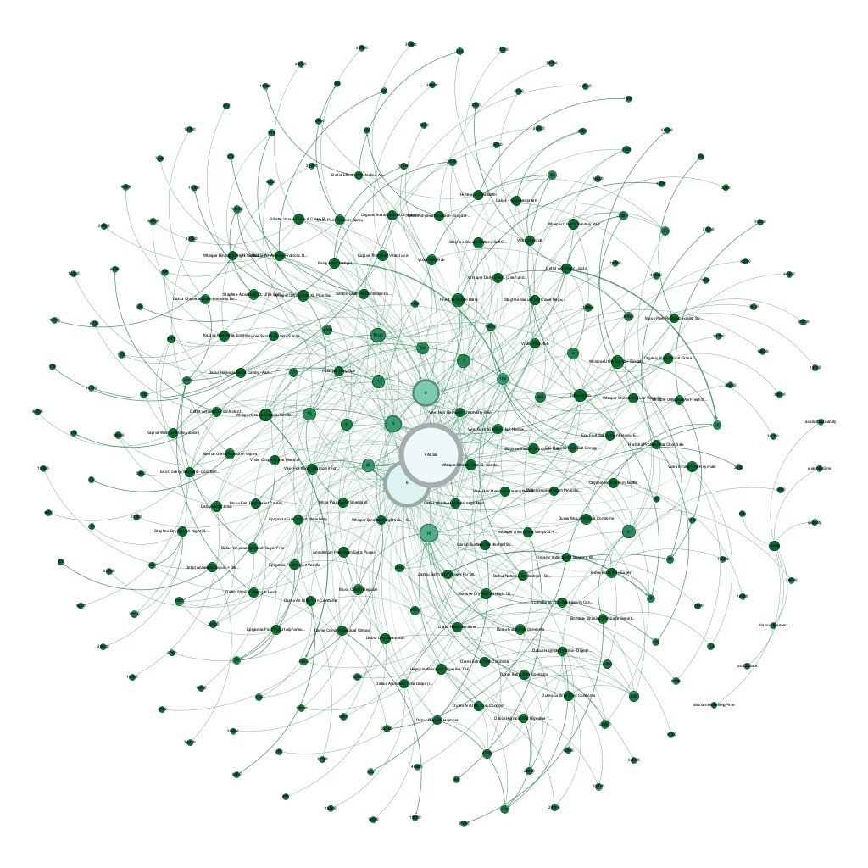
GEPHI REPRESENTATION

Slide 19
conclusion
In our thorough exploration of Zepto's pricing strategy, focusing on Maximum Retail Price (MRP) and Discounted Prices, it becomes evident that Zepto places a strong emphasis on customer satisfaction and affordability. By displaying MRP alongside Discounted Prices, Zepto provides a level of transparency that fosters trust among its users. This transparency empowers customers to make informed choices while ensuring they perceive the value in their purchases. Moreover, Zepto's commitment to competitive pricing strategies is highlighted by the fluctuations in Discounted Prices, demonstrating its agility in adapting to market conditions and meeting evolving consumer preferences. This approach extends across a wide spectrum of essential products, encompassing dairy, bread, meat, fish, eggs, health, and hygiene items, ultimately creating a comprehensive and value-centric shopping experience. In conclusion, Zepto's utilization of MRP and Discounted Prices underscores its dedication to delivering customer-centric solutions and maintaining its competitive edge in the dynamic landscape of online retail.

Slide 20
Thank you

