Slide 1
Event Planner with Laravel
Premier University, Chittagong
Sohela Showrin: 2104010202199
Rahin Toshmi Ohee: 2104010202204
Tahsin Tanvin: 2104010202226

Slide 2





Outlines
Introduction Motivation Features Methodology
Selected Screenshots Limitations & future works Conclusion
References

Slide 3
Introduction to Event Planning
Event management platform Laravel 10 backend
Bootstrap 4 frontend Web technologies
Secure, eﬃcient, and customizable User-friendly
Event registration, payment, and management Integration with other tools
Data encryption, user authentication Customizable features for event organizers

Slide 4
Motivation
Importance of event planning Streamlined event management Online event planning tools Eﬃcient event organization Modern technology solutions
User-friendly and ﬂexible platform Scheduling, mailing, review
Simpliﬁed process for individuals and organizations

Slide 5
Key Features
Easy to use interface
End-to-end event management Customizable event setup Email notiﬁcation system
Service packages (basic, medium, premium) Aﬀordable and complete event planning solution Registration, scheduling, communication Customizable for diﬀerent event types

Slide 6
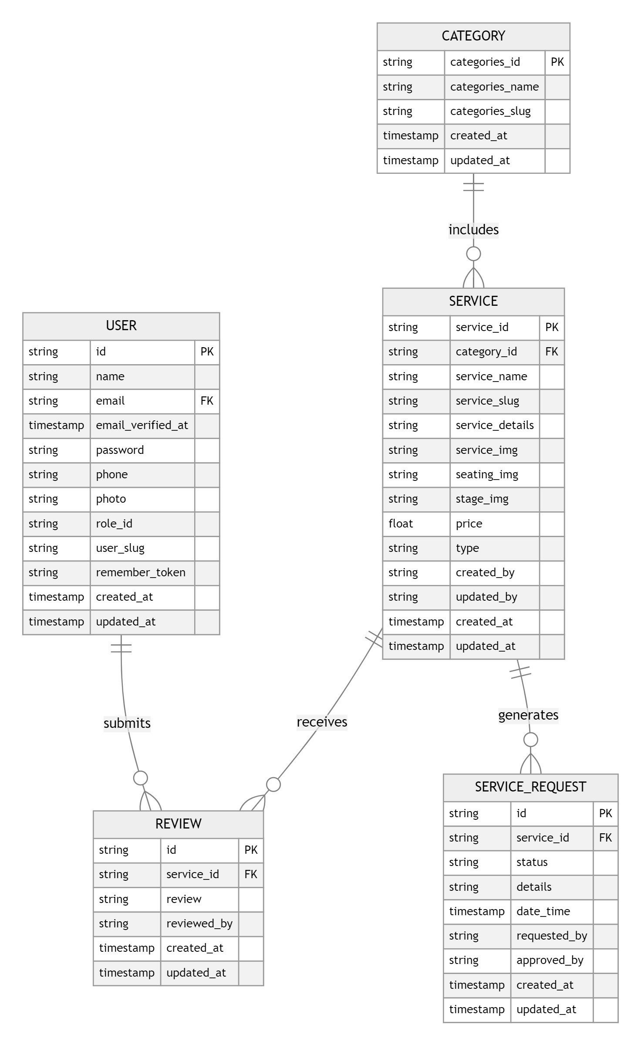
Methodology
ER Diagram
Entities: User, Event, Service, Review
Attributes: User ID, Event ID, Service ID, Review ID, Name, Email, Event Date, Service Details, Rating Relationships: Users book Events, Events have Services, Users leave Reviews
Primary Keys, Foreign Keys Database structure Relational database schema One-to-many relationships
Event management system data model

Slide 7
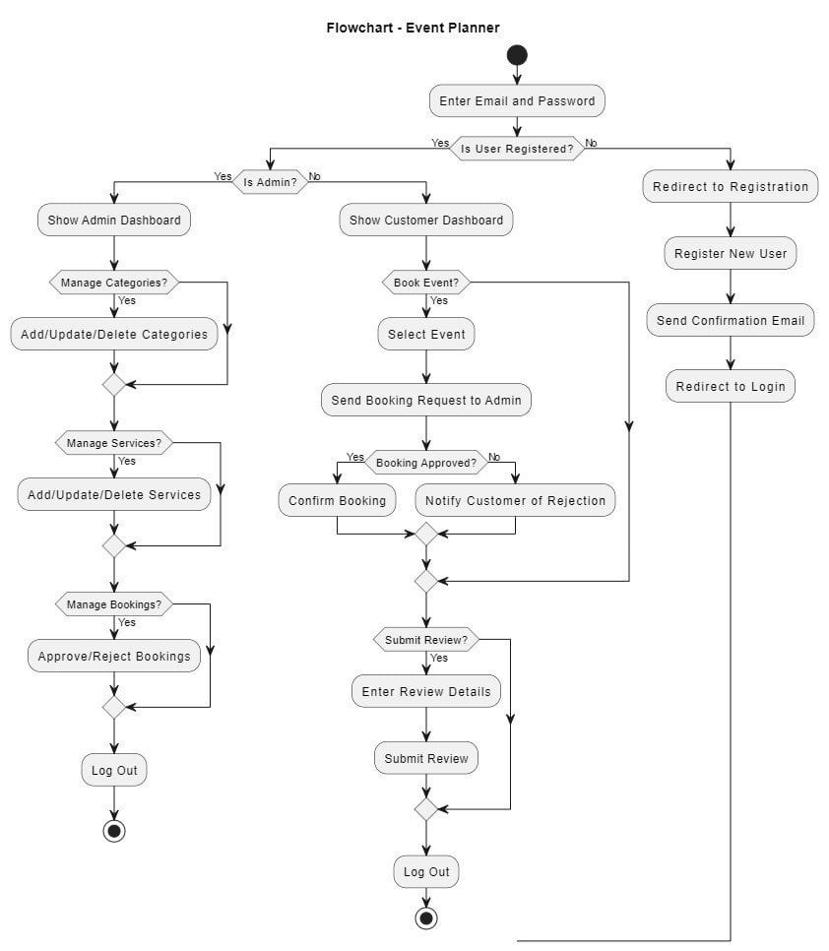
Methodology
Flow Chart
Process steps: Event booking, Service selection, Payment processing
Decision points: Payment successful, Payment pending
User roles: Admin, Customer
Actions: Book event, Submit payment, Receive conﬁrmation
Sequence of actions
Workﬂow of event management system Interaction between users and system

Slide 8
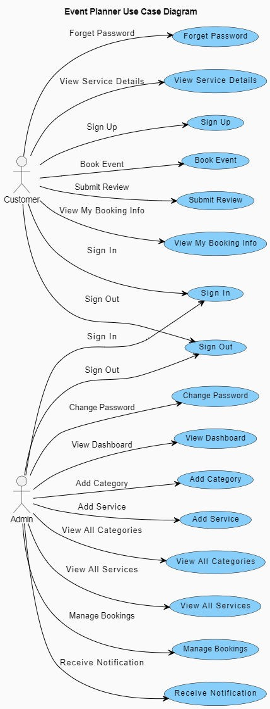
Methodology
USE case Diagram
Event booking workﬂow
Admin and Customer interactions Service request and management Payment gateway integration Transaction ID management
Pending vs completed payment status Dashboard functionality
Stripe integration for payments
Event booking system process ﬂow

Slide 9
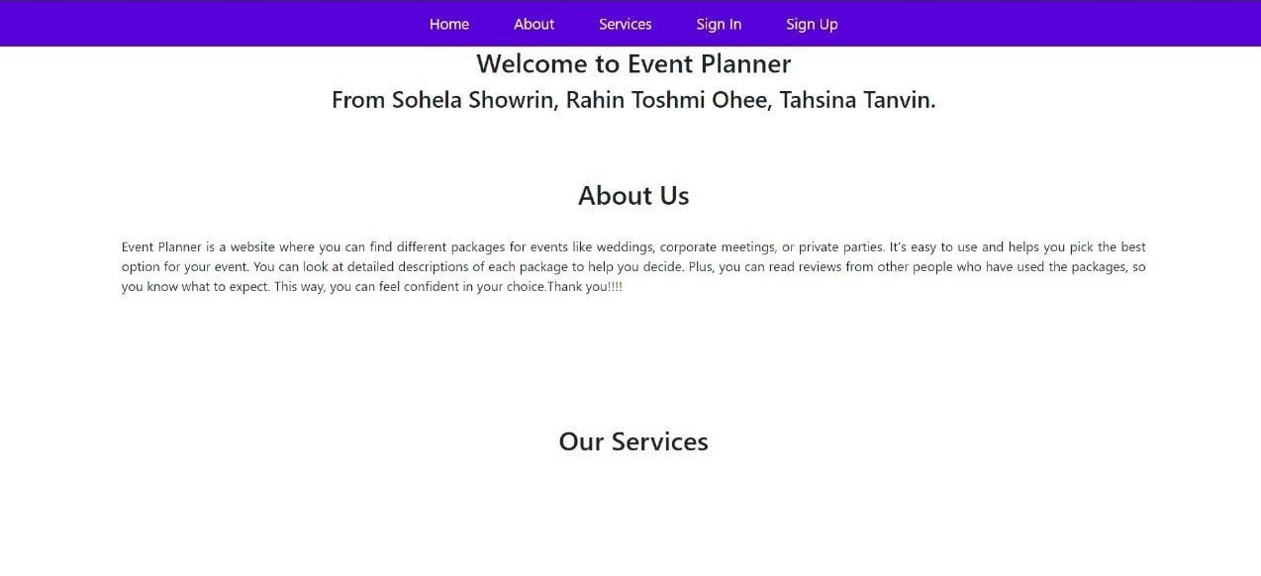
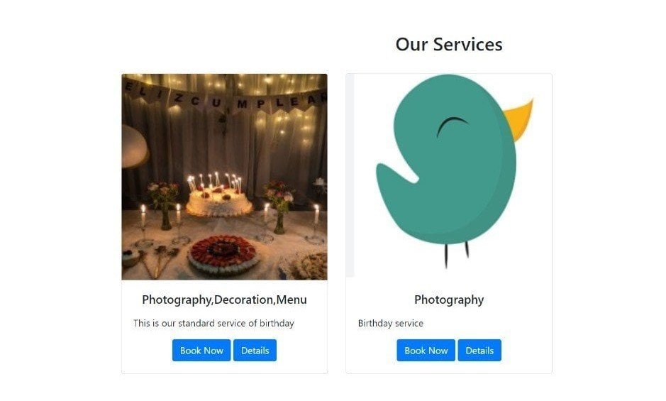
Selected Screenshots
Website Dashboard

Slide 10
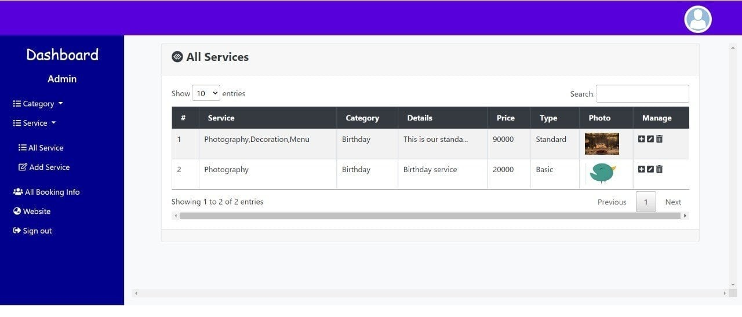
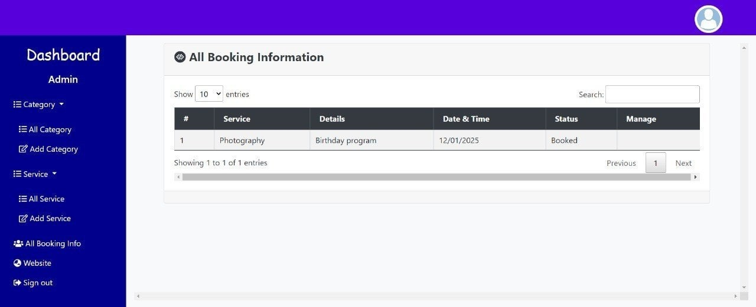
Admin Dashboard(All Services)
Admin Dashboard(ALL Booking Information)

Slide 11
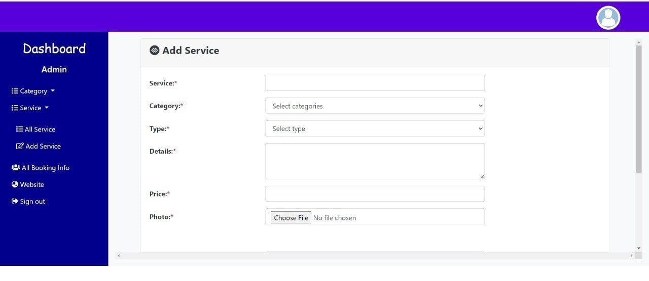
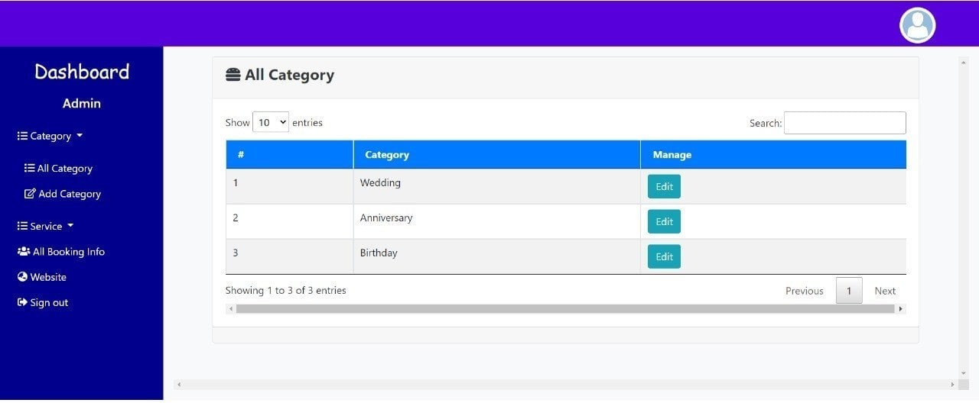
Admin Dashboard(Add service)
Admin Dashboard(All Category)

Slide 12
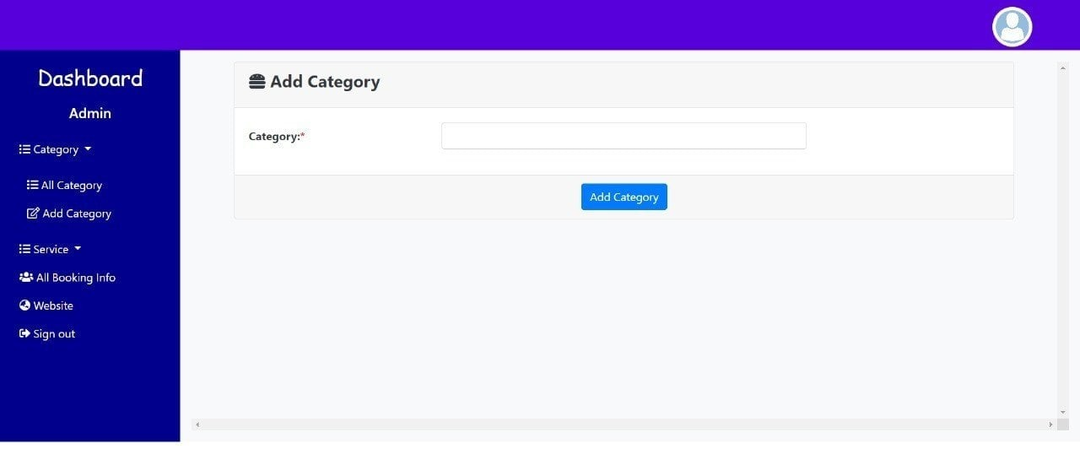
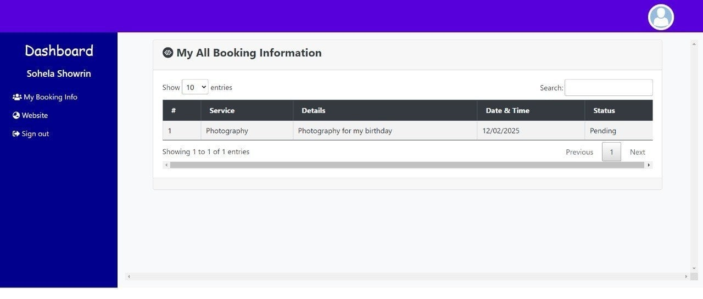
Admin Dashboard(Add Category)
Customer Dashbord(Booking Information

Slide 13
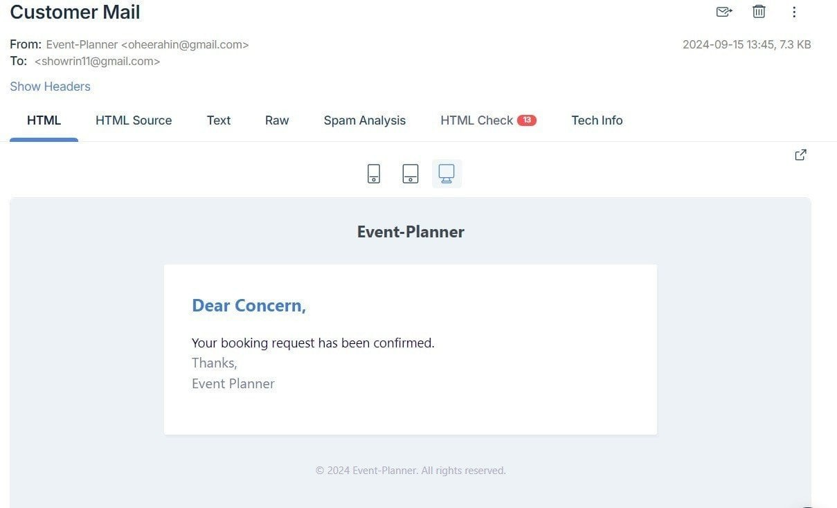
Customer Receive Mail Via Mailtrap

Slide 14
Conclusion and Future Steps
Lack of payment integration (future: Stripe) No "Contact Us" page
Basic user proﬁle management
Future work :
Payment gateway integration Contact form addition
Mobile responsiveness
Advanced analytics and reporting Expanded user roles
Feedback and rating system
Enhanced security (multi-factor authentication)

Slide 15
References
. B. Abdullahi, H. I. Ndayagi, and F. A. Adeyinka, “Eventplan: A framework for web- based integrated event planning and management system,” 2018.
. Bhoumik, “Event organization system,” Ph.D. dissertation, National University, Bangladesh, 2023.
A. Ashfaq, “Event management system: Eventcart,” 2014.
. Smith, “A comprehensive web-based event management tool,” International Jour- nal of Event Management, vol. 15, no. 2, pp. 123–135, 2023.
. Johnson, “Integrating modules in event management systems,” in Proceedings of the International Conference on Event Technology, Tech Conferences, 2023, pp. 76– 85.
. Doe, Event Organization and Job Placement Systems, 1st. City, Country: Event Solutions Press, 2023.

Slide 16
Thanks!

