Slide 1
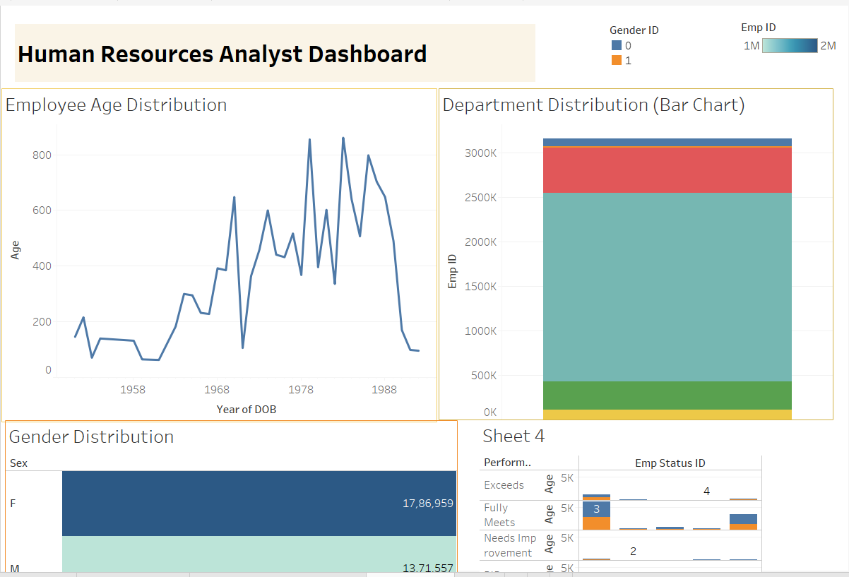
Human Resources Analyst
Internship ID: UMIP19869
Name: Muhammad Sohel Ali
Employee Age Distribution:
The majority of employees were born between 1978 and 1988, with a peak in 1988.There is a significant drop in the number of employees born before 1978.
Department Distribution (Bar Chart):
The largest department has approximately 30,000 employees .
The second-largest department has around 20,000 employees.
The smallest department has around 5,000 employees).
Gender Distribution:
There are more female employees (17,86,959) than male employees (13,71,557).
Performance Ratings:
The majority of employees have a performance rating of "Fully Meets" (around 40%).
Around 30% of employees have a performance rating of "Exceeds".
A smaller percentage of employees have a performance rating of "Needs Improvement" (around 10%).

Slide 2
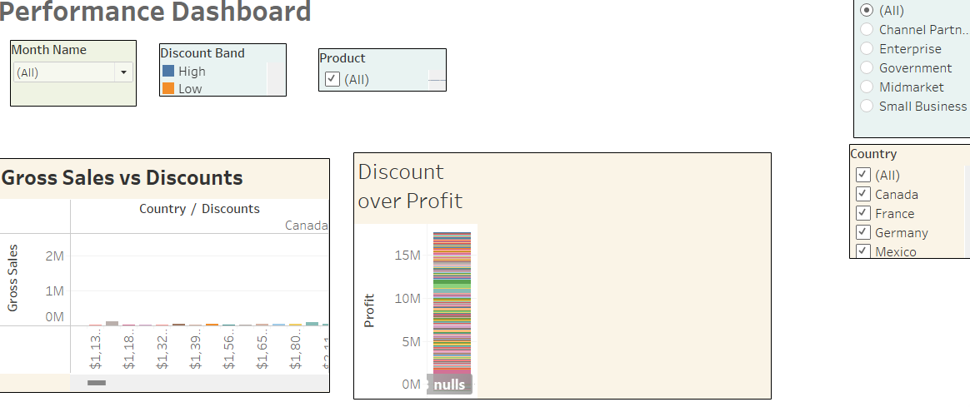
Financial Performance
Gross Sales vs Discounts:
The graph shows a very low sales volume across different discount levels, with the highest sales volume at a discount of $1.13.
The sales volume is almost negligible at higher discount levels.
Discount over Profit:
The graph shows a single bar representing the profit, which reaches approximately 15M.
The profit is not broken down by country or product category, but rather shows a cumulative total.
Overall, the graphs suggest that sales volumes are low across different discount levels, and the profit is relatively high, but not broken down by specific categories.

Slide 3
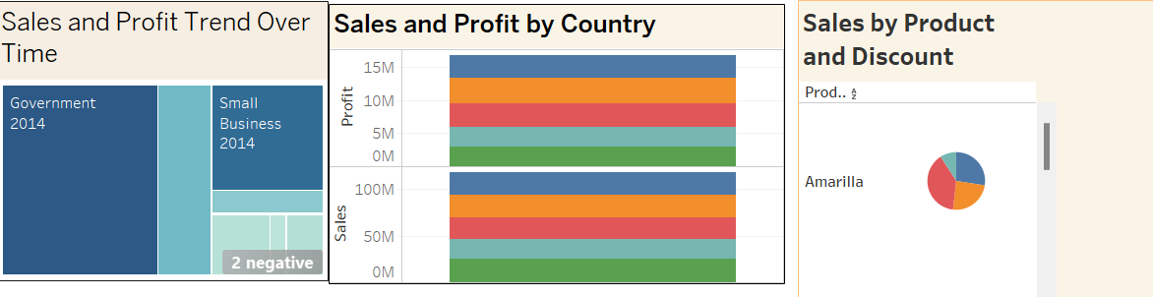
Sales and Profit Trend Over Time:
The majority of sales and profit come from the Government sector in 2014.
Small Business sector in 2014 is the second-largest contributor.
There are some negative values in the data, but the exact details are not clear.
Sales and Profit by Country:
The company has sales and profit in multiple countries, with 4-5 countries represented.
The profit figures range from 0 to 15M, while sales figures range from 0 to 100M.
The exact country-by-country breakdown is not clear, but the graph suggests a diverse geographic presence.
Sales by Product and Discount:
The pie chart shows that the product "Amarilla" has a significant share of sales.
The chart is divided into 3-4 segments, suggesting that there are multiple product categories or discount levels.
The exact details of the pie chart are partially cut off, but it appears to show a diverse product mix.

Slide 4
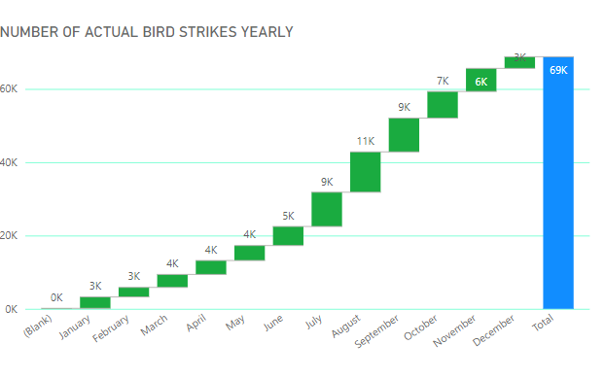
Data Visualization of Bird Strikes between 2000 – 2011
The number of bird strikes varies throughout the year, with the lowest numbers in winter months (January to March) and a gradual increase through spring and summer.
There is a significant spike in bird strikes in the fall months, with November reaching 7K and December peaking at 6K.
The yearly total of bird strikes is 69,000, with the majority of incidents occurring in the fall migration period.
The graph suggests a seasonal pattern in bird strikes, with the highest numbers occurring during the fall months.

Slide 5
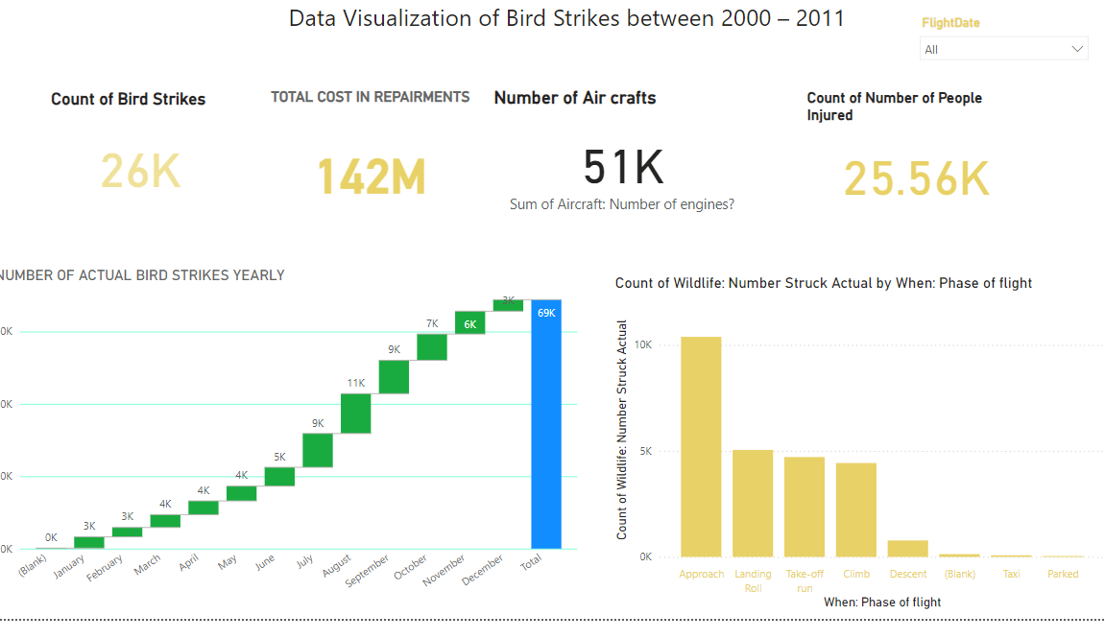
The number of bird strikes varies throughout the year, with the highest number in December (around 7K) and the lowest in January (around 3K).
The majority of bird strikes occur during the approach phase of flight (around 10K), followed by landing roll, take-off run, and climb.
The total cost of repairments due to bird strikes is 142M, and the number of people injured is 25.56K.
The number of aircraft affected is 51K.
Overall, the graphs suggest that bird strikes are a significant issue in aviation, with a clear seasonal pattern and a high frequency during certain phases of flight.
Internship ID: UMIP19869
Name: Muhammad Sohel Ali

