Slide 1
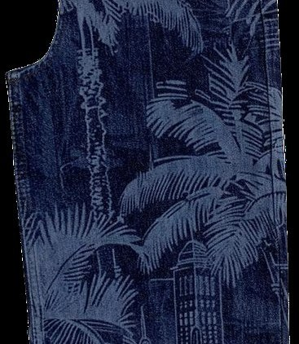

DENIM WASHING
A Buyer's Introduction
Denim washing for buyers, merchandisers and product developers
Compiled and built by Md. Sohel Rana
RMG Xpress Insights by Sohel
sohelprsnl.com
Eleven sections · Open edition · 2026
Notes:
Open by asking how many in the room have stood inside a denim laundry. Usually one or two. This programme is built for everyone else.

Slide 2
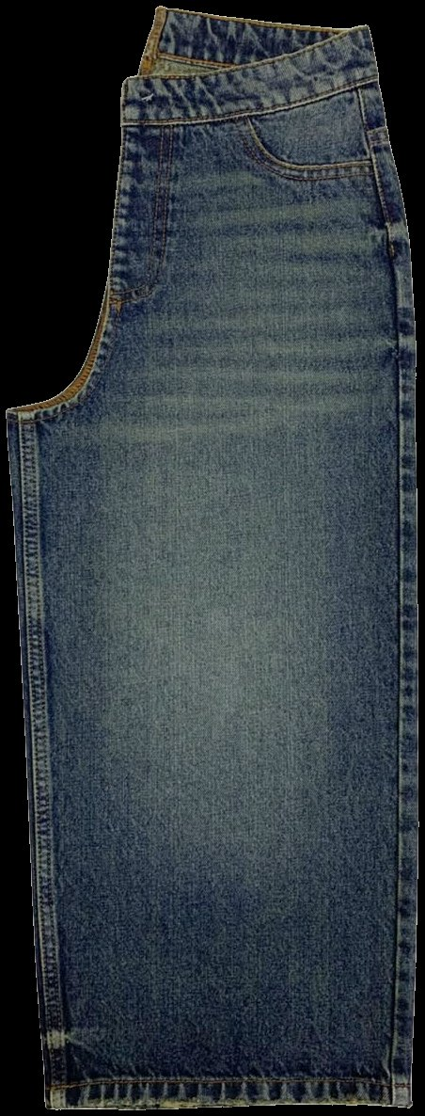
SECTION 1 · OPENING
What you will be able to do after this session
Seven things. Each one is something you will actually do on a live order.
1
Name the main denim washes and recognise them on a garment
2
Explain roughly how each effect is created
3
Say why the same wash name gives different results in different factories
4
Identify the common wash defects and know what causes them
5
Ask a laundry the right questions before you approve a wash
6
Judge whether a sustainability claim about a wash is supported
7
Understand how wash complexity drives cost, lead time and risk
BUYER TAKEAWAY
You are not being trained to run a laundry. You are being trained to judge one.
Notes:
Read the takeaway line out loud. It sets the level of the whole programme and it stops people worrying that they are about to be tested on chemistry.

Slide 3
SECTION 1 · OPENING
The five questions to ask about any wash
Every wash and every effect in this programme is explained against the same five questions.
1
What is it?
The process in one sentence.
2
What does it look like?
The visual signature you can recognise on a garment.
3
How does it feel?
Hand feel, and whether the process changes it.
4
What can go wrong?
The defects that come with this process.
5
What does it cost me?
Price, lead time, complexity, reproducibility.
BUYER TAKEAWAY
A wash you cannot answer all five questions about is a wash you cannot approve.
Notes:
Keep these five on a card. When a supplier presents a new wash, work down the list in order. The gaps in their answer tell you where the risk is.

Slide 4
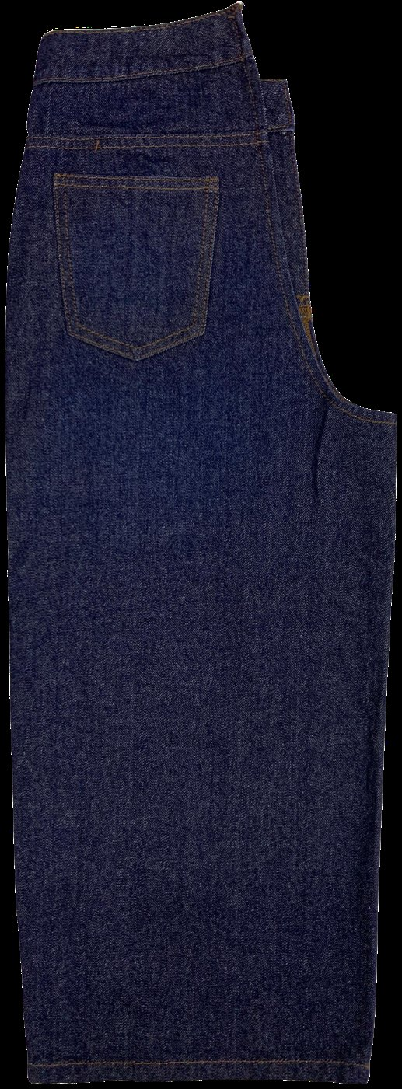
02
Denim basics
Denim fades the way it does because of how it is woven and how it is dyed
WHAT YOU SHOULD UNDERSTAND AFTER THIS SECTION
Why indigo behaves differently from every other dye, and why the fabric decision and the wash decision are one decision, not two.

Slide 5
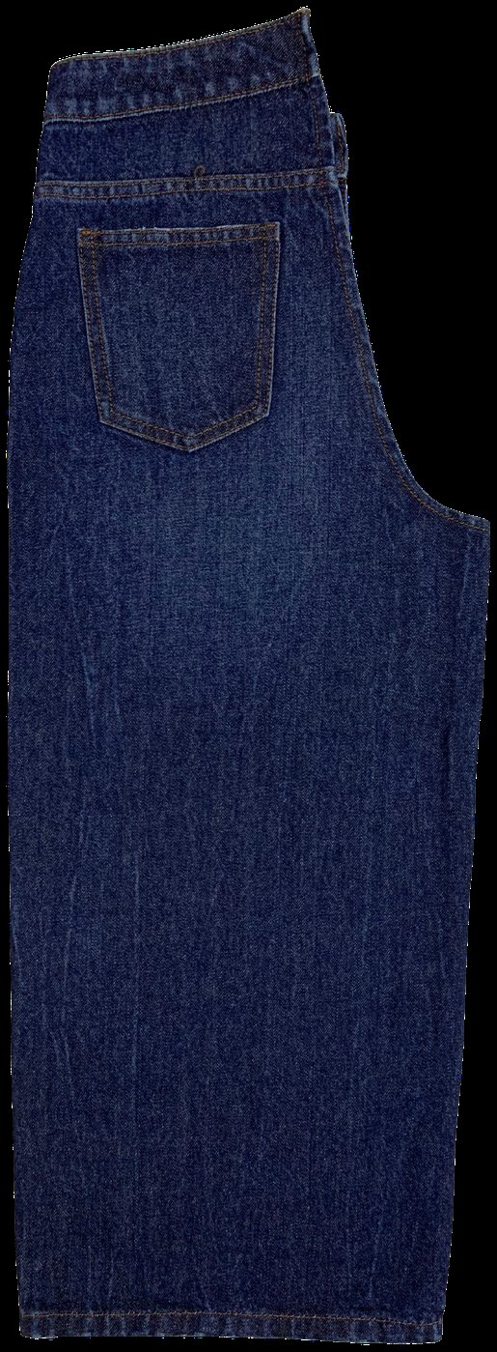
SECTION 2 · DENIM BASICS
What denim is
WARP-FACED TWILL
The warp yarns run down the length and sit mostly on the face. The weft runs across and sits mostly on the back.
DYED WARP, UNDYED WEFT
In classic denim the warp is dyed and the weft is left undyed. That is why the face is blue and the inside is pale.
THE TWILL LINE
The diagonal on the face is the weave. Right-hand, left-hand and broken twills each fade differently.
WHERE FADING HAPPENS
The exposed warp on the face is what abrades, and abrasion is what makes the fade.
BUYER CHECKPOINT
Twill direction and construction are part of the wash result, not just the fabric spec. If the mill changes the weave, the approved wash will not look the same.
Rinse wash, close to the original shade
Notes:
Hold up a jean if one is available. Show the face and the inside. The contrast between them is the whole subject in one gesture.

Slide 6
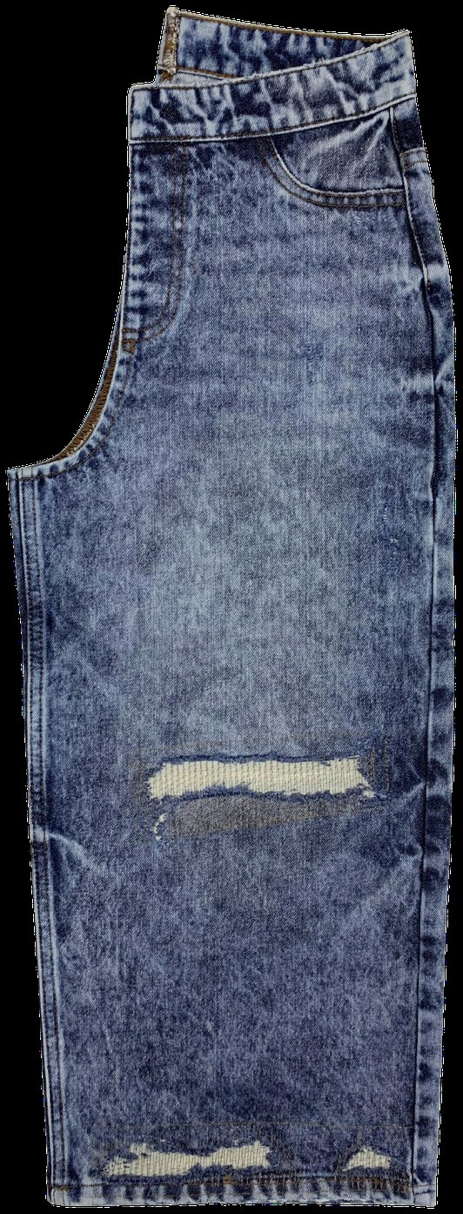
SECTION 2 · DENIM BASICS
Indigo and ring dyeing: why denim fades
INDIGO HAS POOR AFFINITY FOR COTTON
It does not penetrate to the core of the yarn. Repeated dips build up rings of dye around a white core, which is why it is called ring dyeing.
A FADE IS SURFACE REMOVAL
Remove the outer layer of the yarn and the white core shows through. Stone, enzyme, bleach, laser and ozone are all doing the same job by different means.
DYE DEPTH SETS THE CEILING
Deeper penetration gives a garment that fades slowly and stays dark. Shallower penetration fades fast and shows high contrast.
BUYER TAKEAWAY
Wash development and fabric selection are one decision, not two. A wash approved on one fabric will not reproduce on another, however similar the spec sheet looks.
Acid wash: white core exposed
Notes:
This is the most important slide in the first hour. If the room leaves with one idea, make it this one, because every other slide depends on it.

Slide 7
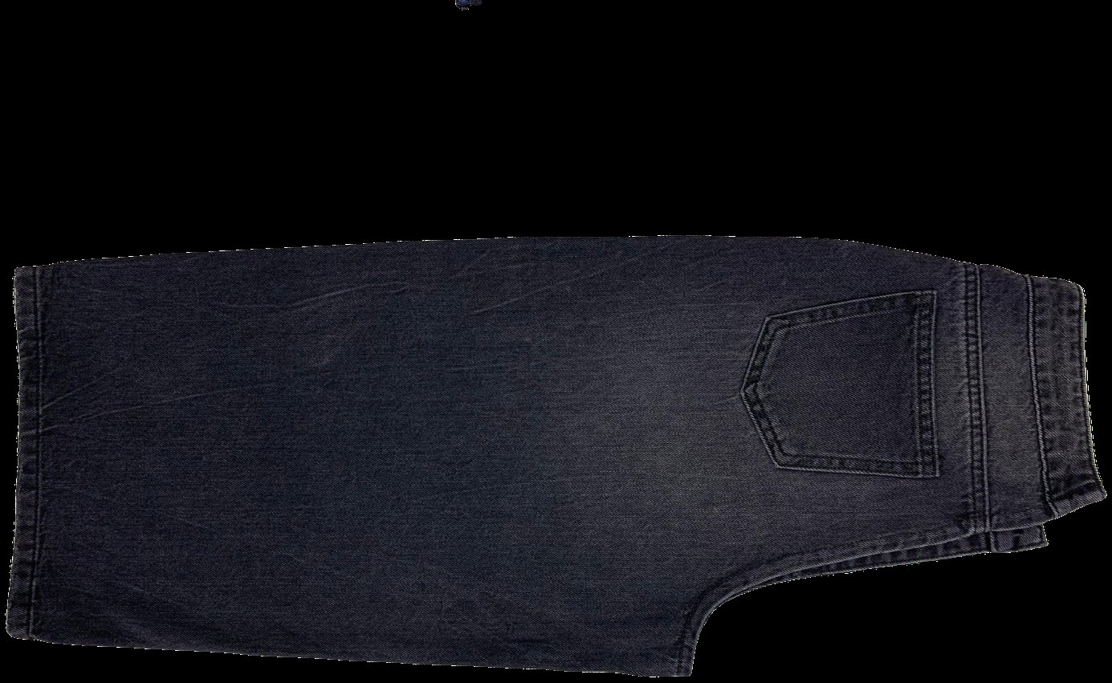
SECTION 2 · DENIM BASICS
Black and sulphur denim behaves differently
DIFFERENT DYE CLASS
Most black and grey denim is dyed with sulphur dyes, not indigo. Some fabrics use sulphur under indigo, or indigo under sulphur, to shift the cast.
DIFFERENT RESPONSE
Sulphur dyes respond differently to enzyme, bleach and oxidation. A recipe that works on indigo will not translate.
CAST SHIFT
Black denim commonly shifts cast during washing, going brown, green or blue depending on the chemistry.
SHADE VARIATION READS HARDER
The eye reads small differences in a dark shade more easily than in a mid blue, so black shows garment-to-garment variation more.
Black denim, sulphur dyed
BUYER CHECKPOINT
Never approve a black wash by reference to a blue standard. Ask for a black-specific development and a black-specific shade band.
Notes:
Cast shift is the one that catches people. The shade is right, the tone is wrong, and it only becomes obvious under store lighting.

Slide 8
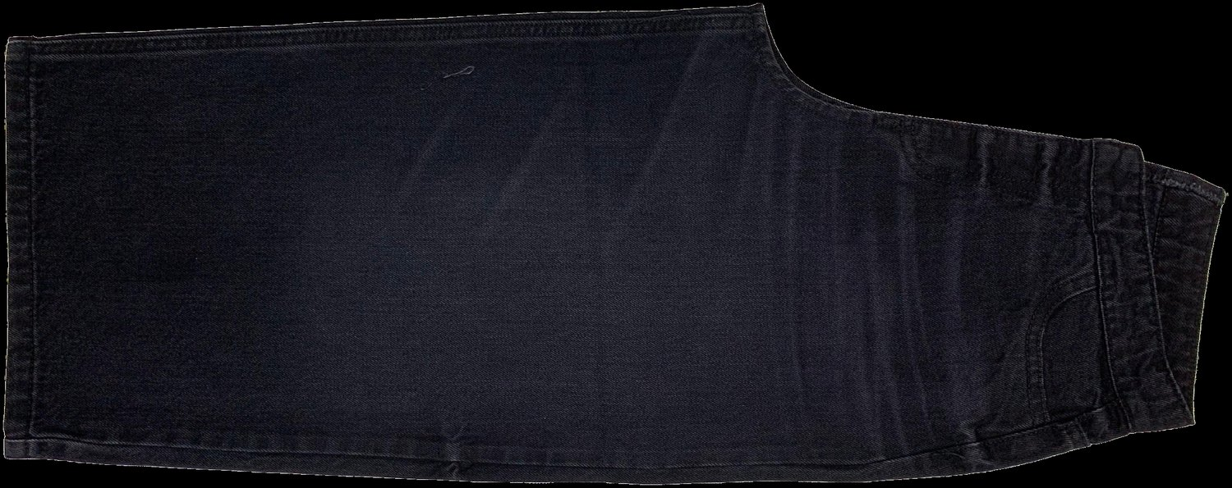
SECTION 2 · DENIM BASICS
Weight, construction and stretch
WEIGHT
Given in ounces per square yard. It affects how much abrasion the fabric can take and how long a cycle it needs. Lighter fabric reaches the target faster and damages faster.
RIGID OR STRETCH
Elastane changes everything. Heat and chemistry damage elastane, which shows as loss of recovery, bagging at knee and seat, and growth in wear.
YARN CHARACTER
Slub, neps and irregular yarns produce a textured fade. The same wash on a flat yarn looks completely different.
Enzyme wash on a dark base
WEFT COLOUR
A coloured or black weft changes the whole result even when the warp is identical.
BUYER CHECKPOINT
Ask for the wash to be developed on the actual bulk fabric. A wash approved on a substitute fabric is not approved, whatever the substitute cost you in sampling time.
Notes:
Elastane damage is the expensive one because it does not show at inspection. It shows on the customer after a day of wear.

Slide 9
SECTION 2 · DENIM BASICS
From fabric to finished garment
Cotton
→
Yarn
→
Dyeing
→
Weaving
→
Fabric finishing
→
Delivered to factory
Cutting
→
Sewing
→
Dry process
→
Washing
→
Drying
→
Pressing
Trims and finishing
→
QA
→
Shade sorting
→
Packing
Washing happens after sewing, on a complete garment
Everything on that garment goes through the process: fabric, thread, pocketing, labels, rivets, buttons and zips.
Dry processes may come before the wet process, after it, or both
Whiskering is usually marked on a dry garment. Grinding often follows the wet process.
The garment leaves the wash a different size from the one that entered
Shrinkage allowances are built into the pattern, so a change of wash is also a change of fit.
BUYER TAKEAWAY
Trims are part of the wash. A button that corrodes or a label that bleeds is a wash problem, and it is usually found in bulk rather than in the sample.
Notes:
Ask the room which of these steps they currently have visibility of. The honest answer is usually cutting, sewing and packing.

Slide 10
SECTION 2 · DENIM BASICS
Why the same wash looks different on different fabrics
The same written process gives a different garment when any one of these changes.
At the mill
Fabric construction, weight and weave
Indigo depth and dyeing method
Yarn type: ring spun, open end, slub
Weft colour and elastane content
In the laundry
Garment volume in the machine
Machine type, drum size and action
Water quality and temperature
Chemical supplier and product grade
On the floor
The operator, on any manual step
Loading practice and cycle timing
Whether a reference garment is at the workstation
Which shift ran the lot
A wash name is not a specification. Always work to a physical standard.
Notes:
Three columns, three owners. Two of them are outside the laundry's control, which is worth saying out loud when a supplier is being blamed for a shade problem.

Slide 11
SECTION 2 · DENIM BASICS
Twelve words you need on day one
TERM
PLAIN MEANING
TERM
PLAIN MEANING
Desize
Removing the weaving size from the warp
Neutralisation
The step that stops and clears an oxidising treatment
Ring dyeing
Dye on the yarn surface, white core inside
Cast
The tone of a shade: too red, green or yellow
Back staining
Loose dye redepositing on pockets and weft
Shade band
Sealed lightest and darkest acceptable garments
Hand feel
How the fabric feels: soft, dry, papery, stiff
Sealed standard
The signed physical garment bulk is judged against
Contrast
Difference between the lightest and darkest area
Liquor ratio
Water per kilogram of garment in the machine
Crocking
Colour transferring by rubbing, wet or dry
Growth and recovery
How far stretch fabric bags out and springs back
These twelve cover most of what you will hear in a wash review. The glossary at the end of this deck carries the rest.
Notes:
Ask which of these they have used in an email this week without being certain of the definition. It gets a laugh and it makes the section land.

Slide 12
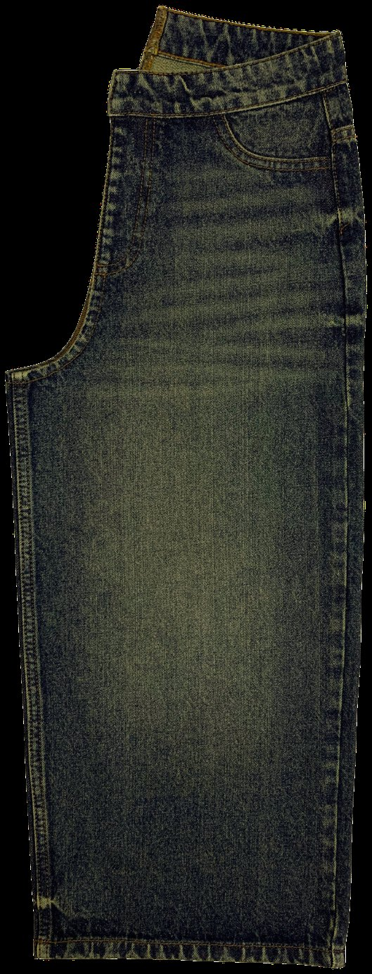
03
Washing fundamentals
What washing actually does, and why bulk differs from your sample
WHAT YOU SHOULD UNDERSTAND AFTER THIS SECTION
How to place any technique in the right family, read a wash cycle as a sequence of steps, and understand why a recipe does not travel between laundries.

Slide 13
SECTION 3 · FUNDAMENTALS
What garment washing actually does
Washing does four jobs at once. When you approve a wash you are approving all four.
1 · Cleans
Removes size, loose dye and soil left from production.
2 · Softens
Changes the hand feel from stiff and dry to the target feel.
3 · Ages
Creates the fade, contrast and wear pattern the design calls for.
4 · Stabilises
Relaxes the fabric so the garment is closer to its final size.
Reject a garment that has the right shade and the wrong hand feel. It has failed two of the four jobs.
Notes:
Most wash comments only mention shade. Train the room to comment on all four, because the laundry can only fix what it is told about.

Slide 14
SECTION 3 · FUNDAMENTALS
The map: wet, dry and advanced
Every technique in this programme sits in one of these three groups. Most finished garments use all three.
Wet processes
Carried out in water in a washing machine.
Rinse · desize · enzyme · stone · bleach · acid · tint · overdye · garment dye · dip dye · tie dye · discharge · softening
Dry processes
Carried out on a dry garment, by hand or by a machine acting on one area.
Whiskering · hand sanding · grinding · destroy · rip and repair · PP spray and rubbing · resin and 3D crinkle · tagging · pigment spray and drop
Advanced technologies
Replace or reduce steps in either group.
Laser · ozone · low-liquor systems · water recycling · foam and spray chemical delivery
A finished garment is a sequence, not a single process. When you ask a laundry what the process is, you are asking for an ordered list of steps.
Notes:
A garment can be whiskered dry, washed with enzyme, sprayed dry with PP, then washed again to neutralise and soften. Four steps, two families, one garment.

Slide 15
SECTION 3 · FUNDAMENTALS
Wash type or wash effect?
The most common confusion among new buyers. A garment has one wash type and usually several wash effects.
WASH TYPE
WASH EFFECT
What it describes
The overall look and shade of the finished garment
One localised technique applied within a wash
Examples
Rinse · mid · dark · vintage · acid · snow
Whiskers · PP spray · grinding · destroy · tagging · pigment drop
How many per garment
One
Usually several
Where the cost sits
Machine time, chemicals, water
Labour, operator skill, equipment
Main risk
Shade variation lot to lot
Position and consistency garment to garment
If you cannot name both for a garment in front of you, you cannot brief it to a second supplier or compare two quotations.
Notes:
Give them three photographs and ask for the type and the effects on each. This is the practical skill the whole programme is building.

Slide 16
SECTION 3 · FUNDAMENTALS
A standard wash cycle, step by step
A common sequence. The steps and their order change with the target effect, so treat this as a frame rather than a specification.
1 · Desize
Warm wash with an enzyme to remove the size applied to the warp for weaving. Incomplete desizing gives patchy results in every later step.
2 · Rinse
Removes loose dye and the desize liquor.
3 · Fading step
Enzyme, stone, both, bleach, or a dry-tumble effect.
4 · Neutralisation
Required after any oxidising step. Without it the chemistry stays in the garment and shows later as a cast or a failed test.
5 · Rinse
Repeated until the effluent runs clear.
6 · Tint or overdye
If the target shade calls for it.
7 · Softening
Sets the final hand feel.
8 · Extract and dry
Where most of the shrinkage happens.
Two steps to always ask about: was the garment properly desized, and was it properly neutralised. Almost every chemical defect traces back to one of those two.
Notes:
Neither of the two critical steps produces a visible result on its own, which is exactly why they are the ones that get shortened when the laundry is behind schedule.

Slide 17
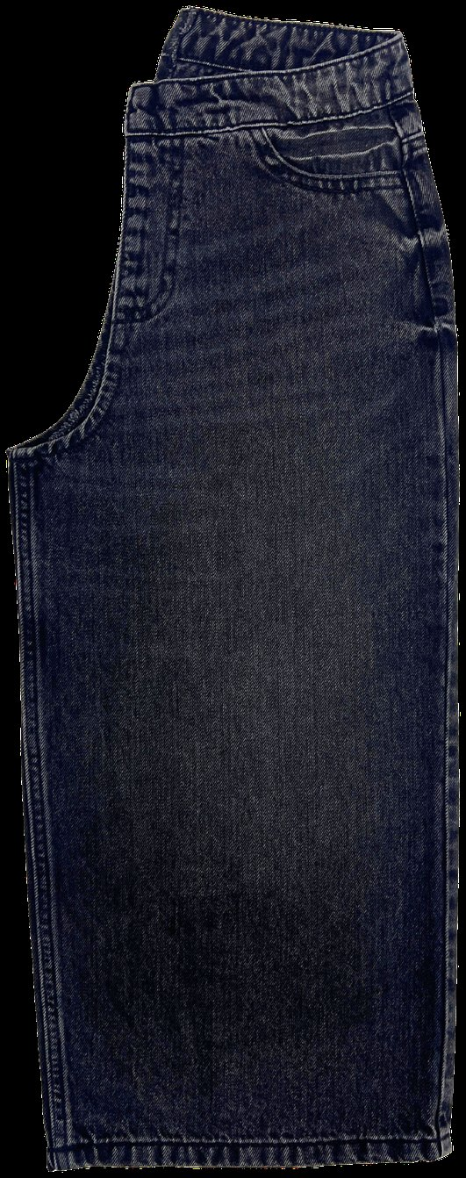
SECTION 3 · FUNDAMENTALS
Machines, load size and why bulk differs from sample
TWO DIFFERENT MACHINES
Sample washes are done in small machines with small loads. Bulk washes are done in large machines with large loads.
MECHANICAL ACTION CHANGES
Garments in a full drum rub against each other. A garment washed almost alone does not.
LIQUOR RATIO CHANGES
The water per kilogram of garment changes with the load, which changes chemical concentration at the fabric surface.
THE CONSEQUENCE
A sample washed at sample load will not reproduce at bulk load unless the laundry adjusts the recipe for the change.
BUYER CHECKPOINT
Ask whether the approved standard was washed at production load. If it was not, expect a shade shift at bulk and plan a size set before you commit the delivery date.
Dark wash, low contrast
Notes:
This single question explains most bulk-versus-sample disputes in the category. Ask it at approval, not at inspection.

Slide 18
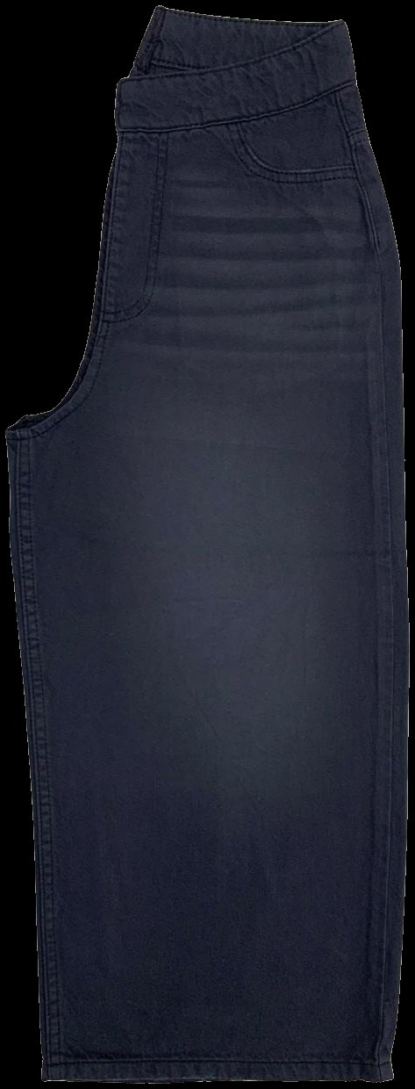
SECTION 3 · FUNDAMENTALS
Why a recipe does not transfer between factories
Two laundries running the same written recipe will produce different garments, because all of these differ between them.
—
Machine make, drum size, drum action and extraction
Mechanical action is a physical property of the machine, not something in the recipe.
—
Water hardness, temperature and source
Water chemistry changes how enzymes and bleach behave, and it changes by season.
—
Chemical brands and product grades
The same generic chemical from two suppliers is not the same product.
—
Operator technique on every manual step
Whiskering, scraping, spraying and towel work are hand skills.
—
Loading practice and cycle timing
How full the drum is run, and how strictly the timings are held.
Garment-dyed dark shade
A recipe is not portable. A physical standard is.
Notes:
If you move an order to a second laundry, that is a new wash development, not a transfer. Build the time into the TNA before you commit the delivery date.

Slide 19
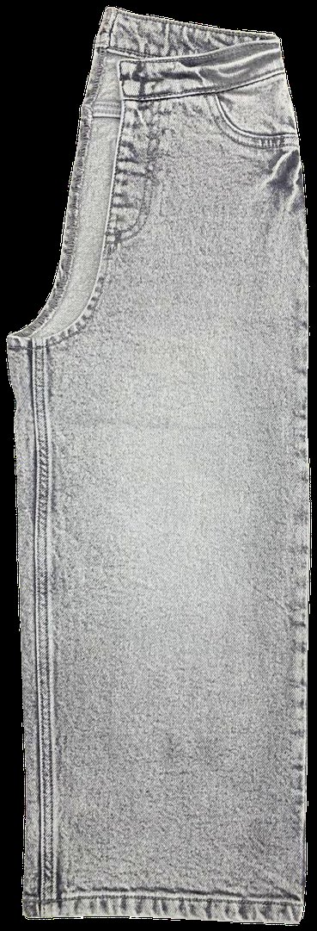
04
Wet processes
The washes that set the shade
WHAT YOU SHOULD UNDERSTAND AFTER THIS SECTION
What each wet process is, what it looks like on a garment, what it does to the hand feel, what goes wrong, and what it costs you.

Slide 20
SECTION 4 · WET PROCESSES
Rinse wash
WHAT IT IS
The lightest wet process. A short water wash, usually with softener.
WHAT IT LOOKS LIKE
Dark, close to the original fabric. Size and loose dye removed, very little fade.
HOW IT FEELS
Softer than raw denim but still crisp.
WHAT CAN GO WRONG
Uneven rinsing, residual dye, crocking on dark shades.
WHAT IT COSTS
Lowest cost, shortest cycle, easiest to reproduce in bulk.
BUYER CHECKPOINT
Check shade consistency lot to lot, and check back staining on pockets and labels. Rinse looks simple, which is exactly why shade variation slips through unnoticed.
Rinse wash on indigo
Notes:
Rinse is the baseline every other wash adds cost to. Useful reference point when a costing looks high.

Slide 21
SECTION 4 · WET PROCESSES
Enzyme wash
WHAT IT IS
Cellulase enzymes remove the fibre surface, which fades and softens the garment.
WHAT IT LOOKS LIKE
Even natural fading, highlights on seams and edges, no hard contrast.
HOW IT FEELS
Noticeably soft. This is the main reason it is specified.
WHAT CAN GO WRONG
Back staining, uneven fading, strength loss if over-treated.
WHAT IT COSTS
Low to medium, medium cycle, repeatable when properly dosed.
Enzyme wash, even natural fading
ALSO WORTH KNOWING
Enzyme replaces pumice stone, so it avoids stone sludge and machine wear. It is still a full wet process with heating and effluent load.
BUYER CHECKPOINT
Ask which enzyme type is used and what the anti-back-staining agent is. Check pocketing and weft for staining, and ask for tensile and tear results on a washed garment.
Notes:
The failure mode on enzyme is almost always back staining rather than the fade itself.

Slide 22
SECTION 4 · WET PROCESSES
How enzyme washing actually works
THE ENZYME ATTACKS THE FIBRE, NOT THE DYE
Cellulase hydrolyses cellulose at the fibre surface. Fibrils loosen and detach, and the indigo on those fibrils leaves with them. The fade is a consequence.
ACID OR NEUTRAL CELLULASE
Acid cellulase strips more colour but attacks the cotton harder and causes noticeably more back staining. Neutral cellulase is gentler, with less colour removal.
OVER-TREATMENT IS FIBRE LOSS
Because the enzyme removes cellulose, running it too long or too hot means measurable weight loss and lower tensile and tear strength.
BUYER TAKEAWAY
The softest hand feel and the weakest fabric often arrive together. Test strength on the washed garment, because that is where the loss shows up.
Enzyme wash, dark shade
Notes:
This is the technical basis for the strength test in Section 8. Worth the two minutes.

Slide 23
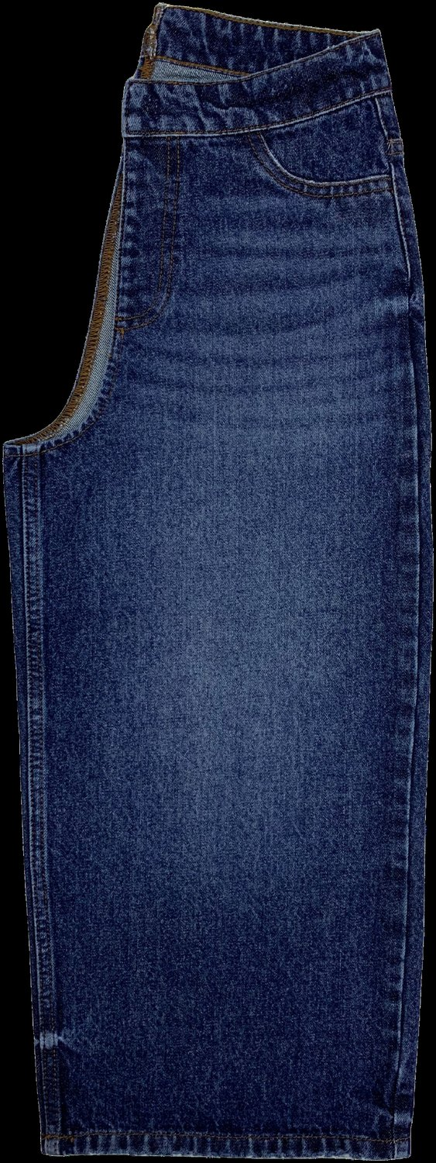
SECTION 4 · WET PROCESSES
Stone wash
WHAT IT IS
Pumice stones tumbled with the garments. Mechanical abrasion rather than chemistry.
WHAT IT LOOKS LIKE
Higher contrast than enzyme, with pronounced highlights on seams, hems and pocket edges.
HOW IT FEELS
Softened by the abrasion, sometimes slightly fuzzy on the surface.
WHAT CAN GO WRONG
Stone marks, damage at seams and hems, pumice trapped in pockets, machine wear.
WHAT IT COSTS
Medium. Stone handling, sludge disposal and higher machine maintenance sit in the price.
BUYER CHECKPOINT
Ask whether stone is used alone or with enzyme, and check hems, belt loops and pocket corners on the approved standard. That is where stone damage appears first.
Mid blue with seat and hip fading
Notes:
Stone is increasingly replaced by enzyme or ozone, mostly on sludge and machine-wear grounds rather than on the look.

Slide 24
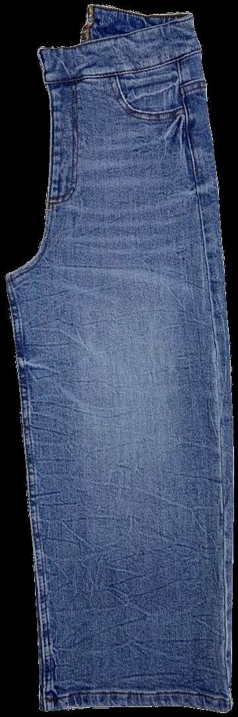
SECTION 4 · WET PROCESSES
Bleach wash
WHAT IT IS
An oxidising bath, normally hypochlorite based, that destroys the dye rather than abrading it.
WHAT IT LOOKS LIKE
Light and fairly even. Can go very light, and can flatten contrast if pushed.
HOW IT FEELS
Can be harsh and dry if the neutralisation and softening are short.
WHAT CAN GO WRONG
Over-bleaching, which is irreversible, plus strength loss, yellowing and cast shift.
WHAT IT COSTS
Medium, but the rejection risk is real because the process cannot be reversed.
BUYER CHECKPOINT
Ask for the neutralisation and clearing steps by name, and for a residual chemical and pH result on the finished garment. Bleach damage does not show at once.
Light shade reached by bleach
Notes:
Bleach is the process where an extra minute cannot be undone. That is what makes it a control question rather than a recipe question.

Slide 25
SECTION 4 · WET PROCESSES
Acid wash
WHAT IT IS
Pumice soaked in an oxidiser and tumbled with dry or damp garments, so the stones deposit chemistry in random contact points.
WHAT IT LOOKS LIKE
Sharp white marbling against a darker ground. No two garments identical.
HOW IT FEELS
Dry, sometimes slightly harsh where the oxidiser hit hardest.
WHAT CAN GO WRONG
Difficult to control, high rejection, strength loss, yellowing if neutralisation is incomplete.
WHAT IT COSTS
Medium price with a real rejection allowance that must be in the quotation.
ALSO WORTH KNOWING
No acid is used at any stage. The name is historical. Say oxidising agent when you brief a supplier, and always ask about the neutralisation step.
BUYER CHECKPOINT
Agree a shade band rather than a single standard, because the effect is random by design. Ask the laundry for its actual rejection rate on this wash before you accept a price.
Acid wash marbling
Notes:
Also called snow wash, marble wash and ice wash. One family, several trade names.

Slide 26
SECTION 4 · WET PROCESSES
Neutralisation is not optional
Neutralisation is where oxidising washes are won or lost. Nothing looks wrong at the time, which is why the step gets shortened.
After potassium permanganate
Manganese dioxide forms on the garment and must be cleared.
Ask what clearing agent is used and for the residual result.
After sodium hypochlorite
Residual chlorine must be removed with a reducing agent such as sodium bisulphite.
Chlorine left on the garment keeps working in the warehouse.
If it is skipped
Yellowing in storage, continued strength loss, a cast shift, and residual chemistry on a garment worn against the skin.
Ask for the residual chemical and pH result on the finished garment. It is a cheap test and it is the only evidence the step was done properly.
Notes:
Yellowing complaints that arrive months after shipment almost always trace back to this slide.

Slide 27
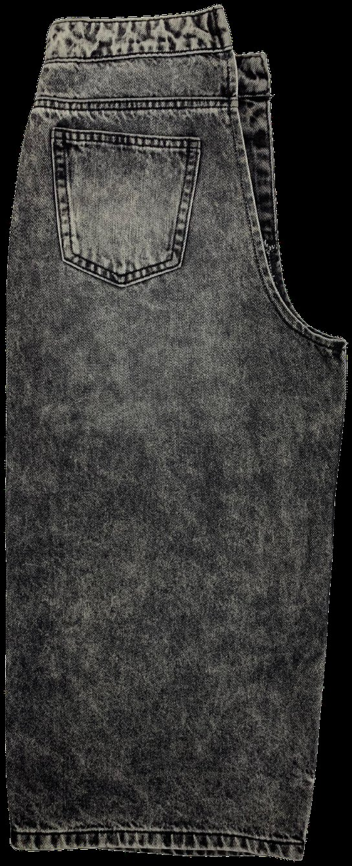
SECTION 4 · WET PROCESSES
One family, three names
Where the oxidiser touches the cloth is what makes the pattern. How much of it there is makes the shade.
Snow wash
Acid wash
Towel bleach
Bleach only
The first three are the same chemistry carried onto the cloth three different ways: by stone, by towel, and by stone again at a lighter setting. The fourth was bleached in the bath, which is why it has no marbling at all.
Notes:
Pass these round and ask the room to sort them before you explain. The fourth one is the useful mistake.

Slide 28
SECTION 4 · WET PROCESSES
Vintage wash
WHAT IT IS
A combination wash. Stone or enzyme, plus bleach, plus tint, plus localised dry effects.
WHAT IT LOOKS LIKE
Warm, aged and uneven in a natural way, usually with a tint pulling the blue towards yellow, grey or brown.
HOW IT FEELS
Soft and broken in. Part of what the customer is paying for.
WHAT CAN GO WRONG
Cumulative shade variation, strength loss from stacked treatments, and drift between lots.
WHAT IT COSTS
High price, long cycle, highest fashion value of any wash family.
BUYER CHECKPOINT
Vintage is the highest-risk wash for bulk-to-standard matching, because every added step adds variation. Ask how many steps the wash has. Four steps means four chances to drift.
Vintage wash with thigh fading
Notes:
Expect higher MOQ and longer lead time than a plain enzyme wash. If the buying plan does not allow for that, simplify the wash at concept stage, not at PP sample.

Slide 29
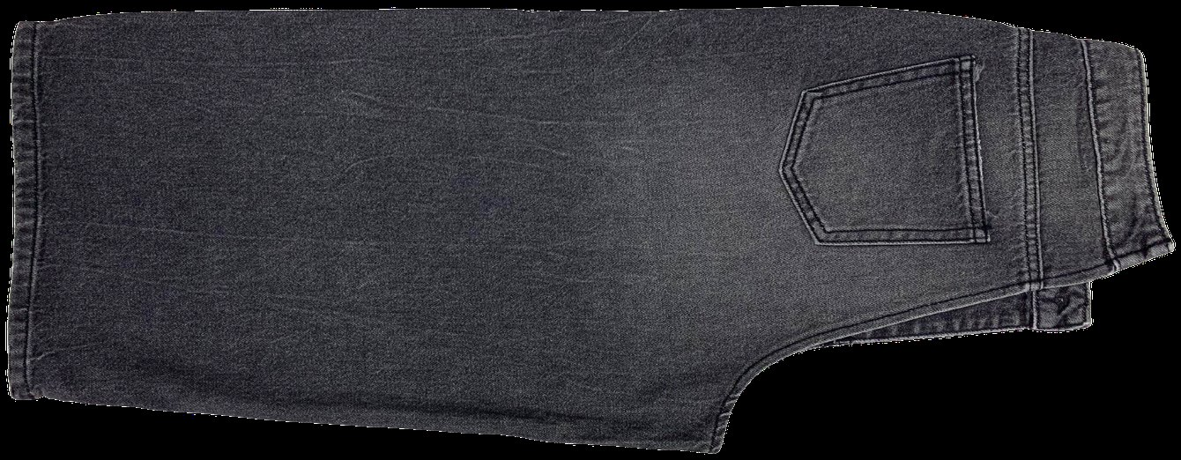
SECTION 4 · WET PROCESSES
Shade words are not washes
MID, LIGHT AND DARK DESCRIBE THE RESULT
They tell you where the finished garment sits on the shade scale. They tell you nothing about how it got there.
THE ROUTE IS A SEPARATE QUESTION
Enzyme, stone, bleach, laser, ozone or a combination will all reach a mid shade, at very different costs and with very different risks.
ASK BOTH QUESTIONS EVERY TIME
First, what shade is the target. Second, what process reaches it. Write both into the technical pack.
Charcoal wash, mid shade depth
BUYER TAKEAWAY
You cannot compare two quotations for a mid wash until both suppliers have answered the second question. When a costing looks unusually cheap, this is usually why.
Notes:
Show two quotations for the same shade word and ask which is cheaper. The answer is that they cannot tell yet.

Slide 30
SECTION 4 · WET PROCESSES
Tinting and overdye
WHAT IT IS
A light colour applied over a washed garment to shift its cast, or a full re-dye to a new colour.
WHAT IT LOOKS LIKE
Tinting warms or cools the cast: dirty, yellow, grey or green. Overdye gives a new colour with the wash structure showing through.
HOW IT FEELS
Largely unchanged, though heavy overdye can stiffen slightly.
WHAT CAN GO WRONG
Difficulty matching the tint from lot to lot, change in cast, and unevenness of the tint across the garment.
WHAT IT COSTS
Medium, and it adds a step, so it adds both cycle time and a failure point.
BUYER CHECKPOINT
Ask for a tinted band, not just a tinted standard, and expect more variation than on an untinted wash. Cast is the property that drifts.
Vintage wash with a warm tint
Notes:
Tint is often used late to rescue a shade that has drifted. Worth knowing when you see one appear in a revision.

Slide 31
SECTION 4 · WET PROCESSES
Garment dyeing
WHAT IT IS
Dyeing the finished sewn garment rather than the fabric. Used for colour flexibility and late colour decisions.
WHAT IT LOOKS LIKE
Solid colour with the garment structure showing through. Seams and thread often take colour differently.
HOW IT FEELS
Softer than piece-dyed fabric of the same colour, because the garment has been through a full wet cycle.
WHAT CAN GO WRONG
Shade variation between garments, poor fixation, streaks in the body, and seam colour differing from the panel.
WHAT IT COSTS
Medium to high, dye-lot bound, with colour matching as the main risk.
BUYER CHECKPOINT
Ask how shade variation is controlled and how garments are sorted before packing. Check inside pockets and along seams for uneven penetration.
Garment-dyed dark shade
Notes:
Dye class and dyeing stage are two different axes. Reactive, direct, pigment and sulphur are dye classes. Garment dyeing is a stage. Specify both.

Slide 32
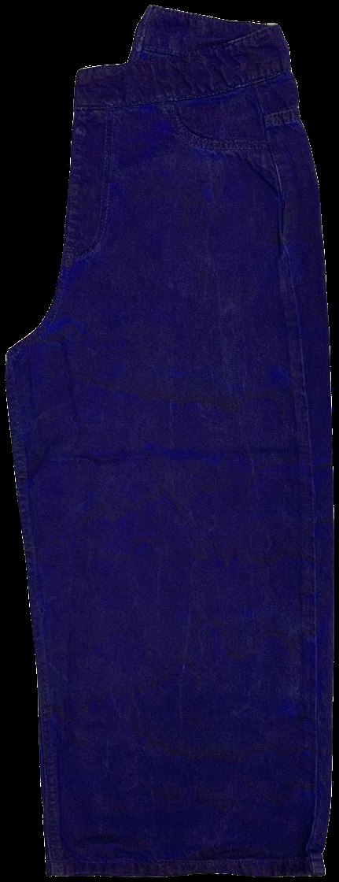
SECTION 4 · WET PROCESSES
Cold dyeing
WHAT IT IS
Dyeing at low temperature, close to ambient, instead of in a hot bath.
WHAT IT LOOKS LIKE
Anything from soft pastels to fully saturated colour. The temperature does not limit the shade.
HOW IT FEELS
Softer, with less fabric damage than a hot bath.
WHAT CAN GO WRONG
Uneven dyeing, poor fixation and colour variation, all of which come from the longer dwell.
WHAT IT COSTS
Energy saving against a hot process, but a longer cycle and a narrower dye selection.
BUYER CHECKPOINT
Confirm the working temperature and the fixation system with the dye supplier before it goes into a technical pack, and approve against a physical standard rather than a description.
Deep purple-blue garment dyeing
Notes:
Cold pad batch and cold exhaust dyeing are related but not identical. Ask which one the laundry runs before assuming the cycle time.

Slide 33
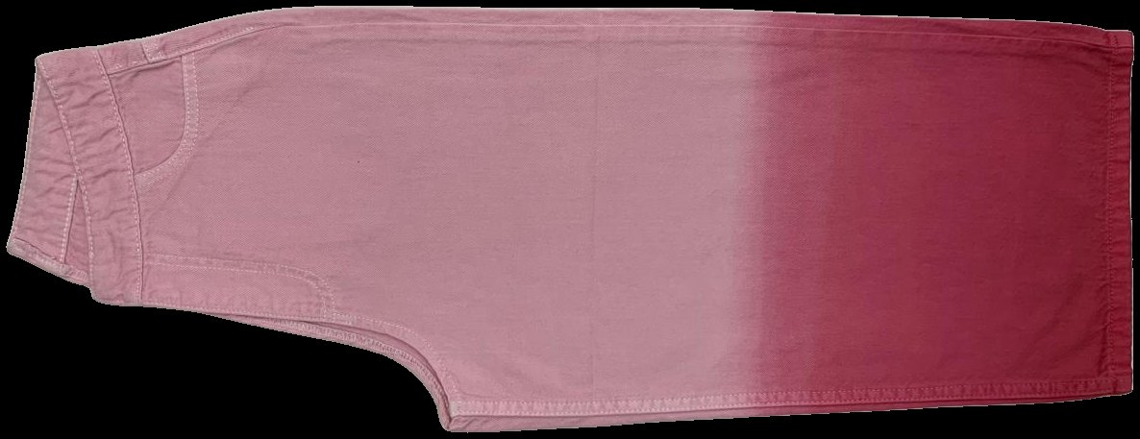
SECTION 4 · WET PROCESSES
Dip dyeing and gradient effects
WHAT IT IS
The garment is partially immersed in a dye bath to create a gradient, an ombre or a sharp two-tone break.
WHAT IT LOOKS LIKE
A colour gradient, usually rising from the hem, with a transition zone whose softness depends on how the dip is controlled.
HOW IT FEELS
Unchanged from the base wash in most cases.
WHAT CAN GO WRONG
Uneven dip line, poor fixation at the transition, and streak marks where the garment was lifted.
Two-tone dip at the hem
WHAT IT COSTS
Medium. Strong visual differentiation for relatively low process complexity.
BUYER CHECKPOINT
Measure the dip height from the hem on a measured garment and agree a tolerance in centimetres. Check it across the whole size range, because a line set from the hem will look wrong on a larger size unless it is set proportionally.
Notes:
The dip line is the one measurement on this garment a customer notices immediately if it drifts.

Slide 34
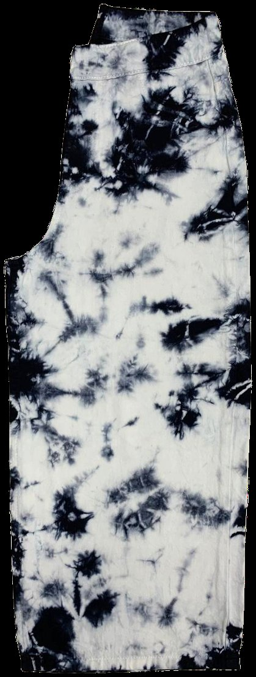
SECTION 4 · WET PROCESSES
Tie dye and tie bleach
WHAT IT IS
The garment is tied, folded, knotted or clamped. The compressed areas resist the liquor and stay dark.
WHAT IT LOOKS LIKE
Sharp organic starburst and ring patterns. Every garment different by design.
HOW IT FEELS
Unchanged by the tying itself. The base wash sets the hand.
WHAT CAN GO WRONG
Very difficult to reproduce, uneven pattern density, and high rejection.
WHAT IT COSTS
High. The tying is a hand skill, so output is limited per operator per day.
ALSO WORTH KNOWING
Tie effects are sometimes confused with 3D crinkle, which is a resin and heat treatment producing texture rather than a colour pattern. They are different techniques.
BUYER CHECKPOINT
A single approved standard is not workable. Agree a high and a low limit sample with a pattern density expectation, then inspect against the range rather than against one garment.
High-contrast tie pattern
Notes:
Ask how many people in the laundry can do the tying, and what happens to output when one of them is absent.

Slide 35
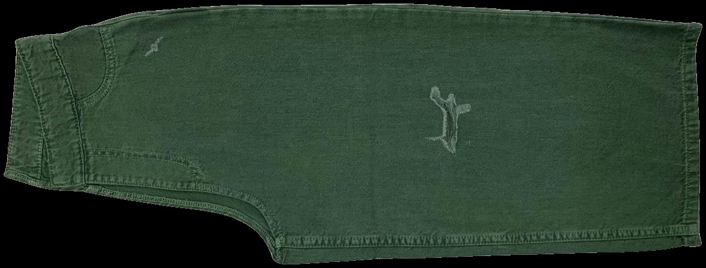
SECTION 4 · WET PROCESSES
Dischargeable dyeing
WHAT IT IS
The garment is dyed with a reducible dye, then a discharge chemical removes colour in selected areas.
WHAT IT LOOKS LIKE
Contrasting patterns or faded areas lifted out of a solid dyed ground, with a soft edge.
HOW IT FEELS
Soft. The discharged area is chemically stripped rather than abraded.
WHAT CAN GO WRONG
Incomplete discharge, uneven patterns, shade variation, and odour or residual chemistry if the wash is short.
Discharge mark on garment dye
WHAT IT COSTS
High, and it is limited to dyes that will actually discharge.
BUYER CHECKPOINT
Confirm the dye is dischargeable before the colour is approved, not after. Ask which discharge chemistry is used, check it against the restricted substances list, and ask for the residual and pH result.
Notes:
The neutralisation step at the end is not optional. Discharge chemistry left in the garment causes the same problems as an uncleared oxidiser.

Slide 36
SECTION 4 · WET PROCESSES
Wet processes at a glance
PROCESS
HOW THE SHADE IS REACHED
LOOKS LIKE
MAIN RISK
Rinse
Water and softener only
Dark, close to raw
Shade variation lot to lot
Enzyme
Cellulase removes the fibre surface
Even fading, soft
Back staining, strength loss
Stone
Pumice abrasion in the drum
High contrast on seams and edges
Seam damage, sludge
Bleach
Oxidising bath destroys the dye
Light and fairly even
Over-bleaching, irreversible
Acid or snow
Oxidiser carried on stones
Random white marbling
High rejection, yellowing
Vintage
Several processes stacked
Warm, aged, tinted
Cumulative shade drift
Tint and overdye
Colour applied over the wash
Shifted cast or new colour
Cast drift lot to lot
Garment dye
Dyed after sewing
Solid colour, structure visible
Shade variation, fixation
Dip dye
Partial immersion
Gradient or two-tone
Uneven dip line
Tie dye and tie bleach
Mechanical resist then treatment
Organic starburst patterns
Reproducibility
Dischargeable
Colour chemically removed
Contrast on a solid ground
Incomplete discharge
Shade words such as mid, light and dark describe the target, not the route. Establish both before comparing two quotations.
Notes:
Use this as the recap. Cover the last column and ask the room to fill it in from memory.

Slide 37
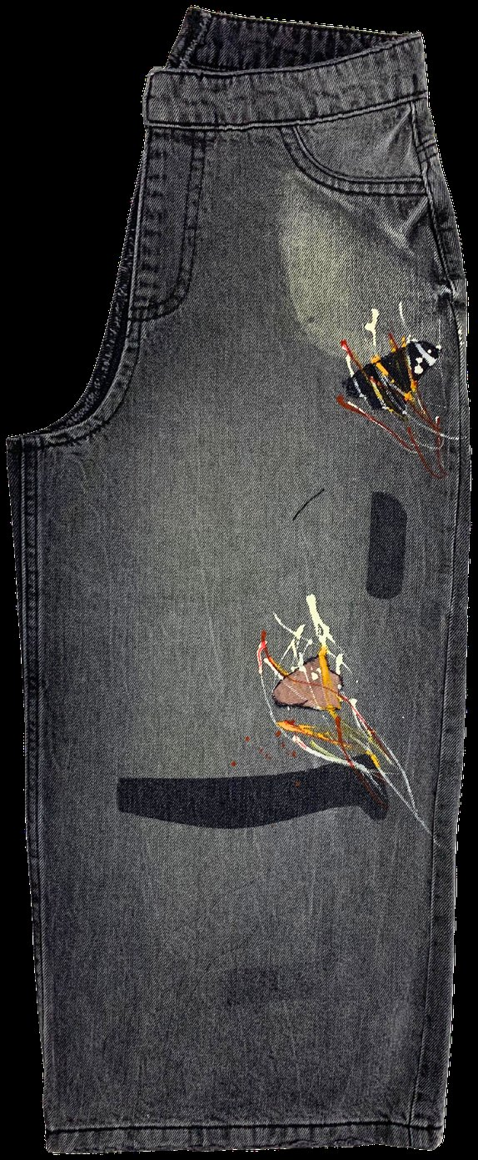
05
Dry and localised processes
Placed effects mean dry processes
WHAT YOU SHOULD UNDERSTAND AFTER THIS SECTION
How each localised effect is made by hand or machine, why operator skill decides the result, and which effects now carry a compliance question.

Slide 38
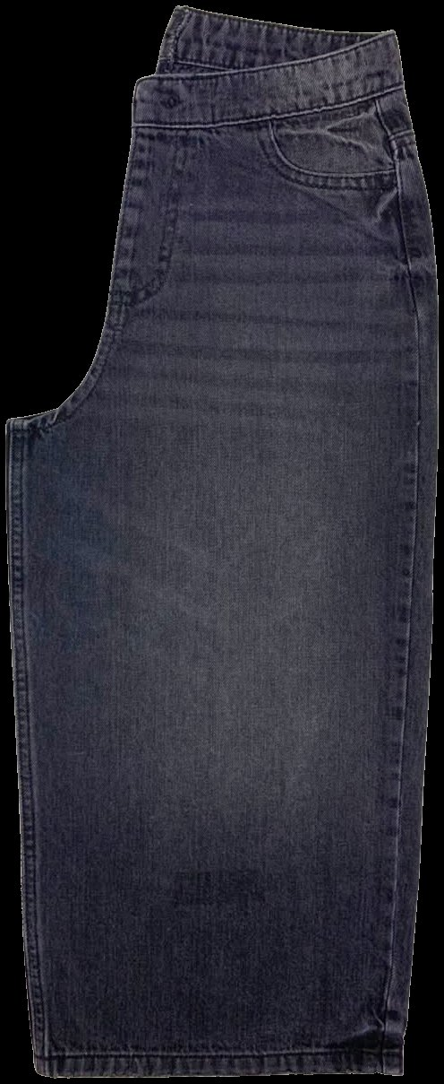
SECTION 5 · DRY PROCESSES
Whiskering
WHAT IT IS
The garment is folded or moulded over a form, then the raised creases are faded by hand, PP spray or laser.
WHAT IT LOOKS LIKE
Horizontal faded lines at the hip and upper thigh imitating natural creasing, defined and radiating from the crotch.
HOW IT FEELS
Slightly drier where the surface has been abraded.
WHAT CAN GO WRONG
Left and right not matching, position drifting between garments and operators, and pattern looking wrong across sizes.
WHAT IT COSTS
High if manual, because it is a hand skill on every garment. Low per piece once it is a laser file.
BUYER CHECKPOINT
Lay five garments from one lot flat and compare left with right. Check the whisker position across the size range. If those five differ, nothing else in the wash will be consistent.
Whiskers on a dark grey wash
Notes:
This is the best five-second test you can run standing at an inspection table.

Slide 39
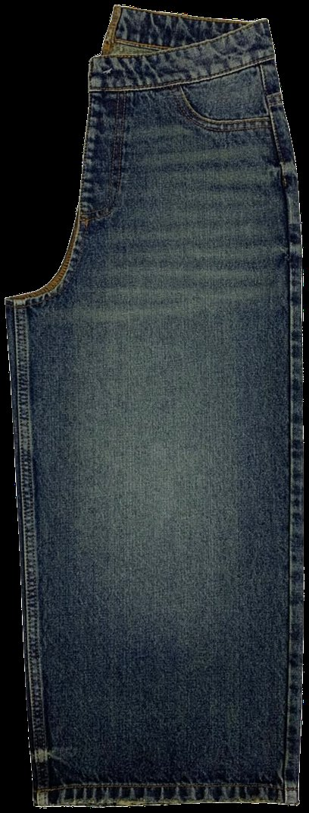
SECTION 5 · DRY PROCESSES
Hand sanding and scraping
WHAT IT IS
Manual abrasion of selected areas, usually the thigh, seat and back pocket, using abrasive paper or a pad over a form.
WHAT IT LOOKS LIKE
Soft graded fading in the high-wear areas. Done well, the edges are hand and the pattern is obviously man-made.
HOW IT FEELS
Softer and thinner in the sanded area, with a slightly raised surface.
WHAT CAN GO WRONG
Inconsistency between operators and between garments, hard edges, and over-sanding that thins the fabric.
WHAT IT COSTS
High. It is entirely labour, and labour scales with volume rather than with machinery.
BUYER CHECKPOINT
Ask how many operators run the style and whether each has a sealed reference garment at the workstation. Look at the edges of the sanded area for a hard line.
Thigh and seat highlights
Notes:
Hand sanding generates dust, so extraction and PPE are the controls. Section 11 covers why that matters more here than anywhere else in the laundry.

Slide 40
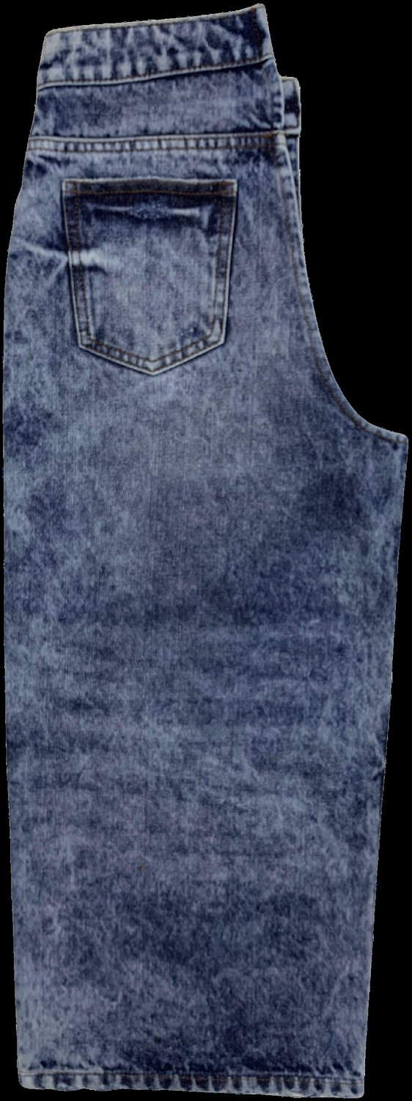
SECTION 5 · DRY PROCESSES
Grinding and edge abrasion
WHAT IT IS
Mechanical abrasion of edges and seams with a grinding wheel or stone.
WHAT IT LOOKS LIKE
Frayed pocket edges, worn hems, thinned seam tops, and broken belt loops.
HOW IT FEELS
Locally thin and sometimes fluffy where fibres have lifted.
WHAT CAN GO WRONG
Excessive grinding, which opens the seam rather than aging it, and inconsistency between garments.
WHAT IT COSTS
Medium. Fast per garment, but it needs a control sample on the line.
BUYER CHECKPOINT
Pull gently at a ground seam. If it opens, the grinding has gone through the seam. Ask for a seam slippage and tear result after grinding, not before it.
Abraded edges on acid wash
Notes:
Grinding is also the second step inside every destroy process, so its risks appear twice on a heavily distressed garment.

Slide 41
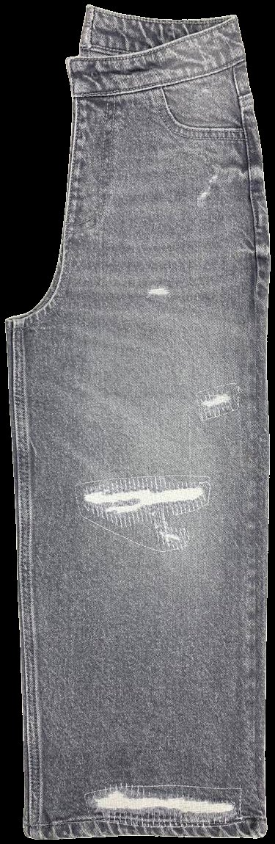
SECTION 5 · DRY PROCESSES
Destroy, rip and repair
WHAT IT IS
Deliberate cuts, holes and fraying, then optionally backed with contrast fabric or darned with thread.
WHAT IT LOOKS LIKE
Open holes with exposed weft threads, or holes backed with contrast fabric and visible stitching.
HOW IT FEELS
Locally stiffer where a backing fabric or dense stitching sits.
WHAT CAN GO WRONG
Tears spreading beyond the design in washing, in the shop or in wear, and inconsistent damage size across garments.
WHAT IT COSTS
High, and it carries a higher return rate in the market than most effects.
ALSO WORTH KNOWING
Check whether the damage sits over a stress point such as the knee or the seat. That is where a fashion detail becomes a durability claim.
BUYER CHECKPOINT
Approve the exact size, position and density on a marked-up garment, then check the tears again after the wash. Destroy that is correct before the machine is often too large after it.
Tears backed and darned in white
Notes:
Rip and repair is a separate cost line from plain destroy. Specify the backing fabric and the stitch density, not just the tear.

Slide 42
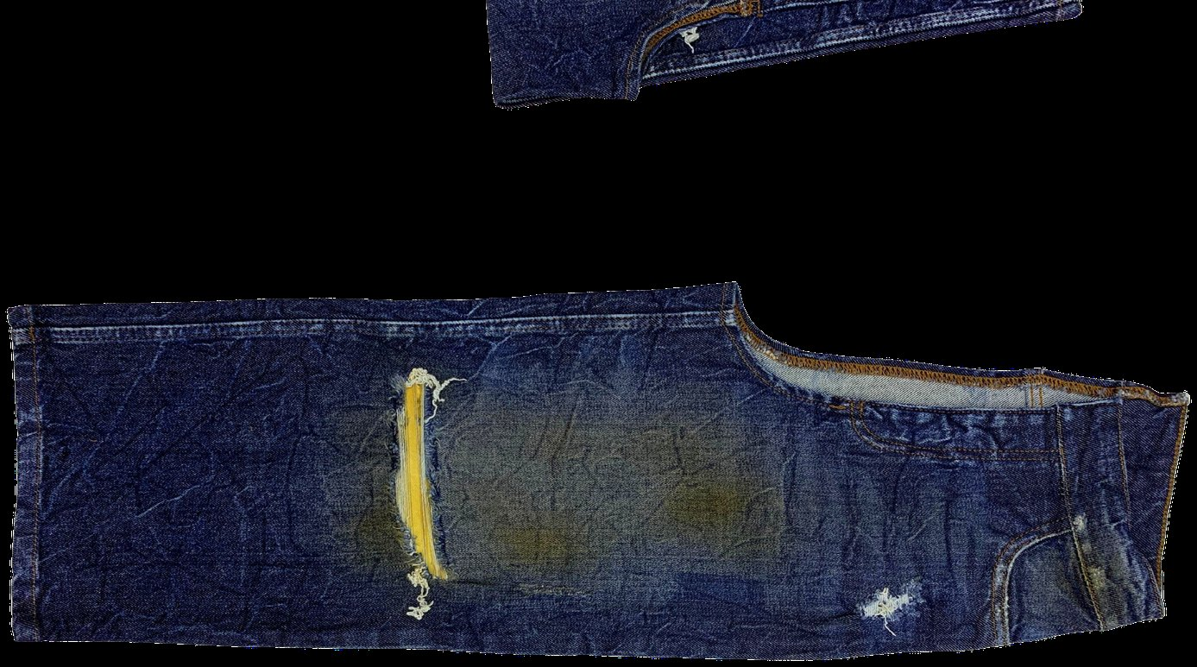
SECTION 5 · DRY PROCESSES
PP spray and PP rubbing
WHAT IT IS
Potassium permanganate solution sprayed or rubbed onto selected areas to bleach out local highlights.
WHAT IT LOOKS LIKE
Sharp local highlights on whiskers, thigh, seat, knee and hem. Precise in skilled hands.
HOW IT FEELS
Drier and slightly harsh in the treated area.
WHAT CAN GO WRONG
Incomplete neutralisation leaving a brown or yellow cast, over-application weakening the fabric, and operator variation.
WHAT IT COSTS
Medium in money, but it now carries a compliance cost that is covered on the next slide.
Localised PP marks on resin crinkle
BUYER CHECKPOINT
Ask whether the laundry can reach the same effect by laser instead. Ask for the neutralisation procedure and the residual manganese result on the finished garment.
Notes:
PP has been routine in denim laundries for decades. The next slide explains why that is changing.

Slide 43
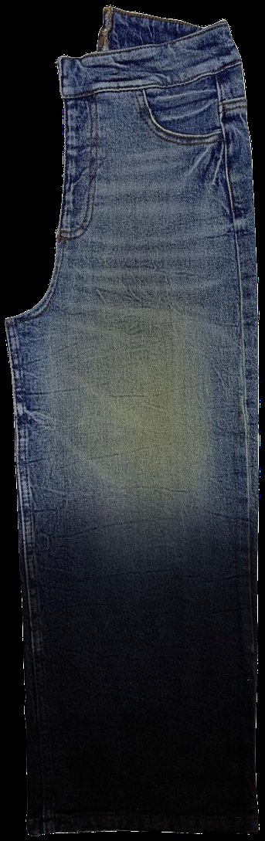
SECTION 5 · DRY PROCESSES
PP spray is now a compliance question
For a buyer, potassium permanganate is no longer only a quality and safety question.
—
Potassium permanganate is on the ZDHC Chemical Watchlist
Brands and laundries face growing expectation to justify continued use or replace it.
—
Technology suppliers are pushing for a full phase-out
The stated alternative is laser, which reaches similar local fading without the chemistry.
—
It changes the question you ask
Not whether the laundry can do the effect, but whether it can do the effect without PP, and if not, why not.
—
It changes your own exposure
A wash approved today can become a brand-risk conversation later. Check the restricted substances list before approval, not after.
Localised fading, gradient application
Confirm your own brand's restricted substances position before this goes into a technical pack.
Notes:
This is the slide most often shared after the session.

Slide 44
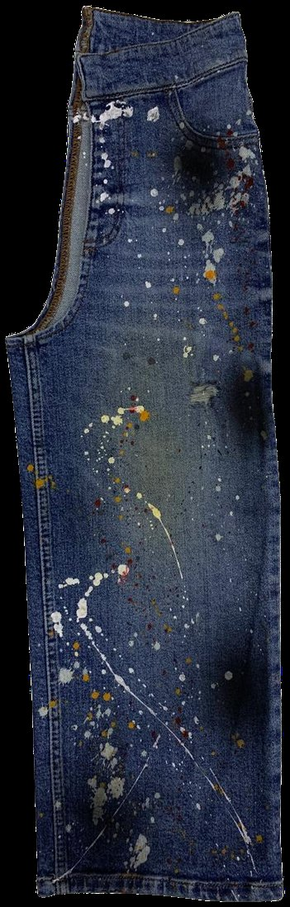
SECTION 5 · DRY PROCESSES
Tagging, pigment spray and drop
WHAT IT IS
A group of localised colour applications. Pigment with a binder is sprayed, pressed, flicked or dripped on, then dried and heat cured.
WHAT IT LOOKS LIKE
Handmade irregular colour marks. Splatter reads as paint. Spray reads as a soft gradient or a shadow.
HOW IT FEELS
Stiffer where the binder is heavy, because pigment sits on the surface rather than in the fibre.
WHAT CAN GO WRONG
Crocking, uneven curing that leaves the pigment unfixed, and poor reproducibility because it is a hand process.
WHAT IT COSTS
Very high. Output is limited per operator per day, which makes it an MOQ constraint as much as a price one.
BUYER CHECKPOINT
Ask for rubbing fastness, dry and wet, before approval. Then rub a white cloth across the area yourself and look at the cloth.
Pigment drop over a vintage wash
Notes:
The white-cloth test takes five seconds and it is the one thing a buyer can do without a lab.

Slide 45
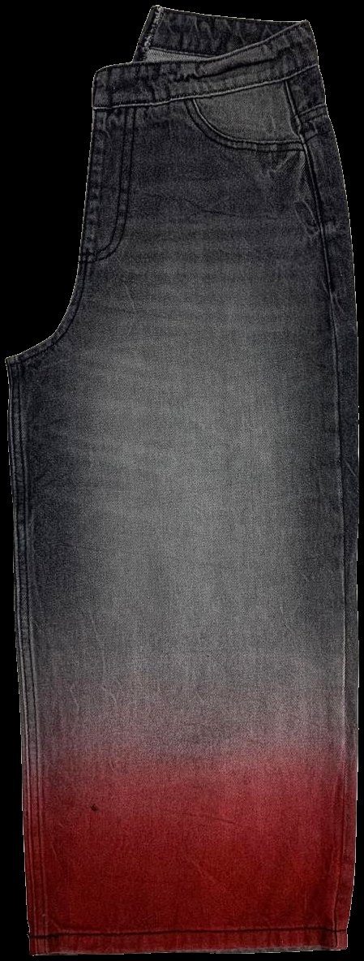
SECTION 5 · DRY PROCESSES
Pigment application, step by step
1 · PREPARE THE SURFACE
A cationic pretreatment is exhausted onto the garment first. It acts as the link between the fabric and the pigment, because pigment has no affinity for cotton on its own.
2 · APPLY THE PIGMENT
By exhaust, spray or drop. A high liquor ratio and a low starting bath temperature give even take-up, and the temperature is then raised slowly.
3 · FIX WITH A BINDER
An acrylic-based binder is applied and cured, low temperature or air-cured. The binder is what gives the garment its rubbing fastness.
4 · DRY AND FINISH
Softener and drying set the final hand feel, which is stiffer in the pigmented area.
THE ONE TRADE-OFF TO REMEMBER
Deeper pigment shades always rub worse, and adding more binder does not fully fix it. Decide the acceptable crocking level before the shade is approved, not after.
Gradient application at the hem
Notes:
This sequence explains every pigment defect a buyer meets. Patchy colour comes from steps one and two, poor crocking from step three, stiff hand from steps three and four.

Slide 46
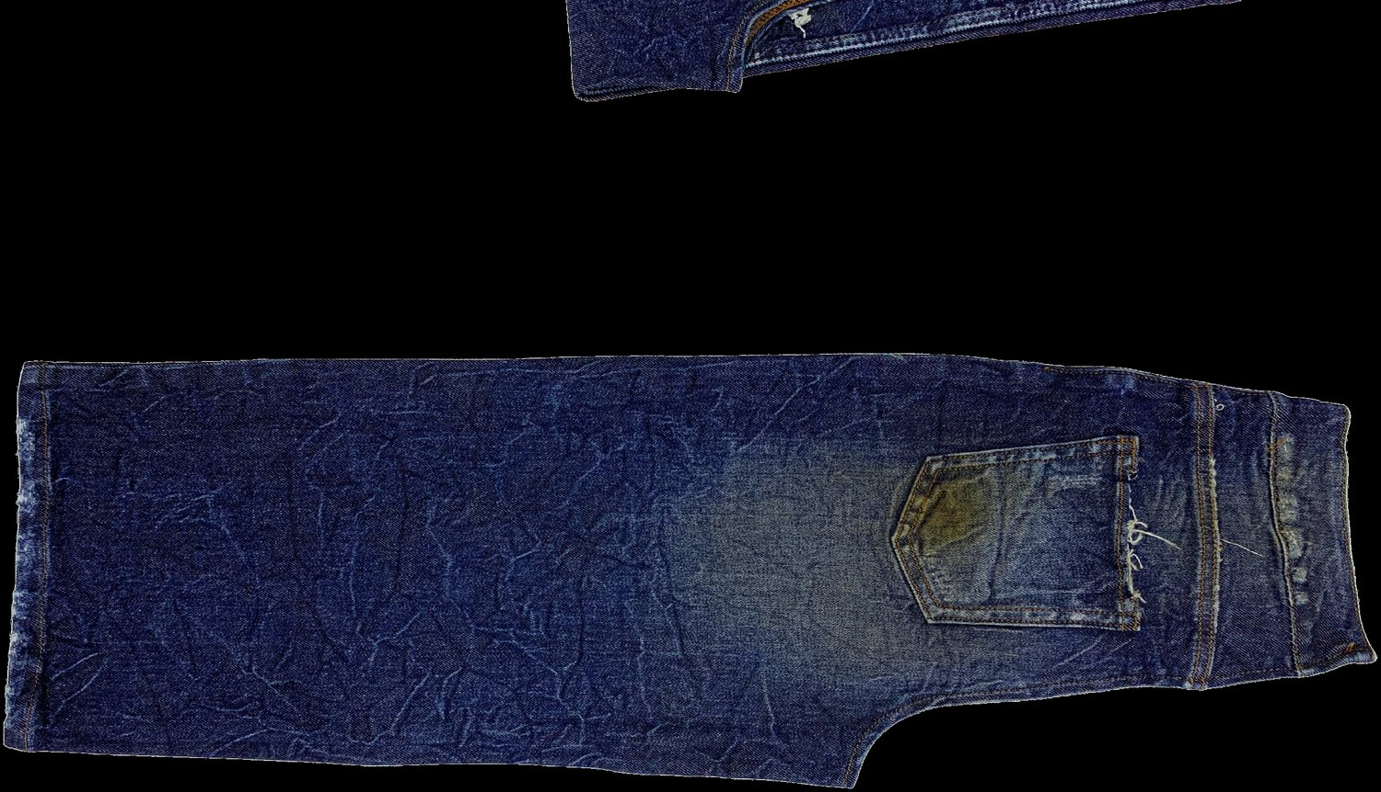
SECTION 5 · DRY PROCESSES
Resin, 3D crinkle and permanent creases
WHAT IT IS
A crosslinking chemical is applied, the garment is formed into the required crease, and heat cures it in place.
WHAT IT LOOKS LIKE
Permanent three-dimensional creases, crinkles or shape retention that survive laundering.
HOW IT FEELS
Stiffer, and drier. This is the trade-off the customer notices first.
WHAT CAN GO WRONG
Residual formaldehyde from conventional resins, loss of tear strength, uneven curing and resin marks.
WHAT IT COSTS
High, and oven capacity is usually the bottleneck, so it constrains the delivery date more than the price.
Resin crinkle, all-over texture
ALSO WORTH KNOWING
Formaldehyde-free crosslinking systems are commercially available and are designed to give the same 3D effect with less strength loss. Ask whether one is being used.
BUYER CHECKPOINT
Ask which resin system is used and confirm the formaldehyde position against the restricted substances list. Ask for tensile and tear results after curing, on the finished garment.
Notes:
If the style also carries destroy or grinding, the strength losses compound. Always test the finished garment rather than the fabric.

Slide 47
SECTION 5 · DRY PROCESSES
Dry processes at a glance
EFFECT
HOW IT IS MADE
OPERATOR DEPENDENT
MAIN BUYER RISK
Whiskering
Moulding then fading, by hand, PP or laser
High if manual
Left and right not matching
Hand sanding
Abrasive paper over a form
Very high
Hard edges, over-thinning
Grinding
Wheel or stone abrasion at edges
Medium
Seams opening
Destroy
Cutting then grinding then washing
High
Tears growing after wash
Rip and repair
Destroy then backing or darning
Very high
Backing failing in wear
PP spray and rubbing
Potassium permanganate applied locally
High
Compliance, residual chemistry
Tagging and pigment
Pigment plus binder, then cured
Very high
Crocking, stiff hand
Resin and 3D crinkle
Crosslinker then heat cure
Medium
Formaldehyde, strength loss
Operator dependence is the best single predictor of how far bulk will drift from the approved standard. Count the manual steps before you approve the wash.
Notes:
If they take one column away from this table, make it the third one. It is the column that predicts trouble.

Slide 48
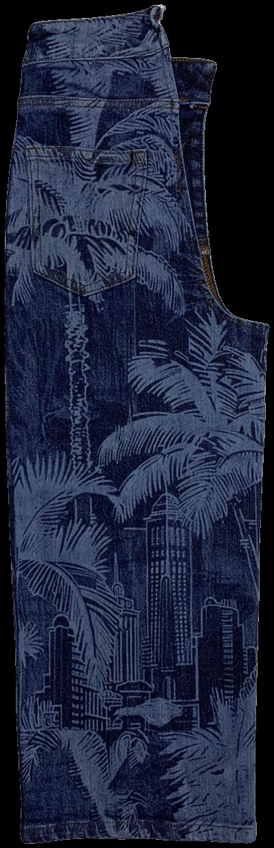
06
Advanced technologies
Judge the route, not the technology
WHAT YOU SHOULD UNDERSTAND AFTER THIS SECTION
What laser and ozone actually do, what they replace, and how to test a supplier's claim that a route has been made cleaner.

Slide 49
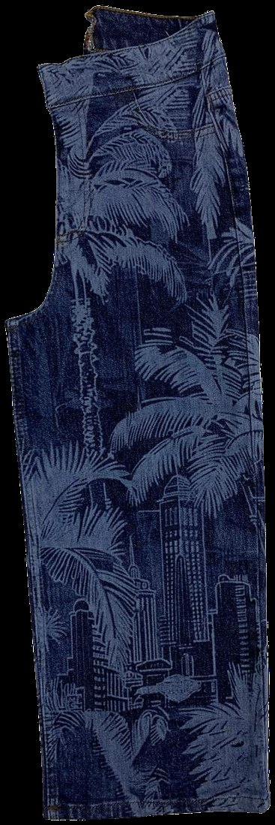
SECTION 6 · ADVANCED TECHNOLOGIES
Laser
WHAT IT IS
A focused beam removes the dyed surface of the fabric under digital control. It replaces hand scraping, whiskering and much PP spray work.
WHAT IT LOOKS LIKE
Anything from a soft whisker to a photographic all-over design. Precise edges, and identical garment to garment.
HOW IT FEELS
Unchanged at low power. Harsh or scorched if the power is set too high for the fabric.
WHAT CAN GO WRONG
Over-power settings causing yellowing, strength loss and holes, and a file that does not transfer to another fabric.
WHAT IT COSTS
Expensive equipment, very fast per garment. Strong for repeat programmes, weak for one-off small runs.
BUYER CHECKPOINT
Ask whether the laser file was developed on the bulk fabric, and what wash follows the laser. Check the reverse of the lasered area for scorching.
All-over laser design
Notes:
The laser step uses no water and no chemicals, but garments are normally washed after lasering. Judge the whole route, not the laser step alone.

Slide 50
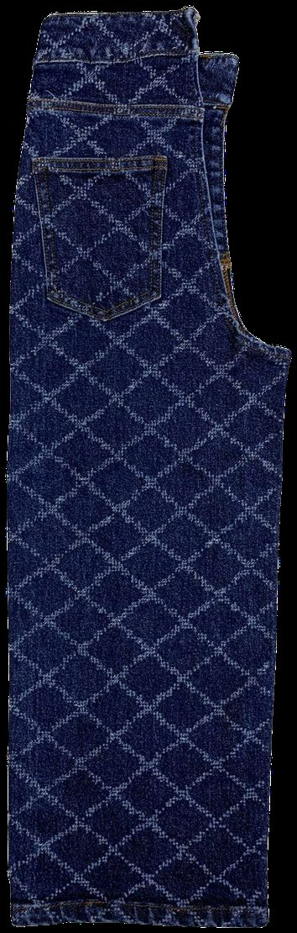
SECTION 6 · ADVANCED TECHNOLOGIES
Marking, engraving and perforation
MARKING
The lightest setting. Affects the surface layer only, so it changes colour without changing the handle. Used for overall fading and soft worn effects.
ENGRAVING
A deeper pass. Removes more of the surface and leaves a tactile as well as a visual effect. Used for patterns, images and hard-edged distress.
PERFORATION
Full power, through the fabric, creating holes. A different operation with a different durability consequence, not simply a stronger version of engraving.
WHY THE WORDS MATTER
All three come off the same machine and the same file, and the difference is a setting. Use all-over laser design for a surface pattern. If you brief the wrong term, the laundry quotes the wrong price and produces the wrong garment.
Engraved lattice pattern
Notes:
Terminology errors in a technical pack propagate straight into purchase orders. This slide takes two minutes and saves an argument.

Slide 51
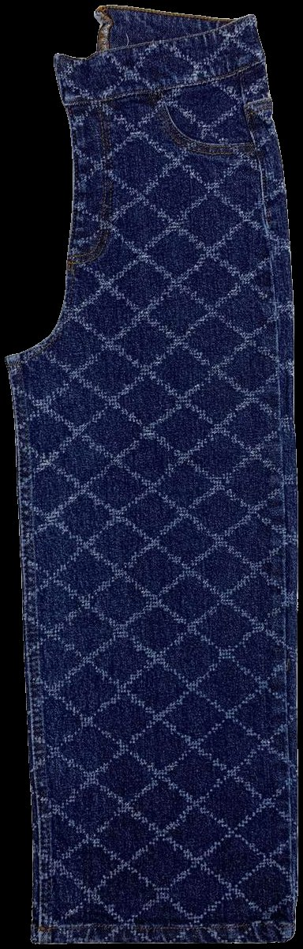
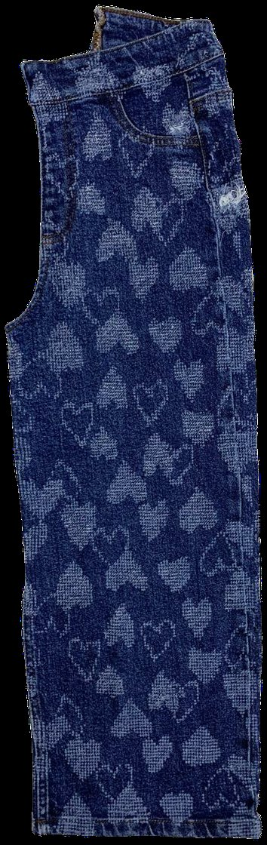
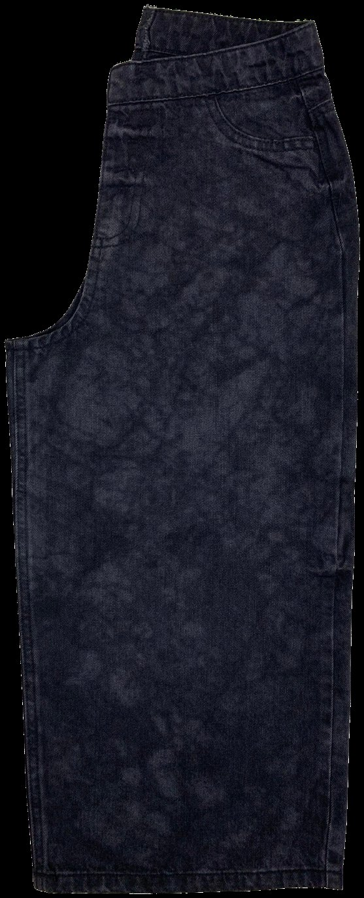
SECTION 6 · ADVANCED TECHNOLOGIES
What laser can do that chemistry cannot
Precision and repeatability, rather than sustainability alone, are the commercial case for laser.
Diamond lattice
Heart motif
Pictorial scene
Cloud effect
Every one of these is a digital file. Send the same file to the same machine on the same fabric and you get the same garment, which no chemical process can promise.
Notes:
Ask the room how they would specify the third garment to a supplier. The answer is a file, not a description. That is the shift laser represents.

Slide 52
SECTION 6 · ADVANCED TECHNOLOGIES
Ozone
WHAT IT IS
Ozone gas, generated from the oxygen in air, fades garments in a closed drum. It reacts with the dye, giving a bleached or worn look without a bleach bath.
WHAT IT LOOKS LIKE
Overall lightening with a cleaner, less redeposited surface. Often used together with laser.
HOW IT FEELS
Largely unchanged, and softer than the equivalent bleach route because there is less wet processing.
WHAT CAN GO WRONG
Shade control across batches, over-treatment causing strength loss, and an effect that is not identical to a bleach bath.
WHAT IT COSTS
Equipment cost, low running cost. It removes wet bleaching steps and the pumice in some routes.
ALSO WORTH KNOWING
The gas is generated from air and destroyed at the end of the cycle inside a closed system, which is why the step itself carries very little chemical load.
BUYER CHECKPOINT
If a supplier proposes converting an approved bleach wash to ozone, treat it as a new development and ask for a new sealed standard. It is not a like-for-like substitution.
Overall lightening on a dark base
Notes:
Be careful with savings figures. The direction of travel is well established, but the specific number depends entirely on the route it replaced.

Slide 53
SECTION 6 · ADVANCED TECHNOLOGIES
Low-liquor and water-saving systems
Machines and delivery systems designed to run at much lower water-to-garment ratios, or to recover and reuse process water.
Low-liquor machines
Run at a lower water-to-garment ratio, so less water to heat and less to treat.
Chemistry has to be re-dosed for the new ratio.
Foam and spray delivery
Chemicals delivered as foam, mist or spray rather than in a full bath.
Applies chemistry to the surface where the effect is wanted.
Water recovery loops
Process water filtered and reused within the laundry rather than discharged.
Recovery capacity is the constraint, not the intent.
Ask for water consumption per garment and how it is measured. A figure per batch tells you nothing unless you also know the batch size.
Notes:
There is no photograph of a low-liquor machine in the current image library. Take one on the next laundry visit and add it here.

Slide 54
SECTION 6 · ADVANCED TECHNOLOGIES
What replaces what
A substitution changes the impact profile. It does not automatically make the route clean. A laser garment washed in a high-liquor machine is not obviously better than an enzyme garment washed in a low-liquor machine with heat recovery.
TRADITIONAL STEP
MODERN ALTERNATIVE
WHAT ACTUALLY CHANGES
Hand scraping
Laser
Repeatability, speed, less dust exposure for the operator
Manual whiskering
Laser
Left and right consistency, faster design change
PP spray
Laser, sometimes with ozone
Removes an oxidising chemical and the operator exposure
Stone wash
Enzyme, ozone
Removes pumice sludge and machine wear
Bleach bath
Ozone
Reduces chemical load and effluent
High liquor ratio
Low-liquor and recovery systems
Reduces water volume and heating energy
When a supplier says they use laser and ozone, the next question is on which steps, and what the rest of the route still is.
Notes:
This table is the practical form of judge the route, not the technology. Work across the row rather than reading the middle column on its own.

Slide 55
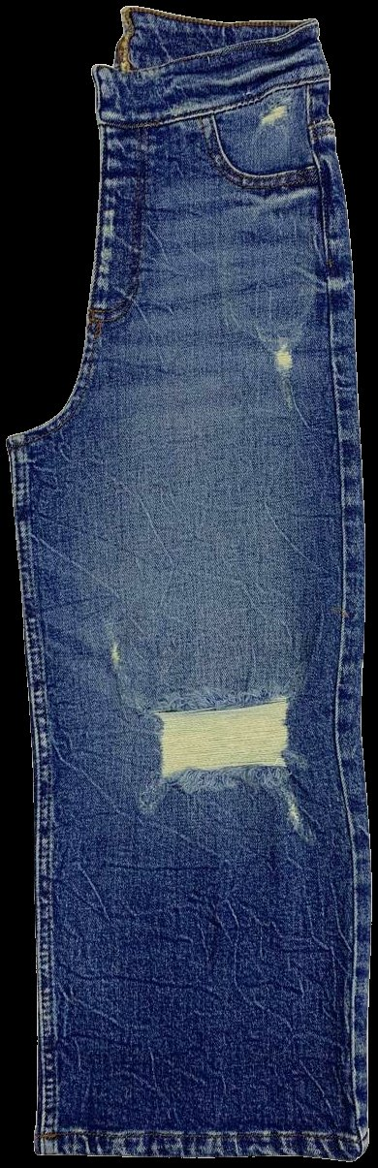
07
Building and approving a wash
A wash name is not a specification. The sealed physical standard is
WHAT YOU SHOULD UNDERSTAND AFTER THIS SECTION
How to read a finished garment as a sequence of processes, and how a wash gets from a reference image to an approved standard that will actually hold in bulk.

Slide 56
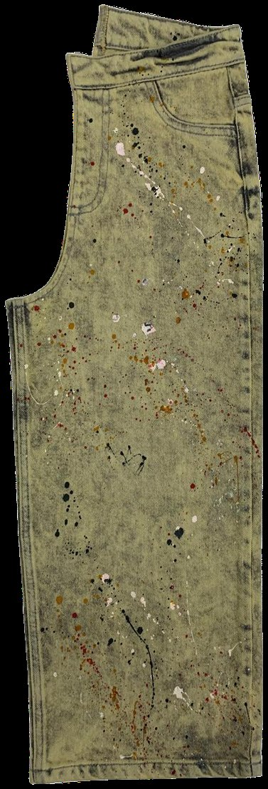
SECTION 7 · BUILDING A WASH
Reading a wash: seven things, in order
Take a finished garment and work through it in this order. It is a habit worth building, because it turns looking into specifying.
1
Overall shade
How light or dark is the ground?
2
Contrast
Even, or sharp highlights against a darker base?
3
Pattern
Random like acid and tie, or placed like whiskers and sanding?
4
Placement
Placed effects mean dry processes, so look for the form marks.
5
Damage
Holes, fraying, ground edges, and whether they are backed.
6
Colour additions
Tint, overdye, pigment, splatter, discharge.
7
Hand feel
Soft, rough, stiff, papery. Feel the inside as well as the face.
Tinted vintage with pigment drop
A garment with a light even ground, sharp whiskers and a soft hand has been through at least three processes: a fading wet process, a dry whisker process and a softening step.
Notes:
When you can name the processes in a garment you can price it, and you can predict what will go wrong with it. That is the whole point of the exercise.

Slide 57
SECTION 7 · BUILDING A WASH
Combination washes: how a look is layered
Desize
→
Enzyme or stone fade
→
Dry effects
→
Local highlights
Neutralise and wash
→
Tint
→
Soften
→
Dry
Every step adds cost and time
A five-step wash costs more and takes longer than a two-step wash, on the same fabric and the same garment.
Every step adds a failure point
Rejection rates compound. Two steps at ninety-five per cent good are not ninety-five per cent good together.
Every step adds variation
Combination washes are harder to reproduce, and they drift further between lots.
BUYER TAKEAWAY
Count the steps in a wash before you agree a price or a delivery date. The step count is the best single predictor of both.
Notes:
This is the typical order for a vintage look, and the order changes with the target. The three points below it do not change.

Slide 58
SECTION 7 · BUILDING A WASH
Wash development: standard to bulk
Seven stages. The one people skip under time pressure is stage five.
1 · Wash standard
The buyer or designer supplies the target: a garment, a swatch or a reference image.
2 · Wash trial
The laundry produces first trials against the target.
3 · Comments
Usually several rounds of revision.
4 · Approved standard
A physical garment is sealed, signed and dated. Both sides hold a copy.
5 · Size set
Run across the size range, at production load, on bulk fabric.
6 · Bulk trial
A production run at production conditions, in the nominated laundry.
7 · Bulk
With shade banding and in-line control against the sealed garment.
The size set catches the two most expensive problems: measurement change across sizes, and dry-effect placement that does not scale.
Notes:
When a TNA is compressed, stage five is the first casualty and stage six is the second. Both are the ones that protect the shipment.

Slide 59
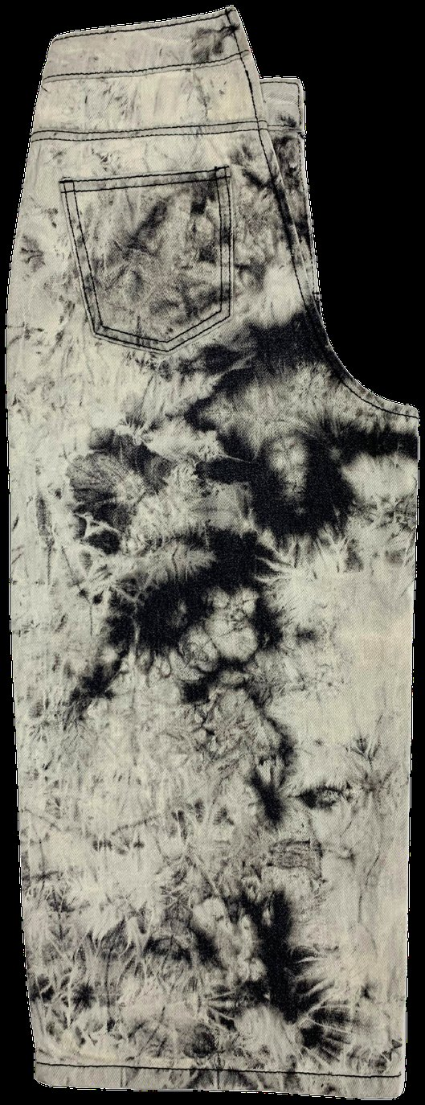
SECTION 7 · BUILDING A WASH
The approval documents you must have
Before bulk starts, you should be holding all seven of these. If you are not, you are relying on goodwill.
1
Sealed wash standard
A physical garment, signed and dated by both parties.
2
Shade band
Lightest and darkest acceptable, sealed, not described in an email.
3
Recipe reference
Held by the laundry and referenced in the approval.
4
Fabric approval for the actual bulk lot
Not for the development lot.
5
Test reports
Fastness, dimensional stability, tensile and tear, and the chemical tests your brand requires.
6
Placement specification
Every dry effect, with measurements, on a marked-up garment.
7
Trim approvals after washing
Not before. Buttons, rivets and labels go through the wash too.
Tie bleach, high operator dependence
If you do not hold a sealed standard, you have no basis on which to reject a shipment. Verbal approval is not approval.
Notes:
Read the last line twice. Almost every dispute that cannot be won comes back to a missing sealed standard.

Slide 60
SECTION 7 · BUILDING A WASH
Shade bands and shade variation
No wash produces identical garments. Variation shows up in three places: garment to garment, panel to panel within a garment, and lot to lot.
Dark limit
Light limit
Standard
A shade band is a set of sealed garments defining the acceptable range, normally a lightest and a darkest against the standard. Bulk garments are then sorted so that each carton, and ideally each store delivery, is consistent.
Notes:
Agree the shade band before bulk, not when the shipment is inspected. A shade band agreed after the fact is a negotiation, not a standard.

Slide 61
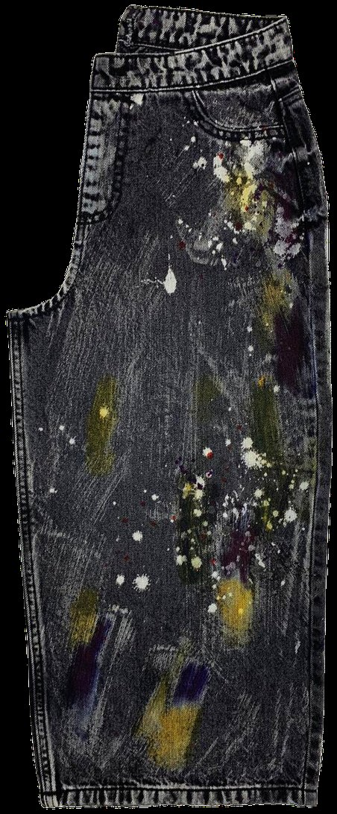
08
Quality and risk
Most disputes come from reproducibility. The ones that cannot be fixed come from chemistry
WHAT YOU SHOULD UNDERSTAND AFTER THIS SECTION
The defects you will actually meet, the technically defensible cause of each, and the tests that stop them reaching a customer.

Slide 62
SECTION 8 · QUALITY AND RISK
The risk map
GROUP
EXAMPLES
WHERE IT IS CAUGHT
1 · Shade and appearance
Uneven shade, patchiness, streaks, cast shift, back staining
Inline and final inspection, under controlled light
2 · Chemical and strength
Over-bleaching, strength loss, residual chemistry, formaldehyde, crocking
Laboratory testing on the finished garment
3 · Dry process
Uneven whiskers, inconsistent scraping, excessive grinding, spreading tears
Inline against a sealed reference garment
4 · Dimensional and performance
Measurement change, shrinkage, growth, loss of recovery
Measurement after wash, across the size range
5 · Reproducibility
Bulk not matching the sealed standard
Size set and bulk trial, before the main run
Most disputes come from group five. Most of the ones that cannot be fixed come from group two, because chemistry is not reversible.
Notes:
The rest of this section takes the groups in turn. Group five gets its own slide at the end because it is the commercial one.

Slide 63
SECTION 8 · QUALITY AND RISK
Shade and appearance defects
DEFECT
WHAT IT LOOKS LIKE
COMMON CAUSES
Uneven shade
One area lighter or darker than another
Overloaded machine, poor liquor circulation, incomplete desizing
Patchiness
Irregular light or dark patches
Uneven chemical distribution, garment folding in the drum
Streaks
Linear marks along the garment
Creasing during the process, mechanical marks
Back staining
Dull face, dirty-looking pockets and lining
Released indigo redepositing: enzyme choice, liquor ratio, short rinsing
Cast shift
Shade correct but the tone is wrong: too yellow, red or green
Incomplete neutralisation, residual chemistry, tint dosing
Garment-to-garment variation
Garments do not match each other
Batch, load and operator differences
Inspect under a controlled light source. Laundry lighting will hide a cast shift that a store's lighting will show immediately.
Notes:
The controlled light point is the most useful line on the slide. Most cast complaints are found by the customer, not by the inspector.

Slide 64
SECTION 8 · QUALITY AND RISK
Chemical and strength defects
DEFECT
WHY IT MATTERS
WHAT TO ASK FOR
Over-bleaching
Irreversible, and it weakens the fabric
Tensile and tear on a bulk garment
Strength loss from enzyme or laser
The garment tears in wear
Tensile and tear on the treated area
Residual manganese from PP
Brown or yellow cast appearing after shipment
Neutralisation and rinse confirmation, finished garment test
Formaldehyde from resin
Restricted substance, legal exposure
Finished garment test report
Crocking on pigment
Colour rubs onto other clothing
Rubbing fastness, dry and wet
Elastane damage
Loss of recovery, bagging, growth
Growth and recovery test after wash
Every item here is found after the garment leaves the factory if it is not tested before. Chemical defects do not announce themselves at final inspection.
Notes:
This is the group two table. Nothing on it can be reworked, which is why it belongs in the technical pack rather than in the inspection report.

Slide 65
SECTION 8 · QUALITY AND RISK
Dry process defects
DEFECT
WHAT CAUSES IT
Whiskers not matching left to right
Operator inconsistency, poor marking, no template
Whisker position wrong across sizes
Pattern set on one size only and scaled without checking
Hand sanding with hard edges
Operator technique, wrong abrasive grade
Sanding inconsistent between garments
Multiple operators with no reference garment on the line
Excessive grinding opening seams
Wheel pressure, time, no control sample
Tears spreading beyond the design
Damage placed on a stress point, no post-wash check
Laser scorching
Power setting too high for the fabric
Placement drift through the run
No inline control against a sealed garment
Ask whether the operators have a sealed reference garment at the workstation. That single control fixes most of this table.
Notes:
Every line here is an operator or control problem rather than a chemistry problem, which means every line is fixable inside the laundry.

Slide 66
SECTION 8 · QUALITY AND RISK
Measurement and performance after wash
The garment that leaves the wash is a different size from the one that entered. Patterns are built with wash shrinkage allowances already in them.
—
Shrinkage differs by fabric, by wash and by measurement point
Length and width do not move by the same amount, and the difference is not proportional.
—
Stretch fabrics add growth and recovery
Heat and chemistry damage elastane, giving a garment that bags at the knee and seat within a day of wear.
—
Skewing and twisting at the leg
Happens when the fabric relaxes unevenly through the wash and dry.
—
A wash revision is also a fit revision
If the wash changes, the measurements change. The two cannot be approved separately.
Rinse wash, minimal shrinkage
Measure after wash, at bulk, across the size range. Ask for growth and recovery on every stretch quality.
Notes:
The last point is the one that surprises people. A wash comment late in the process can quietly invalidate an approved fit.

Slide 67
SECTION 8 · QUALITY AND RISK
Bulk versus approved sample
WHY BULK DOES NOT MATCH
HOW TO PREVENT IT
The sample was washed at sample load, not production load
Seal a physical standard, signed and dated
The bulk fabric came from a different lot
Agree a shade band before bulk
The laundry changed, or the machine changed
Run a size set at production load on bulk fabric
Different operators ran the manual steps
Fix the laundry in the order confirmation
Stones or chemicals were replaced with a different grade
Keep a sealed reference garment at every manual workstation
No shade band was agreed
Ask for the recipe reference to be held and quoted
The standard was a photograph or a swatch, not a sealed garment
Require inline checks, not only end-line
BUYER TAKEAWAY
Every prevention step costs a small amount of time in the TNA. The failure costs a shipment.
Notes:
This is the single most common commercial dispute in denim, and most of it is preventable on the right-hand column.

Slide 68
09
Buyer checkpoints
You are not being trained to run a laundry. You are being trained to judge one
WHAT YOU SHOULD UNDERSTAND AFTER THIS SECTION
What to physically check at each stage of an order, and the questions that separate a strong laundry from a weak one on a first visit.

Slide 69
SECTION 9 · BUYER CHECKPOINTS
Buyer checkpoints, stage by stage
AT DEVELOPMENT
AT APPROVAL
AT SIZE SET
AT BULK
BEFORE SHIPMENT
Is the wash developed on the actual bulk fabric?
Is the standard a sealed physical garment?
Was it washed at production load?
Is there a sealed reference garment at each manual workstation?
Does the bulk sit inside the agreed shade band?
How many process steps does this wash have?
Is there a shade band with sealed extremes?
Do the measurements hold across the size range?
Is shade banding running, and how are garments sorted?
Inspect under a controlled light source.
Which steps are manual?
Are dry-effect placements specified with measurements?
Do the dry effects scale correctly across sizes?
Check pockets, lining and thread for back staining.
Does it use PP, resin or pigment?
Is the laundry the one named in the order?
Have trims been approved after washing?
Is the shrinkage allowance still correct?
Check the reverse of lasered and ground areas.
Is the effect reproducible at volume?
Are inline checks recorded, not just end-line?
Are the test reports in hand?
Is growth and recovery tested on stretch?
Measure after wash, across the size range.
BUYER TAKEAWAY
Five columns, five moments. If you only ever use one column, use the last one, because that is the one that stops a claim.
Notes:
Print this slide and keep it in the sample room. It is the operational core of the whole programme.

Slide 70
SECTION 9 · BUYER CHECKPOINTS
Questions to ask a laundry
ABOUT THE PROCESS
ABOUT CONTROL
ABOUT CHEMISTRY
ABOUT CAPACITY
ABOUT SAFETY
What are the steps, in order?
Was the standard washed at production load?
Do you use PP on this style?
What is your capacity for this specific process?
Is sandblasting used anywhere in your facility?
Which of them are manual?
Do operators have a sealed reference garment at the workstation?
Which resin system?
What is your minimum load?
Do you have an enclosed booth with extraction for spraying?
Was this developed on our bulk fabric?
How do you neutralise, and how do you verify it?
How long does redevelopment take if this moves to another laundry?
How do you shade band and sort?
Is your effluent treated on site or off site?
What is the expected rejection rate on this wash?
Can you provide finished garment test reports?
What is recorded inline, and by whom?
What is your water consumption per garment, and how is it measured?
BUYER TAKEAWAY
Ask the capacity question about the specific process, not about the laundry's total capacity. A large laundry may have one laser machine.
Notes:
The safety column is not optional and it is not rude. Every question in it is one you can ask on a normal factory visit.

Slide 71
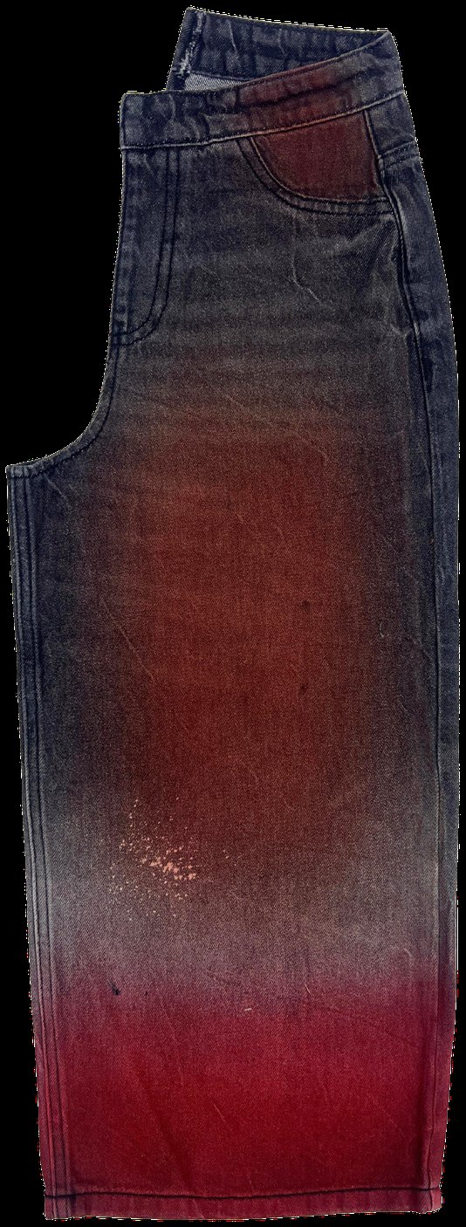
10
Cost, lead time and MOQ
The wash decision sets the price and the delivery date
WHAT YOU SHOULD UNDERSTAND AFTER THIS SECTION
What actually drives the cost of a wash, why manual content behaves differently from machine time, and where the real capacity constraints sit.

Slide 72
SECTION 10 · COST AND LEAD TIME
What drives the cost of a wash
In rough order of impact. The first two account for most of the difference between two washes that look similar.
1 · Number of process steps
Each step is machine time, labour, chemicals and a rejection risk.
2 · Manual content
Hand sanding, tagging and towel work are labour, and labour scales with volume rather than with machinery.
3 · Rejection rate
Acid, tie and heavy destroy carry rejection that must be costed in, not discovered later.
4 · Machine time
Long cycles occupy capacity that could run two shorter washes.
5 · Chemicals
Enzyme, resin and dyestuff costs vary widely by grade and supplier.
6 · Testing
Chemical-heavy washes need more test reports on the finished garment.
7 · Inspection load
Variable washes need more inspection hours per thousand pieces.
8 · Rework
Anything that can be re-washed will be, and it costs twice.
Two washes that look similar can differ substantially in cost because one is four steps and the other is seven. Ask for the step count when you ask for the price.
Notes:
The step count question is the single most useful thing on this slide. It reframes the negotiation from price to process.

Slide 73
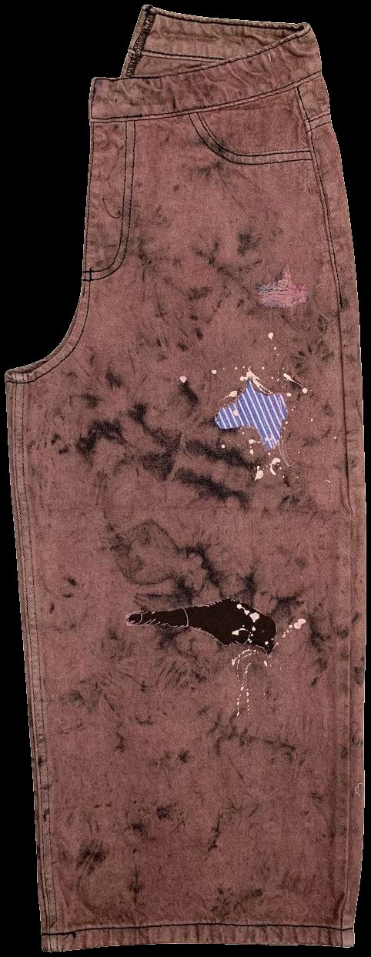
SECTION 10 · COST AND LEAD TIME
Lead time, capacity and MOQ
Wash choice constrains the delivery date as often as it constrains the price.
—
Development time scales with the number of trial rounds
Heavily manual effects take more rounds, because each round depends on a hand skill.
—
Laundry capacity is a real constraint
Laser, ozone and resin curing exist in fewer laundries and in limited capacity within them.
—
Manual processes do not scale by adding machines
They scale by adding trained operators, which is slower and harder to reverse.
—
Minimum load sizes drive MOQ
A wash below the minimum load either costs more per piece or gets washed at the wrong load, which changes the result.
—
A late laundry change is a new development
Build the redevelopment time into the TNA before committing the date.
Tie bleach over an overdyed base
Ask the laundry's capacity for the specific process, not their total capacity.
Notes:
The MOQ point is worth dwelling on. A small order washed at the wrong load is not a cheaper garment, it is a different garment.

Slide 74
SECTION 10 · COST AND LEAD TIME
What each wash family costs you
Relative positions rather than fixed prices. Confirm the actual bands with your own costing team and your nominated laundries.
WASH CHARACTER
COST
CYCLE TIME
BULK RISK
MOQ PRESSURE
WHY
Rinse
Lowest
Shortest
Low
Low
One short wet cycle, nothing manual
Enzyme
Low to medium
Medium
Medium
Low
Controlled and repeatable if dosed properly
Stone
Medium
Medium
Medium
Low
Stone handling, sludge, machine wear
Bleach
Medium
Medium
High
Low
Irreversible if over-run
Acid and snow
Medium
Medium
High
Medium
Rejection rate must sit in the price
Vintage combination
High
Long
High
Medium
Every stacked step adds cost and drift
Heavy manual work
High
Long
Very high
High
Output limited per operator per day
Resin and 3D crinkle
High
Long
Very high
High
Oven capacity is the bottleneck
Laser all-over
Medium per piece
Fast per piece
Low
High
High file setup cost, spread over the order
Garment dye and overdye
Medium to high
Medium
Medium
Medium
Dye lot bound, colour matching risk
A wash decision made in the design meeting sets the price, the lead time and the minimum order. It is not a late-stage detail.
Notes:
Fill in the actual cost bands from your own costing data before the session. The relative order holds; the absolute numbers depend on the supplier base.

Slide 75
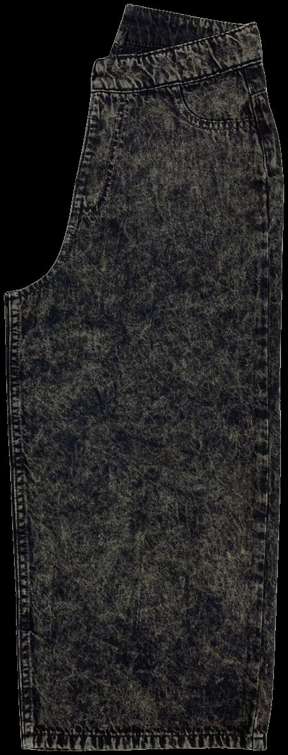
11
Safety, compliance and sustainability
No technology is sustainable in itself. Judge the complete route
WHAT YOU SHOULD UNDERSTAND AFTER THIS SECTION
The finishing techniques that carry a worker safety history, how restricted substances actually reach you, and how to test a sustainability claim in one question.

Slide 76
SECTION 11 · SAFETY AND SUSTAINABILITY
Worker safety in a denim laundry
Some denim finishing techniques have a documented history of serious harm to workers. A buyer needs to know which, and why.
Sandblasting
Abrading denim with high-pressure sand. It causes silicosis, an incurable lung disease, and deaths were documented among denim workers.
Turkey banned the practice, and from 2010 campaigning led major brands to ban or phase it out. It should not appear in any garment you approve.
Dry abrasion generally
Hand sanding and grinding generate dust.
Extraction at the workstation and PPE are the controls.
Chemical spraying
PP spray generates airborne particles.
The control is an enclosed booth with extraction and full PPE.
Chemical handling and storage
Oxidising agents, resins and dyestuffs need handling controls, correct storage and trained operators.
Ask directly whether sandblasting is used anywhere in the facility, and ask to see the spray booth and its extraction. Both are normal factory-visit questions.
Notes:
Do not soften the sandblasting point. It is the clearest case in the category of a fashion effect that cost lives, and buyers were part of how it stopped.

Slide 77
SECTION 11 · SAFETY AND SUSTAINABILITY
Restricted substances and your chemical policy
Your brand holds a restricted substances list. It sets limits for the finished product, and it is your responsibility as well as the factory's.
—
Two different lists
A restricted substances list covers what remains in the garment. A manufacturing list covers what is used in the process, whether or not it stays in the garment.
—
ZDHC maintains the industry manufacturing list and a watchlist
The watchlist is the early signal. Chemicals move from watchlist to restricted.
—
Potassium permanganate is on the ZDHC Chemical Watchlist
Check your brand's position before approving any PP effect.
—
Formaldehyde from crosslinking resins is restricted in finished garments
Ask which resin system is used and whether a formaldehyde-free alternative was offered.
—
Test the garment, not the drum
Test reports should be on the finished garment, not on the chemical supplied to the laundry.
Localised PP application
A chemical that is legal today and watchlisted tomorrow is still in the garments you approved. That is why the watchlist matters more than the restricted list.
Notes:
The last line is the commercial argument for reading the watchlist rather than only the restricted list.

Slide 78
SECTION 11 · SAFETY AND SUSTAINABILITY
Water, energy and effluent
Where the impact actually sits, so you can tell which part of a claim is doing the work.
Water
Driven mainly by liquor ratio, and by the number of wet steps and rinses.
A dry step that adds two rinses afterwards has not saved water.
Energy
Mostly heating water, plus drying and machine running.
An electric process on coal-fired power is not automatically better than a thermal one.
Chemistry
Dyes, oxidising agents, enzymes, resins and softeners, plus the neutralising chemicals used to deal with them.
Effluent and solid waste
Everything that goes in comes out. Treatment capability matters as much as consumption.
Stone washing also produces pumice sludge.
No technology is sustainable in itself. One route is more or less resource intensive than another route, and the comparison has to be stated.
Notes:
The framing to leave them with: we use laser is not a claim. We removed the PP step and the bleach bath from this route, and here is the water figure per garment, is a claim.

Slide 79
SECTION 11 · SAFETY AND SUSTAINABILITY
Reading a sustainability claim
THE CLAIM YOU WILL HEAR
WHAT IS TRUE
WHAT IS LEFT OUT
HOW TO RESPOND
"Laser is chemical-free"
The laser step itself uses no wash chemistry
The garment is still washed before and after, and laser uses electricity
Ask what the laser replaced, and what is left in the route
"Enzyme is eco-friendly"
It removes pumice stone, sludge and machine damage
It is still a full wet process with heating and effluent
Ask for the comparison baseline: eco-friendly against what
"Ozone is zero discharge"
The ozone step uses very little water and no bath chemistry
The garment is still washed before and after, and generation uses energy
Ask which of your current washes could actually move onto it
"This process saves 90 per cent water"
Savings on a single step can be large
Whether it is per step or per garment, and against which process
Ask for the figure per garment and the baseline
Four questions cover almost every claim: what is the boundary, compared with what, how is it measured, and what is the energy source.
Notes:
The last row is the one to practise. Almost every percentage in this category is quoted per step and heard as per garment.

Slide 80
PRACTICAL TAKEAWAYS
Ten things to take away
The first five.
1
Denim fades because indigo sits on the surface of the yarn
Everything else in this programme follows from that one fact.
2
Wash type is the shade. Wash effect is the local technique
Learn to name both separately and you can specify any garment.
3
A wash name is not a specification
Approve a sealed physical standard and a shade band, never a description.
4
Every manual step is a variation risk
Count them before you approve the wash. The step count predicts your bulk problems.
5
Test strength and measurement after the wash, never before it
Greige results are not evidence for a washed garment.
Mid indigo with hip and seat fading
Notes:
Ask the room to write down the two of these five they most need to change in their own working week. Specific beats comprehensive.

Slide 81
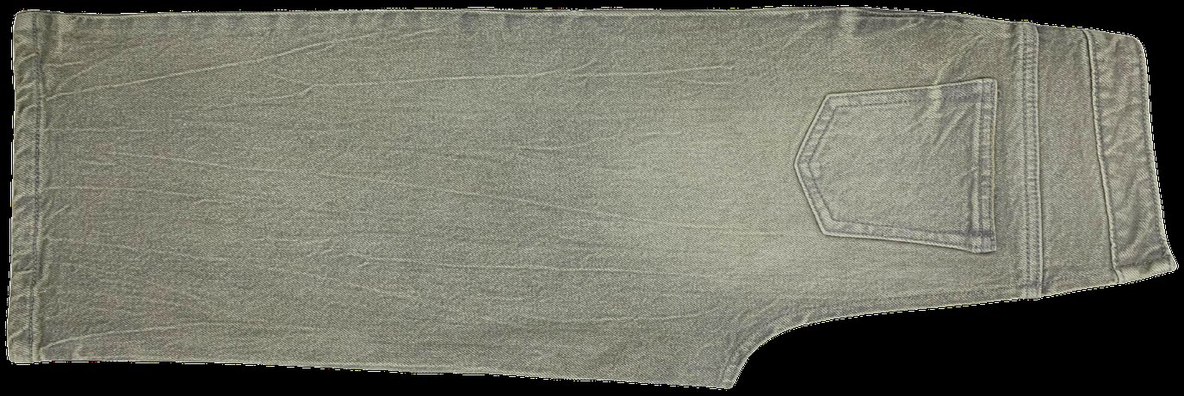
PRACTICAL TAKEAWAYS
Ten things to take away
The second five.
6
Back staining is the defect that most often gets past sample approval
It shows on the parts of the garment nobody photographs.
7
Acid wash uses no acid
Say oxidising agent, and always ask about neutralisation.
8
Cellulase attacks the fibre, not the dye
That is why over-treatment costs you strength, not just colour.
9
PP spray is now a compliance question, not only a quality question
Check the restricted substances list before you approve, not after.
10
Judge the route, not the technology
One step being clean says nothing about the other seven.
Tinted wash, olive cast over grey
Notes:
Close the section here and move straight to the checklist. Do not add a summary slide, because these ten are the summary.

Slide 82
The wash decision checklist
One line per stage. If you cannot tick the third column, do not move to the next row.
STAGE
WHAT YOU DECIDE
WHAT YOU MUST HAVE IN HAND
WHAT STOPS YOU
Concept
Wash type and effects
The fabric that is actually booked
No fabric confirmed yet
Development
Route to the shade
Step count, manual step count, RSL position
A wash needing chemistry your brand restricts
Approval
The shade band
Sealed standard, signed and dated by both parties
A standard that is a photograph or a swatch
Size set
Positions and tolerances
Production load, bulk fabric, full size range
A size set skipped to save a week
Bulk
Accept or hold
Reference garment at each workstation, inline records
End-line inspection only
Shipment
Release
Measurement after wash, strength and chemical reports
Greige results offered as evidence
Print this one. It is the slide people take back to their desk.
Notes:
Close the training on this. It converts everything in the deck into a sequence they can follow on a live order.

Slide 83
REFERENCE · PART ONE
Glossary
TERM
DEFINITION
TERM
DEFINITION
Acid wash
High-contrast random marbling from oxidiser-soaked pumice. No acid is used.
Grinding
Abrasion of seams and edges with a wheel or stone.
Back staining
Loose dye redepositing on the lighter parts of a garment.
Growth and recovery
How far stretch fabric bags out, and how far it springs back.
Cast
The tone of a shade: too red, green or yellow against the standard.
Hand feel
The tactile quality of the finished fabric.
Cellulase
Enzyme that hydrolyses cellulose at the fibre surface.
Liquor ratio
Water per kilogram of garment in the machine.
Crocking
Colour transferring by rubbing, wet or dry.
Marking
Lightest laser setting, surface layer only.
Desize
Removing the weaving size so chemicals penetrate evenly.
Neutralisation
The step that stops and clears an oxidising treatment.
Discharge dyeing
Dyeing with a reducible dye, then chemically removing colour.
Overdye
Re-dyeing a finished garment to a new colour.
Dip dyeing
Partial immersion for a gradient or two-tone effect.
Ozone finishing
Fading with ozone gas in a closed drum instead of a bleach bath.
Notes:
Print the glossary as a two-page handout. It is the part of the deck people keep.

Slide 84
REFERENCE · PART TWO
Glossary
TERM
DEFINITION
TERM
DEFINITION
Pigment
Insoluble colourant fixed with a binder, not bonded to the fibre.
Shade band
Sealed lightest and darkest acceptable garments.
PP spray
Potassium permanganate applied locally. On the ZDHC Watchlist.
Silicosis
Incurable lung disease caused by inhaling silica dust.
Resin finish
Crosslinking treatment that makes creases and 3D shapes permanent.
Snow wash
Variant of acid wash giving a white speckled surface.
Ring dyeing
Dye on the yarn surface with a white core inside.
Sulphur denim
Denim dyed or bottomed with sulphur dyes. Fades and casts differently.
RSL
Restricted substances list. Limits for the finished garment.
Tagging
Manual localised colour with a sponge, cloth, brush or tag.
MRSL
Manufacturing restricted substances list. Covers process chemicals.
Tint
Light overall colour applied to shift the cast of a wash.
Sealed standard
The signed physical garment bulk is judged against.
Towel bleach
Bleach applied by hand with a soaked towel.
Sandblasting
Abrading denim with high-pressure sand. Banned. Causes silicosis.
ZDHC
Zero Discharge of Hazardous Chemicals. Publishes the MRSL and watchlist.
Notes:
The last two entries in each column are the ones most often missing from denim glossaries and most often needed in a compliance conversation.

Slide 85
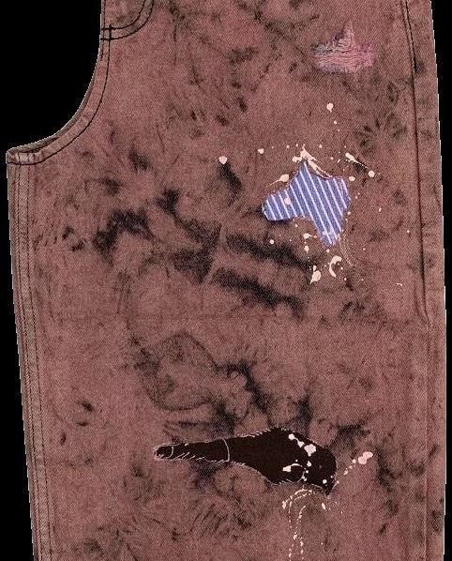
Questions
Denim washing is not a finishing detail. It sets the price, the delivery date and most of the quality risk on the order.
The checklist two slides back is the practical summary. Everything else in this deck exists to explain why each line is on it.
Prepared by Md. Sohel Rana · RMG Xpress Insights by Sohel · Dhaka.
Notes:
Leave the checklist slide on screen during questions rather than this one.

