Slide 1

Software Engineering Damir Dobric/Andreas Pech
Presentation on
ML24/25-03 Implement Anomaly Detection Sample
Md Ashiqur Rahman Md Sohel Rana
Matriculation Number: 1393169 Matriculation Number: 1415765
md.rahman3@stud.fra-uas.de sohel.rana@stud.fra-uas.de
Team Name: CodeHive
Date:29/03/2025
M.Eng. Information Technology WS24-25/ Damir Dobric & Andreas Pech/ Module Software Engineering

Slide 2
Overview
Introduction
Objectives
NeoCortex API
Methodology
Anomaly Detection
Result
Discussion
References
M.Eng. Information Technology WS24-25/ Damir Dobric & Andreas Pech/ Module Software Engineering

Slide 3
Introduction
HTM is a machine learning algorithm inspired by the neocortex of the human brain.
Recognizes temporal patterns and predicts time-series data.
Uses Sparse Distributed Representations (SDRs) for efficient data processing.
In the project, the NeoCortexAPI – a .NET implementation of the HTM framework – will be used to make an anomaly detection system. The project include two parts:
Training: The HTM model trains from the normal numeric sequences, such as network traffic loads, from artificially created data.
Testing: The trained model is tested on new sequences containing both normal data and anomalies. The model identifies anomalies based on deviations from predicted values.
M.Eng. Information Technology WS24-25/ Damir Dobric & Andreas Pech/ Module Software Engineering

Slide 4
Introduction
The project will used C# and the NeoCortexAPI library to process the data, train the HTM model, and evaluate the performance. The main objective of the project is to determine a robust and efficient system which can accurately predict the anomalies while analyzing the results using metrics like False Negative Rate(FNR) and False Positive Rate(FNR).
The anomaly detection helps to identify any unusual traffic patterns or anomalies in the network such as cyber-attacks or system failures. Moreover it is used for fraud detection in financial transactions. For monitoring machine and equipment performance and detecting anomalies to prevent breakdowns. The model can also be used to detect diseases on the human body or energy consumption to survey irregularities and optimize energy distribution.
M.Eng. Information Technology WS24-25/ Damir Dobric & Andreas Pech/ Module Software Engineering

Slide 5
Objectives
Feature Engineering: Generate artificial numeric data representing network traffic load percentages. Also prepare training data with normal sequences and testing data with random anomalies.
HTM Model Training: Configure and train the HTM model using the NeoCortexAPI to identify normal patterns from the training dataset.
HTM Model Training: Configure and train the HTM model using the NeoCortexAPI to identify normal patterns from the training dataset.
Performance Evaluation: Measure the system’s effectiveness using performance metrics using False Negative Rate(FNR), False Positive Rate(FPR), Mean Square Error(MSE) etc.
M.Eng. Information Technology WS24-25/ Damir Dobric & Andreas Pech/ Module Software Engineering

Slide 6
NeoCortex API
NeoCortex API is an advanced AI-driven framework designed for cognitive computing.
It mimics the human neocortex, enabling intelligent decision-making and pattern recognition.
The implementation of the Hierarchical Temporal Memory Cortical Learning Algorithm is the main emphasis of NeoCortex API.
Spatial pooling, temporal memory, sequence learning, and anomaly detection are among the HTM algorithms that are supported.
Sensory Input Processing: Encodes data into sparse distributed representations (SDRs).
Learning and Inference: Enables real-time learning, prediction, and anomaly detection
M.Eng. Information Technology WS24-25/ Damir Dobric & Andreas Pech/ Module Software Engineering

Slide 7
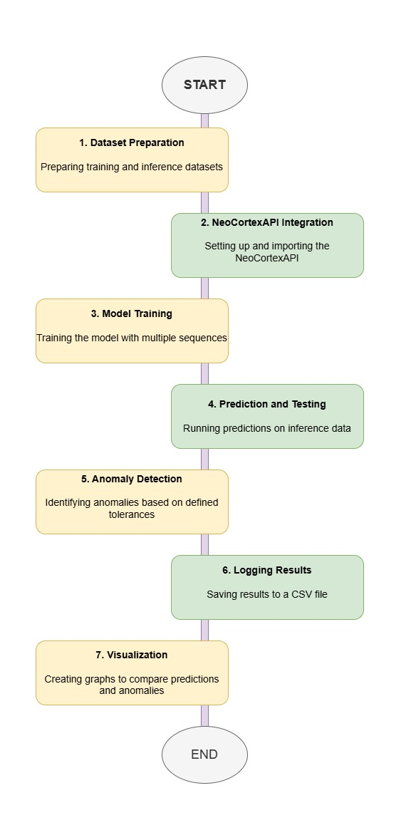
Methodology
M.Eng. Information Technology WS24-25/ Damir Dobric & Andreas Pech/ Module Software Engineering

Slide 8
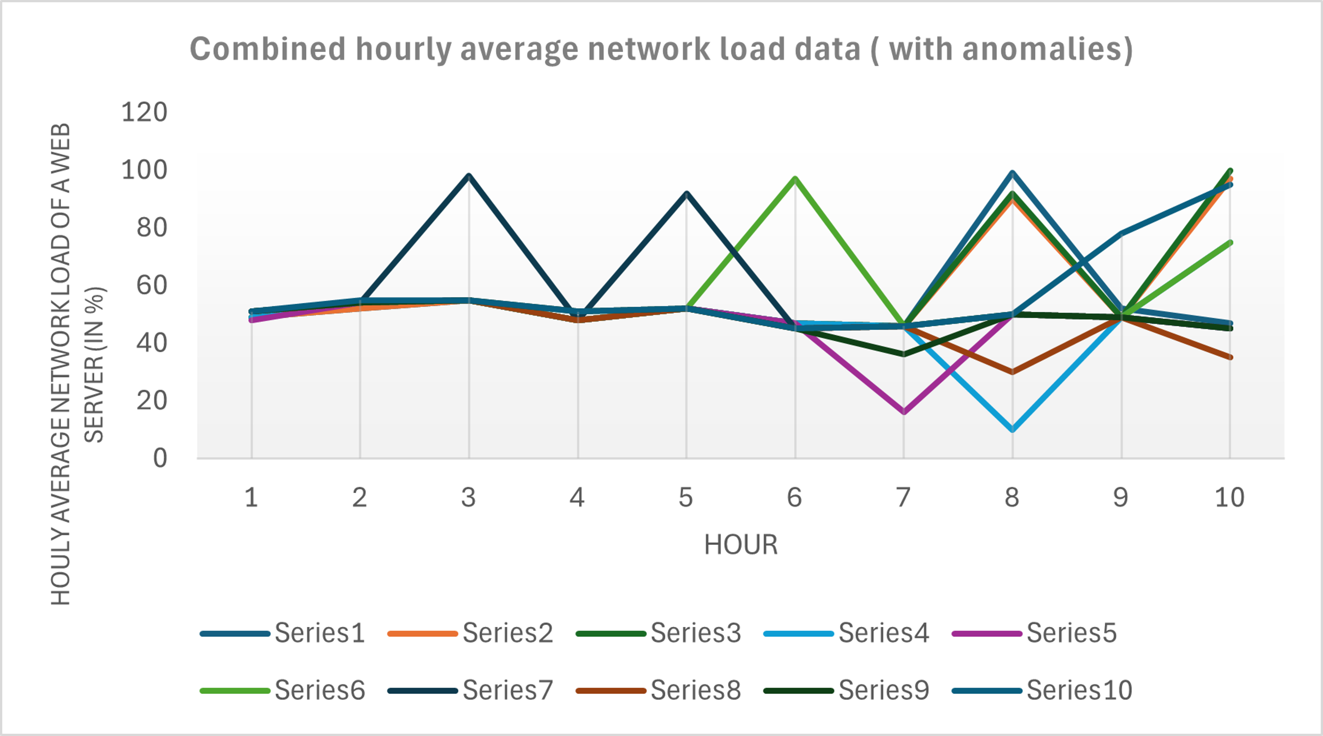
Anomaly Detection
We have taken network load data and trained our htm engine.
After that added anomalies randomly in our prediction data.
Later on trained our data and detect anomalies using trained htm engine
Here(in figure) is the shown outcome of the project where both combined training data and predicting data.
The Range 45 to 55 is the normal range and all outliers outside the range are considered as Anomalies.
M.Eng. Information Technology WS24-25/ Damir Dobric & Andreas Pech/ Module Software Engineering

Slide 9
Result
Average FNR of the experiment: 0.19
Average FPR of the experiment: 0.13
Testing the sequence for anomaly detection: 54, 55, 48, 52, 47, 16, 50, 49, 45.
First element in the testing sequence from input list: 54
No anomaly detected in the first element. HTM Engine found similarity to be: 62,79%. Starting check from beginning of the list.
Current element in the testing sequence from input list: 55
Anomaly not detected in the next element!! HTM Engine found similarity to be: 92,59%.
Current element in the testing sequence from input list: 52
****Anomaly detected**** in the next element. HTM Engine predicted it to be 97 with similarity: 100%, but the actual value is 47.
As anomaly was detected, so we are skipping to the next element in our testing sequence.
Current element in the testing sequence from input list: 16
Anomaly not detected in the next element!! HTM Engine found similarity to be: 100%.
Current element in the testing sequence from input list: 49
****Anomaly detected**** in the next element. HTM Engine predicted it to be 75 with similarity: 55,81%, but the actual value is 45.
M.Eng. Information Technology WS24-25/ Damir Dobric & Andreas Pech/ Module Software Engineering

Slide 10
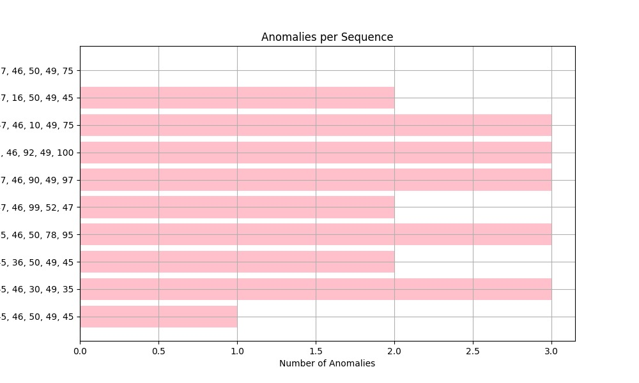
Result
The visualization displays the number of anomalies detected in various numerical sequences.
X-axis: Represents the number of anomalies.
Y-axis: Represents different numerical sequences.
Each sequence consists of five numerical values, indicating multiple five-element sequences analyzed.
Some sequences exhibit more anomalies than others, suggesting heterogeneous data patterns.
Higher anomaly counts may indicate outliers, systematic errors, or data behavior changes.
Sequences with fewer anomalies may represent regular patterns or stable trends.
M.Eng. Information Technology WS24-25/ Damir Dobric & Andreas Pech/ Module Software Engineering

Slide 11
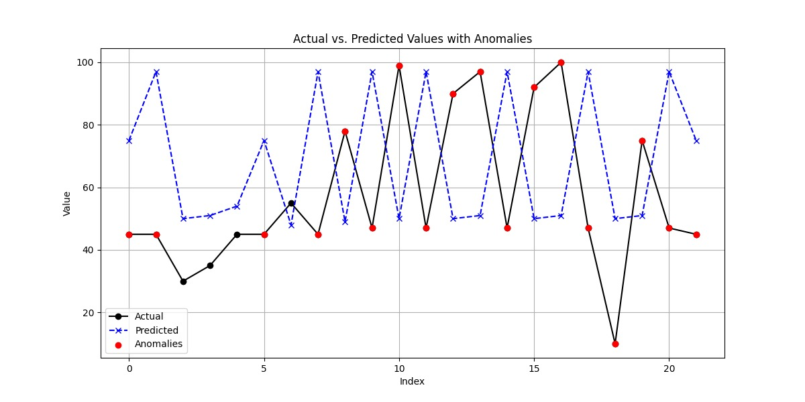
Result
A time-series comparison plot showing the relationship between actual values, predicted values, and detected anomalies.
Black Solid Line: Represents actual values, showing fluctuations over time.
Blue Dashed Line: Represents predicted values, indicating the expected trend.
Red Dots: Mark detected anomalies where actual values significantly diverge from predictions.
Large deviations indicate unexpected real-world events, sensor malfunctions, or model inaccuracies.
The predictive model struggles with sudden spikes or drops, revealing potential forecasting limitations.
M.Eng. Information Technology WS24-25/ Damir Dobric & Andreas Pech/ Module Software Engineering

Slide 12
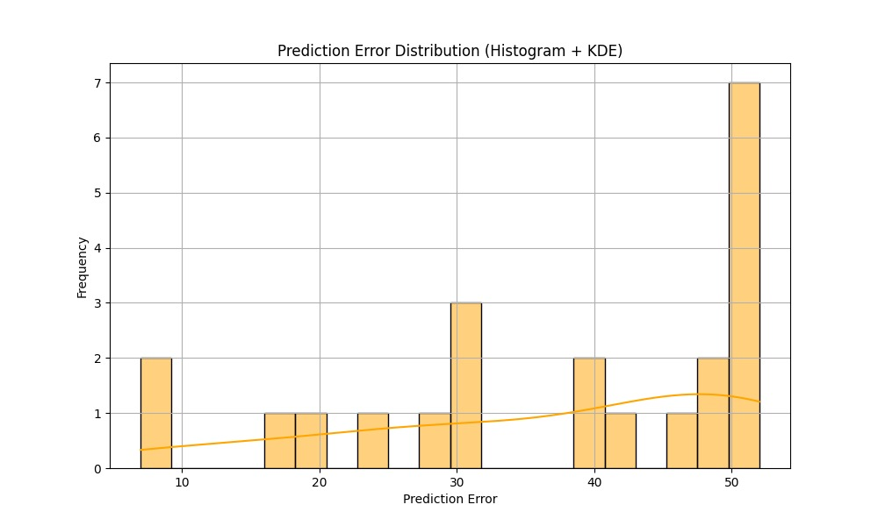
Result
A histogram combined with a Kernel Density Estimate (KDE) curve to visualize prediction error distribution.
X-axis: Represents prediction error values.
Y-axis: Represents the frequency of prediction errors.
Light Orange Histogram Bars: Show the number of occurrences for different error ranges.
KDE Curve: Smooths the distribution to reveal underlying error patterns.
Multiple peaks and large errors suggest variable model inaccuracies.
High-frequency large errors indicate systemic biases or inefficiencies in the model.
M.Eng. Information Technology WS24-25/ Damir Dobric & Andreas Pech/ Module Software Engineering

Slide 13
Discussion
Model effectively identifies outliers in datasets.
Important applications: network security, fraud detection, predictive maintenance.
Enhances real-time decision-making, reducing operational risks and improving system performance.
FNR indicates the ratio of missed anomalies (actual anomalies reported as normal).
Low FNR is crucial to prevent major consequences (e.g., fraud detection failures).
False positives should be minimized to reduce unnecessary investigations.
Limitations & Challenges:
Data Quality Dependency: Model performance is affected by data noise & inconsistencies.
Computational Constraints:
Limited sample size due to local machine processing power.
Cloud computing could improve training efficiency.
Hyperparameter Optimization:
Fine-tuning can enhance anomaly detection accuracy.
M.Eng. Information Technology WS24-25/ Damir Dobric & Andreas Pech/ Module Software Engineering

Slide 14
References
[1] J. H. a. S. Blakeslee, "On Intelligence," in Henry Holt, New York, 2004.
[2] J. S. a. S. Latré, "Hierarchical temporal memory and recurrent neural networks for time series prediction: An empirical validation and reduction to multilayer perceptrons," in Neurocomputing, 2020.
[3] V. Lomonaco, "A machine learning guide to HTM (Hierarchical Temporal Memory)," 2019. [Online].Available: https://www.numenta.com/blog/2019/10/24/machinelearning-guide-to-htm.
[4] a. H. H. J. A. Starzyk, "Spatio–Temporal Memories for Machine Learning: A Long-Term Memory Organization,“ in IEEE TRANSACTIONS ON NEURAL NETWORKS, 2009.
[5] A. &. A. S. Lavin, "Evaluating real-time anomaly detection algorithms - the Numenta Anomaly Benchmark," in In arXiv [cs.AI], 2015.
M.Eng. Information Technology WS24-25/ Damir Dobric & Andreas Pech/ Module Software Engineering

Slide 15
Q&A
Thank you for your attention!
M.Eng. Information Technology WS24-25/ Damir Dobric & Andreas Pech/ Module Software Engineering

