Slide 1

Software Engineering Damir Dobric/Andreas Pech
Presentation on
ML24/25-03 Implement Anomaly Detection Sample
Md Ashiqur Rahman Md Sohel Rana
Matriculation Number: 1393169 Matriculation Number: 1415765
md.rahman3@stud.fra-uas.de sohel.rana@stud.fra-uas.de
Team Name: CodeHive
Date:22/03/2025
M.Eng. Information Technology WS24-25/ Damir Dobric & Andreas Pech/ Module Software Engineering

Slide 2
Overview
Introduction
Objectives
NeoCortex API
Methodology
Anomaly Detection
Result & Discussion
M.Eng. Information Technology WS24-25/ Damir Dobric & Andreas Pech/ Module Software Engineering

Slide 3
Introduction
HTM is a machine learning algorithm inspired by the neocortex of the human brain.
Recognizes temporal patterns and predicts time-series data.
Uses Sparse Distributed Representations (SDRs) for efficient data processing.
In the project, the NeoCortexAPI – a .NET implementation of the HTM framework – will be used to make an anomaly detection system. The project include two parts:
Training: The HTM model trains from the normal numeric sequences, such as network traffic loads, from artificially created data.
Testing: The trained model is tested on new sequences containing both normal data and anomalies. The model identifies anomalies based on deviations from predicted values.
M.Eng. Information Technology WS24-25/ Damir Dobric & Andreas Pech/ Module Software Engineering

Slide 4
Introduction
The project will used C# and the NeoCortexAPI library to process the data, train the HTM model, and evaluate the performance. The main objective of the project is to determine a robust and efficient system which can accurately predict the anomalies while analyzing the results using metrics like False Negative Rate(FNR) and False Positive Rate(FNR).
The anomaly detection helps to identify any unusual traffic patterns or anomalies in the network such as cyber-attacks or system failures. Moreover it is used for fraud detection in financial transactions. For monitoring machine and equipment performance and detecting anomalies to prevent breakdowns. The model can also be used to detect diseases on the human body or energy consumption to survey irregularities and optimize energy distribution.
M.Eng. Information Technology WS24-25/ Damir Dobric & Andreas Pech/ Module Software Engineering

Slide 5
Objectives
Feature Engineering: Generate artificial numeric data representing network traffic load percentages. Also prepare training data with normal sequences and testing data with random anomalies.
HTM Model Training: Configure and train the HTM model using the NeoCortexAPI to identify normal patterns from the training dataset.
HTM Model Training: Configure and train the HTM model using the NeoCortexAPI to identify normal patterns from the training dataset.
Performance Evaluation: Measure the system’s effectiveness using performance metrics using False Negative Rate(FNR), False Positive Rate(FPR), Mean Square Error(MSE) etc.
M.Eng. Information Technology WS24-25/ Damir Dobric & Andreas Pech/ Module Software Engineering

Slide 6
NeoCortex API
NeoCortex API is an advanced AI-driven framework designed for cognitive computing.
It mimics the human neocortex, enabling intelligent decision-making and pattern recognition.
The implementation of the Hierarchical Temporal Memory Cortical Learning Algorithm is the main emphasis of NeoCortex API.
Spatial pooling, temporal memory, sequence learning, and anomaly detection are among the HTM algorithms that are supported.
Sensory Input Processing: Encodes data into sparse distributed representations (SDRs).
Learning and Inference: Enables real-time learning, prediction, and anomaly detection
M.Eng. Information Technology WS24-25/ Damir Dobric & Andreas Pech/ Module Software Engineering

Slide 7
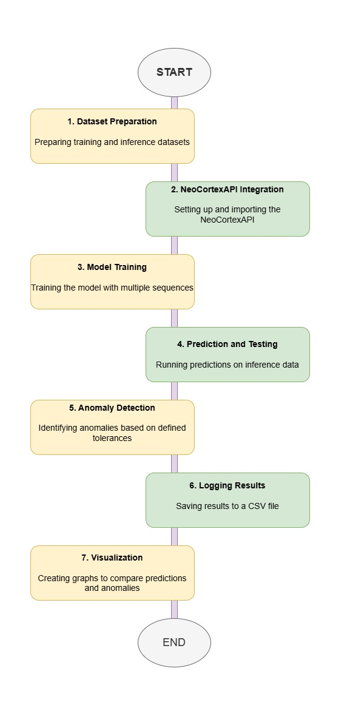
Methodology
M.Eng. Information Technology WS24-25/ Damir Dobric & Andreas Pech/ Module Software Engineering

Slide 8
Anomaly Detection
M.Eng. Information Technology WS24-25/ Damir Dobric & Andreas Pech/ Module Software Engineering

