Slide 1

Why do I act this way?
Because I can’t control it
I Have
Tourette's Syndrome
A medical condition that causes me to frequently make involuntary movements, twitches and noises called tics. Treatment is limited and there is no known cure.
It is involuntary. I can’t control it and it’s exhausting.
Thank you for your kind understanding and empathy.
Flip over to learn more ! >

Slide 2
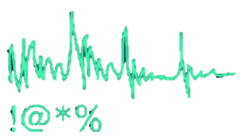


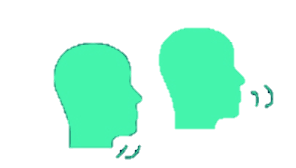
Raising Awareness
Tourette’s Syndrome is a neurobiological disorder that affects approximately 1% of school-age children and adolescents world-wide. Tourette’s is an inheritable disease that emerges in childhood and is characterized by involuntary and repetitive motor/vocal tics.
Simple Vocal Tics
Complex Vocal Tics
Simple Motor Tics
Complex Motor Tics
Sudden, meaningless sounds or noises
Throat clearing
Coughing
Spitting
Barking
Sudden, more meaningful utterances
Repetitive words or phrases : “shut up” or “stop that”
Echoing one’s own or another’s words/phrases
“Coprolalia” – uttering obscene or socially unacceptable phrases
Sudden, brief movements
Eye blinking
Jerking
Lip pouting
Tooth clicking
Slower, longer movements
Throwing
“Copropraxia” - Obscene Gestures
Biting
Banging
https://ticcare.wordpress.com/about-tourette-syndrome-care-group-singapore/

