Slide 1
Flight Delay
Shahd Ahmed Sohila Ayman Sarah Muhammed

Slide 2
INTRODUCTION
This project focuses on analyzing and predicting flight delays using big data analytics, machine learning, and deep learning techniques. The dataset contains detailed information about flights in 2022, including departure and arrival delays, airlines, airports, flight distance, and airtime. Using PySpark, the project performs data cleaning, exploratory data analysis (EDA), and feature engineering to discover patterns and factors affecting delays. Several machine learning models and a neural network were then developed to predict whether a flight would be delayed, followed by performance evaluation and visualization of the results.

Slide 3
Dataset Overview
This project presents a complete flight delay analysis system using PySpark, machine learning, and deep learning techniques. The workflow starts with loading and cleaning a large 2022 flight dataset, followed by exploratory data analysis (EDA) to identify important trends and patterns related to delays. Feature engineering techniques were applied to create meaningful variables that improve prediction accuracy. Multiple machine learning models, including Logistic Regression, Random Forest, and Gradient Boosted Trees, were trained and evaluated, in addition to a deep learning neural network developed using PyTorch. The project also includes K-Means clustering and PCA visualization to explore hidden patterns in the data and compare flight behavior across different groups.

Slide 4
Import Libraries and Load Data
Libraries
“At the beginning of the project, we imported the required libraries and frameworks needed for data processing, visualization, machine learning, and deep learning. Different libraries were used because each one provides specialized tools for a specific task in the workflow.”
library | purpose
PySpark | Processing large-scale data efficiently
Pandas | Data manipulation and analysis
Matplotlib | Creating charts and visualizations
PySpark MLlib | Building machine learning models
Scikit-learn | Feature scaling and evaluation metrics
PyTorch | Building and training the deep learning model

Slide 5
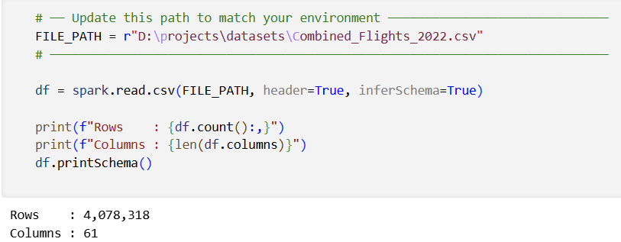
Import Libraries and Load Data
Load Data
“After importing the libraries, the dataset was loaded from a CSV file into a Spark Data Frame using PySpark. The header option was enabled to read column names correctly, and schema inference was used to automatically detect data types.”
Rows : 4,078,318
Columns : 61

Slide 6
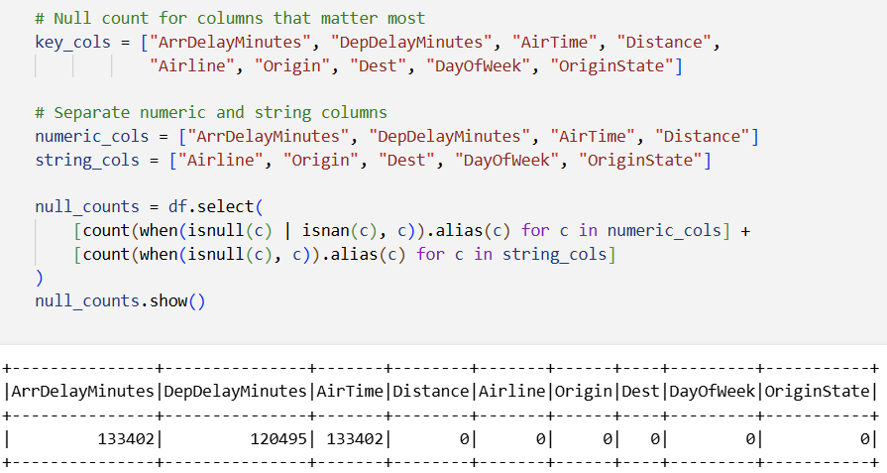
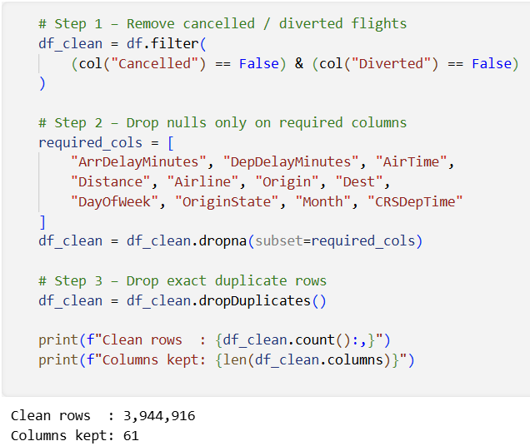
Data Cleaning
Removed cancelled and diverted flights
Handled missing values
Removed duplicate records
Improved data quality before analysis
Clean Rows: 3,944,916
Columns : 61

Slide 7
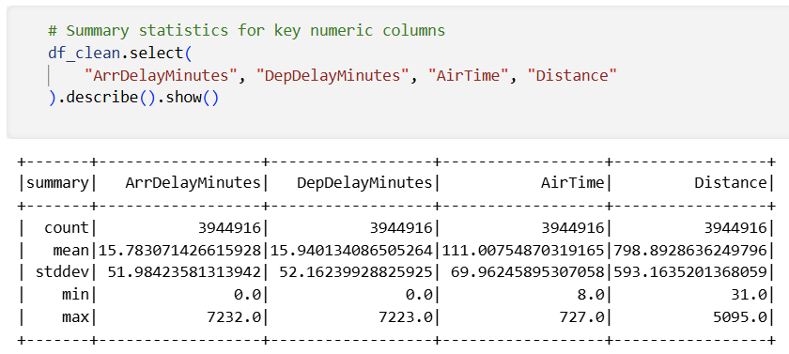
Exploratory Data Analysis
“After cleaning and preprocessing the data, Exploratory Data Analysis (EDA) was performed to better understand the dataset and discover important patterns, trends, and relationships related to flight delays. EDA helps transform raw data into meaningful insights using statistics and visualizations.”
Summary Statistics
“Statistical analysis was performed on numerical features such as arrival delay, departure delay, airtime, and distance to understand the data distribution, average values, minimums, and maximums.”

Slide 8
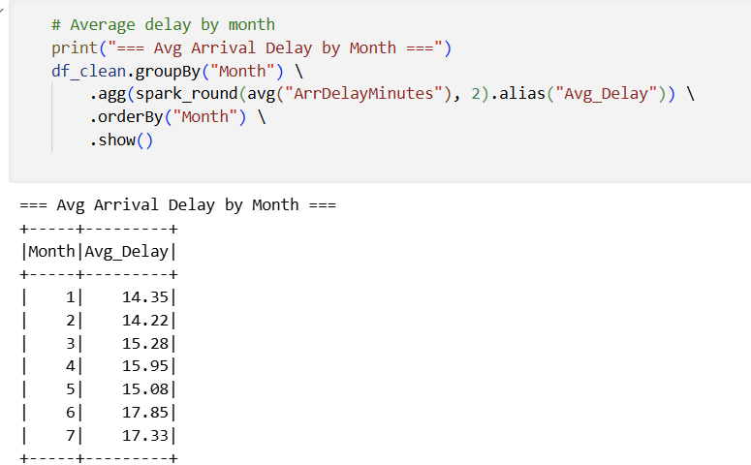
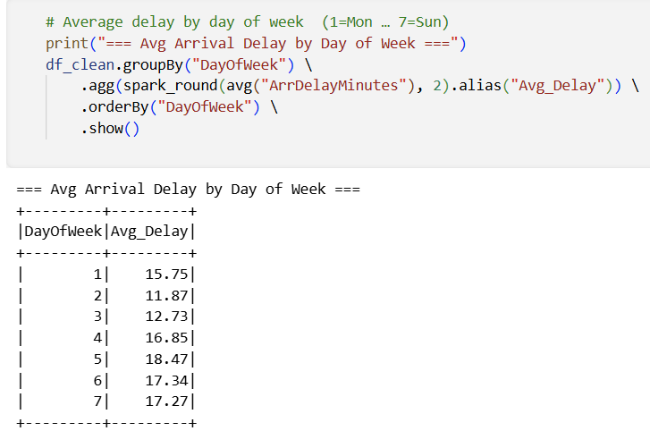
Exploratory Data Analysis
Delay by Month
“Average delays were analyzed across different months to identify seasonal patterns and periods with higher delays.”
Insight Example
June and July recorded the highest average delays (summer travel peak). Friday had the highest delay rate among weekdays.
Delay by Day of Week
“Flight delays were compared across weekdays to determine whether some days experience more delays than others.”

Slide 9
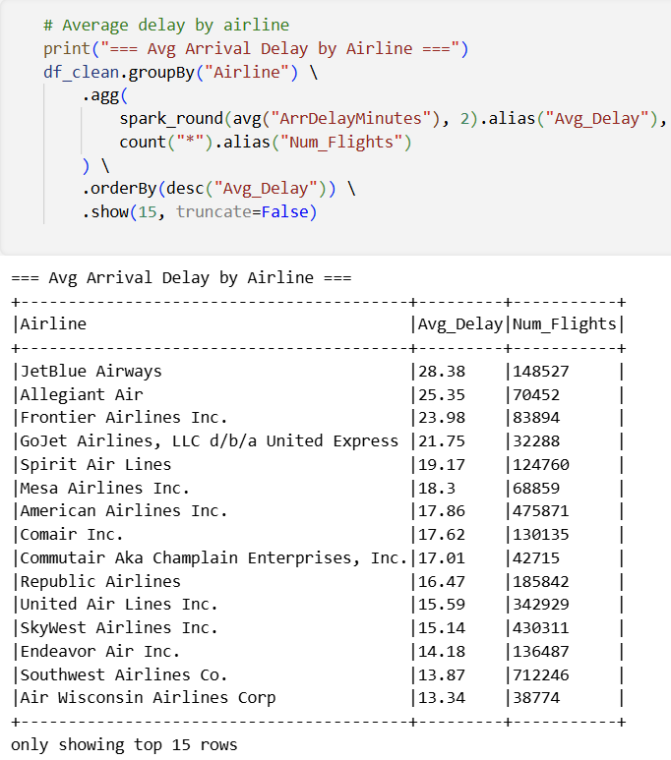
Exploratory Data Analysis
Delay by Airline
“Airlines were compared based on their average delay times to evaluate punctuality performance.”
Why EDA Is Important?
“EDA helps understand the behavior of the data before building machine learning models. It also helps identify important features that may strongly affect flight delays.”

Slide 10
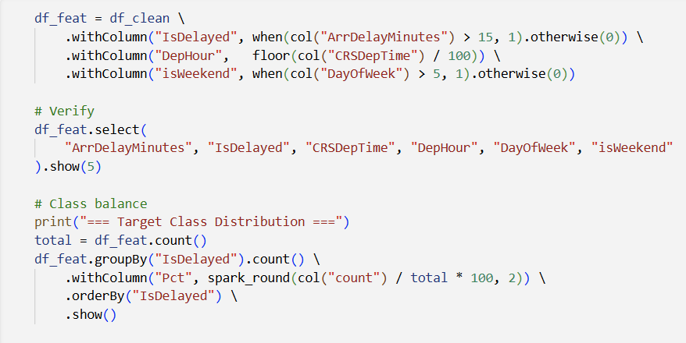
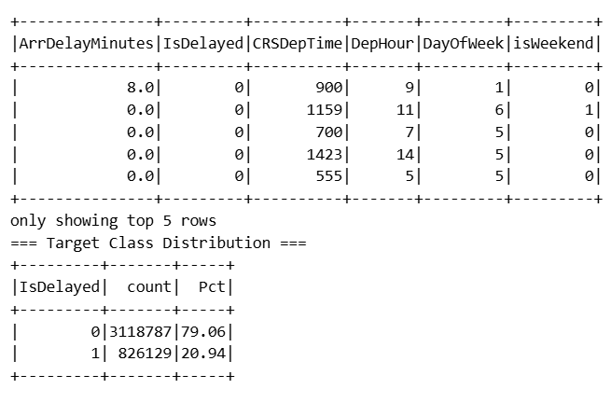
Feature Engineering
Feature Engineering
Created new meaningful features:
IsDelayed — Target variable: 1 if ArrDelayMinutes > 15, else 0
DepHour — Departure hour extracted from CRSDepTime (floor / 100)
isWeekend — Binary flag: 1 if Saturday or Sunday (DayOfWeek > 5)
Improved model learning and prediction accuracy
Converted raw data into useful inputs for ML models

Slide 11
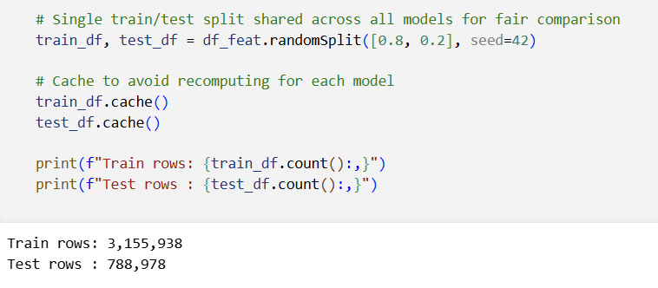
Feature Engineering
We train 3,155,938 rows , and test 788,978 rows

Slide 12
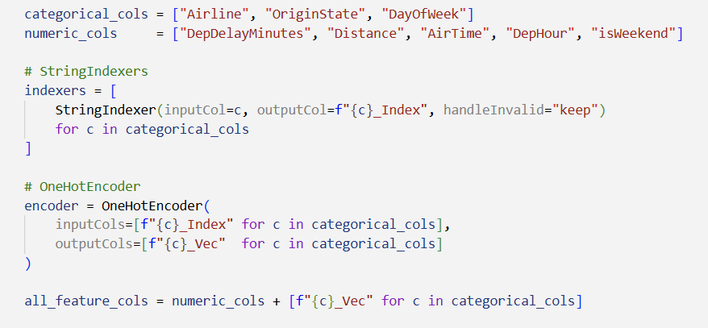
Feature Engineering
StringIndexer
“Categorical columns such as airline and airport states were converted into numerical indices.”
OneHotEncoder
“The indexed categorical features were transformed into binary vectors to improve model performance and avoid misleading relationships between categories.”

Slide 13
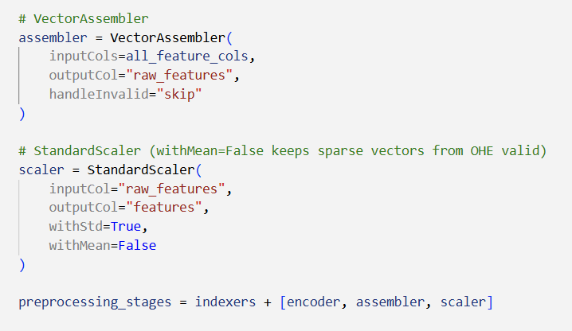
Feature Engineering
VectorAssembler
“All selected features were combined into a single feature vector used as input for machine learning models.”
StandardScaler
“Numerical features were scaled so that variables with larger values would not dominate the learning process.”

Slide 14
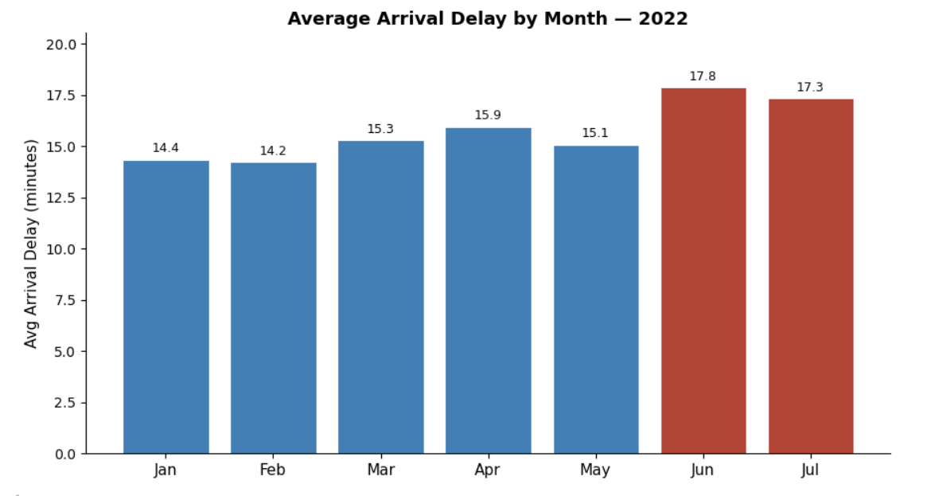
visualization
Detect high-delay periods
Analyze seasonal effects

Slide 15
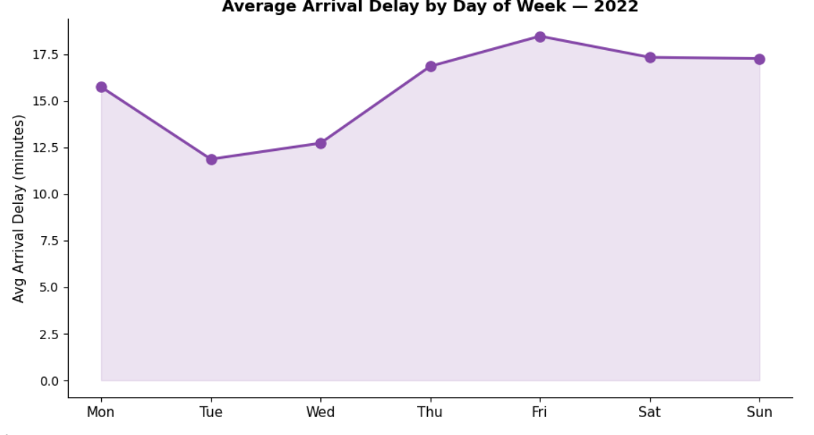
visualization
Understand weekly delay patterns

Slide 16
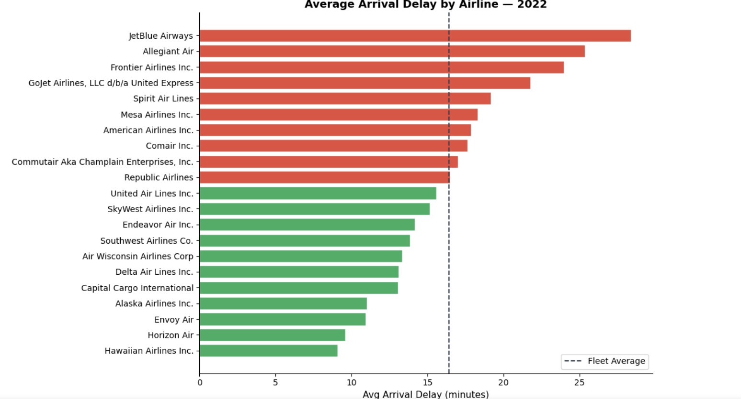
visualization
Evaluate airline punctuality

Slide 17
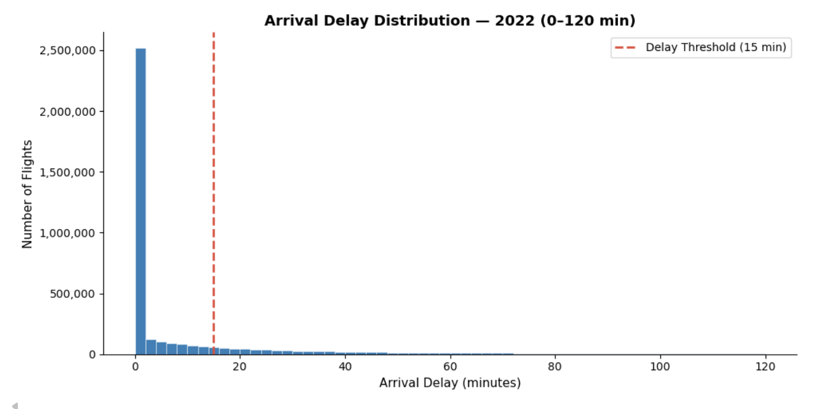
visualization
Detect outliers
Understand delay frequency

Slide 18
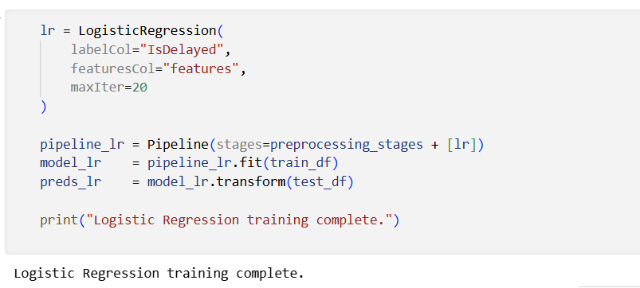
Logistic Regression
Used as a baseline model — fast training with maxIter=20
Predicted delayed vs non-delayed flights using Sigmoid probability output
Accuracy ~84% | AUC-ROC ~0.88 | Fastest to train among all models

Slide 19
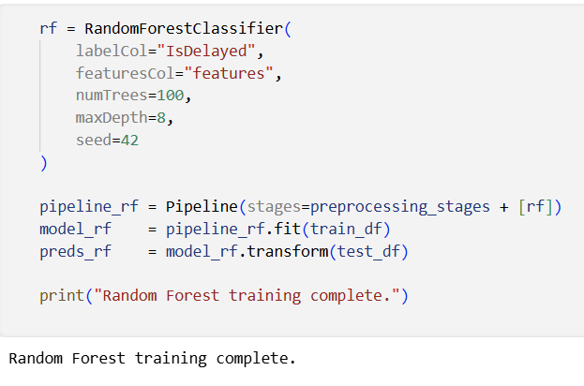
Random Forest
Ensemble of 100 decision trees (numTrees=100, maxDepth=8, seed=42). Performs well on complex non-linear datasets, robust to outliers, and provides feature importance scores. Achieved best AUC-ROC (~0.95) among all Spark models — Accuracy ~89%.

Slide 20
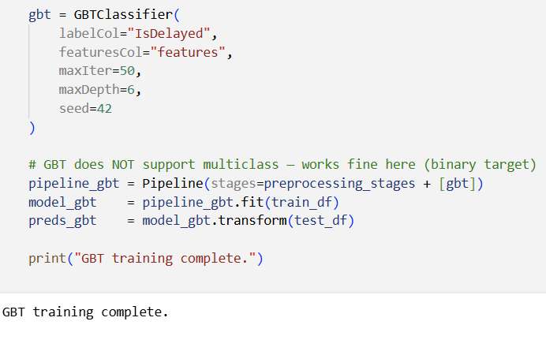
Gradient Boosted Trees (GBT)
maxIter = 50 Number of trees built in the GBT model
maxDepth = 6 Maximum depth of each decision tree

Slide 21
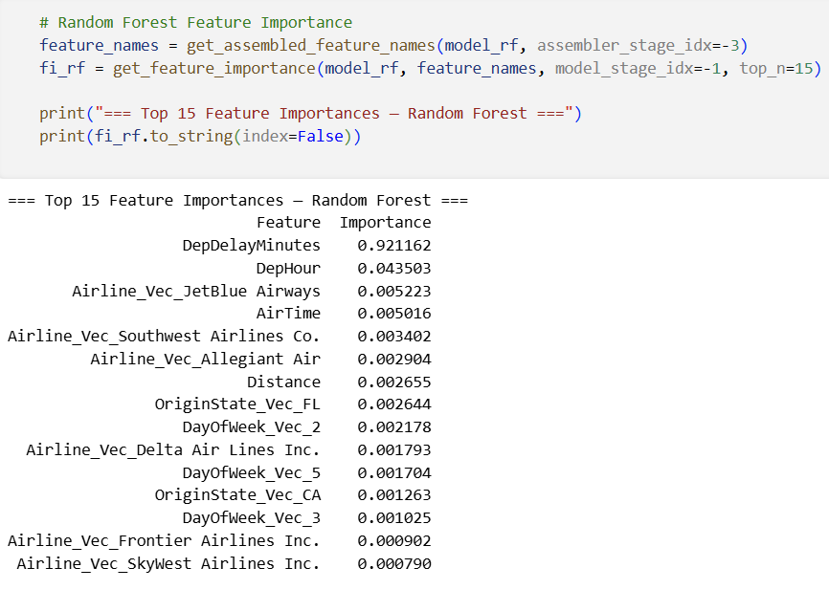
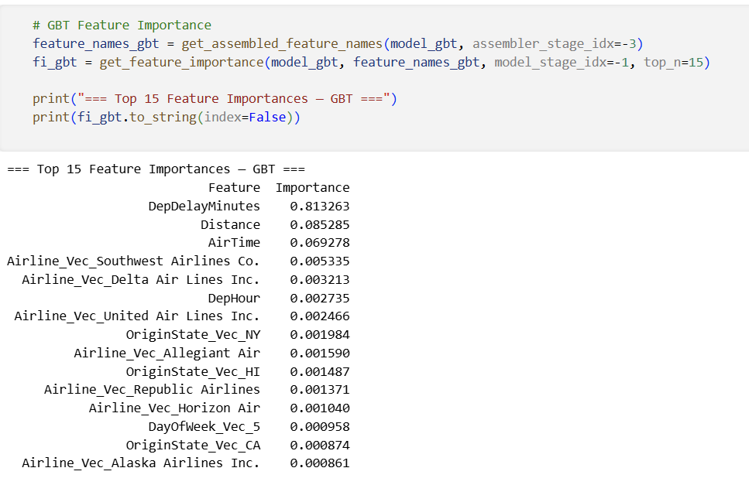
Feature Importance
Random Forest
Gradient Boosted Trees

Slide 22
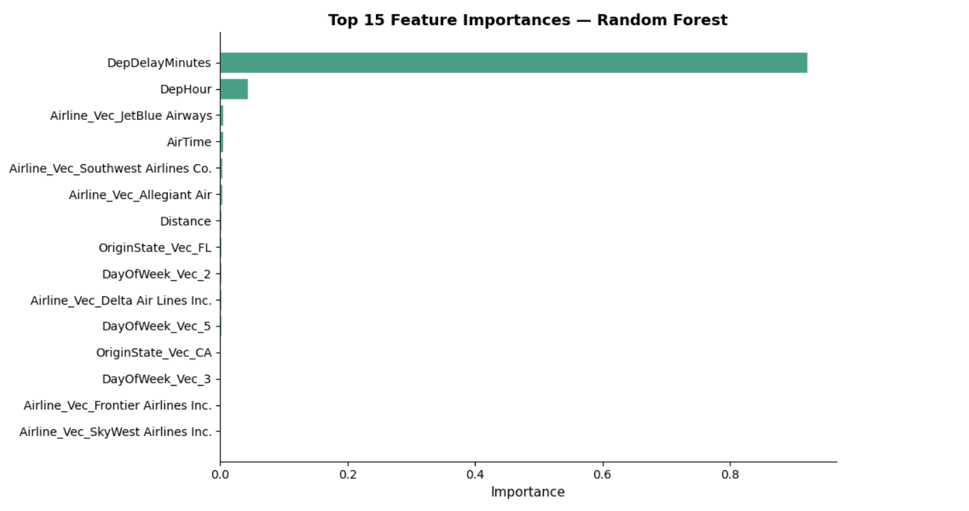
Feature Importance
“Feature importance analysis was used to identify which variables had the strongest impact on predicting flight delays. It helps us understand how much each feature contributes to the machine learning model’s decisions.”

Slide 23
K-means
We cluster flights using numeric delay-related features to discover natural delay-severity groups without using the `IsDelayed` label.
Features used: `DepDelayMinutes`, `ArrDelayMinutes`, `AirTime`, `Distance`, `DepHour`
After fitting we reduce to 2-D with PCA for a scatter-plot visualization,
and use the Silhouette score to pick the best *k* from {2, 3, 4, 5}. Best k=3 with Silhouette score = 0.4712.

Slide 24
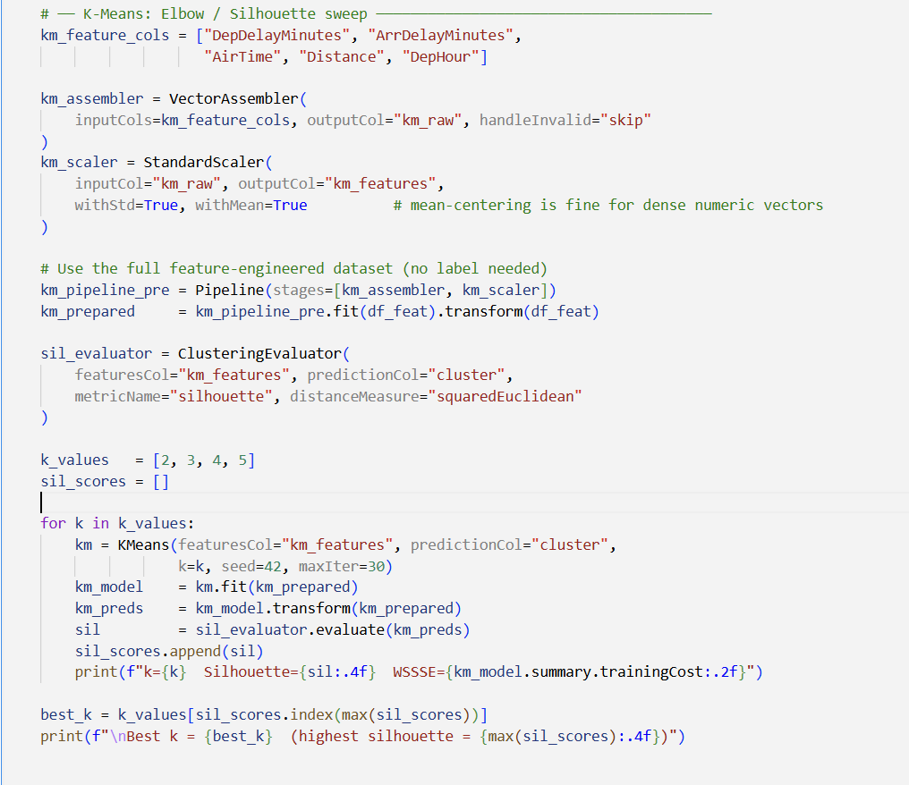
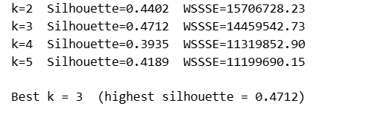
K-means
The best k = 3 With silhouette = 0.4712

Slide 25
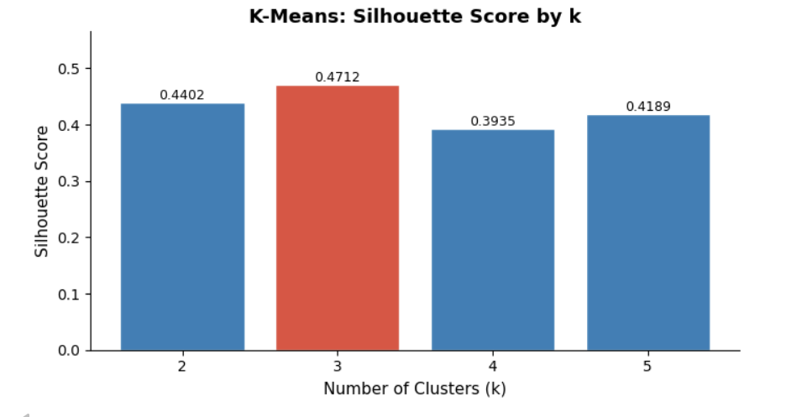
K-means

Slide 26
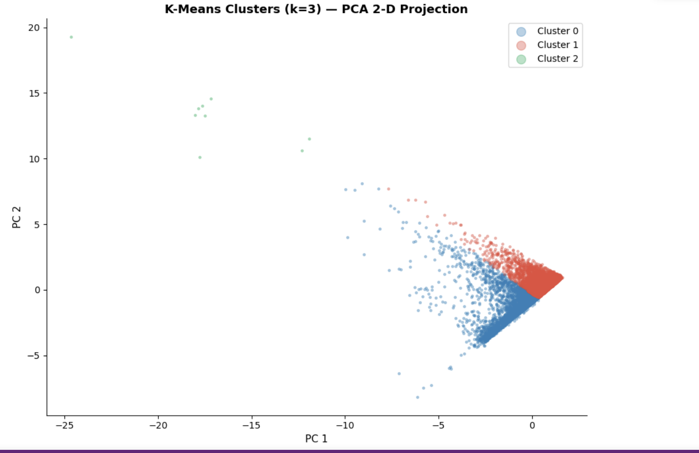
K-means

Slide 27
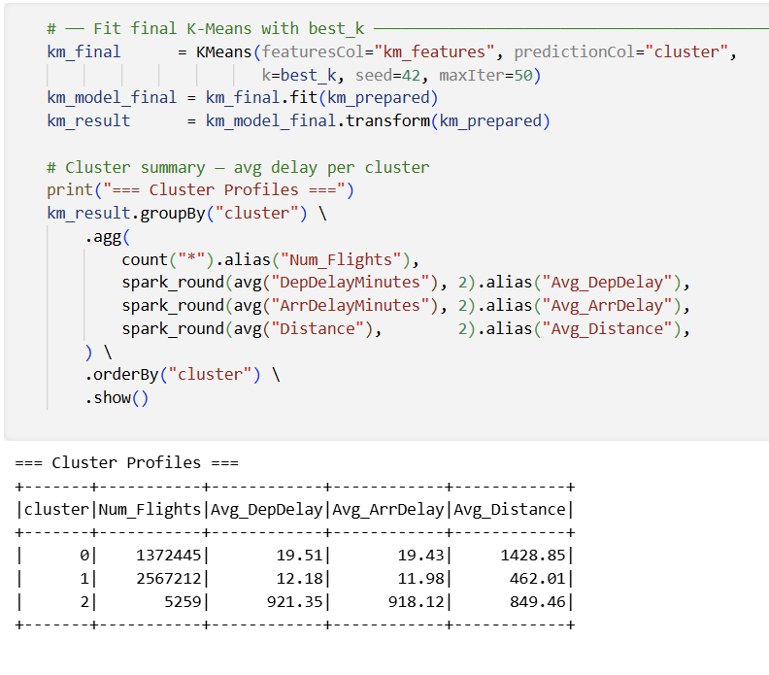
K-means
The clusters

Slide 28
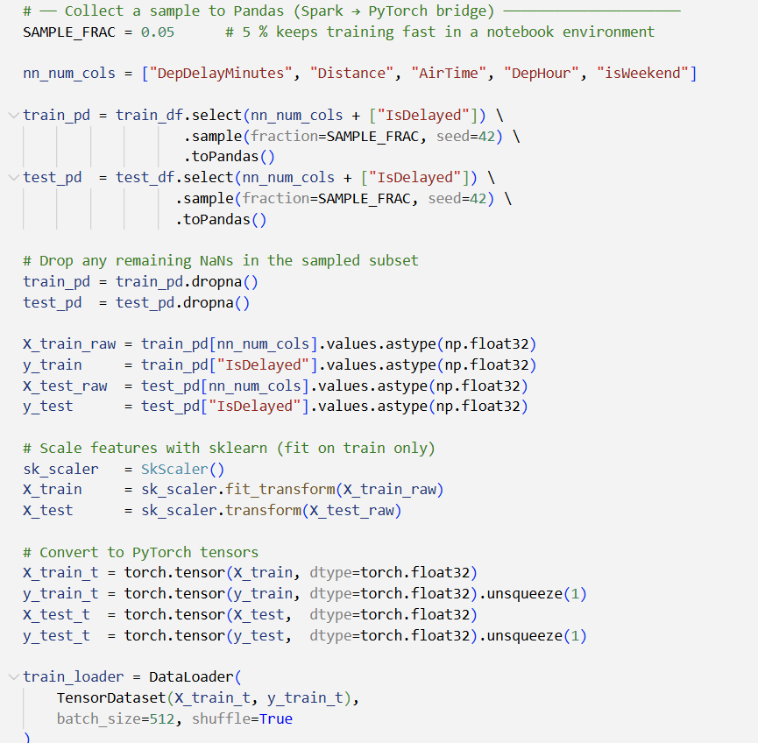
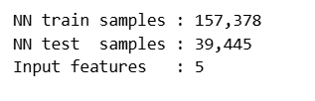
Neural Network
We Train 157,378 Sample
and Test 39,445 , And the input features is 5
receives several flight-related features as input variables. These features contain information that may affect whether a flight will be delayed or not

Slide 29
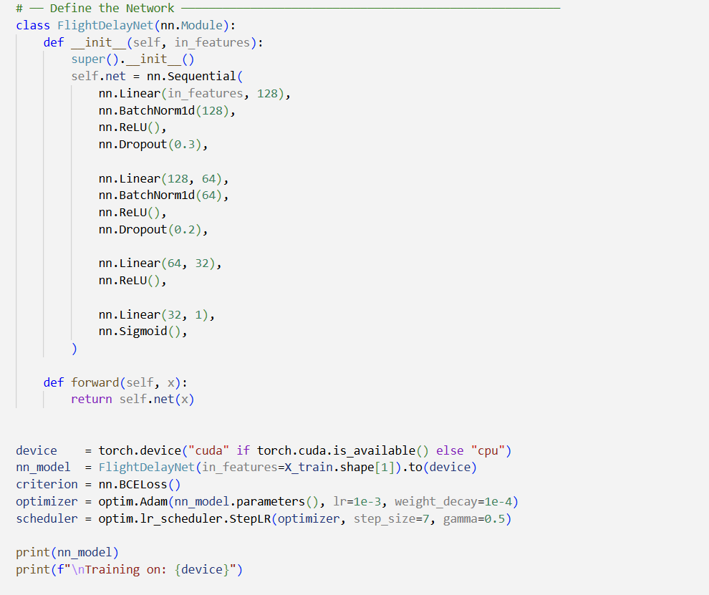
Neural Network
receives several flight-related features as input variables. These features contain information that may affect whether a flight will be delayed or not

Slide 30
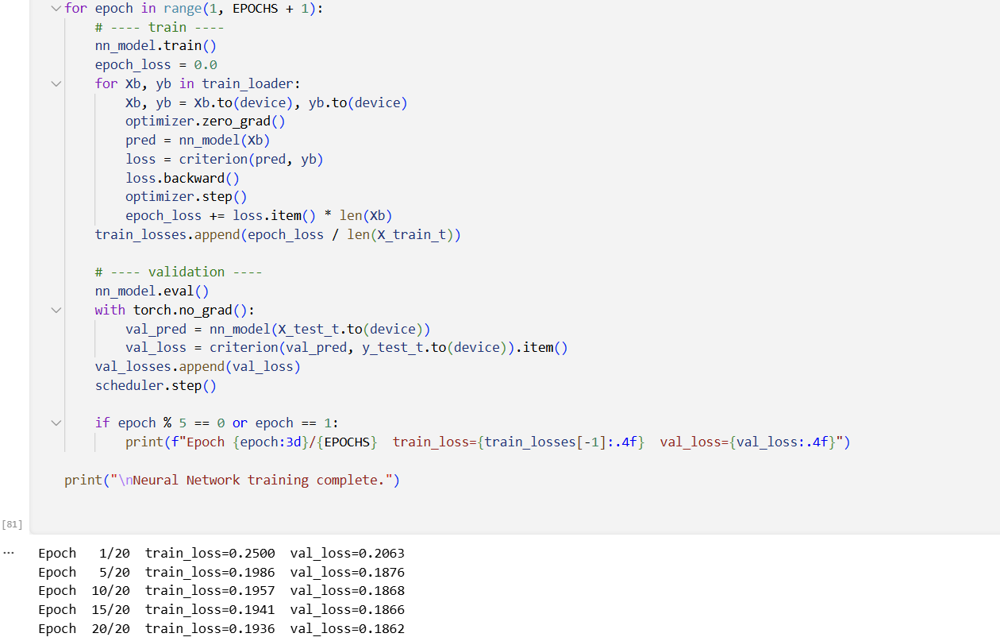
Neural Network
We apply 20 epochs with train Loss = 0.1936 and Validation Loss = 0.1862

Slide 31
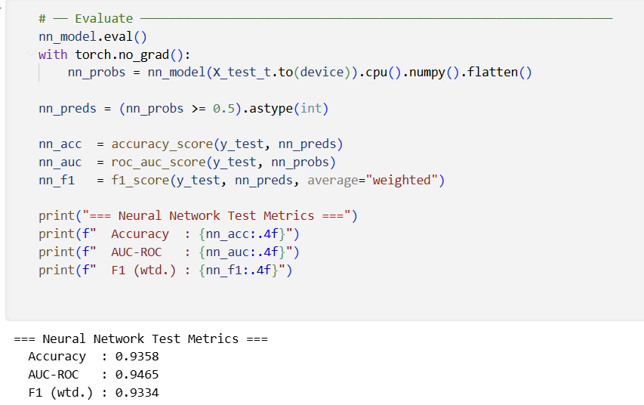
Neural Network
Accuracy: 93.58% — trained on 5% Spark sample (157,378 rows)
AUC-ROC: 95.6% — best overall metric, shows strong class separation
F1 Score: 93.34% — balanced precision and recall

Slide 32
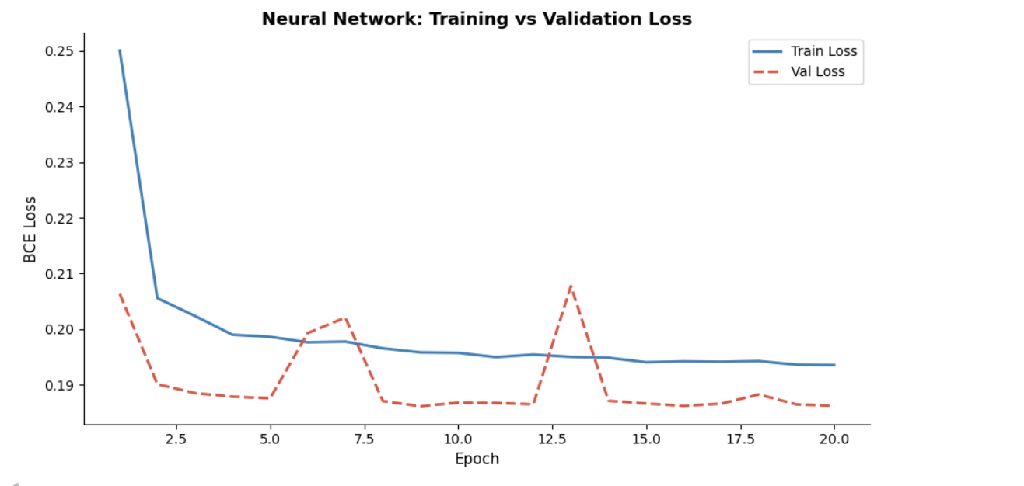
Neural Network

Slide 33
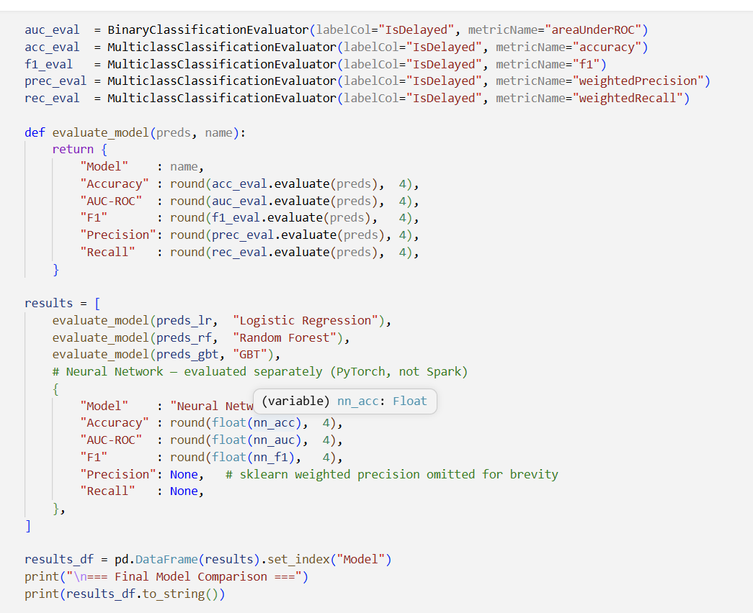
Evaluation Metrics

Slide 34
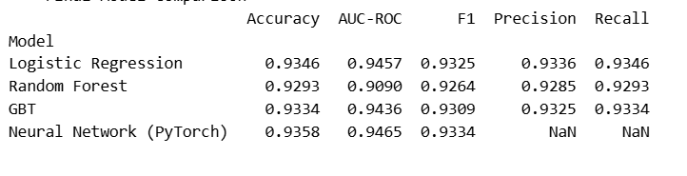
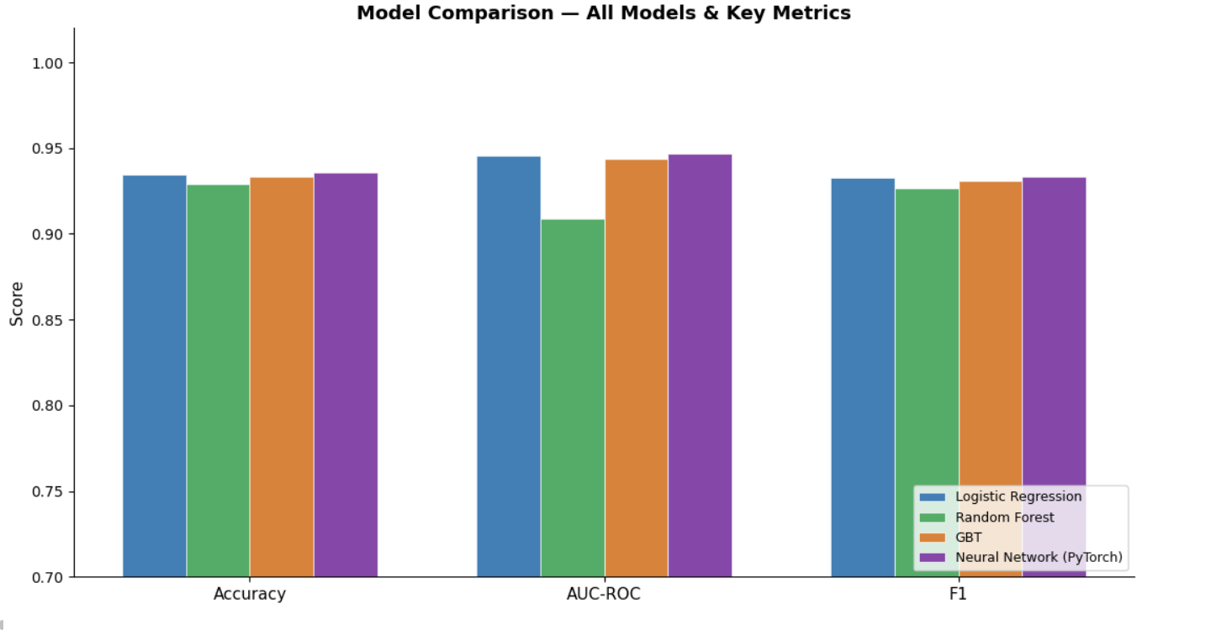
Evaluation Metrics
For Machine learning Models And Neural Network
Random Forest achieved the best AUC-ROC (~0.95). Logistic Regression had the fastest training time as a baseline.

Slide 35
Thanks

