Slide 1

Stroke
Predection
Healthcare

Slide 2

Presented by:
Sohila Ayman
Rana Emad
Yasmeen Ahmed
Omar Emam
Mahmoud Ahmed

Slide 3

Overview
01
Project Overview
02
Data Collection, Exploration, and Preprocessing (Milestone 1)
03
Data Analysis and Visualization(Milestone 2)
04
Predictive Model (Milestone 3)
05
Deployment, and Monitoring(Milestone 4)

Slide 4

Project Overview
The Healthcare Predictive Analytics project focuses on developing a predictive model to improve healthcare outcomes by providing data-driven insights.
help healthcare professionals with tasks such as patient risk prediction, trend identification in health metrics, and making informed decisions based on predictive analytics.
forecast healthcare-related outcomes, focusing on improving patient care and resource management.

Slide 5
Milestone 1
Data Collection, Exploration, and Preprocessing

Slide 6
1. Data Collection:
Obtain healthcare datasets (e.g., patient records, clinical data, or health metrics) that contain key features like age, medical history, test results, treatments, and patient outcomes.
Ensure the dataset contains relevant health information and is structured for predictive modeling.

Slide 7



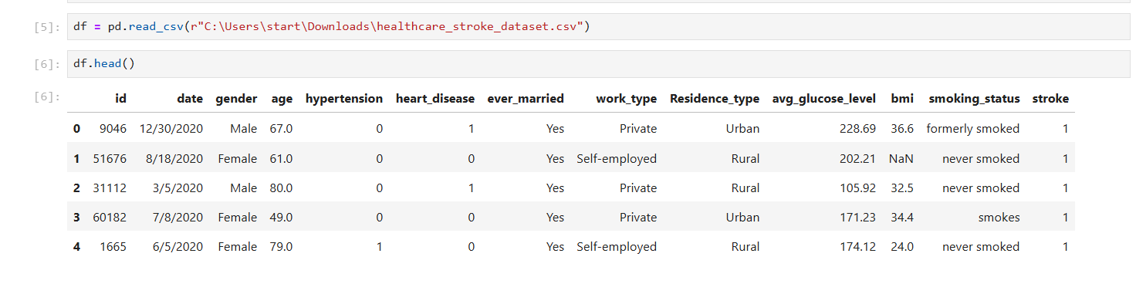
1. Data Collection:

Slide 8
2. Data Exploration:
Conduct exploratory data analysis (EDA) to understand the structure of the dataset.
Identify key features, the distribution of health-related data points, and any potential patterns.
Identify key features, the distribution of health-related data points, and any potential patterns.

Slide 9

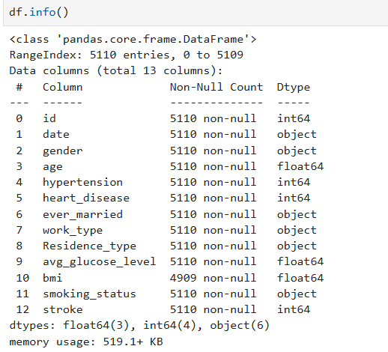

Data types

Slide 10
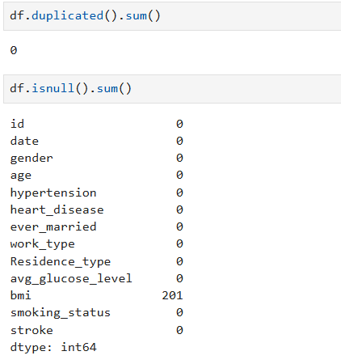
Missing values & duplicates

Slide 11
3. Data Preprocessing:
Encode categorical variables if necessary (e.g., encoding medical conditions or diagnoses).
Handle missing data using techniques such as imputation or removal.
Normalize or standardize data for model compatibility.

Slide 12
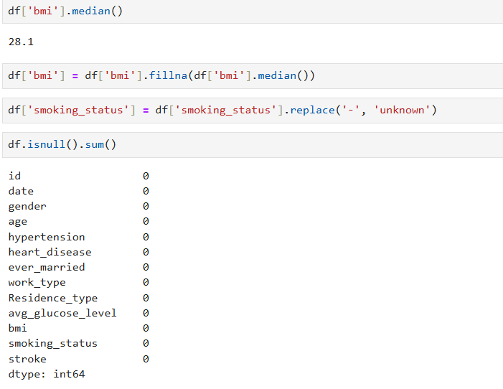
Handling missing values

Slide 13
Milestone 2
Data Analysis and Visualization

Slide 14


1. Data Cleaning:
Continue the cleaning process by addressing any remaining missing values, outliers, and inconsistencies.
Normalize or apply transformations to ensure the data is model-ready.
2. Data Analysis:
Analyze relationships between health metrics and outcomes (e.g., the risk of disease or patient recovery).
Use statistical methods such as correlation analysis, hypothesis testing, or feature importance analysis to identify key factors affecting healthcare outcomes.
3. Data Visualization:
Create compelling visualizations like heatmaps, trend lines, and scatter plots to highlight trends, outliers, and significant patterns in health metrics.
Develop interactive dashboards or charts (using tools like Plotly, Dash, or Tableau) to enable stakeholders to easily view and interpret the data.

Slide 15
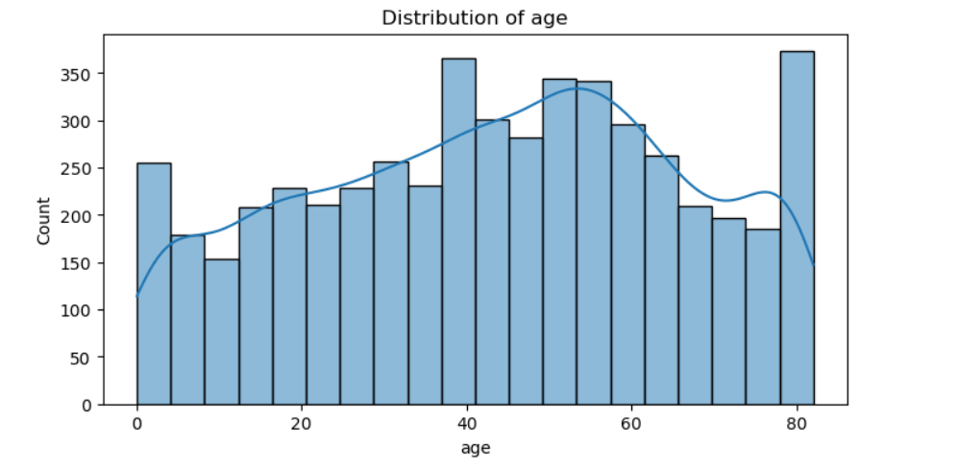
Distribution of age

Slide 16
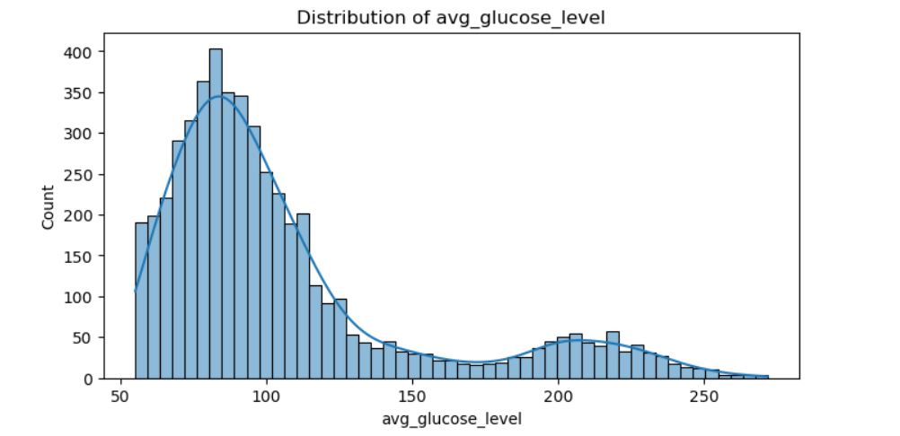
Distribution of average glucose level

Slide 17
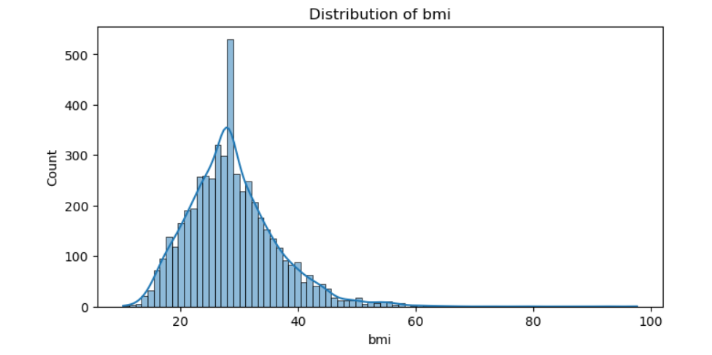
Distribution of BMI

Slide 18
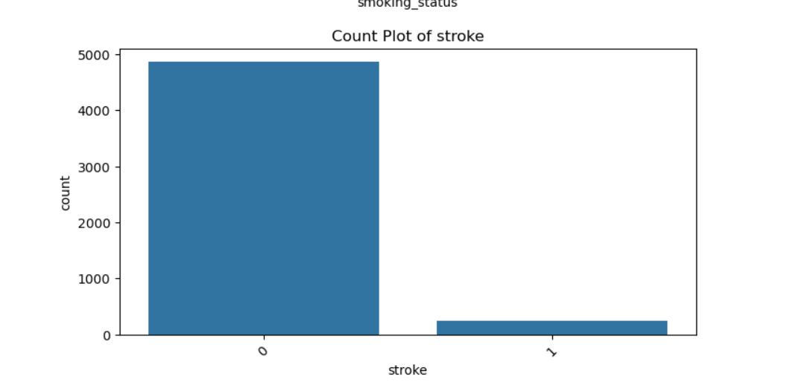
Stroke count

Slide 19
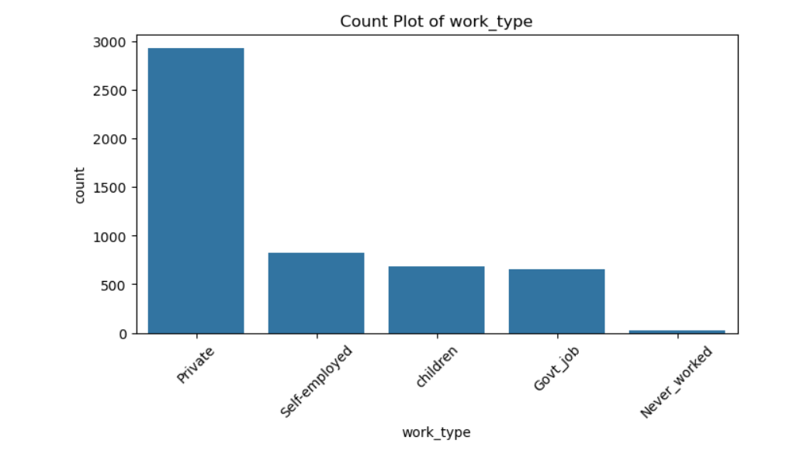
Work types count

Slide 20
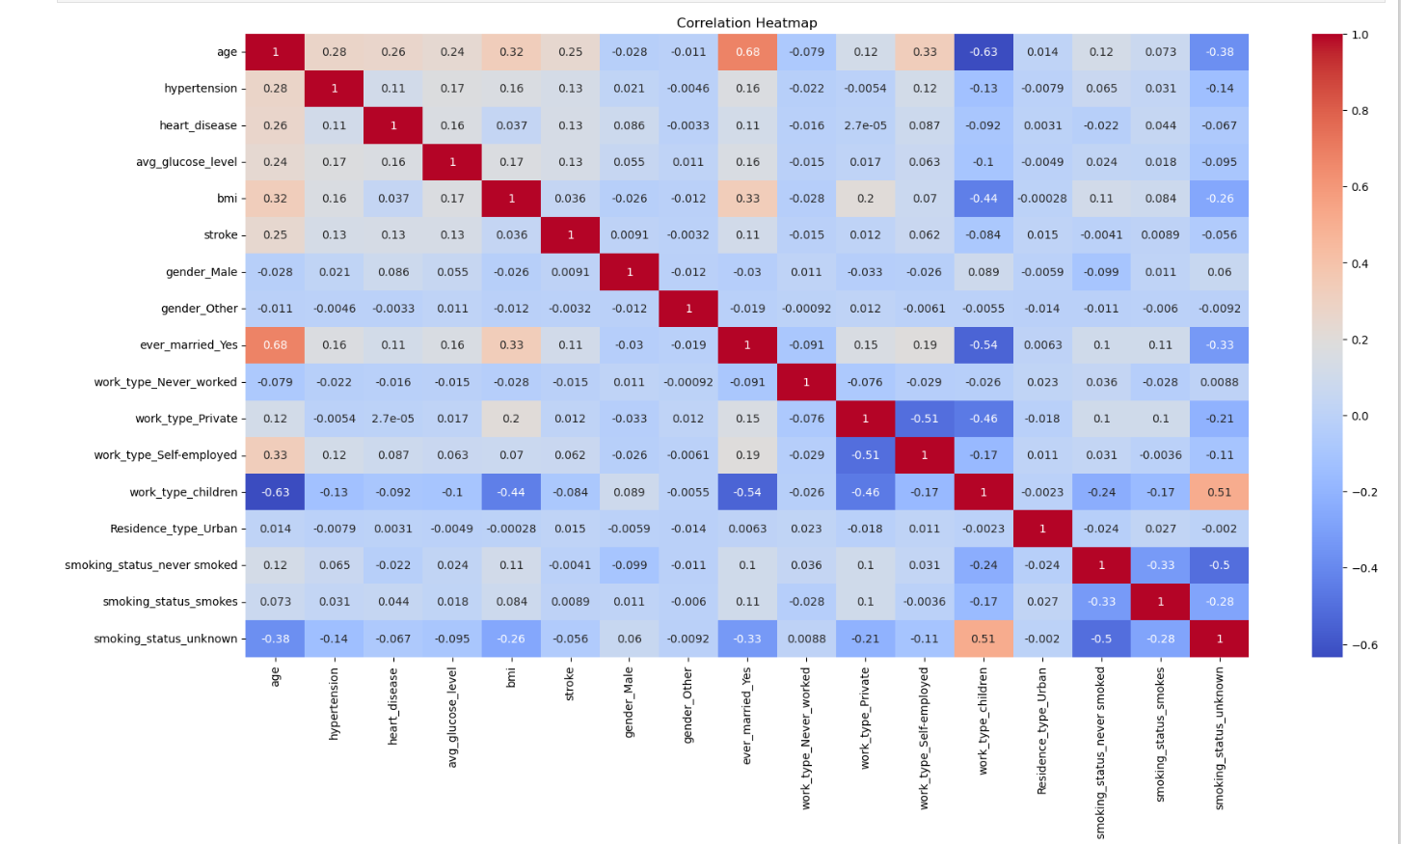
Correlation

Slide 21
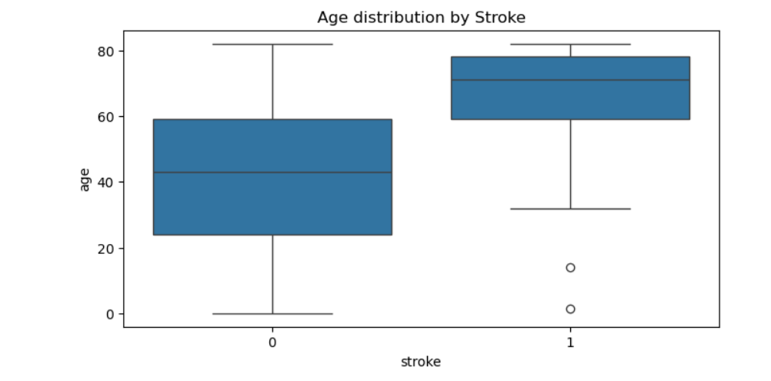
Relation between the age and having a stroke or not

Slide 22
Milestone 3
Predictive Model Development and Optimization

Slide 23
1. Model Selection:
Choose suitable machine learning algorithms based on the nature of the problem
Consider both supervised models and unsupervised models depending on the data and goals.
2. Model Training:
Split the data into training and testing sets, ensuring proper time-series validation (if applicable).
Train models on the training data and evaluate their performance on the test set.
Use cross-validation to assess model generalization and avoid overfitting.
3. Model Evaluation:
Use relevant evaluation metrics for the models, such as accuracy, precision, recall, F1-score, ROC-AUC for classification models.
Evaluate confusion matrices to understand model performance on false positives and false negatives.
4. Model Optimization:
Use hyperparameter tuning methods such as Grid Search or Random Search to optimize model performance.
Fine-tune the models to increase prediction accuracy and avoid overfitting.

Slide 24
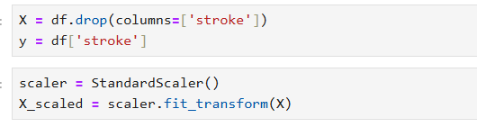
Select the features

Slide 25

feature scaling using StandardScaler

Slide 26
Split the data

Slide 27
Model Selection
Tested multiple models:
• Logistic Regression
• Random Forest
• Gradient Boosting
• Neural Network
• Evaluated using accuracy, precision, recall, F1 score, ROC AUC

Slide 28
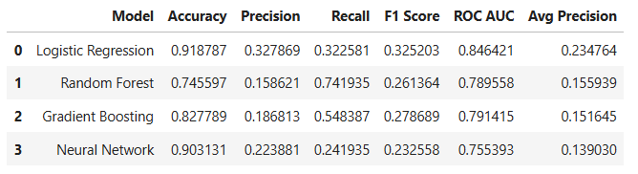
Models

Slide 29
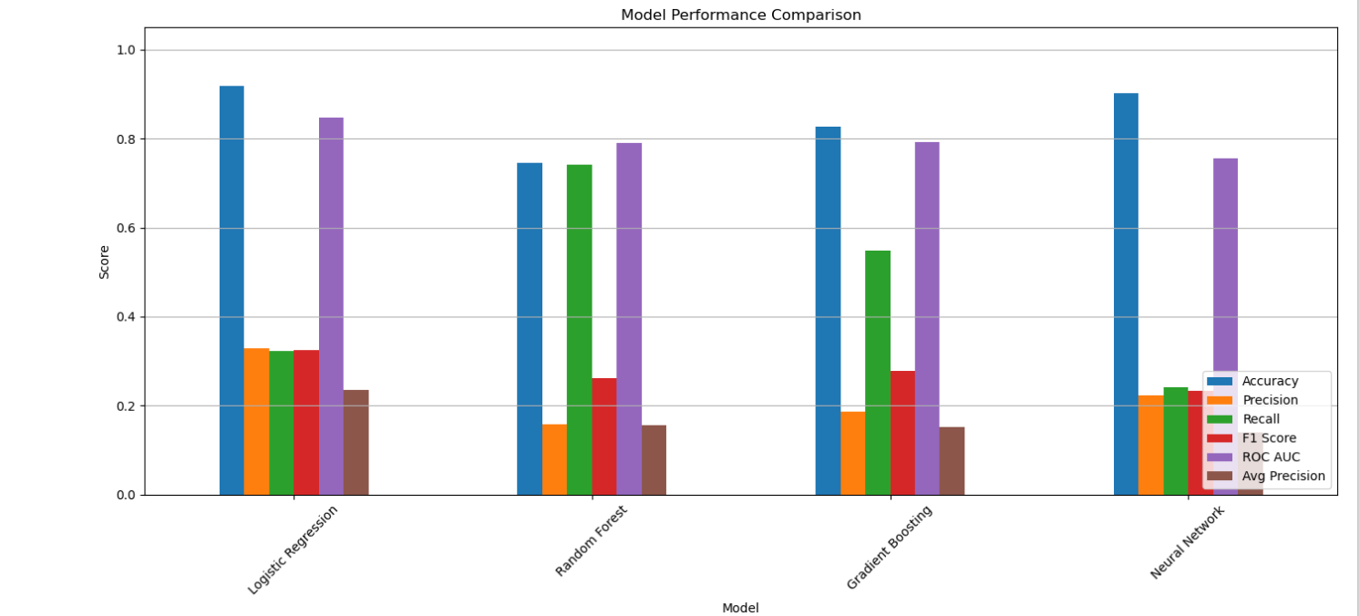

Slide 30
Best Model: Random Forest
•Random Forest achieved the best balance between precision and recall
•Used RandomizedSearchCV and GridSearchCV for hyperparameter tuning
•Final model saved using pickle

Slide 31
Milestone 4
Deployment, and Monitoring

Slide 32
Deployment

Slide 33

Deploy the model using streamlit

Slide 34
Interface

Slide 35
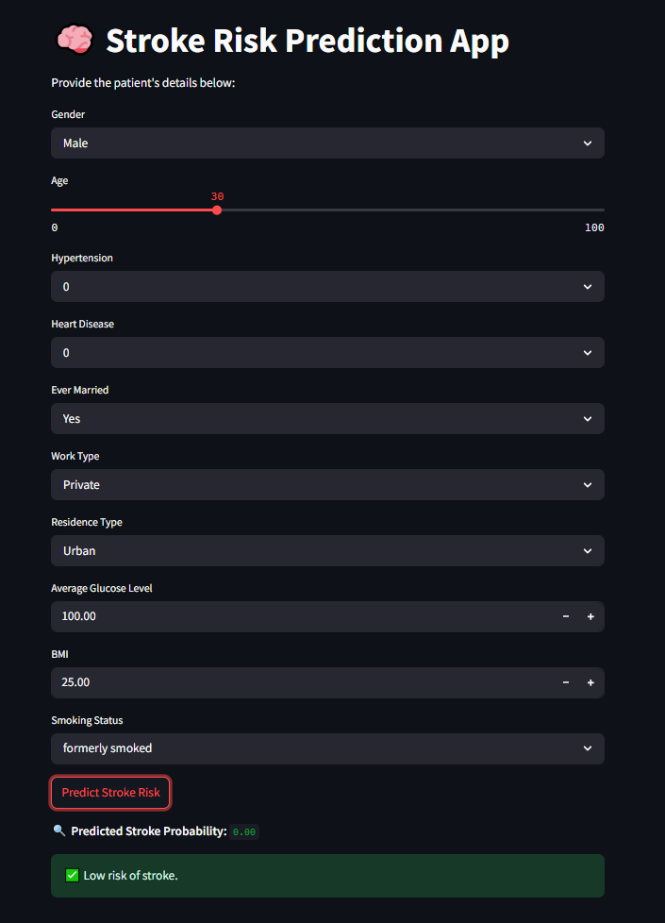
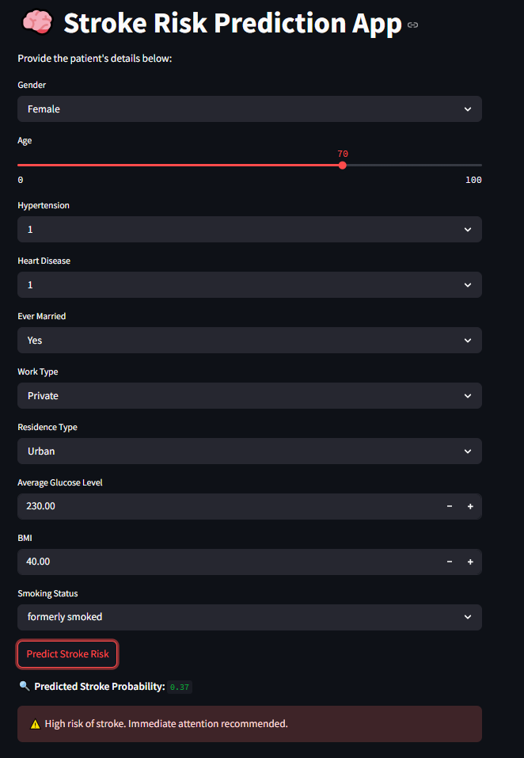

Slide 36
Conclusion
•AI can support early medical decision-making
•System is accurate, fast, and easy to use
•Can be expanded to other health conditions in the future

Slide 37
Thank
You
Thank
You

