Slide 1
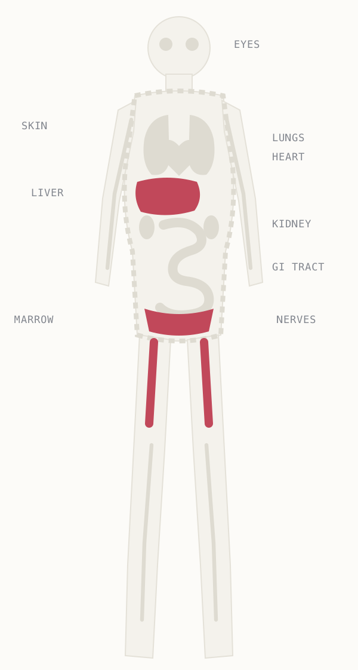
A cancer drug that worked.
It destroyed their livers instead.
Nobody could see which organ was at risk. We built the thing that shows you.
ToxAI Organ Atlas
SynBio Startup Summer School 2026 · Demo Day
1 / 12
Notes:
A cancer drug that worked. It destroyed their livers instead. Nobody could see which organ was at risk before the trial. We built the thing that shows you.

Slide 2
THE PROBLEM
Drugs fail late, and they fail on the organ nobody was watching.
9 in 10
2 of every 3 €
Years
drugs that reach human trials never make it. That has not improved in sixty years.
spent to get one drug approved is paying for the ones that died on the way.
and hundreds of millions are committed before the damage shows up in a person.
The question "which organ will this hurt?" gets answered by patients. We think it should be answered by a computer, first.
Sertkaya, JAMA Network Open 2024 · Filipova, NAM Journal 2026
2 / 12
Notes:
Nine in ten drugs that reach human trials never make it, and that has not improved in sixty years. Two of every three euros spent getting a drug approved pays for the ones that died. And the damage usually shows up years in, in a person. The question which organ will this hurt gets answered by patients. It should be answered by a computer first.

Slide 3
OUR SOLUTION
Type in a molecule. See the body it will damage.
Liver
The liver shuts down. Can be fatal.
HIGH
Bone marrow
Blood cell production collapses.
HIGH
Nerves
This warhead leaves nerves alone.
NO SIGNAL
Thirty seconds. No animals, no patients, no waiting.
3 / 12
Notes:
This is it. You type in a molecule and you see the body it will damage. Liver, high, it shuts down, can be fatal. Marrow, high, blood cell production collapses. Nerves, nothing, because this particular warhead leaves nerves alone. Thirty seconds. No animals, no patients, no waiting.

Slide 4
TECHNOLOGY AND WHAT MAKES US DIFFERENT
The harm follows the warhead, not the target.
Two completely different drugs
So the organ is predictable
Different antibodies. Different cancers. Different targets. They share exactly one thing: the toxic warhead they carry.
If you know the warhead, you can name the organ before anyone is dosed. Change the warhead and the map moves with it, every time.
Both carry the same warning. Both destroy the liver.
That is the pattern we learn from.
Everyone else returns a score between zero and one. We return an organ and a reason, which a scientist can agree or disagree with in five seconds.
4 / 12
Notes:
Here is the science, in one idea. Take two completely different drugs. Different antibodies, different cancers, different targets. They share exactly one thing, the toxic warhead they carry. Both carry the same warning and both destroy the liver. So if you know the warhead, you can name the organ before anyone is dosed. Everyone else returns a score between zero and one. We return an organ and a reason.

Slide 5
MARKET
The money is already being spent. Badly.
€13bn
€2M
1,300+
€100
spent every year on laboratory toxicity testing worldwide
is what one safety package costs, for one drug, before it ever reaches a person
drugs already have their liver risk catalogued in one public database alone
is what we charge for one answer today
A team choosing between four candidate drugs is about to spend two million euros to find out. The answer should not cost more than the question.
In-vitro toxicology testing market, Precedence Research · USAspending contract records · FDA DILIrank
5 / 12
Notes:
The money is already being spent. Thirteen billion euros a year on laboratory toxicity testing. Two million for one safety package, for one drug. And thirteen hundred drugs already have their liver risk catalogued in one public database. A team choosing between four candidates is about to spend two million to find out. The answer should not cost more than the question.

Slide 6
COMPETITION
Everyone answers a different question.
Animal studies
The standard. Slow, expensive, and often wrong about humans.
Months and millions
Existing software
Returns a probability of toxicity. No organ, no reason, no next step.
A number you cannot check
Lab-on-a-chip startups
Grow human tissue and test on it. Real, but one organ at a time.
Weeks per organ
ToxAI Organ Atlas
Which organ, how badly, and why. In thirty seconds.
The whole body at once
6 / 12
Notes:
Animal studies are the standard: slow, expensive, and often wrong about humans. Existing software returns a probability, with no organ and no reason. The lab-on-a-chip companies grow human tissue and test on it, which is real, but one organ at a time. We give you the whole body at once, in thirty seconds, with a reason attached.

Slide 7
BUSINESS MODEL
Sell answers now. Sell the safety layer later.
NOW
NEXT
LATER
€100
€5–20k
Enterprise
per answer
per programme
per year
A researcher with one molecule and a question. Card payment, no sales call.
A team screening a family of candidates before they commit to a safety package.
The safety layer a pharma company runs every new molecule through by default.
7 / 12
Notes:
Three steps. Today, a hundred euros for one answer, paid by card, no sales call. Next, five to twenty thousand for a team screening a family of candidates before they commit to a safety package. Later, the enterprise layer that every new molecule passes through by default. We start where we can actually get a customer this month.

Slide 8
GO-TO-MARKET
Start with the people who already know they have this problem.
01
02
03
Guided-missile drugs
Publish, do not sell
One design partner
The field our first case comes from is small, fast-growing, and every team in it has been burned by the warhead problem. They do not need convincing that it is real.
Put the organ maps out in public. In this field the tool that scientists cite is the tool their company ends up buying.
One team, their real molecules, every prediction logged before they get the lab result back.
8 / 12
Notes:
We start where the pain is already understood. The guided-missile drug field is small, growing fast, and every team in it has been burned by exactly this problem. We publish the organ maps rather than cold-selling them, because in this field the tool scientists cite is the tool their company buys. Then one design partner, real molecules, every prediction logged before the lab result comes back.

Slide 9
METRICS
Three numbers, and we will publish all three.
Were we right?
Did they come back?
Did it change a decision?
For every molecule we score, did the organ we named turn out to be the organ that was harmed? Logged before the answer is known.
A second question from the same scientist. Not signups, not demos. A second question.
The only one that matters. Did a team drop, redesign or reorder a candidate because of what we showed them?
If the first number is bad, we will say so publicly. A safety tool that is quietly wrong is worse than no tool at all.
9 / 12
Notes:
Three numbers and we publish all three. Were we right: did the organ we named turn out to be the organ harmed, logged before the answer was known. Did they come back: a second question from the same scientist. And did it change a decision, which is the only one that really matters. If the first number is bad we will say so publicly, because a safety tool that is quietly wrong is worse than none.

Slide 10
TEAM
We met on day one of this school. We built the thing by day three.
PRODUCT AND ENGINEERING
TOXICOLOGY
DATA AND MODELLING
COMMERCIAL
Sebastian Roy
[name]
[name]
[name]
Builds and ships the platform.
Owns what the organ maps say and whether they are right.
Turns labels and failures into something a model can learn.
Finds the first team willing to test a prediction against a real result.
We are continuing after this week. The next milestone is booked: one design partner, real molecules, predictions logged before the results come back.
10 / 12
Notes:
We met on day one of this school and the tool was running by day three. We are continuing after this week, and the next milestone is already defined: one design partner, real molecules, every prediction logged before the results come back.

Slide 11
TRACTION
What exists right now, and what does not.
Built and running
Not yet
· A working web tool, not a mockup
· No paying customer yet
· Eight molecules, three species
· The maps are read from drug labels, not predicted
· Organ maps with mechanism and severity
· No model has been tested against a held-out drug
· A price on it: €100 per answer
· That test is the next thing we do
We would rather show you a working tool and an honest gap than a slide of promises.
11 / 12
Notes:
Built and running: a working web tool, not a mockup. Eight molecules, three species, organ maps with mechanism and severity, and a price on it. Not yet: no paying customer, and the maps today are read from drug labels rather than predicted. No model has been tested against a drug it has never seen. That test is the next thing we do. We would rather show you a working tool and an honest gap than a slide of promises.

Slide 12
Every drug that failed
already told us which organ it would break.
Nobody was listening. We built the thing that listens.
Design partner
A toxicologist
€1.4M
One team with real molecules to test us against
To join us and own what the maps say
Eighteen months to prove the prediction works
ToxAI Organ Atlas · toxai.demo
12 / 12
Notes:
Every drug that failed already told us which organ it would break. Nobody was listening. We built the thing that listens. We are asking for three things: one design partner with real molecules, a toxicologist to join us and own what the maps say, and one point four million to prove over eighteen months that the prediction actually works. Thank you.

