Slide 1
Architecture of 80386
The Internal Architecture of 80386 is divided into 3 sections.
Central processing unit
Memory management unit
Bus interface unit
Central processing unit is further divided into Execution unit and Instruction unit
Execution unit has 8 General purpose and 8 Special purpose registers which are either used for handling data or calculating offset addresses.
Next page

Slide 2
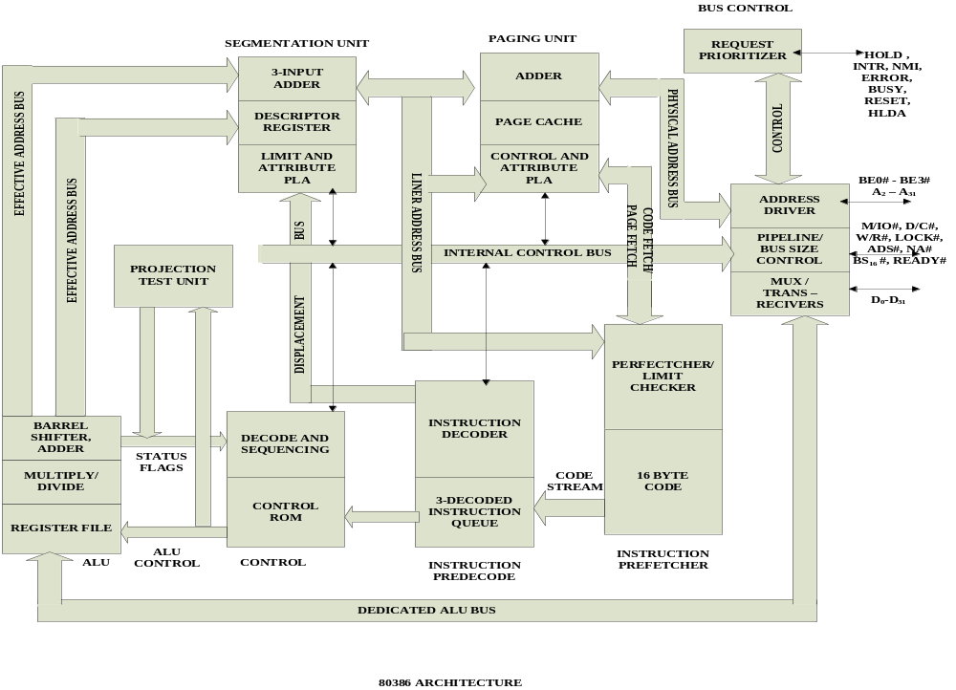

Slide 3
The Instruction unit decodes the opcode bytes received from the 16-byte instruction code queue and arranges them in a 3- instruction decoded instruction queue.
After decoding them pass it to the control section for deriving the necessary control signals. The barrel shifter increases the speed of all shift and rotate operations.
The multiply / divide logic implements the bit-shift-rotate algorithms to complete the operations in minimum time.
Even 32- bit multiplications can be executed within one microsecond by the multiply / divide logic.
Next page

Slide 4
The Memory management unit consists of a Segmentation unit and a Paging unit.
Segmentation unit allows the use of two address components, viz. segment and offset for relocability and sharing of code and data.
Segmentation unit allows segments of size 4Gbytes at max.
The Paging unit organizes the physical memory in terms of pages of 4kbytes size each.
Paging unit works under the control of the segmentation unit, i.e. each segment is further divided into pages. The virtual memory is also organizes in terms of segments and pages by the memory management unit.
Next page

Slide 5
The Segmentation unit provides a 4 level protection mechanism for protecting and isolating the system code and data from those of the application program.
Paging unit converts linear addresses into physical addresses.
The control and attribute PLA checks the privileges at the page level. Each of the pages maintains the paging information of the task. The limit and attribute PLA checks segment limits and attributes at segment level to avoid invalid accesses to code and data in the memory segments.
Next page

Slide 6
The Bus control unit has a prioritizer to resolve the priority of the various bus requests. This controls the access of the bus. The address driver drives the bus enable and address signal A₀ – A_{31.} The pipeline and dynamic bus sizing unit handle the related control signals.
The data buffers interface the internal data bus with the system bus.

Slide 7
Signal Descriptions of 80386
CLK₂ :The input pin provides the basic system clock timing for the operation of 80386.
D₀ – D₃₁:These 32 lines act as bidirectional data bus during different access cycles.
A₃₁ – A₂: These are upper 30 bit of the 32- bit address bus.
BE₀ to BE₃: The 32- bit data bus supported by 80386 and the memory system of 80386 can be viewed as a 4- byte wide memory access mechanism. The 4 byte enable lines BE₀ to BE₃, may be used for enabling these 4 blanks. Using these 4 enable signal lines, the CPU may transfer 1 byte / 2 / 3 / 4 byte of data simultaneously.
Next page

Slide 8
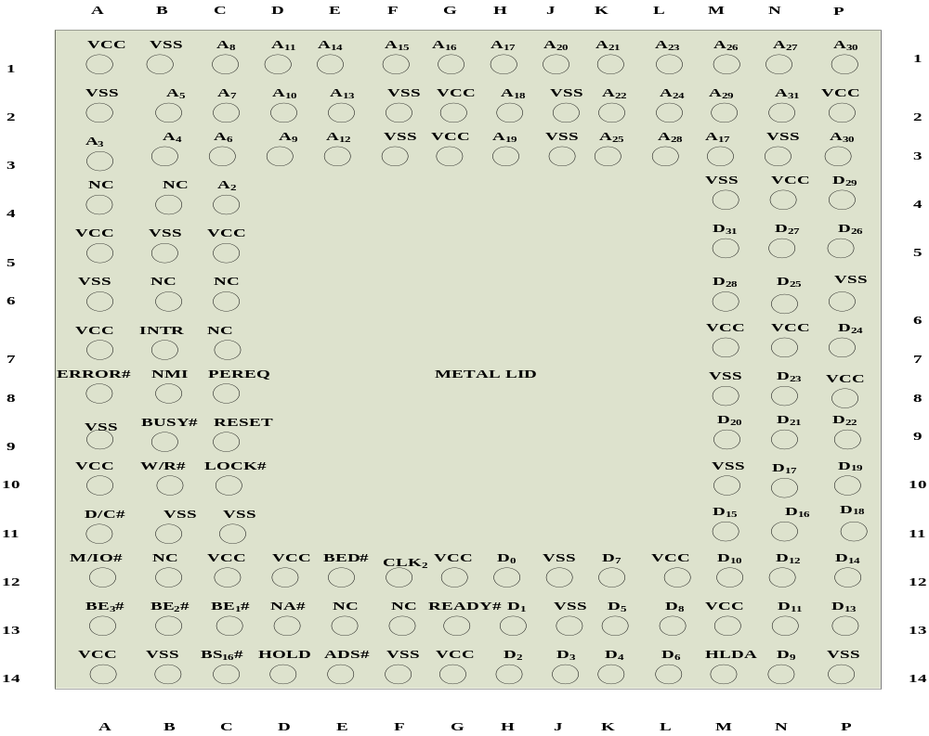
PIN DIAGRAM OF 80386

Slide 9
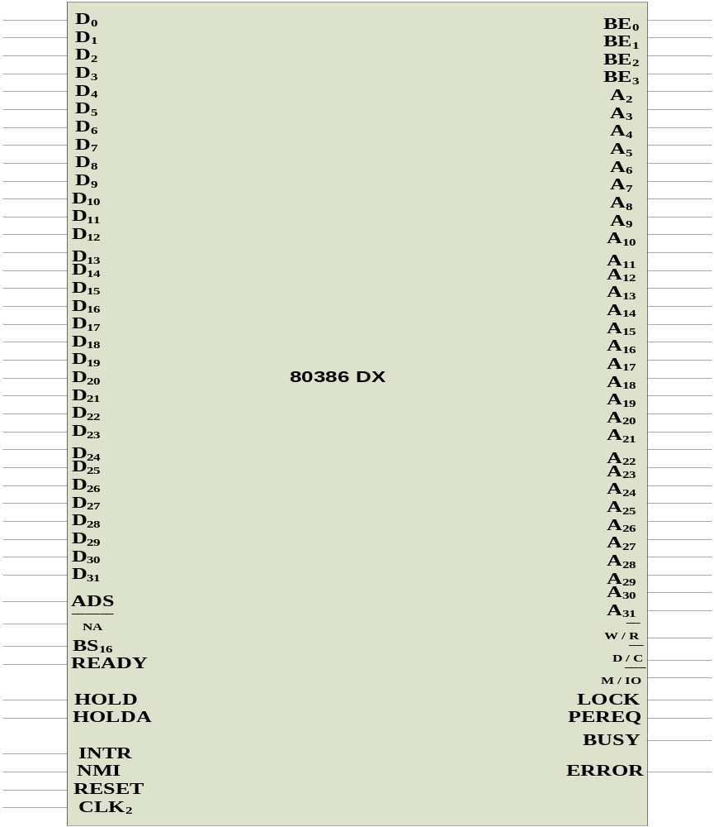

Slide 10
2
X CLOCK
CLK
2
ADDRESS
A
–
A
BUS
2
31
32
BIT
BE
3
#
DATA
D
0
–
D
31
DATA
BE
2
#
32
–
BIT
BUS
BYTE
ADDRESS
BE
1
#
ENABLI
BE
0
#
NES
ADS
#
W
/
R
#
NA
#
D
/
C
#
BUS
BS
16
#
M
/
IO
BUS CYCLE
CONTROL
READY
DEFINATION
80386
LOCK
#
PROCESSOR
HOLD
PEREQ
BUS
HLDA
BUSY
#
COPROCESS
ARBITRATION
OR
ERROR
#
SIGNALLING
INTR
NMI
V
CC
INTERRUPTS
POWER
GND
CONNECTIO
RESET
NS

Slide 11
W/R#: The write / read output distinguishes the write and read cycles from one another.
D/C#: This data / control output pin distinguishes between a data transfer cycle from a machine control cycle like interrupt acknowledge.
M/IO#: This output pin differentiates between the memory and I/O cycles.
LOCK#: The LOCK# output pin enables the CPU to prevent the other bus masters from gaining the control of the system bus.
NA#: The next address input pin, if activated, allows address pipelining, during 80386 bus cycles.
Next page

Slide 12
ADS#: The address status output pin indicates that the address bus and bus cycle definition pins( W/R#, D/C#, M/IO#, BE₀# to BE₃# ) are carrying the respective valid signals. The 80383 does not have any ALE signals and so this signals may be used for latching the address to external latches.
READY#: The ready signals indicates to the CPU that the previous bus cycle has been terminated and the bus is ready for the next cycle. The signal is used to insert WAIT states in a bus cycle and is useful for interfacing of slow devices with CPU.
VCC: These are system power supply lines.
VSS: These return lines for the power supply.
Next page

Slide 13
BS₁₆#: The bus size – 16 input pin allows the interfacing of 16 bit devices with the 32 bit wide 80386 data bus. Successive 16 bit bus cycles may be executed to read a 32 bit data from a peripheral.
HOLD: The bus hold input pin enables the other bus masters to gain control of the system bus if it is asserted.
HLDA: The bus hold acknowledge output indicates that a valid bus hold request has been received and the bus has been relinquished by the CPU.
BUSY#: The busy input signal indicates to the CPU that the coprocessor is busy with the allocated task.
Next page

Slide 14
ERROR#: The error input pin indicates to the CPU that the coprocessor has encountered an error while executing its instruction.
PEREQ: The processor extension request output signal indicates to the CPU to fetch a data word for the coprocessor.
INTR: This interrupt pin is a maskable interrupt, that can be masked using the IF of the flag register.
NMI: A valid request signal at the non-maskable interrupt request input pin internally generates a non- maskable interrupt of type2.
Next page

Slide 15
RESET: A high at this input pin suspends the current operation and restart the execution from the starting location.
N / C : No connection pins are expected to be left open while connecting the 80386 in the circuit.

Slide 16
Register Organisation
The 80386 has eight 32 - bit general purpose registers which may be used as either 8 bit or 16 bit registers.
A 32 - bit register known as an extended register, is represented by the register name with prefix E.
Example : A 32 bit register corresponding to AX is EAX, similarly BX is EBX etc.
The 16 bit registers BP, SP, SI and DI in 8086 are now available with their extended size of 32 bit and are names as EBP,ESP,ESI and EDI.
AX represents the lower 16 bit of the 32 bit register EAX.
BP, SP, SI, DI represents the lower 16 bit of their 32 bit counterparts, and can be used as independent 16 bit registers.
Next page

Slide 17
GENERAL DATA AND ADDRESS REGISTERS
31
16
15
0
AX
EAX
BX
EBX
CX
ECX
DX
EDX
SI
ESI
DI
EDI
BP
EBP
SP
ESP
SEGMENT SELECTOR REGISTERS
CS
CODE SEGMENT
SS
STACK SEGMENT
DS
ES
DATA SEGMENT
FS
GS
INSTRUCTION POINTER AND FLAG REGISTER
31
16
15
0
IP
EIP
FLAGS
EFLAGS

Slide 18
The six segment registers available in 80386 are CS, SS, DS, ES, FS and GS.
The CS and SS are the code and the stack segment registers respectively, while DS, ES, FS, GS are 4 data segment registers.
A 16 bit instruction pointer IP is available along with 32 bit counterpart EIP.
Flag Register of 80386: The Flag register of 80386 is a 32 bit register. Out of the 32 bits, Intel has reserved bits D₁₈ to D₃₁, D₅ and D₃, while D₁ is always set at 1.Two extra new flags are added to the 80286 flag to derive the flag register of 80386. They are VM and RF flags.
Next page

Slide 19
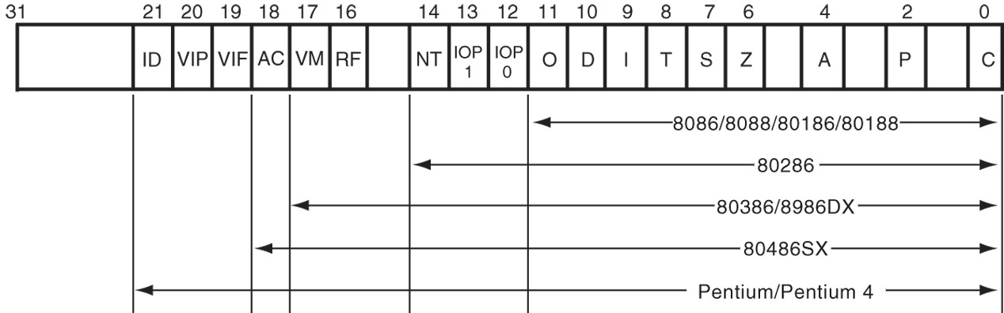
Figure 2–2 The EFLAG and FLAG register counts for the entire 8086 and Pentium microprocessor family.
Flags never change for any data transfer or program control operation.
Some of the flags are also used to control features found in the microprocessor.

Slide 20
Flag bits, with a brief description of function.
C (carry) holds the carry after addition or borrow after subtraction.
  also indicates error conditions
P (parity) is the count of ones in a number expressed as even or odd. Logic 0 for odd parity; logic 1 for even parity.
  if a number contains three binary one bits, it has odd parity
  if a number contains no one bits, it has even parity

Slide 21
List of Each Flag bit, with a brief description of function.
C (carry) holds the carry after addition or borrow after subtraction.
  also indicates error conditions
P (parity) is the count of ones in a number expressed as even or odd. Logic 0 for odd parity; logic 1 for even parity.
  if a number contains three binary one bits, it has odd parity; If a number contains no one bits, it
  has even parity

Slide 22
A (auxiliary carry) holds the carry (half-carry) after addition or the borrow after subtraction between bit positions 3 and 4 of the result.
Z (zero) shows that the result of an arithmetic or logic operation is zero.
S (sign) flag holds the arithmetic sign of the result after an arithmetic or logic instruction executes.
T (trap) The trap flag enables trapping through an on-chip debugging feature.

Slide 23
I (interrupt) controls operation of the INTR (interrupt request) input pin.
D (direction) selects increment or decrement mode for the DI and/or SI registers.
O (overflow) occurs when signed numbers are added or subtracted.
  an overflow indicates the result has exceeded
  the capacity of the machine

Slide 24
IOPL used in protected mode operation
to select the privilege level for I/O devices.
NT (nested task) flag indicates the current task is nested within another task in protected mode operation.
RF (resume) used with debugging to control resumption of execution after the next instruction.
VM (virtual mode) flag bit selects virtual mode operation in a protected mode system.

Slide 25
AC, (alignment check) flag bit activates if a word or doubleword is addressed on a non-word or non-doubleword boundary.
VIF is a copy of the interrupt flag bit available to the Pentium 4–(virtual interrupt)
VIP (virtual) provides information about a virtual mode interrupt for (interrupt pending) Pentium.
  used in multitasking environments to provide virtual interrupt flags

Slide 26
ID (identification) flag indicates that the Pentium microprocessors support the CPUID instruction.
  CPUID instruction provides the system with information about the Pentium microprocessor

Slide 27
FLAGS
31
18
17
16
15
14
13
12
11
10
9
8
7
6
5
4
3
2
1
0
FLAGS
RESERVED FOR
VM
RF
0
NT
IOPL
OF
DF
IF
TF
SF
ZF
0
AF
0
PF
1
CF
INTEL
FLAG REGISTER OF 80386

Slide 28
VM - Virtual Mode Flag: If this flag is set, the 80386 enters the virtual 8086 mode within the protection mode. This is to be set only when the 80386 is in protected mode. In this mode, if any privileged instruction is executed an exception 13 is generated. This bit can be set using IRET instruction or any task switch operation only in the protected mode.
RF- Resume Flag: This flag is used with the debug register breakpoints. It is checked at the starting of every instruction cycle and if it is set, any debug fault is ignored during the instruction cycle. The RF is automatically reset after successful execution of every instruction, except for IRET and POPF instructions.
Next page

Slide 29
Also, it is not automatically cleared after the successful execution of JMP, CALL and INT instruction causing a task switch. These instruction are used to set the RF to the value specified by the memory data available at the stack.
Segment Descriptor Registers: This registers are not available for programmers, rather they are internally used to store the descriptor information, like attributes, limit and base addresses of segments.
The six segment registers have corresponding six 73 bit descriptor registers. Each of them contains 32 bit base address, 32 bit base limit and 9 bit attributes. These are automatically loaded when the corresponding segments are loaded with selectors.
Next page

Slide 30
Control Registers: The 80386 has three 32 bit control registers CR), CR₂ and CR₃ to hold global machine status independent of the executed task. Load and store instructions are available to access these registers.
System Address Registers: Four special registers are defined to refer to the descriptor tables supported by 80386.
The 80386 supports four types of descriptor table, viz. global descriptor table (GDT), interrupt descriptor table (IDT), local descriptor table (LDT) and task state segment descriptor (TSS).
Next page

Slide 31
Debug and Test Registers: Intel has provide a set of 8 debug registers for hardware debugging. Out of these eight registers DR₀ to DR₇, two registers DR₄ and DR₅ are Intel reserved.
The initial four registers DR₀ to DR₃ store four program controllable breakpoint addresses, while DR₆ and DR₇ respectively hold breakpoint status and breakpoint control information.
Two more test register are provided by 80386 for page cacheing namely test control and test status register.
Next page

Slide 32
ADDRESSING MODES: The 80386 supports overall eleven addressing modes to facilitate efficient execution of higher level language programs.
In case of all those modes, the 80386 can now have 32-bit immediate or 32- bit register operands or displacements.
The 80386 has a family of scaled modes. In case of scaled modes, any of the index register values can be multiplied by a valid scale factor to obtain the displacement.
The valid scale factor are 1, 2, 4 and 8.
Next page

Slide 33
The different scaled modes are as follows.
Scaled Indexed Mode: Contents of the an index register are multiplied by a scale factor that may be added further to get the operand offset.
Based Scaled Indexed Mode: Contents of the an index register are multiplied by a scale factor and then added to base register to obtain the offset.
Based Scaled Indexed Mode with Displacement: The Contents of the an index register are multiplied by a scaling factor and the result is added to a base register and a displacement to get the offset of an operand.

Slide 34
Real Address Mode of 80386
After reset, the 80386 starts from memory location FFFFFFF0H under the real address mode. In the real mode, 80386 works as a fast 8086 with 32-bit registers and data types.
In real mode, the default operand size is 16 bit but 32- bit operands and addressing modes may be used with the help of override prefixes.
The segment size in real mode is 64k, hence the 32-bit effective addressing must be less than 0000FFFFFH. The real mode initializes the 80386 and prepares it for protected mode.
Next page

Slide 35
15
0
OFFSET
19
0
SEGMENT
SELECTOR
0000
MAX LIMIT FIXED
AT
64
K IN REAL
c
MODE
c
+
MEMORY OPERAND
64
K
SELECTED
c
BYTES
SEGMENT
c
c
SEGMENT BASE
Physical Address Formation In Real Mode Of 80386
Next page

Slide 36
Memory Addressing in Real Mode: In the real mode, the 80386 can address at the most 1Mbytes of physical memory using address lines A₀-A₁₉.
Paging unit is disabled in real addressing mode, and hence the real addresses are the same as the physical addresses.
To form a physical memory address, appropriate segment registers contents (16-bits) are shifted left by four positions and then added to the 16-bit offset address formed using one of the addressing modes, in the same way as in the 80386 real address mode.
The segment in 80386 real mode can be read, write or executed, i.e. no protection is available.
Next page

Slide 37
Any fetch or access past the end of the segment limit generate exception 13 in real address mode.
The segments in 80386 real mode may be overlapped or non-overlapped.
The interrupt vector table of 80386 has been allocated 1Kbyte space starting from 00000H to 003FFH.
Next page

Slide 38
Protected Mode of 80386
All the capabilities of 80386 are available for utilization in its protected mode of operation.
The 80386 in protected mode support all the software written for 80286 and 8086 to be executed under the control of memory management and protection abilities of 80386.
The protected mode allows the use of additional instruction, addressing modes and capabilities of 80386.
ADDRESSING IN PROTECTED MODE: In this mode, the contents of segment registers are used as selectors to address descriptors which contain the segment limit, base address and access rights byte of the segment.
Next page

Slide 39
48
/
32
–
BIT POINTER
SELECTOR
SELECTOR
OFFSET
OFFSET
47
/
31
31
/
15
0
SEGMENT LIMIT
ACCESS RIGHT
c
c
LIMIT
c
c
BASE ADDRESS
+
MEMORY OPERAND
c
UP TO
SELECTED
SEGMENT DESCRIPTOR
4
GB
SEGMENT
c
SEGMENT BASE ADDRESS
Protected Mode Addressing Without Paging Unit

Slide 40
The effective address (offset) is added with segment base address to calculate linear address. This linear address is further used as physical address, if the paging unit is disabled, otherwise the paging unit converts the linear address into physical address.
The paging unit is a memory management unit enabled only in protected mode. The paging mechanism allows handling of large segments of memory in terms of pages of 4Kbyte size.
The paging unit operates under the control of segmentation unit. The paging unit if enabled converts linear addresses into physical address, in protected mode.

Slide 41
Segmentation
DESCRIPTOR TABLES: These descriptor tables and registers are manipulated by the operating system to ensure the correct operation of the processor, and hence the correct execution of the program.
Three types of the 80386 descriptor tables are listed as follows:
GLOBAL DESCRIPTOR TABLE ( GDT )
LOCAL DESCRIPTOR TABLE ( LDT )
INTERRUPT DESCRIPTOR TABLE ( IDT )
Next page

Slide 42
DESCRIPTORS: The 80386 descriptors have a 20-bit segment limit and 32-bit segment address. The descriptor of 80386 are 8-byte quantities access right or attribute bits along with the base and limit of the segments.
Descriptor Attribute Bits: The A (accessed) attributed bit indicates whether the segment has been accessed by the CPU or not.
The TYPE field decides the descriptor type and hence the segment type.
The S bit decides whether it is a system descriptor (S=0) or code/data segment descriptor ( S=1).
Next page

Slide 43
31
0
A
D
D
B
SEGMENT BASE
15
…
R
Y
SEGMENT BASE
.
0
15
...
0
E
T
S
E
S
LIMIT
BASE
0
BASE
31
TYPE
+
4
..
24
G
D
0
AVL
19
…
P
DPL
S
A
.
16
23
…
.
26
Structure of An Descriptor
BASE
Base Address of the segment
LIMIT
The length of the segment
P
Present Bit
-
1
=
Present
,
0
=
not present
S
Segment Descriptor
-
0
=
System Descriptor
,
1
=
Code or data segment
descriptor
TYPE
Type of segment
G
Granularity Bit
-
1
=
Segment length is page granular
,
0
=
Segment length is byte granular
D
Default Operation size
0
Bit must be zero
AVL
Available field for user or OS
Next page

Slide 44
The DPL field specifies the descriptor privilege level.
The D bit specifies the code segment operation size. If D=1, the segment is a 32-bit operand segment, else, it is a 16-bit operand segment.
The P bit (present) signifies whether the segment is present in the physical memory or not. If P=1, the segment is present in the physical memory.
The G (granularity) bit indicates whether the segment is page addressable. The zero bit must remain zero for compatibility with future process.
Next page

Slide 45
The AVL (available) field specifies whether the descriptor is for user or for operating system.
The 80386 has five types of descriptors listed as follows:
Code or Data Segment Descriptors.
System Descriptors.
Local descriptors.
TSS (Task State Segment) Descriptors.
GATE Descriptors.
The 80386 provides a four level protection mechanism exactly in the same way as the 80286 does.

Slide 46
Paging
PAGING OPERATION: Paging is one of the memory management techniques used for virtual memory multitasking operating system.
The segmentation scheme may divide the physical memory into a variable size segments but the paging divides the memory into a fixed size pages.
The segments are supposed to be the logical segments of the program, but the pages do not have any logical relation with the program.
The pages are just fixed size portions of the program module or data.
Next page

Slide 47
The advantage of paging scheme is that the complete segment of a task need not be in the physical memory at any time.
Only a few pages of the segments, which are required currently for the execution need to be available in the physical memory. Thus the memory requirement of the task is substantially reduced, relinquishing the available memory for other tasks.
Whenever the other pages of task are required for execution, they may be fetched from the secondary storage.
The previous page which are executed, need not be available in the memory, and hence the space occupied by them may be relinquished for other tasks.
Next page

Slide 48
Thus paging mechanism provides an effective technique to manage the physical memory for multitasking systems.
Paging Unit: The paging unit of 80386 uses a two level table mechanism to convert a linear address provided by segmentation unit into physical addresses.
The paging unit converts the complete map of a task into pages, each of size 4K. The task is further handled in terms of its page, rather than segments.
The paging unit handles every task in terms of three components namely page directory, page tables and page itself.
Next page

Slide 49
Paging Descriptor Base Register: The control register CR₂ is used to store the 32-bit linear address at which the previous page fault was detected.
The CR₃ is used as page directory physical base address register, to store the physical starting address of the page directory.
The lower 12 bit of the CR₃ are always zero to ensure the page size aligned directory. A move operation to CR₃ automatically loads the page table entry caches and a task switch operation, to load CR₀ suitably.
Next page

Slide 50
Page Directory : This is at the most 4Kbytes in size. Each directory entry is of 4 bytes, thus a total of 1024 entries are allowed in a directory.
The upper 10 bits of the linear address are used as an index to the corresponding page directory entry. The page directory entries point to page tables.
Page Tables: Each page table is of 4Kbytes in size and many contain a maximum of 1024 entries. The page table entries contain the starting address of the page and the statistical information about the page.
Next page

Slide 51
PAGE TABLE ADDRESS
OS
U
R
31
…
0
0
-
.
12
RESERVED
0
0
D
A
-
W
P
S
PAGE DIRECTORY ENTRY
PAGE FRAME ADDRESS
OS
U
R
31
…
0
0
-
.
12
RESERVED
0
0
D
A
-
W
P
S
PAGE TABLE ENTRY
Next page

Slide 52
U
R
PERMITTED FOR
PERMITTED FOR
-
-
LEVEL
3
LEVEL
S
W
2
,
1
OR
0
0
0
NONE
READ
/
WRITE
0
1
NONE
READ
/
WRITE
1
0
READ ONLY
READ
/
WRITE
1
READ
-
WRITE
READ
/
WRITE
1
Next page

Slide 53
The upper 20 bit page frame address is combined with the lower 12 bit of the linear address. The address bits A₁₂- A₂₁ are used to select the 1024 page table entries. The page table can be shared between the tasks.
The P bit of the above entries indicate, if the entry can be used in address translation.
If P=1, the entry can be used in address translation, otherwise it cannot be used.
The P bit of the currently executed page is always high.
The accessed bit A is set by 80386 before any access to the page. If A=1, the page is accessed, else unaccessed.
Next page

Slide 54
INSIDE
80386
IN THE MEMORY
31
22
12
0
DIRECTORY
TABLE
OFFSET
USER
MEMORY
10
10
+
12
31
0
31
0
CR
0
31
DIRECTORY
0
CR
1
+
CR
+
2
PAGE TABLE
CR
3
DBA
CONTROL
REGISTERS
DBA Physical directory base address
Next page

Slide 55
The D bit ( Dirty bit) is set before a write operation to the page is carried out. The D-bit is undefined for page director entries.
The OS reserved bits are defined by the operating system software.
The User / Supervisor (U/S) bit and read/write bit are used to provide protection. These bits are decoded to provide protection under the 4 level protection model.
The level 0 is supposed to have the highest privilege, while the level 3 is supposed to have the least privilege.
This protection provide by the paging unit is transparent to the segmentation unit.

Slide 56
Virtual 8086 Mode
In its protected mode of operation, 80386DX provides a virtual 8086 operating environment to execute the 8086 programs.
The real mode can also used to execute the 8086 programs along with the capabilities of 80386, like protection and a few additional instructions.
Once the 80386 enters the protected mode from the real mode, it cannot return back to the real mode without a reset operation.
Thus, the virtual 8086 mode of operation of 80386, offers an advantage of executing 8086 programs while in protected mode.
Next page

Slide 57
The address forming mechanism in virtual 8086 mode is exactly identical with that of 8086 real mode.
In virtual mode, 8086 can address 1Mbytes of physical memory that may be anywhere in the 4Gbytes address space of the protected mode of 80386.
Like 80386 real mode, the addresses in virtual 8086 mode lie within 1Mbytes of memory.
In virtual mode, the paging mechanism and protection capabilities are available at the service of the programmers.
The 80386 supports multiprogramming, hence more than one programmer may be use the CPU at a time.
Next page

Slide 58
020000000
PHYSICAL MEMORY
H
PAGE N
386
DX CPU OS
MEMORY
TASK
2
8086
OS
MEMORY
TASK
1
EMPTY
MEMORY
TASK
TASK
2
VIRTUAL MODE
2
PAGE TABLE
MEMORY
TASK
8086
PAGE DIRECTOR TASK
2
TASK
2
MEMORY
PAGE N
TASK
1
MEMORY
PAGE
1
AVAILABLE
8086
OS
`
TASK
1
PAGE
EMPTY
MEMORY
DIRECTORY
ROOT
TASK
8086
OS
1
PAGE
TABLE
VIRTUAL MODE
PAGE DIRECTORY TASK
MEMORY
8086
TASK
1
000000000
H
Memory Management In Virtual 8086 Mode
Next page

Slide 59
Paging unit may not be necessarily enable in virtual mode, but may be needed to run the 8086 programs which require more than 1Mbyts of memory for memory management function.
In virtual mode, the paging unit allows only 256 pages, each of 4Kbytes size.
Each of the pages may be located anywhere in the maximum 4Gbytes physical memory. The virtual mode allows the multiprogramming of 8086 applications.
The virtual 8086 mode executes all the programs at privilege level 3.Any of the other programmes may deny access to the virtual mode programs or data.
Next page

Slide 60
However, the real mode programs are executed at the highest privilege level, i.e. level 0.
The virtual mode may be entered using an IRET instruction at CPL=0 or a task switch at any CPL, executing any task whose TSS is having a flag image with VM flag set to 1.
The IRET instruction may be used to set the VM flag and consequently enter the virtual mode.
The PUSHF and POPF instructions are unable to read or set the VM bit, as they do not access it.
Even in the virtual mode, all the interrupts and exceptions are handled by the protected mode interrupt handler.
Next page

Slide 61
To return to the protected mode from the virtual mode, any interrupt or execution may be used.
As a part of interrupt service routine, the VM bit may be reset to zero to pull back the 80386 into protected mode.

Slide 62
Features of 80386
This 80386 is a 32bit processor that supports, 8bit/32bit data operands.
The 80386 instruction set is upward compatible with all its predecessors.
The 80386 can run 8086 applications under protected mode in its virtual 8086 mode of operation.
With the 32 bit address bus, the 80386 can address upto 4Gbytes of physical memory. The physical memory is organised in terms of segments of 4Gbytes at maximum.
The 80386 CPU supports 16K number of segments and thus the total virtual space of 4Gbytes * 16K = 64 Terrabytes.
Next page

Slide 63
The memory management section of 80386 supports the virtual memory, paging and four levels of protection, maintaining full compatibility with 80286.
The 80386 offers a set of 8 debug registers DR₀-DR₇ for hardware debugging and control. The 80386 has on-chip address translation cache.
The concept of paging is introduced in 80386 that enables it to organise the available physical memory in terms of pages of size 4Kbytes each, under the segmented memory.
The 80386 can be supported by 80387 for mathematical data processing.

