Slide 1


FOOD ZAIKA
Ek baar khao baar baar aao

Slide 2
FOOD ZAIKA
Developed By..
SOHIL LUHAR
ASHRAF KHAN
ANAM KHAN

Slide 3
FOOD ZAIKA
food application
For android devices

Slide 4
Problem ?
Not proper Menu images
Wait at counter
Visit hotels or restaurants to know about food items and then place order and pay

Slide 5
Solution
Automated order taking and menu management functionalities for the restaurant
Offered application as a choice for making orders in online mode
Real time Update
Notes:
border

Slide 6
INTRODUCTION
Food Zaika is a free online food order app for foodies.
It has around different cuisines.
Ordering food online is easy on the Food Zaika app. For meals from healthy to hearty, from breakfast to midnight munchies, for a rush-hour bite or late night delivery of your favorite snack - we’ve got you covered.
Food ordering and delivery with Food Zaika is so simple that you'll want to do away with your kitchens before you know it. No more calling to check if your order is ready or not, because on Food Zaika , you can place your order and track it live
Notes:
border

Slide 7
Features
User can Create an account.
User Log in to the system.
Navigate the restaurant’s menu.
Select an item from the menu.
Add an item to their current cart order.
Review their current cart order.
Remove an item/remove all items from their current card order.
Provide payment details.
Place an order.
View order placed
Notes:
Add 2 point

Slide 8
Technology Used
Android Studio
XML
Firebase
JSNO
Local Database
SQL
Java

Slide 9
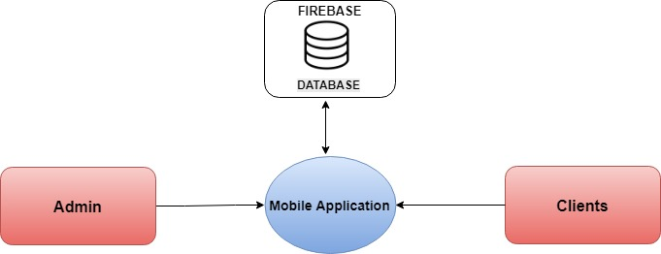
System Diagrams
Block Diagrams

Slide 10
System Module
Food Ordering System
User Login
Admin Login
Menu
View Food List
View Food Detail
Add Food to Card
Cart
Add food to cart
Remove Food From Cart
Place order
Order
View Order Status
View Order Detail
Logout
Logout from system
Menu
Order
Logout
Update Menu detail
Edit Menu Detail
Food
Add new Menu
Remove Menu
Update Food Detail
Edit Food
Add new Food
Remove Food
Notification on New Order
View Order detail
Remove order
Trace order Location
Change Order Status
Notification On Status Changed
Logout From System
Search for food
View User Detail
Home

Slide 11
Working of User

Slide 12
Working of Admin

Slide 13
3.Less probable to make mistake
2.Reduce labor cost
1.Minimize the number of employees
ADVANTAGES
4.order your food from where you are
5.Saves Time

Slide 14
Disadvantages
Android phone
Inaccurate GPS Signals
User Registration
An Internet connection is needed

Slide 15
Future Scope
Order cancel with in 10 min
Live order tracking from customer site
Verified user can comment
Multiple Restaurant

Slide 16
Thank You
for
Your Time

