Slide 1


Slide 2
Challenge 2 – Classification of Home Network Users to Improve User Experience Network users to Improve User Experience
Team : SilverSharks
Team Member 1 : Aman Raparia
Team Member 2 : Divakar Sharma
Team Member 3 : Mohit Gupta
Team Member 4 : Nitin Khanna
Team Member 5 : Sohil Sharma

Slide 3
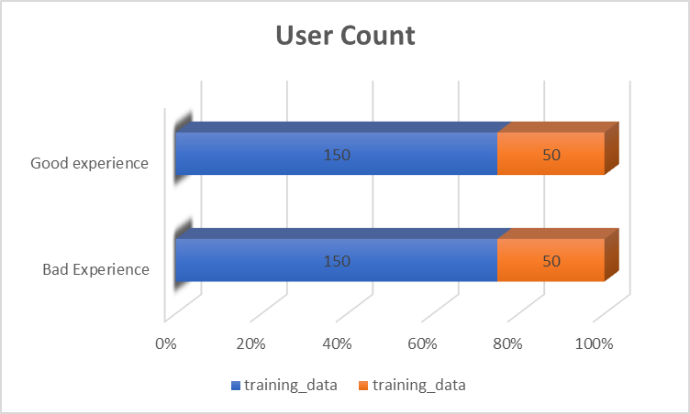
Insights from data
Total Number of users in Good Experience class : 150(train), 50(Validation)
Total Number of users in Bad Experience class : 150(train), 50(Validation)

Slide 4
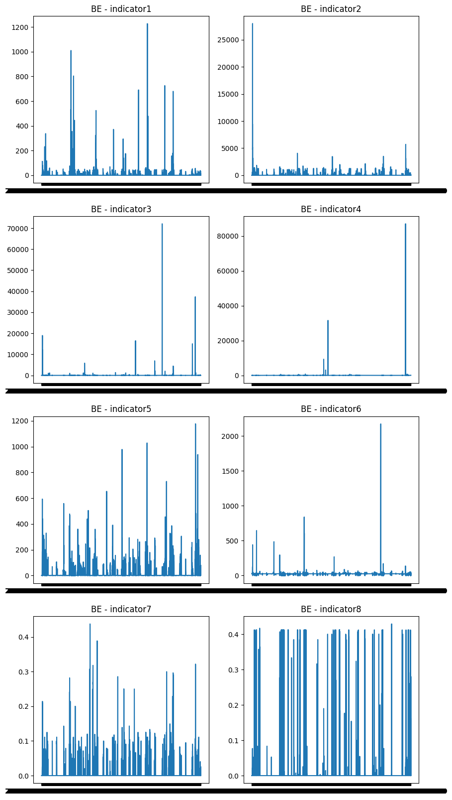
Insights from data
Customers with unusual or spikes in the data are labelled as “Bad Experience”

Slide 5
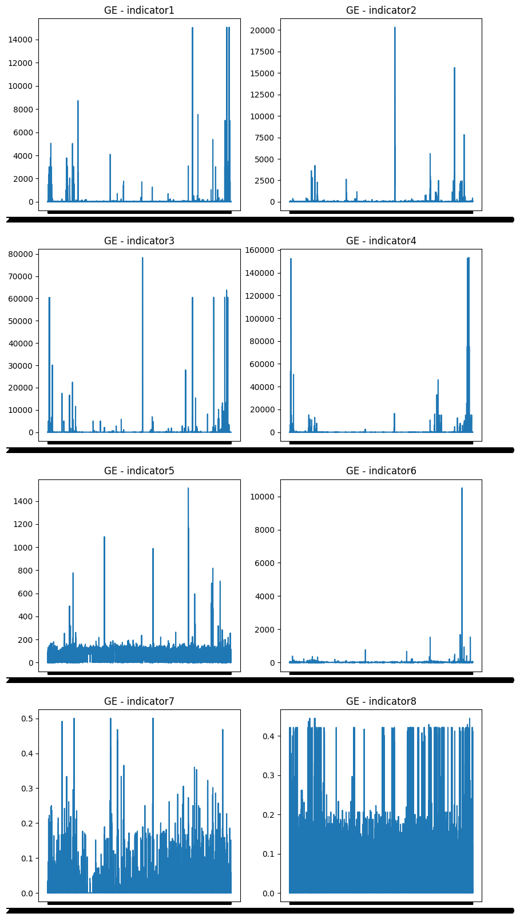
Insights from data
Customers with same behavior across whole timeframe are labelled as “Good Experience”

Slide 6
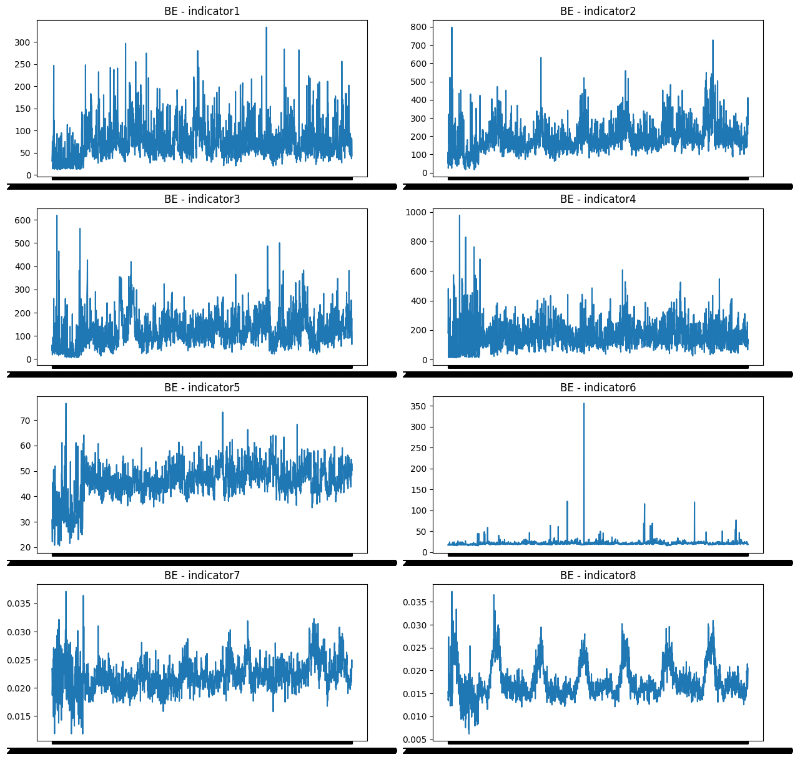

Absolute values are not suitable for the modelling purpose. Some transformation is required in the data engineering step to make the data more useful for modelling

Slide 7
Feature Engineering
Analyzed all the indicators for outliers and marked outliers within range ± 2 standard deviations
Analyzed spikes at daily and weekly level.
Transformed train data at daily level with 1 row for each user and day combination.
Notes:
EDA/Pre-processing - 10 points

Slide 8
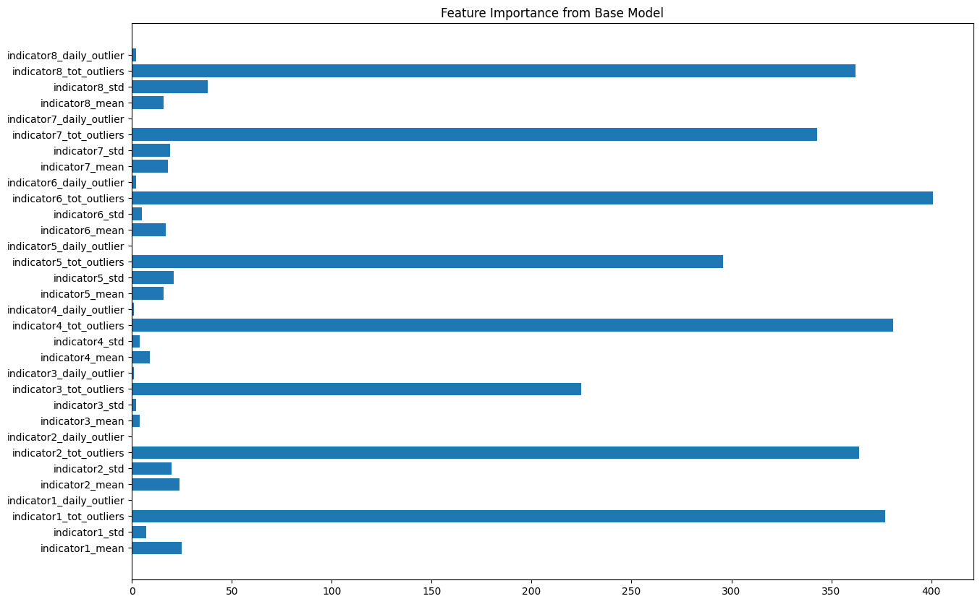
Feature Engineering
From the base model run, feature importance shows which features can be removed in the next runs to improve the model performance.
Notes:
EDA/Pre-processing - 10 points

Slide 9
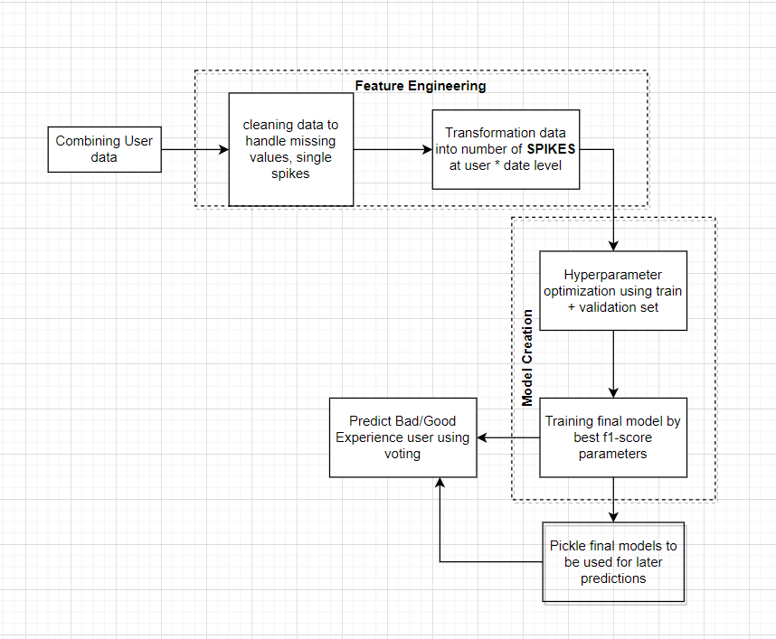
Solution Outline
After combining the data and removing sudden single spikes, transformation of the combined data, boosted tree models can be applied on the resultant data to classify each record as good or bad experience.
In the predict stage, voting can be used to find prediction at a user level.
Currently, LGBM was used to create a base model and select features based on importance.

Slide 10
AI/ML algorithms to explore in priority order
Some more features can be added to involve z-score or trend related values.
LGBM is the first choice due to its speed and robust behavior for shorter datasets.
After few rounds of hyperparameter optimization and cross-validation, Xgboost can be tried if LGBM doesn’t perform well.
Dynamic time warping can be used to find n-vector distance between users in the same class and the new record can be compared with centroids of both classes.

Slide 11
Summary
Since LGBM is used currently, the training time is very less and the memory requirements are also less.
Due to feature engineering proposed, overall training data size reduces by 20 times which further increases the time required for training and predicting.
Due to non-linear nature of the data, tree-based algorithms should be the first choice for any sensible data scientist to build the classifier.
Feature selection should be done as not all 8 features are contributing equally in the class decision.

