Slide 1
Big Data Applications Symposium - Spring 2018
Project Name: Airline Stock Prediction Based on Alternate Data
Team:
Jyotirmoy Mohapatra - jm7432@nyu.edu
Shubhankar Panse – ssp573@nyu.edu
Sohil Shah - sss847@nyu.edu
Abstract: In this project, we intend to predict the prices of Airline industry stocks and find the correlation between the stock market price of American Airlines and United Airlines, current trending topics searched on Google and the crude oil US market prices.

Slide 2
Airline Stock Prediction Based on Alternate Data
Motivation
Who are the users of this application?
Stock buyers, brokers, financial investment firms, airline companies.
Who will benefit from this application?
Stock buyers, brokers, financial investment firms, airline companies.
Why is this application important?
A way to map the interest of the society to stock prices of your company.
An attempt to tackle the unpredictable nature of stock prices and thus increase returns.

Slide 3
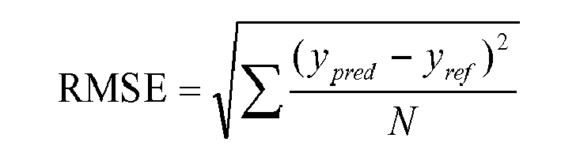
Airline Stock Prediction Based on Alternate Data
Goodness
What steps were taken to assess the ‘goodness’ of the analytic?
Regression algorithms were used to predict the stock prices.
Root Mean Squared error is used to measure how well the regression model fits the dataset.

Slide 4
Airline Stock Prediction Based on Alternate Data
Remediation
What actuation(s) or remediation actions are performed by the application?
We run linear regression on the alternate data and train a model which reflects the relations between these factors and stock prices.
The model can be used to predict prices and compare to the actual prices.
Using the coefficients of the trained regression model, we can decide which parameters are closely correlated to the stock price.

Slide 5
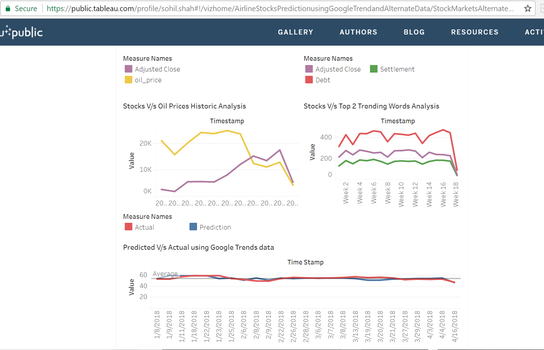
Our Analytical Rendering/ Visualization - Overview
Link To Application

Slide 6
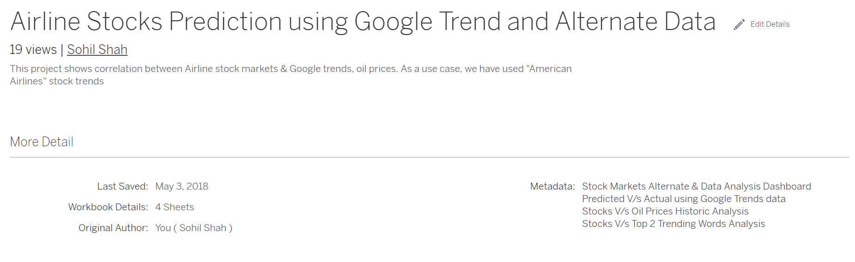
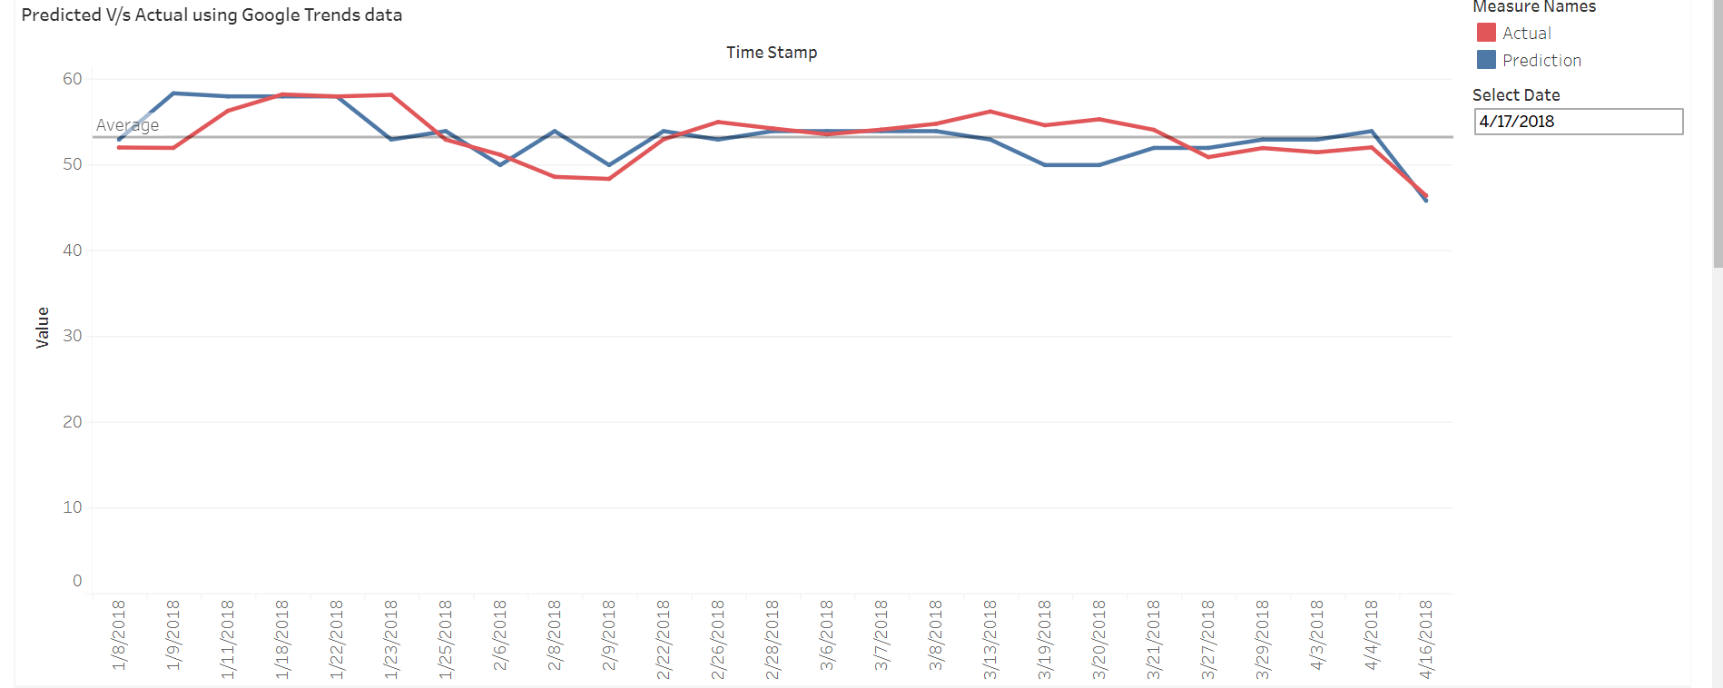
Navigations and Tab & Date Functionality
This is Navigation pane on Tableau Public webpage for visualizations with more details.This is on the lower half of the first page.
Enter the Date in the Select Date panel above in the MM/DD/YYYY format and the date filter would work upto that date only for analysis.

Slide 7
Airline Stock Prediction Based on Alternate Data
Data Sources
Name: Alpha Vantage
Description: Daily Stock Price data
Size of data: 100 MB
Name: Google Trends
Description: Daily Interest over Time data of words
Size of data: 1 MB
Name: Crude Oil WTI Futures
Description: Crude Oil Prices
Size of data: 50MB

Slide 8
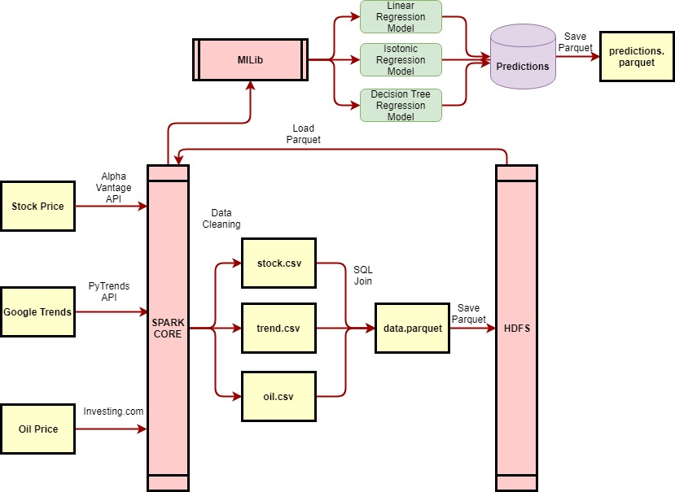
Airline Stock Prediction Based on Alternate Data
Design Diagram:

Slide 9
Airline Stock Prediction Based on Alternate Data
Platform(s) on which the application runs:
NYU HPC Cluster

Slide 10
Airline Stock Prediction Based on Alternate Data
Experiments/Results
1. Regression Model using parameters from Stock Price, Google Trends and Oil Price Datasets.
2. Regression Model using parameters from Stock Price and Oil Price Datasets.
3. Regression Model using parameters from Stock Price and Google Trends Datasets.

Slide 11
Airline Stock Prediction Based on Alternate Data
Insights
Decision Tree Regression performed the best in all three experiments showing approximately 30% improvement in predictions.
Linear Regression provided coefficient weights for each feature which can be used for analysing how each feature affects the changes in the stock price. The words “debt” and “settlement” seem to have the most impact on the predictions.
It was observed that Oil Data was not correlated to Airline stock data. The model which used Stock Price and Oil Price data performed very poorly.

Slide 12
Airline Stock Prediction Based on Alternate Data
Sample Predictions of our Application
Actual | Predicted
57.8637 | 57.80883333333333
50.778 | 50.165119999999995
45.69 | 46.68000000000001
47.3115 | 50.670818181818184
52.31 | 53.863038888888894
46.2658 | 47.76202666666666
51.01 | 53.863038888888894
50.2989 | 46.31584864864865
50.85 | 51.838100000000054
51.72 | 53.863038888888894

Slide 13
Airline Stock Prediction Based on Alternate Data
Obstacles
Out of Memory errors in DUMBO while running spark-shell.
The PyTrends API used to collect Google Trends data provided daily data for a time period of only 4 months. So we had to develop a script to fetch the data for multiple 4 month intervals.
Spark does not provide any APIs or implementation for Granger Causality because of which we could not analyse the correlation between the time series of various features used in our regression model.

Slide 14
Airline Stock Prediction Based on Alternate Data
Summary
We found that crude oil prices are not necessarily correlated with the airline stock prices. However, the interest over time data from Google Trends is actually a good indicator for predicting stock prices.
Acknowledgements
This study was supported by our professor Suzanne McIntosh (mcintosh@cs.nyu.edu). We also thank the High Performance Computing department in NYU for supporting the computing resources, and most parts of our program was run on Dumbo.
We thank AlphaVantage for providing an API to pull stock market data.
We also thank the authors of the pytrends API to retrieve Google Trends historical data.

Slide 15
Airline Stock Prediction Based on Alternate Data
References
Girija V Attigeri , Manohara Pai M M, Radhika M Pai, Aparna Nayak Stock Market Prediction: A Big Data Approach
Todsanai Chumwatana, Ichayaporn Chuaychoo, “Using social media listening technique for monitoring people's mentions from social media: A case study of Thai airline industry”
Yahya Eru Cakra, Bayu Distiawan Trisedya, “Stock Price Prediction using Linear Regression based on Sentiment Analysis”
Md. Rafiul Hassan, Baikunth Nath, “Stock Market Forecasting Using Hidden Markov Model: A New Approach”
K. Tziridis, Th. Kalampokas, G.A. Papakostas, “Airfare Prices Prediction Using Machine Learning Techniques”
Yuling Li1,2,Ping Zhu1 ,Sujuan Qin2, “Optimization of ticket purchasing strategy based on machine learning”
Yauheniya Shynkevichl, T.M. McGinnityl, Sonya Colemanl, Ammar Belatrechel, “Stock Price Prediction based on Stock-Specific and Sub-Industry-Specific News Articles”
Tobias Preis, Helen Susannah Moat & H. Eugene Stanley, “Quantifying Trading Behavior in Financial Markets Using GoogleTrends”
Helen Susannah Moat, Chester Curme, Adam Avakian, Dror Y. Kenett, H. Eugene Stanley & Tobias Preis, “Quantifying Wikipedia Usage Patterns Before Stock Market Moves”
Min-Hsua Fan, Mu-Yen Chen, En-Chih Liao, “A TAIEX Forecasting Model Based on Changes of Keyword Search Volume on Google Trends”
Hyunyoung Choi and Hal Varian, “Predicting the Present with Google Trends “
Roberto Cervelló-Royo, Francisco Guijarro, Karolina Michniuk, “Stock market trading rule based on pattern recognition and technical analysis: Forecasting the DJIA with intraday data”[

Slide 16
Airline Stock Prediction Based on Alternate Data
Thank you!

