Slide 1

ParaScout
Group 27
Group members: Sohini Dutta
Julius Chuhwak Matthew
Kutay Arınç Çokluk
Sethulakshmi Vazhayil
TA: Chaitanya Chawak

Slide 2
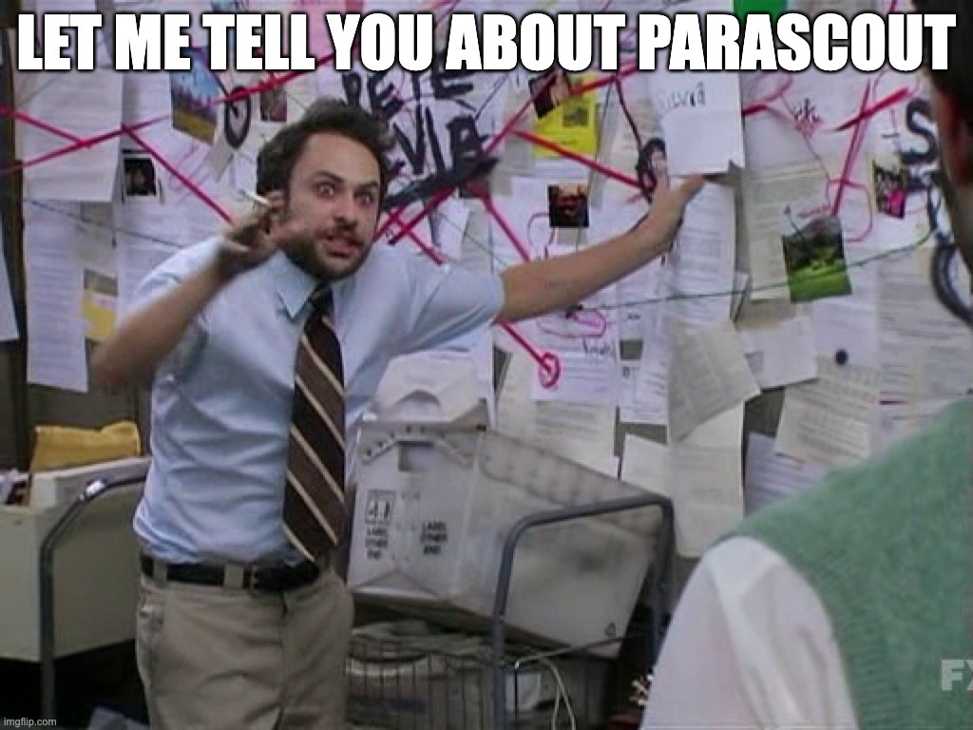
INTRODUCTION
ParaScout is a tool for evaluating and visualizing how well a parameter space has been explored.
ParaScout aims to provide a lightweight framework for:
  Automatically identifying the dimensionality of the parameter space
  Generating appropriate visualisations for the data

Slide 3
PACKAGE STRUCTURE
ParaScout/
├── parascout/ # Installable Python package
│ ├── __init__.py # Public API and visualise() wrapper
│ ├── dispatcher.py # Routes arrays to plotting functions
│ └─plotting_functions.py #plot_bubble_map, plot_volumetric_density
├── data/ # Place input data files here
├── pyproject.toml # Build configuration and metadata
└── README.md

Slide 4
Installation
pip install parascout
Documentation
https://parascout.readthedocs.io/en/latest/
PyPi page
https://pypi.org/project/parascout/

Slide 5
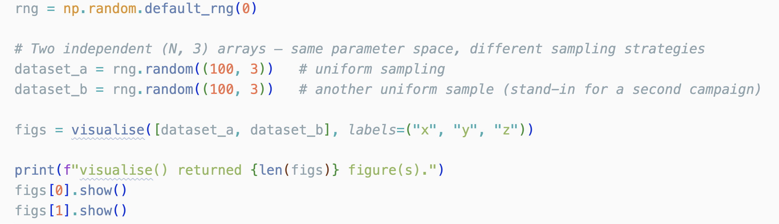
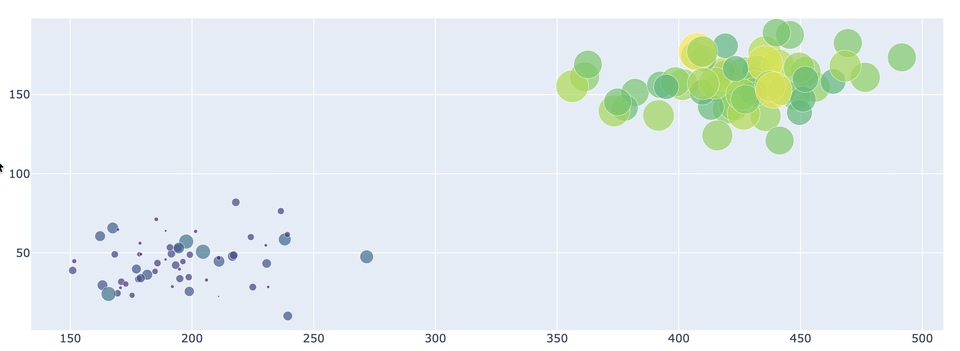
A demo:
Clustered sampling spotted!!!
Sample set A
Sample set B

Slide 6
