Slide 1
GRA_Net
Deep Learning Model for Age and Gender Classification
Complete Student Project

Slide 2
Problem Statement
Age and gender estimation from unconstrained facial images is difficult because of pose, blur, illumination, expression and occlusion.
Goal: build a runnable deep-learning system inspired by the supplied GRA_Net paper.
GRA_Net Student Project

Slide 3
Objectives
Implement gated residual attention.
Train age-category + age-unit models and a gender model.
Evaluate MAE and gender accuracy.
Deploy a Streamlit demo.
GRA_Net Student Project

Slide 4
Paper Contributions
Classification + regression for age.
Separate gender classification.
Trainable gate added to Residual Attention Network.
Attention masks for feature selection.
Evaluation on five benchmark datasets.
GRA_Net Student Project

Slide 5
Datasets
FG-NET: 1002 images, 82 subjects.
AFAD: 164,432 labeled photos in the paper.
Wikipedia Age: 62,328 images / 20,284 celebrities.
UTKFace: >20K images, age 0-116.
AdienceDB: Flickr-derived, manually labeled.
GRA_Net Student Project

Slide 6
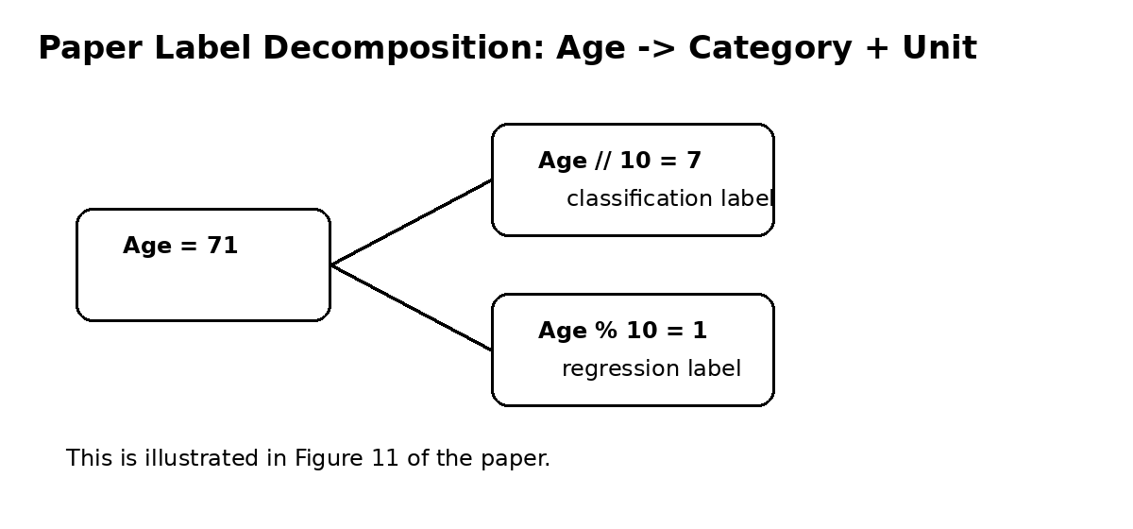
Age Label Decomposition
Example from Figure 11: age 71 -> age // 10 = 7 (classification) and age % 10 = 1 (regression).
Predicted age = predicted decade * 10 + rounded unit digit.
GRA_Net Student Project

Slide 7
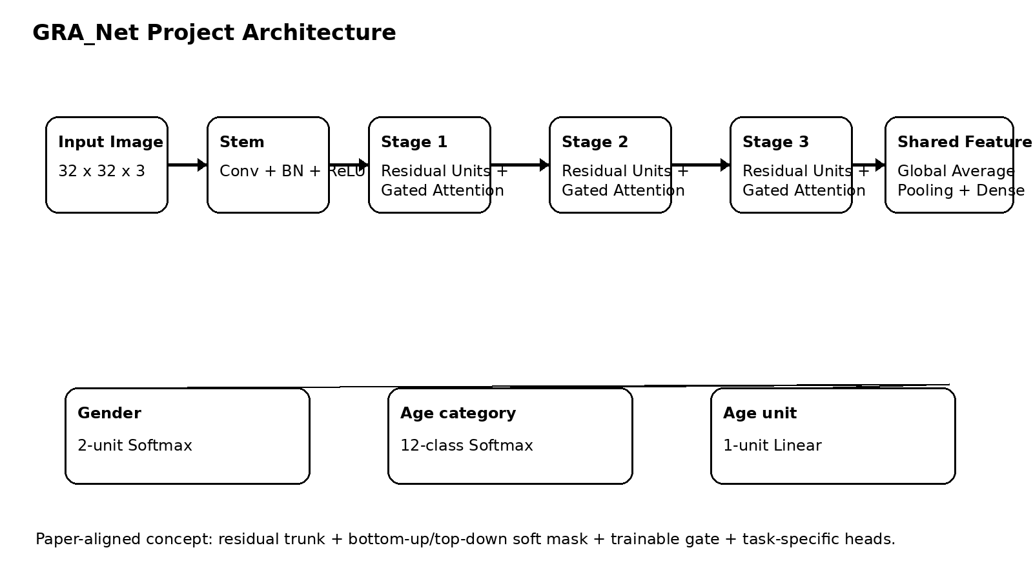
GRA_Net Architecture
Residual/ResNeXt-style trunk.
Bottom-up/top-down soft mask.
Trainable gated residual attention.
Three task-specific outputs in the student implementation.
GRA_Net Student Project

Slide 8
Gated Residual Attention
Eq. (3): O = (gamma + (1-gamma)K) * F.
K is the soft mask; gamma is trainable.
The gate can preserve useful trunk features while allowing attention to modulate them.
GRA_Net Student Project

Slide 9
Attention Modes
Mixed: sigmoid per channel and spatial position.
Channel: L2 normalization across channels.
Spatial: channel-wise standardization followed by sigmoid.
GRA_Net Student Project

Slide 10
Training Settings
Input: 32x32 RGB.
Gender: 2-unit softmax + BCE.
Age category: categorical cross entropy.
Optimizer: Nadam, lr=0.001.
Age unit: single linear output; MSE is the project choice because the paper does not specify the regression loss in the experimental paragraph.
GRA_Net Student Project

Slide 11
Evaluation
Primary paper metrics: age MAE and gender accuracy.
Project diagnostics: exact-age accuracy and within ±5 years.
Generate confusion matrix and age-error distribution.
GRA_Net Student Project

Slide 12
Results - Fill After Training
Age MAE: [YOUR RESULT]
Gender accuracy: [YOUR RESULT]
Exact-age accuracy: [YOUR RESULT]
Within ±5 years: [YOUR RESULT]
Important: these must come from results/results.csv.
GRA_Net Student Project

Slide 13
Paper Benchmark Reference
Reported by the supplied paper: FG-NET 3.23, AFAD 3.10, Wikipedia Age 5.45, UTKFace 1.07, AdienceDB 10.57 MAE.
Gender: 99.2% on UTKFace and 82% on AdienceDB.
These are literature reference values, not student results.
GRA_Net Student Project

Slide 14
Error Analysis
Paper discusses blur, side pose, occlusion, glasses/hats, children and feature ambiguity.
Use your own test examples to explain where your trained model fails.
GRA_Net Student Project

Slide 15
Deployment
Streamlit image upload.
Largest-face detection for the demo.
32x32 preprocessing.
Age + gender prediction and confidence display.
GRA_Net Student Project

Slide 16
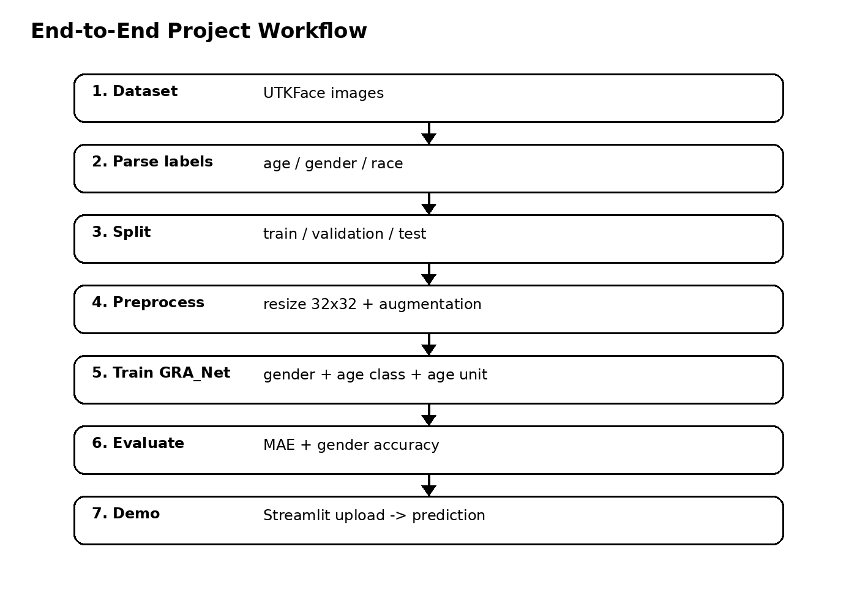
Project Structure
Core model: gra_net.py
Data: data_utils.py
Training: train.py
Evaluation: evaluate.py
Inference: predict.py
Demo: app.py
Colab: notebooks/GRA_Net_Complete_Colab.ipynb
GRA_Net Student Project

Slide 17
Limitations and Future Scope
Default UTKFace split is practical rather than subject-disjoint.
Compact stage configuration is a project choice, not a layer-by-layer paper reproduction.
Future: all five datasets, stronger occlusion/pose robustness, children, geographic robustness, improved losses.
GRA_Net Student Project

Slide 18
Conclusion
A complete student pipeline was built from the supplied paper: preprocessing, GRA_Net, three task models, evaluation, inference and demo.
Always present your own experimental results separately from the paper benchmarks.
GRA_Net Student Project

