Slide 1
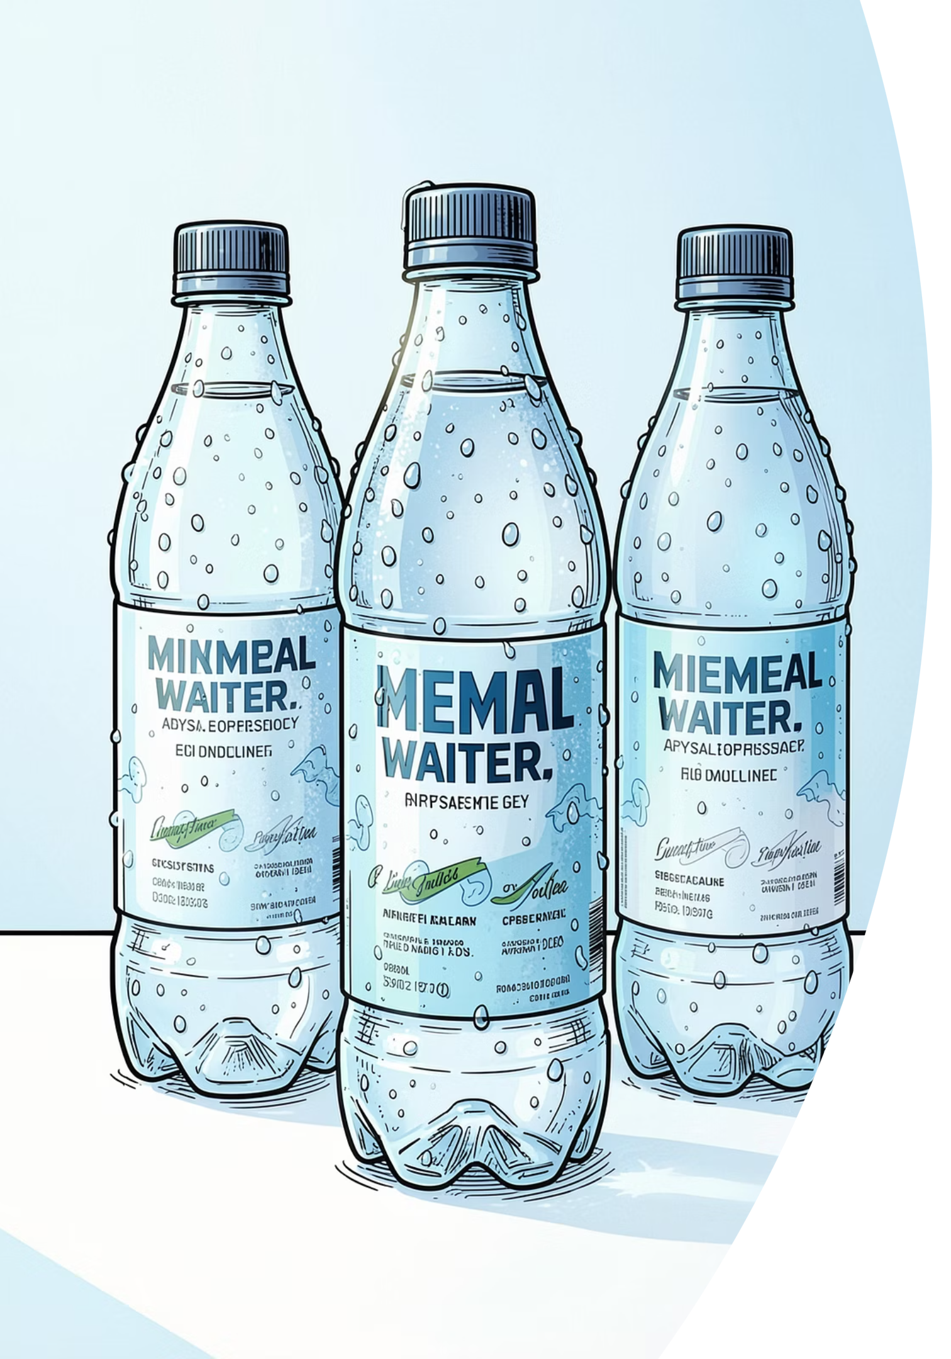
AquaVital Mineral Water
Marketing Mix Proposal (4Ps)
A strategic marketing framework integrating SWOT analysis with the 4Ps — Product, Price, Place, and Promotion — for a new affordable mineral water brand targeting health-conscious families in Singapore.
BRAND POSITIONING
ACADEMIC MARKETING STRATEGY

Slide 2

Target Market & Brand Positioning
"Healthy Hydration. Everyday Value."
Who They Are
Where They Shop
Parents aged 30–55 from lower-middle to middle-income households seeking healthy, affordable hydration for their families.
Supermarkets, neighborhood minimarts, and online grocery platforms — prioritizing convenience and value.
What They Value
Health, affordability, and reliability — mineral water that supports daily family wellness without premium pricing.

Slide 3
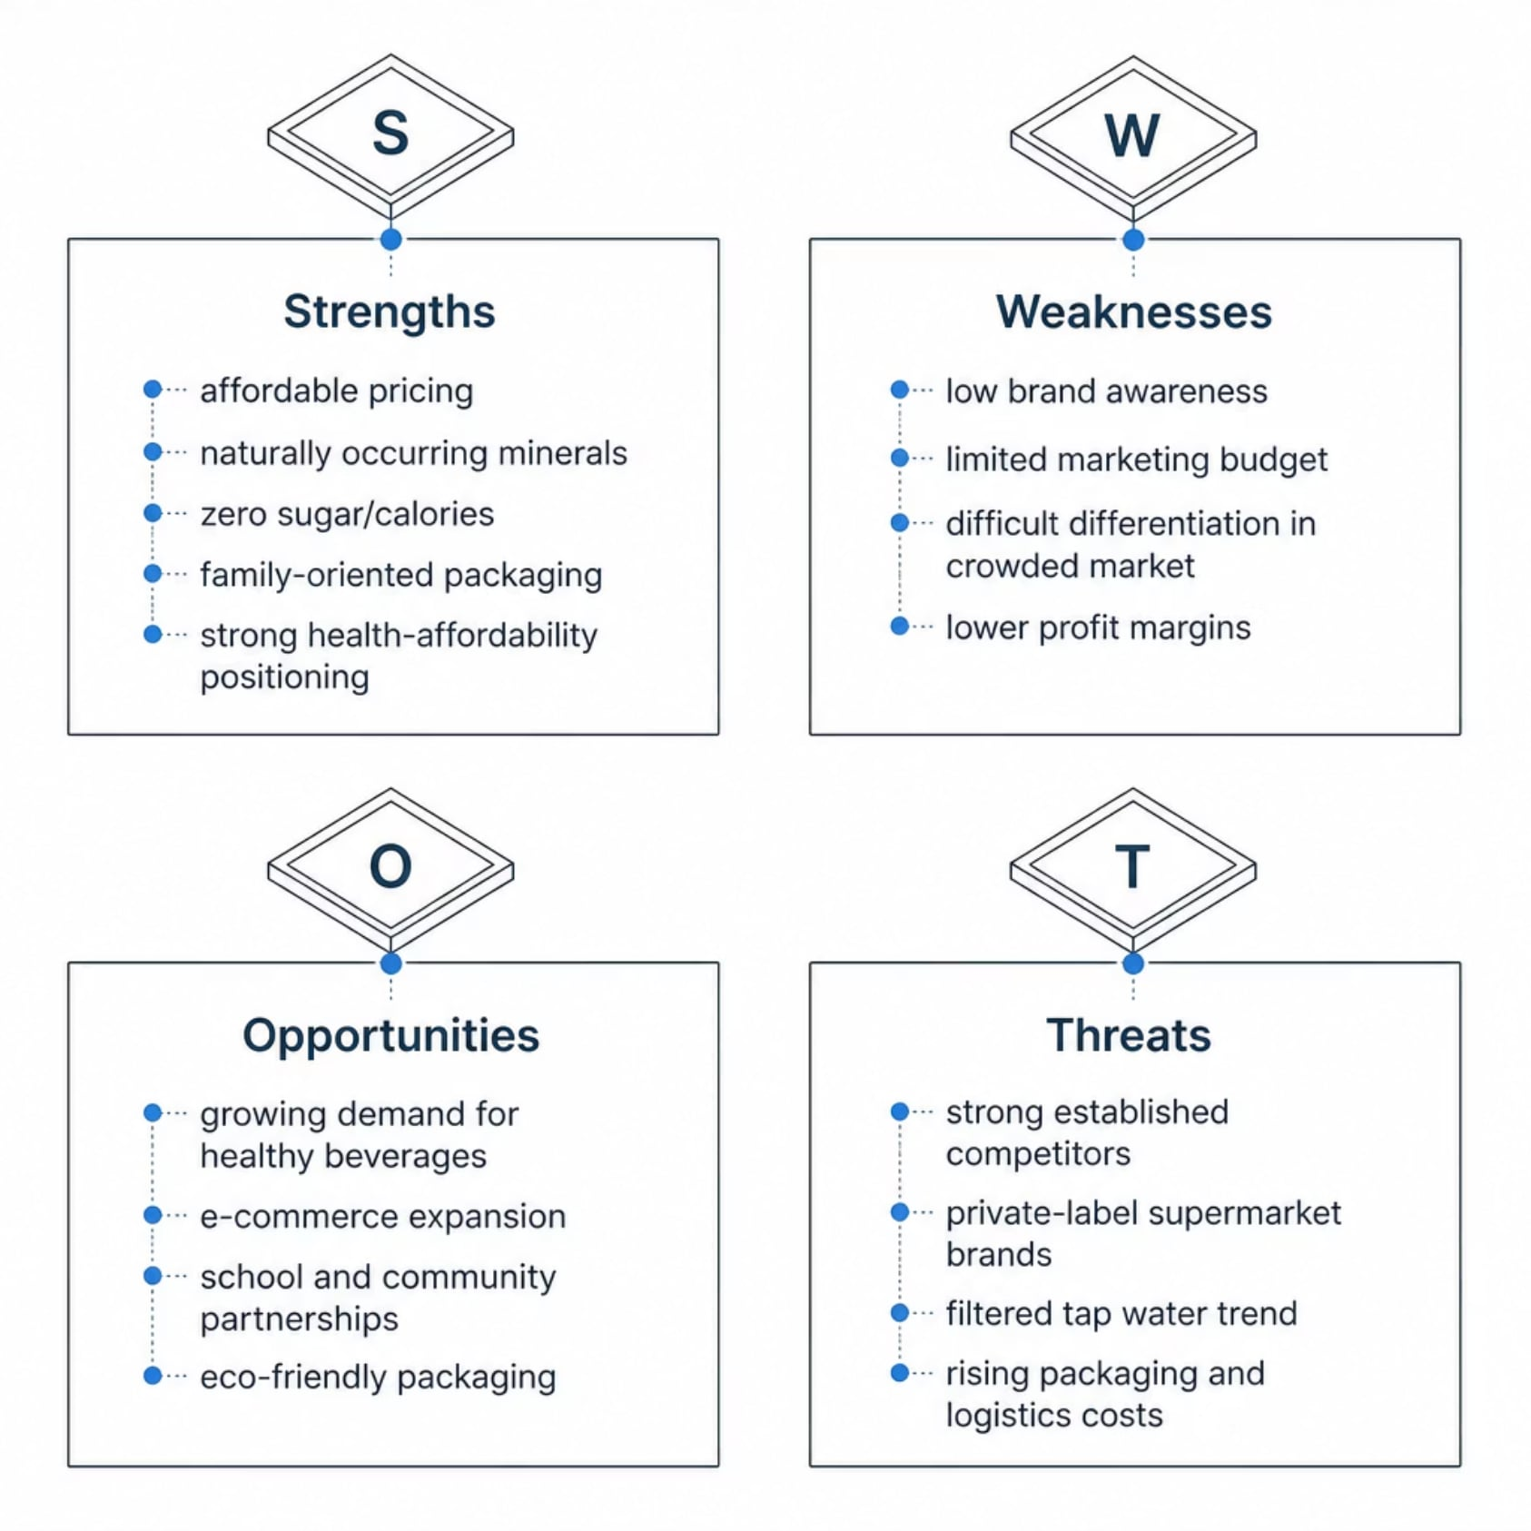
SWOT Analysis
AquaVital enters a competitive market with clear structural advantages in health positioning and affordability. The key strategic imperative: leverage strengths in natural minerals and value pricing while building brand awareness through broad distribution and targeted promotions to overcome low initial consumer recognition.

Slide 4
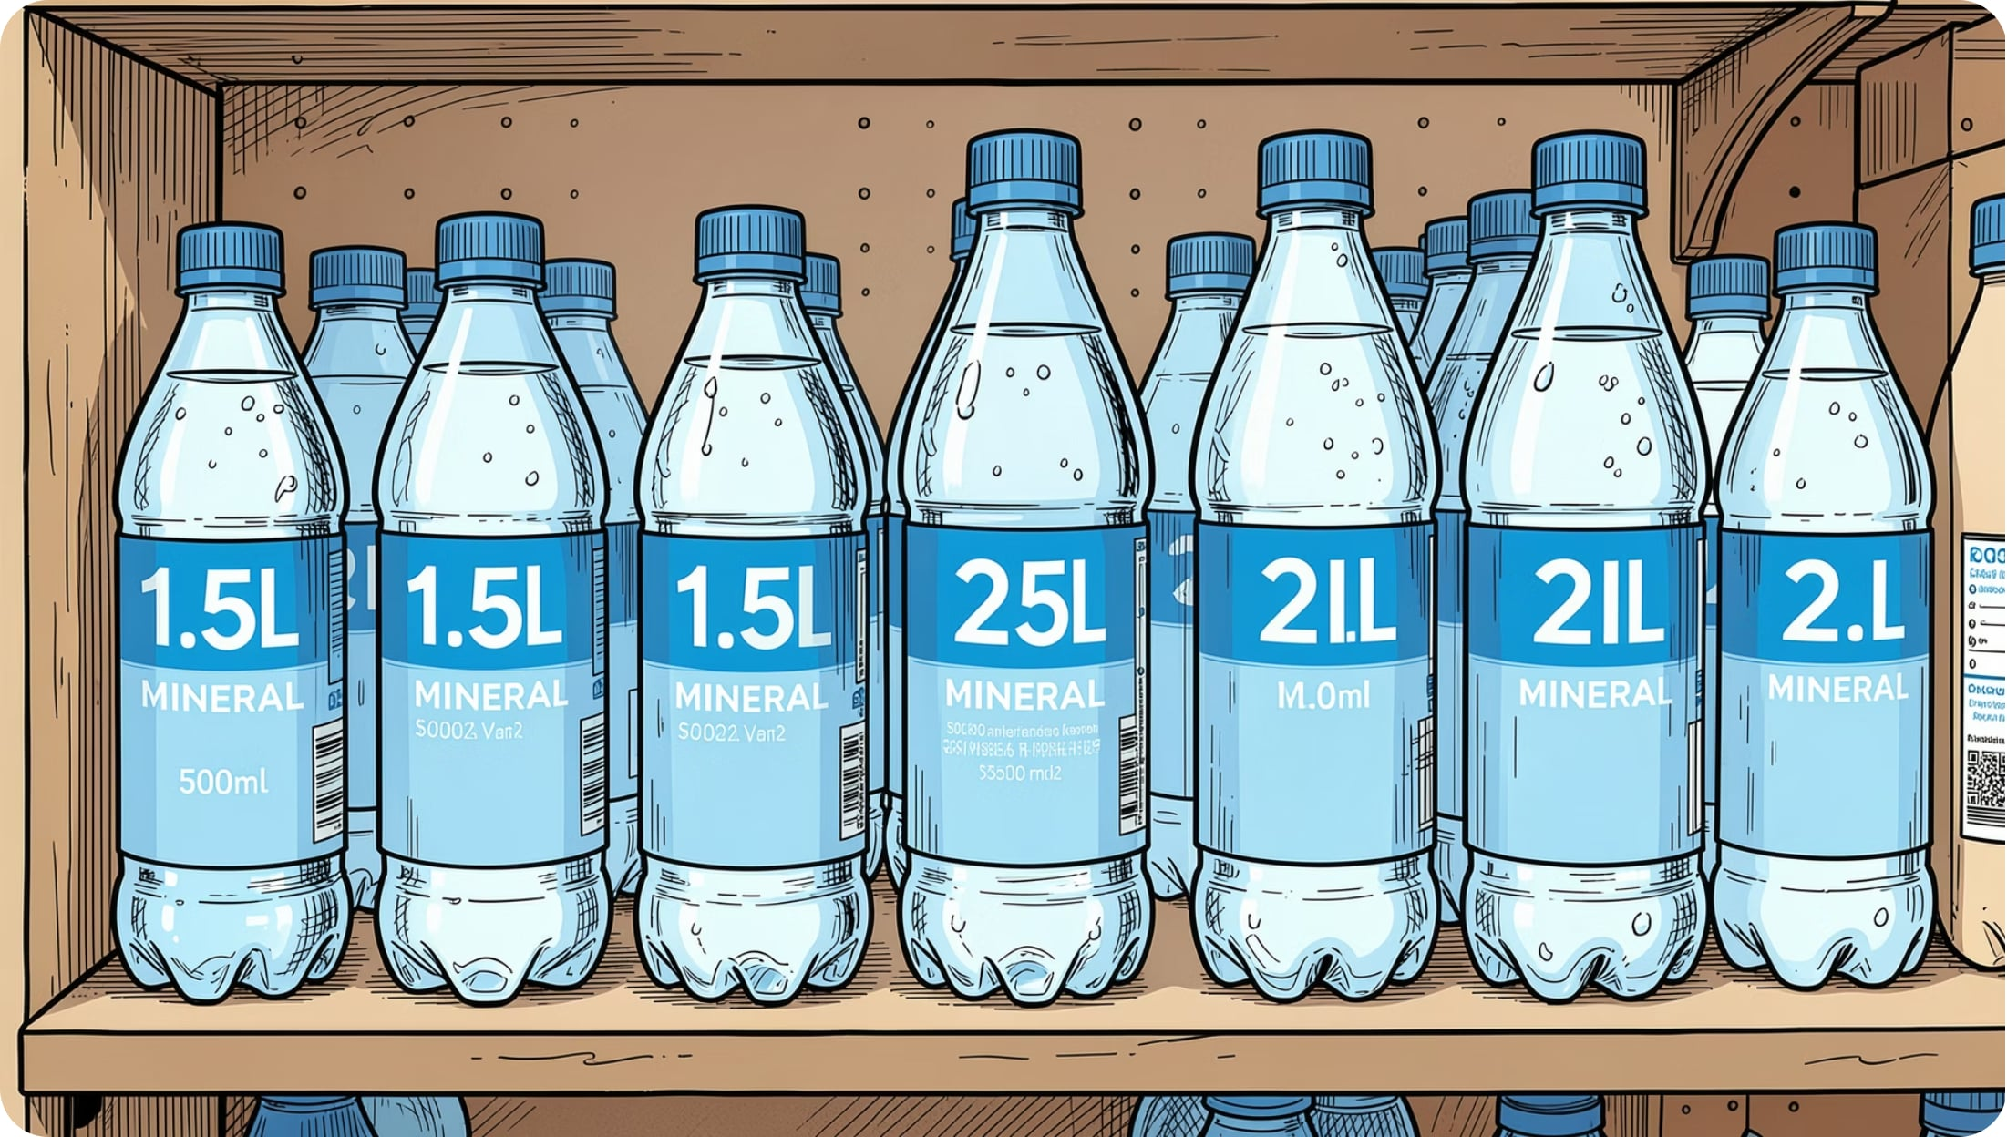
Product Strategy
What AquaVital Offers
An affordable natural mineral water with naturally occurring essential minerals — zero sugar, zero calories, no preservatives. Designed for healthy everyday family hydration across all settings.
500 mL
1.5 L
2 L
24-Bottle Carton
Individual on-the-go consumption
Small family daily use
Household consumption
Family value pack

Slide 5
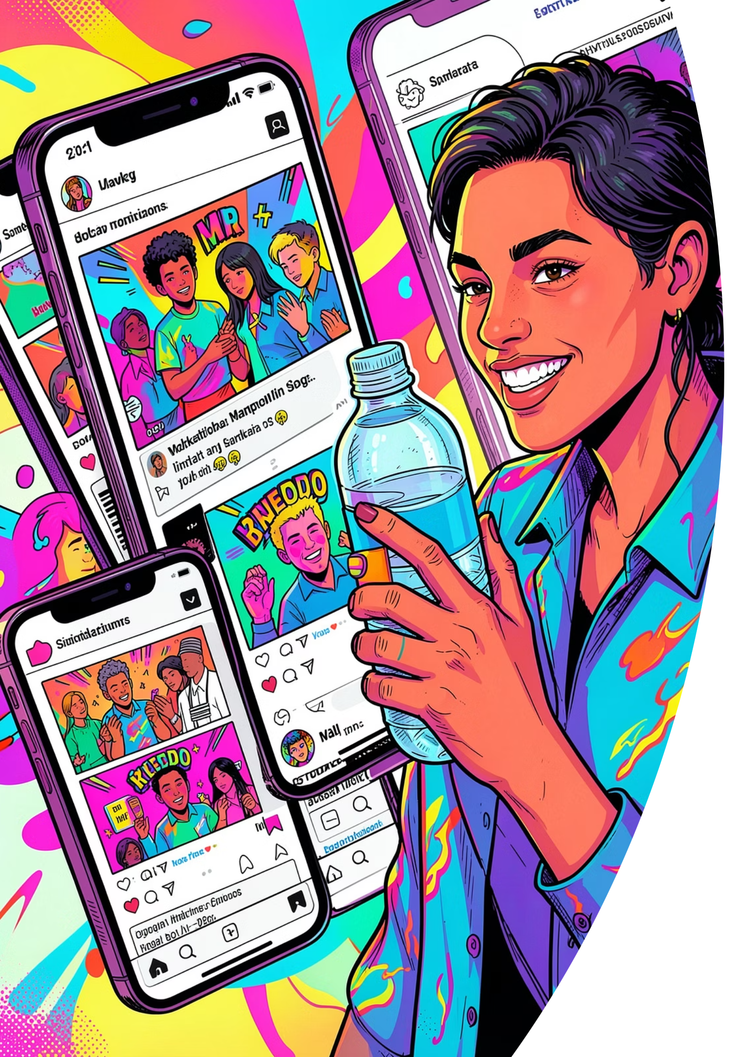




Promotion Strategy
Objective: Increase brand awareness and encourage trial among health-conscious budget families through multi-channel engagement.
Digital Marketing
Campaigns across Facebook, Instagram, TikTok, and YouTube targeting family-oriented audiences.
Retail Promotions
Supermarket bundle offers, introductory discounts, product sampling, and loyalty reward programs.
Community Engagement
Sponsorship of school events, community health campaigns, and family wellness activities.
E-Commerce Incentives
Online grocery promotional vouchers and platform-exclusive family value bundles.

Slide 6
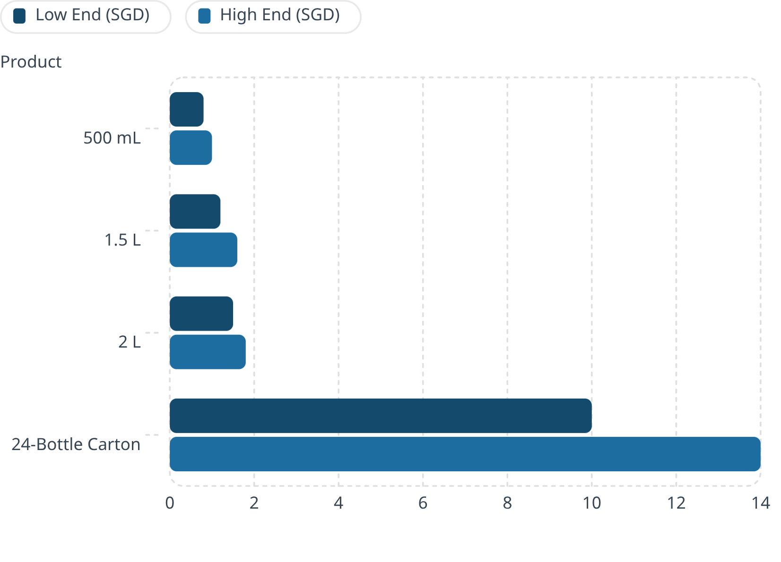

Pricing Strategy
Value-Based Pricing
AquaVital is priced to deliver strong value for money — competitive within Singapore's affordable mineral water segment, accessible for frequent household purchases, and positioned below premium imported brands without compromising quality.
Core Principle: Affordability without compromise. Healthy hydration should be accessible to every family.

Slide 7




Place (Distribution) Strategy
Objective: Ensure AquaVital is widely available wherever target families shop, work, and stay active — maximizing convenience and daily accessibility.
Retail
Online
NTUC FairPrice, Sheng Siong, Giant, Cold Storage, neighborhood minimarts, and convenience stores.
Online grocery platforms and e-commerce marketplaces for home delivery convenience.
Institutional
On-the-Go
School canteens, office pantries, community centers, and healthcare facilities.
Vending machines, gyms, sports facilities, recreational parks, and event venues.

Slide 8
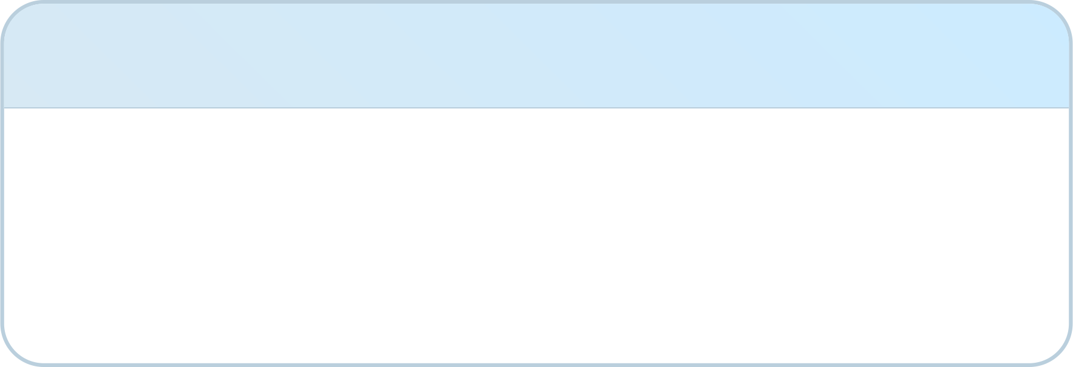




Marketing Mix Summary
AquaVital's 4Ps form a cohesive strategy — each element reinforces the brand's core promise of healthy hydration at everyday value.
Product
Promotion
Natural mineral water with essential minerals, zero sugar/calories, in family-friendly sizes for everyday use.
Digital campaigns, retail sampling, family bundles, loyalty programs, and community sponsorships.
Price
Place
Value-based pricing within Singapore's affordable segment — competitive, accessible, and quality-assured.
Omni-channel distribution across supermarkets, minimarts, online platforms, schools, and sports venues.

Slide 9
Strategic Alignment: SWOT & the 4Ps
The marketing mix is directly informed by the SWOT analysis — each element responds to a specific strategic factor.
SWOT Factor
Marketing Mix Response
Strength: Affordable pricing & natural minerals
Product: Highlight minerals & family packaging. Price: Maintain value-based pricing.
Weakness: Low brand awareness
Promotion: Digital campaigns, sampling, and community sponsorships.
Opportunity: Demand for healthy, affordable beverages
Product: Promote hydration benefits. Place: Expand retail and online availability.
Threat: Strong competition from established brands
Promotion: Family-focused messaging. Price: Multipack bundles. Place: Maximize availability.

Slide 10


Key Takeaways
This eight-slide framework presents a coherent marketing proposal where each element is logically connected — from situational analysis to strategic execution.
01
Introduction & Target Market
Define the brand, positioning, and primary segment.
02
SWOT Analysis
Identify internal strengths/weaknesses and external opportunities/threats.
03
The 4Ps Strategy
Develop Product, Promotion, Price, and Place decisions.
04
Strategic Alignment
Ensure every mix element responds to the SWOT findings.
Core Insight: AquaVital leverages health, affordability, and quality to compete effectively — building brand equity through broad availability and family-focused positioning.

