Slide 1

AquaVital Mineral Water
Comprehensive Marketing Plan — Establish AquaVital as a trusted, affordable mineral water brand for health-conscious budget families in Singapore. Increase brand awareness and encourage repeat purchases through value-driven marketing.

Slide 2



TARGET MARKET
Target Market Strategies
Who We Serve
Parents aged 30–55, lower-middle to middle-income households, regular supermarket shoppers seeking healthy and affordable hydration.
Positioning
Value Proposition
Acquisition
Retention
Healthy, affordable mineral water with naturally occurring essential minerals for everyday family hydration.
"Healthy hydration for every family at an affordable price."
Product sampling, supermarket promotions, family bundle offers, and introductory discounts.
Loyalty rewards, seasonal promotions, family multipack discounts, and online grocery vouchers.
Competitive Advantage
Combines natural mineral content, affordability, trusted quality, and wide availability.

Slide 3



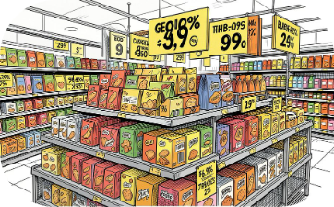

CONTENT STRATEGY
Content & Community Engagement
Educational Content
Family Lifestyle Content
Social Media Marketing
Promotional Campaigns
Share the importance of daily hydration and the role of naturally occurring minerals in supporting everyday family wellness.
Showcase families enjoying healthy lifestyles with AquaVital during meals, school, work, and outdoor activities.
Publish engaging posts, short videos, hydration tips, and healthy living content on Facebook, Instagram, TikTok, and YouTube.
Highlight bundle promotions, supermarket discounts, and festive family value packs.
Community Engagement
Sponsor school activities, community health programmes, family fun runs, and wellness events to build trust and brand recognition.

Slide 4
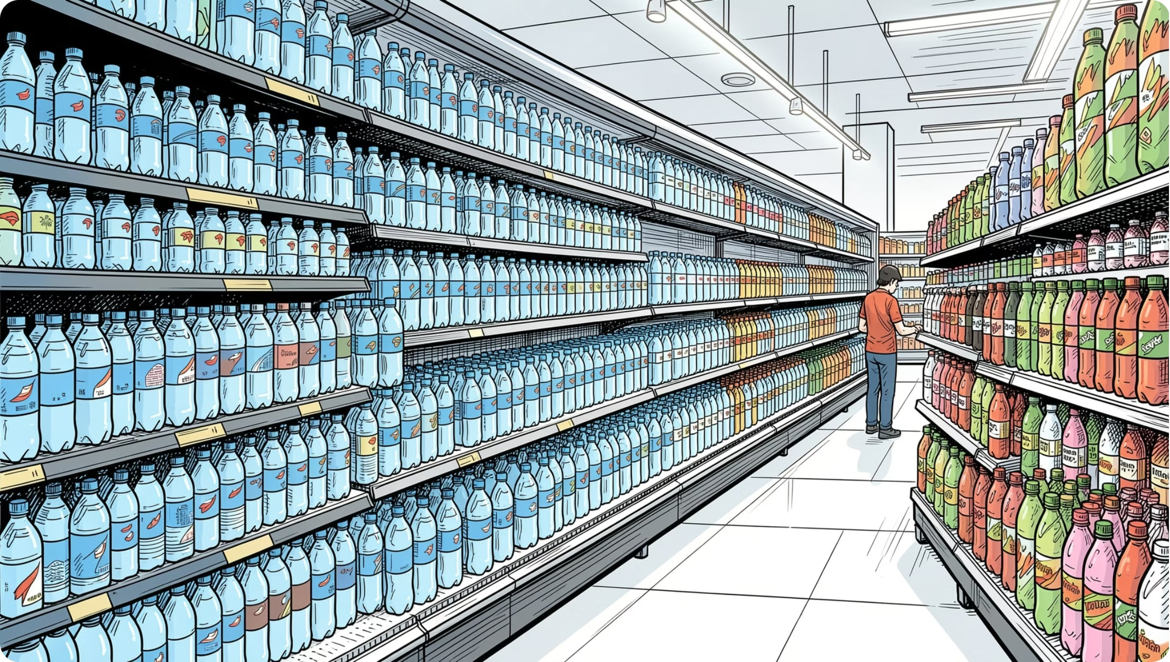

DISTRIBUTION
Distribution Channels
AquaVital reaches families through every touchpoint — from weekly grocery shops to on-the-go purchases.
Supermarkets
Primary retail channel for weekly family grocery shopping.
Minimarts & Convenience Stores
Convenient access for local communities and quick purchases during commuting.
Online Grocery Platforms
Home delivery and recurring household purchases.
Vending Machines
Convenient hydration at schools, offices, and transport hubs.
Schools, Community Centres & Sports Facilities
Support family-oriented community activities and reach consumers seeking convenient hydration during physical activities.

Slide 5
MEASUREMENT
Metrics & Performance Targets
60%
3Y
Brand Awareness
Market Share
Aided brand awareness target within 12 months.
Build measurable share within Singapore's affordable mineral water segment.
Additional KPIs tracked across the first year and beyond:
Sales Revenue
Retail Distribution
Customer Retention
Meet or exceed monthly sales targets for the first year.
Secure placement in major supermarket chains, minimarts, convenience stores, and online grocery platforms.
Achieve repeat purchase rates through loyalty programmes and family value packs.
Digital Engagement
Customer Satisfaction
Increase website visits, social media followers, engagement rates, and campaign participation over time.
Maintain consistently positive customer feedback and high product ratings.

Slide 6
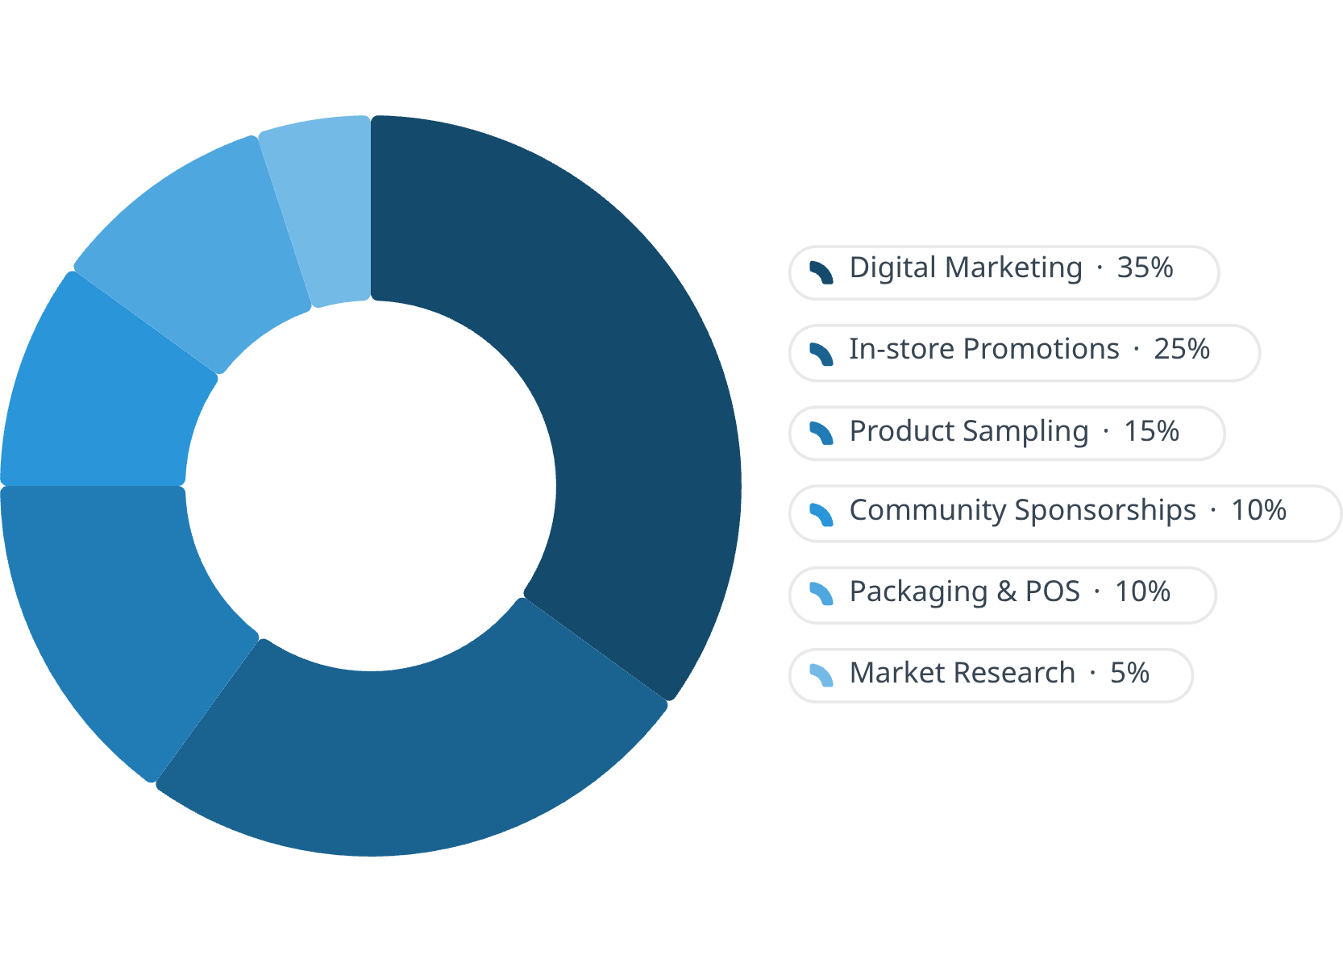



BUDGET
First-Year Budget Allocation
Budget Justification
Digital Marketing — 35%
In-store Promotions — 25%
Cost-effective method to reach health-conscious families through targeted online advertising and social media campaigns.
Encourages product trials and increases purchase conversion at the point of sale.
Product Sampling — 15%
Community Sponsorships — 10%
Builds consumer confidence and introduces AquaVital to new customers.
Enhances brand credibility and strengthens relationships with local families and communities.
Packaging & POS — 10%
Market Research — 5%
Reinforces brand identity and communicates the product's health and affordability benefits.
Collects customer insights to refine future marketing strategies and product improvements.

Slide 7
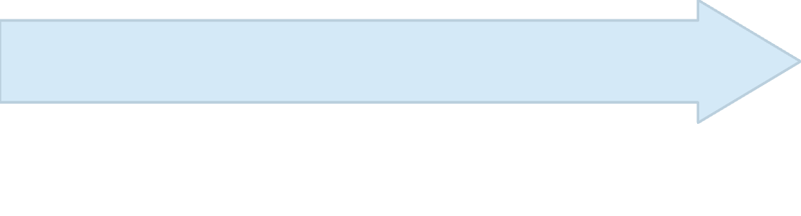

OUTCOMES
Expected Outcomes
Long-Term (Beyond 3 Years)
Medium-Term (Years 2–3)
Become one of Singapore's most trusted mainstream mineral water brands. Introduce complementary product variants (e.g., sparkling mineral water or environmentally friendly packaging) while maintaining the brand's core promise of health, affordability, and quality.
Short-Term (First 12 Months)
Increase repeat purchases and customer loyalty. Expand retail presence across Singapore. Strengthen market share within the affordable and healthy mineral water segment.
Establish strong brand awareness among health-conscious budget families. Secure distribution through major retail channels. Encourage first-time purchases through promotional campaigns. Develop a positive reputation for affordable, healthy hydration.

Slide 8

AquaVital's Promise
"Healthy hydration for every family at an affordable price."
AquaVital's marketing strategy is centred on delivering healthy, naturally mineral-rich hydration at an affordable price for Singapore's health-conscious budget families. By integrating targeted marketing, engaging educational content, broad retail availability, measurable performance indicators, and a balanced marketing budget, AquaVital aims to establish a sustainable competitive position within Singapore's affordable and healthy mineral water market.

