Slide 1


ETL Project:
Using GCP
Deepak V & Robert S

Slide 2
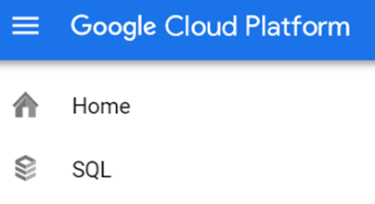
Summary
What we did:
  Create Instance
  Connect to instance
  Create database
  Import CSV
  Clean Data

Slide 3
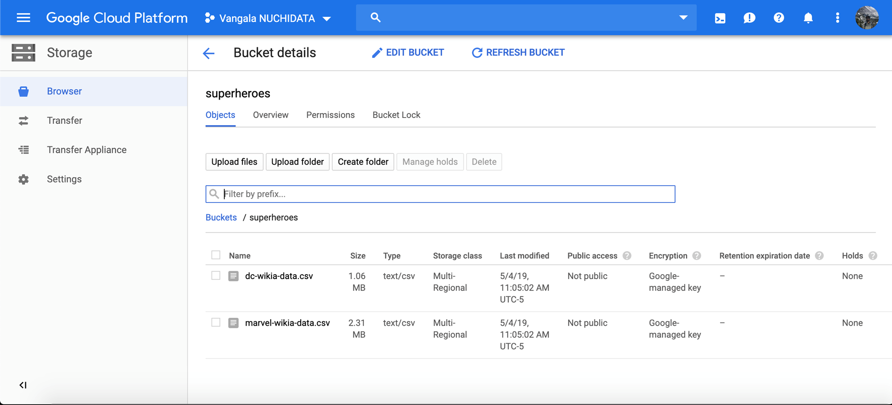
E-Extract
Kaggle – Super Hero Dataset
Scrapped from Marvel Wikia and DC Wikia
Compiled by FiveThirtyEight
Imported and uploaded to Google Cloud Platform
This dataset is maintained using GitHub's API and Kaggle's API.

Slide 4
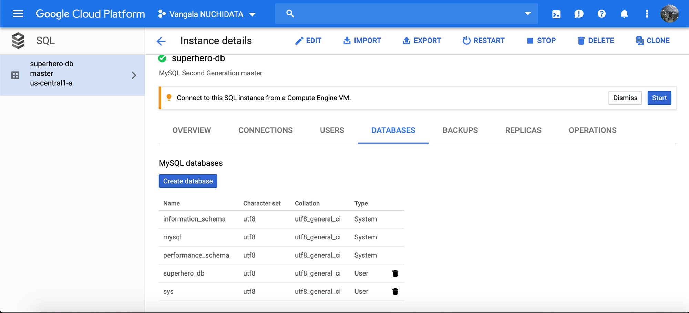
T-Transform
Imported CSV
Created Database
Cleaned dataset

Slide 5
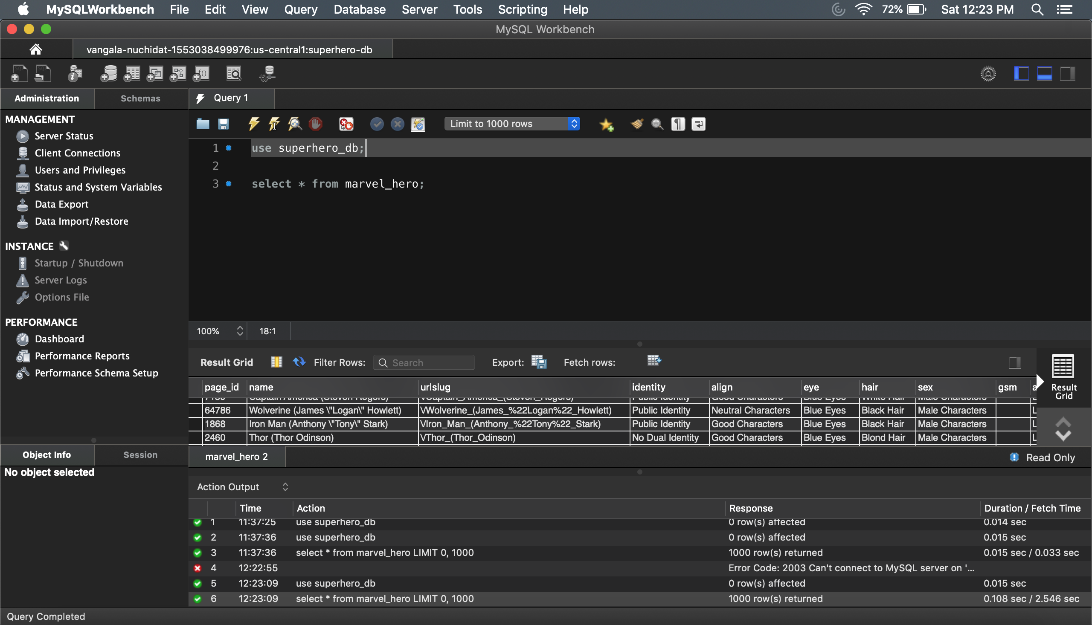
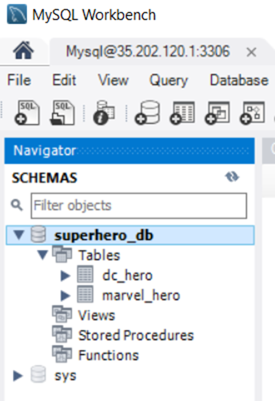
L-Load

Slide 6
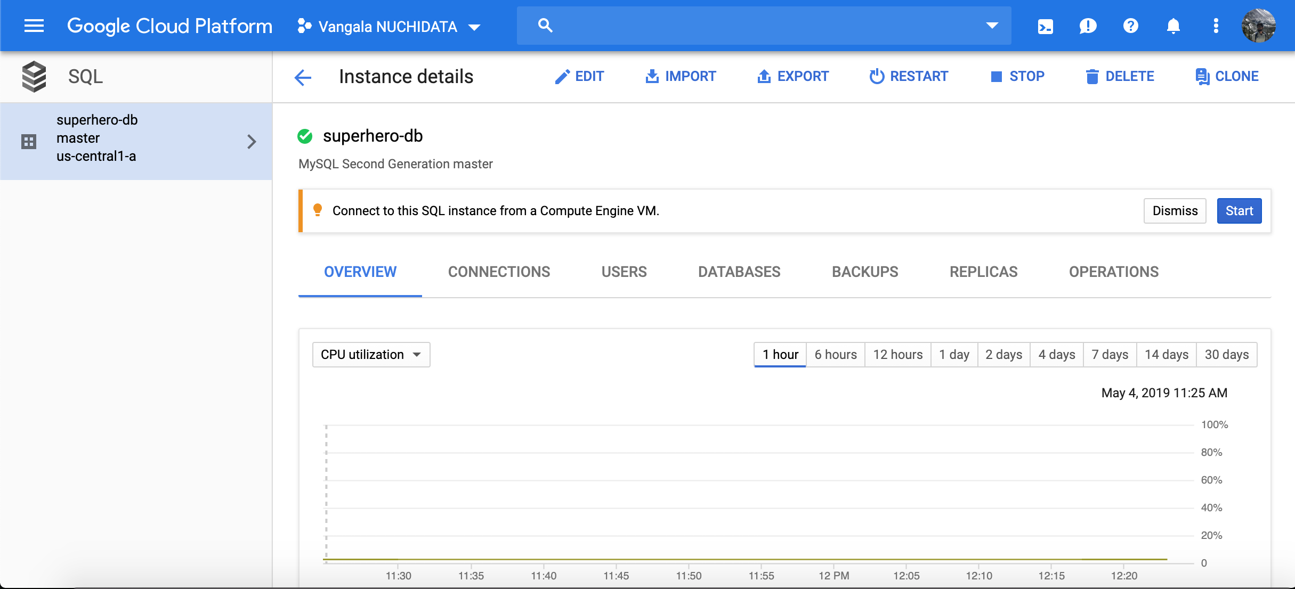

Slide 7
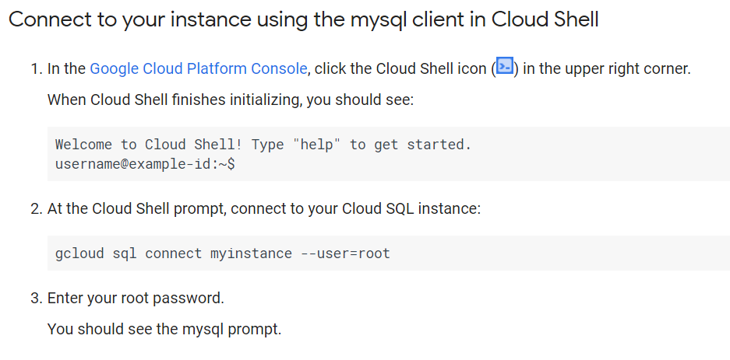

Slide 8
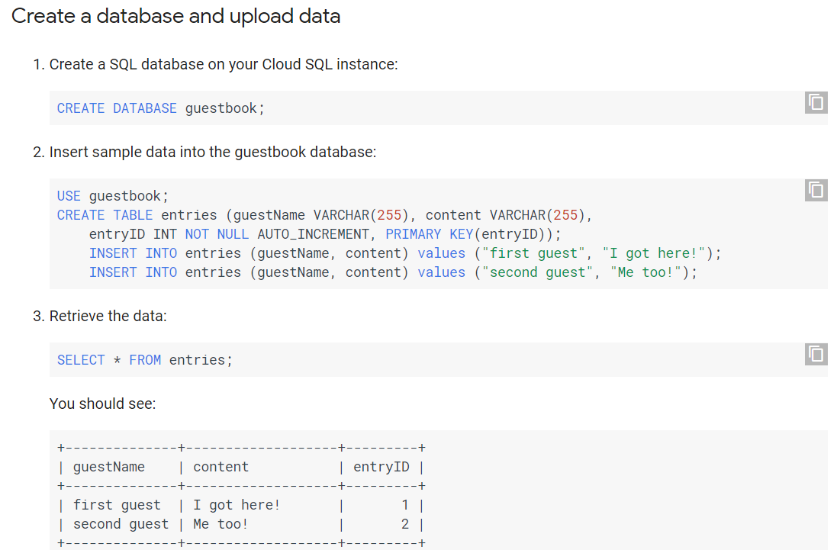

Slide 9
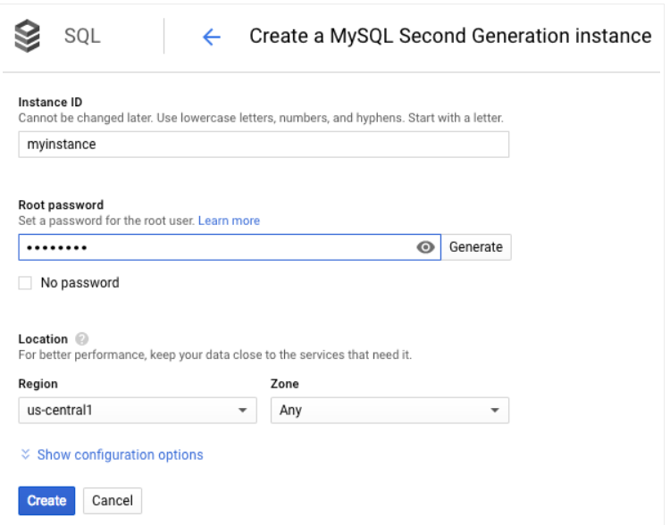

Slide 10
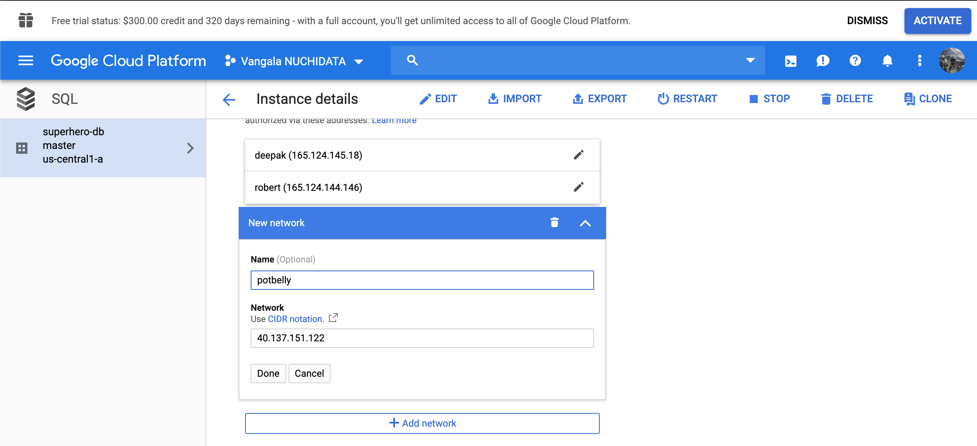

Slide 11
