Slide 1
Lecture 7-1 : Manycore GPU Programming with CUDA
Courtesy : Prof. Christopher Cooper’s and Prof. Chowdhury’s course note slides are used in this lecture note

Slide 2
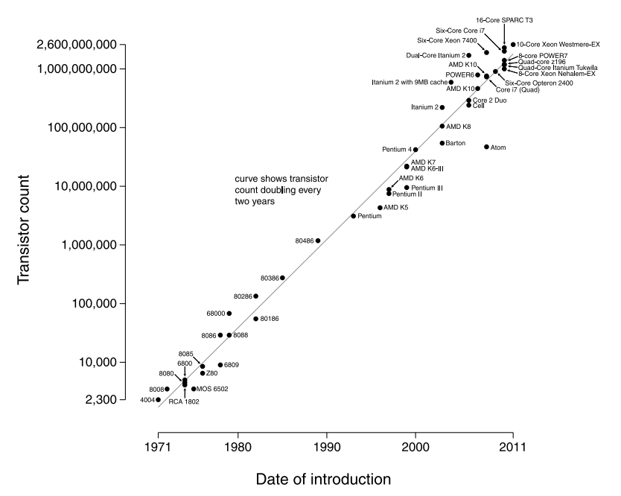
Moore’s Law
Transistor count of integrated circuits doubles every two years

Slide 3
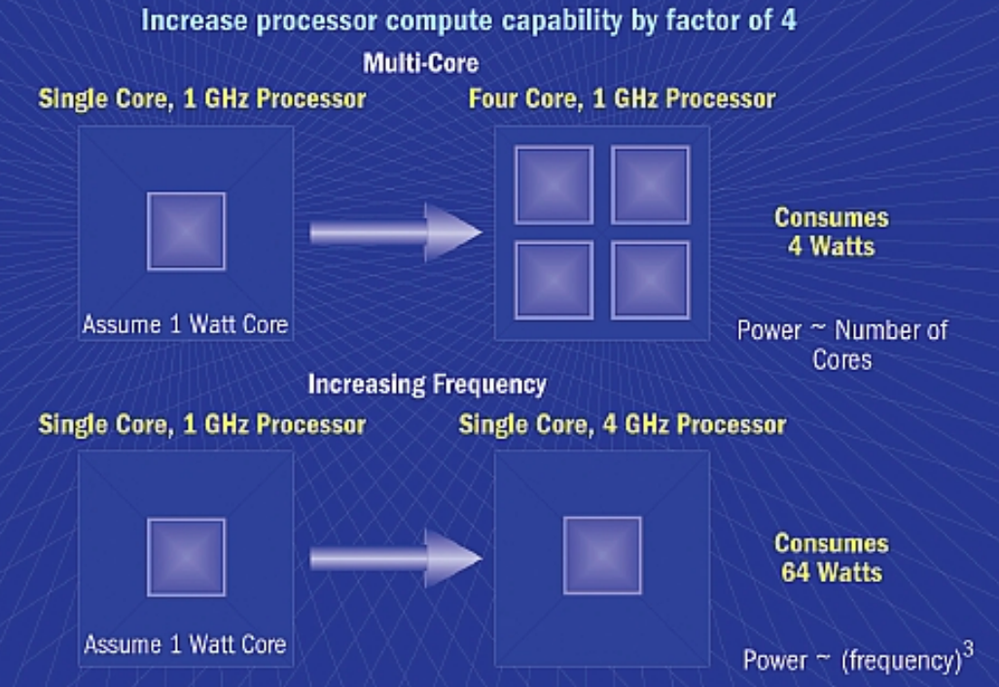
The Need of Multicore Architecture
Hard to design high clock speed (frequency)
power consumption and heat generation : too high
# of cores may still increase

Slide 4
Parallelism
Task parallelism
Distributing different tasks across multiple processors or threads
Amount of parallelization is proportional to the number of independent tasks
Suitable to CPU
Data parallelism
Same task are performed on different subsets of same data
Amount of parallelization is proportional to the input data size
Suitable to GPU

Slide 5
SIMT
The architecture of GPU is based on SIMT
Single Instruction, Multiple Threads
Executes the same instruction across multiple threads
A group of threads is controlled by a control unit
E.g. 32 threads (=warp)
Divergent workflow among threads in a group is allowed
With a little performance penalty (e.g. work serialization)

Slide 6
SIMT in GPUs
A GPU consists of many Streaming Multiprocessors (SMs)
Each SM executes a warp, which is a group of typically 32 threads
These threads run the same instruction at the same time, just like SIMD, but
Each thread has its own program counter and registers
Threads can diverge, allowing for some conditional execution
This gives SIMT flexibility over SIMD, which usually requires all operations to be strictly identical per cycle

Slide 7
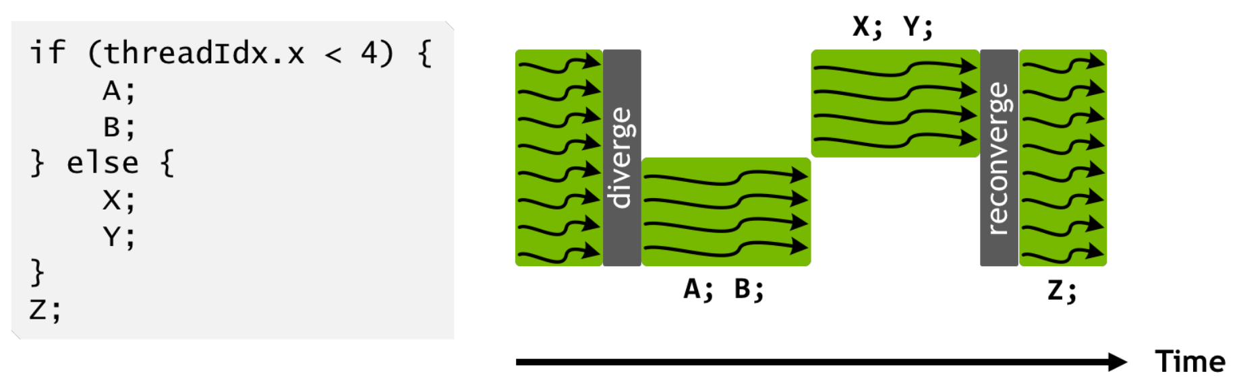
Warp Divergence
If threads in the same warp follows different branch paths, each branch will be serially executed.
Warp divergence can easily result in bad performance. Avoid branches!
[Source: from Prof. Duksu Kim’s lecture slides]

Slide 8
Many-core GPUs
Motivation
Originally driven by the insatiable market demand for realtime, high-definition 3D graphics
programmable GPU has evolved into a highly parallel, multithreaded, manycore processor with tremendous computational horsepower and very high memory bandwidth
GPGPU
General Purpose computing on GPU (Graphical Processing Unit)
Utilization of GPU (typically handles computations for graphics) to perform general purpose computation (traditionally handled by CPU)

Slide 9
Processor : Multicore vs Many-core
Multicore direction (CPU) : 2~8 cores
Typically handles general purpose computation
seeks to maintain/increase the execution speed of sequential programs
Complex : out-of-order, multiple instruction issue, branch prediction, pipelining, large cache, …
while moving into multiple cores
Ex) Intel i7 has 4 cores (hexa-core was released recently)
Many-core direction (GPU) : 100~3000 cores
Focus on the execution throughput of parallel applications
Simple : in order, single instruction issue
Large number of smaller cores

Slide 10
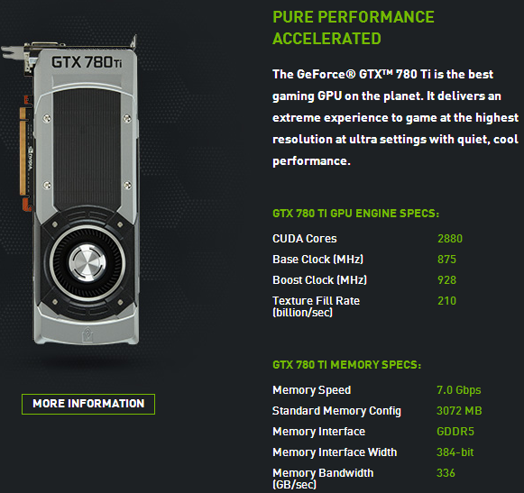
Many-core GPU
NVIDIA GTX 780 Ti
Around 3000 cores on single chip
Economic price : mass-market product (around $700)
Easy to program : CUDA

Slide 11
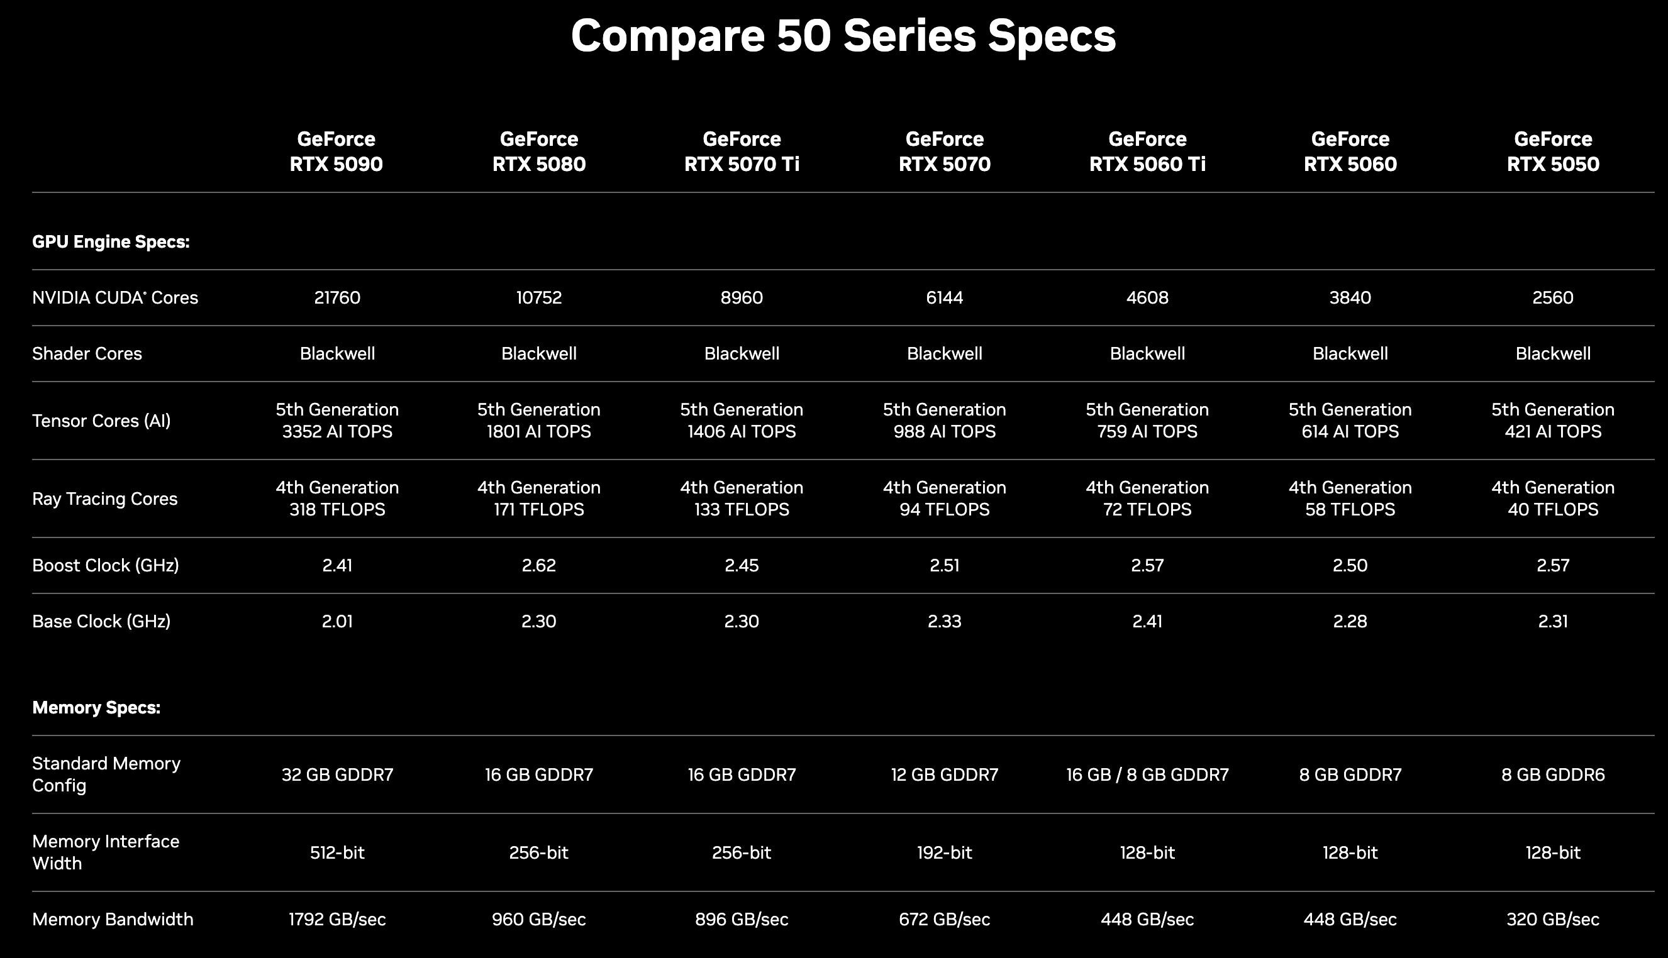

Slide 12
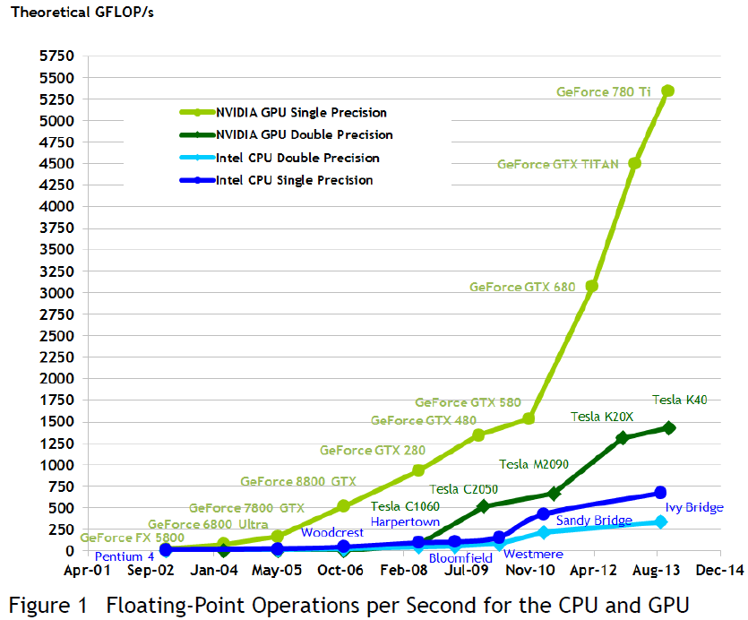
GPU
Specially designed for highly parallel applications
Programmable using high level languages (C/C++)
Supports standard 32-bit floating point precision
Lots of GFLOPS

Slide 13
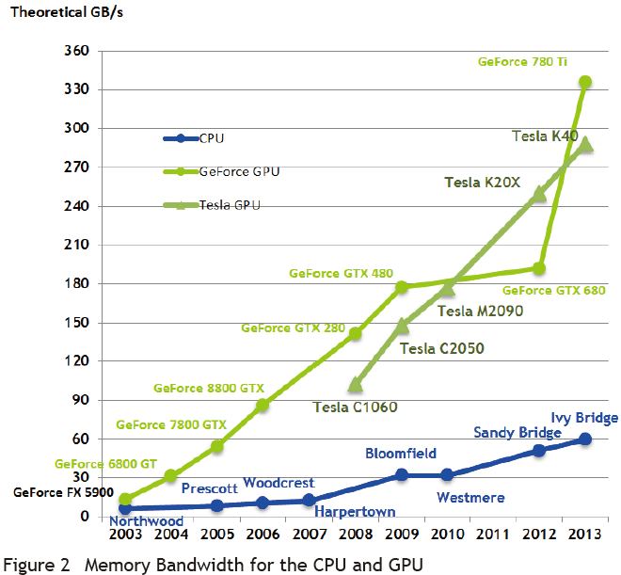
GPU
Fast processing must come with high bandwidth!
Simpler memory models and fewer constraints allow high bandwidth
Memory bandwidth
the rate at which data can be read from or stored into memory by a processor

Slide 14
GPU
GPU is specialized for
Compute-intensive
Highly data parallel computation
the same program is executed on many data elements in parallel
Ex) matrix computation
More transistors devoted to data processing rather than data caching and flow control
What graphics rendering needs?
Geometry(vertex) + Pixel processing
Motivates many application developers to move the computationally intensive parts of their software to GPUs for execution

Slide 15
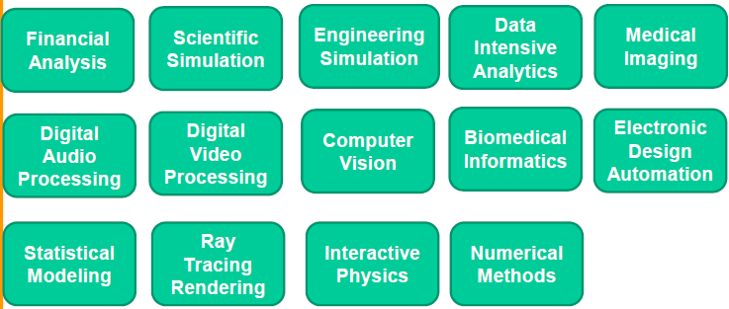
Applications
3D rendering
large sets of pixels and vertices are mapped to parallel threads.
image and media processing applications such as post-processing of rendered images, video encoding and decoding, image scaling, stereo vision, and pattern recognition
can map image blocks and pixels to parallel processing threads.
many other kinds of algorithms are accelerated by data-parallel processing
from general signal processing or physics simulation to computational finance or computational biology.

Slide 16
CPU vs GPU
CPU: Optimized for sequential code performance
sophisticated control logic
to allow instructions from single thread to execute in parallel or even out-of-order
branch prediction
large cache memory
to reduce the instruction and data access latencies
Powerful ALU : reduced operation latency
Control
ALU
ALU
ALU
ALU
Cache
CPU
GPU
DRAM
DRAM
CPU vs GPU : fundamentally different design philosophies

Slide 17
CPU vs GPU
GPU: Optimized for execution throughput of multiple threads
Originally for fast (3D) video game
Requires a massive number of floating-point calculations per frame
Minimize control logic and cache memory
Much more chip area is dedicated to the floating-point calculations
Boost memory throughput
Energy Efficient ALU
Designed as (data parallel) numeric computing engines
Control
ALU
ALU
ALU
ALU
Cache
CPU
GPU
DRAM
DRAM
CPU vs GPU : fundamentally different design philosophies

Slide 18
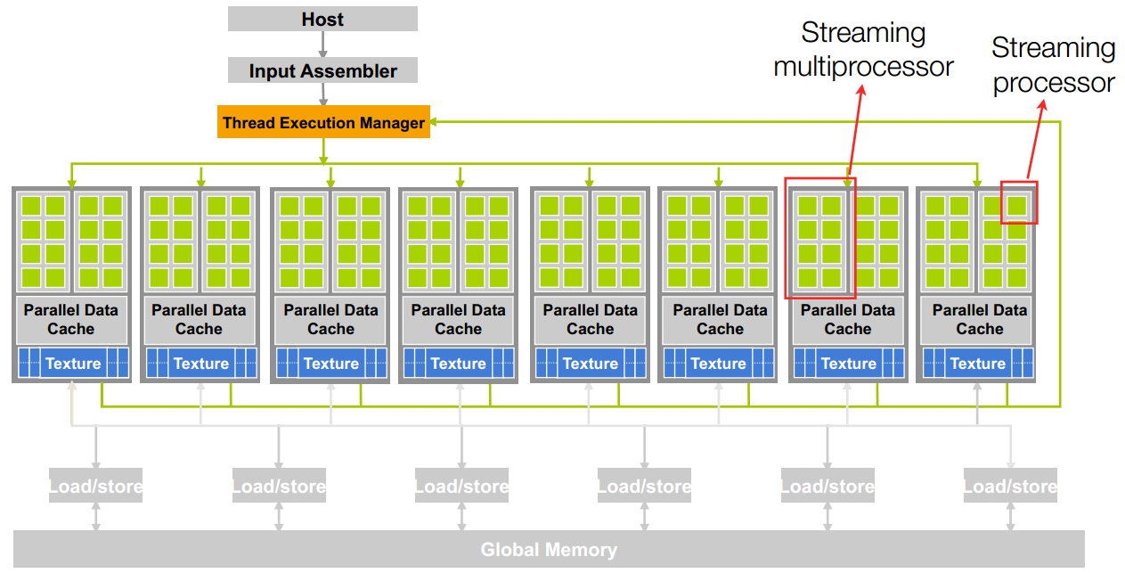
GPU Architecture
GPUs consist of many simple cores
Array of highly threaded streaming multiprocessors (SMs)
Two or more SMs form a buliding block.

Slide 19
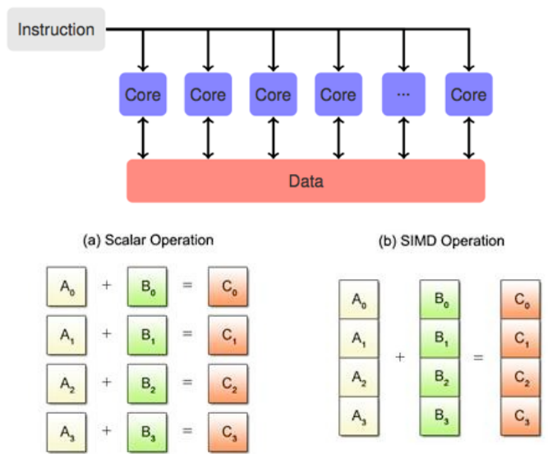
GPU chip design
GPU core is stream processor
Stream processors are grouped in stream multiprocessors
SM is basically a SIMD processor (single instruction multiple data)

Slide 20
CPU vs GPU
GPU
GPU designed for many simple tasks
Maximize throughput (# of tasks in fixed time)
CPU
Minimize latency (time to complete a task)

Slide 21
Winning Applications Use Both CPU and GPU
GPUs will not perform well on some tasks on which CPUs perform well
Use both CPUs and GPUs
Executing essentially sequential parts on CPU
Numerically intensive parts on GPU
CUDA
Introduced by NVIDIA in 2007
Designed to support joint CPU/GPU execution of applications

Slide 22
Popularity of GPUs
Performance
Cost
large marketplace & customer population
Practical factors and easy accessibility
GE MRI with {clusters and GPU}
Support of IEEE floating-point standard
CUDA
Programmer can use C/C++ programming tools
No longer go through complex graphics interface

Slide 23
Why more parallelism?
Applications will continue to demand increased speed
A good implementation on GPU can achieve more than 100 times speedup over sequential execution
Supercomputing applications
Any applications that require data-parallel calculations such as
matrix calculations

Slide 24
CUDA (Computer Unified Device Architecture)
Parallel Computing Framework Developed by NVIDIA (working only on NVIDIA cards)
Introduced in 2006
General Purpose Programming Model
GPGPU (General Purpose GPU)
Offers a computing API
Explicit GPU memory management
Goal
Develop application SW that transparently scales its parallelism to leverage the increasing number of processor cores

Slide 25
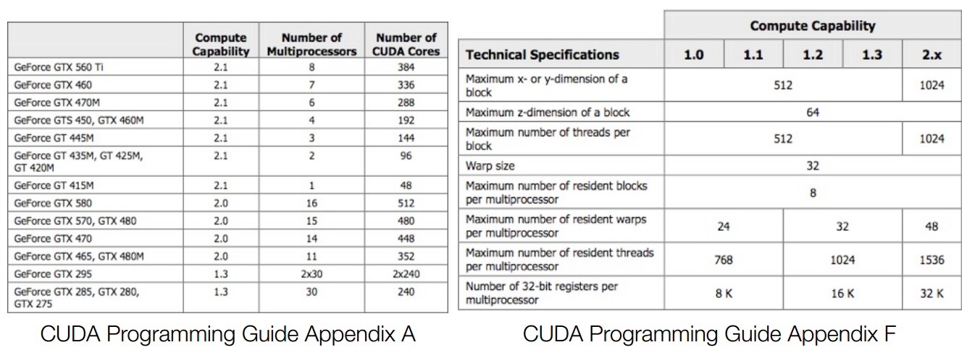
CUDA enabled GPUs
warp : group of threads where multiprocessor executes the same instruction at each clock cycle

Slide 26
Compute Capability
general specifications and features of compute device
Defined by major revision number and minor revision number
Ex) 1.3 , 2.1 , 3.5 , 5.0
5 : maxwell architecture
3 : Kepler architecture
2 : Fermi architecture
1 : Tesla architecture

Slide 27
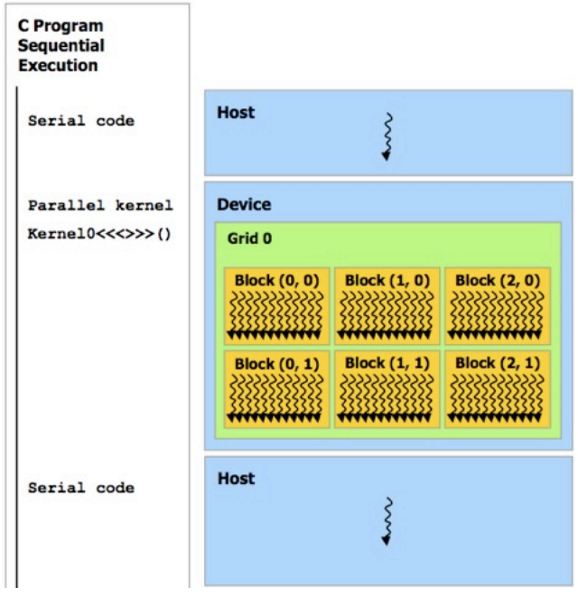
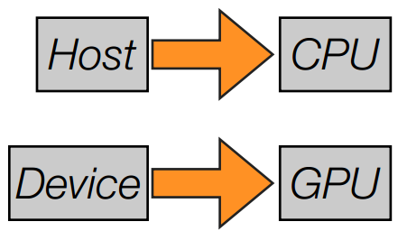
CUDA – Main Features
C/C++ with extensions
Heterogeneous
programming model
Operates in CPU(host)
and GPU (device)

Slide 28
CUDA Device and Threads
Device
Is a coprocessor to the CPU or host
Has access to DRAM (device memory)
Runs many threadsin parallel
Is typically a GPUbut can also be another type of parallel processing device
Data-parallel portions of an application are expressed as device kernels which run on many threads
Differences between GPU and CPU threads
GPU threads are extremely lightweight (little overhead for creation)
GPU needs 1000s of threads for full efficiency
(multicore CPU needs only a few)

Slide 29
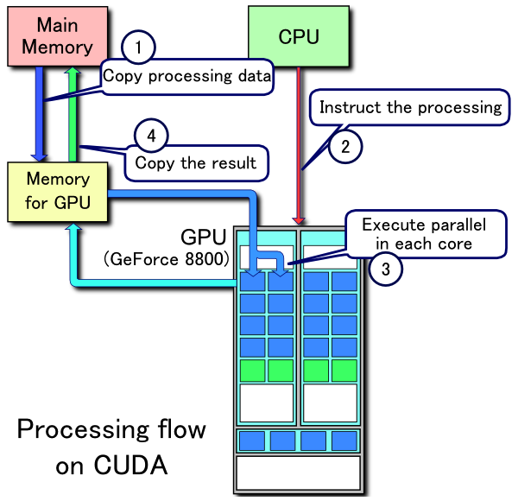
Processing Flow

Slide 30
Example 1: Hello world
#include <stdio.h>
void hello_world(void) {
printf(“Hello World\n”);
}
int main (void) {
hello_world();
return 0;
}

Slide 31
Example 1: CUDA Hello world
#include <stdio.h>
__global__ void hello_world(void) {
printf(“Hello World\n”);
}
int main (void) {
hello_world<<<1,5>>>();
cudaDeviceSynchronize();
return 0;
}

Slide 32
Compile and Run
output
Hello World
Hello World
Hello World
Hello World
Hello World

Slide 33
C Language Extensions
Function Type Qualifiers
__global__
executed on the device (GPU)
callable from the host (CPU) only
functions should have void return type
any call to a __global__ function must specify the
execution configuration for that call

Slide 34
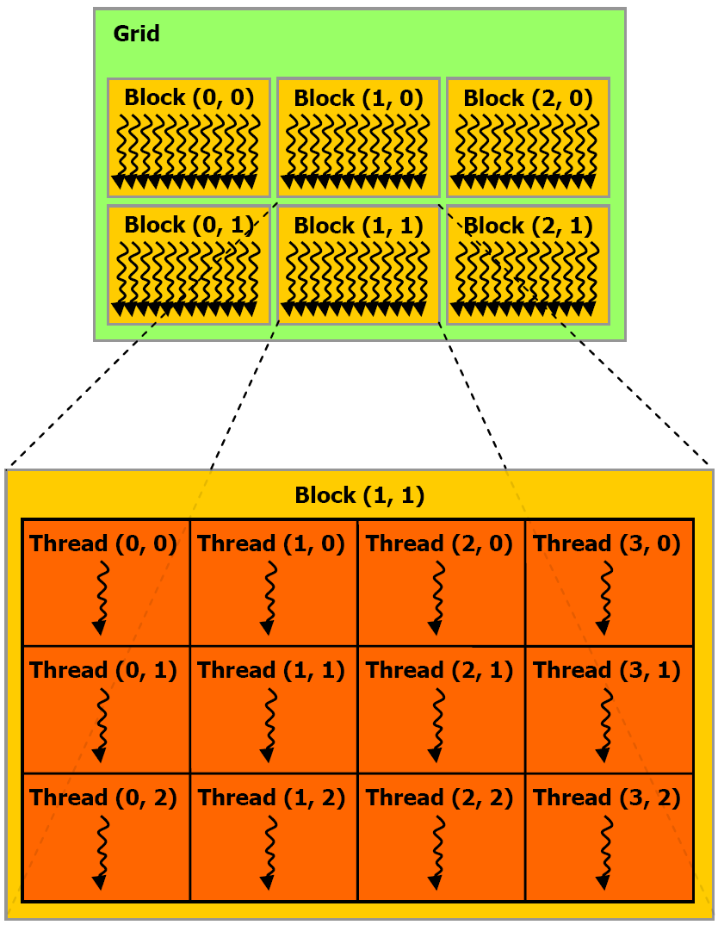
Grid, Block, Thread
Tesla S2050, Geforce 580
max. block size of each
Dim per grid
65535x65535x1
max. thread size of
each Dim per block
1024x1024x64
max. # of threads per block
1024

Slide 35
C Language Extensions
Execution configuration
<<<blocksPerGrid,threadsPerBlock>>>
<<<1,1>>>
<<<65535,1024>
dim3 blocksPerGrid(65535,65535,1)
dim3 threadsPerBlock(1024,1,1)
<<<blocksPerGrid,threadsPerBlock>>>

Slide 36
C Language Extensions
Built-in Variables
blockIdx = (blockIdx.x, blockIdx.y, blockIdx.z)
three unsigned integers, uint3
threadIdx = (threadIdx.x, threadIdx.y, threadIdx.z)
three unsigned integers, uint3
blockDim: the number of threads in a block
gridDim: the number of blocks in a grid
Built-in Vector types
dim3:
Integer vector type based on unit3
used to specify dimensions

Slide 37
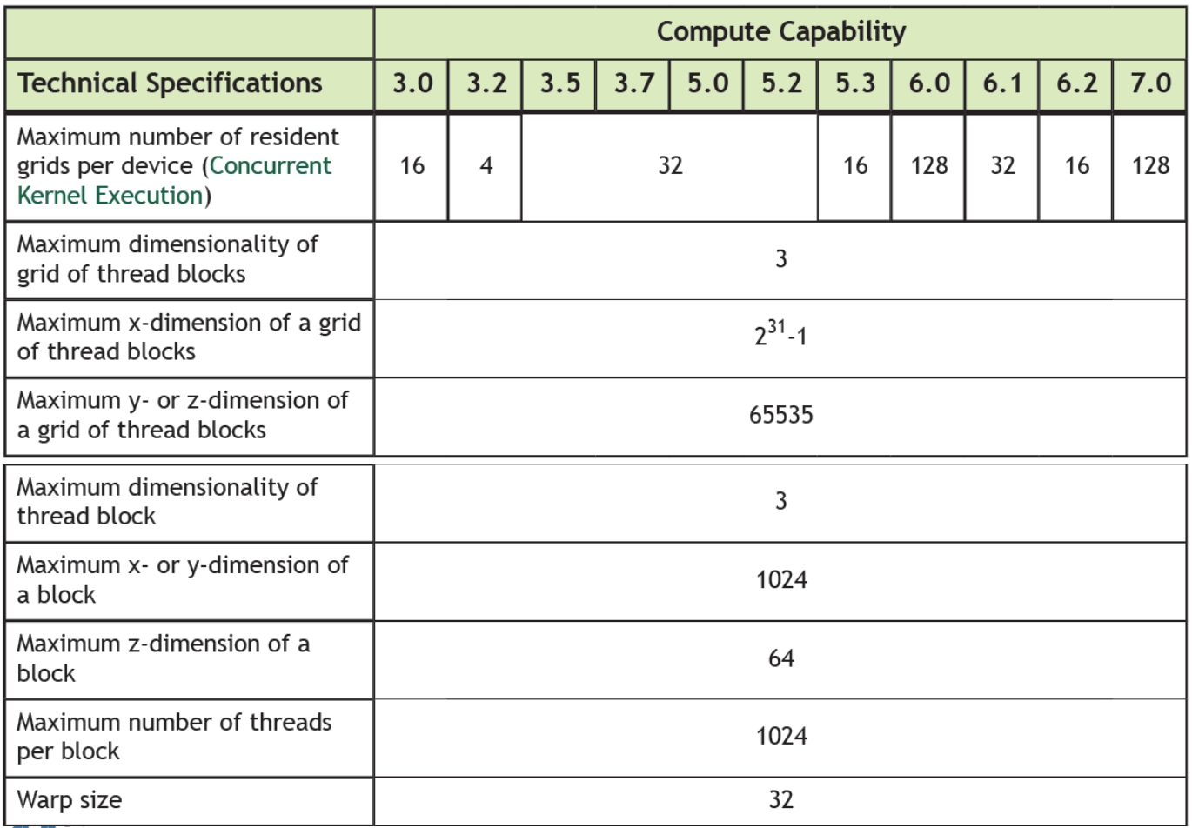
Technical Specs per Compute Capability
[The table image is from Prof. Duksu Kim’s lecture note]

Slide 38
#include <stdio.h>
__global__ void exec_conf(void) {
int ix = threadIdx.x + blockIdx.x * blockDim.x;
printf("gridDim = (%d,%d,%d), blockDim = (%d,%d,%d)\n",
gridDim.x,gridDim.y,gridDim.z,
blockDim.x,blockDim.y,blockDim.z);
printf("blockIdx = (%d,%d,%d), threadIdx = (%d,%d,%d), arrayIdx %d\n",
blockIdx.x,blockIdx.y,blockIdx.z,
threadIdx.x,threadIdx.y,threadIdx.z, ix);
}
int main (void) {
exec_conf<<<2,3>>>();
cudaDeviceSynchronize();
return 0;
}

Slide 39
Compile and Run
Output
gridDim = (2,1,1), blockDim = (3,1,1)
gridDim = (2,1,1), blockDim = (3,1,1)
gridDim = (2,1,1), blockDim = (3,1,1)
gridDim = (2,1,1), blockDim = (3,1,1)
gridDim = (2,1,1), blockDim = (3,1,1)
gridDim = (2,1,1), blockDim = (3,1,1)
blockIdx = (0,0,0), threadIdx = (0,0,0), arrayIdx = 0
blockIdx = (0,0,0), threadIdx = (1,0,0), arrayIdx = 1
blockIdx = (0,0,0), threadIdx = (2,0,0), arrayIdx = 2
blockIdx = (1,0,0), threadIdx = (0,0,0), arrayIdx = 3
blockIdx = (1,0,0), threadIdx = (1,0,0), arrayIdx = 4
blockIdx = (1,0,0), threadIdx = (2,0,0), arrayIdx = 5

Slide 40
#include <stdio.h>
__global__ void exec_conf(void) {
int ix = threadIdx.x + blockIdx.x * blockDim.x;
int iy = threadIdx.y + blockIdx.y * blockDim.y;
printf("gridDim = (%d,%d,%d), blockDim = (%d,%d,%d)\n",
gridDim.x,gridDim.y,gridDim.z,
blockDim.x,blockDim.y,blockDim.z);
printf("blockIdx = (%d,%d,%d), threadIdx = (%d,%d,%d), arrayIdx=(%d,%d)\n",
blockIdx.x,blockIdx.y,blockIdx.z,
threadIdx.x,threadIdx.y,threadIdx.z, ix,iy);
}
int main (void) {
dim3 blocks(2,2,1);
dim3 threads(2,2,2);
exec_conf<<<blocks,threads>>>();
cudaDeviceSynchronize();
return 0;
}

Slide 41
Example 3: Vector sum
#include <stdio.h>
const int N=128;
void add(int *a, int *b, int *c) {
for (int i=0; i<N; i++) {
c[i] = a[i] + b[i];
}
}
int main (void) {
int a[N], b[N], c[N];
for (int i=0; i<N; i++) {
a[i] = -i;
b[i] = i * i;
}
add (a, b, c);
for (int i=0; i<N; i++) {
printf("%d + %d = %d\n", a[i],b[i],c[i]);
}
return 0;
}

Slide 42
Example 3: Vector sum
#include <stdio.h>
const int N=10;
__global__ void add(int *a, int *b, int *c) {
int tid = threadIdx.x;
c[tid] = a[tid] + b[tid];
}

Slide 43
int main (void) {
int a[N], b[N], c[N];
int *dev_a, *dev_b, *dev_c;
cudaMalloc( (void**)&dev_a, N * sizeof(int) );
cudaMalloc( (void**)&dev_b, N * sizeof(int) );
cudaMalloc( (void**)&dev_c, N * sizeof(int) );
for (int i=0; i<N; i++) {
a[i] = -i; b[i] = i * i;
}
cudaMemcpy ( dev_a, a, N * sizeof(int), cudaMemcpyHostToDevice );
cudaMemcpy ( dev_b, b, N * sizeof(int), cudaMemcpyHostToDevice );
add<<<1,N>>>(dev_a, dev_b, dev_c);
// add<<<N,1>>>(dev_a, dev_b, dev_c);
// add<<<128,128>>>(dev_a, dev_b, dev_c);
cudaMemcpy(c, dev_c, N * sizeof(int),cudaMemcpyDeviceToHost );
for (int i=0; i<N; i++) {
printf("%d + %d = %d\n", a[i],b[i],c[i]);
}
cudaFree (dev_a); cudaFree (dev_b); cudaFree (dev_c);
return 0;
}

Slide 44
Compile and Run
Output
0 + 0 = 0
-1 + 1 = 0
-2 + 4 = 2
-3 + 9 = 6
-4 + 16 = 12
-5 + 25 = 20
-6 + 36 = 30
-7 + 49 = 42
-8 + 64 = 56
-9 + 81 = 72

