Slide 1
Lecture 4-2 : JAVA Memory Model and volatile variable
Courtesy : MIT Prof. Amarasinghe and Dr. Rabbah’s course note
Prof. Dr. Alois Schütte’s lecture notes
Java in Jenkov.com (Jacob Jenkov)

Slide 2
Java Memory Model
a set of rules on how JVM and HW interact with main memory
guarantees you get about visibility, ordering, and atomicity
primary purpose
ensure that shared variables are handled consistently across different threads

Slide 3
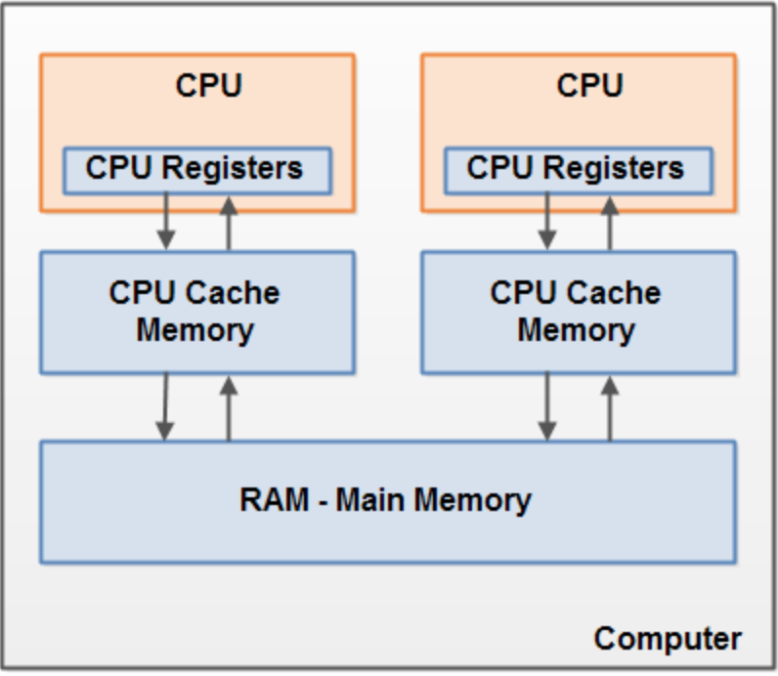
Core Problems: Why do we need JMM?
Code is not just executed straight from main memory.
to increase speed,
they use
CPU caches
instruction reordering
a = b + c
d = a + e
l = m + n
y = x + z
a = b + c
l = m + n
y = x + z
d = a + e

Slide 4
Core Problems: Why do we need JMM?
In multi-threading, two major issues
Visibility
Thread A updates a value in its
cache, but Thread B still sees
the old value in RAM.
Ordering
Thread B sees Thread A's operations in a different order than they were written.
boolean flag = false;
Thread A: flag = true;
Thread B: while (!flag) {}
// may loop forever!
int x = 0, y = 0;
Thread A: x = 1; r1 = y;
Thread B: y = 1; r2 = x;
possible result:
r1 = 0, r2 = 0 ❗ (due to reordering)
(this looks impossible, but JMM allows it unless synchronization is used)

Slide 5
Happens-Before Relationship (core concept of JMM)
Happens-before relationship guarantees
if Action A "happens-before" Action B, then the results of A are visible to B
In JMM, "Happens-before" does not mean "happens before in time."
It is a guarantee of visibility and logical consistency, not a physical restriction on the CPU's execution order
If:
Then:
A happens-before B
A’s changes are visible to B
A’s execution is ordered before B

Slide 6
Happens-Before Rules guaranteed in JMM
A. Program Order Rule
B. Monitor Lock Rule
C. Volatile Variable Rule (+ atomic variables)
D. Thread Start/Termination Rule
E. Transitivity Rule

Slide 7
A. Program Order Rule
Within a single thread,
each action happens-before every action
that comes later in the program order.
Meaning (As-If-Serial Semantics)
From the perspective of that single thread, the code behaves as if it's executed sequentially.
Reordering is Still Allowed
The JVM is allowed to physically reorder instructions even if a happens-before relationship exists, provided the reordering is invisible to the thread.

Slide 8
B. Monitor Lock Rule
An unlock on a monitor (leaving a synchronized block) happens-before every subsequent lock on that same monitor.
Guarantee
Everything a thread did while holding a lock is visible to the next thread that acquires the same lock.
synchronized(lock) {
// A
}
// unlock
synchronized(lock) {
// B
}

Slide 9
C. Volatile Variable Rule (+ atomic variables)
A write to a volatile field happens-before every subsequent read of that same field.
Guarantee
Rule 1: Anything that happens before a volatile write in your code cannot be reordered to happen after it.
Rule 2: Anything that happens after a volatile read in your code cannot be reordered to happen before it.

Slide 10
public class ReorderingDemo {
private int data = 0;
private volatile boolean ready = false;
// Note the volatile keyword
public void writerThread() {
data = 42; // (1) Normal Write
ready = true; // (2) Volatile Write (Release Barrier)
}
public void readerThread() {
if (ready) { // (3) Volatile Read (Acquire Barrier)
System.out.println(data); // (4) Guaranteed to see 42
}
}
}
Without volatile: The compiler might flip (1) and (2) because they look independent. If ready becomes true before data is set to 42, the reader thread might print 0.
With volatile: Because (2) is a Volatile Write, the JMM guarantees that (1) stays above (2). Because (3) is a Volatile Read, it guarantees that (4) stays below (3)

Slide 11
Atomic operations
good for creating happens-before relationships in high-performance code.
provide
visibility of volatile
thread-safety of synchronized
without putting thread into "blocked" or "waiting" state.

Slide 12
D. Thread Start/Termination Rules
Thread.start()
A call to Thread.start() happens-before any action in the started thread.
All actions before start() are visible inside the new thread
t.join()
All actions in thread t are visible after join

Slide 13
E. Transitivity
If Action A happens-before Action B, and
Action B happens-before Action C,
then Action A happens-before Action C

Slide 14
Synchronization mechanisms
synchronized (lock) guarantees
Mutual exclusion
Visibility
Ordering
volatile
Visibility
Changes to a volatile variable are consistently visible to all threads
Ordering (no reordering across volatile)
No atomicity
synchronized(lock) {
sharedVar++;
}
Flush working memory -> main memory on exit
Reload from main memory on entry

Slide 15
Summary Table
Feature | Visibility | Ordering | Atomicity
Normal field | X | X | partial
volatile | O | O | X
Synchronized (lock) | O | O | O
Atomic variables | O | O | O
If you properly use synchronization methods
(synchronized(lock), atomic variables, or volatile),
when accessing shared data,
race condition problems, visibility problems, reordering problems
Can be solved.

