Slide 1
Lecture 8-1 :
Parallel Algorithms
(focus on sorting algorithms)
Courtesy : Prof. Chowdhury(SUNY-SB) and Prof.Grossman(UW)’s course note slides are used in this lecture note

Slide 2
Parallel/Distributed Algorithms
Parallel program(algorithm)
  A program (algorithm) is divided into multiple processes(threads) which are run on multiple processors
  The processors normally are in one machine execute one program at a time have high speed communications between them
Distributed program(algorithm)
  A program (algorithm) is divided into multiple processes which are run on multiple distinct machines
  The multiple machines are usual connected by network. Machines used typically are workstations running multiple programs.

Slide 3
Parallelism idea
Example: Sum elements of a large array
Idea: Have 4 threads simultaneously sum 1/4 of the array
  Warning: This is an inferior first approach
ans0 ans1 ans2 ans3
+
ans
  Create 4 thread objects, each given a portion of the work
  Call start() on each thread object to actually run it in parallel
  Wait for threads to finish using join()
  Add together their 4 answers for the final result
  Problems? : processor utilization, subtask size

Slide 4
A Better Approach
ans0 ans1 … ansN
ans
Problem Solution is to use lots of threads, far more than the number of processors
reusable and efficient across platforms
Use processors “available to you now” :
  Hand out “work chunks” as you go
Load balance
  in general subproblems may take significantly different amounts of time

Slide 5
Naïve algorithm is poor
Suppose we create 1 thread to process every 1000 elements
int sum(int[] arr){
…
int numThreads = arr.length / 1000;
SumThread[] ts = new SumThread[numThreads];
…
}
Then combining results will have arr.length / 1000 additions
  Linear in size of array (with constant factor 1/1000)
  Previously we had only 4 pieces (constant in size of array)
In the extreme, if we create 1 thread for every 1 element, the loop to combine results has length-of-array iterations
  Just like the original sequential algorithm

Slide 6
A better idea : devide-and-conqure
+
+
+
+
+
+
+
+
+
+
+
+
+
+
+
This is straightforward to implement using divide-and-conquer
  Parallelism for the recursive calls
The key is divide-and-conquer parallelizes the result-combining
  If you have enough processors, total time is height of the tree: O(log n) (optimal, exponentially faster than sequential O(n))
We will write all our parallel algorithms in this style

Slide 7
Divide-and-conquer to the rescue!
class SumThread extends java.lang.Thread {
int lo; int hi; int[] arr; // arguments
int ans = 0; // result
SumThread(int[] a, int l, int h) { … }
public void run(){ // override
if(hi – lo < SEQUENTIAL_CUTOFF)
for(int i=lo; i < hi; i++)
ans += arr[i];
else {
SumThread left = new SumThread(arr,lo,(hi+lo)/2);
SumThread right= new SumThread(arr,(hi+lo)/2,hi);
left.start();
right.start();
left.join(); // don’t move this up a line – why?
right.join();
ans = left.ans + right.ans;
}
}
}
int sum(int[] arr){
SumThread t = new SumThread(arr,0,arr.length);
t.run();
return t.ans;
}
The key is to do the result-combining in parallel as well
  And using recursive divide-and-conquer makes this natural
  Easier to write and more efficient asymptotically!
Sophomoric Parallelism and Concurrency, Lecture 1

Slide 8
Being realistic
In theory, you can divide down to single elements, do all your result-combining in parallel and get optimal speedup
  Total time O(n/numProcessors + log n)
In practice, creating all those threads and communicating swamps the savings, so:
  Use a sequential cutoff, typically around 500-1000
    Eliminates almost all the recursive thread creation (bottom levels of tree)
    Exactly like quicksort switching to insertion sort for small subproblems, but more important here
  Do not create two recursive threads; create one and do the other “yourself”
    Cuts the number of threads created by another 2x

Slide 9
Similar Problems
Maximum or minimum element
Is there an element satisfying some property
  (e.g., is there a 17)?
Left-most element satisfying some property
  (e.g., first 17)
Corners of a rectangle containing all points (a bounding box)
Counts, for example, number of strings that start with a vowel
Computations of this form are called reductions

Slide 10
Even easier: Maps (Data Parallelism)
A map operates on each element of a collection independently to create a new collection of the same size
  No combining results
  For arrays, this is so trivial some hardware has direct support
Canonical example: Vector addition
int[] vector_add(int[] arr1, int[] arr2){
assert (arr1.length == arr2.length);
result = new int[arr1.length];
FORALL(i=0; i < arr1.length; i++) {
result[i] = arr1[i] + arr2[i];
}
return result;
}

Slide 11
Maps and reductions
Maps and reductions: the “workhorses” of parallel programming
  By far the two most important and common patterns
    Two more-advanced patterns in next lecture
  Learn to recognize when an algorithm can be written in terms of maps and reductions
  Use maps and reductions to describe (parallel) algorithms

Slide 12
Divide-and-Conquer in more detail

Slide 13
Divide-and-Conquer
Divide
  divide the original problem into smaller subproblems that are easier are to solve
Conquer
  solve the smaller subproblems (perhaps recursively)
Merge
  combine the solutions to the smaller subproblems to obtain a solution for the original problem
Can be extended to parallel algorithm

Slide 14
Divide-and-Conquer
The divide-and-conquer paradigm improves program modularity, and often leads to simple and efficient algorithms
Since the subproblems created in the divide step are often independent, they can be solved in parallel
If the subproblems are solved recursively, each recursive divide step generates even more independent subproblems to be solved in parallel
In order to obtain a highly parallel algorithm it is often necessary to parallelize the divide and merge steps, too

Slide 15
Example of Parallel Program
(divide-and-conquer approach)
spawn
  Subroutine can execute at the same time as its parent
sync
  Wait until all children are done
  A procedure cannot safely use the return values of the children it has spawned until it executes a sync statement.
Fibonacci(n)
1: if n < 2
2: return n
3: x = spawn Fibonacci(n-1)
4: y = spawn Fibonacci(n-2)
5: sync
6: return x + y

Slide 16
Analyzing algorithms
Like all algorithms, parallel algorithms should be:
  Correct
  Efficient
For our algorithms so far, correctness is “obvious” so we’ll focus on efficiency
  Want asymptotic bounds
  Want to analyze the algorithm without regard to a specific number of processors

Slide 17
Performance Measure
T_{p}
  running time of an algorithm on p processors
T₁ : work
  running time of algorithm on 1 processor
T∞ : span
  the longest time to execute the algorithm on infinite number of processors.

Slide 18
Performance Measure
Lower bounds on T_{p}
  T_{p} >= T₁ / p
  T_{p} >= T∞
    P processors cannot do more than infinite number of processors
Speedup
  T₁ / T_{p} : speedup on p processors
Parallelism
  T₁ / T∞
  Max possible parallel speedup

Slide 19
Related Sorting Algorithms
Sorting Algorithms
  Sort an array A[1,…,n] of n keys (using p<=n processors)
Examples of divide-and-conquer methods
  Merge-sort
  Quick-sort

Slide 20
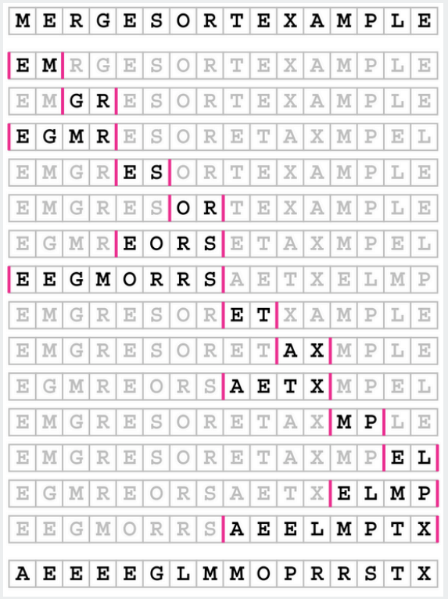
Merge-Sort
Basic Plan
  Divide array into two halves
  Recursively sort each half
  Merge two halves
  to make sorted whole

Slide 21
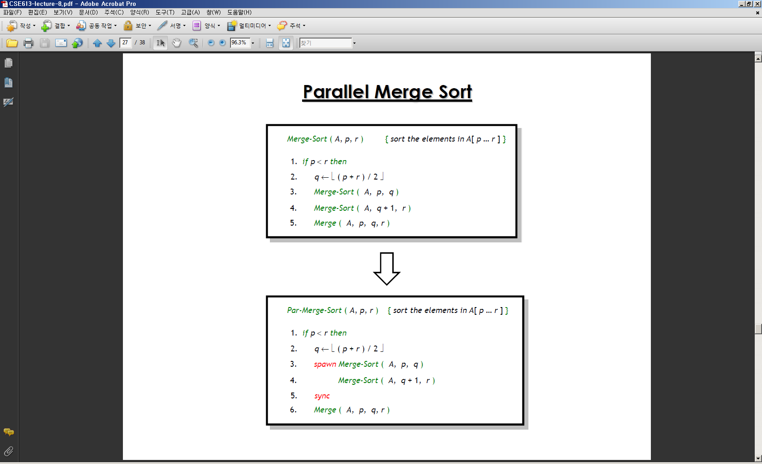
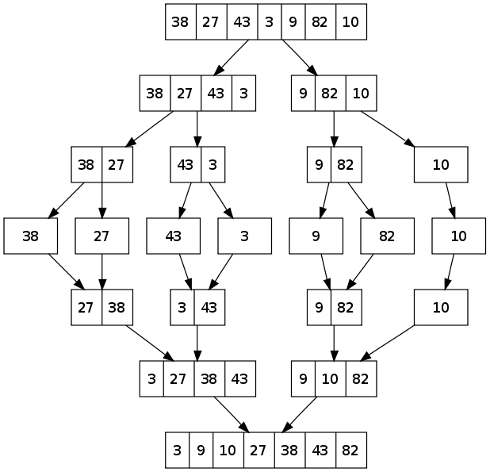
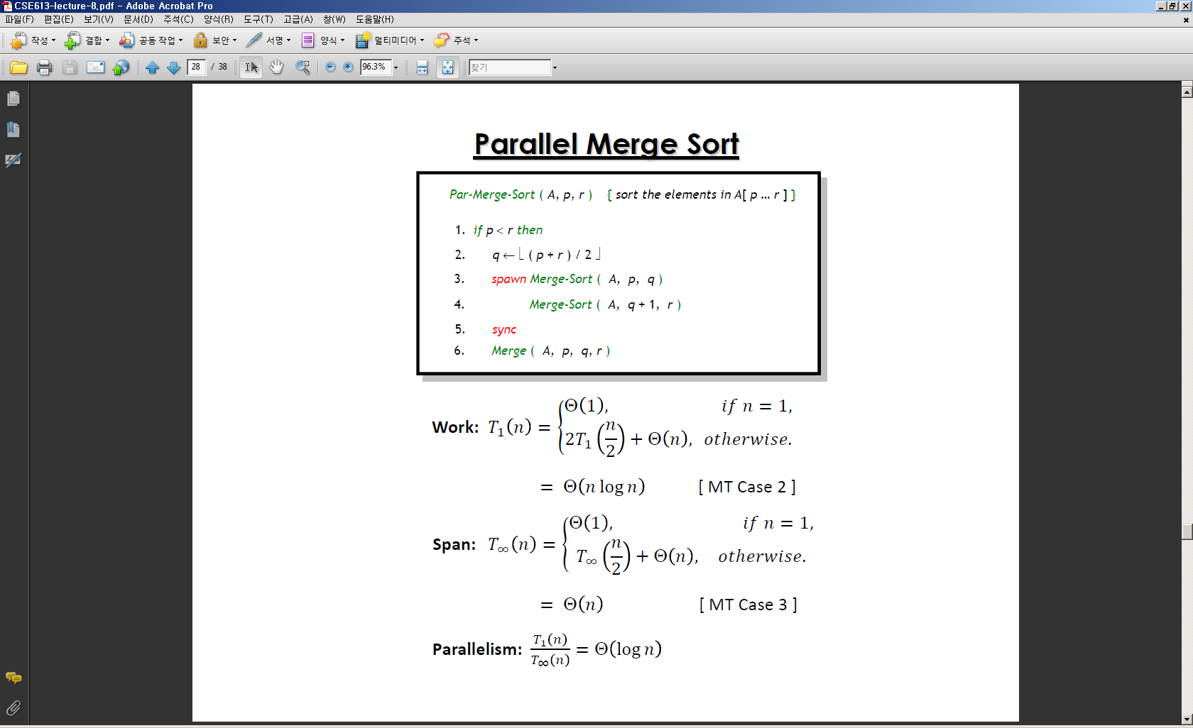
Merge-Sort Algorithm

Slide 22
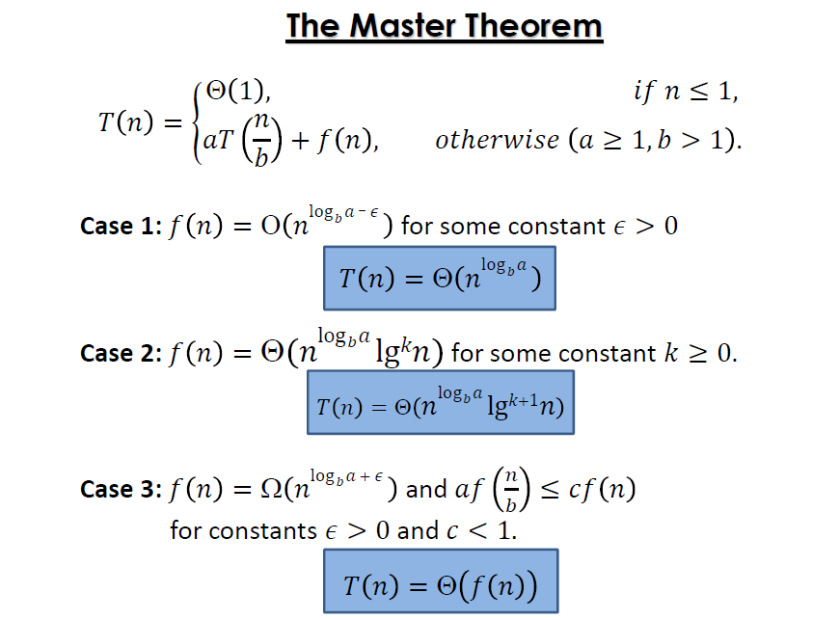
Performance analysis

Slide 23
Time Complexity Notation
Asymptotic Notation (점근적 표기법)
  A way to describe the behavior of functions in the limit
  (어떤 함수의 인수값이 무한히 커질때, 그 함수의 증가율을 더 간단한 함수를 이용해 나타내는 것)

Slide 24
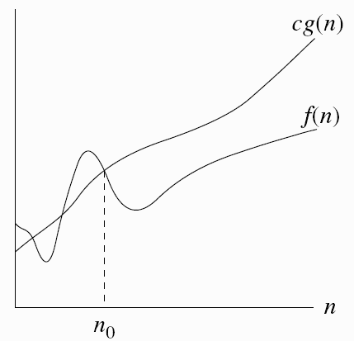
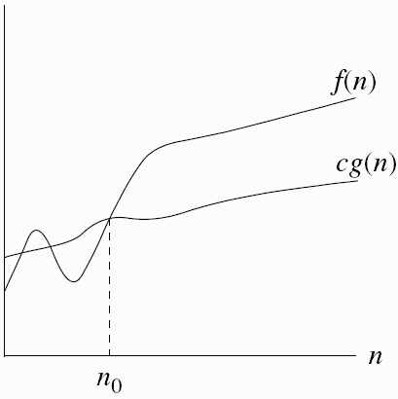
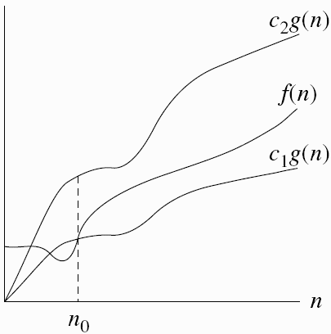
Time Complexity Notation
O notation – upper bound
  O(g(n)) = { h(n): ∃ positive constants c, n₀ such that 0 ≤ h(n) ≤ cg(n), ∀ n ≥ n₀}
Ω notation – lower bound
  Ω(g(n)) = {h(n): ∃ positive constants c > 0, n₀ such that 0 ≤ cg(n) ≤ h(n), ∀ n ≥ n₀}
Θ notation – tight bound
  Θ(g(n)) = {h(n): ∃ positive constants c₁, c₂, n₀ such that 0 ≤ c₁g(n) ≤ h(n) ≤ c₂g(n), ∀ n ≥ n₀}

Slide 25
Parallel merge-sort

Slide 26
Performance Analysis
Too small!
Need to parallelize
Merge step

Slide 27
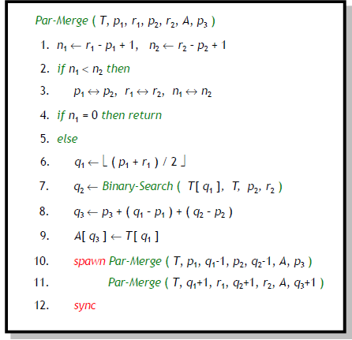
Parallel Merge

Slide 28
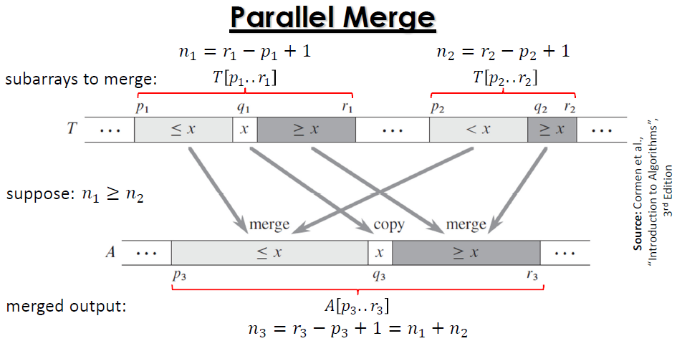
Parallel merge

Slide 29
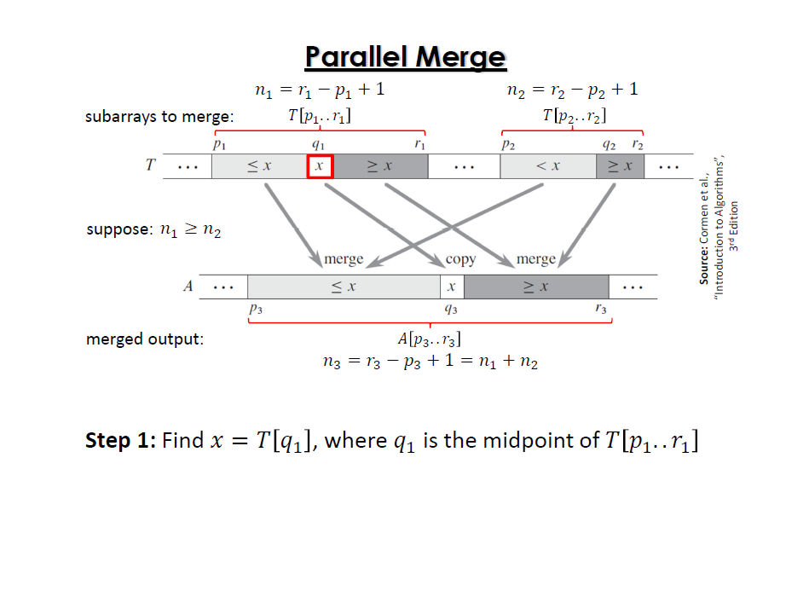

Slide 30
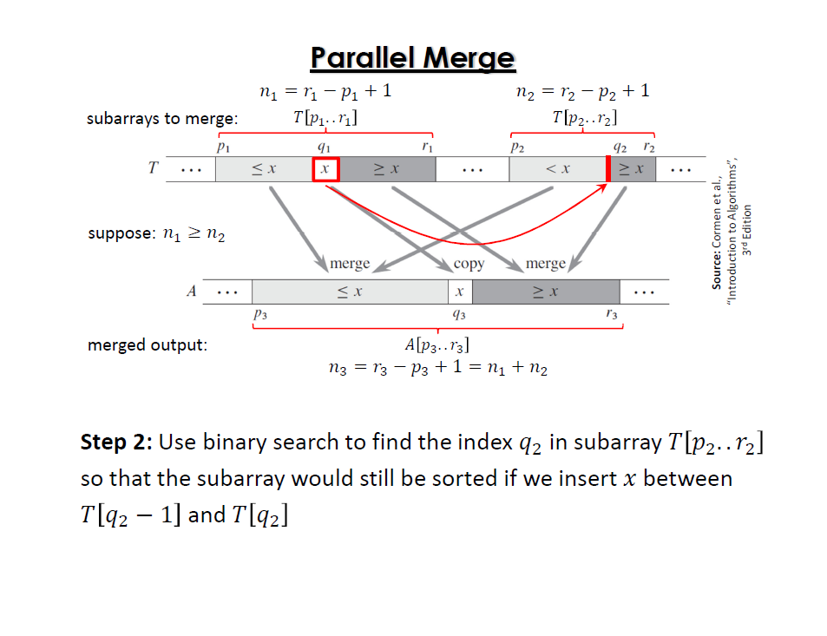

Slide 31
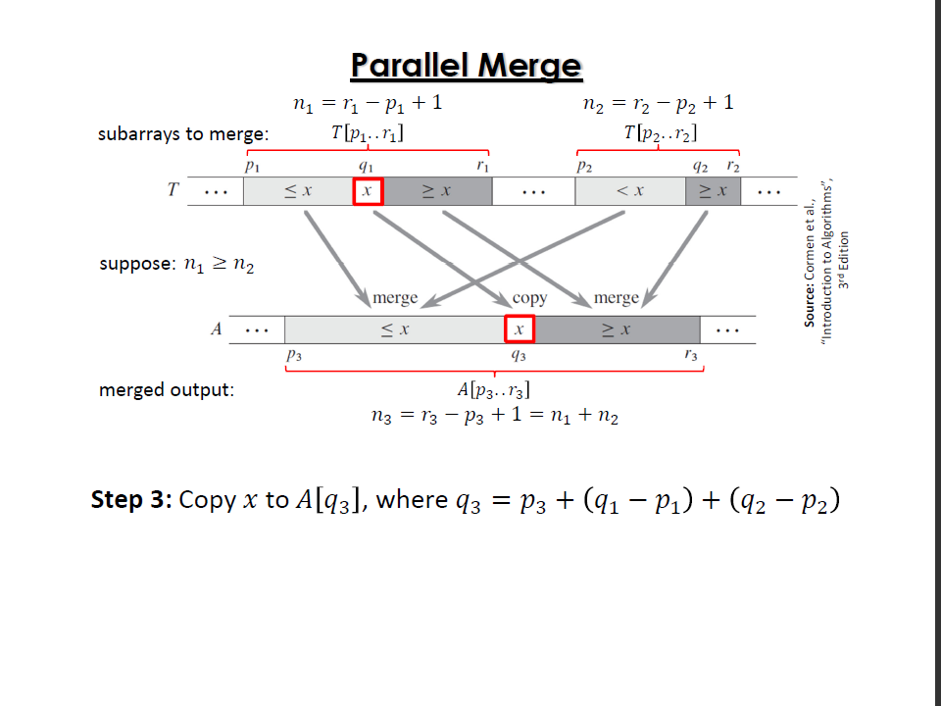

Slide 32
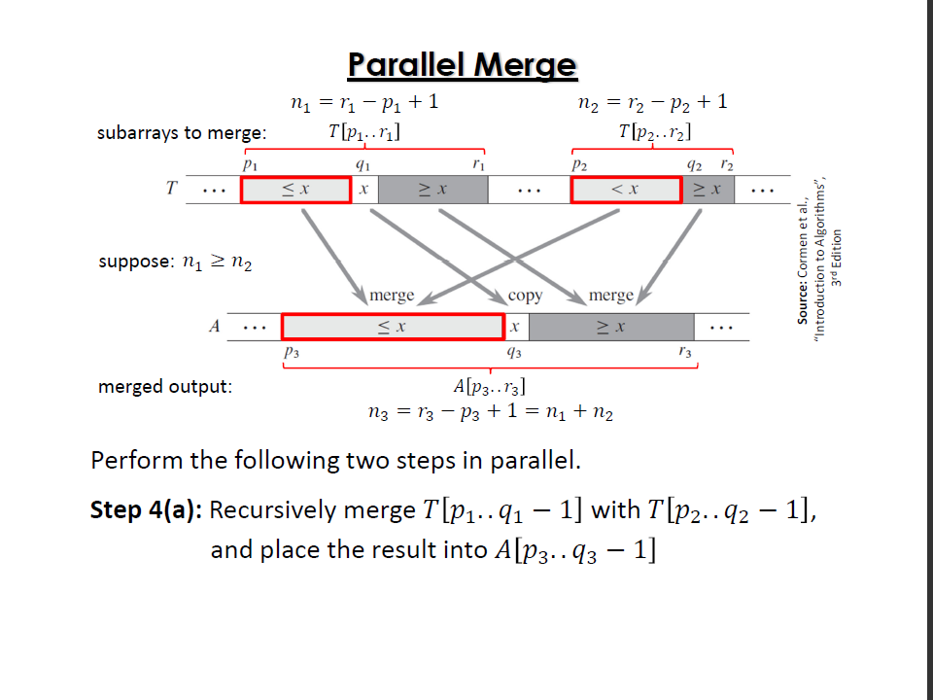

Slide 33
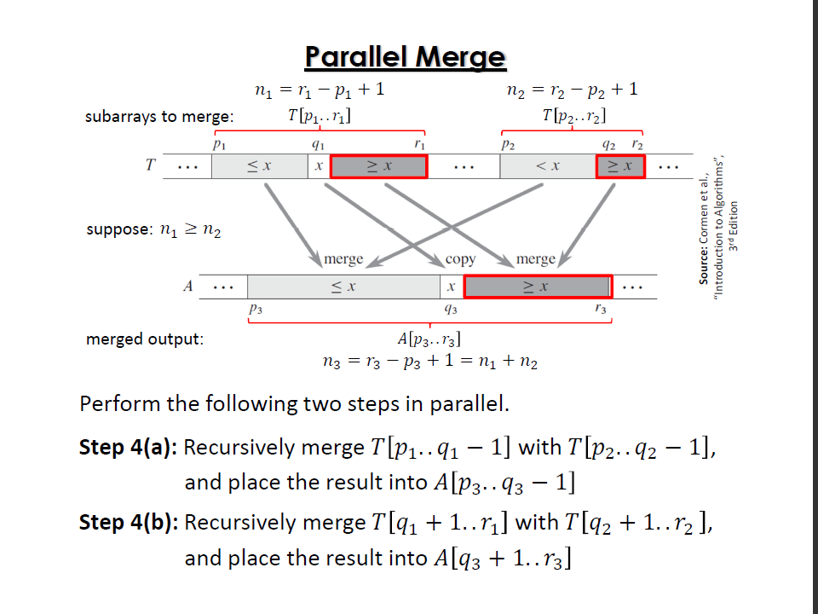

Slide 34
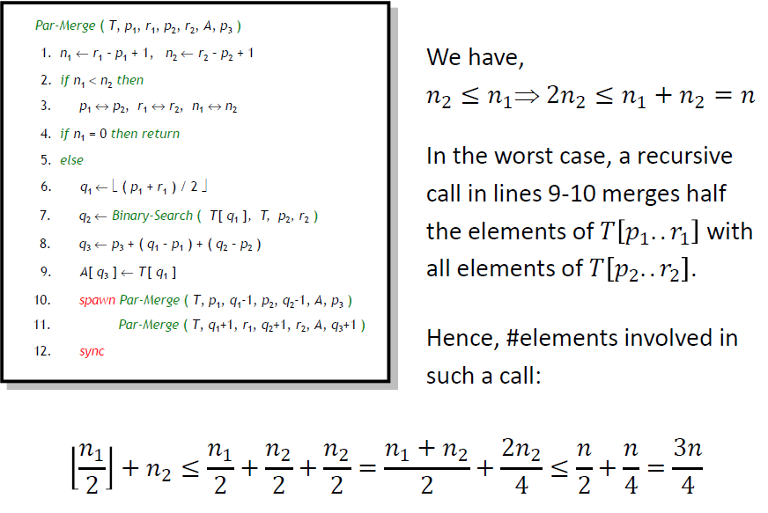
Parallel Merge

Slide 35
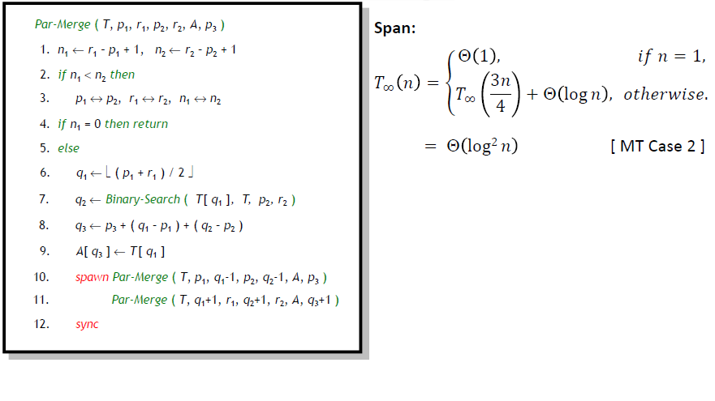
Parallel Merge

Slide 36
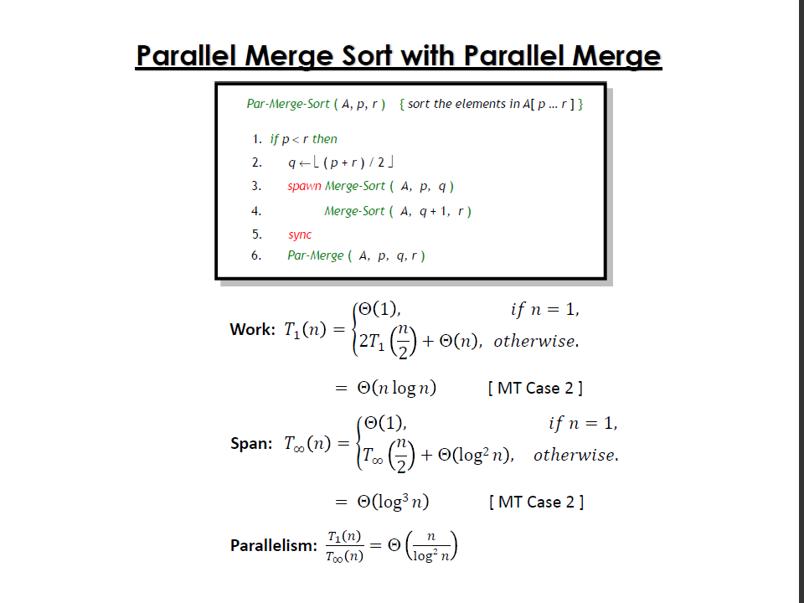

Slide 37
(Sequential) Quick-Sort algorithm
a recursive procedure
  Select one of the numbers as pivot
  Divide the list into two sublists: a “low list” containing numbers smaller than the pivot, and a “high list” containing numbers larger than the pivot
  The low list and high list recursively repeat the procedure to sort themselves
  The final sorted result is the concatenation of the sorted low list, the pivot, and the sorted high list

Slide 38
(Sequential) Quick-Sort algorithm
Given a list of numbers: {79, 17, 14, 65, 89, 4, 95, 22, 63, 11}
The ﬁrst number, 79, is chosen as pivot
  Low list contains {17, 14, 65, 4, 22, 63, 11}
  High list contains {89, 95}
For sublist {17, 14, 65, 4, 22, 63, 11}, choose 17 as pivot
  Low list contains {14, 4, 11}
  High list contains {64, 22, 63}
. . .
{4, 11, 14, 17, 22, 63, 65} is the sorted result of sublist
{17, 14, 65, 4, 22, 63, 11}
For sublist {89, 95} choose 89 as pivot
  Low list is empty (no need for further recursions)
  High list contains {95} (no need for further recursions)
  {89, 95} is the sorted result of sublist {89, 95}
Final sorted result: {4, 11, 14, 17, 22, 63, 65, 79, 89, 95}

Slide 39
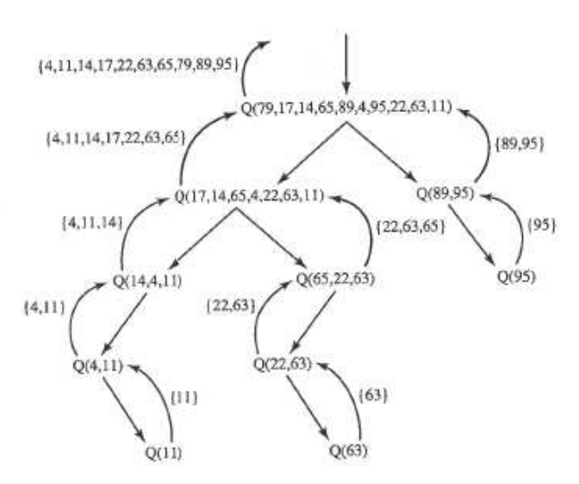
Illustation of Quick-Sort

Slide 40
Randomized quick-sort
Par-Randomized-QuickSort ( A[ q : r ] )
1. n <- r ― q + 1
2. if n <= 30 then
3. sort A[ q : r ] using any sorting algorithm
4. else
5. select a random element x from A[ q : r ]
6. k <- Par-Partition ( A[ q : r ], x )
7. spawn Par-Randomized-QuickSort ( A[ q : k ― 1 ] )
8. Par-Randomized-QuickSort ( A[ k + 1 : r ] )
9. sync
Worst-Case Time Complexity of Quick-Sort : O(N^2)
Average Time Complexity of Sequential Randomized Quick-Sort : O(NlogN)
(recursion depth of line 7-8 is roughly O(logN). Line 5 takes O(N))

Slide 41
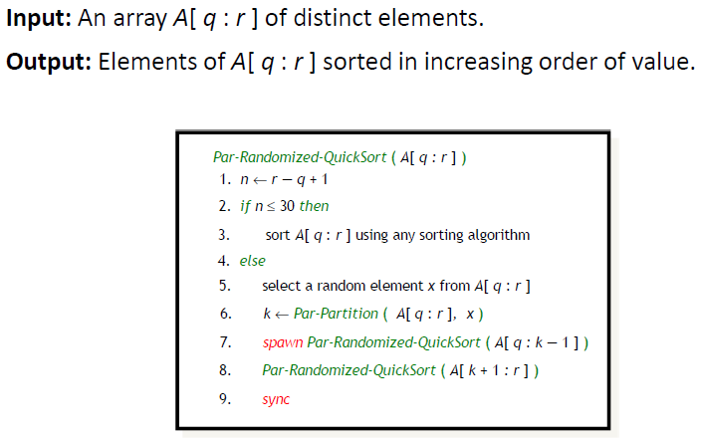
Parallel Randomized Quick-Sort

Slide 42
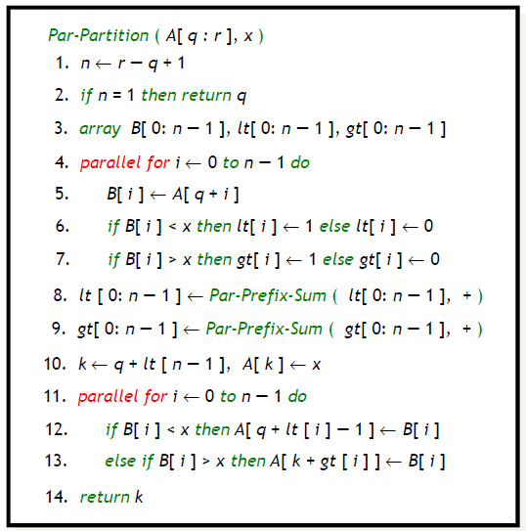
Parallel partition
Recursive divide-and-conquer

Slide 43
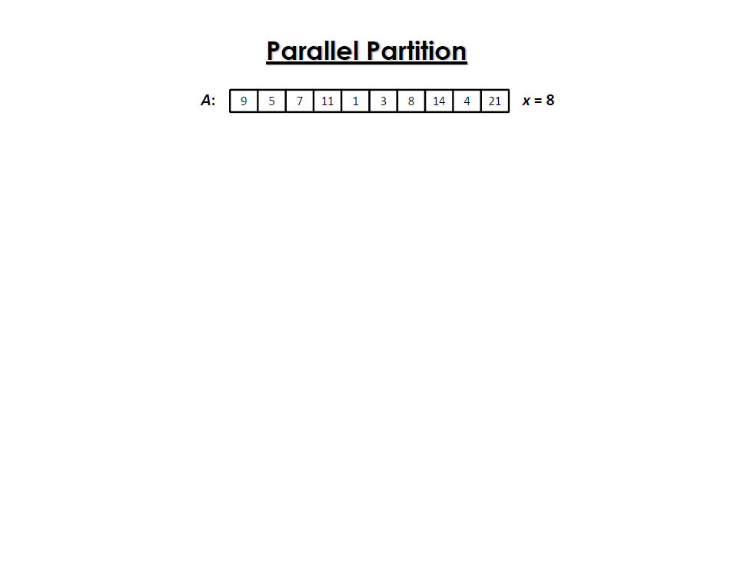

Slide 44
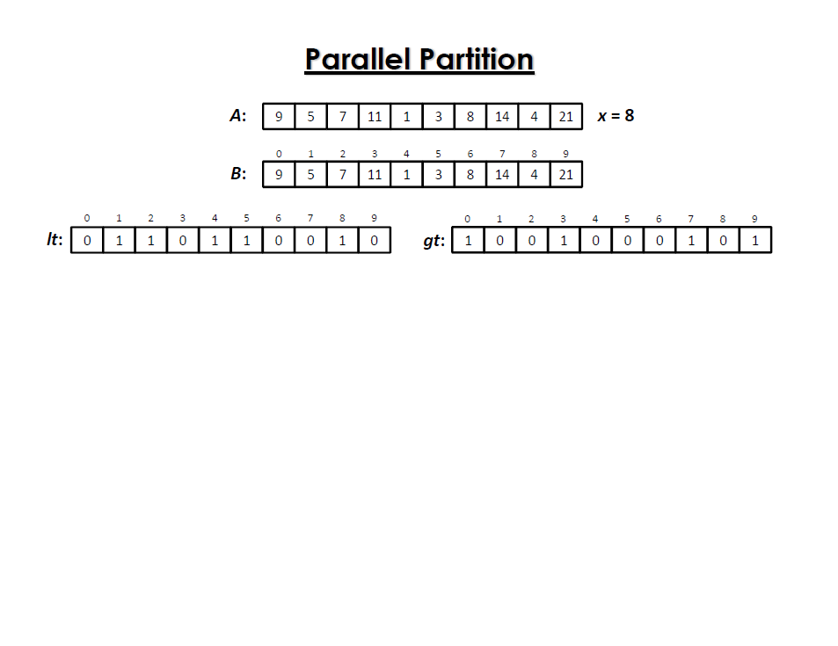

Slide 45
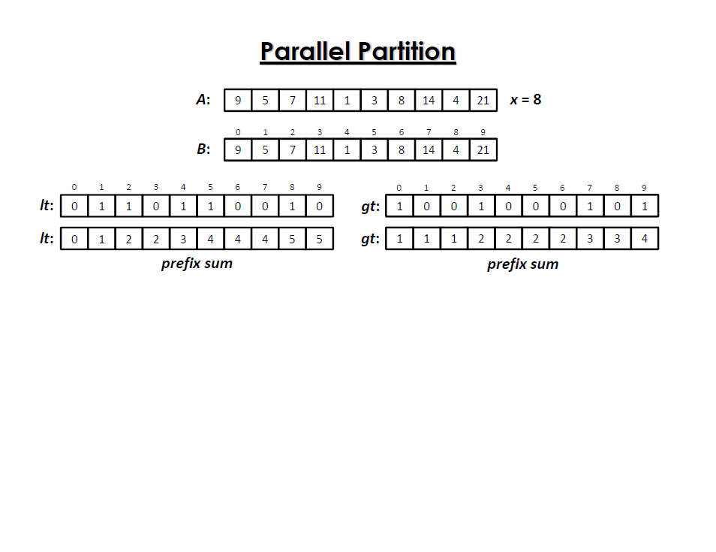

Slide 46
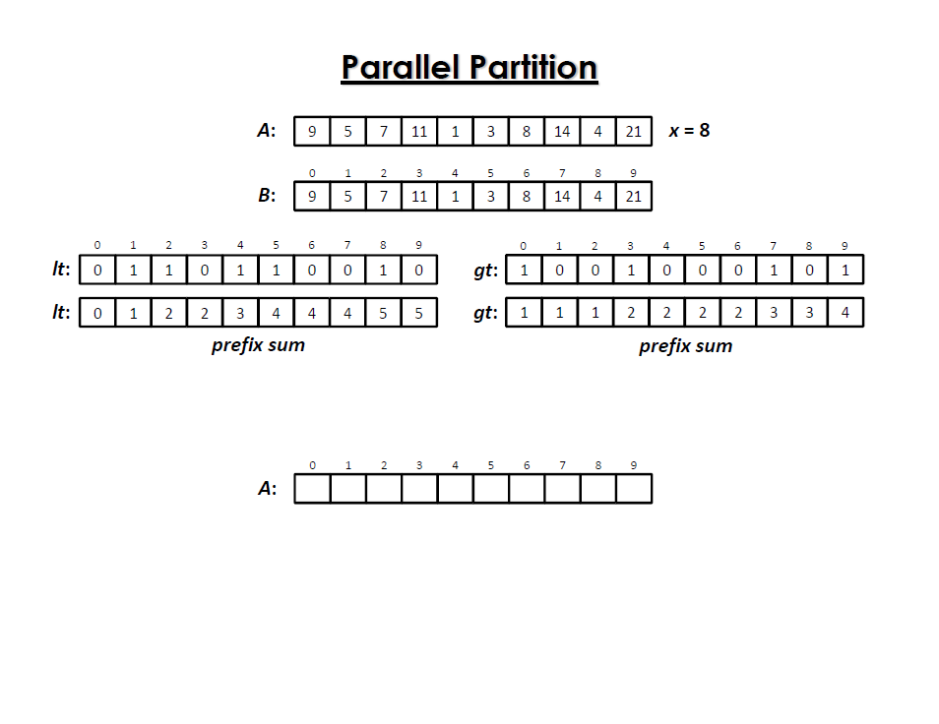

Slide 47
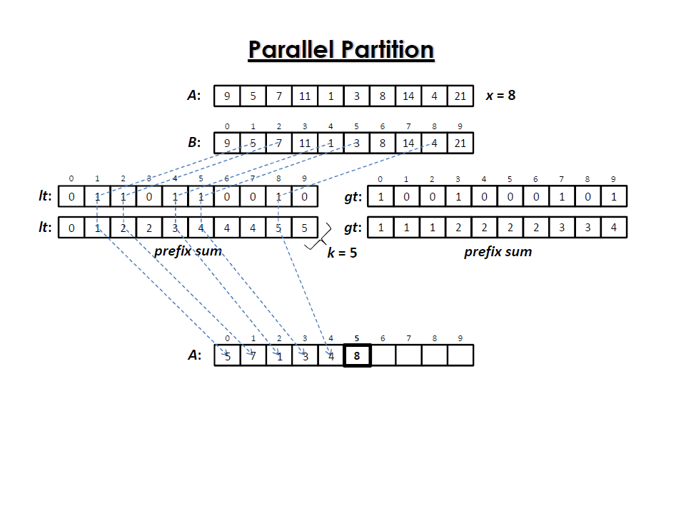

Slide 48
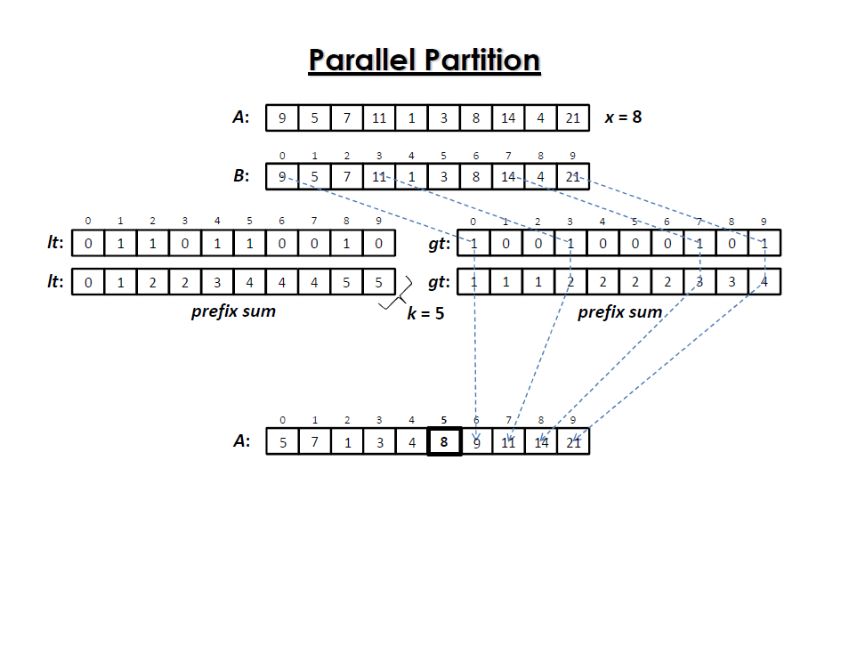

Slide 49
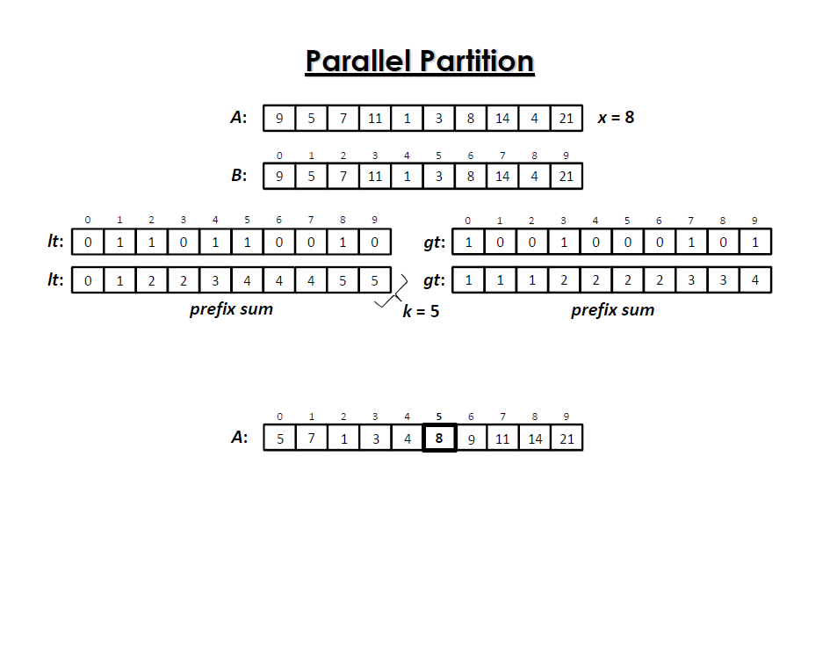

Slide 50
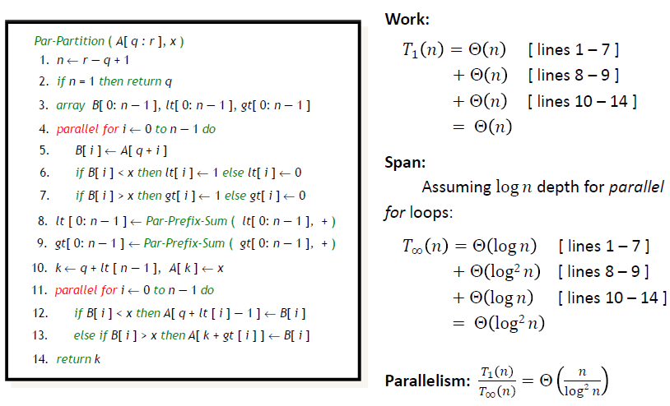
Parallel Partition Algorithm Analysis

Slide 51
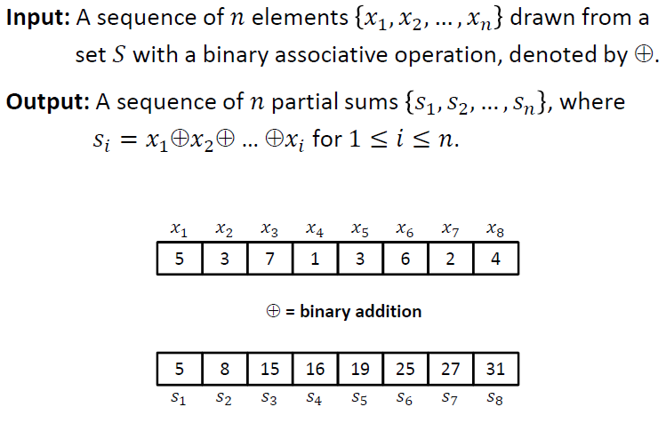
Prefix Sums

Slide 52
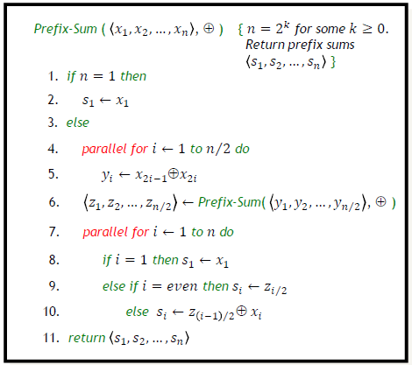
Prefix Sums

Slide 53
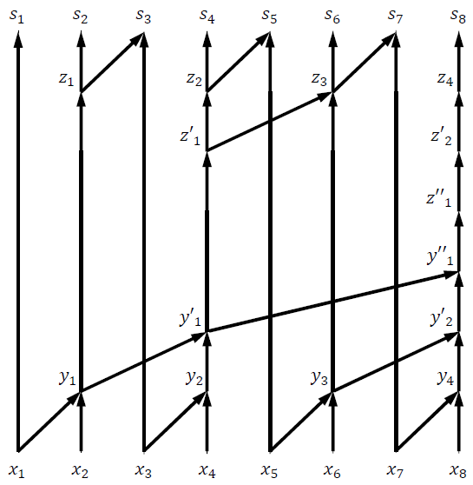
Prefix Sums

Slide 54
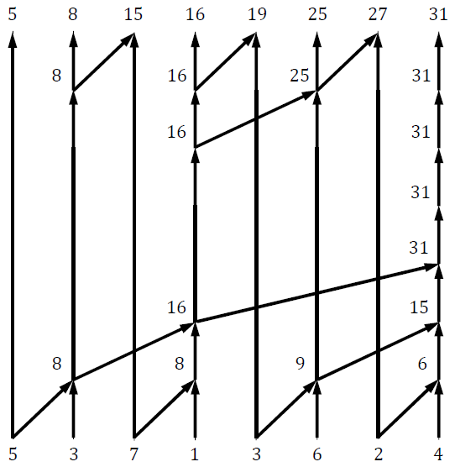
Prefix Sums

Slide 55
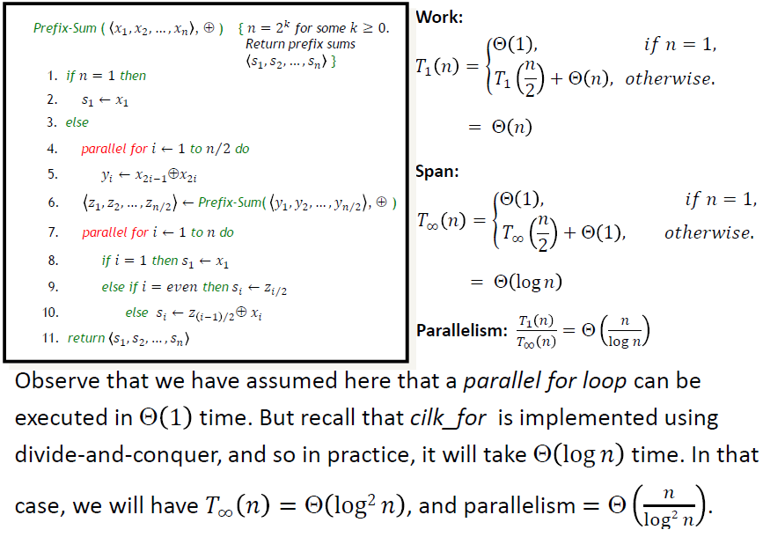
Prefix Sums

Slide 56
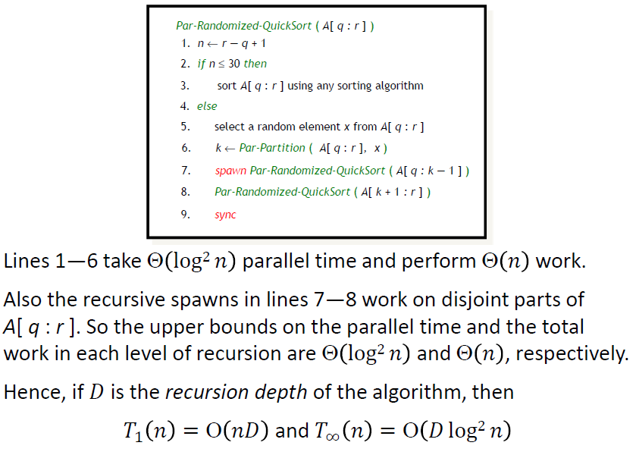
Performance analysis

Slide 57
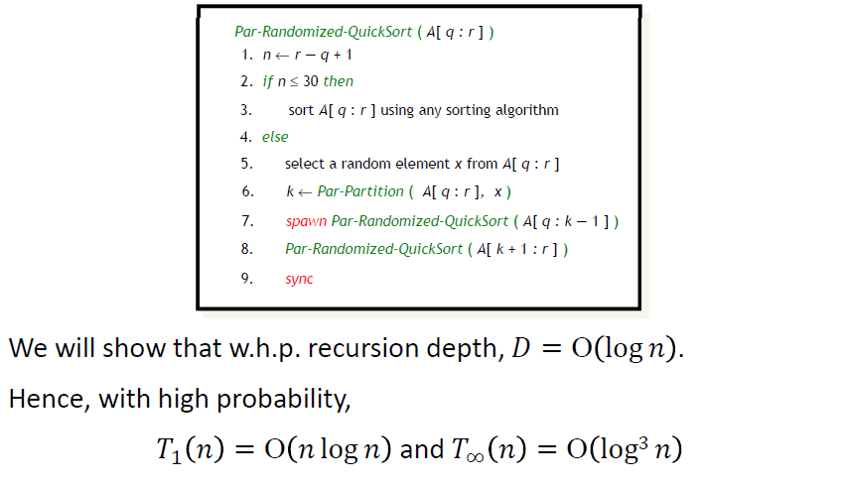
Performance analysis

