Slide 1
Lecture 7-3 : CUDA Programming
Slide Courtesy : Dr. David Kirk and Dr. Wen-Mei Hwu and Mulphy Stein

Slide 2
CUDA Programming Model: A Highly Multithreaded Coprocessor
The GPU is viewed as a compute device that:
Is a coprocessor to the CPU or host
Has its own DRAM (device memory)
Runs many threads in parallel
Data-parallel portions of an application are executed on the device as kernels which run in parallel on many threads
Differences between GPU and CPU threads
GPU threads are extremely lightweight
Very little creation overhead
GPU needs 1000s of threads for full efficiency
Multi-core CPU needs only a few

Slide 3
Thread Batching: Grids and Blocks
A kernel is executed as a grid of thread blocks
All threads share data memory space
A thread block is a batch of threads that can cooperate with each other by:
Synchronizing their execution
For shared memory accesses
Efficiently sharing data through a low latency shared memory
Two threads from two different blocks cannot cooperate
Host
Device
Grid 1
Kernel 1
Block
(0, 0)
Block
(1, 0)
Block
(2, 0)
Block
(0, 1)
Block
(1, 1)
Block
(2, 1)
Grid 2
Kernel 2
Block (1, 1)
Thread
(0, 0)
Thread
(1, 0)
Thread
(2, 0)
Thread
(3, 0)
Thread
(4, 0)
Thread
(0, 1)
Thread
(1, 1)
Thread
(2, 1)
Thread
(3, 1)
Thread
(4, 1)
Thread
(0, 2)
Thread
(1, 2)
Thread
(2, 2)
Thread
(3, 2)
Thread
(4, 2)
Courtesy: NDVIA

Slide 4
Block and Thread IDs
Threads and blocks have IDs
So each thread can decide what data to work on
Block ID: 1D or 2D
Thread ID: 1D, 2D, or 3D
Simplifies memory addressing when processing multidimensional data
Image processing
Solving PDEs on volumes
…
Device
Grid 1
Block
(0, 0)
Block
(1, 0)
Block
(2, 0)
Block
(0, 1)
Block
(1, 1)
Block
(2, 1)
Block (1, 1)
Thread
(0, 0)
Thread
(1, 0)
Thread
(2, 0)
Thread
(3, 0)
Thread
(4, 0)
Thread
(0, 1)
Thread
(1, 1)
Thread
(2, 1)
Thread
(3, 1)
Thread
(4, 1)
Thread
(0, 2)
Thread
(1, 2)
Thread
(2, 2)
Thread
(3, 2)
Thread
(4, 2)
Courtesy: NDVIA

Slide 5
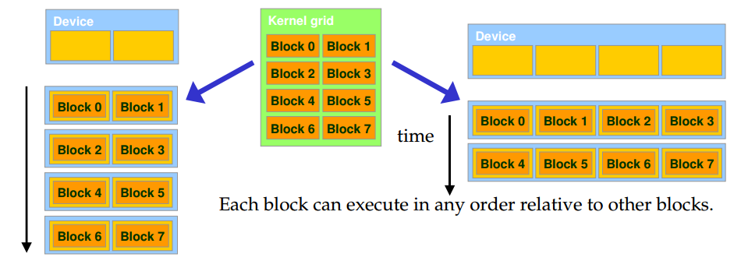
Transparent Scalability
Hardware is free to assign blocks to any processor at any time
Courtesy : Mulphy Stein (NYU)

Slide 6
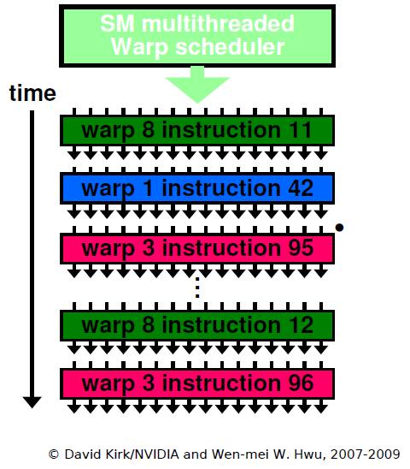
SM Warp Scheduling
Warp
Once a block is assigned to SM, the block is further divided into 32-thread units
All threads in a warp execute the same instruction when selected

Slide 7
CUDA Thread Hierarchy
Thread
Warp
32 threads
Basic execution unit
Controlled by the same instructions (SIMT)
Block
Grid
[Source: from Prof. Duksu Kim’s lecture slides]

Slide 8
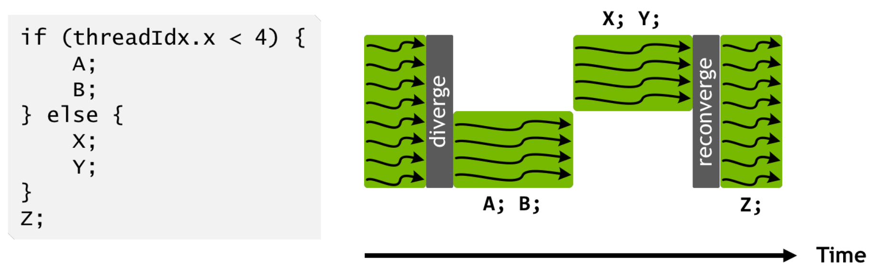
Warp Divergence
If threads in the same warp follows different branch paths, each branch will be serially executed.
Warp divergence can easily result in bad performance. Avoid branches!
[Source: from Prof. Duksu Kim’s lecture slides]

Slide 9
CUDA Device Memory Space Overview
Each thread can:
R/W per-thread registers
R/W per-thread local memory
R/W per-block shared memory
R/W per-grid global memory
Read only per-grid constant memory
Read only per-grid texture memory
(Device) Grid
Block (0, 0)
Block (1, 0)
Shared Memory
Shared Memory
Registers
Registers
Registers
Registers
Thread (0, 0)
Thread (1, 0)
Thread (0, 0)
Thread (1, 0)
Local
Memory
Local
Memory
Local
Memory
Local
Memory
Host
Global
Memory
Constant
Memory
Texture
Memory
Notes:
Global, constant, and texture memory spaces are persistent across kernels called by the same application.

Slide 10
Per-Thread Memory
Register
The fastest, but smallest memory
For variables declared in a kernel (local variable)
Local Memory
Off-chip memory
Reside in DRAM
Slow, but large space
Ex)
Local arrarys
Large logical structure
(Device) Grid
Block (0, 0)
Block (1, 0)
Shared Memory
Shared Memory
Registers
Registers
Registers
Registers
Thread (0, 0)
Thread (1, 0)
Thread (0, 0)
Thread (1, 0)
Local
Memory
Local
Memory
Local
Memory
Local
Memory
Host
Global
Memory
Constant
Memory
Texture
Memory
Courtesy: NDVIA

Slide 11
Per-Block Memory
Shared memory (__shared__)
fast, but small on-chip memory
Shared by all threads in a block
All threads in a block access
the same data
Partitioned by blocks in a SM
Around 100x faster than global memory
(Device) Grid
Block (0, 0)
Block (1, 0)
Shared Memory
Shared Memory
Registers
Registers
Registers
Registers
Thread (0, 0)
Thread (1, 0)
Thread (0, 0)
Thread (1, 0)
Local
Memory
Local
Memory
Local
Memory
Local
Memory
Host
Global
Memory
Constant
Memory
Texture
Memory
Courtesy: NDVIA

Slide 12
Global, Constant, and Texture Memories (Long Latency Accesses)
Global memory
Slowest, but largest off-chip memory
Main means of communicating R/W Data between host and device
Contents visible to all threads
Texture and Constant Memories
Constants initialized by host
Contents visible to all threads
(Device) Grid
Block (0, 0)
Block (1, 0)
Shared Memory
Shared Memory
Registers
Registers
Registers
Registers
Thread (0, 0)
Thread (1, 0)
Thread (0, 0)
Thread (1, 0)
Local
Memory
Local
Memory
Local
Memory
Local
Memory
Host
Global
Memory
Constant
Memory
Texture
Memory
Courtesy: NDVIA

Slide 13
CUDA – API

Slide 14
CUDA Highlights: Easy and Lightweight
The API is an extension to the ANSI C programming language
Low learning curve
The hardware is designed to enable lightweight runtime and driver
High performance

Slide 15
A Small Detour: A Matrix Data Type
NOT part of CUDA
It will be frequently used in many code examples
2 D matrix
single precision float elements
width * height elements
data elements allocated and attached to elements
typedef struct {
int width;
int height;
float* elements;
} Matrix;

Slide 16
CUDA Device Memory Allocation
cudaMalloc()
Allocates object in the device Global Memory
Requires two parameters
Address of a pointer to the allocated object
Size of of allocated object
cudaFree()
Frees object from device Global Memory
Pointer to freed object
(Device) Grid
Block (0, 0)
Block (1, 0)
Shared Memory
Shared Memory
Registers
Registers
Registers
Registers
Thread (0, 0)
Thread (1, 0)
Thread (0, 0)
Thread (1, 0)
Local
Memory
Local
Memory
Local
Memory
Local
Memory
Host
Global
Memory
Constant
Memory
Texture
Memory

Slide 17
CUDA Device Memory Allocation
cudaMallocManged()
memory allocation using unified memory model
the host and the device access the same memory address (pointer).
CUDA automatically migrates the data between host and device memory, allowing the host to accesss the data stored on the device.
unified memory enables seamless access from both the host and device, but the data migration comes with some overhead.

Slide 18
CUDA Device Memory Allocation (cont.)
Code example:
Allocate a 64 * 64 single precision float array
Attach the allocated storage to Md.elements
“d” is often used to indicate a device data structure
BLOCK_SIZE = 64;
Matrix Md
int size = BLOCK_SIZE * BLOCK_SIZE * sizeof(float);
cudaMalloc((void**)&Md.elements, size);
cudaFree(Md.elements);

Slide 19
CUDA Host-Device Data Transfer
cudaMemcpy()
memory data transfer
Requires four parameters
Pointer to source
Pointer to destination
Number of bytes copied
Type of transfer
Host to Host
Host to Device
Device to Host
Device to Device
(Device) Grid
Block (0, 0)
Block (1, 0)
Shared Memory
Shared Memory
Registers
Registers
Registers
Registers
Thread (0, 0)
Thread (1, 0)
Thread (0, 0)
Thread (1, 0)
Local
Memory
Local
Memory
Local
Memory
Local
Memory
Host
Global
Memory
Constant
Memory
Texture
Memory

Slide 20
CUDA Host-Device Data Transfer (cont.)
Code example:
Transfer a 64 * 64 single precision float array
M is in host memory and Md is in device memory
cudaMemcpyHostToDevice and cudaMemcpyDeviceToHost are symbolic constants
cudaMemcpy(Md.elements, M.elements, size, cudaMemcpyHostToDevice);
cudaMemcpy(M.elements, Md.elements, size, cudaMemcpyDeviceToHost);

Slide 21
CUDA Function Declarations
 | Executed on the: | Only callable from the:
__device__ float DeviceFunc() | device | device
__global__ void KernelFunc() | device | host
__host__ float HostFunc() | host | host
__global__ defines a kernel function
Must return void
__device__ and __host__ can be used together

Slide 22
Calling a Kernel Function – Thread Creation
A kernel function must be called with an execution configuration:
__global__ void KernelFunc(...);
dim3 DimGrid(100, 50); // 5000 thread blocks
dim3 DimBlock(4, 8, 8); // 256 threads per block
size_t SharedMemBytes = 64; // 64 bytes of shared memory
KernelFunc<<< DimGrid, DimBlock, SharedMemBytes >>>(...);

Slide 23
A Simple Running Example Matrix Multiplication
A straightforward matrix multiplication example that illustrates the basic features of memory and thread management in CUDA programs
Leave shared memory usage until later
Local, register usage
Thread ID usage
Memory data transfer API between host and device

Slide 24
Programming Model: Square Matrix Multiplication Example
P = M * N of size WIDTH x WIDTH
Without tiling:
One thread handles one element of P
M and N are loaded WIDTH times from global memory
N
WIDTH
M
P
WIDTH
WIDTH
WIDTH

Slide 25
Step 1: Matrix Data Transfers
// Allocate the device memory where we will copy M to
Matrix Md;
Md.width = WIDTH;
Md.height = WIDTH;
int size = WIDTH * WIDTH * sizeof(float);
cudaMalloc((void**)&Md.elements, size);
// Copy M from the host to the device
cudaMemcpy(Md.elements, M.elements, size, cudaMemcpyHostToDevice);
// Read M from the device to the host into P
cudaMemcpy(P.elements, Md.elements, size, cudaMemcpyDeviceToHost);
...
// Free device memory
cudaFree(Md.elements);

Slide 26
Step 2: Matrix Multiplication A Simple Host Code in C
// Matrix multiplication on the (CPU) host in double precision
// for simplicity, we will assume that all dimensions are equal
void MatrixMulOnHost(const Matrix M, const Matrix N, Matrix P)
{
for (int i = 0; i < M.height; ++i)
for (int j = 0; j < N.width; ++j) {
double sum = 0;
for (int k = 0; k < M.width; ++k) {
double a = M.elements[i * M.width + k];
double b = N.elements[k * N.width + j];
sum += a * b;
}
P.elements[i * N.width + j] = sum;
}
}

Slide 27
Multiply Using One Thread Block
N
One Block of threads compute matrix P
Each thread computes one element of P
Each thread
Loads a row of matrix M
Loads a column of matrix N
Perform one multiply and addition for each pair of M and N elements
Size of matrix limited by the number of threads allowed in a thread block
Grid 1
Block 1
Thread
(2, 2)
48
BLOCK_SIZE
M
P

Slide 28
Step 3: Matrix Multiplication Host-side Main Program Code
int main(void)
{
// Allocate and initialize the matrices
Matrix M = AllocateMatrix(WIDTH, WIDTH);
Matrix N = AllocateMatrix(WIDTH, WIDTH);
Matrix P = AllocateMatrix(WIDTH, WIDTH);
// M * N on the device
MatrixMulOnDevice(M, N, P);
// Free matrices
FreeMatrix(M);
FreeMatrix(N);
FreeMatrix(P);
return 0;
}

Slide 29
Step 3: Matrix Multiplication Host-side Main Program Code
Matrix AllocateMatrix(int height, int width)
{
Matrix M;
M.width = width;
M.height = height;
int size = M.width * M.height;
M.elements = NULL;
M.elements = (float*) malloc(size*sizeof(float));
for(unsigned int i = 0; i < M.height * M.width; i++)
{
M.elements[i] = (rand() / (float)RAND_MAX);
if(rand() % 2)
M.elements[i] = - M.elements[i];
}
return M;
}

Slide 30
Step 3: Matrix Multiplication Host-side code
// Matrix multiplication on the device
void MatrixMulOnDevice(const Matrix M, const Matrix N, Matrix P)
{
// Load M and N to the device
Matrix Md = AllocateDeviceMatrix(M);
CopyToDeviceMatrix(Md, M);
Matrix Nd = AllocateDeviceMatrix(N);
CopyToDeviceMatrix(Nd, N);
// Allocate P on the device
Matrix Pd = AllocateDeviceMatrix(P);
CopyToDeviceMatrix(Pd, P); // Clear memory
// Setup the execution configuration
dim3 dimBlock(WIDTH, WIDTH);
dim3 dimGrid(1, 1);
// Launch the device computation threads!
MatrixMulKernel<<<dimGrid, dimBlock>>>(Md, Nd, Pd);
// Read P from the device
CopyFromDeviceMatrix(P, Pd);
// Free device matrices
FreeDeviceMatrix(Md);
FreeDeviceMatrix(Nd);
FreeDeviceMatrix(Pd);
}

Slide 31
Step 4: Matrix Multiplication Device-side Kernel Function
// Matrix multiplication kernel – thread specification
__global__ void MatrixMulKernel(Matrix M, Matrix N, Matrix P)
{
// 2D Thread ID
int tx = threadIdx.x;
int ty = threadIdx.y;
// Pvalue is used to store the element of the matrix
// that is computed by the thread
float Pvalue = 0;
for (int k = 0; k < M.width; ++k)
{
float Melement = M.elements[ty * M.width + k];
float Nelement = N.elements[k * N.width + tx];
Pvalue += Melement * Nelement;
}
// Write the matrix to device memory;
// each thread writes one element
P.elements[ty * P.width + tx] = Pvalue;
}

Slide 32
Step 4: Matrix Multiplication Device-Side Kernel Function (cont.)
N
WIDTH
M
P
ty
WIDTH
tx
WIDTH
WIDTH

Slide 33
Step 5: Some Loose Ends
// Allocate a device matrix of same size as M.
Matrix AllocateDeviceMatrix(const Matrix M)
{
Matrix Mdevice = M;
int size = M.width * M.height * sizeof(float);
cudaMalloc((void**)&Mdevice.elements, size);
return Mdevice;
}
// Free a device matrix.
void FreeDeviceMatrix(Matrix M) {
cudaFree(M.elements);
}
void FreeMatrix(Matrix M) {
free(M.elements);
}
// Copy a host matrix to a device matrix.
void CopyToDeviceMatrix(Matrix Mdevice, const Matrix Mhost)
{
int size = Mhost.width * Mhost.height * sizeof(float);
cudaMemcpy(Mdevice.elements, Mhost.elements, size,
cudaMemcpyHostToDevice);
}
// Copy a device matrix to a host matrix.
void CopyFromDeviceMatrix(Matrix Mhost, const Matrix Mdevice)
{
int size = Mdevice.width * Mdevice.height * sizeof(float);
cudaMemcpy(Mhost.elements, Mdevice.elements, size,
cudaMemcpyDeviceToHost);
}

Slide 34
Step 6: Handling Arbitrary Sized Square Matrices
Have each 2D thread block to compute a (BLOCK_WIDTH)² sub-matrix (tile) of the result matrix
Each has (BLOCK_WIDTH)² threads
Generate a 2D Grid of (WIDTH/BLOCK_WIDTH)² blocks
N
WIDTH
M
P
You still need to put a loop around the kernel call for cases where WIDTH is greater than Max grid size!
by
ty
WIDTH
bx
tx
WIDTH
WIDTH

