Slide 1
Lecture 2-1 : Introduction to Multicore Computing
Bong-Soo Sohn
Associate Professor
School of Computer Science and Engineering
Chung-Ang University

Slide 2
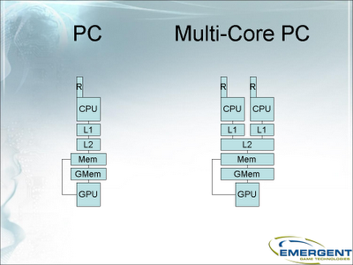
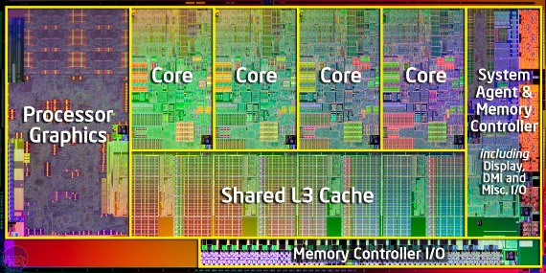
Multicore Processor
A single computing component with two or more independent cores
Core (CPU): computing unit that reads/executes program instructions
Ex) dual-core, quad-core, hexa-core, octa-core, …
share cache or not
symmetric or asymmetric
Ex) intel i9-13900K (link)
Intel Quad-core processors (Sandy Bridge)

Slide 3

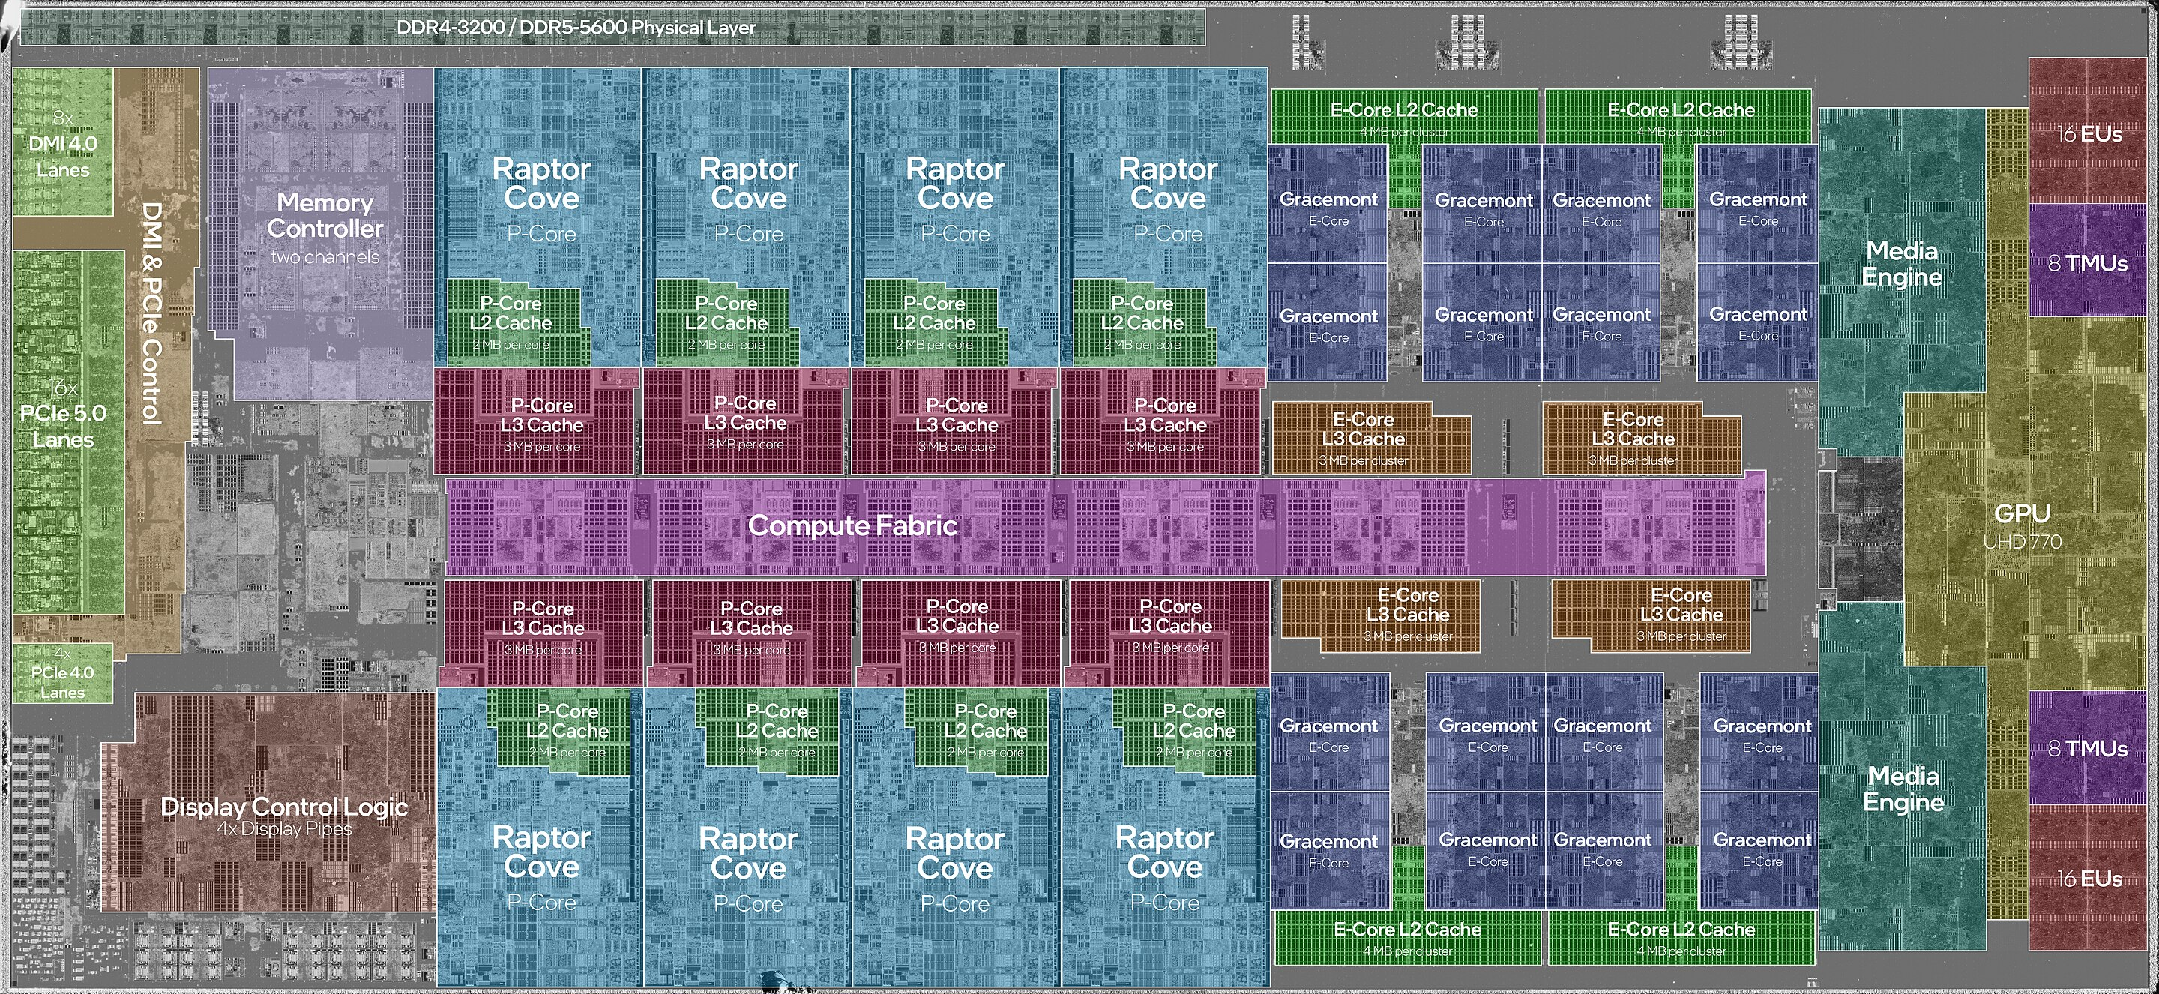
Intel Multicore CPU (Recent)
[source (2024.3): enuri.com]
Performance Cores vs Efficiency Cores
Intel i9-13900K
L3 cache (shared)

Slide 4
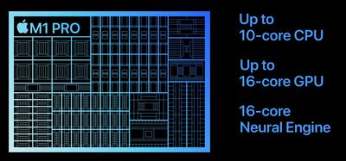
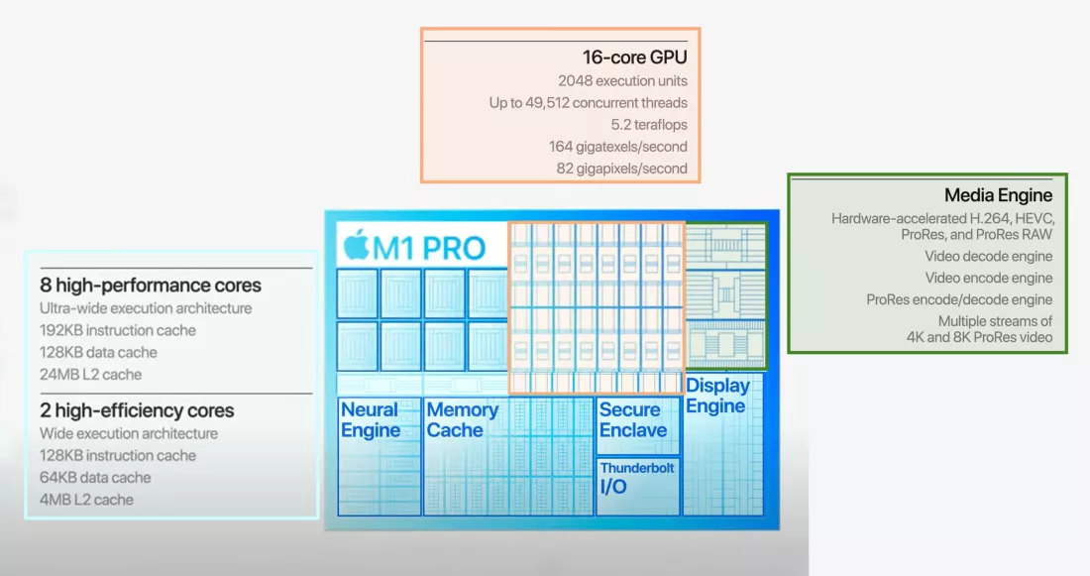
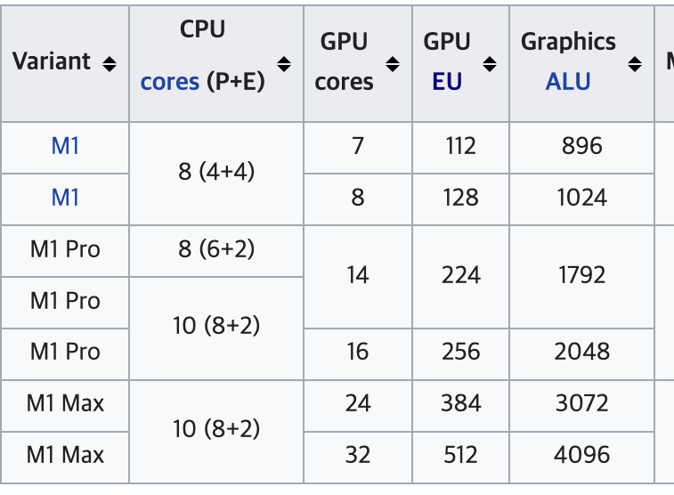
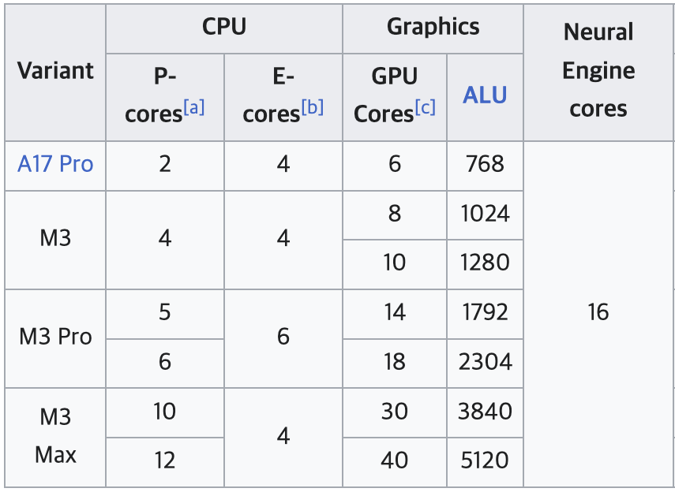
Apple CPUs: M1 (2021) , M3 (2023)
CPU clock rate: 3.2GHz (M1) , 4.05GHz (M3)

Slide 5
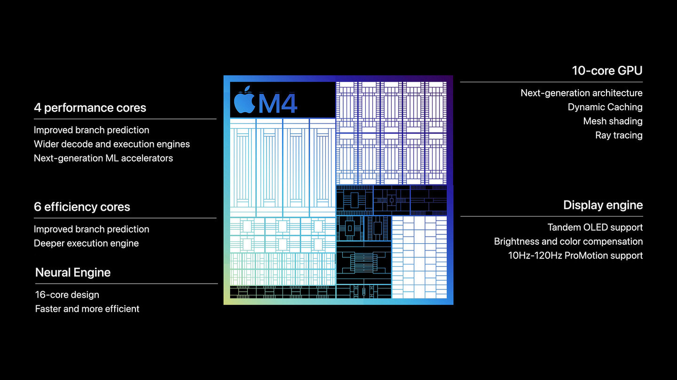
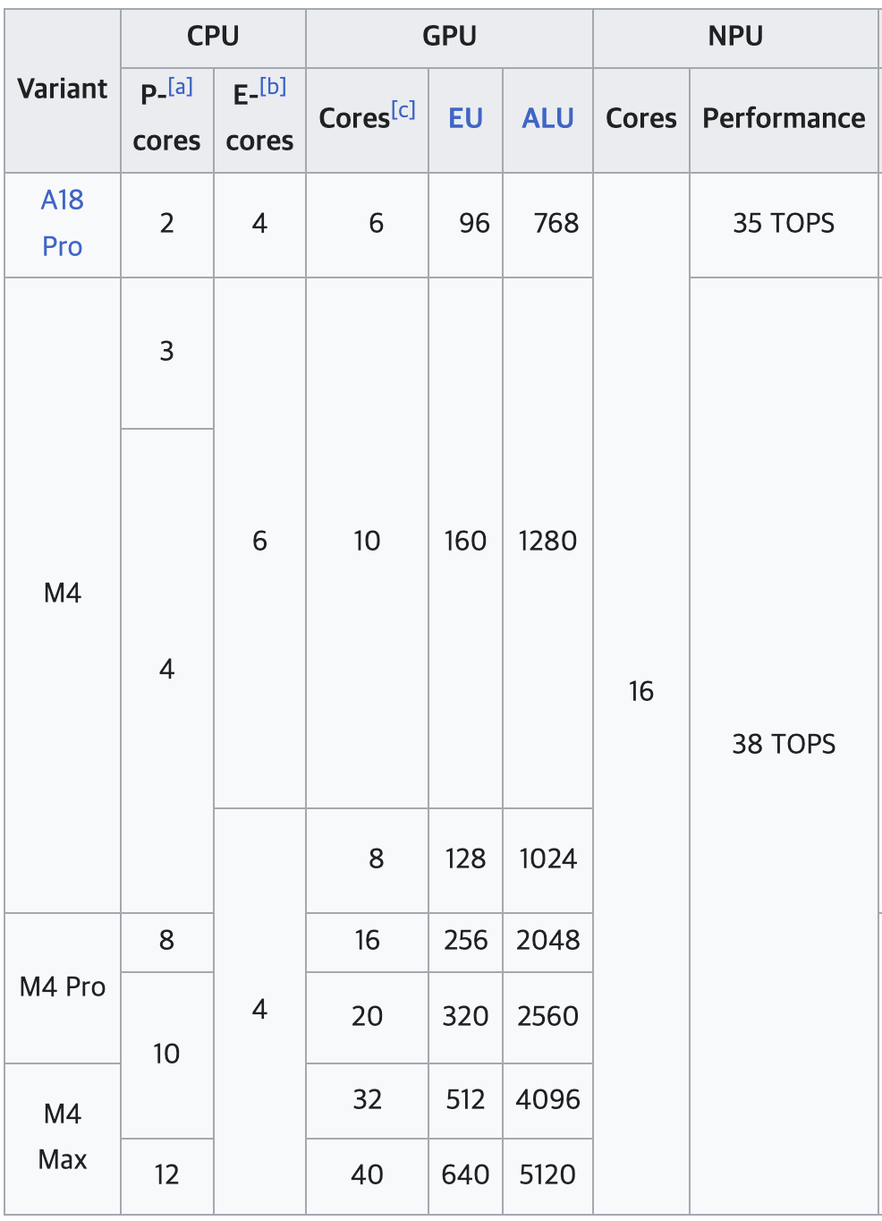
Apple M4 CPU (2024)

Slide 6
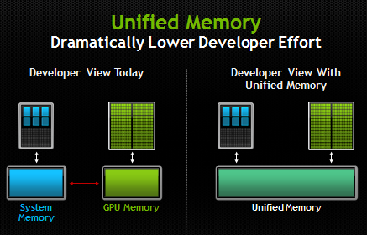
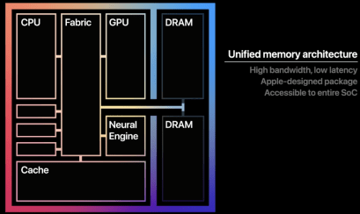
Apple Unified Memory
Unified memory
CPU, GPU, NPU share memory on a single chip
+: efficient
-: cannot be changed/replaced after production.

Slide 7
Multicore Processor
Multiple cores run multiple instructions at the same time (concurrently)
Increase overall program speed (performance)
performance gained by multi-core processor
strongly dependent on the software algorithms and implementation.
desktop PCs, mobile devices, servers

Slide 8

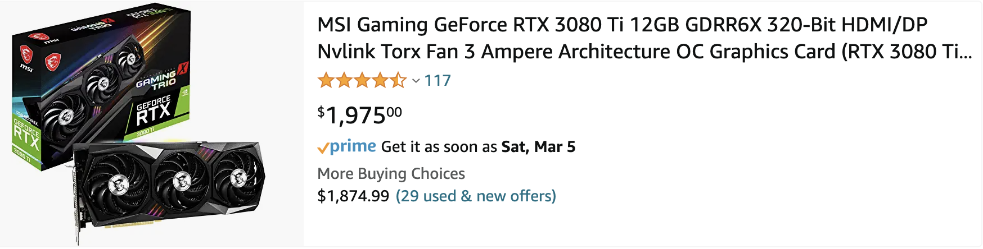
Manycore processor (GPU)
multi-core architectures with an especially high number of cores (thounds)
Ex) nVidia GeForce RTX 3080 Ti (2021.06)

Slide 9
Manycore processor (GPU)
CUDA
Compute Unified Device Architecture
parallel computing platform and programming model created by NVIDIA and implemented by the graphics processing units (GPUs) that they produce
GPGPU (General Purpose Graphics Processing Unit)
OpenCL
Open Standard parallel programming platform

Slide 10
Parallel Applications
Image and video processing
Encoding, editing, filtering
3D graphics (rendering, animation)
3D gaming
Simulation
e.g. protein folding, climate modeling
Machine learning, deep learning

Slide 11
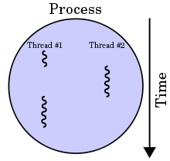
Thread/Process
Both
Independent sequence of execution
Process
run in separate memory space
Thread
Run in shared memory space in a process
One process may have multiple threads
Multithreaded Program
a program running with multiple threads that is executed simultaneously
A process with two threads of execution on a single processor

Slide 12
What is Parallel Computing?
Parallel computing
using multiple processors in parallel to solve problems more quickly than with a single processor
Examples of parallel machines:
A cluster computer that contains multiple PCs combined together with a high speed network
A shared memory multiprocessor by connecting multiple processors to a single memory system
A Chip Multi-Processor (CMP) contains multiple processors (called cores) on a single chip
Concurrent execution comes from desire for performance; unlike the inherent concurrency in a multi-user distributed system

Slide 13
Parallelism vs Concurrency
Parallel Programming
Using additional computational resources to produce an answer faster
Problem of using extra resources effectively?
Example
summing up all the numbers in an array with multiple n processors

Slide 14
Parallelism vs Concurrency
Concurrent Programming
Correctly and efficiently controlling access by multiple threads to shared resources
Problem of preventing a bad interleaving of operations from different threads
Example
Implementation of dictionary with hashtable
operations insert, update, lookup, delete occur simultaneously (concurrently)
Multiple threads access the same hashtable
Web Visit Counter

Slide 15
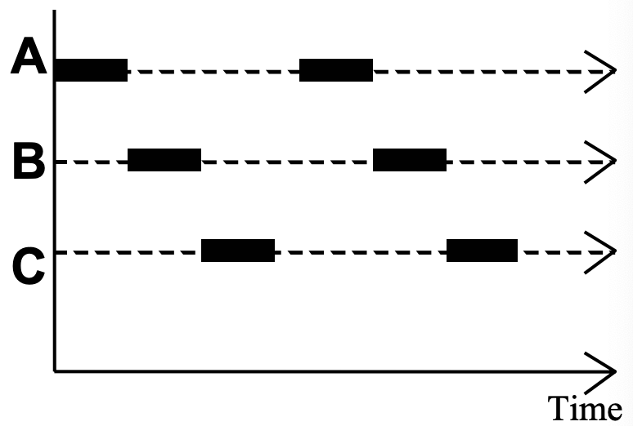
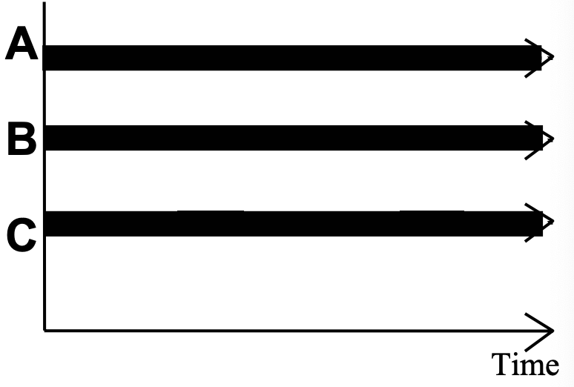
Concurrency is about dealing with lots of things at once.
Parallelism is about doing lots of things at once.
- Rob Pike (Co-creator of Go language)
Concurrency (Concurrent Programming)
A program is organized so multiple tasks can make progress during overlapping time periods
(but, not necessarily at the exact same instant)
Logically simultaneous execution
Can be interleaved execution on a single CPU
Goal: managing many tasks
Parallelism (Parallel Programming)
Multiple tasks execute at the exact same time
Physically simultaneous execution
Requires multiple cores/processors
Goal: speed up computation

Slide 16
Parallelism vs Concurrency
Often Used interchangeably
In practice, the distinction between parallelism and concurrency is not absolute
Many multithreaded programs have aspects of both

Slide 17
Parallel Programming Techniques
Shared Memory
OpenMP, pthreads
Distributed Memory
MPI
Distributed/Shared Memory
Hybrid (MPI+OpenMP)
GPU Parallel Programming
CUDA programming (NVIDIA)
OpenCL

Slide 18
Parallel Processing Systems
Small-Scale Multicore Environment
Notebook, Workstation, Server
OS supports multicore
POSIX threads (pthread) , win32 thread
GPGPU-based supercomputer
Development of CUDA/OpenCL/GPGPU
Large-Scale Multicore Environment
Supercomputer : more than 10,000 cores
Clusters
Servers
Grid Computing

Slide 19
Parallel Computing vs. Distributed Computing
Parallel Computing
all processors may have access to a shared memory to exchange information between processors.
more tightly coupled to multi-threading
Distributed Computing
multiple computers communicate through network
each processor has its own private memory
(distributed memory).
executing sub-tasks on different machines and then merging the results.

Slide 20
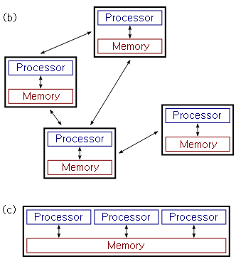
Parallel Computing vs. Distributed Computing
Distributed Computing
Parallel Computing
No Clear Distinction

Slide 21
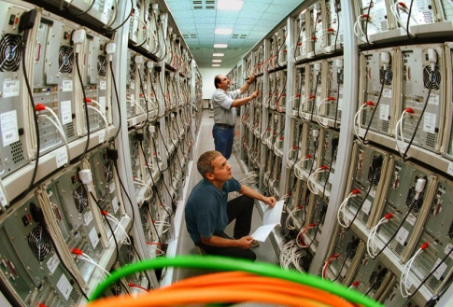
Cluster Computing vs. Grid Computing
Cluster Computing
a set of loosely connected computers that work together so that in many respects they can be viewed as a single system
good price / performance
memory not shared
Grid Computing
federation of computer resources from multiple locations to reach a common goal (a large scale distributed system)
grids tend to be more loosely coupled, heterogeneous, and geographically dispersed

Slide 22
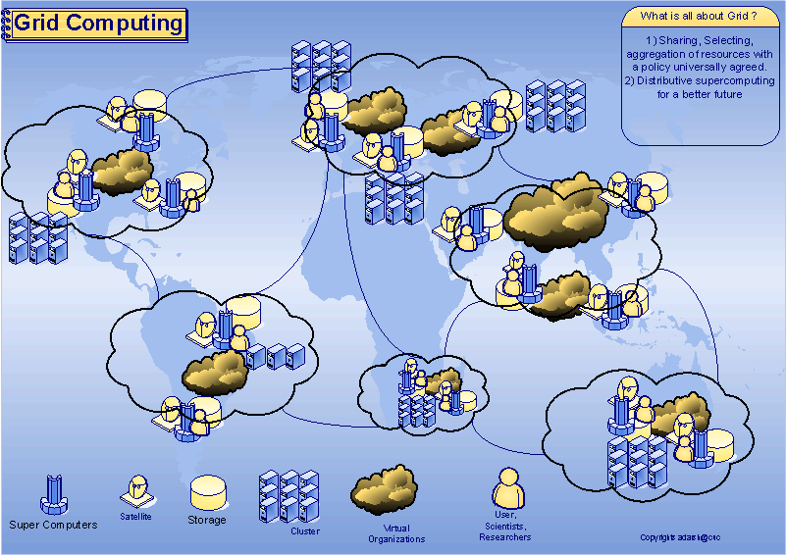
Cluster Computing vs. Grid Computing

Slide 23
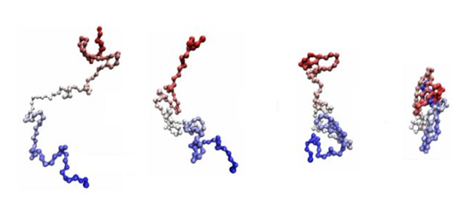
Example of Grid Computing (Folding@Home)

Slide 24
Example of Grid Computing (Folding@Home)

Slide 25

Cloud Computing
shares networked computing resources rather than having local servers or personal devices to handle applications.
“Cloud” is used as a metaphor for “Internet"
meaning "a type of Internet-based computing,“
different services - such as servers, storage and applications - are delivered to an user’s computers and smart phones through the Internet.

Slide 26
Good Parallel Program
Writing good parallel programs
Correct (Result)
Good Performance
Scalability
Load Balance
Portability
Hardware Specific Utilization

Slide 27
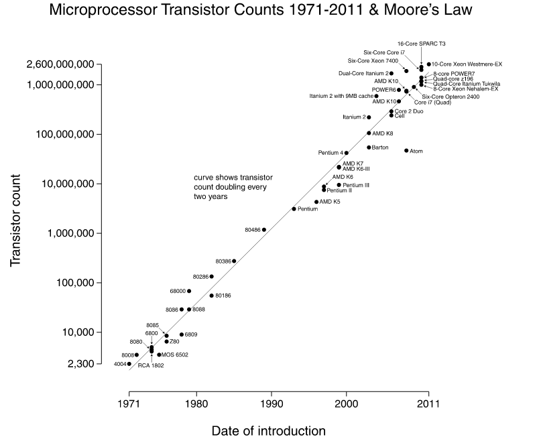
Moore’s Law : Review
Doubling of the number of transistors on integrated circuits roughly every two years.
Microprocessors have become smaller, denser, and more powerful.
processing speed, memory capacity, sensors and even the number and size of pixels in digital cameras.All of these are improving at (roughly) exponential rates

Slide 28
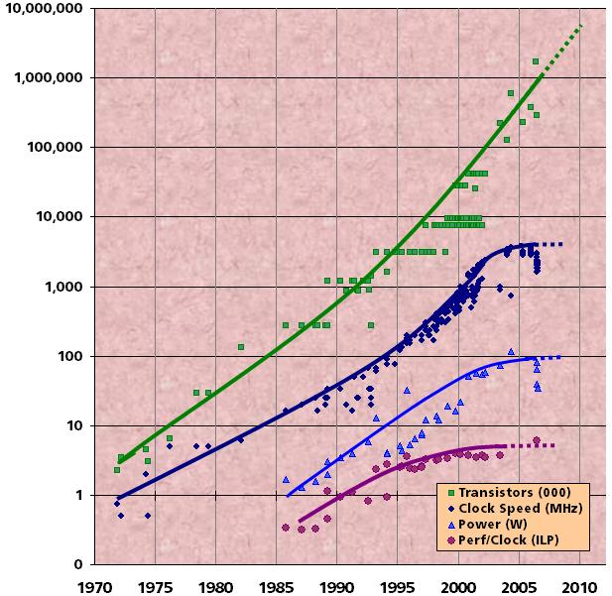
Computer Hardware Trend
Chip density is continuing
increase ~2x every 2years
Clock speed is not
(in high clock speed, power
consumption and heat generation
is too high to be tolerated.)
# of cores may double instead
No more hidden parallelism
(ILP;instruction level parallelism)
to be found
Transistor# still rising
Clock speed flattening sharply
Need Multicore programming!
Source: Intel, Microsoft (Sutter) and Stanford (Olukotun, Hammond)

Slide 29
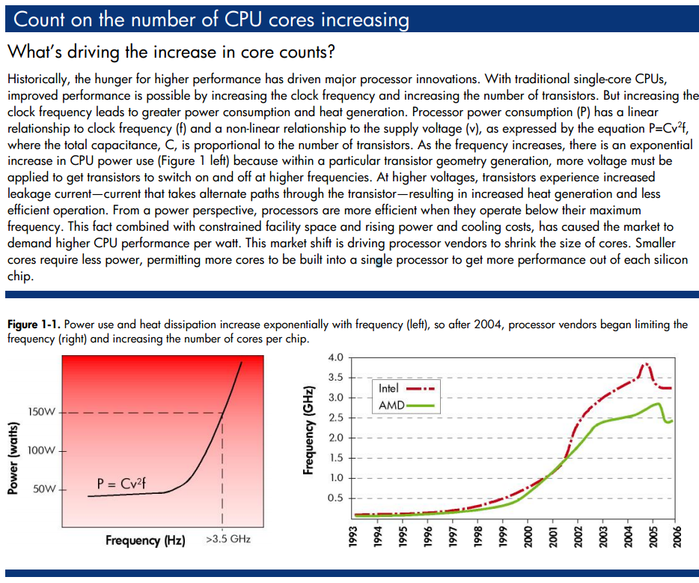

Slide 30
Examples of Parallel Computer
Chip MultiProcessor (CMP)
Intel Core Duo
AMD Dual Core
Symmetric Multiprocessor (SMP)
Sun Fire E25K
Heterogeneous Chips
Cell Processor
Clusters
Supercomputers

Slide 31
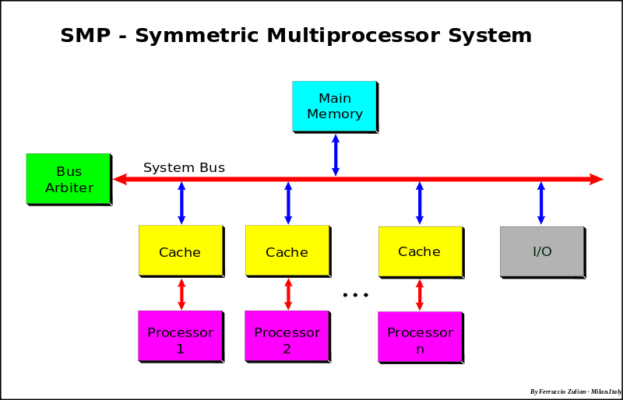
Generic SMP
Symmetric MultiProcessor (SMP) System
multiprocessor hardware architecture
two or more identical processors are connected to a single shared memory
controlled by a single OS instance
Most common multiprocessor systems today use an SMP architecture
Both Multicore and multi-CPU
Single logical memory image
Shared bus often bottleneck

Slide 32
GPGPU : NVIDIA GPU
Tesla K20
GPU : 1 Kepler GK110
2496 cores; 706MHz
Tpeak 3.52Tflop/s – 32bit floating point
Tpeak 1.17Tflop/s – 64bit floating point
GTX 680
1536 CUDA cores; 1.0GHz

Slide 33
Hybrid Programming Model
Main CPU performs hard to parallelize portion
Attached processor (GPU) performs compute intensive parts

Slide 34
Why writing (fast) parallel programs is hard

Slide 35
Principles of Parallel Computing
Finding enough parallelism (Amdahl’s Law)
granularity
Locality
Load balance
Coordination and synchronization
All of these things makes parallel programming even harder than sequential programming.

Slide 36
Overhead of Parallelism
Given enough parallel work, this is the biggest barrier to getting desired speedup
Parallelism overheads include:
cost of starting a thread or process
cost of communicating shared data
cost of synchronizing
extra (redundant) computation
Each of these can be in the range of milliseconds (=millions of flops) on some systems
Tradeoff: Algorithm needs sufficiently large units of work to run fast in parallel (I.e. large granularity), but not so large that there is not enough parallel work

Slide 37
Summary
All computers are now parallel computers!
Multi-core processors represent an important new trend in computer architecture.
Decreased power consumption and heat generation.
Minimized wire lengths and interconnect latencies.
They enable true thread-level parallelism with great energy efficiency and scalability.

Slide 38
Summary
To utilize their full potential, applications will need to move from a single to a multi-threaded model.
Parallel programming techniques likely to gain importance.
Hardware/Software
the software industry needs to get back into the state where existing applications run faster on new hardware.

