Slide 1
Lecture 3 :
Performance of Parallel Programs
Courtesy : MIT Prof. Amarasinghe and Dr. Rabbah’s course note
Introduction to Parallel Computing (Blaise Barney, LLNL)

Slide 2
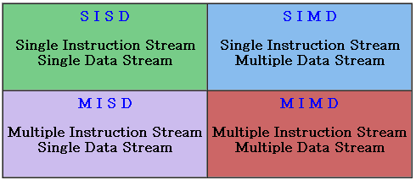
Flynn’s Taxonomy on Parallel Computer
Classified with two independent dimension
  Instruction stream
  Data stream

Slide 3
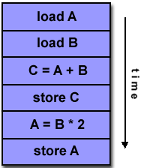
SISD (Single Instruction, Single Data)
A serial (non-parallel) computer
This is the oldest and even today, the most common type of computer

Slide 4
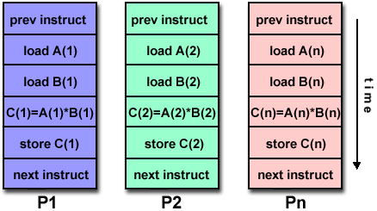
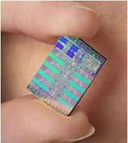
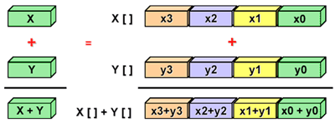
SIMD (Single Instruction, Multiple Data)
All processing units execute the same instruction at any given clock cycle
Best suited for specialized problems characterized by a high degree of regularity, such as graphics/image processing.
<GPU>

Slide 5
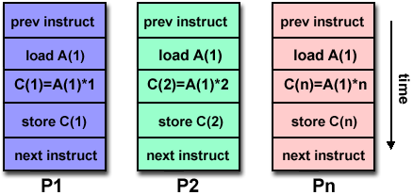
MISD (Multiple Instruction, Single Data)
Each processing unit operates on the data independently via separate instruction streams.
Few actual examples of this class of parallel computer have ever existed.

Slide 6
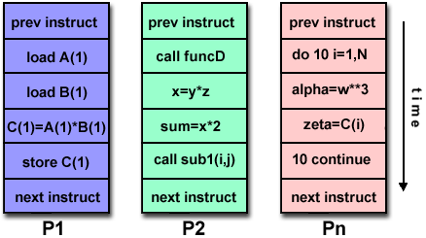
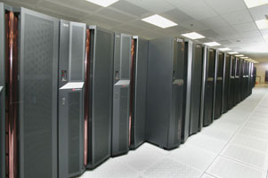
MIMD (Multiple Instruction, Multiple Data)
Every processor may be executing a different instruction stream
Every processor may be working with a different data stream
the most common type of parallel computer
Most modern supercomputers fall into this category
< IBM Power 5>

Slide 7
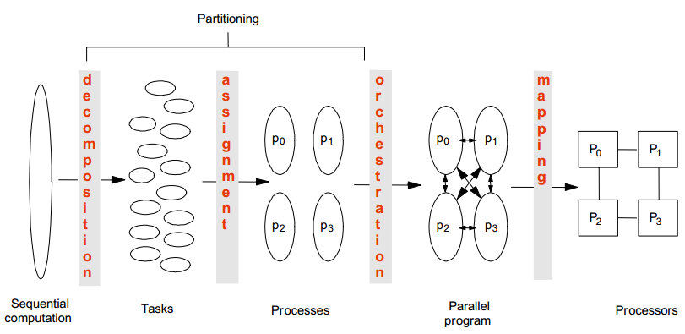
Creating a Parallel Program
Decomposition
Assignment
Orchestration/Mapping

Slide 8
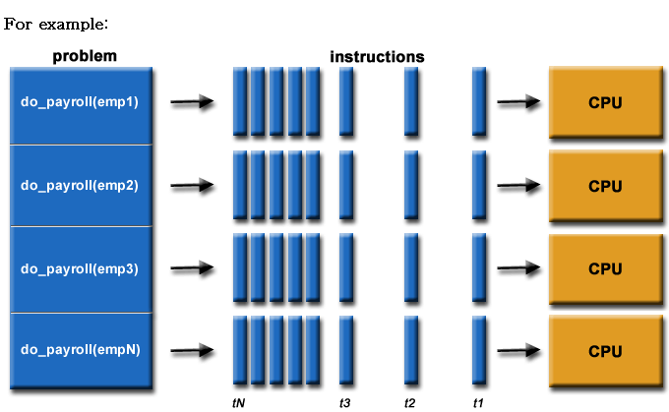
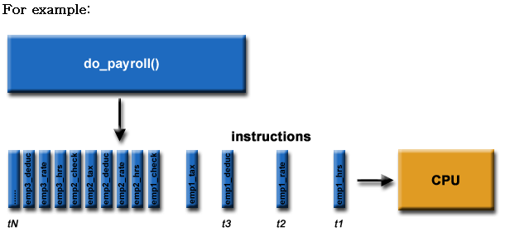
Decomposition
Break up computation into tasks to be divided among processes
identify concurrency and decide level at which to exploit it

Slide 9
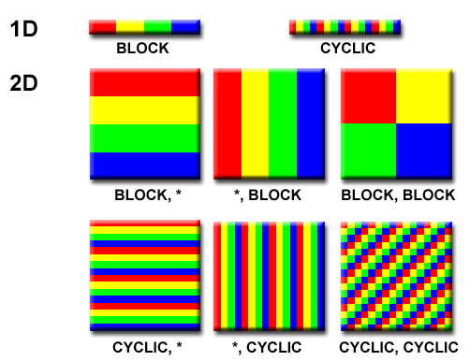
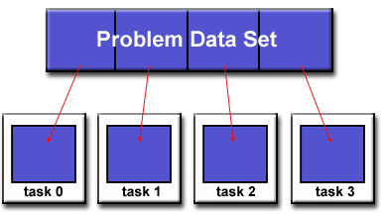
Domain Decomposition
data associated with a problem is decomposed.
Each parallel task then works on a portion of data.

Slide 10
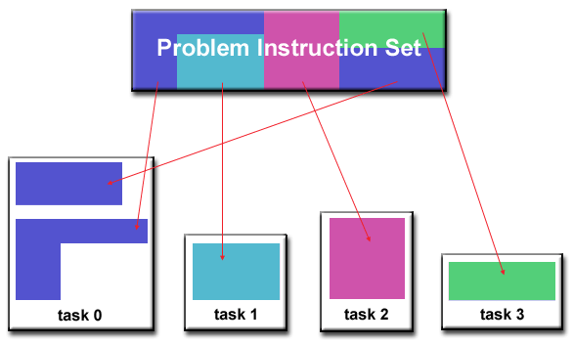
Functional Decomposition
the focus is on the computation that is to be performed rather than on the data
problem is decomposed according to the work that must be done.
Each task then performs a portion of the overall work.

Slide 11
Assignment
Assign tasks to threads
  Balance workload, reduce communication and management cost
  Together with decomposition, also called partitioning
Can be performed statically, or dynamically
Goal
  Balanced workload
  Reduced communication costs

Slide 12
Orchestration
Structuring communication and synchronization
Organizing data structures in memory and scheduling tasks temporally
Goals
  Reduce cost of communication and synchronization as seen by processors
  Reserve locality of data reference (including data structure organization)

Slide 13
Mapping
Mapping threads to execution units (CPU cores)
Parallel application tries to use the entire machine
Usually a job for OS
Mapping decision
  Place related threads (cooperating threads) on the same processor
  maximize locality, data sharing, minimize costs of comm/sync

Slide 14
Performance of Parallel Programs
What factors affect the performance ?
  Decomposition
    Coverage of parallelism in algorithm
  Assignment
    Granularity of partitioning among processors
  Orchestration/Mapping
    Locality of computation and communication

Slide 15
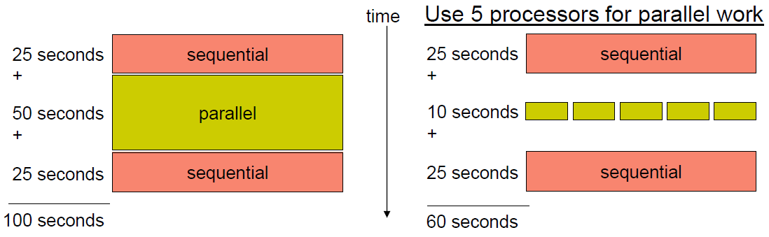
Coverage (Amdahl’s Law)
Potential program speedup is defined by the fraction of code that can be parallelized

Slide 16
Amdahl’s Law
Speedup = old running time / new running time
= 100 sec / 60 sec
= 1.67
(parallel version is 1.67 times faster)

Slide 17
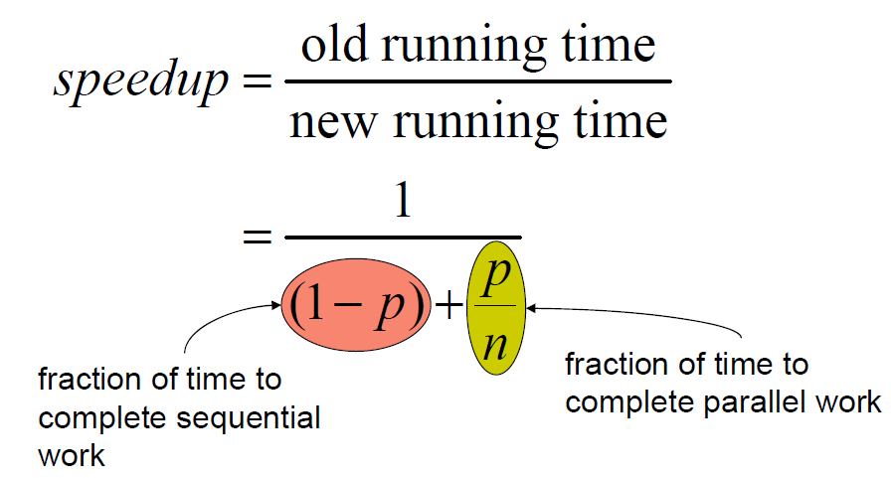
Amdahl’s Law
p = fraction of work that can be parallelized
n = the number of processor

Slide 18
Implications of Amdahl’s Law
Speedup tends to 1/(1-p) as number of processors tends to infinity
Parallel programming is worthwhile when programs have a lot of work that is parallel in nature

Slide 19
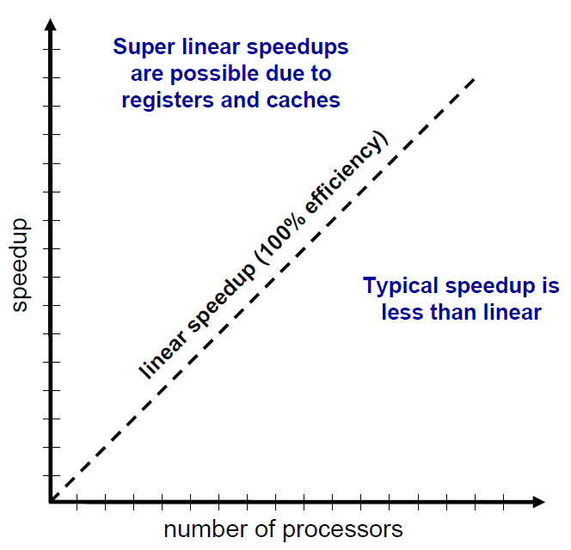
Performance Scalability
Scalability : the capability of a system to increase total throughput under an increased load when resources (typically hardware) are added

Slide 20
Granularity
Granularity is a qualitative measure of the ratio of computation to communication
  Coarse: relatively large amounts of computational work are done between communication events
  Fine: relatively small amounts of computational work are done between communication events
Computation stages are typically separated from periods of communication by synchronization events

Slide 21
Granularity (from wikipedia)
Granularity
  the extent to which a system is broken down into small parts
Coarse-grained systems
  consist of fewer, larger components than fine-grained systems
  regards large subcomponents
Fine-grained systems
  regards smaller components of which the larger ones are composed.

Slide 22
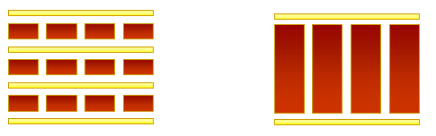
Fine vs. Coarse Granularity
Fine-grain Parallelism
Coarse-grain Parallelism
Low computation to communication ratio
Small amounts of computational work between communication stages
Less opportunity for performance enhancement
High communication overhead
High computation to communication ratio
Large amounts of computational work between communication events
More opportunity for performance increase

Slide 23
Fine vs. Coarse Granularity
The most efficient granularity is dependent on the algorithm and the hardware
In most cases the overhead associated with communications and synchronization is high relative to execution speed so it is advantageous to have coarse granularity.
Fine-grain parallelism can help reduce overheads due to load imbalance.

Slide 24
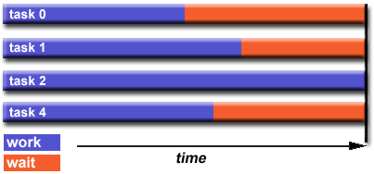
Load Balancing
distributing approximately equal amounts of work among tasks so that all tasks are kept busy all of the time.
It can be considered a minimization of task idle time.
For example, if all tasks are subject to a barrier synchronization point, the slowest task will determine the overall performance.

Slide 25
General Load Balancing Problem
The whole work should be completed as fast as possible.
As workers are very expensive, they should be kept busy.
The work should be distributed fairly. About the same amount of work should be assigned to every worker.
There are precedence constraints between different tasks (we can start building the roof only after finishing the walls). Thus we also have to find a clever processing order of the different jobs.

Slide 26
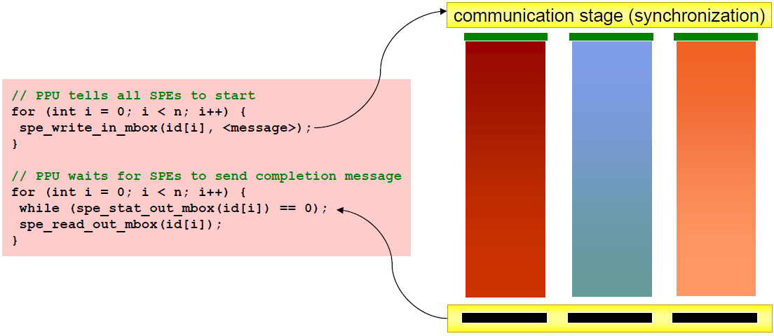
Load Balancing Problem
Processors that finish early have to wait for the processor with the largest amount of work to complete
  Leads to idle time, lowers utilization

Slide 27
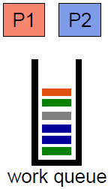
Static load balancing
Programmer make decisions and assigns a fixed amount of work to each processing core a priori
Low run time overhead
Works well for homogeneous multicores
  All core are the same
  Each core has an equal amount of work
Not so well for heterogeneous multicores
  Some cores may be faster than others
  Work distribution is uneven

Slide 28
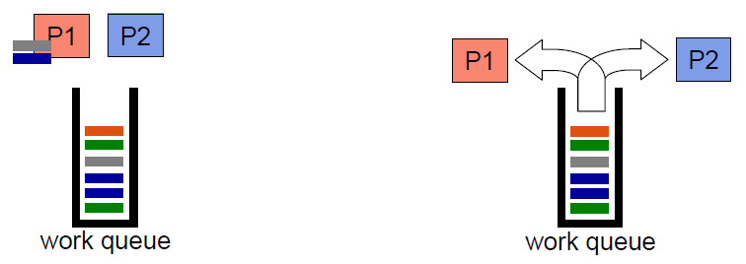
Dynamic Load Balancing
When one core finishes its allocated work, it takes work from a work queue or a core with the heaviest workload
Adapt partitioning at run time to balance load
High runtime overhead
Ideal for codes where work is uneven, unpredictable, and in heterogeneous multicore

Slide 29
Granularity and Performance Tradeoffs
Load balancing
  How well is work distributed among cores?
Synchronization/Communication
  Communication Overhead?

Slide 30
Communication
With message passing, programmer has to understand the computation and orchestrate the communication accordingly
  Point to Point
  Broadcast (one to all) and Reduce (all to one)
  All to All (each processor sends its data to all others)
  Scatter (one to several) and Gather (several to one)

Slide 31
Factors to consider for communcation
Cost of communications
  Inter-task communication virtually always implies overhead.
  Communications frequently require some type of synchronization between tasks, which can result in tasks spending time ‘waiting’ instead of doing work.

Slide 32
Factors to consider for communcation
Latency vs Bandwidth
  Latency
    the time it takes to send a minimal (0 byte) message from point A to point B.
  Bandwidth
    the amount of data that can be communicated per unit of time.
  Sending many small messages can cause latency to dominate communication overheads.
  Often it is more efficient to package small messages into a larger message.

Slide 33
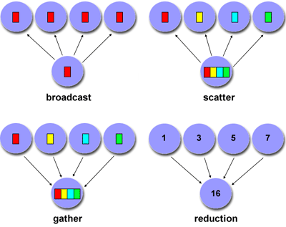
Factors to consider for communcation
synchronous vs asynchronous
  Synchronous : require some type of ‘handshaking’ between tasks that share data
  Asynchronous : transfer data independently from one another.
Scope of communication
  Point-to-point
  collective

Slide 34
MPI : Message Passing Library
MPI : portable specification
  Not a language or compiler specification
  Not a specific implementation or product
  SPMD model (same program, multiple data)
For parallel computers, clusters, and heterogeneous networks, multicores
Multiple communication modes allow precise buffer management
Extensive collective operations for scalable global communication

Slide 35
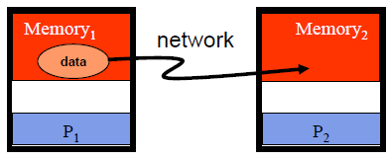
Point-to-Point
Basic method of communication between two processors
  Originating processor "sends" message to destination processor
  Destination processor then "receives" the message
The message commonly includes
  Data or other information
  Length of the message
  Destination address and possibly a tag

Slide 36
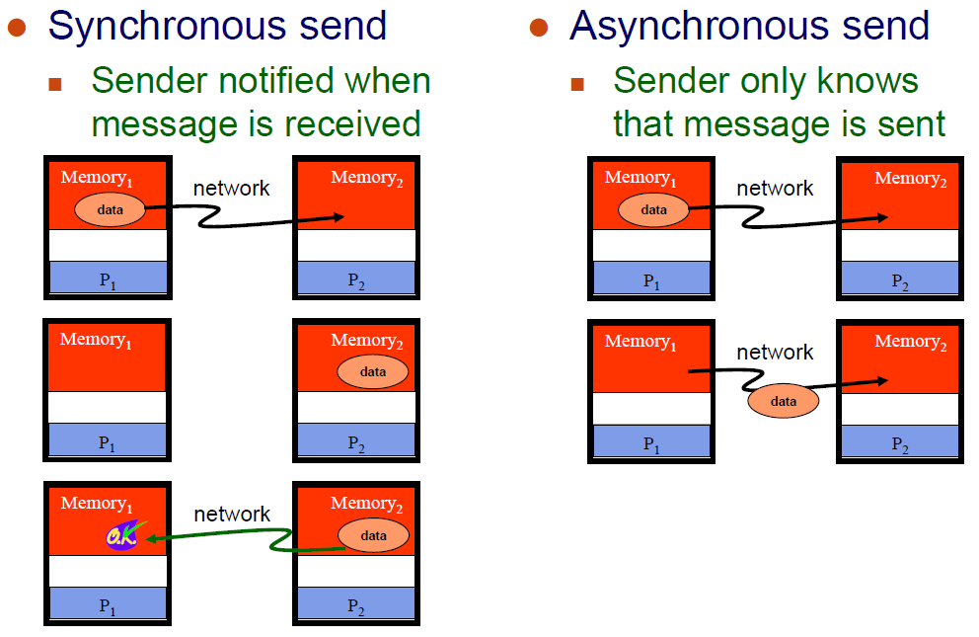
Synchronous vs. Asynchronous Messages

Slide 37
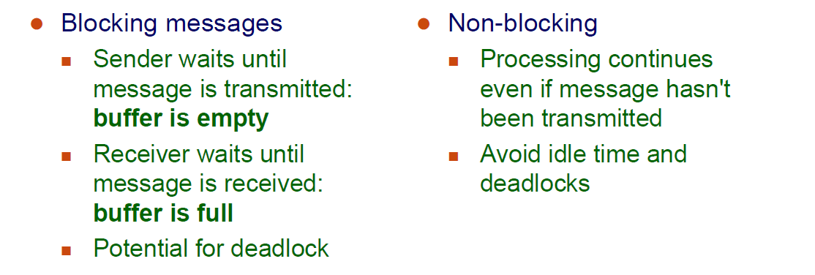
Blocking vs. Non-Blocking Messages

Slide 38
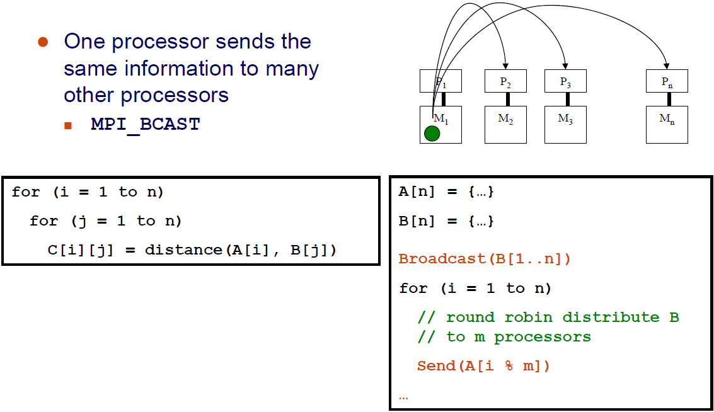
Broadcast

Slide 39
Reduction
Example: every processor starts with a value and needs to know the sum of values stored on all processors
A reduction combines data from all processors and returns it to a single process
  MPI_REDUCE
  Can apply any associative operation on gathered data
    ADD, OR, AND, MAX, MIN, etc.
  No processor can finish reduction before each processor has contributed a value
BCAST/REDUCE can reduce programming complexity and may be more efficient in some programs

Slide 40
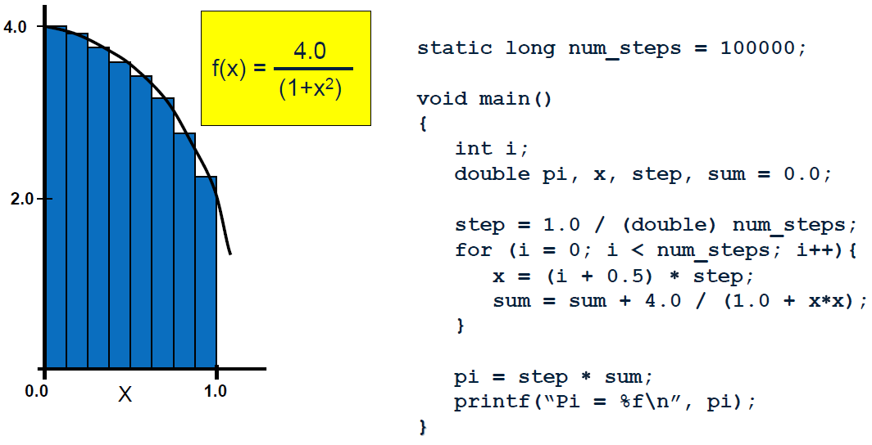
Example : Parallel Numerical Integration

Slide 41
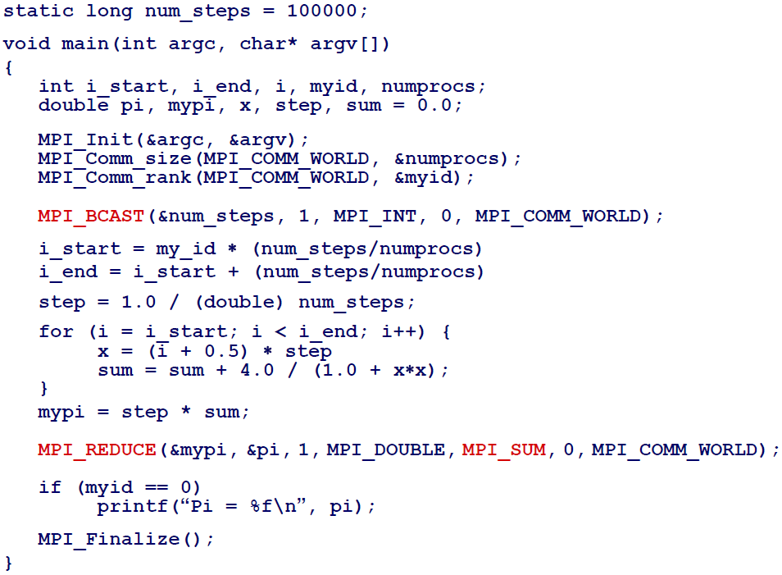
Computing the Integration (MPI)

Slide 42
Synchronization
Coodination of simultaneous events (threads / processes) in order to obtain correct runtime order and avoid unexpected condition
Types of synchronization
  Barrier
    Any thread/process must stop at this point(barrier) and cannot proceed until all other threads/processes reach this barrier
  Lock/semaphore
    The first task acquires the lock. This task can then safely (serially) access the protected data or code.
    Other tasks can attempt to acquire the lock but must wait until the task that owns the lock releases it.

Slide 43
Locality
Conventional
Storage
Hierarchy
Proc
Proc
Proc
Cache
Cache
Cache
L2 Cache
L2 Cache
L2 Cache
L3 Cache
L3 Cache
L3 Cache
potential
interconnects
Memory
Memory
Memory
Large memories are slow, fast memories are small
Storage hierarchies are large and fast on average
Parallel processors, collectively, have large, fast cache
  the slow accesses to “remote” data we call “communication”
Algorithm should do most work on local data
Need to exploit spatial and temporal locality

Slide 44
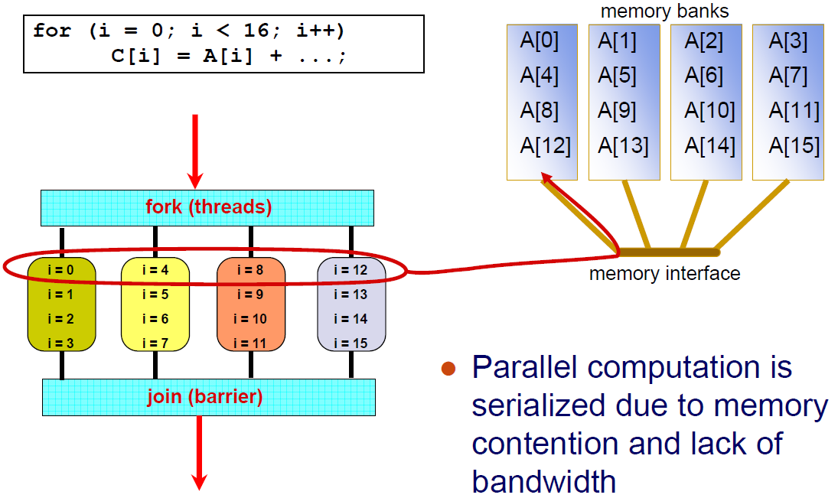
Locality of memory access
(shared memory)

Slide 45
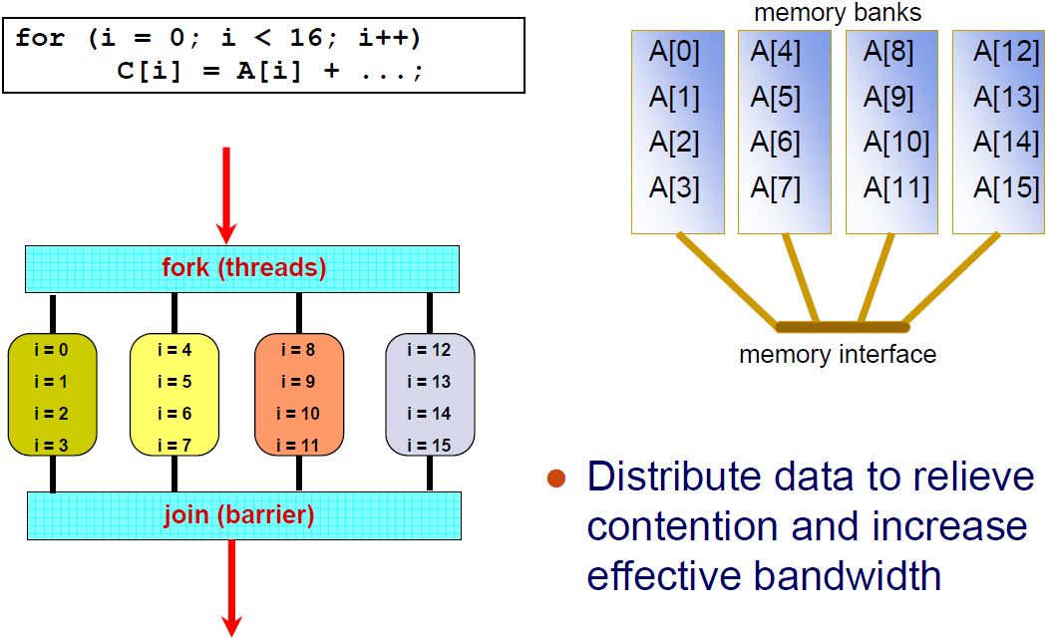
Locality of memory access
(shared memory)

Slide 46
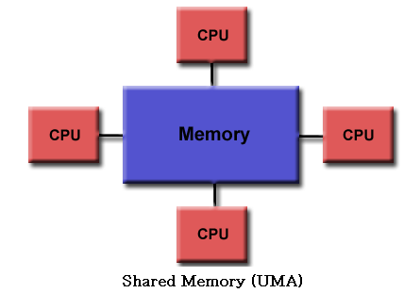
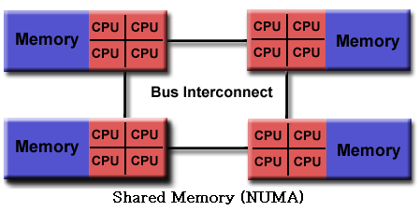
Memory Access Latency in
Shared Memory Architectures
Uniform Memory Access (UMA)
  Centrally located memory
  All processors are equidistant (access times)
Non-Uniform Access (NUMA)
  Physically partitioned but accessible by all
  Processors have the same address space
  Placement of data affects performance
  CC-NUMA (Cache-Coherent NUMA)

Slide 47
Cache Coherence
the uniformity of shared resource data that ends up stored in multiple local caches
Problem: When a processor modifies a shared variable in local cache, different processors may have different value of the variable.
  Copies of a variable can be present in multiple caches
  A write by one processor may not become visible to others
  They'll keep accessing stale value in their caches
  Need to take actions to ensure visibility or cache coherence

Slide 48
Cache Coherence
Snooping cache coherence
  Send all requests for data to all processors
  Works well for small systems
Directory-based cache coherence
  Keep track of what is being shared in a directory
  Send point-to-point requests to processors

Slide 49
Shared Memory Architecture
all processors to access all memory as global address space. (UMA , NUMA)
Advantage
  Global address space provides a user-friendly programming perspective to memory
  Data sharing between tasks is both fast and uniform due to the proximity of memory to CPUs
Disadvantage
  Primary disadvantage is the lack of scalability between memory and CPUs
  Programmer responsibility for synchronization
  Expense: it becomes increasingly difficult and expensive to design and produce shared memory machines with ever increasing numbers of processors.

Slide 50
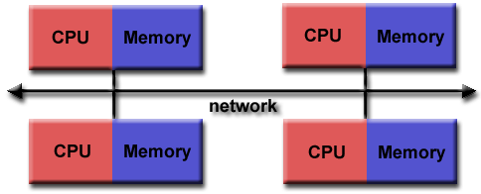
Distributed Memory Architecture
Characteristics
  Only private(local) memory
  Independent
  require a communication network to connect inter-processor memory
Advantages
  Scalable (processors, memory)
  Cost effective
Disadvantages
  Programmer responsibility of data communication
  No global memory access
  Non-uniform memory access time

Slide 51
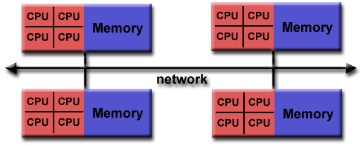
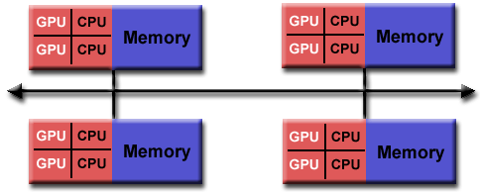
Hybrid Architecture
Advantages/Disadvantage
  Combination of Shared/Distributed architecture
  Scalable
  Increased programmer complexity

Slide 52
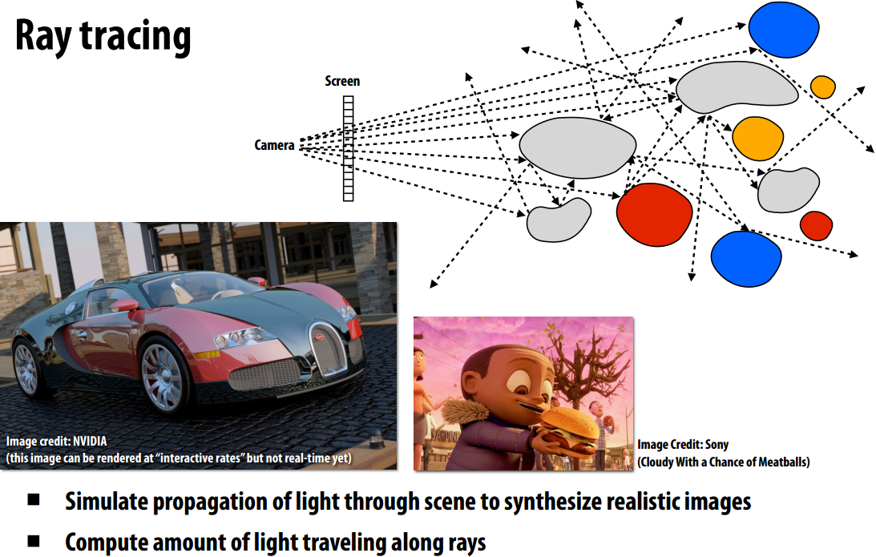
Example of Parallel Program

Slide 53
Ray Tracing
Shoot a ray into scene through every pixel in image plane
Follow their paths
  they bounce around as they strike objects
  they generate new rays: ray tree per input ray
Result is color and opacity for that pixel
Parallelism across rays

