Slide 1
Lecture 3 : Performance of Parallel Programs
Courtesy : MIT Prof. Amarasinghe and Dr. Rabbah’s course note
Introduction to Parallel Computing (Blaise Barney, LLNL)

Slide 2
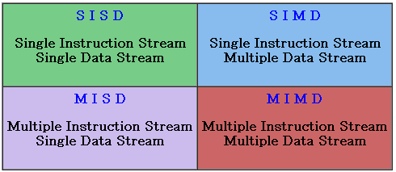
Flynn’s Taxonomy on Parallel Computer
Classified with two independent dimension
Instruction stream
Data stream

Slide 3
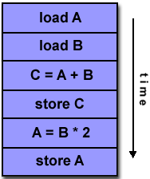
SISD (Single Instruction, Single Data)
A serial (non-parallel) computer
This is the oldest and even today, the most common type of computer

Slide 4
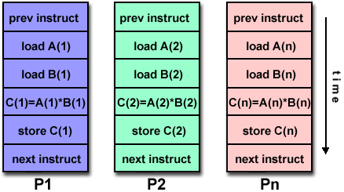
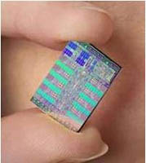
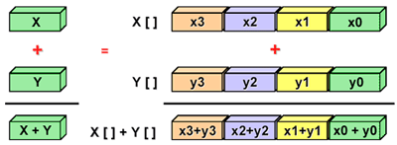
SIMD (Single Instruction, Multiple Data)
All processing units execute the same instruction at any given clock cycle
Best suited for specialized problems characterized by a high degree of regularity, such as graphics/image processing.
<GPU>

Slide 5
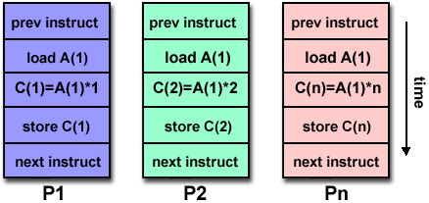
MISD (Multiple Instruction, Single Data)
Each processing unit operates on the data independently via separate instruction streams.
Few actual examples of this class of parallel computer have ever existed.

Slide 6
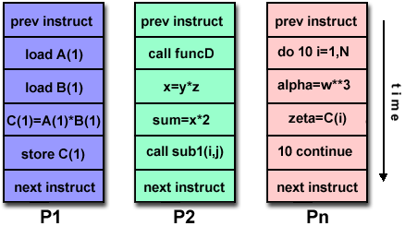
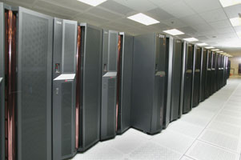
MIMD (Multiple Instruction, Multiple Data)
Every processor may be executing a different instruction stream
Every processor may be working with a different data stream
the most common type of parallel computer
Most modern supercomputers fall into this category
< IBM Power 5>

Slide 7
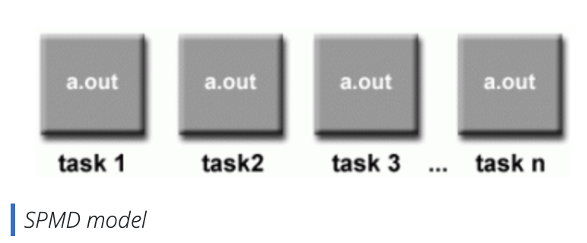
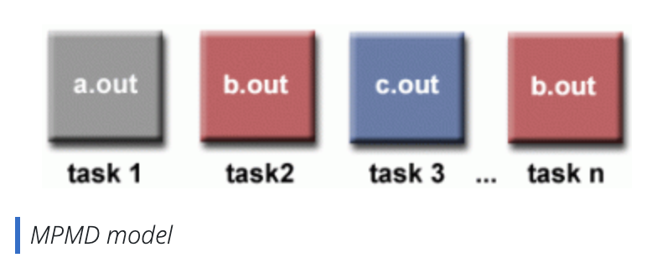
Parallel Program Models
SPMD (Single Program Multiple Data)
All tasks execute their copy of
the same program simultaneously
All tasks may use different data
MPMD (Multiple Program Multiple Data)
Tasks may execute different
programs simultaneously
All tasks may use different data

Slide 8
Types of Parallelism
Task Parallelism
Data Parallelism
Different operations performed on same or different data
Usually a modest number of tasks unleashing a modest amount of parallelism
Same operations performed on different data
Potentially massive amounts of data unleashing massive amounts of parallelism
Most suitable for GPUs
Data 1
Data 2
Data 1
Data 2
Data 3
Data 4
Data 5
Task A
Task B
Task C
Task A
Task A
Task A
Task A
Task A
Slides from Prof. Hwu et al, Programming Massively Parallel Processors

Slide 9
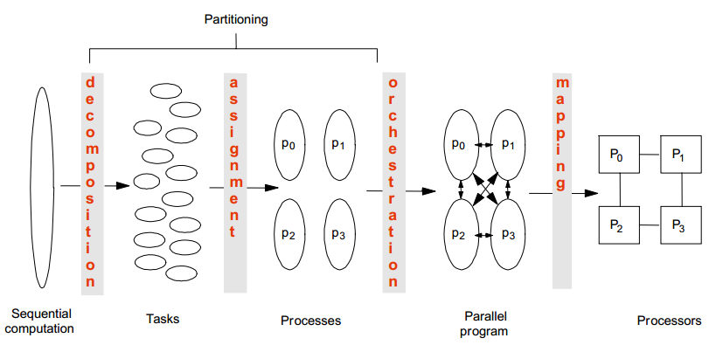
Creating a Parallel Program
Decomposition
Assignment
Orchestration/Mapping

Slide 10
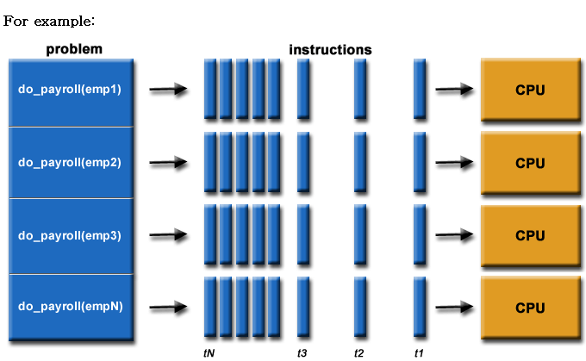
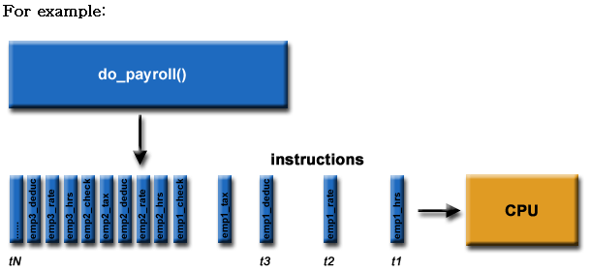
Decomposition
Break up computation into tasks to be divided among processes
identify concurrency and decide level at which to exploit it

Slide 11
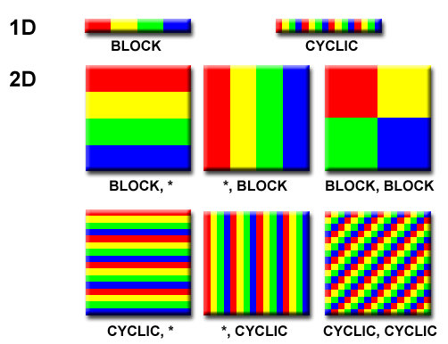
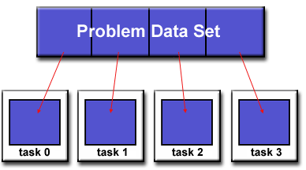
Domain Decomposition
data associated with a problem is decomposed.
Each parallel task then works on a portion of data.

Slide 12
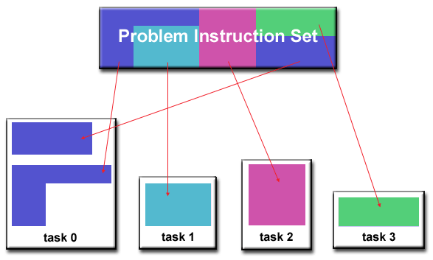
Functional Decomposition
the focus is on the computation that is to be performed rather than on the data
problem is decomposed according to the work that must be done.
Each task then performs a portion of the overall work.

Slide 13
Assignment
Assign tasks to threads
Balance workload, reduce communication and management cost
Together with decomposition, also called partitioning
Can be performed statically, or dynamically
Goal
Balanced workload
Reduced communication costs

Slide 14
Orchestration
Structuring communication and synchronization
Organizing data structures in memory and scheduling tasks temporally
Goals
Reduce cost of communication and synchronization as seen by processors
Reserve locality of data reference (including data structure organization)

Slide 15
Mapping
Mapping threads to execution units (CPU cores)
Parallel application tries to use the entire machine
Usually a job for OS
Mapping decision
Place related threads (cooperating threads) on the same processor
maximize locality, data sharing, minimize costs of comm/sync

Slide 16
Performance of Parallel Programs
What factors affect the performance ?
Decomposition
Coverage of parallelism in algorithm
Assignment
Granularity of partitioning among processors
Orchestration/Mapping
Locality of computation and communication

Slide 17
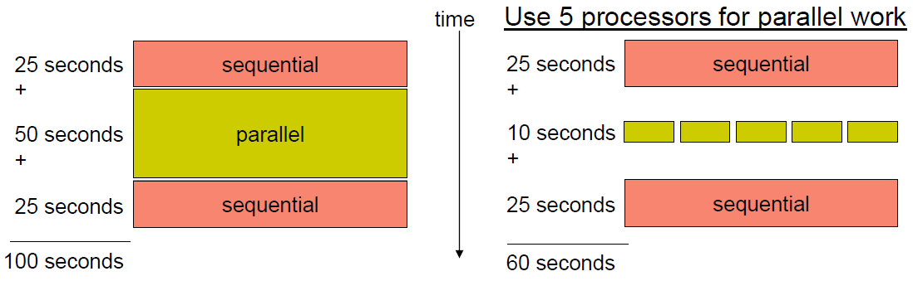
Coverage (Amdahl’s Law)
Potential program speedup is defined by the fraction of code that can be parallelized

Slide 18
Amdahl’s Law
Speedup = old running time / new running time
= 100 sec / 60 sec
= 1.67
(parallel version is 1.67 times faster)

Slide 19
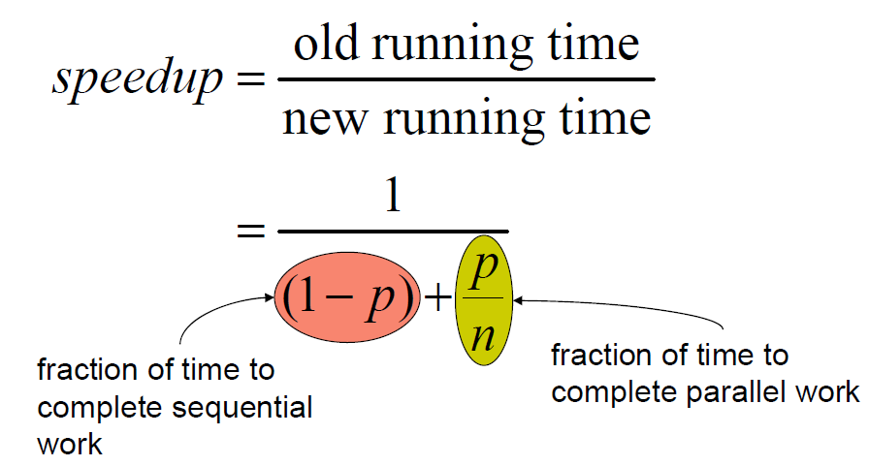
Amdahl’s Law
p = fraction of work that can be parallelized
n = the number of processor
Speedup < 1/(1-p) as n → infinity

Slide 20
Implications of Amdahl’s Law
Speedup tends to 1/(1-p) as number of processors tends to infinity
Even if the parallel part speeds up perfectly performance is limited by the sequential part
Parallel programming is worthwhile when programs have a lot of work that is parallel in nature

Slide 21
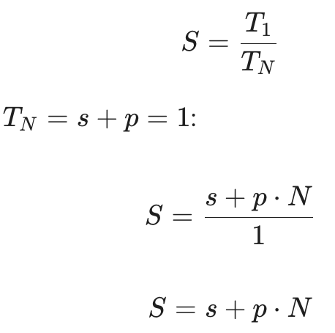
Gustafson’s Law
Amdahl’s law
how much faster you can run a fixed workload
Gustafson’s law
How much more work you can do in the same amount of time by adding processors
s : serial fraction
p : parallel fraction
( s+p = 1 )
N : the number of processors
T₁ : running time on 1 processor
T_{N} : running time on N processor

Slide 22
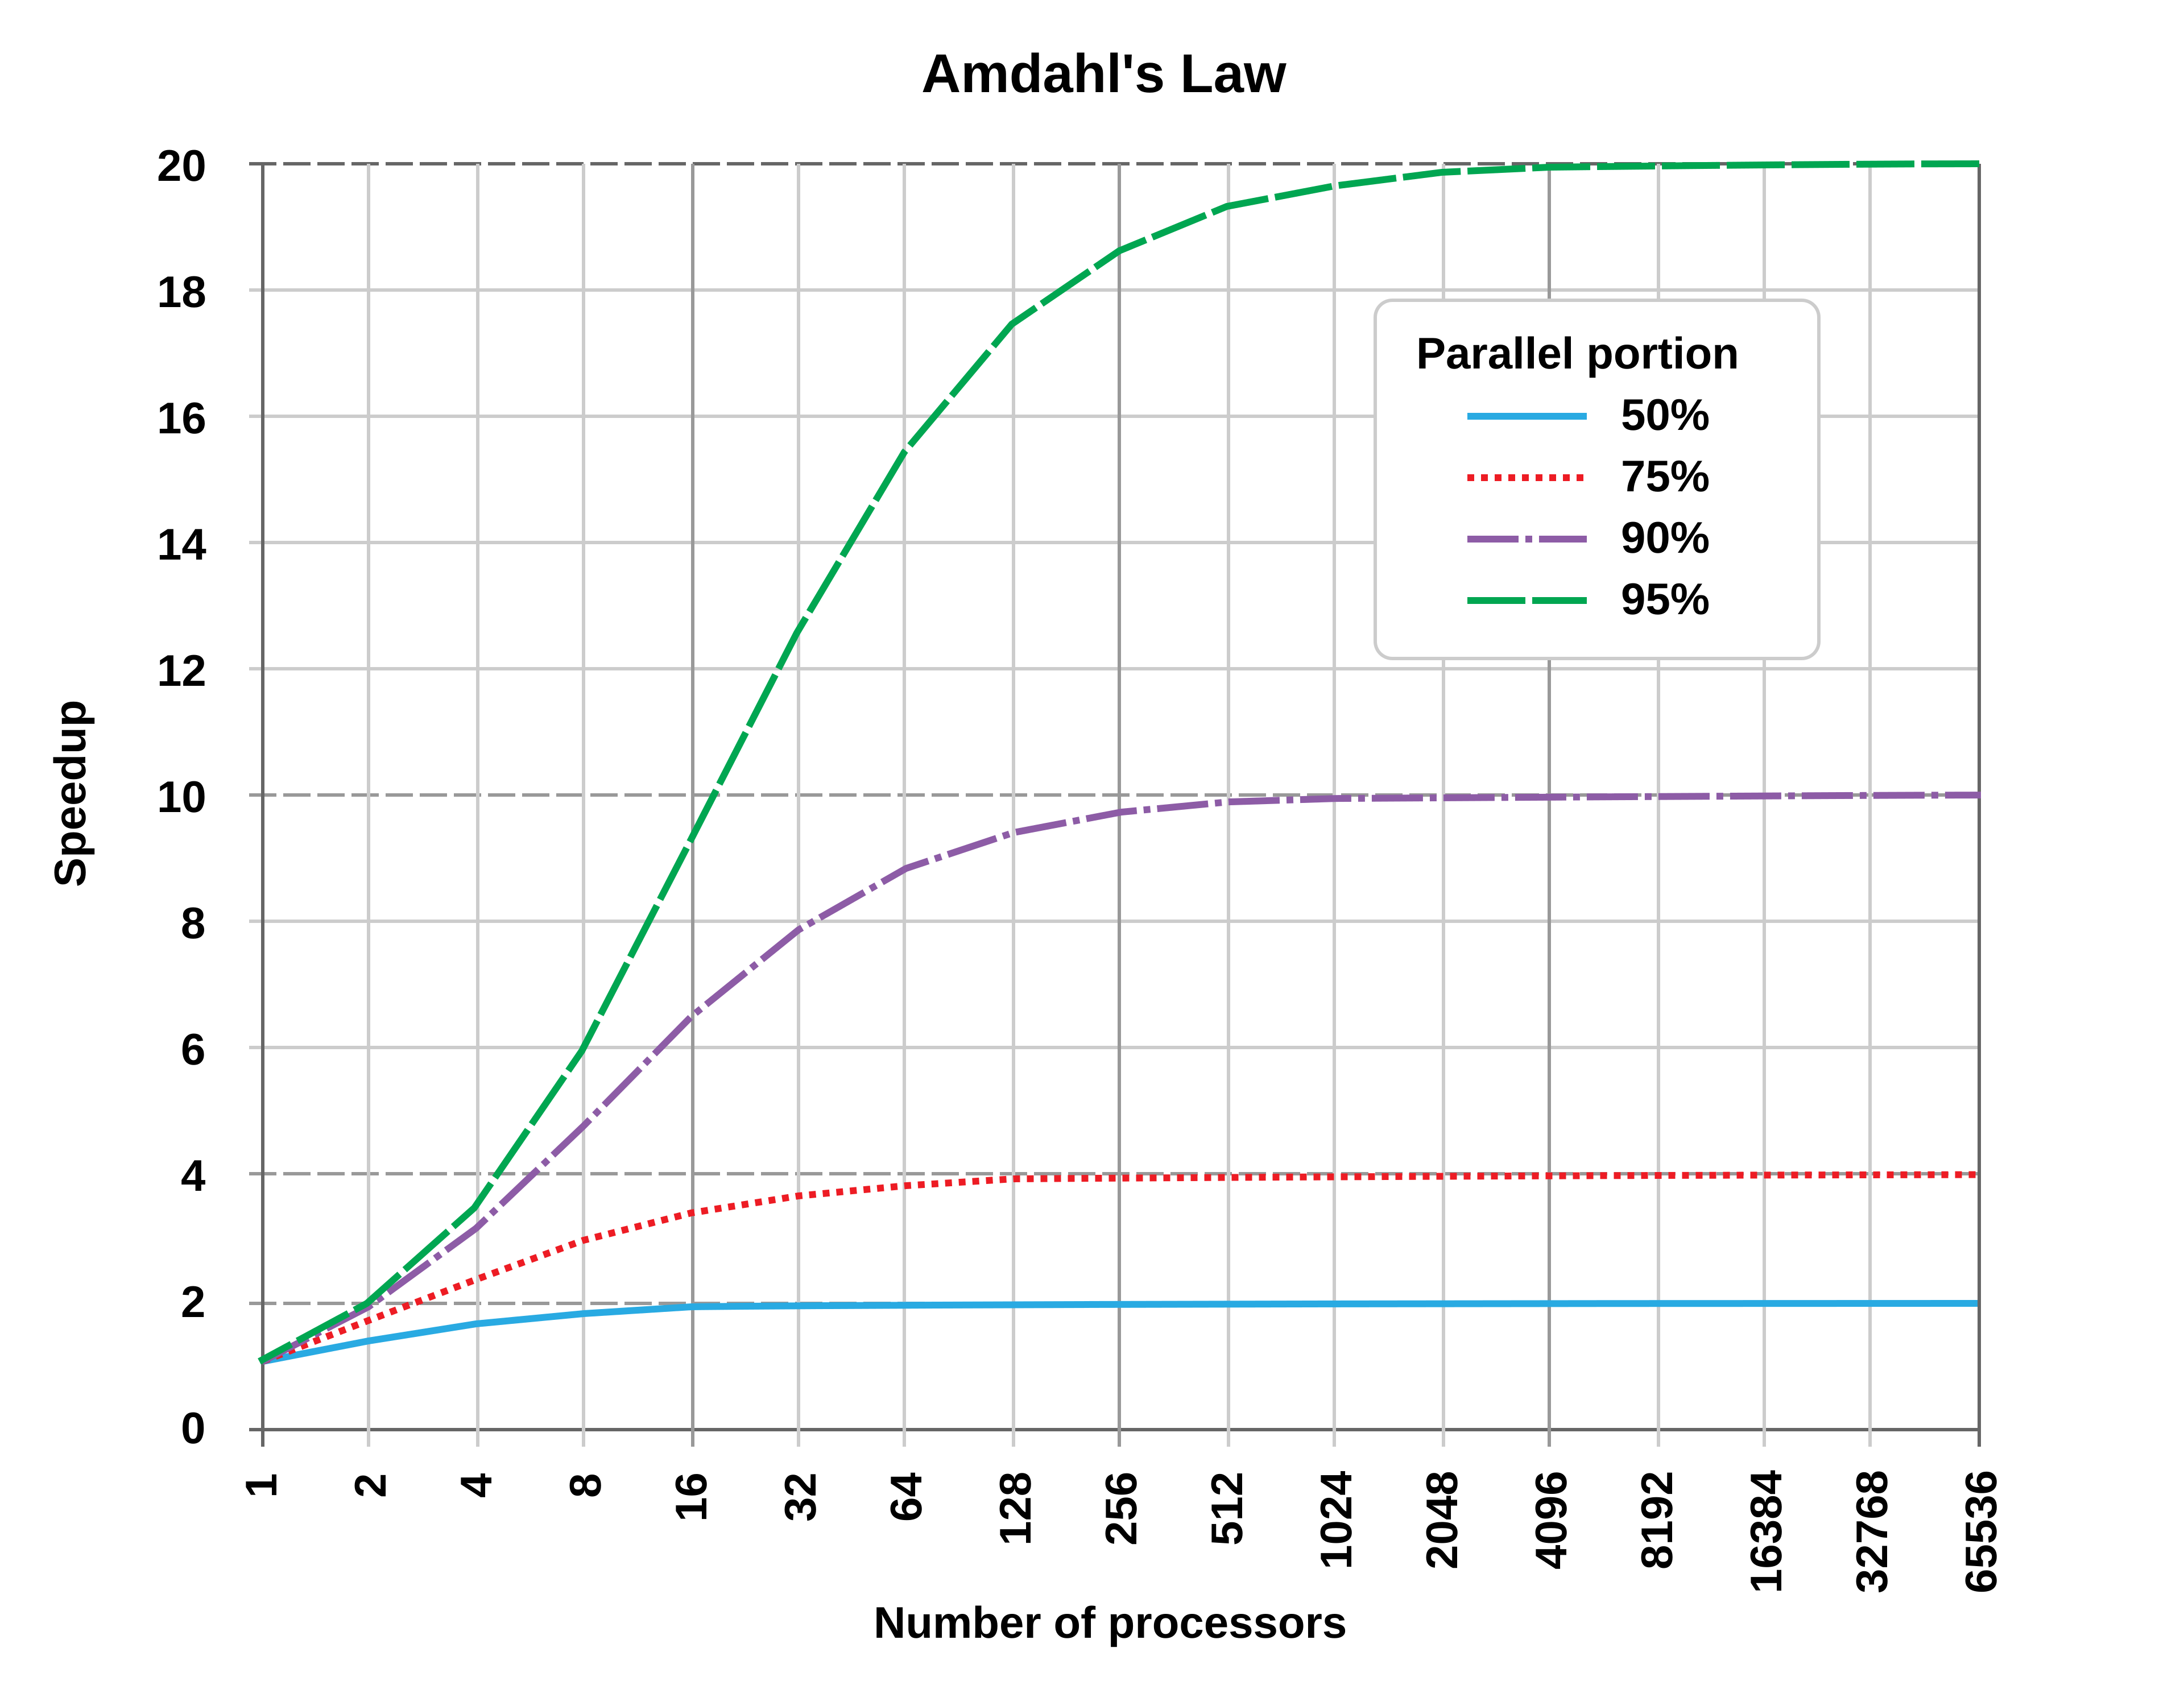
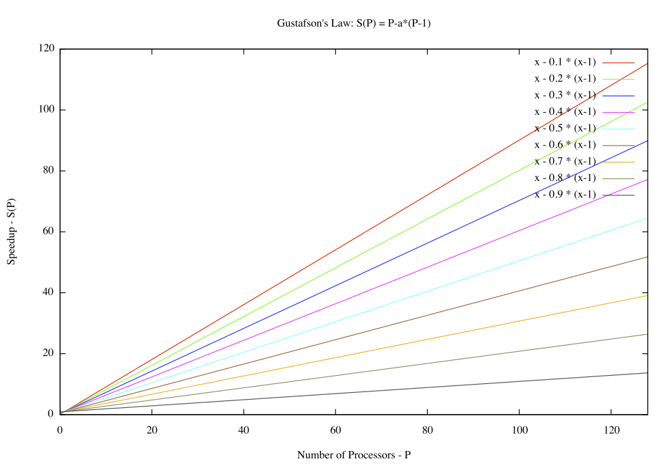
Implications
Amdahl’s law
often pessimistic
(limited speed up)
assumes fixed problem size
Gustafson’s law
Often optimistic
( linear speedup with N)
As we get more powerful computers, we run larger problems in the same amount of time. In this view, the speedup can scale almost linearly with N

Slide 23
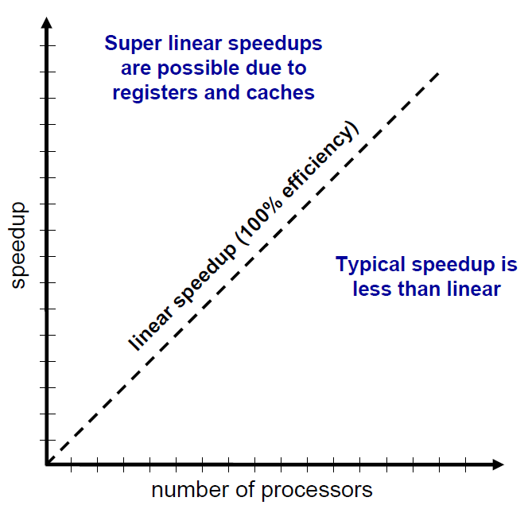
Performance Scalability
Scalability : the capability of a system to increase total throughput under an increased load when resources (typically hardware) are added

Slide 24
Granularity
Granularity is a qualitative measure of the ratio of computation to communication
Coarse: relatively large amounts of computational work are done between communication events
Fine: relatively small amounts of computational work are done between communication events
Computation stages are typically separated from periods of communication by synchronization events

Slide 25
Granularity (from wikipedia)
Granularity
the extent to which a system is broken down into small parts
Coarse-grained systems
consist of fewer, larger components than fine-grained systems
regards large subcomponents
Fine-grained systems
regards smaller components of which the larger ones are composed.

Slide 26
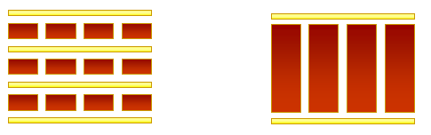
Fine vs. Coarse Granularity
Fine-grain Parallelism
Coarse-grain Parallelism
Low computation to communication ratio
Small amounts of computational work between communication stages
Less opportunity for performance enhancement
High communication overhead
High computation to communication ratio
Large amounts of computational work between communication events
More opportunity for performance increase

Slide 27
Fine vs. Coarse Granularity
The most efficient granularity is dependent on the algorithm and the hardware
In most cases the overhead associated with communications and synchronization is high relative to execution speed so it is advantageous to have coarse granularity.
Fine-grain parallelism can help reduce overheads due to load imbalance.

Slide 28
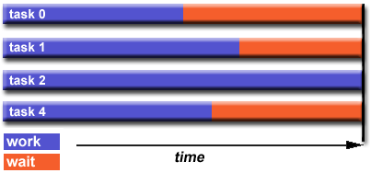
Load Balancing
distributing approximately equal amounts of work among tasks so that all tasks are kept busy all of the time.
It can be considered a minimization of task idle time.
For example, if all tasks are subject to a barrier synchronization point, the slowest task will determine the overall performance.

Slide 29
General Load Balancing Problem
The whole work should be completed as fast as possible.
As workers are very expensive, they should be kept busy.
The work should be distributed fairly. About the same amount of work should be assigned to every worker.
There are precedence constraints between different tasks (we can start building the roof only after finishing the walls). Thus we also have to find a clever processing order of the different jobs.

Slide 30
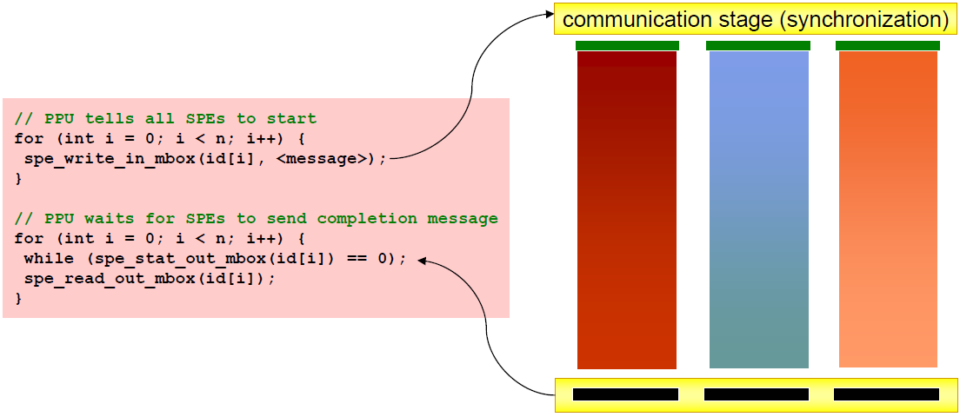
Load Balancing Problem
Processors that finish early have to wait for the processor with the largest amount of work to complete
Leads to idle time, lowers utilization

Slide 31
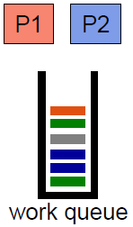
Static load balancing
Programmer make decisions and assigns a fixed amount of work to each processing core a priori
Low run time overhead
Works well for homogeneous multicores
All core are the same
Each core has an equal amount of work
Not so well for heterogeneous multicores
Some cores may be faster than others
Work distribution is uneven

Slide 32
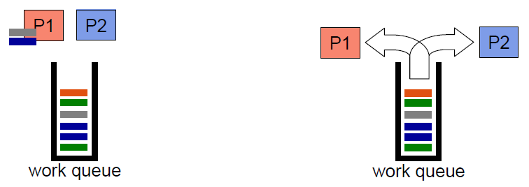
Dynamic Load Balancing
When one core finishes its allocated work, it takes work from a work queue or a core with the heaviest workload
Adapt partitioning at run time to balance load
High runtime overhead
Ideal for codes where work is uneven, unpredictable, and in heterogeneous multicore

Slide 33
Granularity and Performance Tradeoffs
Load balancing
How well is work distributed among cores?
Synchronization/Communication
Communication Overhead?

Slide 34
Communication
With message passing, programmer has to understand the computation and orchestrate the communication accordingly
Point to Point
Broadcast (one to all) and Reduce (all to one)
All to All (each processor sends its data to all others)
Scatter (one to several) and Gather (several to one)

Slide 35
Factors to consider for communcation
Cost of communications
Inter-task communication virtually always implies overhead.
Communications frequently require some type of synchronization between tasks, which can result in tasks spending time ‘waiting’ instead of doing work.

Slide 36
Factors to consider for communcation
Latency vs Bandwidth
Latency
the time it takes to send a minimal (0 byte) message from point A to point B.
Bandwidth
the amount of data that can be communicated per unit of time.
Sending many small messages can cause latency to dominate communication overheads.
Often it is more efficient to package small messages into a larger message.

Slide 37
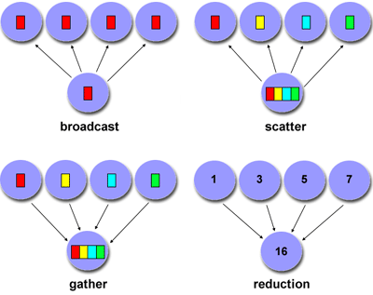
Factors to consider for communcation
synchronous vs asynchronous
Synchronous : require some type of ‘handshaking’ between tasks that share data
Asynchronous : transfer data independently from one another.
Scope of communication
Point-to-point
collective

Slide 38
MPI : Message Passing Library
MPI : portable specification
Not a language or compiler specification
Not a specific implementation or product
SPMD model (same program, multiple data)
For parallel computers, clusters, and heterogeneous networks, multicores
Multiple communication modes allow precise buffer management
Extensive collective operations for scalable global communication

Slide 39
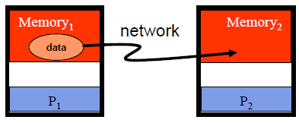
Point-to-Point
Basic method of communication between two processors
Originating processor "sends" message to destination processor
Destination processor then "receives" the message
The message commonly includes
Data or other information
Length of the message
Destination address and possibly a tag

Slide 40
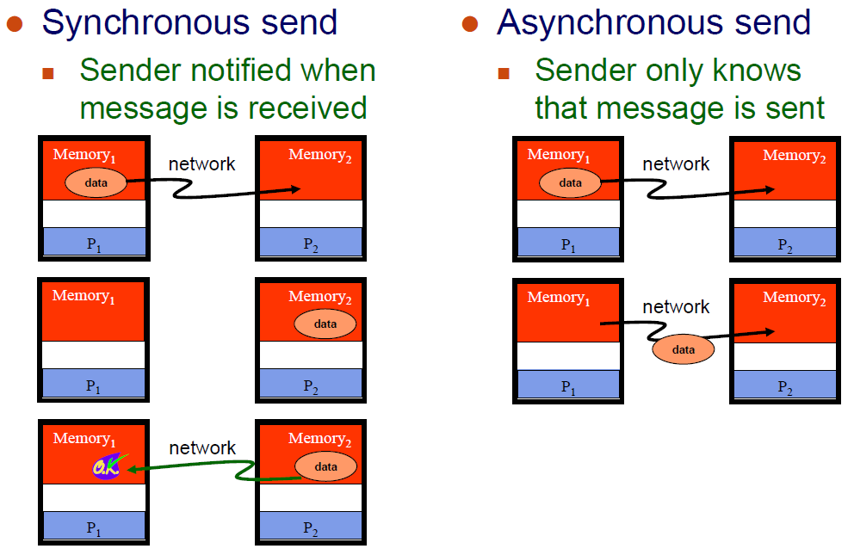
Synchronous vs. Asynchronous Messages

Slide 41
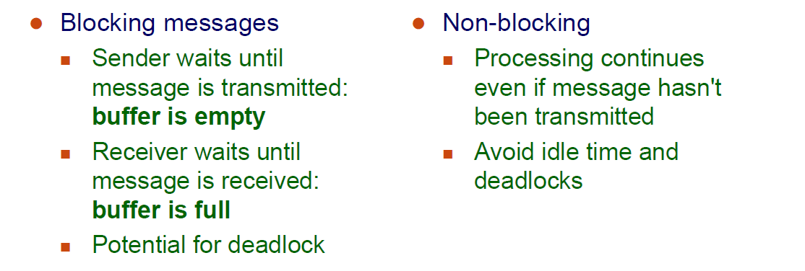
Blocking vs. Non-Blocking Messages

Slide 42
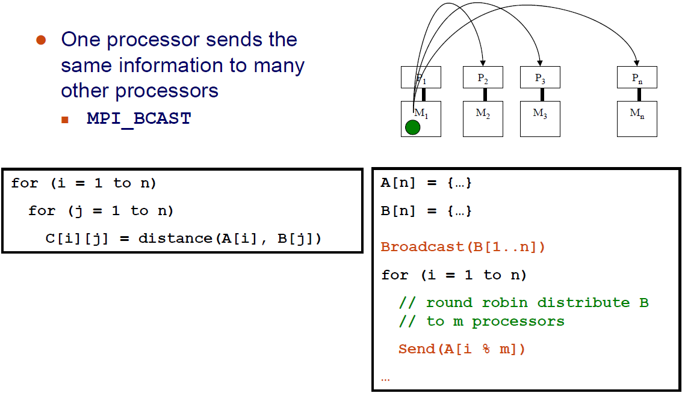
Broadcast

Slide 43
Reduction
Example: every processor starts with a value and needs to know the sum of values stored on all processors
A reduction combines data from all processors and returns it to a single process
MPI_REDUCE
Can apply any associative operation on gathered data
ADD, OR, AND, MAX, MIN, etc.
No processor can finish reduction before each processor has contributed a value
BCAST/REDUCE can reduce programming complexity and may be more efficient in some programs

Slide 44
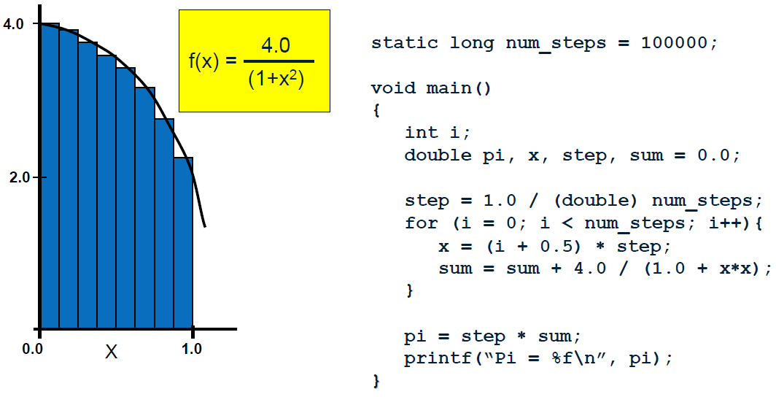
Example : Parallel Numerical Integration

Slide 45
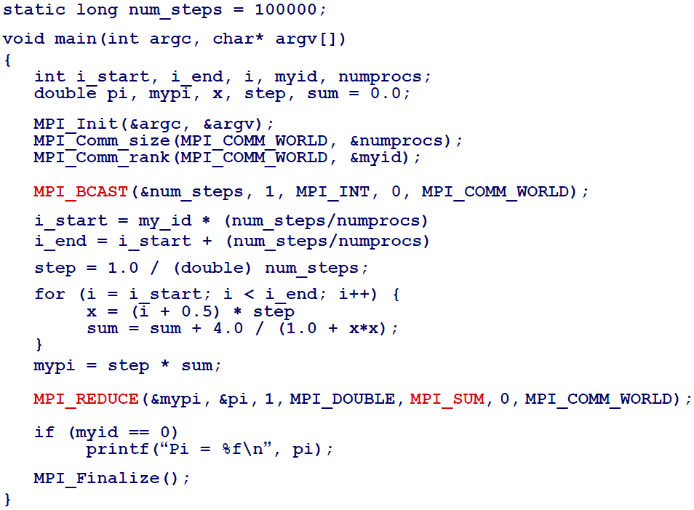
Computing the Integration (MPI)

Slide 46
Synchronization
Coodination of simultaneous events (threads / processes) in order to obtain correct runtime order and avoid unexpected condition
Types of synchronization
Barrier
Any thread/process must stop at this point(barrier) and cannot proceed until all other threads/processes reach this barrier
Lock/semaphore
The first task acquires the lock. This task can then safely (serially) access the protected data or code.
Other tasks can attempt to acquire the lock but must wait until the task that owns the lock releases it.

Slide 47
Locality
Conventional
Storage
Hierarchy
Proc
Proc
Proc
Cache
Cache
Cache
L2 Cache
L2 Cache
L2 Cache
L3 Cache
L3 Cache
L3 Cache
potential
interconnects
Memory
Memory
Memory
Large memories are slow, fast memories are small
Storage hierarchies are large and fast on average
Parallel processors, collectively, have large, fast cache
the slow accesses to “remote” data we call “communication”
Algorithm should do most work on local data
Need to exploit spatial and temporal locality

Slide 48
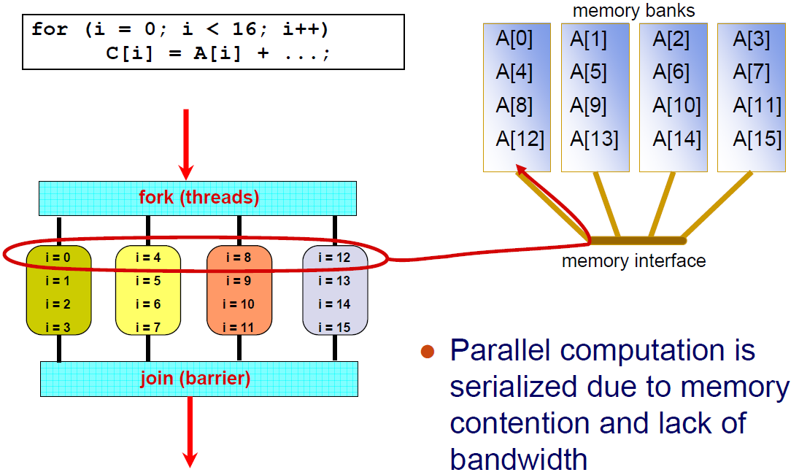
Locality of memory access (shared memory)

Slide 49
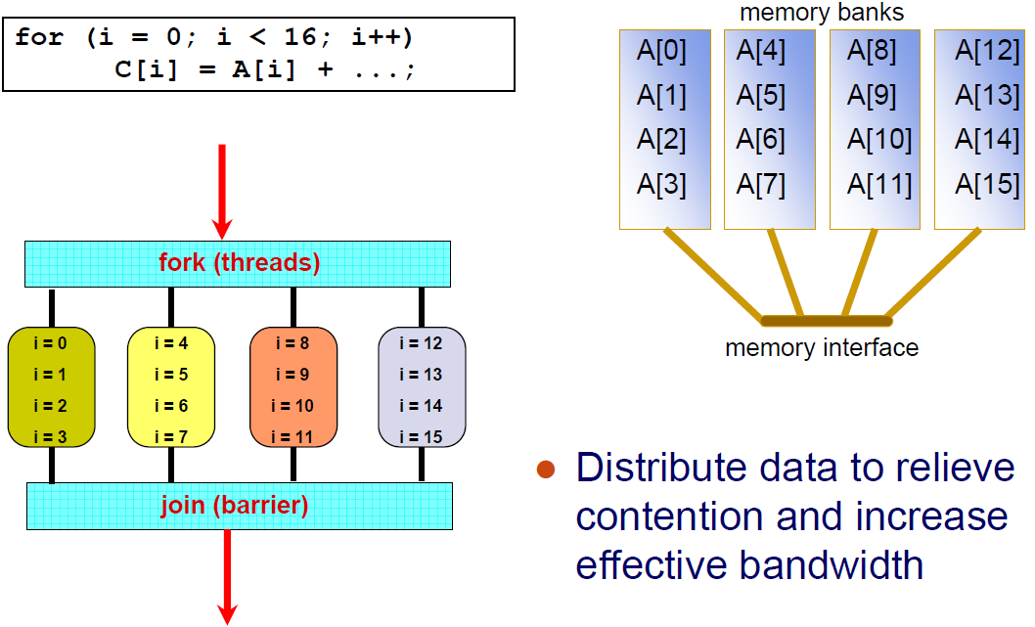
Locality of memory access (shared memory)

Slide 50
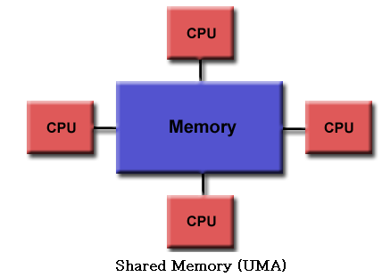
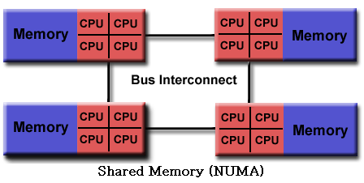
Memory Access Latency in Shared Memory Architectures
Uniform Memory Access (UMA)
Centrally located memory
All processors are equidistant (access times)
Non-Uniform Access (NUMA)
Physically partitioned but accessible by all
Processors have the same address space
Placement of data affects performance
CC-NUMA (Cache-Coherent NUMA)

Slide 51
Cache Coherence
the uniformity of shared resource data that ends up stored in multiple local caches
Problem: When a processor modifies a shared variable in local cache, different processors may have different value of the variable.
Copies of a variable can be present in multiple caches
A write by one processor may not become visible to others
They'll keep accessing stale value in their caches
Need to take actions to ensure visibility or cache coherence

Slide 52
Cache Coherence
Snooping cache coherence
Send all requests for data to all processors
Works well for small systems
Directory-based cache coherence
Keep track of what is being shared in a directory
Send point-to-point requests to processors

Slide 53
Shared Memory Architecture
all processors to access all memory as global address space. (UMA , NUMA)
Advantage
Global address space provides a user-friendly programming perspective to memory
Data sharing between tasks is both fast and uniform due to the proximity of memory to CPUs
Disadvantage
Primary disadvantage is the lack of scalability between memory and CPUs
Programmer responsibility for synchronization
Expense: it becomes increasingly difficult and expensive to design and produce shared memory machines with ever increasing numbers of processors.

Slide 54
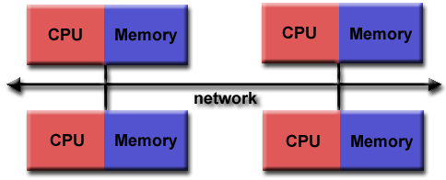
Distributed Memory Architecture
Characteristics
Only private(local) memory
Independent
require a communication network to connect inter-processor memory
Advantages
Scalable (processors, memory)
Cost effective
Disadvantages
Programmer responsibility of data communication
No global memory access
Non-uniform memory access time

Slide 55
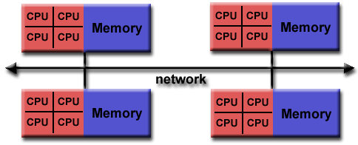
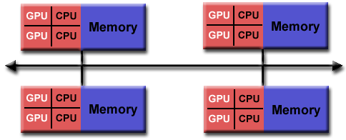
Hybrid Architecture
Advantages/Disadvantage
Combination of Shared/Distributed architecture
Scalable
Increased programmer complexity

Slide 56
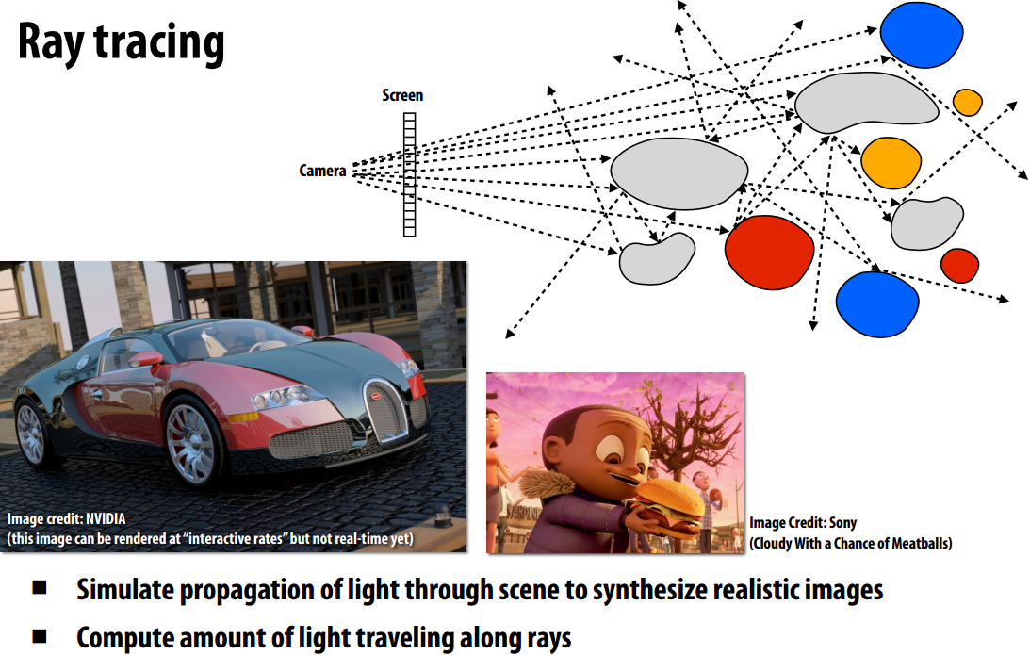
Example of Parallel Program

Slide 57
Ray Tracing
Shoot a ray into scene through every pixel in image plane
Follow their paths
they bounce around as they strike objects
they generate new rays: ray tree per input ray
Result is color and opacity for that pixel
Parallelism across rays

Slide 58
Multithreading Benefits
Better CPU utilization (better throughput)
Blocking I/O + processing
More responsive programs
ex) server loop with listen-for/process request
ex) GUI
More fair distribution of CPU resources
High performance (parallel execution)

Slide 59
Multithreading costs
More complex design
ex) shared data access, thread interaction, bug fix
Context switching overhead
Saving local data and etc of current thread
Load the local data and etc of next thread
Increased resource consumption
Thread memory (local stack), OS management
Thread creation/deletion overhead

