Slide 1
Lecture 4 : Basics of JAVA Thread Programming
Courtesy : MIT Prof. Amarasinghe and Dr. Rabbah’s course note
Prof. Dr. Alois Schütte’s lecture notes
Java in Jenkov.com (Jacob Jenkov)

Slide 2
Process
Process
Operating system abstraction to represent what is needed to run a single program
a sequential stream of execution in its own address space
program in execution

Slide 3
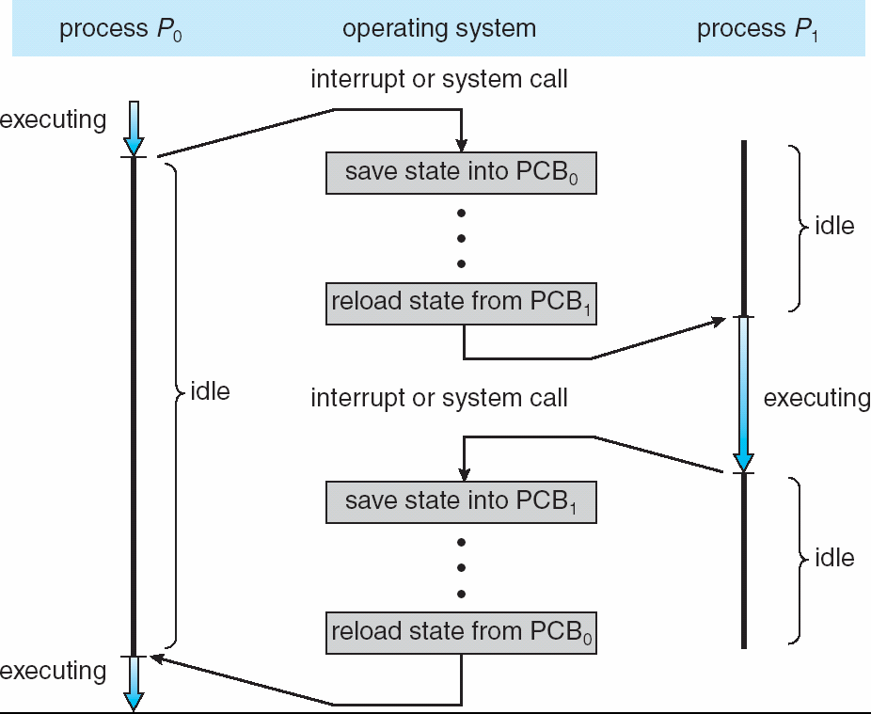
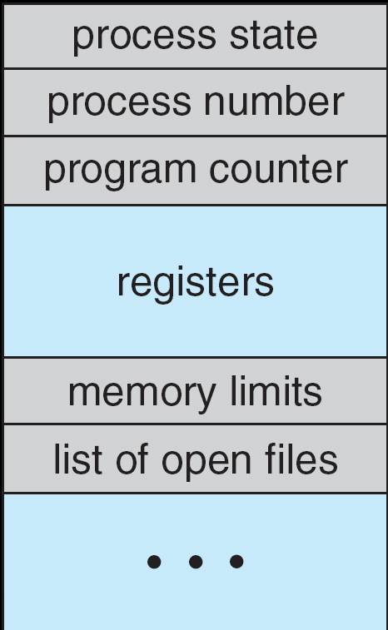
Switch from process to process
PCB

Slide 4
UNIX process
Every process, except process 0, is created by the fork() system call
fork() allocates entry in process table and assigns a unique PID to the child process
child gets a copy of process image of parent
both child and parent are executing the same code following fork()

Slide 5
Process Creation
main ()
{
int pid;
cout<< “just one process so far”<<endl;
pid= fork();
if (pid==0)
cout<<“im the child“<< endl;
else if (pid> 0)
cout<<“im the parent”<< endl;
else
cout<< “fork failed”<< endl;
}

Slide 6
Threads
Definition
single sequential flow of control within a program
A thread runs within the context of a program’s process and takes advantage of the resources allocated for that process and it’s environment
Each thread is comprised of (from OS perspective)
Program counter
Register set
Stack
Threads belonging to the same process share
Code section
Data section
OS resources such as open files

Slide 7
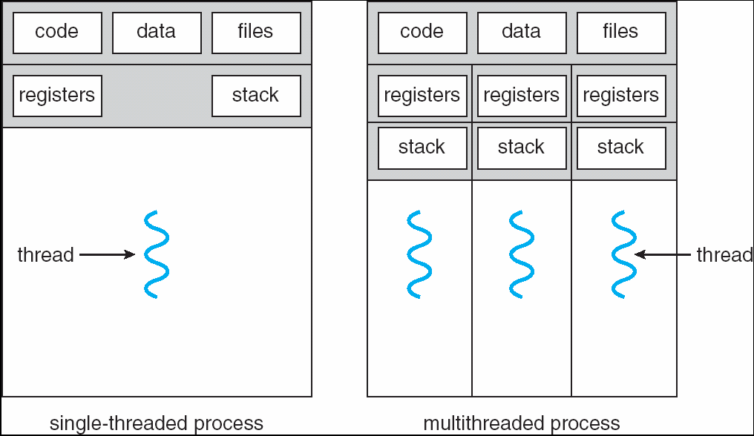
Single and multithreaded program
Shared among threads

Slide 8
Multi-process vs Multi-thread
Process
Child process gets a copy of parents variables
Relatively expensive to start
Don't have to worry about concurrent access to variables
Thread
Child process shares parent’s variables
Relatively cheap to start
Concurrent access to variables is an issue

Slide 9
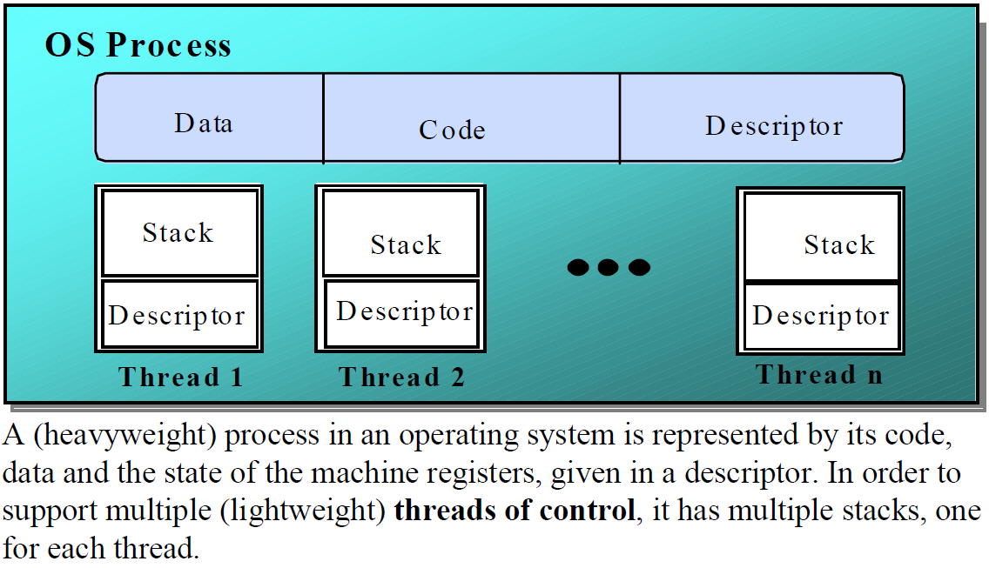
Implementing processes -the OS view

Slide 10
Programming JAVA threads

Slide 11
JAVA Threading Models
Java has threads built-in (java.lang.thread)
Applications consist of at least one thread
Often called ‘main’
The Java Virtual Machine creates the initial thread which executes the main method of the class passed to the JVM
The methods executed by the ‘main’ thread can then create other threads

Slide 12
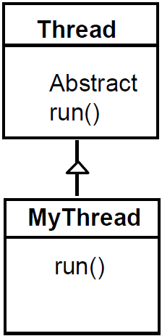
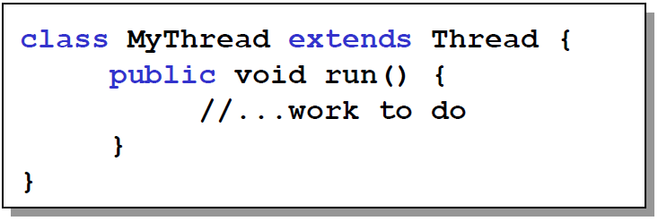
Creating Threads : method 1
A Thread class manages a single sequential thread of control.
The Thread class executes instructions from
its method run().
MyThread t = new MyThread();
t.start();
Note: the invocation returns immediately to the caller

Slide 13
(method 1) anonymous subclass
You can also create
an anonymous subclass of Thread
example code
Thread t = new Thread() {
public void run() {
System.out.println(“Thread Running”);
}
}
t.start();

Slide 14
example1
// ThreadDemo.java
class ThreadDemo
{
public static void main (String [] args)
{
MyThread mt = new MyThread ();
mt.start ();
for (int i = 0; i < 50; i++)
System.out.println ("i = " + i + ", i * i = " + i * i);
}
}
class MyThread extends Thread
{
public void run ()
{
for (int count = 1, row = 1; row < 20; row++, count++)
{
for (int i = 0; i < count; i++)
System.out.print ('*');
System.out.print ('\n');
}
}
}

Slide 15
Thread Names
All threads have a name to be printed out.
The default name is of the format: Thread-No
Thread-1, Thread-2, …
User-deinfed names can be given thru constructor:
Thread myThread= new Thread(“HappyThread”);
Or using the “setName(aString)”method.
There is a method in Thread class, called “getName()”, to obtain a thread’s name

Slide 16
example2
<output>
public class Loop3 extends Thread
{
public Loop3(String name) {
super(name); // pass name to superclass
}
public void run() {
for(int i = 1; i <= 10000; i++)
{
System.out.println(getName() + " (" + i + ")");
try {
sleep(10); // sleep for 10 milisecs
}
catch(InterruptedException e) {
}
}
}
public static void main(String[] args) {
Loop3 t1 = new Loop3("Thread 1");
Loop3 t2 = new Loop3("Thread 2");
Loop3 t3 = new Loop3("Thread 3");
t1.start();
t2.start();
t3.start();
}
}
java Loop3
…
Thread 1 (100)
Thread 2 (98)
Thread 3 (97)
Thread 1 (101)
Thread 3 (98)
Thread 2 (99)
Thread 1 (102)
Thread 3 (99)
Thread 2 (100)
Thread 1 (103)
…

Slide 17
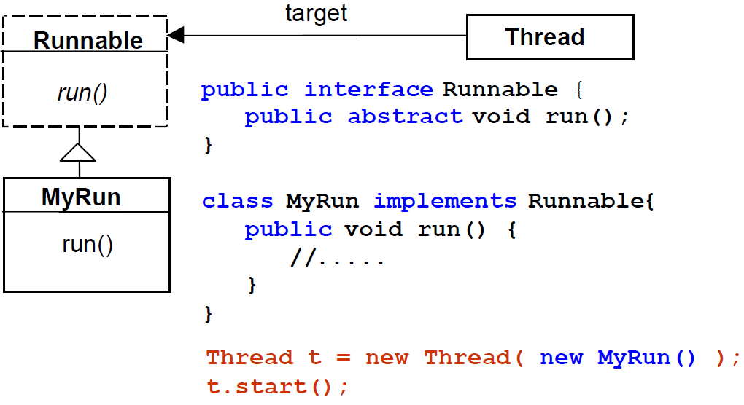
Creating Threads : method 2
Since Java does not permit multiple inheritance, we often implement the run() method in a class not derived from Thread but from the interface Runnable.

Slide 18
Creating & Executing Threads, (Runnable)
Runnable interface has single method
public void run()
Implement a Runnable and define run()
class MyRunnable implements Runnable{
public void run() {
System.out.println(“MyRunnable.run()”);
}
//other methods and data for this class
}

Slide 19
Creating & Executing Threads, (Runnable)
Thread’s run() method invokes the Runnable’s run() method
Class Main {
public static void main(String[] args) {
MyRunnable myrun= new MyRunnable();
Thread t1 = new Thread(myrun);
t1.start();
System.out.println(“InsideMain()”);
}
}

Slide 20
(method 2) three ways
1. Create a Java class that implements
the Runnable interface
2. Create an anonymous class that
implements the Runnable interface
3. Create a Java Lambda expression that
implements the Runnable interface

Slide 21
1. Java Class implements Runnable
2. Anonymous implementation of Runnable
public class MyRunnable implements Runnable {
public void run(){
System.out.println("MyRunnable running");
}
}
MyRunnable r = new MyRunnable();
Thread t = new Thread (r);
t.start();
Runnable r = new Runnable() {
public void run(){
System.out.println("MyRunnable running");
}
}
Thread t = new Thread (r);
t.start();

Slide 22
3. Lambda Implementation of Runnable (conciseness, readability)
Comparison
Runnable r = () -> { System.out.println("MyRunnable running"); };
Thread t = new Thread (r);
t.start();
// Traditional way
Thread t1 = new Thread(new Runnable() {
@Override
public void run() {
System.out.println("Thread 1");
}
});
// Lambda way
Thread t2 = new Thread( () -> System.out.println("Thread 2") );
t1.start();
t2.start();

Slide 23
Calling run() vs start()?
Common mistake
newThread.run() : executed by original thread
newThread.start() : executed by newly created thread
Thread newThread = new Thread(MyRunnable());
newThread.run(); //should be start();

Slide 24
Example : Self-starting Threads
class AutoRun implements Runnable{
public AutoRun() {
new Thread(this).start();
}
public void run() {
System.out.println(“AutoRun.run()”);
}
}
class Main {
public static void main(String[] args) {
AutoRunt1 = new AutoRun();
System.out.println(“InsideMain()”);
}
}

Slide 25
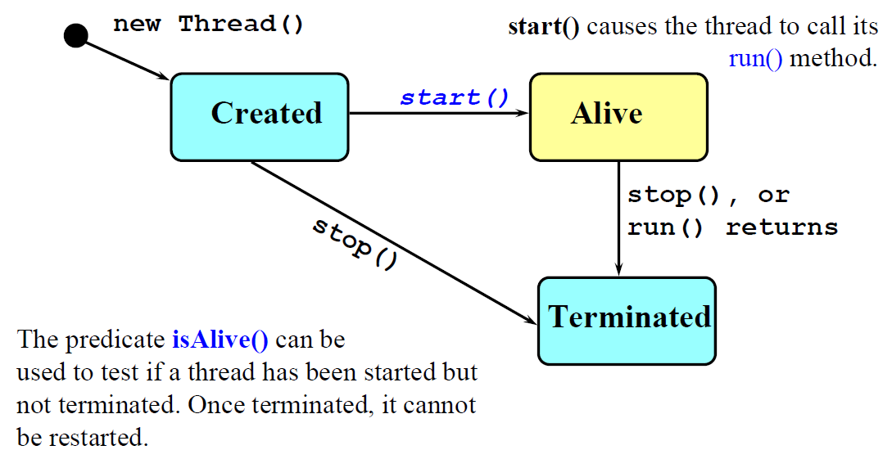
Thread Life-Cycle

Slide 26
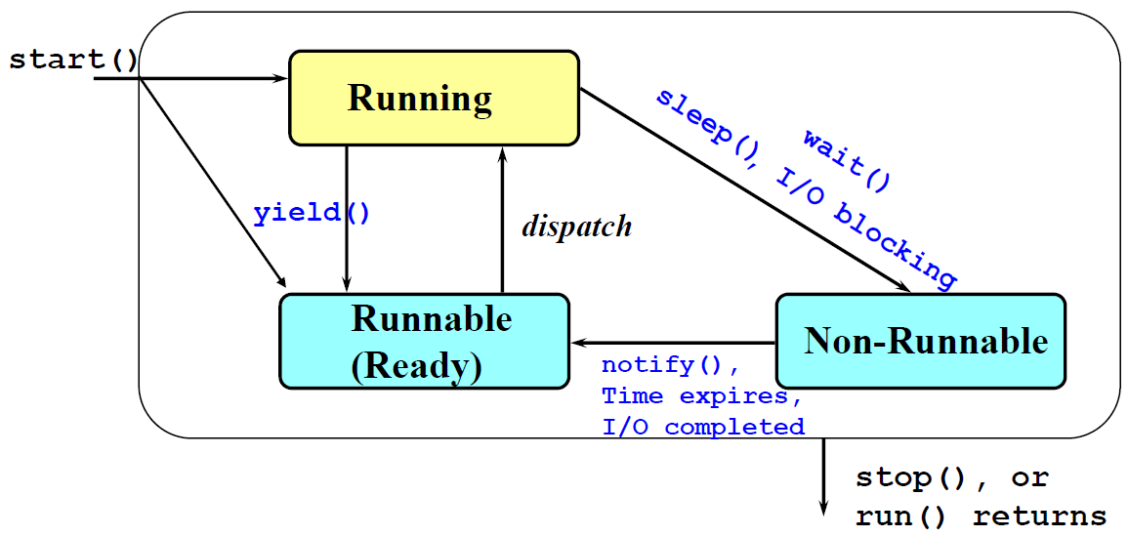
Alive States
Once started, an alivethread has a number of substates

Slide 27
Thread Priority
All Java threads have a priority value, currently between 1 and 10.
Priority can be changed at any time
setPriority(int newPriority)
Initial priority is that of the creating thread
Preemptive scheduling
JVM gives preference to higher priority threads. (Not guaranteed)

Slide 28
yield
Release the right of CPU
static void yield()
allows the scheduler to select another runnable thread (of the same priority)
no guarantees as to which thread

Slide 29
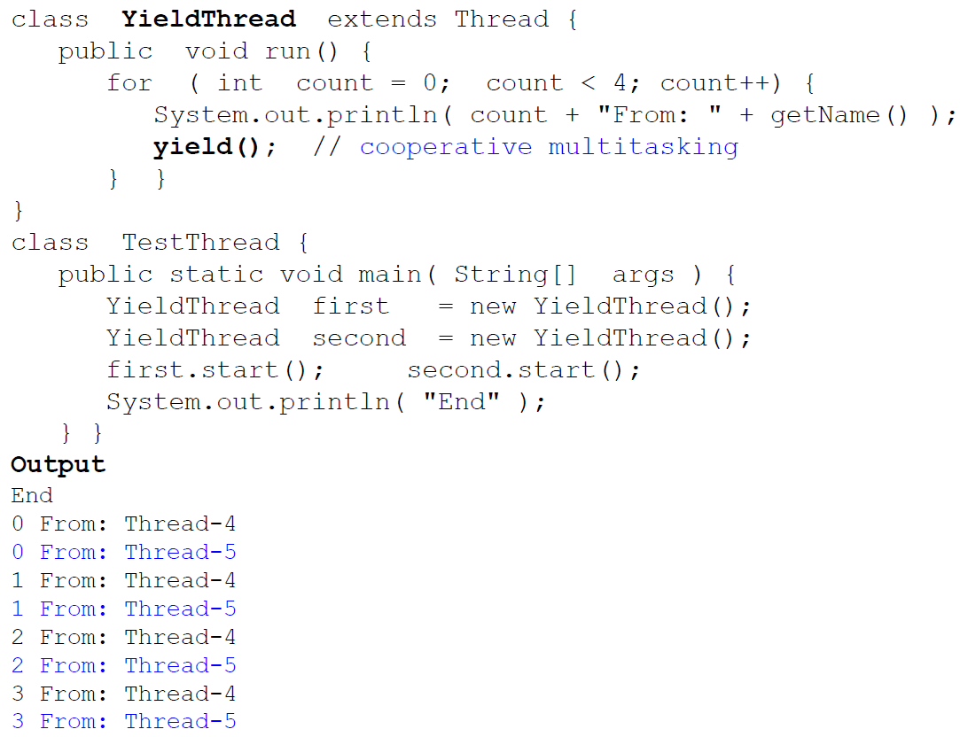

Slide 30
Thread identity
Thread.currentThread()
Returns reference to the running thread
Compare running thread with created thread
class AutoRun implements Runnable{
private Thread _me;
public AutoRun() {
_me = new Thread(this);
_me.start();
}

Slide 31
public void run() {
if (_me == Thread.currentThread())
System.out.println(“AutoRun.run()”);
}
}
class Main {
public static void main(String[] args) {
AutoRun t1 = new AutoRun(); // printout
t1.run(); //no printout
System.out.println(“InsideMain()”);
}
}

Slide 32
Thread sleep, suspend, resume
static void sleep(long millis)
Blocks this thread for at least the time specified
void stop(), void suspend(), void resume()
Deprecated!

Slide 33
Thread Waiting & Status Check
void join(), void join(long), void join(long, int)
One thread (A) can wait for another thread (B) to end
// in thread A
threadB.join()
boolean isAlive()
returns true if the thread has been started and not stopped

Slide 34
Joining a Thread
public class JoinThr
{
static public void main(String s[]) {
MyThread1 Thread_a; // Define a Thread
MyThread2 Thread_b; // Define another Thread
Thread_a = new MyThread1();
Thread_b = new MyThread2(Thread_a);
// Start the threads
System.out.println("Starting the threads...");
Thread_a.start();
Thread_b.start();
}
}

Slide 35
Joining a Thread : MyThread1
// Thread class that just prints a message 5 times
class MyThread1 extends Thread {
public void run(){
System.out.println(getName() + " is running...");
for (int i=0; i<4; i++) {
try { // Sleep a bit
sleep(500);
}
catch (InterruptedException e) {}
System.out.println("Hellothere, from"+getName());
}
}
}

Slide 36
Joining a Thread : MyThread2
class MyThread2 extends Thread {
private Thread wait4me; // Thread to wait for
// Constructor
MyThread2(Thread target) {
super();
wait4me = target;
}
public void run(){
System.out.println(getName() + " is waiting for " + wait4me.getName() + "...");
try { // wait for target thread to finish
wait4me.join();
}
catch (InterruptedException e) {}
// …

Slide 37
Joining a Thread : MyThread2
System.out.println(wait4me.getName() + "has finished...");
// Print message 4 times
for (int i=0; i<4; i++) {
try { // Sleep a bit
sleep(500);
}
catch (InterruptedException e) {}
System.out.println("Hellothere, from " + getName());
}
}
}

Slide 38
Output result
Hello There, From Thread-4
Hello There, From Thread-4
Hello There, From Thread-4
Hello There, From Thread-4
Thread-4 has finished..
Hello There, From Thread-5
Hello There, From Thread-5
Hello There, From Thread-5
Hello There, From Thread-5

Slide 39
Thread synchronization
The advantage of threads is that they allow many things to happen at the same time
The problem with threads is that they allow many things to happen at the same time
Thread Safety
correctness (making sure nothing bad happens) with multiple threads
common problem: race condition
Liveness :
Progress (making sure something good eventually happens)
common problems: deadlock, starvation, livelock

Slide 40
Liveness issues
Deadlock
Two or more threads stop and wait for each other
Livelock
Two or more threads continue to execute, but make no progress toward the ultimate goal
Starvation
Some thread gets deferred forever
Lack of fairness
Some threads monopolize resources while others afre left waiting indefinitely

Slide 41
Synchronization
All the interleavings of the threads are not acceptable correct programs
Java provides synchronization mechanism to restrict interleavings
Synchronization serves two purposes:
Ensure safety for shared updates (mutex/lock)
Avoid race conditions
Coordinate actions of threads
Parallel computation (barrier)
Event notification (condition variables)

Slide 42
Key strategies for thread safety
Immutability
Create objects that cannot be modified after creation
Mutual Exclusion (Locking)
Ensuring that only one thread can access a “critical section” of code at a time
Atomic Operations
Using specialized low-level operations that are guaranteed to happen as a single, indivisible step
Prevent other threads from seeing a half-finished state
Thread-Local Storage
Thread with its own private copy of data so there is no shared state

Slide 43
Definitions
Refer to our class webpage for definitions
Synchronization
Mutual exclusion
Critical section
Race condition

Slide 44
Race condition example
simultaneous access to shared data
class Account {
int balance;
public void deposit(int val)
{
balance = balance + val;
}
}

Slide 45
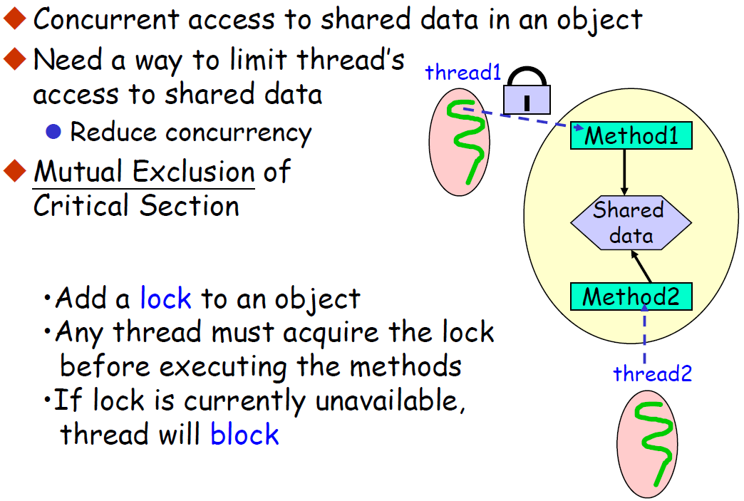
Thread Synchronization

Slide 46
Synchronized JAVA methods
We can control access to an object by using the synchronized keyword
Using the synchronized keyword will force the lock on the object to be used
synchronized methods execute the body as an atomic unit

Slide 47
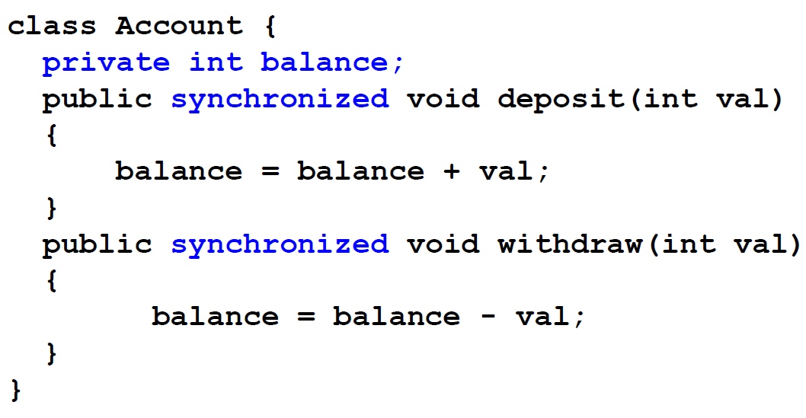
Synchronized Access to Shared Data

Slide 48
Example1 : Need for Sync
// NeedForSynchronizationDemo.java
class NeedForSynchronizationDemo
{
public static void main (String [] args)
{
FinTrans ft = new FinTrans ();
TransThread tt1 = new TransThread (ft, "Deposit Thread");
TransThread tt2 = new TransThread (ft, "Withdrawal Thread");
tt1.start ();
tt2.start ();
}
}
class FinTrans
{
public static String transName;
public static double amount;
}

Slide 49
class TransThread extends Thread
{
private FinTrans ft;
TransThread (FinTrans ft, String name)
{
super (name); // Save thread's name
this.ft = ft; // Save reference to financial transaction object
}
public void run ()
{
for (int i = 0; i < 100; i++)
{
if (getName ().equals ("Deposit Thread"))
{
// Start of deposit thread's critical code section
ft.transName = "Deposit";
try {
Thread.sleep ((int) (Math.random () * 1000));
}
catch (InterruptedException e) {}
ft.amount = 2000.0;
System.out.println (ft.transName + " " + ft.amount);
// End of deposit thread's critical code section
}
else{
// Start of withdrawal thread's critical code section
ft.transName = "Withdrawal";
try {
Thread.sleep ((int) (Math.random () * 1000));
}
catch (InterruptedException e) {}
ft.amount = 250.0;
System.out.println (ft.transName + " " + ft.amount);
// End of withdrawal thread's critical code section
}
}
}
}

Slide 50
Example2 : Synchronized
// SynchronizationDemo2.java
class SynchronizationDemo2
{
public static void main (String [] args)
{
FinTrans ft = new FinTrans ();
TransThread tt1 = new TransThread (ft, "Deposit Thread");
TransThread tt2 = new TransThread (ft, "Withdrawal Thread");
tt1.start ();
tt2.start ();
}
}
class FinTrans
{
private String transName;
private double amount;
synchronized void update (String transName, double amount)
{
this.transName = transName;
this.amount = amount;
System.out.println (this.transName + " " + this.amount);
}
}

Slide 51
class TransThread extends Thread
{
private FinTrans ft;
TransThread (FinTrans ft, String name)
{
super (name); // Save thread's name
this.ft = ft; // Save reference to financial transaction object
}
public void run ()
{
for (int i = 0; i < 100; i++)
if (getName ().equals ("Deposit Thread"))
ft.update ("Deposit", 2000.0);
else
ft.update ("Withdrawal", 250.0);
}
}

Slide 52
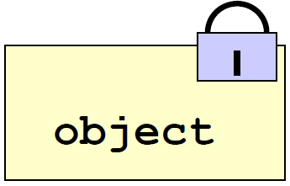
Synchronized Lock Object
Every Java object has an associated lock acquired via
synchronized statements (block) synchronized(anObject){
// execute code while holding anObject's lock
}
Only one thread can hold a lock at a time
Lock granularity: small critical section is better for concurrency object

Slide 53
Example 3 : synchronized lock obj
class SynchronizationDemo1
{
public static void main (String [] args)
{
FinTrans ft = new FinTrans ();
TransThread tt1 = new TransThread (ft, "Deposit Thread");
TransThread tt2 = new TransThread (ft, "Withdrawal Thread");
tt1.start ();
tt2.start ();
}
}
class FinTrans
{
public static String transName;
public static double amount;
}

Slide 54
class TransThread extends Thread
{
private FinTrans ft;
TransThread (FinTrans ft, String name)
{
super (name); // Save thread's name
this.ft = ft; // Save reference to financial transaction object
}
public void run ()
{
for (int i = 0; i < 100; i++){
if (getName ().equals ("Deposit Thread"))
{
synchronized (ft){
ft.transName = "Deposit";
try{
Thread.sleep ((int) (Math.random () * 1000));
}
catch (InterruptedException e) {}
ft.amount = 2000.0;
System.out.println (ft.transName + " " + ft.amount);
}
}
else {
synchronized (ft){
ft.transName = "Withdrawal";
try {
Thread.sleep ((int) (Math.random () * 1000));
}
catch (InterruptedException e) {}
ft.amount = 250.0;
System.out.println (ft.transName + " " + ft.amount);
}
}
}
}
}

Slide 55
Condition Variables
lock (synchronized)
control thread access to data
condition variable (wait,notify/notifyall)
synchronization primitives that enable threads to wait until a particular condition occurs.
enable threads to atomically release a lock and enter the sleeping state.
Without condition variables
the programmer would need to have threads continually polling (possibly in a critical section), to check if the condition is met.
A condition variable is a way to achieve the same goal without polling.
A condition variable is always used in conjunction with a mutex lock.

Slide 56
wait()and notify()
public class Object {
…
public final void wait() throws InterruptedException {…}
public final void notify() { …}
public final void notifall() { …}
}
wait()
If no interrupt (normal case), current thread is blocked
The thread is placed into wait set associated with the object
Synchronization lock for the object is released
notify()
One thread, say T, is removed from wait set, if exists.
T retains the lock for the object
T is resumed from waiting status.

Slide 57
Example : Garage Parking
The actual state of a parking garage is defined by the number of free parking places.
Cars are modelled by thread whereby a car can enter or leave the parking garage
each of these methods changes the actual state of the garage:
When a car enters, the number of free places is decremented; leaving implies incrementing the free places.
The number of free places can not be decremented, if the parking garage has become full (free places == 0)
A parking garage can simultaneously be used by more than one car (each changing the state), therefore methods enter() and leave() have to be marked as synchronized.

Slide 58
Example : Garage Parking
class ParkingGarage {
private int places;
public ParkingGarage(int places) {
if (places < 0)
places = 0;
this.places = places;
}
public synchronized void enter() { // enter parking garage
while (places == 0) {
try {
wait();
} catch (InterruptedException e) {}
}
places--;
}
public synchronized void leave() { // leave parking garage
places++;
notify();
}
}

Slide 59
Example : Garage Parking
class Car extends Thread {
private ParkingGarage parkingGarage;
public Car(String name, ParkingGarage p) {
super(name);
this.parkingGarage = p;
start();
}
public void run() {
while (true) {
try {
sleep((int)(Math.random() * 10000)); // drive before parking
} catch (InterruptedException e) {}
parkingGarage.enter();
System.out.println(getName()+": entered");
try {
sleep((int)(Math.random() * 20000)); // stay within the parking garage
} catch (InterruptedException e) {}
parkingGarage.leave();
System.out.println(getName()+": left");
}
}
}

Slide 60
Example : Garage Parking
public class ParkingGarageOperation {
public static void main(String[] args){
ParkingGarage parkingGarage = new ParkingGarage(10);
for (int i=1; i<= 40; i++) {
Car c = new Car("Car "+i, parkingGarage);
}
}
}

Slide 61
Example : Garage Parking
output
$ java ParkingGarageOperation
Car 38: entered
Car 21: entered
Car 12: entered
Car 22: entered
Car 23: left
Car 5: entered
Car 32: entered
Car 28: entered
Car 18: entered
Car 5: left
Car 37: entered
Car 22: left
Car 35: entered

