Slide 1
Lecture 4-3 : Java Virtual Threads
Courtesy : Java in Jenkov.com (Jacob Jenkov)

Slide 2
Java Virtual Threads
Much more lightweight (cheap to start)
You can have far more virtual threads running in your program than platform threads
With more virtual threads, you can do more blocking IO in parallel than with fewer platform threads.
Compatibility
Implementation based on existing Java Thread API
Requires minimal changes
A virtual thread is still a real Thread from your code perspective

Slide 3
Virtual threads vs Platform threads
Platform threads (traditional Java threads)
Backed directly by OS threads.
More expensive to create and keep around.
(memory and scheduling overhead)
Systems usually limit the number with thread pools
Good for a moderate number of long-lived threads.
Fine for CPU-bound worker pools sized near the number of cores.

Slide 4
Virtual threads vs Platform threads
Virtual threads
Managed by the JVM.
Much cheaper to create.
Ideal for large numbers of mostly waiting tasks.
(JVM can schedule a very large number of virtual threads onto a much smaller set of OS threads)
Best for request-per-thread or task-per-thread designs (at high concurrency)
Database queries, HTTP calls (web requests), etc
with platform threads, these can be expensive

Slide 5
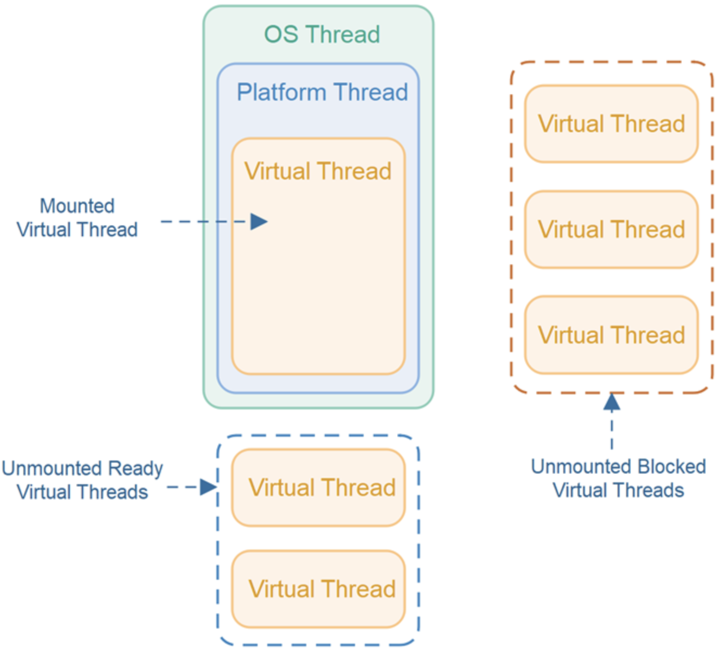
Java Virtual Thread Diagram
Mounting
When a virtual thread starts, JVM mounts it onto a platform thread
Platform thread can only execute a single virtual thread at a time
It can switch to executing a different virtual thread when currently executed virtual thread makes a blocking call (e.g. network IO)

Slide 6
Java Virtual Thread Diagram
New virtual threads are queued up until a platform thread is ready to execute it.
When a platform thread becomes ready, it will take a virtual thread.
A virtual thread that executes blocking call will be unmounted. In the meantime, the platform thread can execute another virtual thread
The platform thread does not switch between executing multiple virtual threads – except in the case of blocking network calls.

Slide 7
Creating a Java Virtual Thread
Runnable runnable = () -> {
for(int i=0; i<10; i++) {
System.out.println("Index: " + i);
}
};
Thread vThread = Thread.ofVirtual().start(runnable);
// Thread vThread = Thread.startVirtualThread(runnable);
…
vThread.join(); // join
Creating a thread pool that uses virtual threads
(usually you do not specify the number of virtual threads)
ExecutorService e = Executors.newVirtualThreadPerTaskExecutor();

